Slide 1

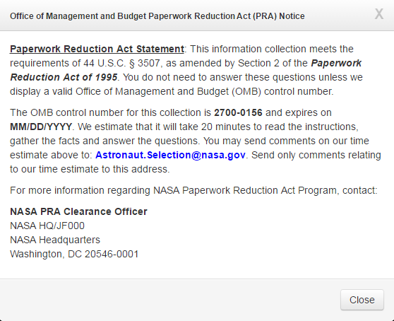

ASCAN Candidate Qualifications Inquiry
PRA Notification Modal
.
Following the initial connection and access to the application, the modal can be manually recalled by clicking the PRA link located on the bottom-right corner of the footer.
The footer is displayed on every page of the collection instrument.

Slide 2
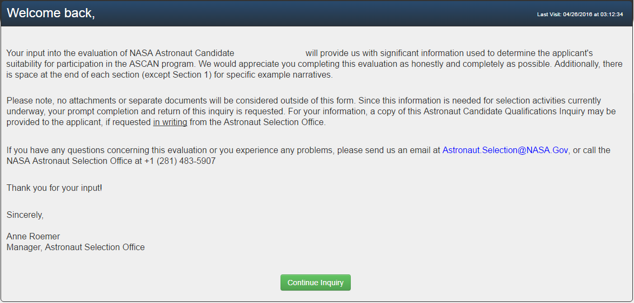
ASCAN Candidate Qualifications Inquiry
Welcome Page
[ REFERENCE NAME ]
[Candidate Name]

Slide 3
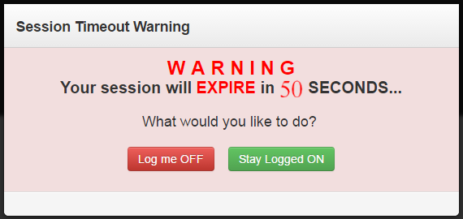
ASCAN Candidate Qualifications Inquiry
Timeout Warning
Inactivity timeout and logoff occurs after fifteen (15) minutes. Respondents receive a Session Timeout Warning after 14 minutes of inactivity, and are subsequently disconnected after sixty additional (60) seconds.

Slide 4
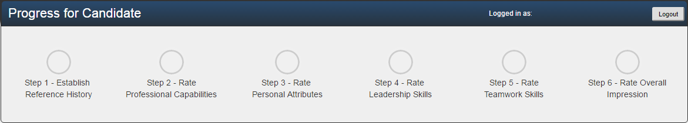

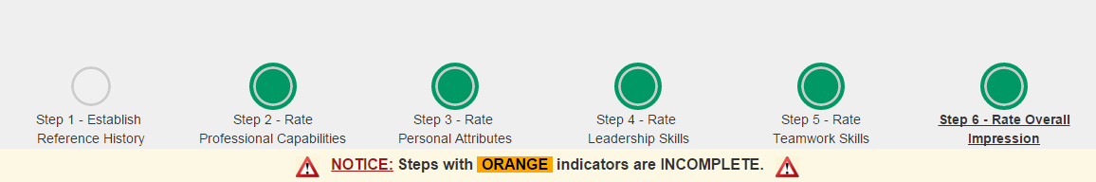
ASCAN Candidate Qualifications Inquiry
Navigation / Progress Bar
The Progress Bar Indicators display progress of Step completion. Indicators can be click to navigate to that Step.
[ Candidate Name Here ]
[ Reference Name Here ]
An alert is displayed when Step 6 is completed and any other step remains un-started/incomplete.

Slide 5
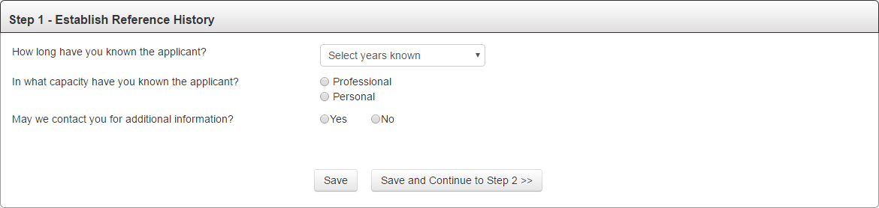
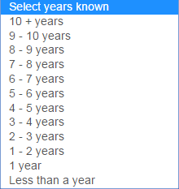
ASCAN Candidate Qualifications Inquiry
Step 1

Slide 6
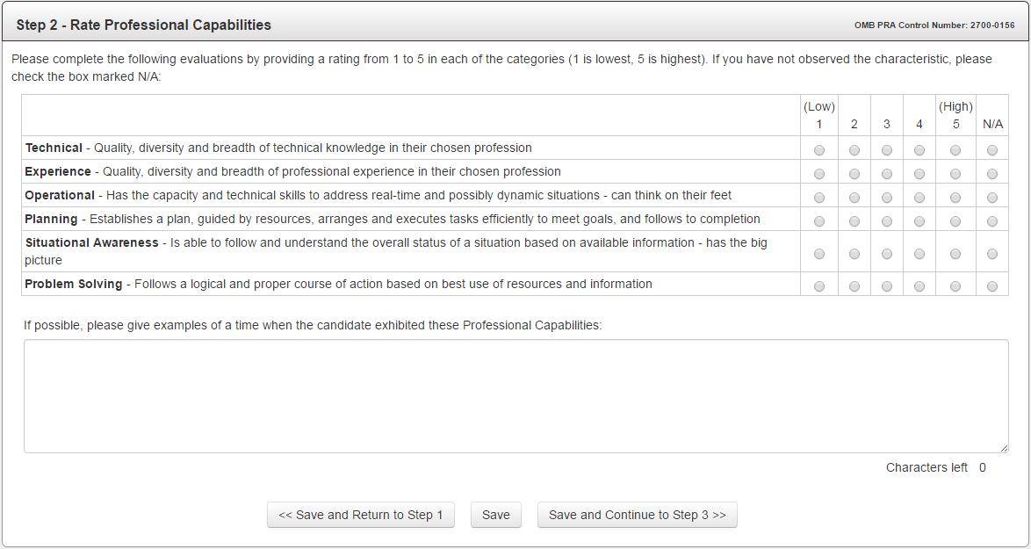
ASCAN Candidate Qualifications Inquiry
Step 2

Slide 7
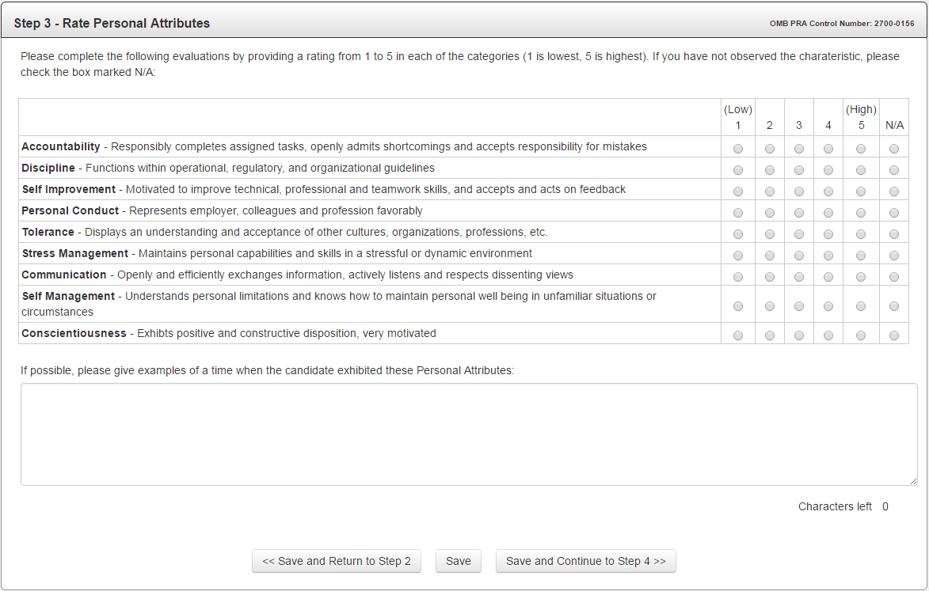
ASCAN Candidate Qualifications Inquiry
Step 3

Slide 8
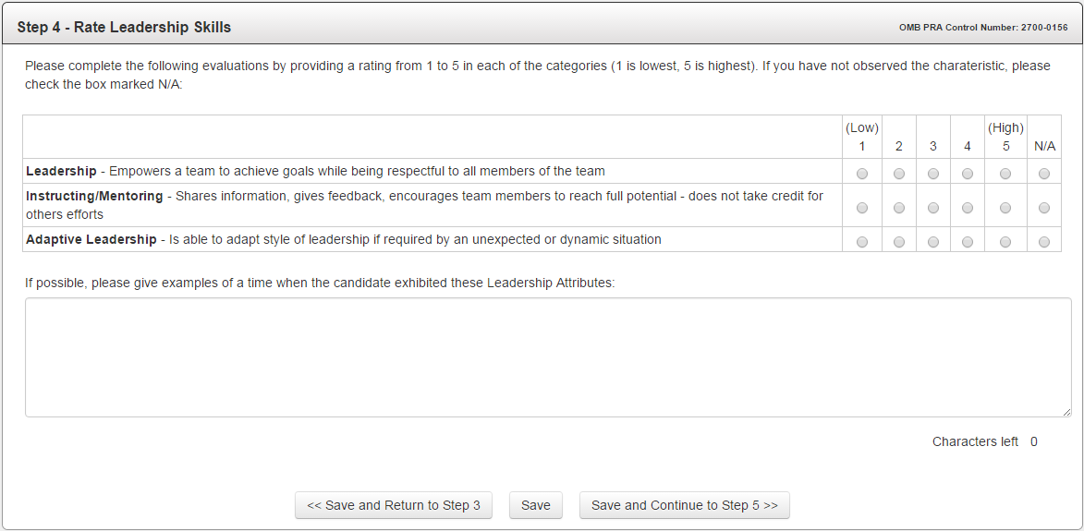
ASCAN Candidate Qualifications Inquiry
Step 4

Slide 9
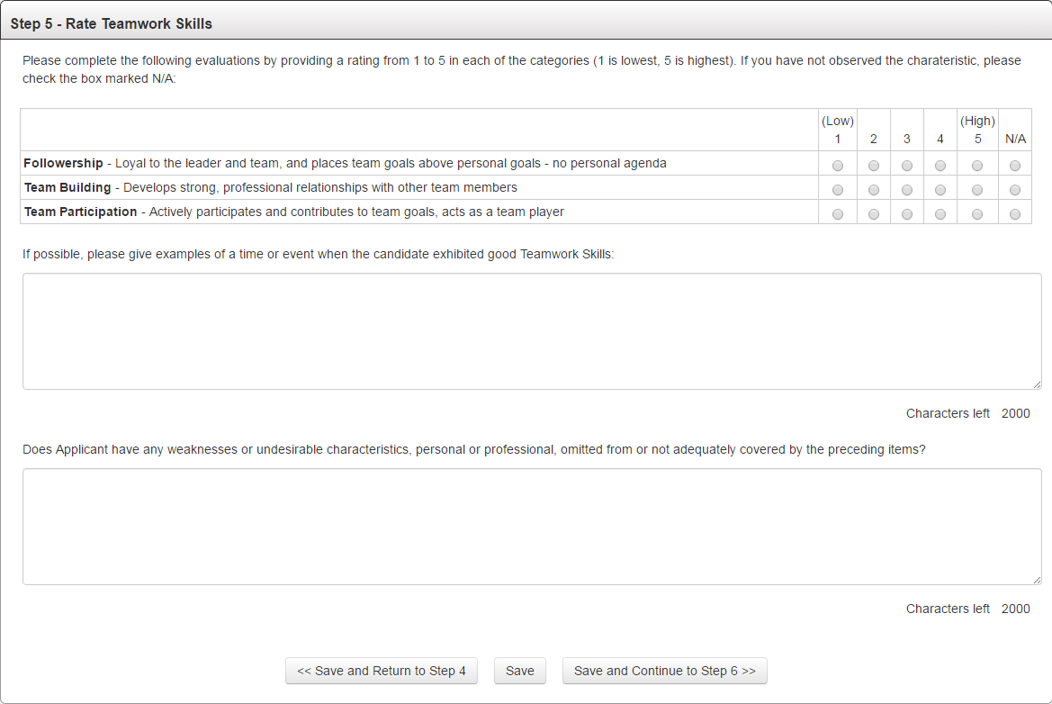
ASCAN Candidate Qualifications Inquiry
Step 5

Slide 10
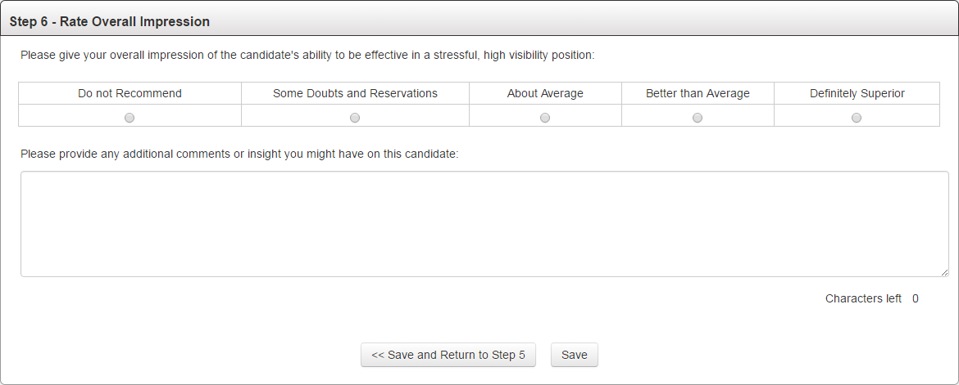
ASCAN Candidate Qualifications Inquiry
Step 6

Slide 11
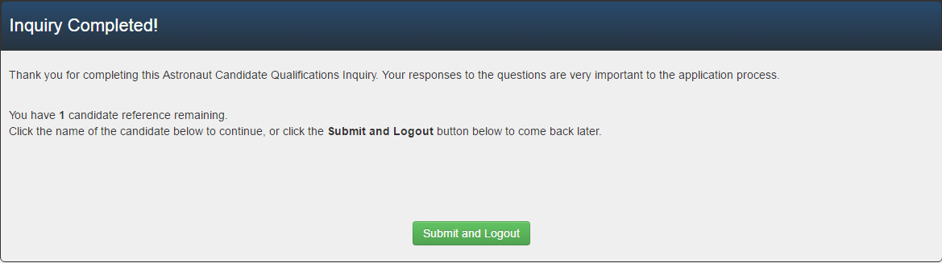
ASCAN Candidate Qualifications Inquiry
Closing Salutation (Additional Input Requested)
[Candidate Names Listed Here]

