Slide 1
HOMES.mil
Property Manager Access and Property Screens
03 October 2016

Slide 3
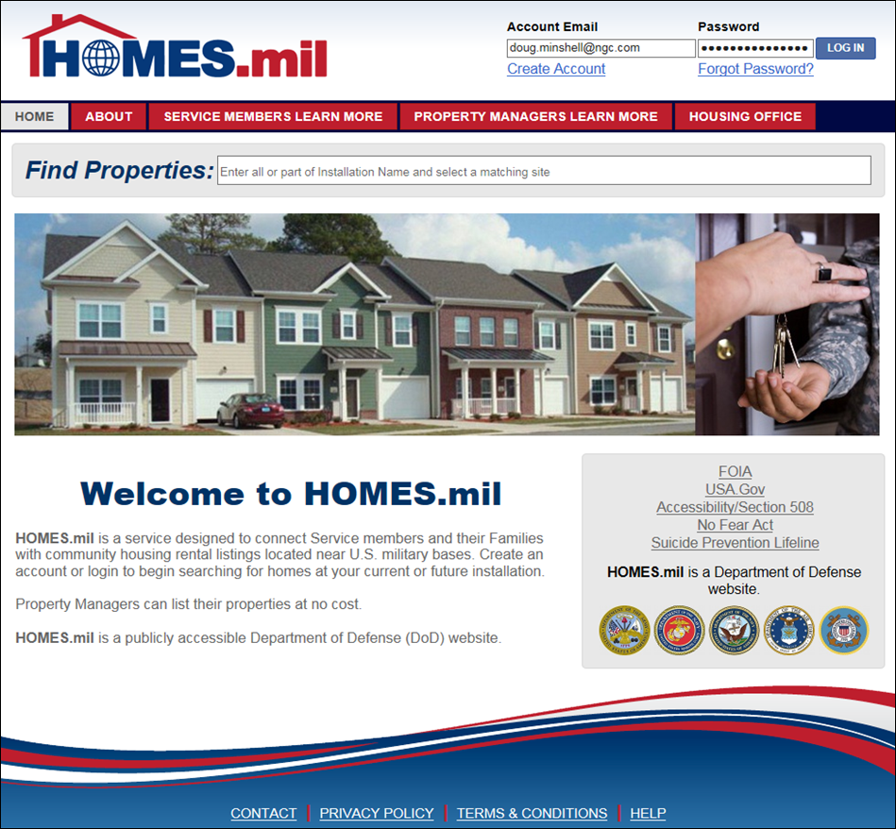

Slide 4
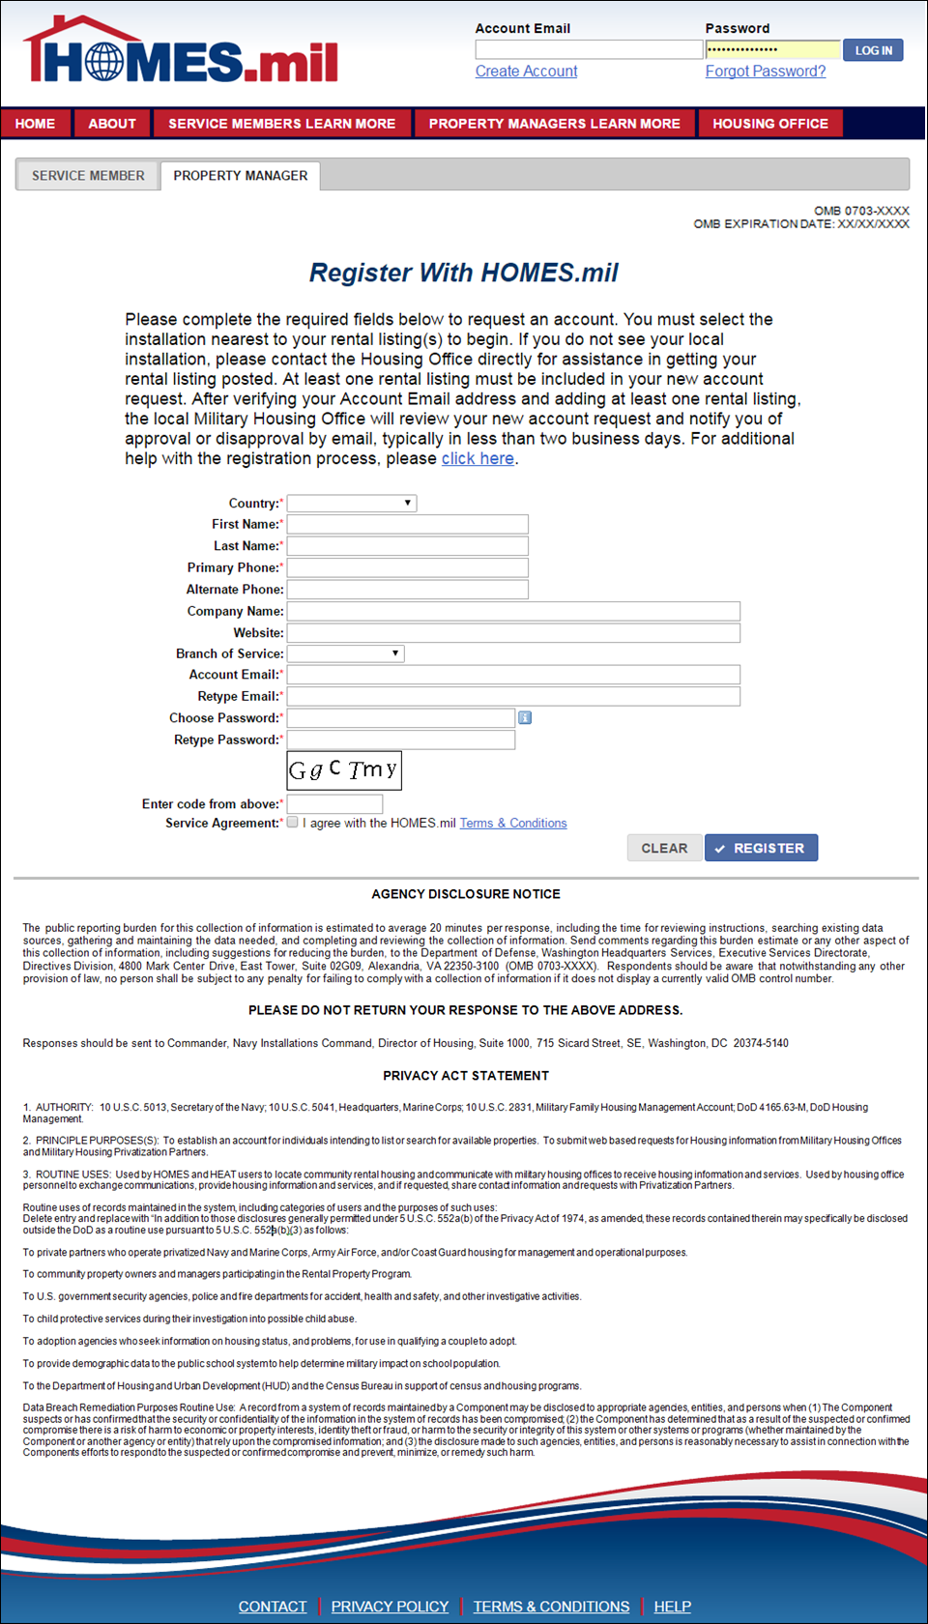
Collection Point 1
Property Manager Create Account Page
OMB #
OMB Expiration Date
Agency Disclosure Statement
Privacy Statement
DRAFT

Slide 5
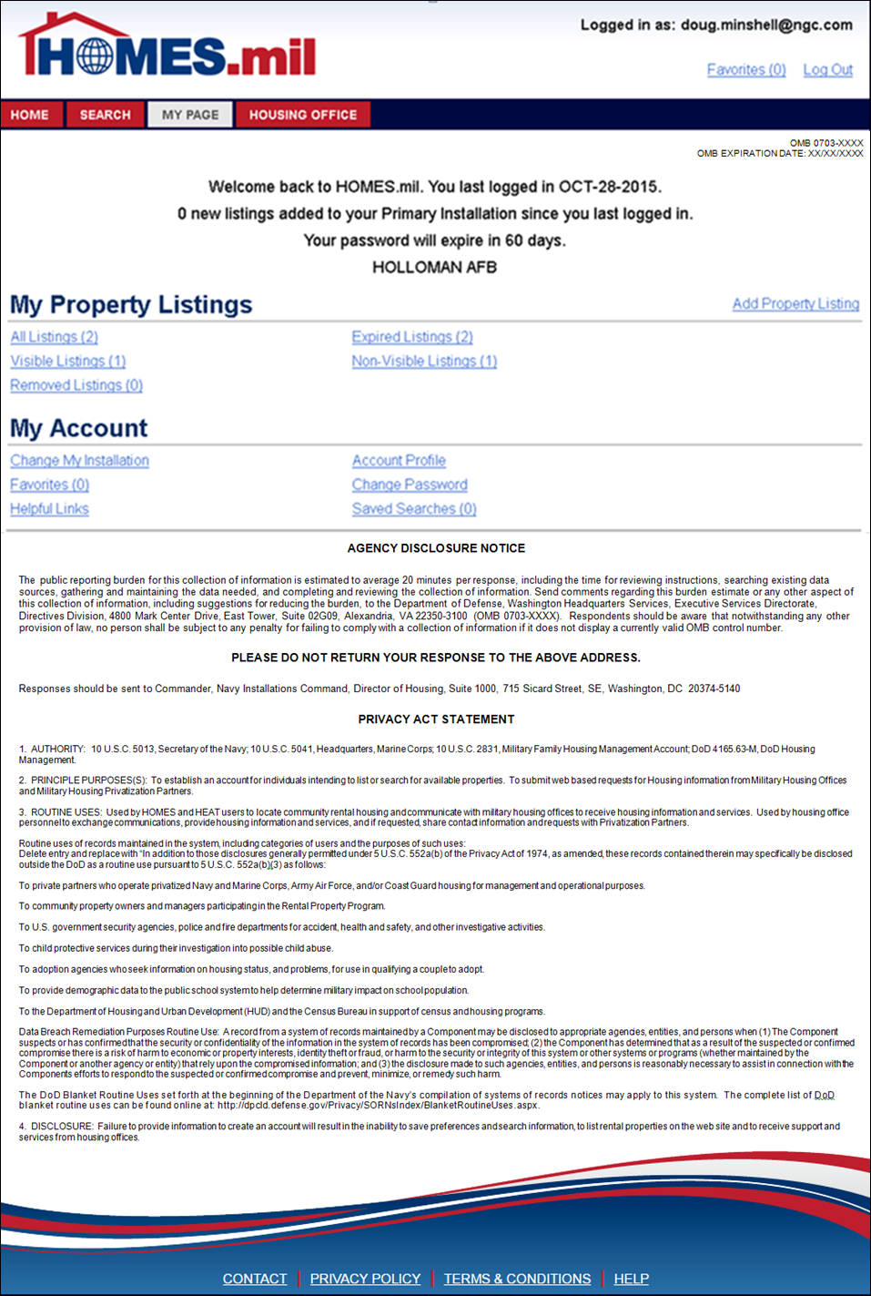
Property Manager Home Page
OMB #
OMB Expiration Date
Agency Disclosure Statement
Privacy Statement
DRAFT

Slide 6
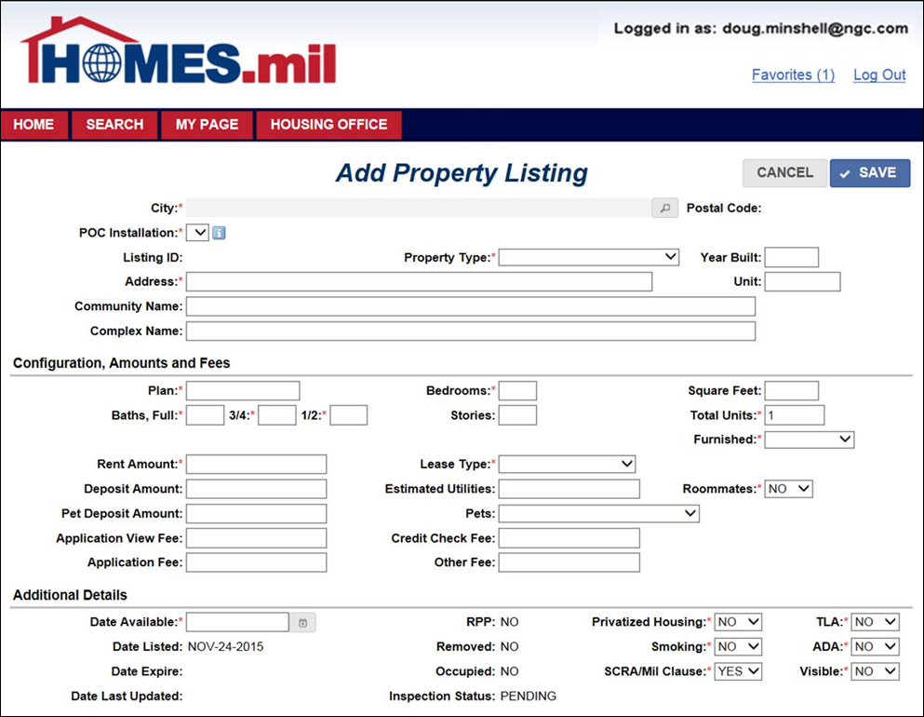

Slide 7
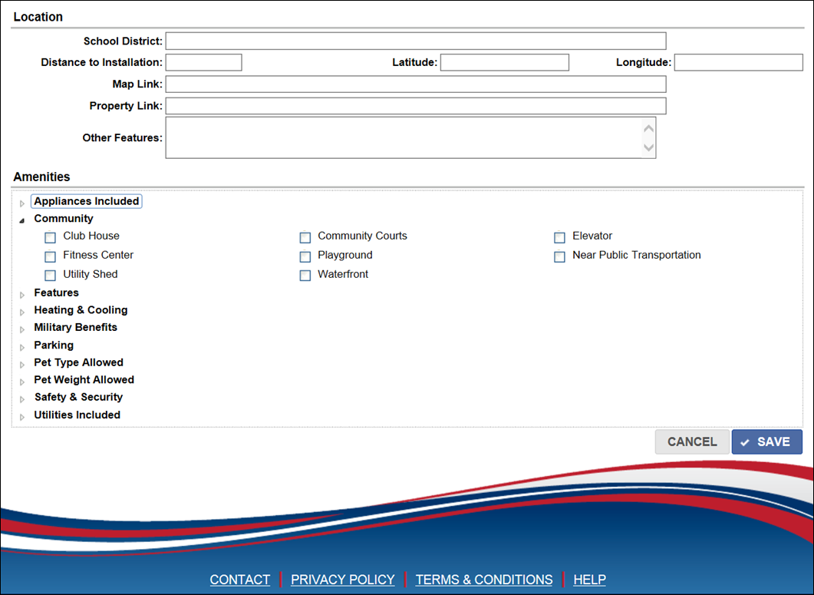

Slide 8
HOMES.mil
Service Member Access and Functionality

Slide 10
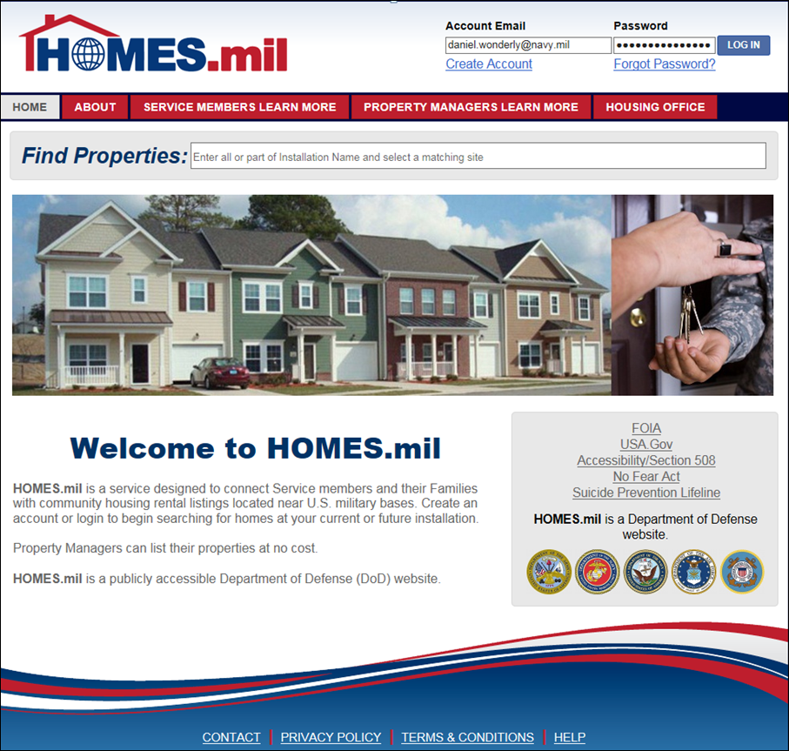

Slide 11
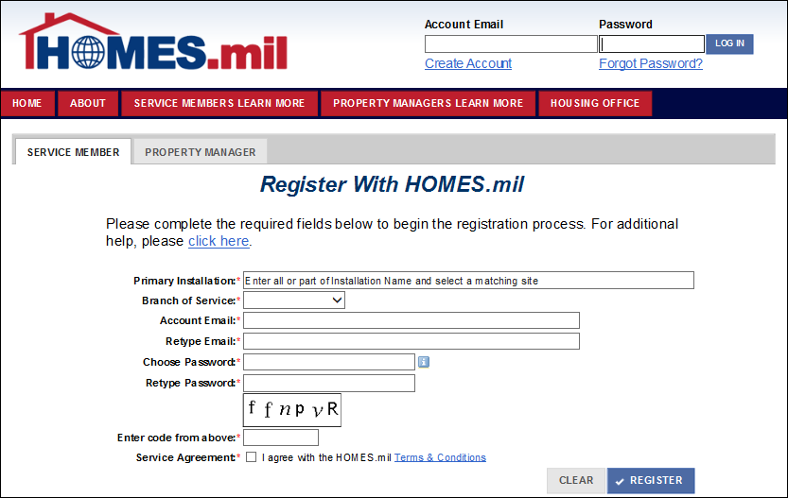
Collection Point 2
Service Member Create Account Page
OMB #
OMB Expiration Date
Agency Disclosure Statement
Privacy Statement
DRAFT

Slide 12
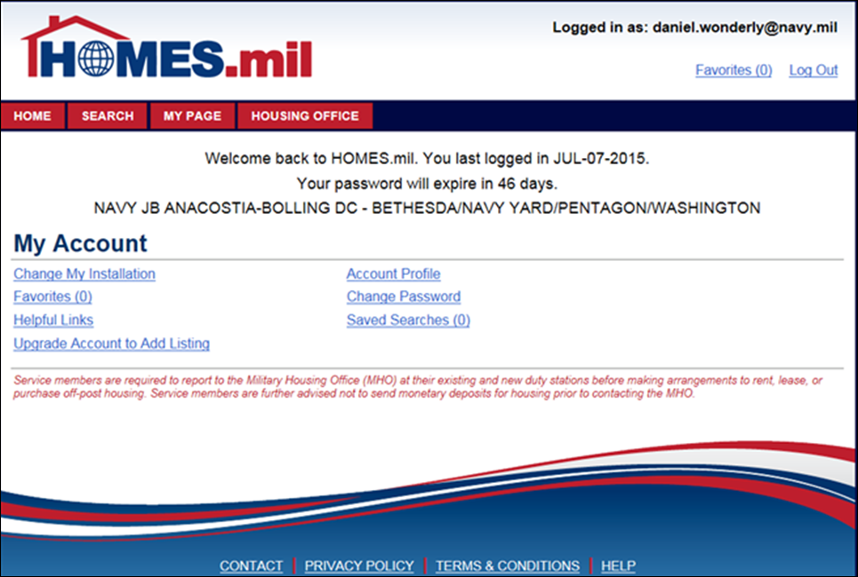

Slide 13
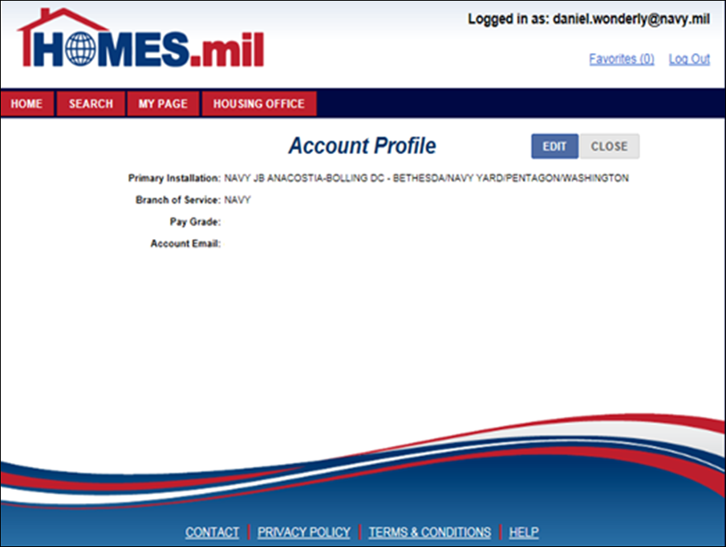

Slide 14
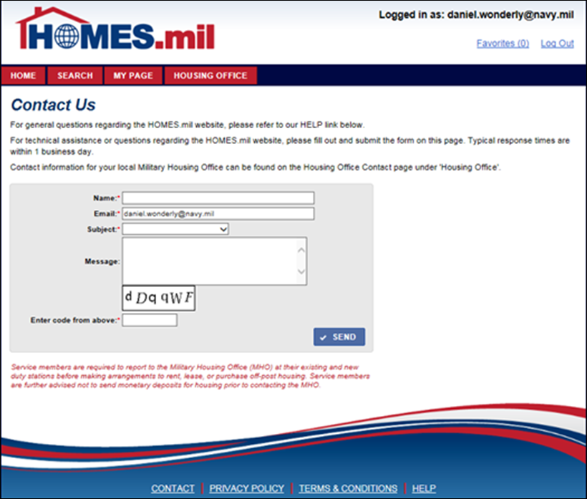

Slide 15
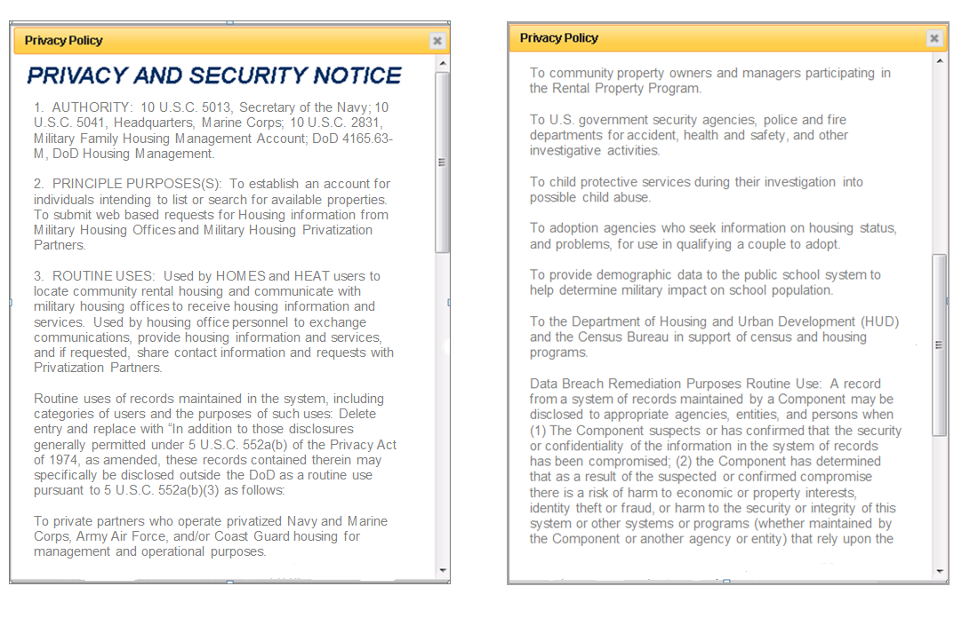
Privacy Policy Updated
Hyperlink to pop-up window on bottom of every HOMES.mil Page
DRAFT
DRAFT

Slide 16
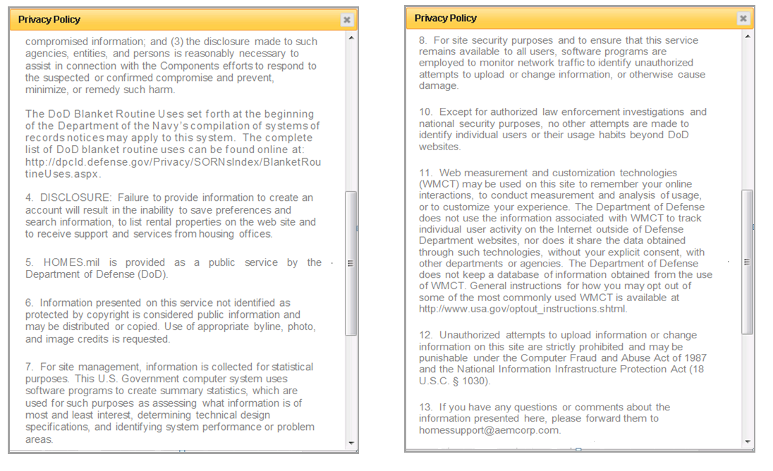
Privacy Policy Updated continued
Hyperlink to pop-up window on bottom of every HOMES.mil Page
DRAFT
DRAFT

Slide 17
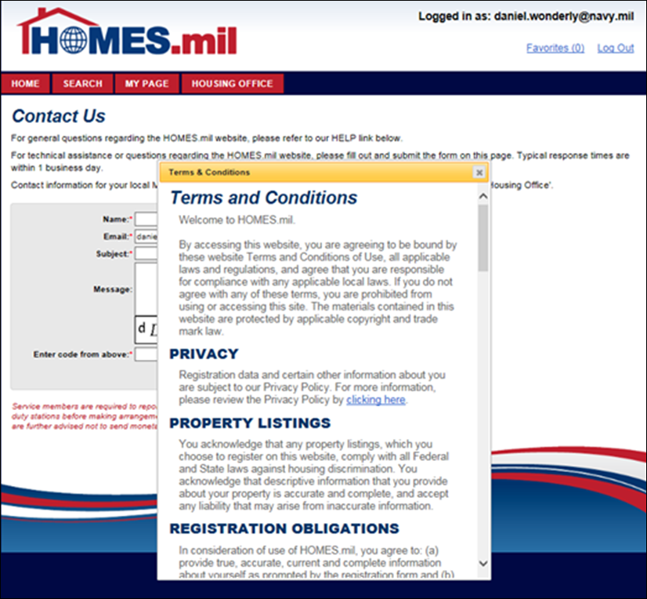

Slide 18
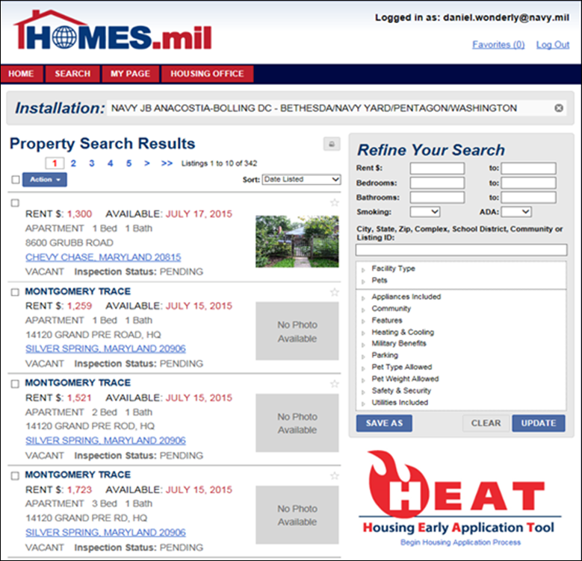

Slide 19
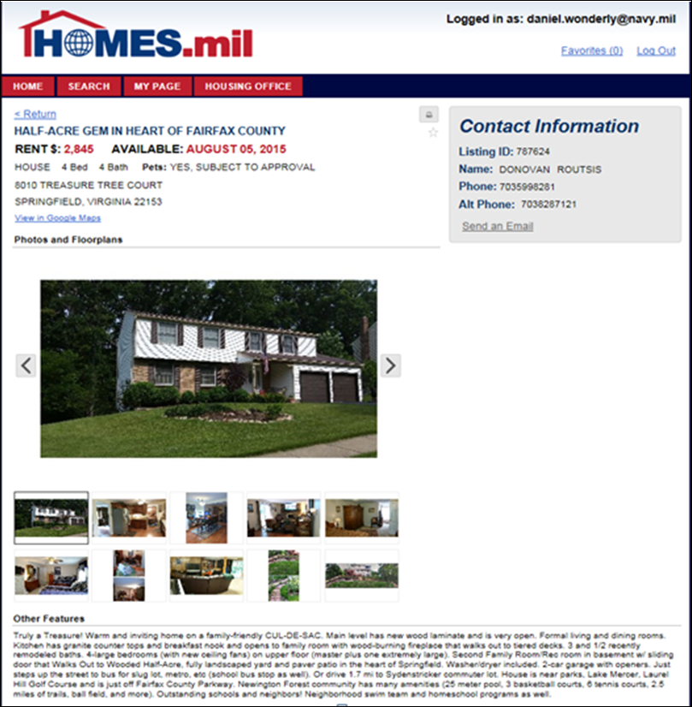

Slide 20
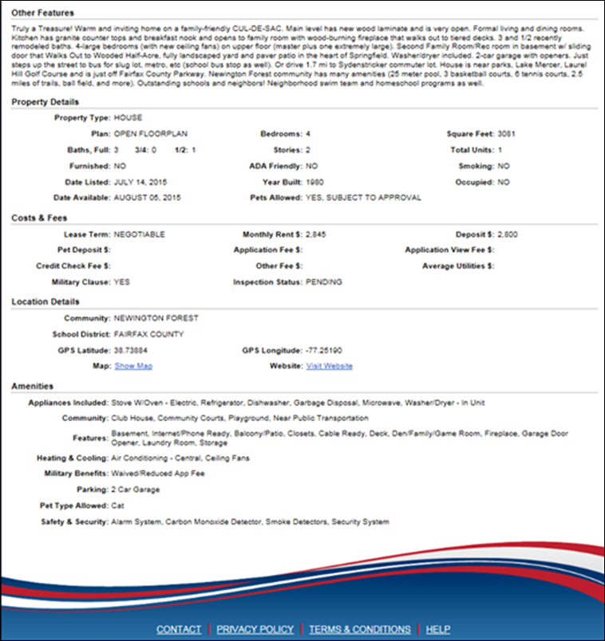

Slide 21
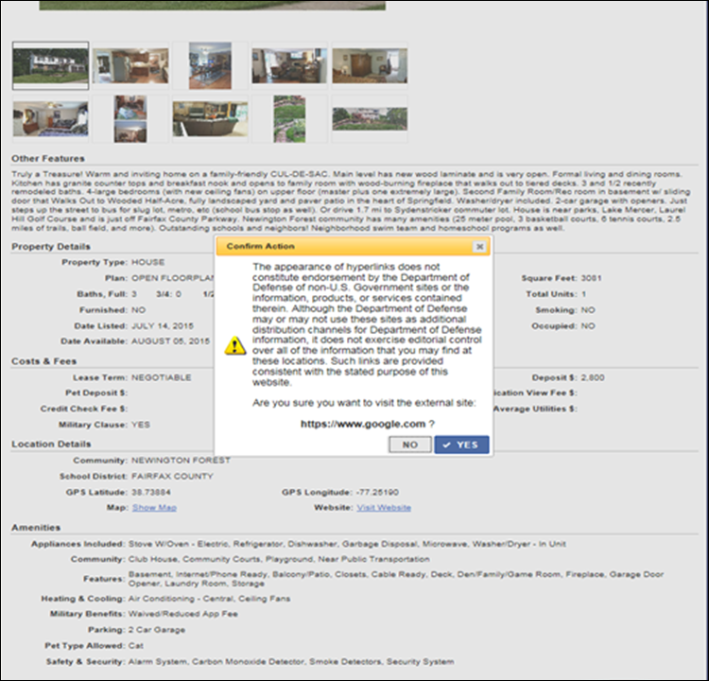

Slide 22
