Slide 1
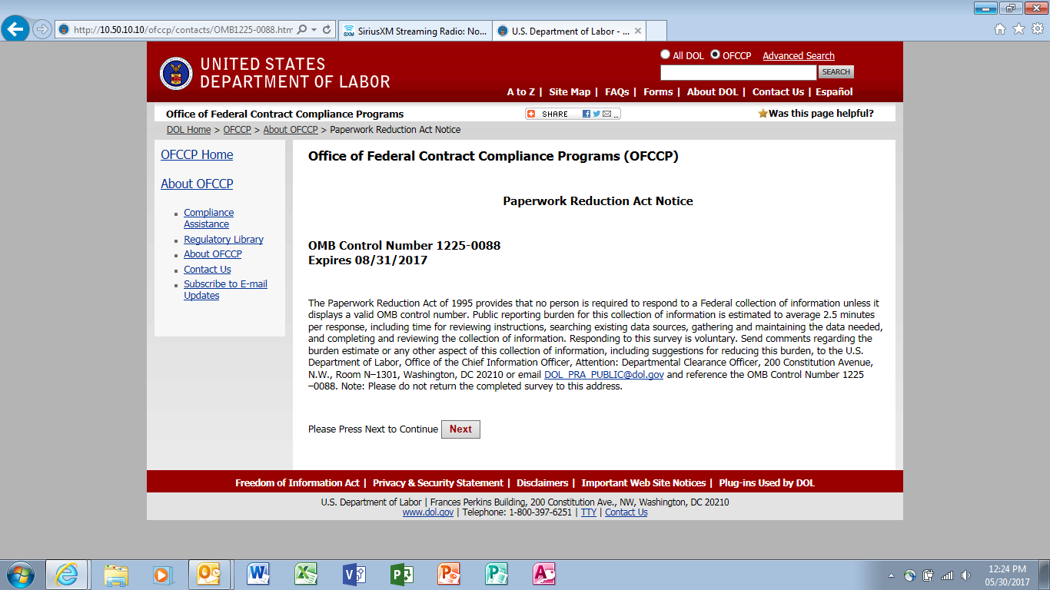
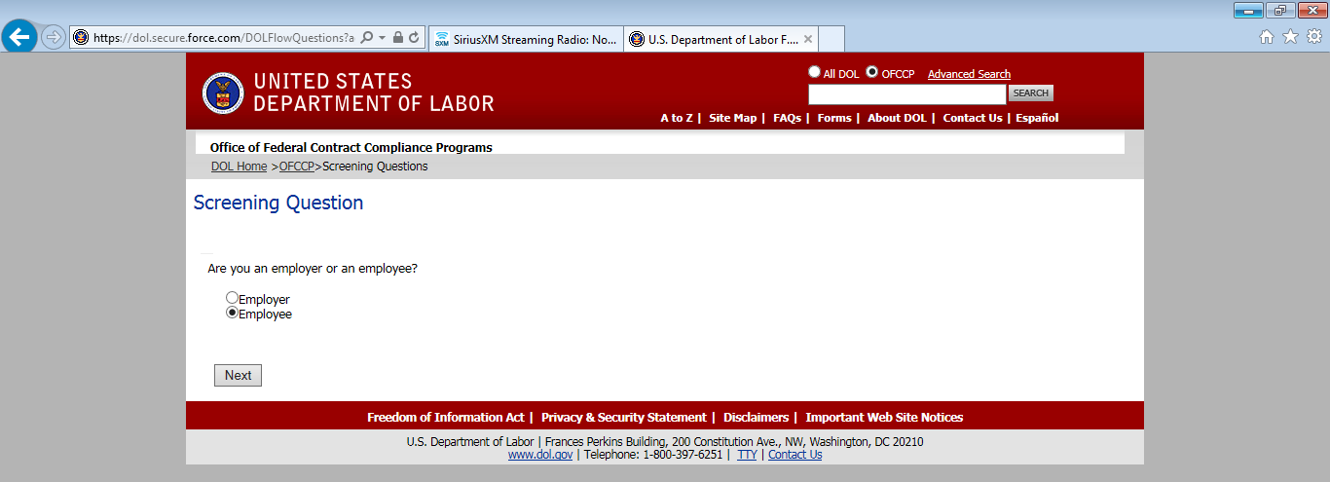
An individual must identify as an employee or employer – screening questions differ slightly based on the response provided.
Employee Flow

Slide 2
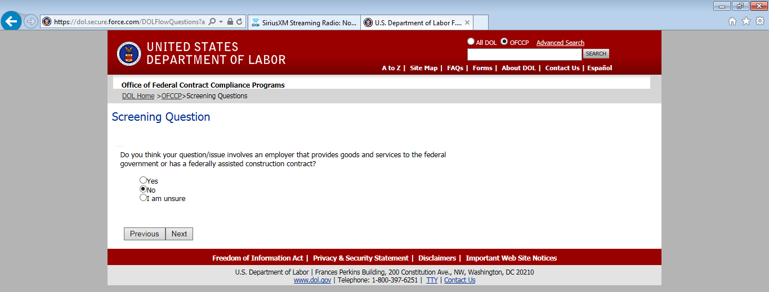
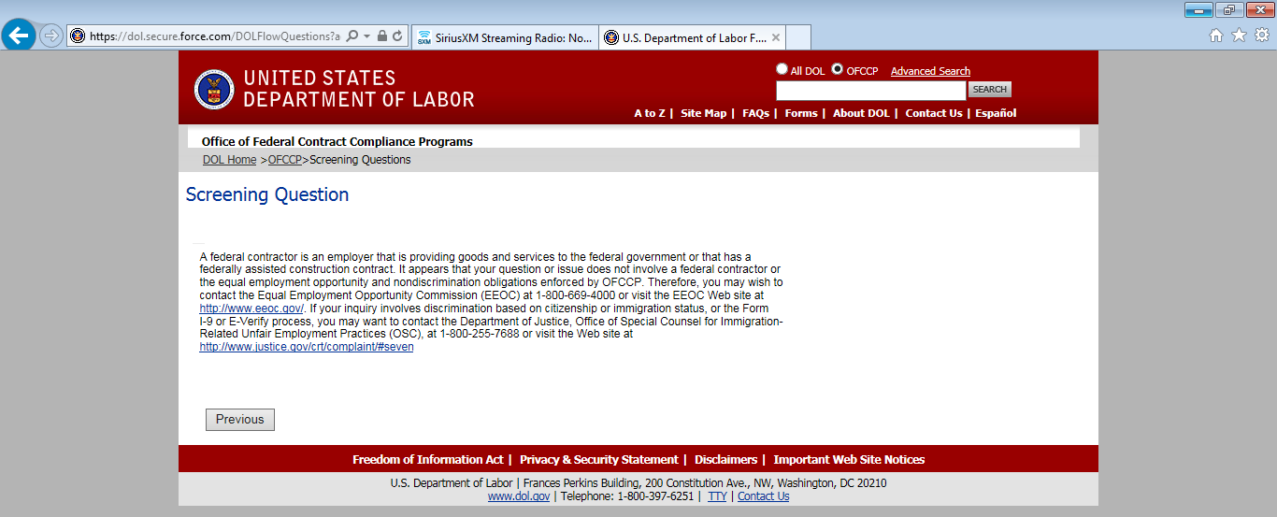
If answer is “No”, the following statement ends process

Slide 3
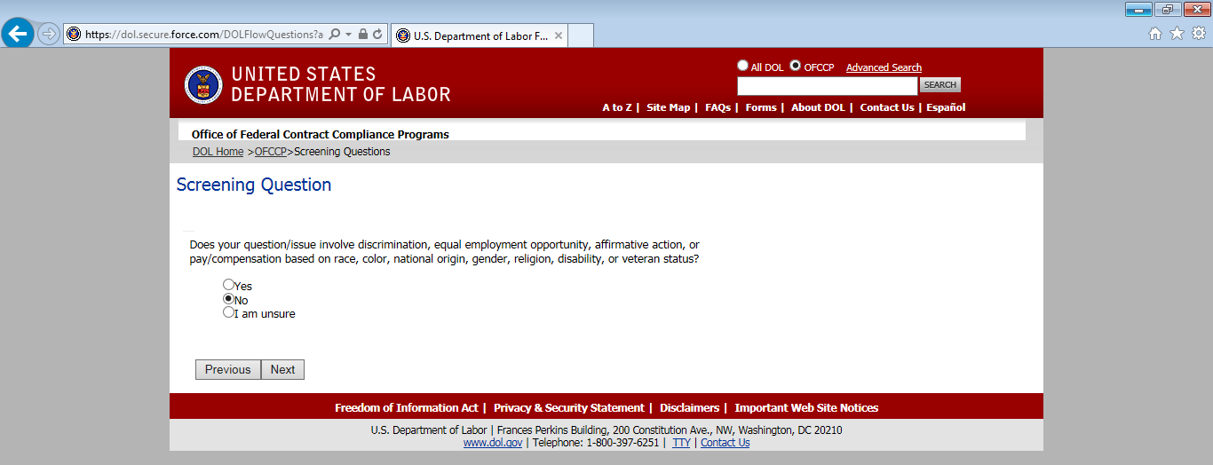
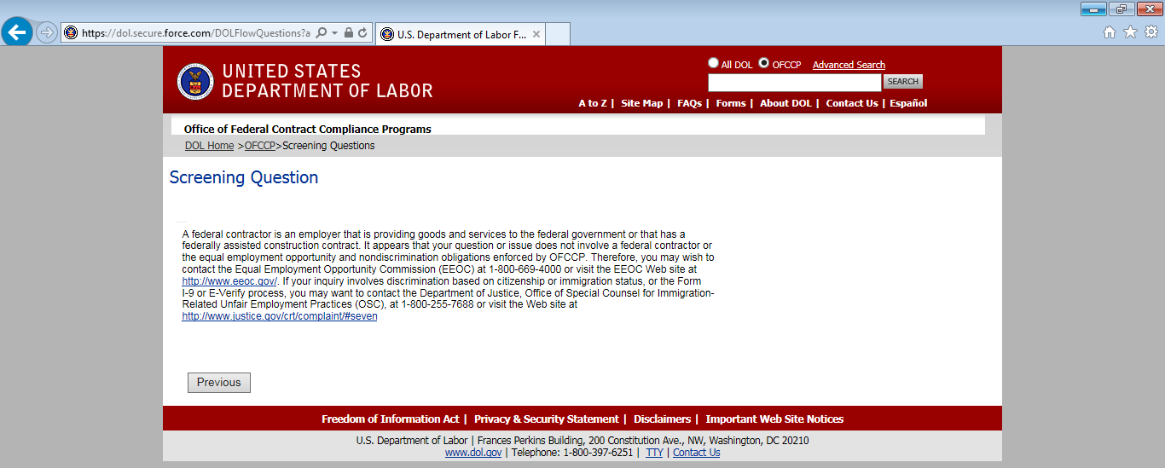
If answer is “Yes” or “I am unsure” press yes to continue with screening questions
If answer is “No”, the following statement ends process

Slide 4
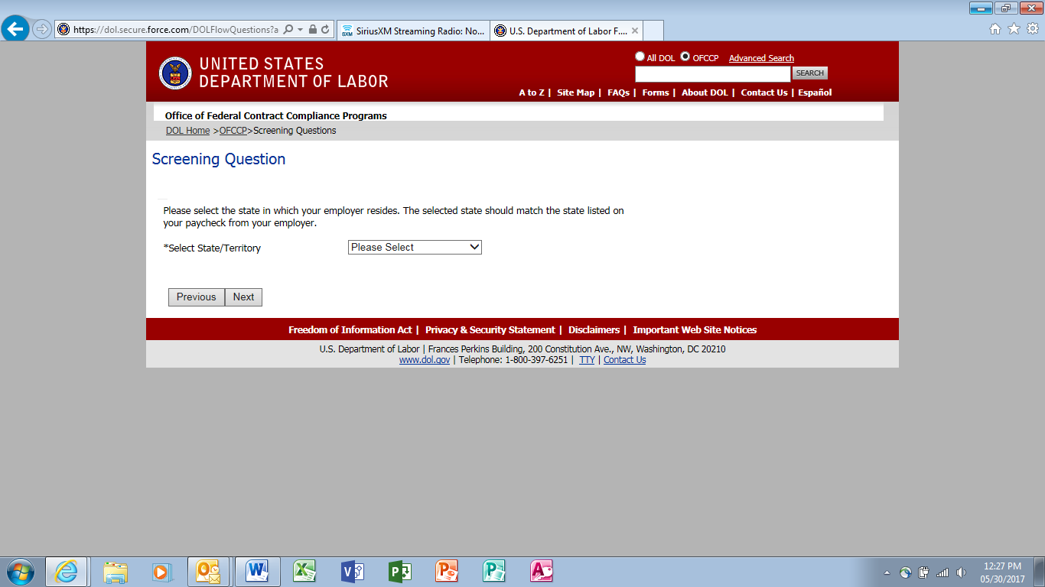
If answer is “Yes” or “I am unsure” continue with screening questions

Slide 5
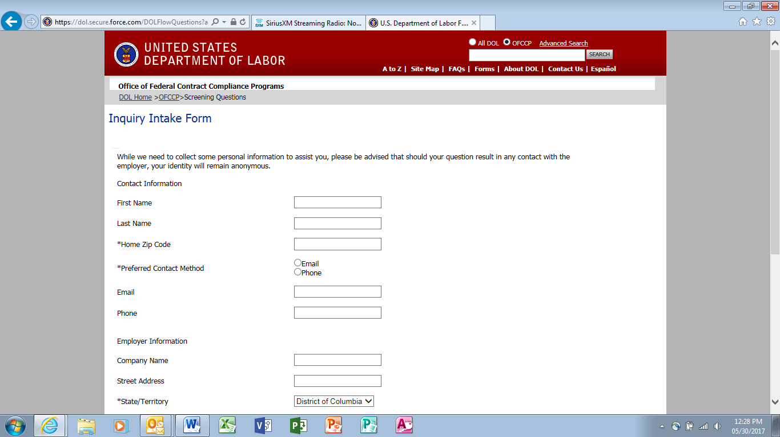
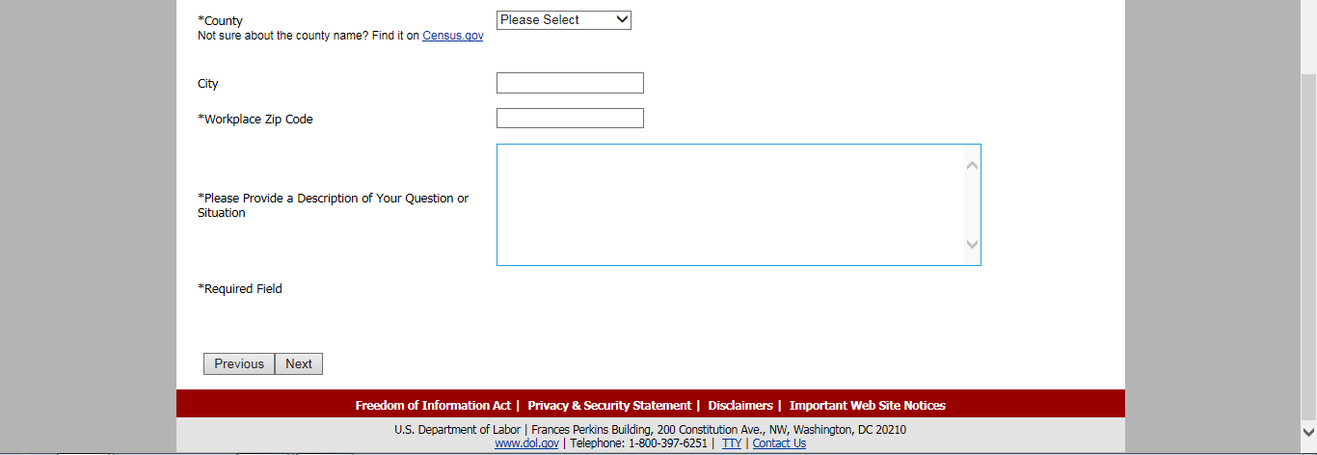
Press “Next” to submit question

Slide 6
Employer Flow
If answer is “No”, the following statement ends process

Slide 7
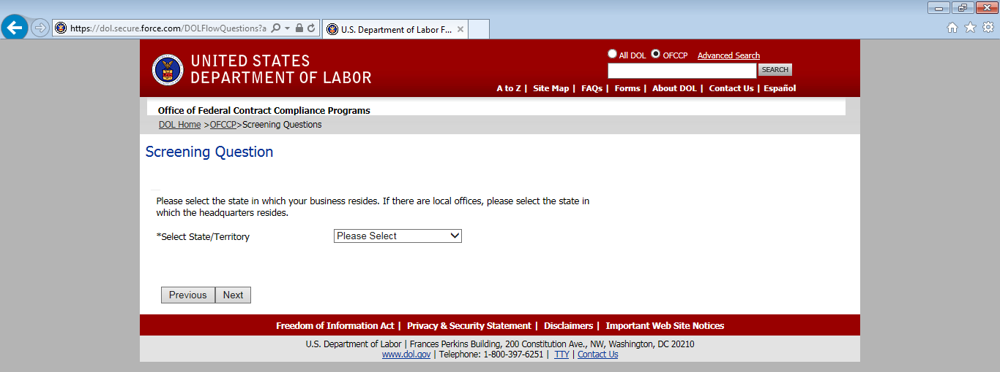
If answer is “Yes” or “I am unsure” press yes to continue with screening questions

Slide 8
Press “Next” to submit question

