Slide 1
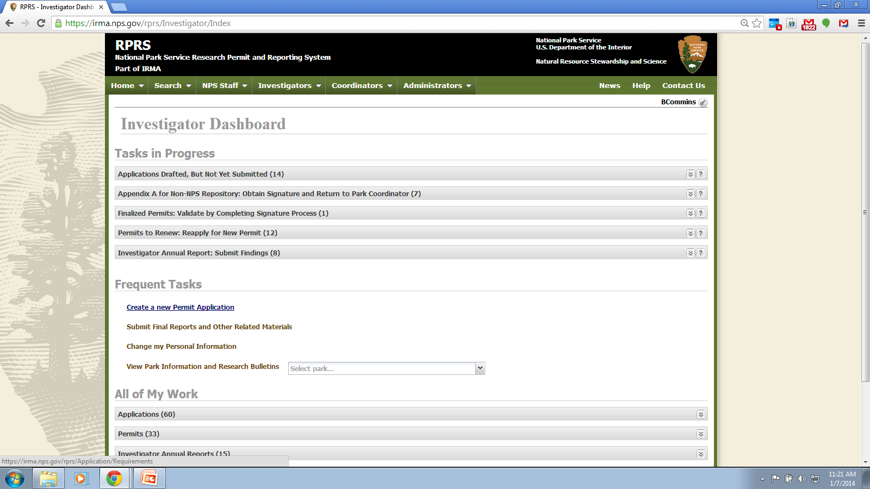
Notes:
Password protected investigator account homepage: choose “Create a new permit Application” link

Slide 3
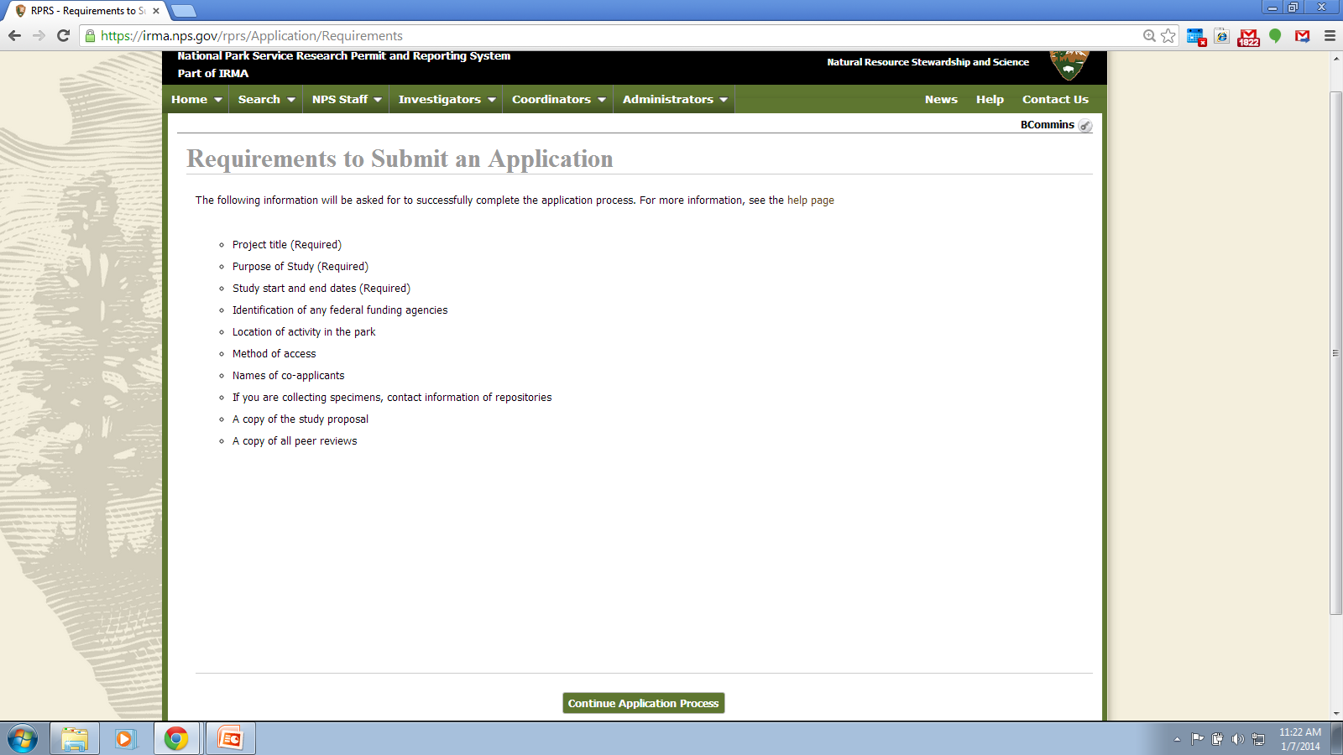

Slide 4
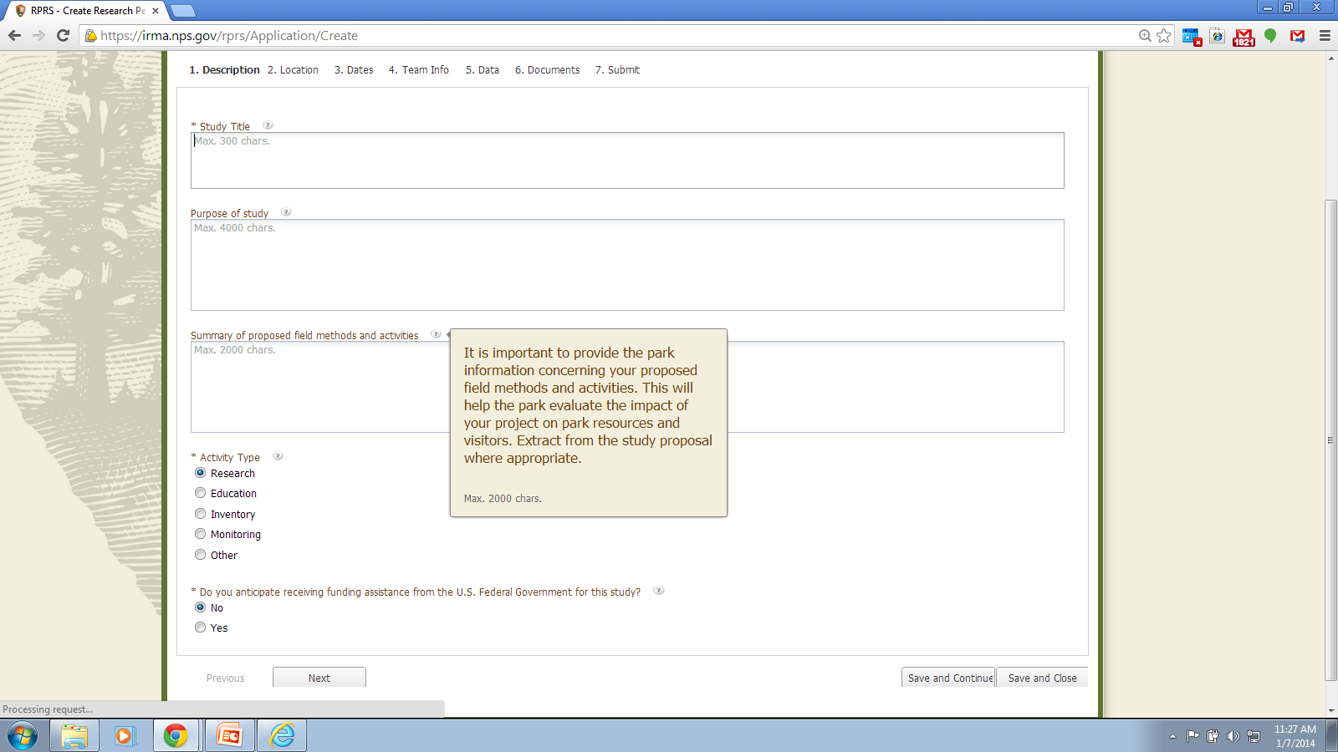
Does your study propose to involve any of the following
(check all that apply):
handle live vertebrates __
T&E species __
migratory birds __
marine mammals __
unmanned aircraft __
designated wilderness __
hazardous activity __
ground disturbance __
Notes:
Opening tab: Description, Note: example of hover text content (users access hovertext by clicking on question mark icon next to field)

Slide 5
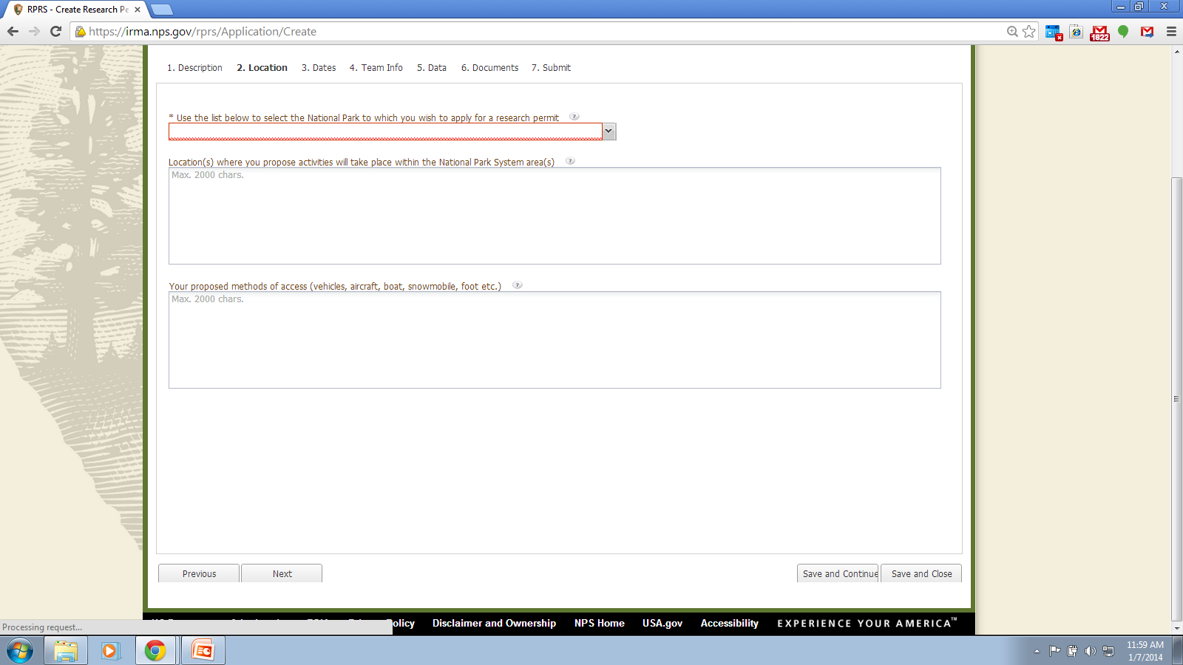
Notes:
Location Tab: park options are a pick list

Slide 6
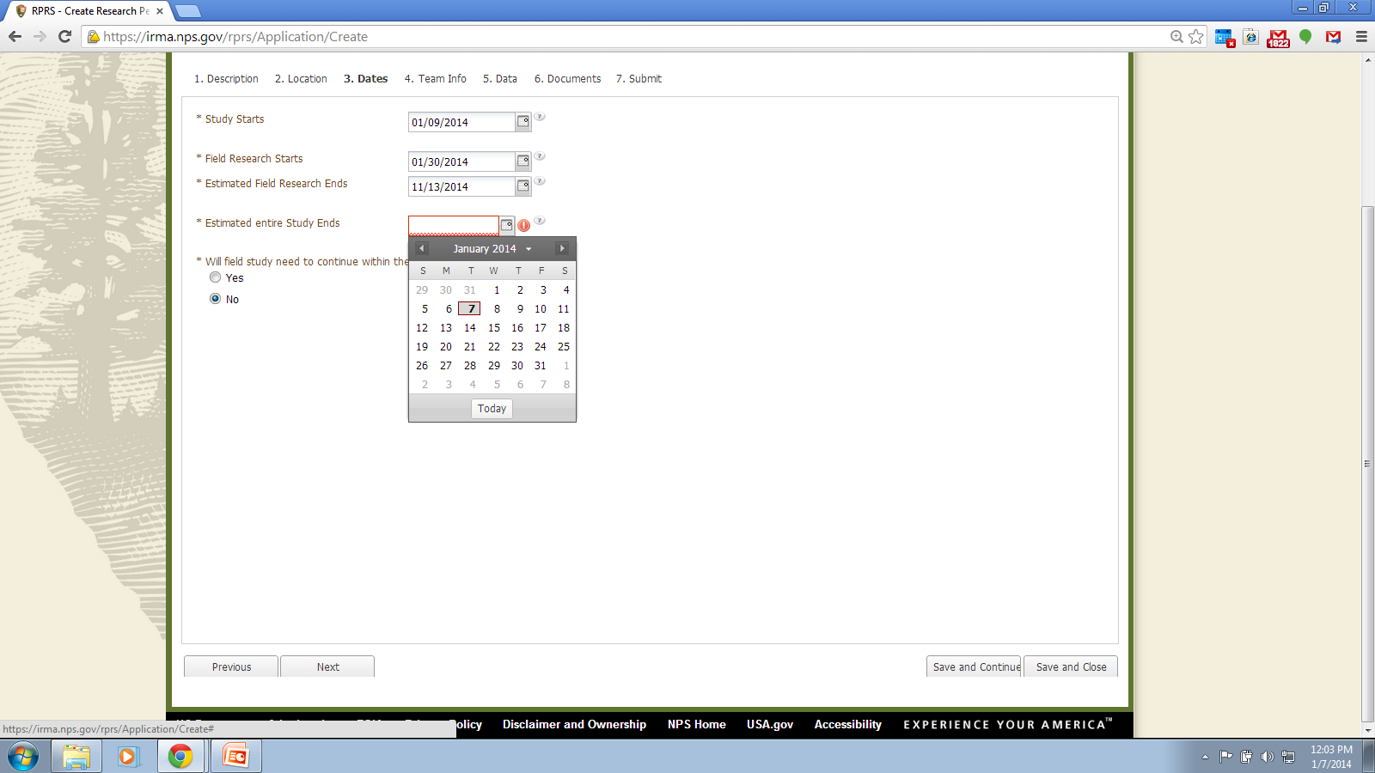
Notes:
Dates tab: user may enter dates directly or use pop up calendar screen (shown).

Slide 7
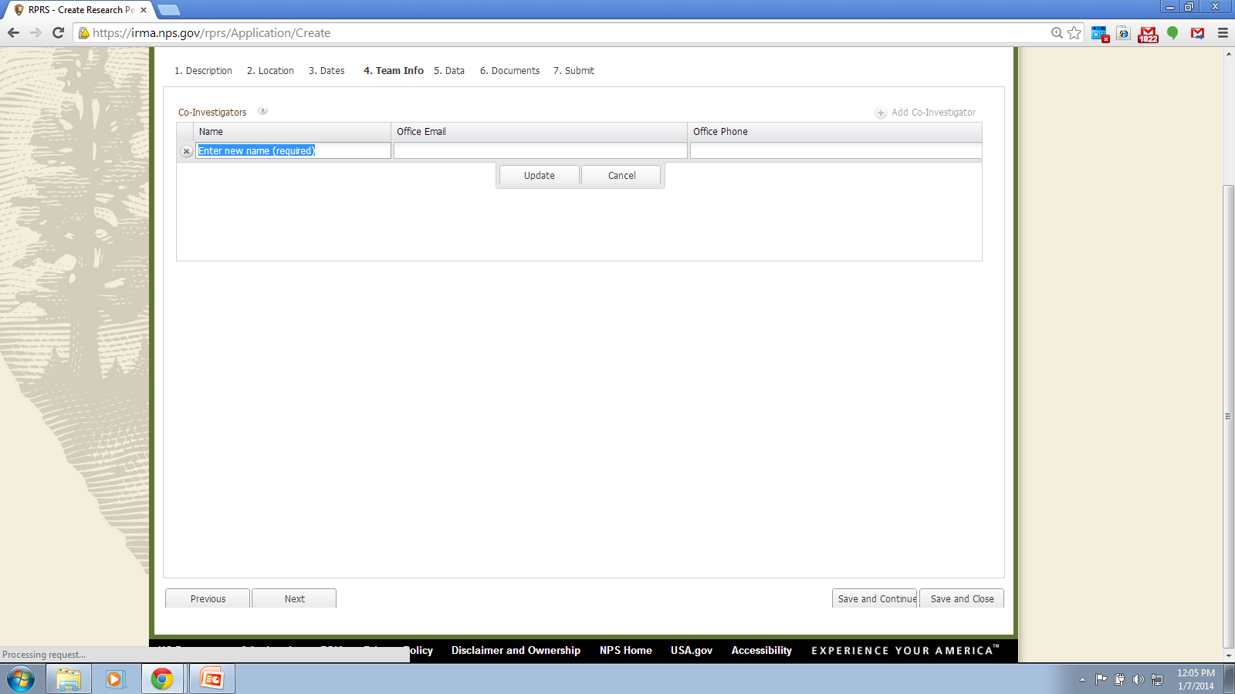
Notes:
Team Info. Tab: this is optional information, it is used to document co-investigators, field assistants, ect.
Screen shot shows what user sees when they click on “Add Co-Investigator” icon. User may enter as many persons as desired.

Slide 8
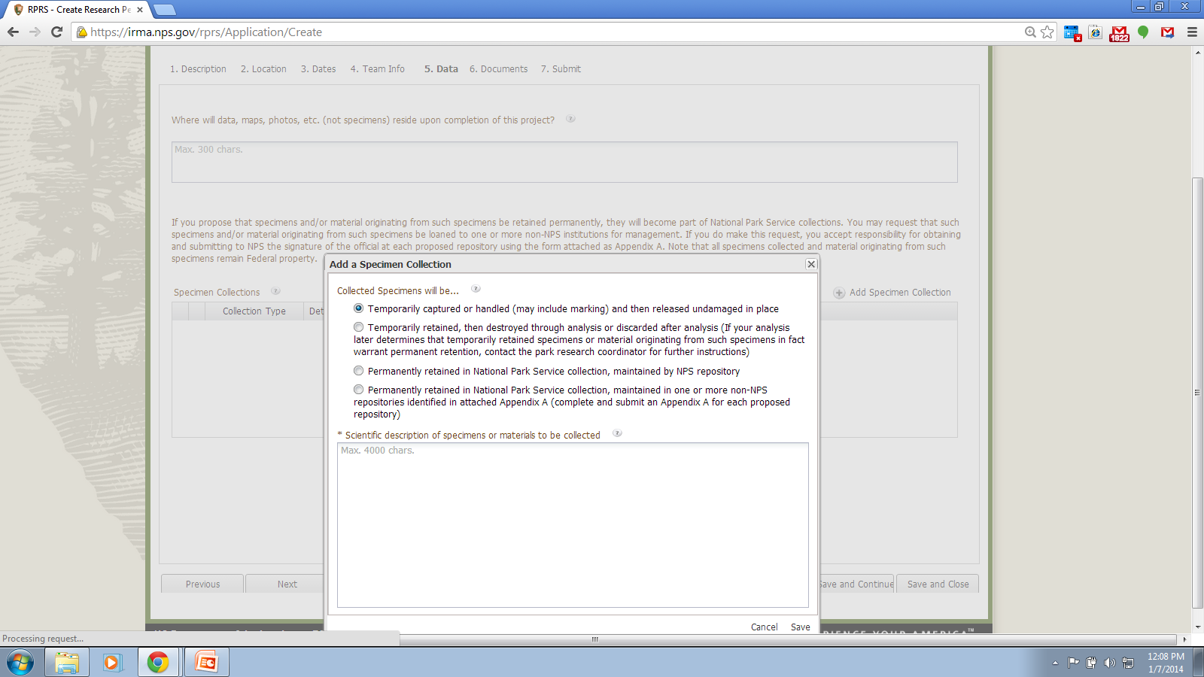
Notes:
Data tab: screen shot shows pop up screen which is triggered by the user clicking on the “Add Specimen Collection” button. The user may submit as many Specimen Collection entries as needed.

Slide 9
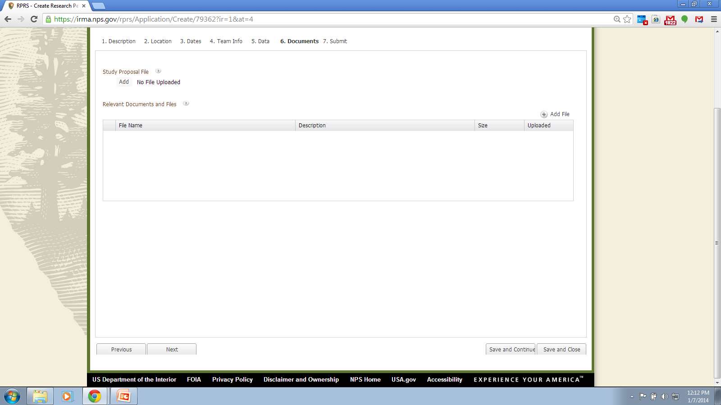
Notes:
Documents tab: It is optional to submit documents with an application. Generally a Study Proposal File will be needed to properly evaluate an application (unless the proposed study is simple enough that the information entered on the application is sufficient for park reviewers to understand the full scope of the proposed study.

Slide 10
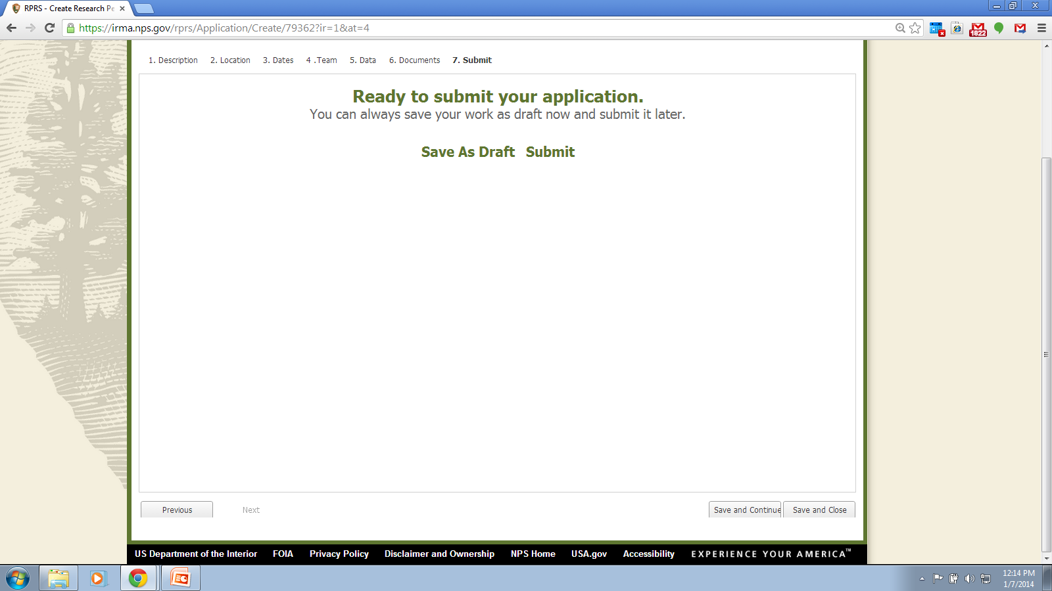
Notes:
Submit tab: users may save their application as a draft or may submit it directly.

Slide 11
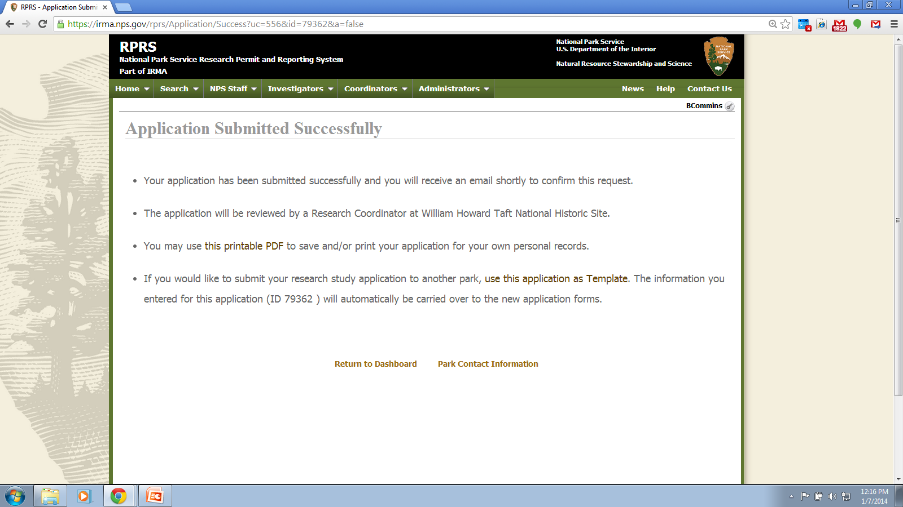
Notes:
Application submitted successfully screen: Note the option to use the application as a template if the user intends to submit applications to multiple parks for similar or equivalent studies. NOTE also: Users who have been issued permits may use the permit renewal application process. This process ports the data from the permit into an application form, which may be completed by the user. This is a time saving device for those who need to renew their permits for ongoing studies.

