Slide 1


Electronic Visa Update System (EVUS)
U.S. Customs and Border Protection
April 2018

Slide 2
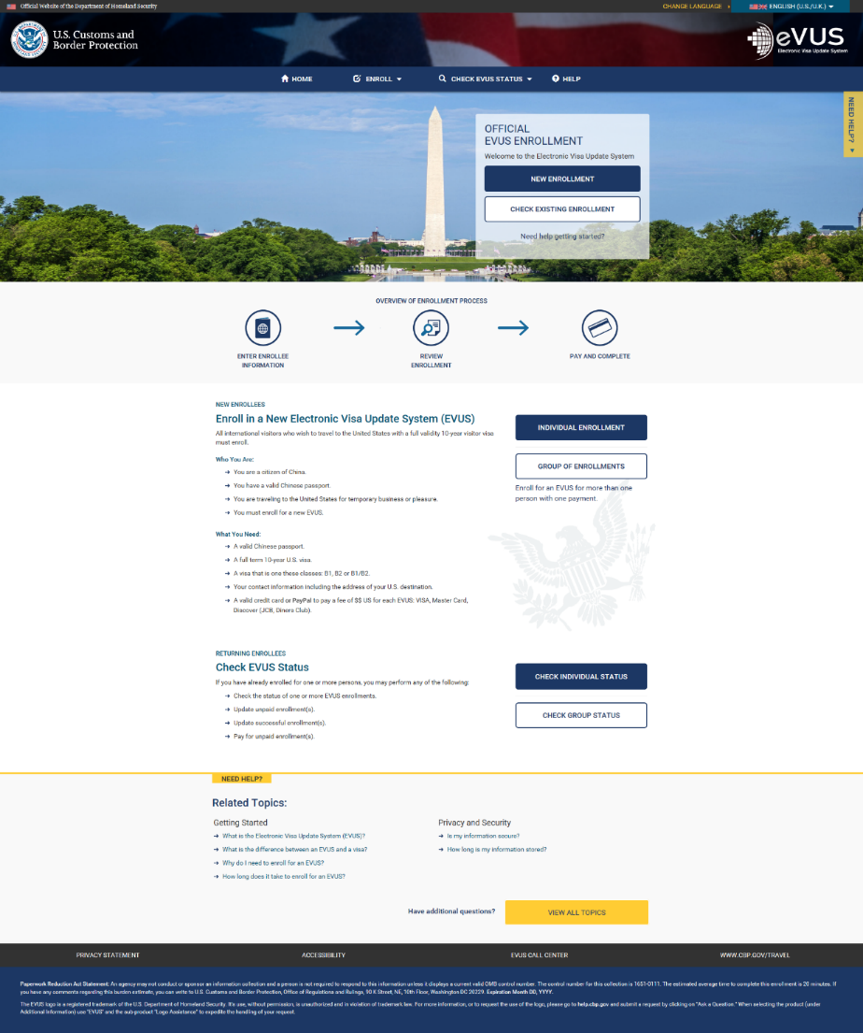
EVUS Welcome Page
Navigation Menu
Overview of Enrollment Process
Enrollment Information
Help Topics
Paperwork Reduction Act

Slide 3
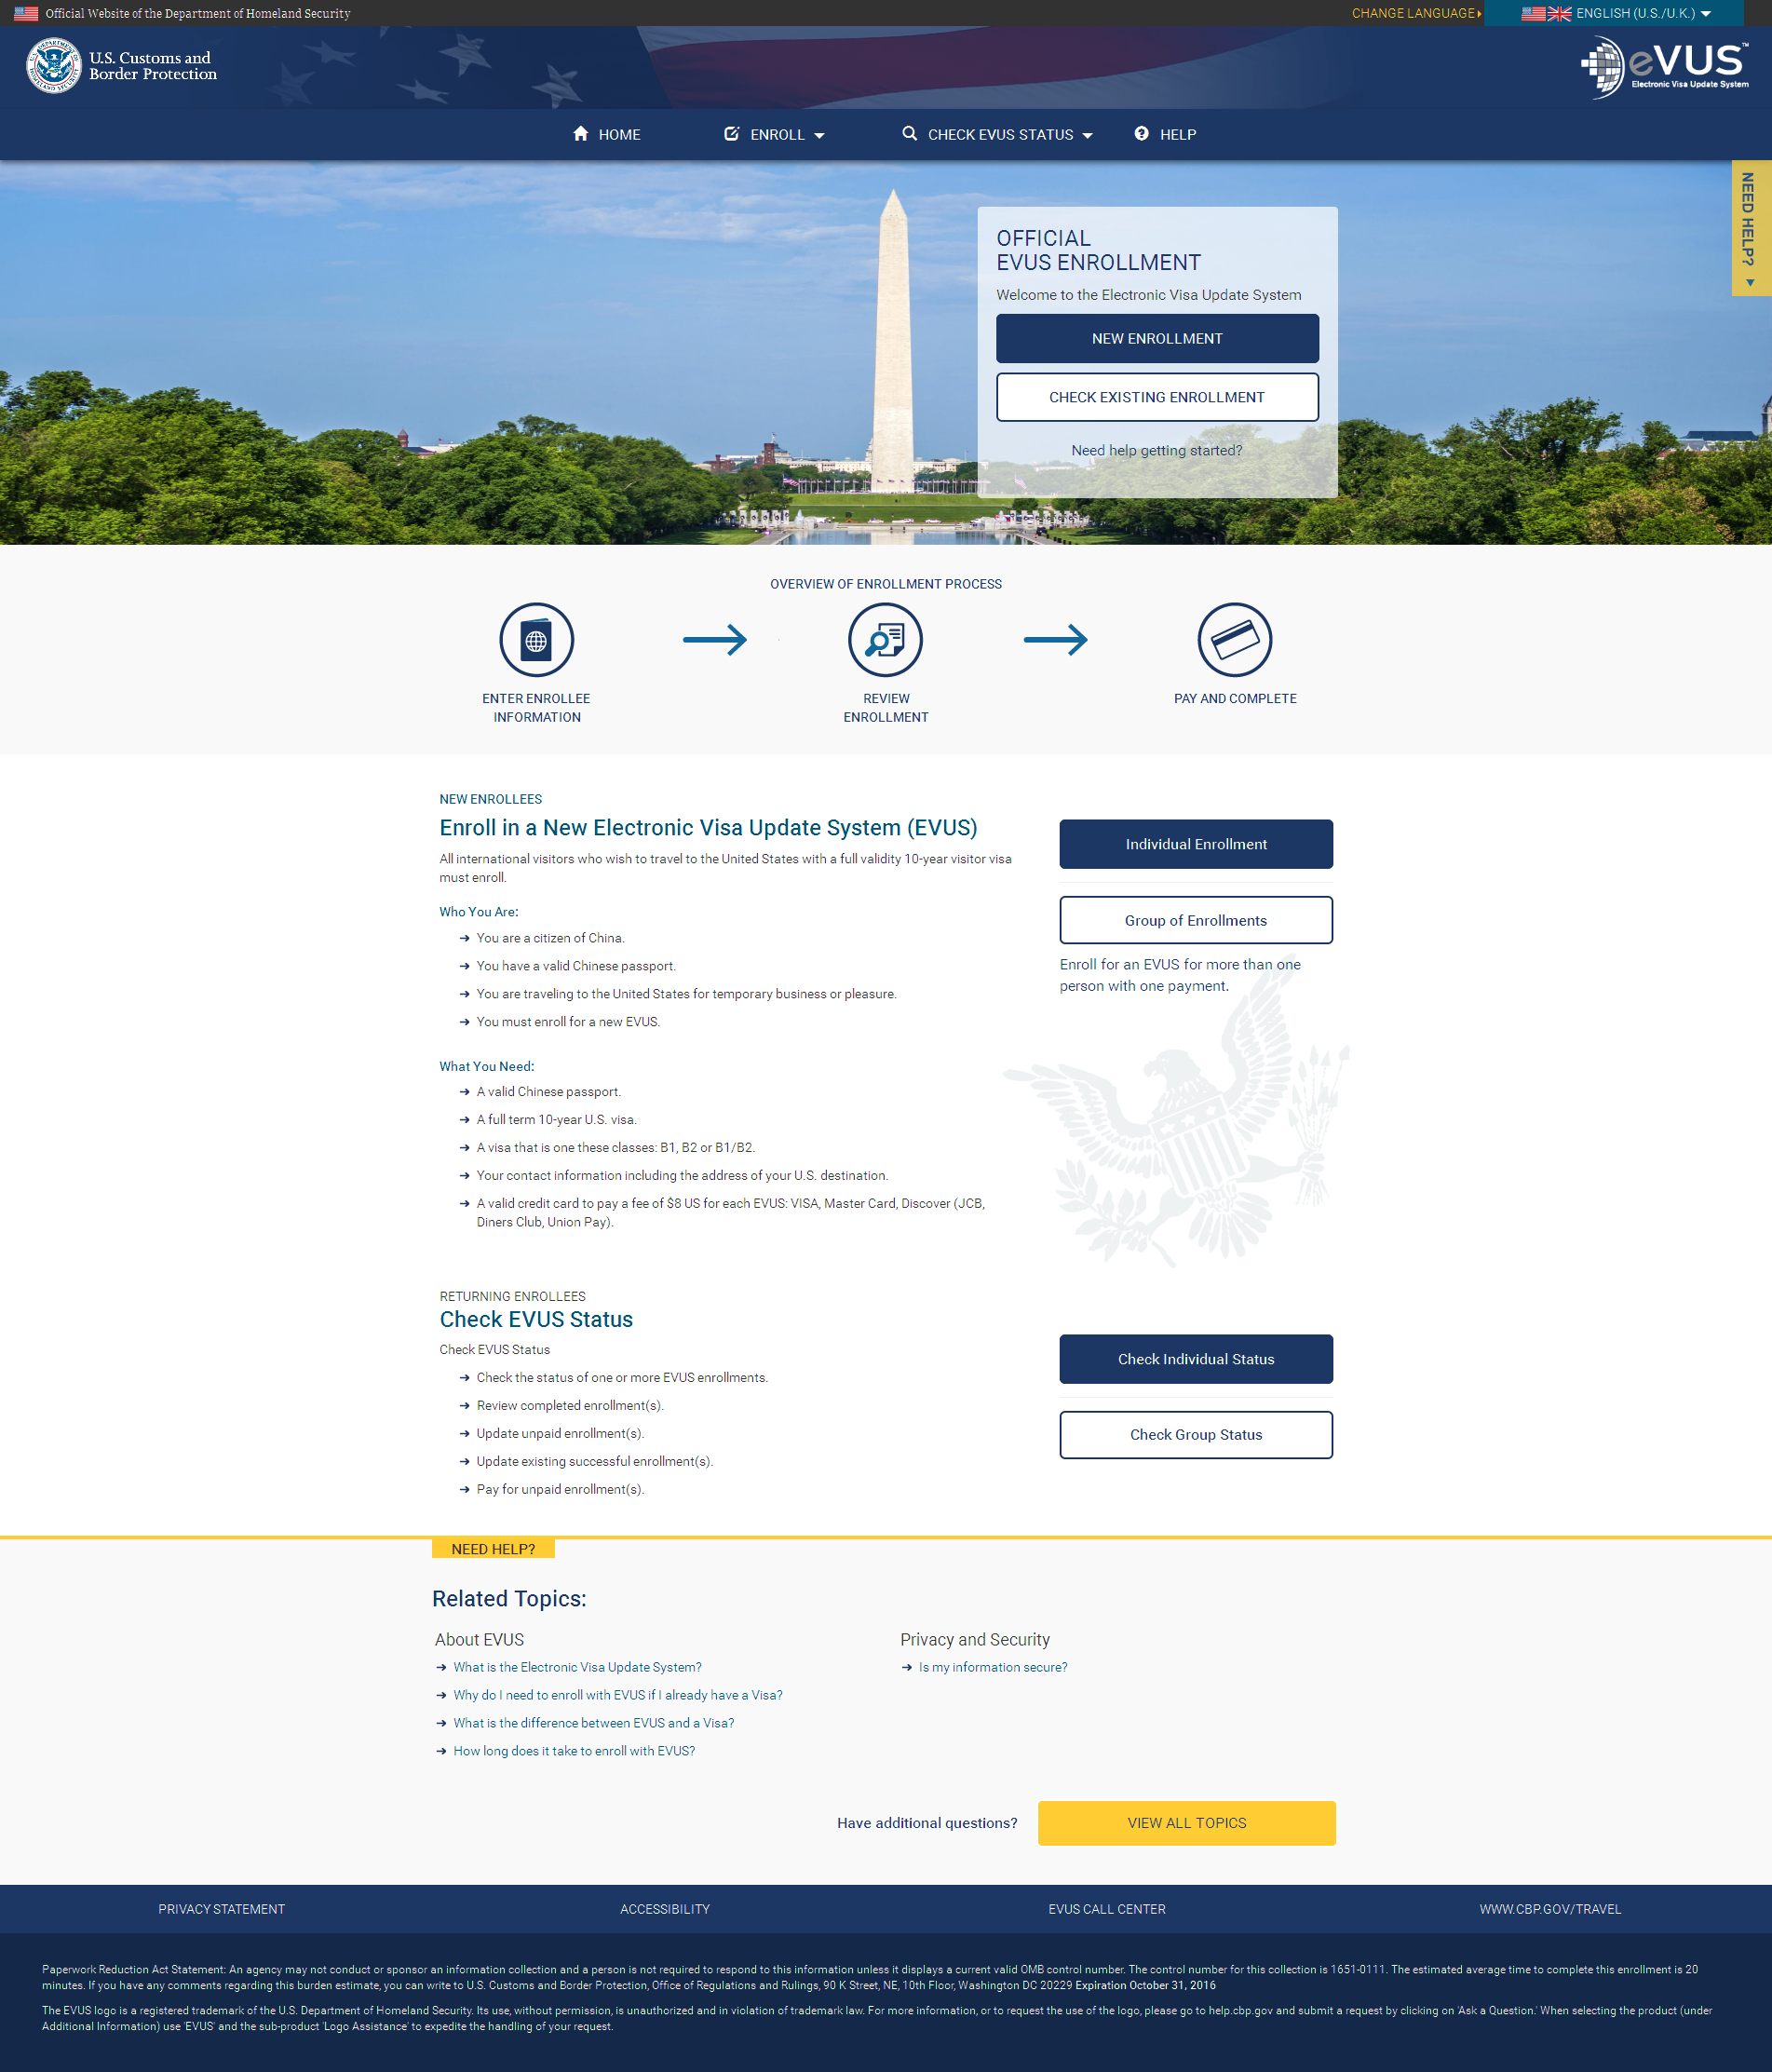
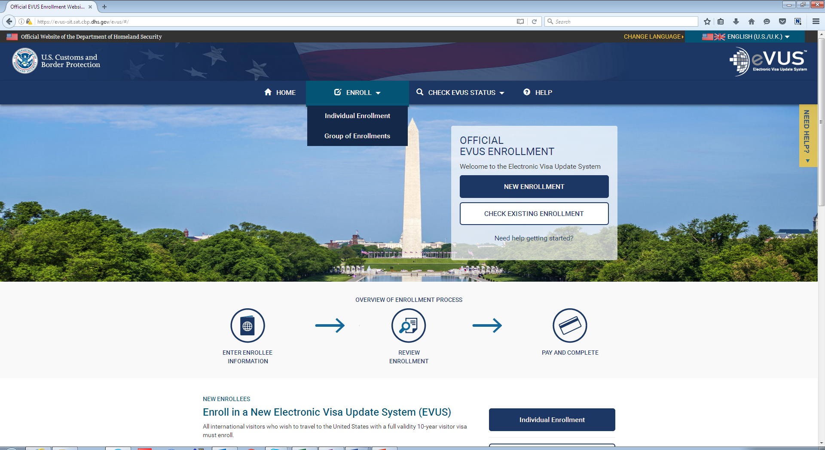
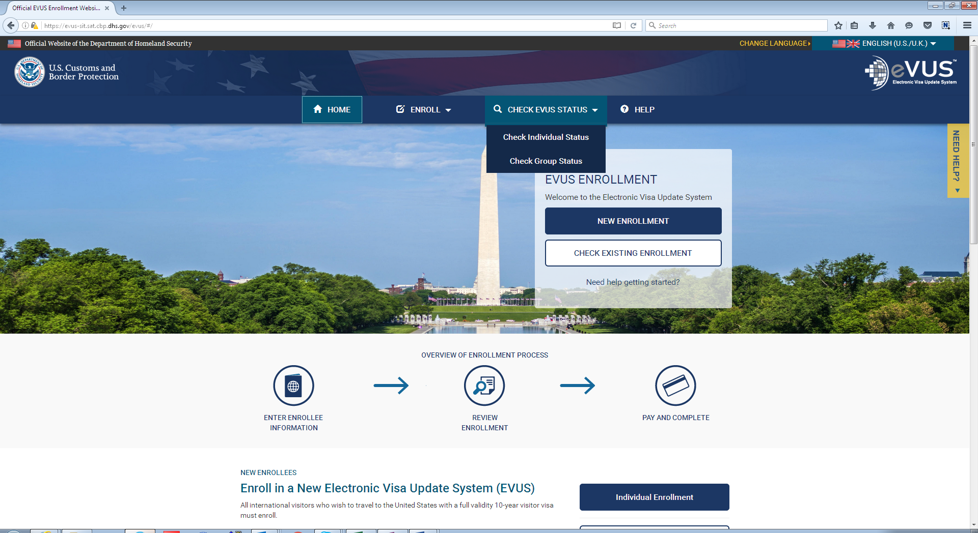
Navigation Menu
For enrollees updating or checking the status of an existing enrollment.
For enrollees submitting a new enrollment.

Slide 4
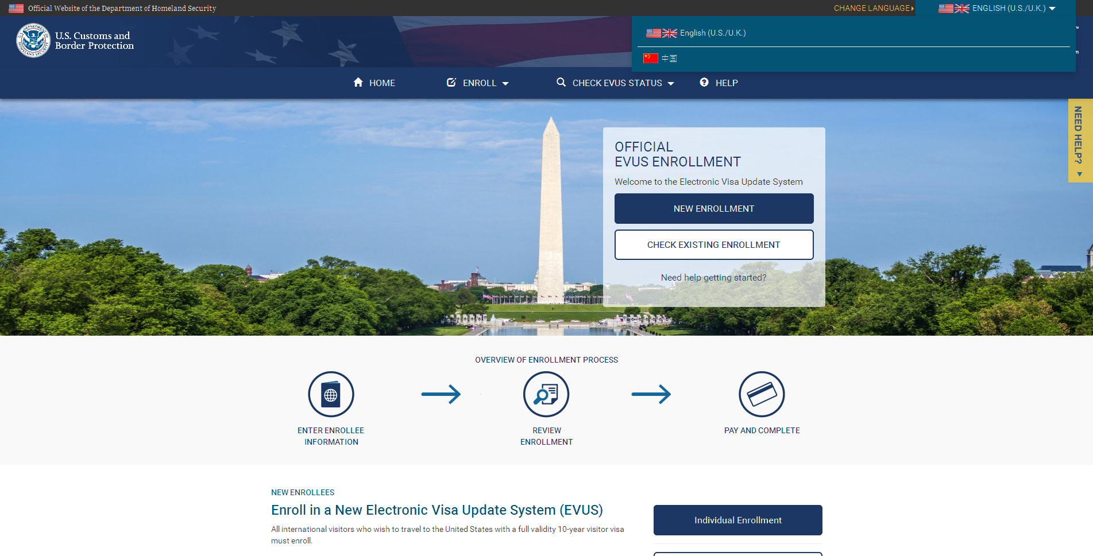
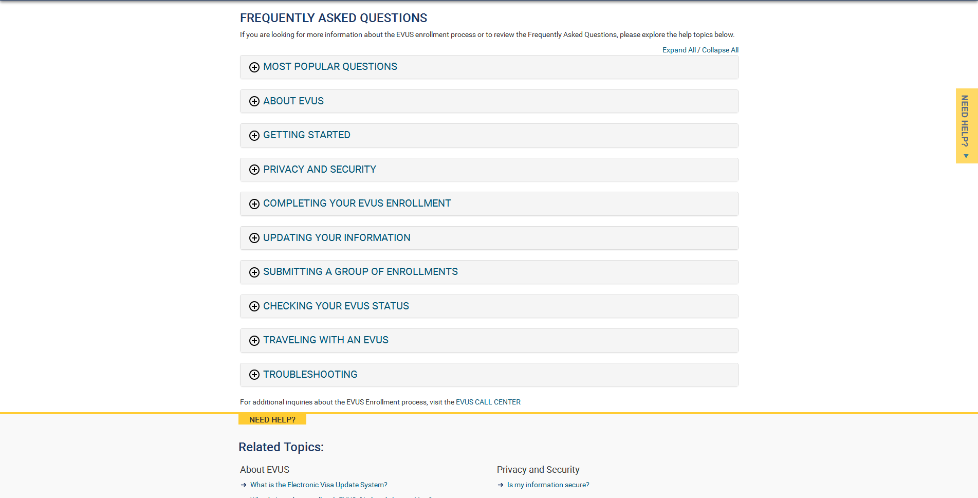
FAQ Page and Language Menu
Enrollees can choose to view the EVUS site in Chinese by clicking the down arrow on the upper right corner. This option is available on every page.
The FAQ page can be accessed by clicking the “Help” icon on the main menu at the bottom of the screen.

Slide 5
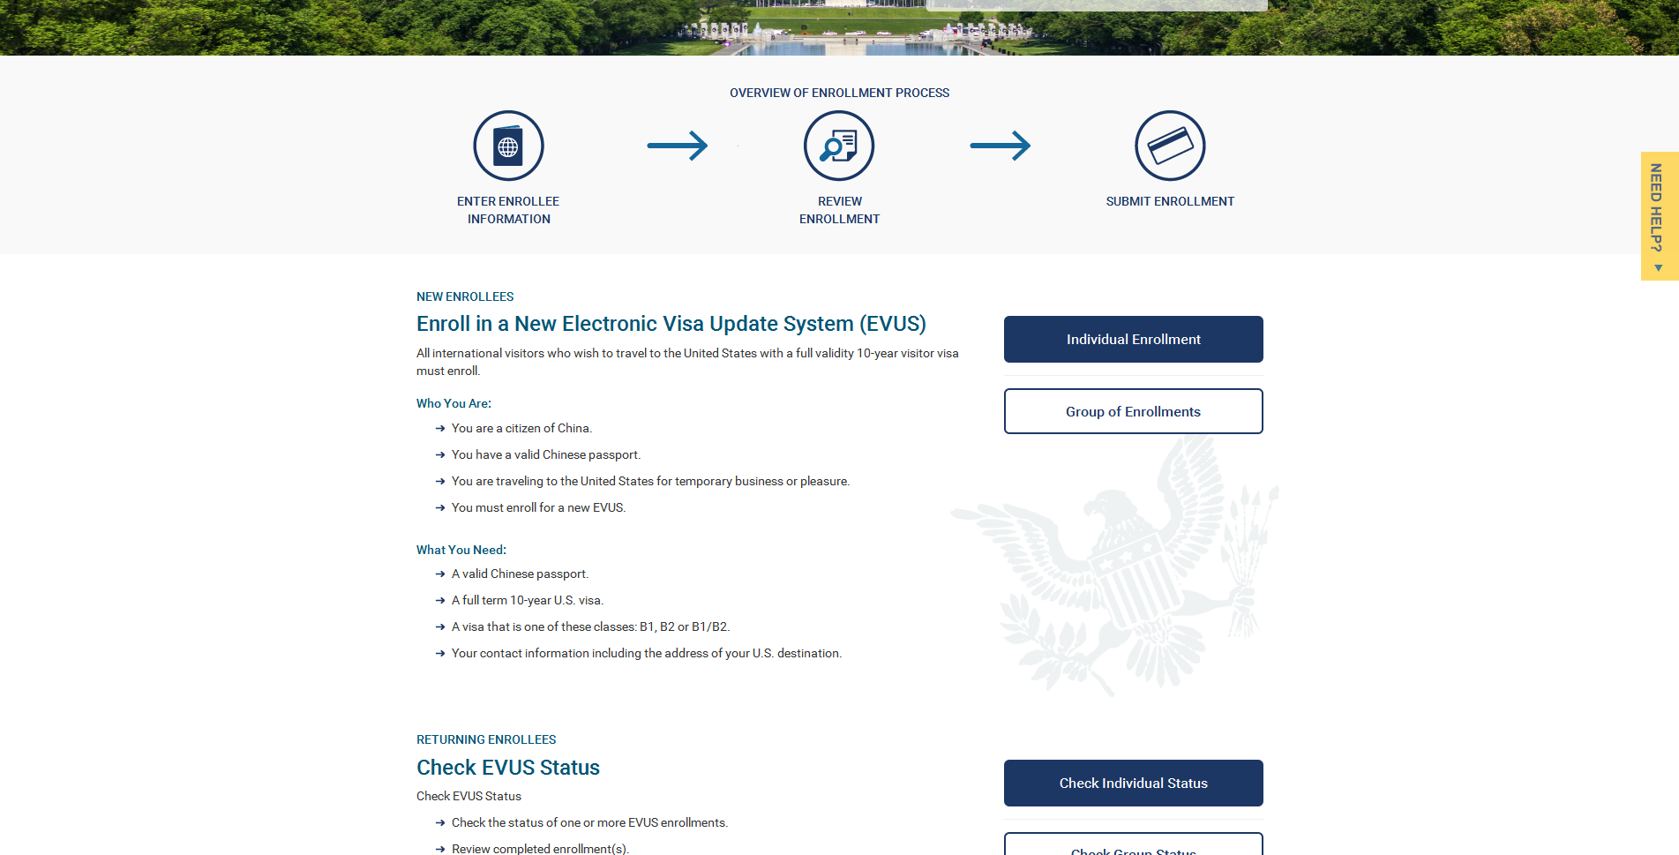
Instructions and Links for Enrolling and Checking Status
The main page of the EVUS site contains instructions on how to enroll and check the status of an existing enrollment.

Slide 6
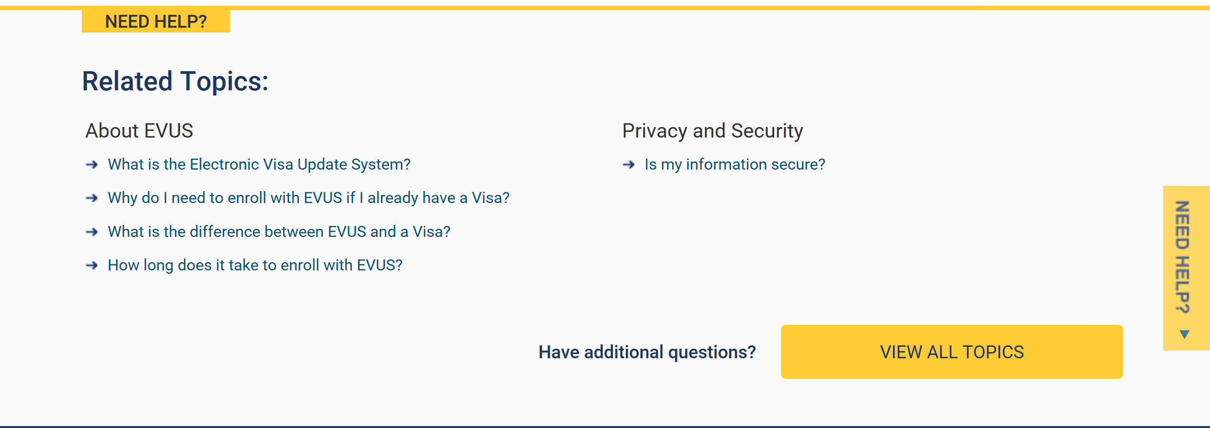
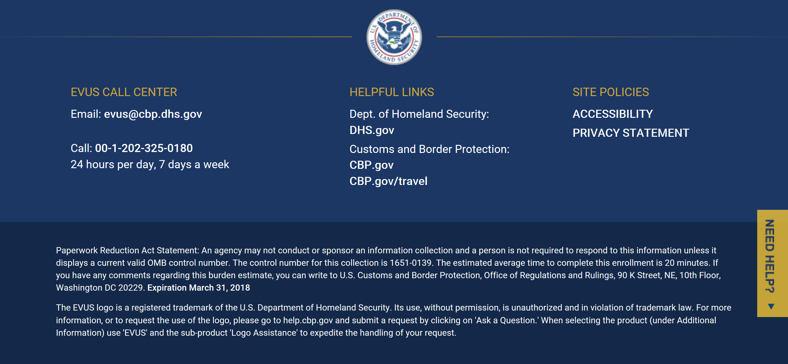
Official Statements and Information Topics
EVUS’s Privacy and Accessibility Statements can be accessed by clicking their respective links at the bottom of each screen. This menu also includes links to the EVUS Call Center and the CBP Travel website. The OMB control number is located within the Paperwork Reduction Act Statement that can be found at the bottom of every screen.

Slide 7
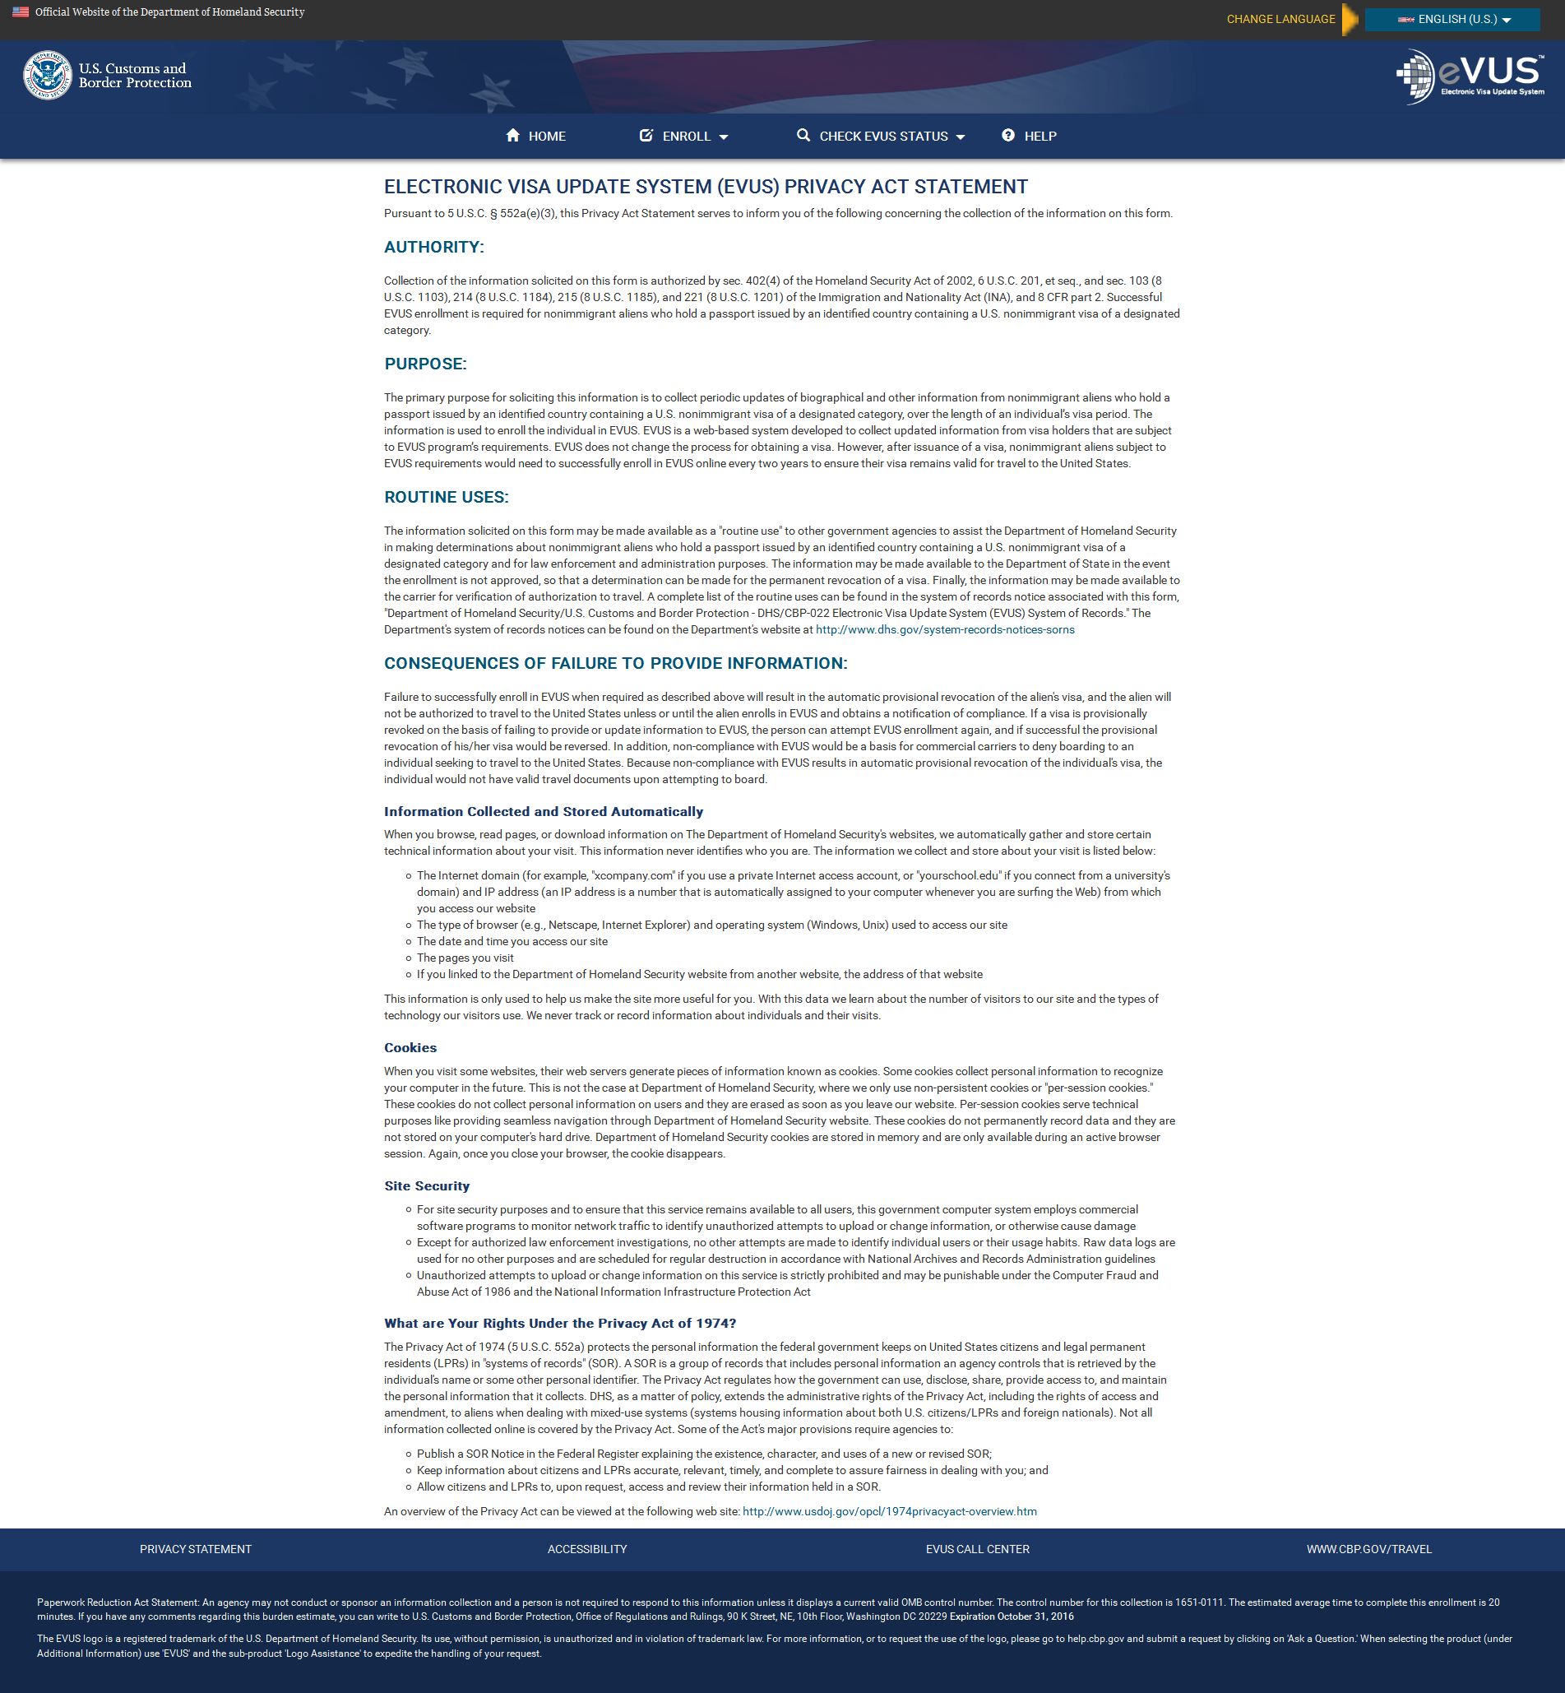
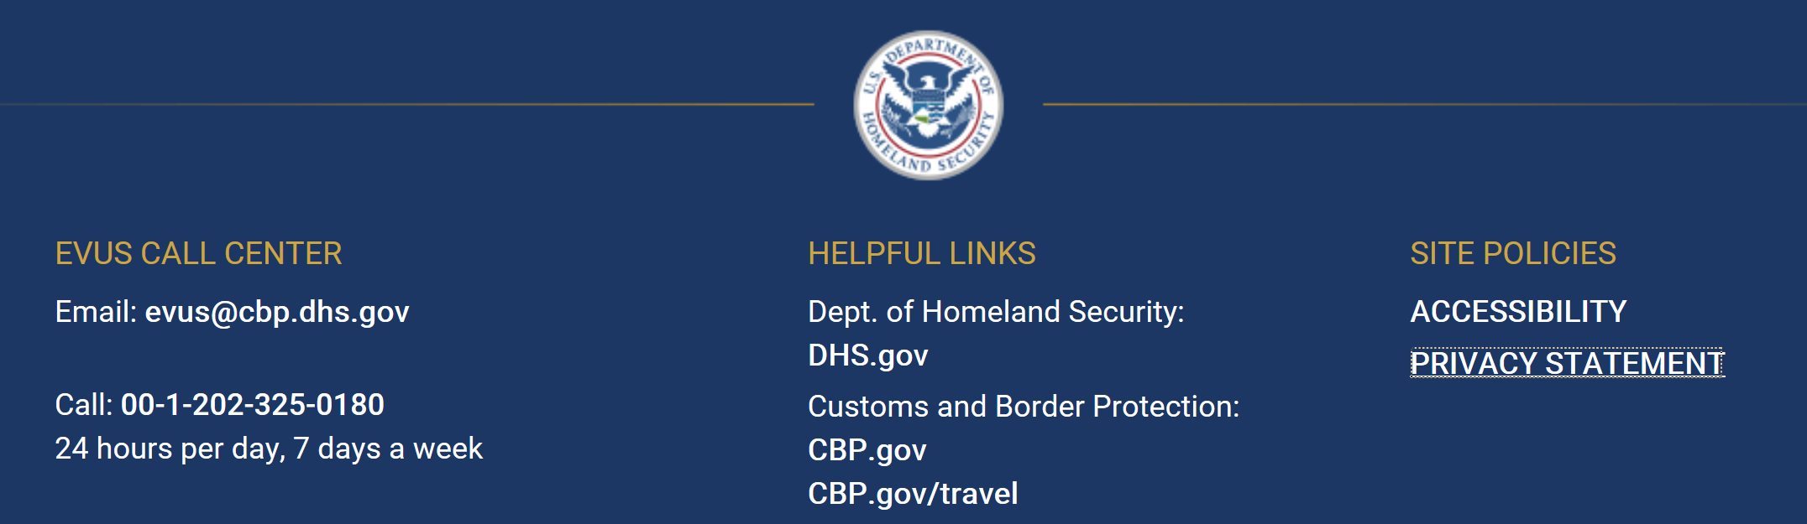
Privacy Act Statement
The Privacy Act Statement can be accessed by clicking the link at the bottom of every screen.

Slide 8
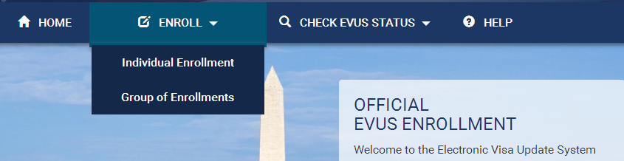
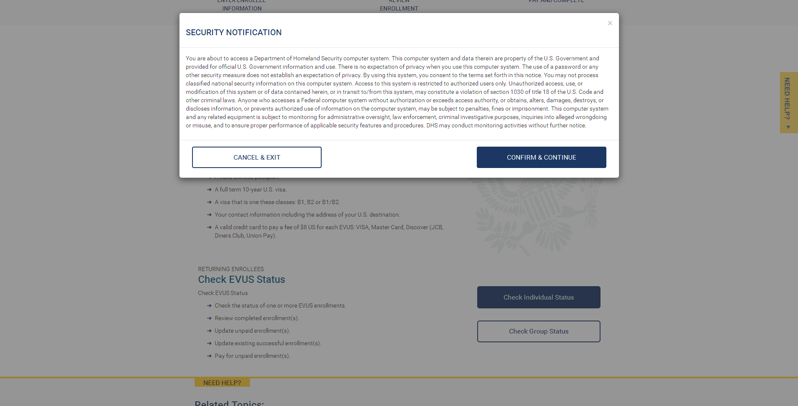
Enrolling for an EVUS
To enroll for a group or individual enrollment click one of the two options provided under the “Enroll” icon. After the enrollee makes a selection, a Security Notification will pop up. In order to continue with the enrollment process, they must select “Confirm and Continue”. On the following screens, the enrollee will be asked to acknowledge a Disclaimer.

Slide 9
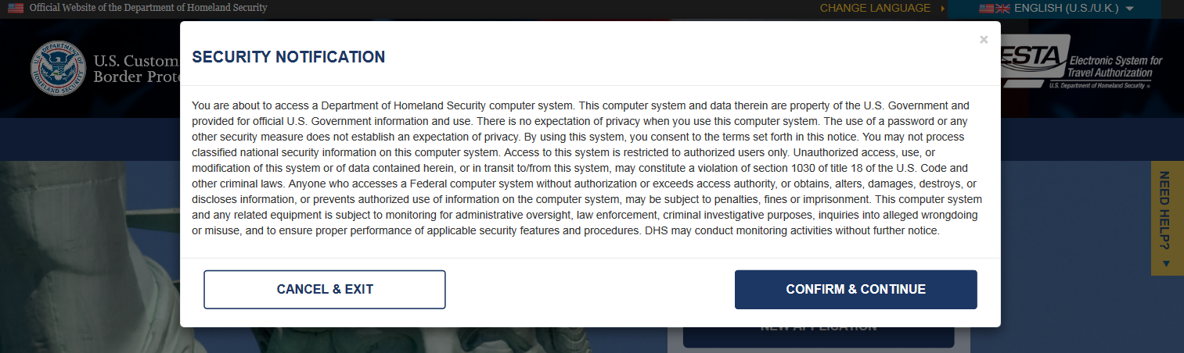
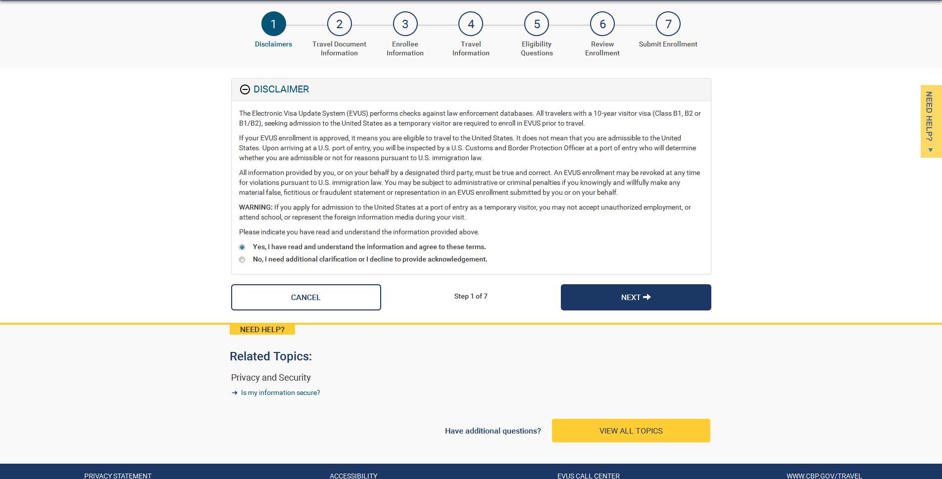
Disclaimer Page
The enrollees much click the “Yes” radio button and select “Next” in order to continue on to the next page of the application.

Slide 10
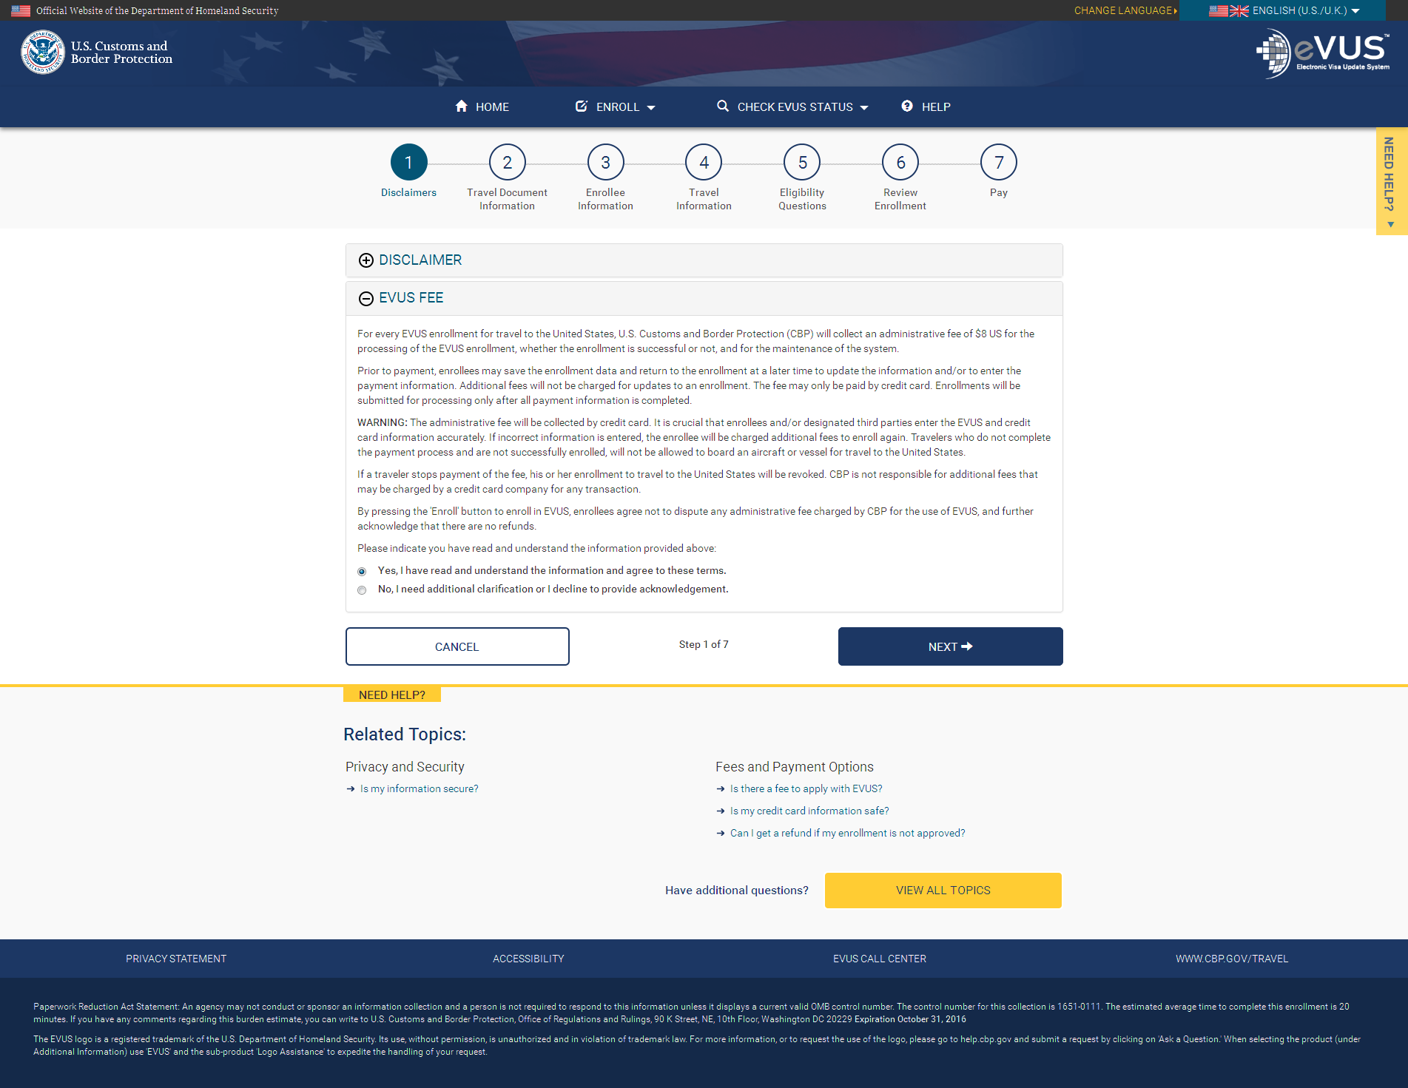
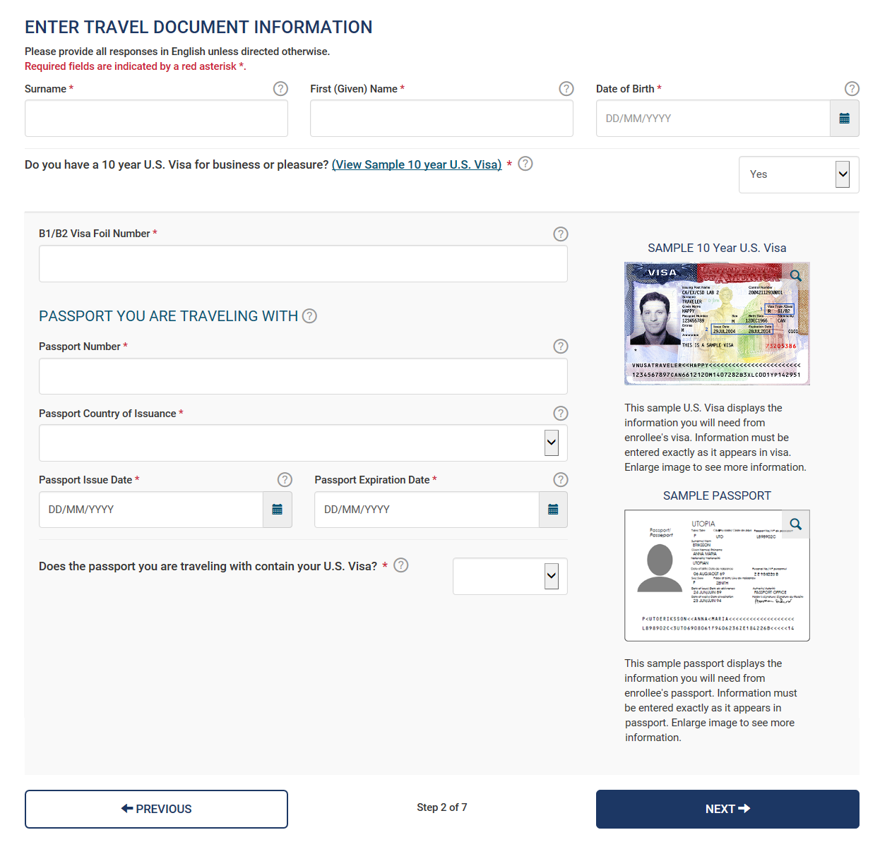
Travel Document Information
After acknowledging the disclaimers, the enrollee will be asked to enter in their travel document information (or the information for whomever they are assisting by completing the application on their behalf). Users can also view a sample 10-year U.S. Visa or passport for reference by clicking on the links on the right side of the form.

Slide 11
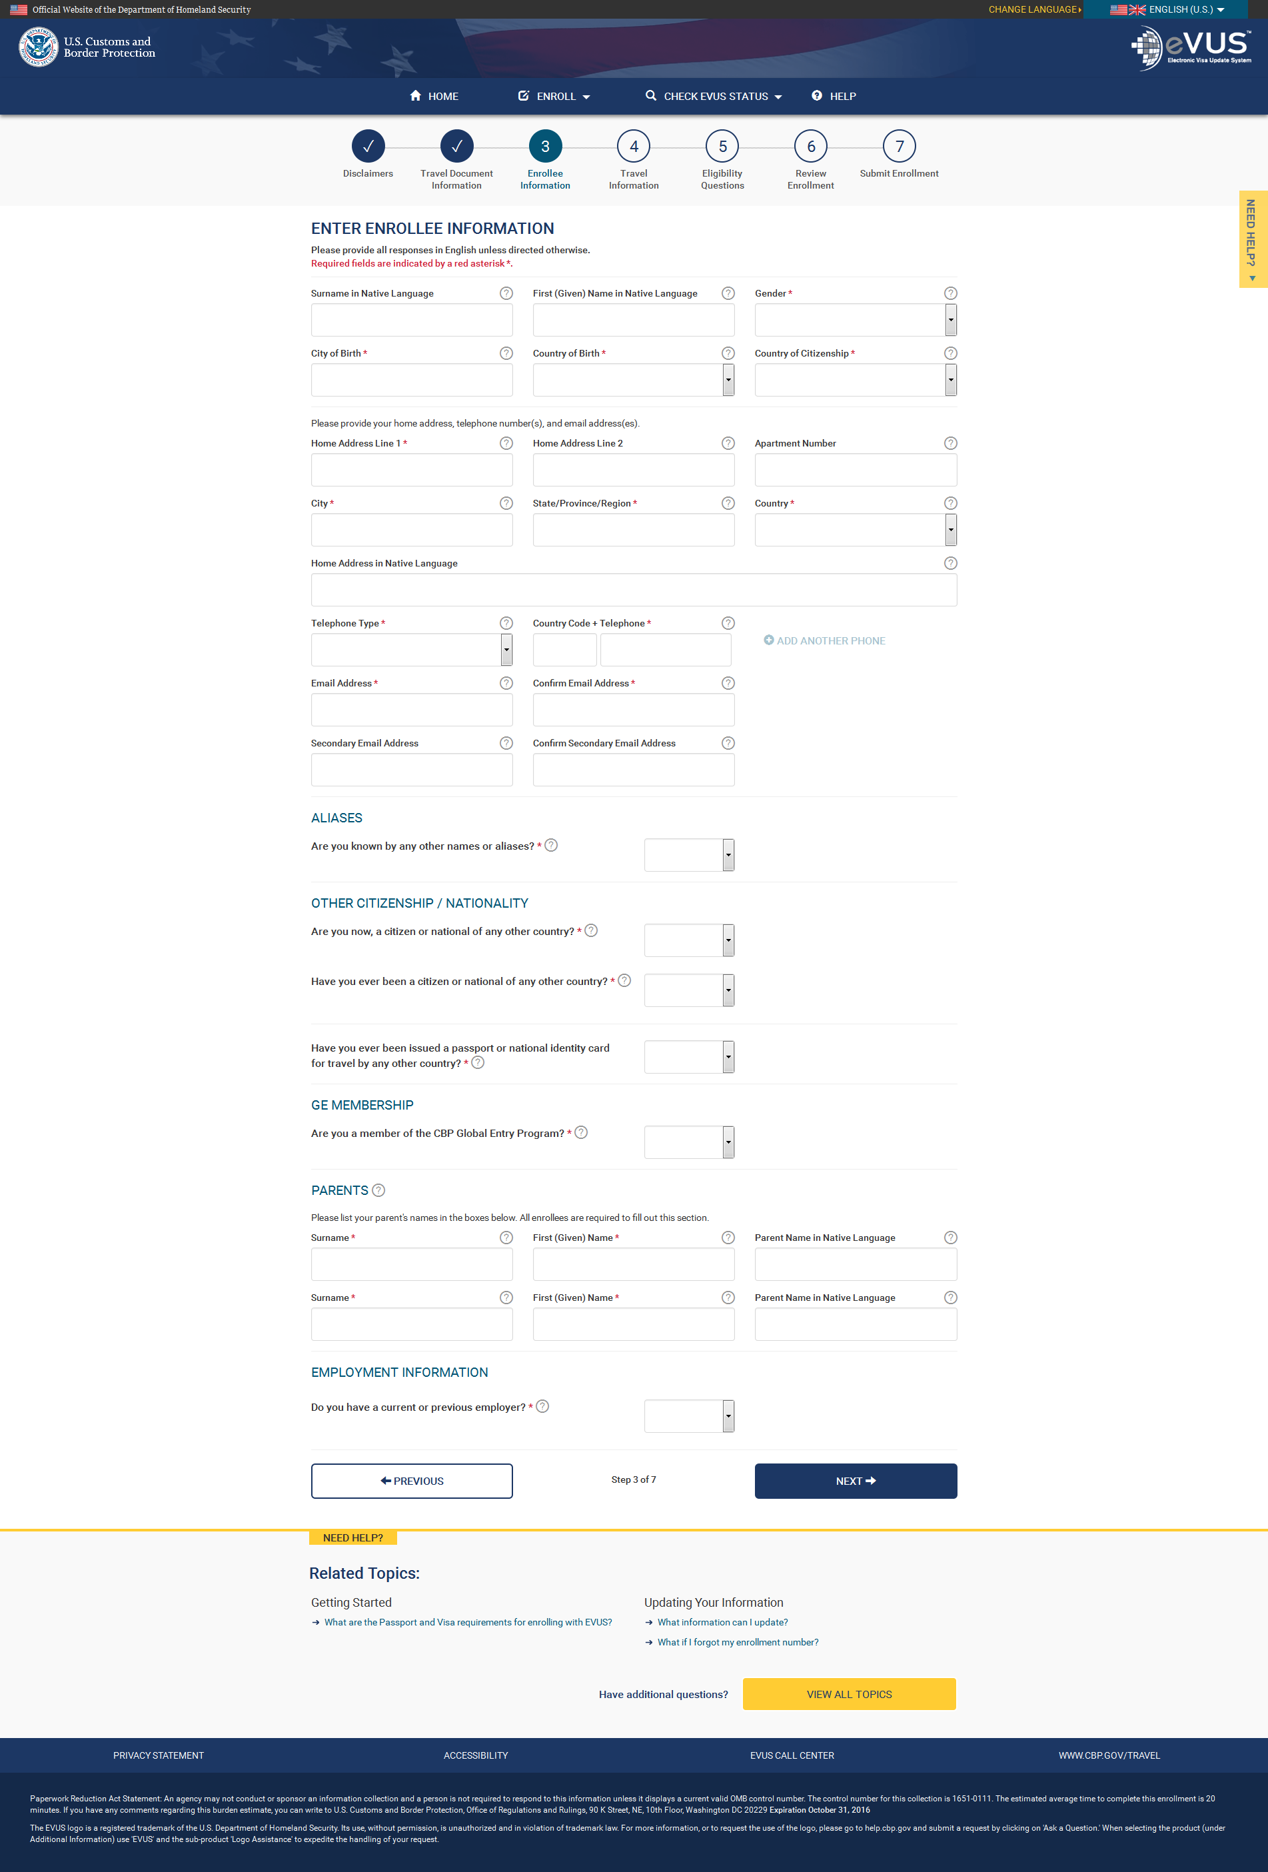
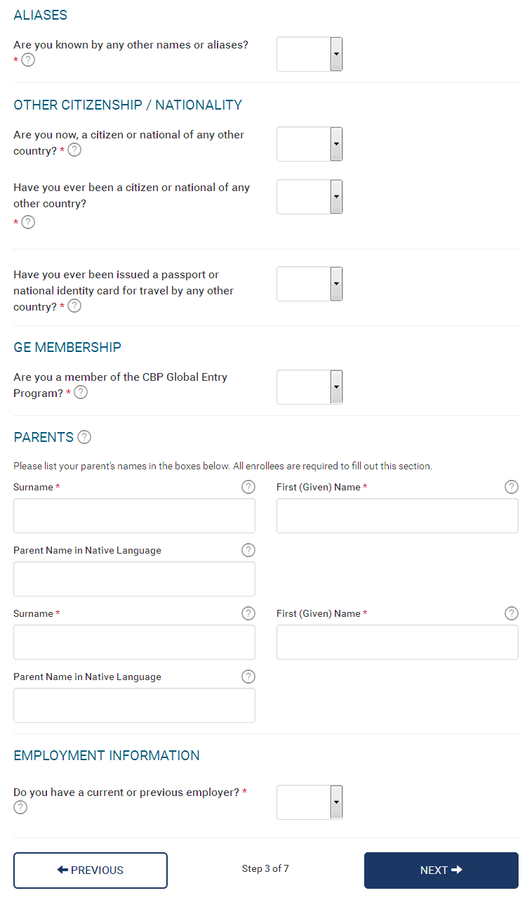
Enrollee Information
On the next screen, the enrollee will be asked to enter their personal, contact and citizenship information.

Slide 12
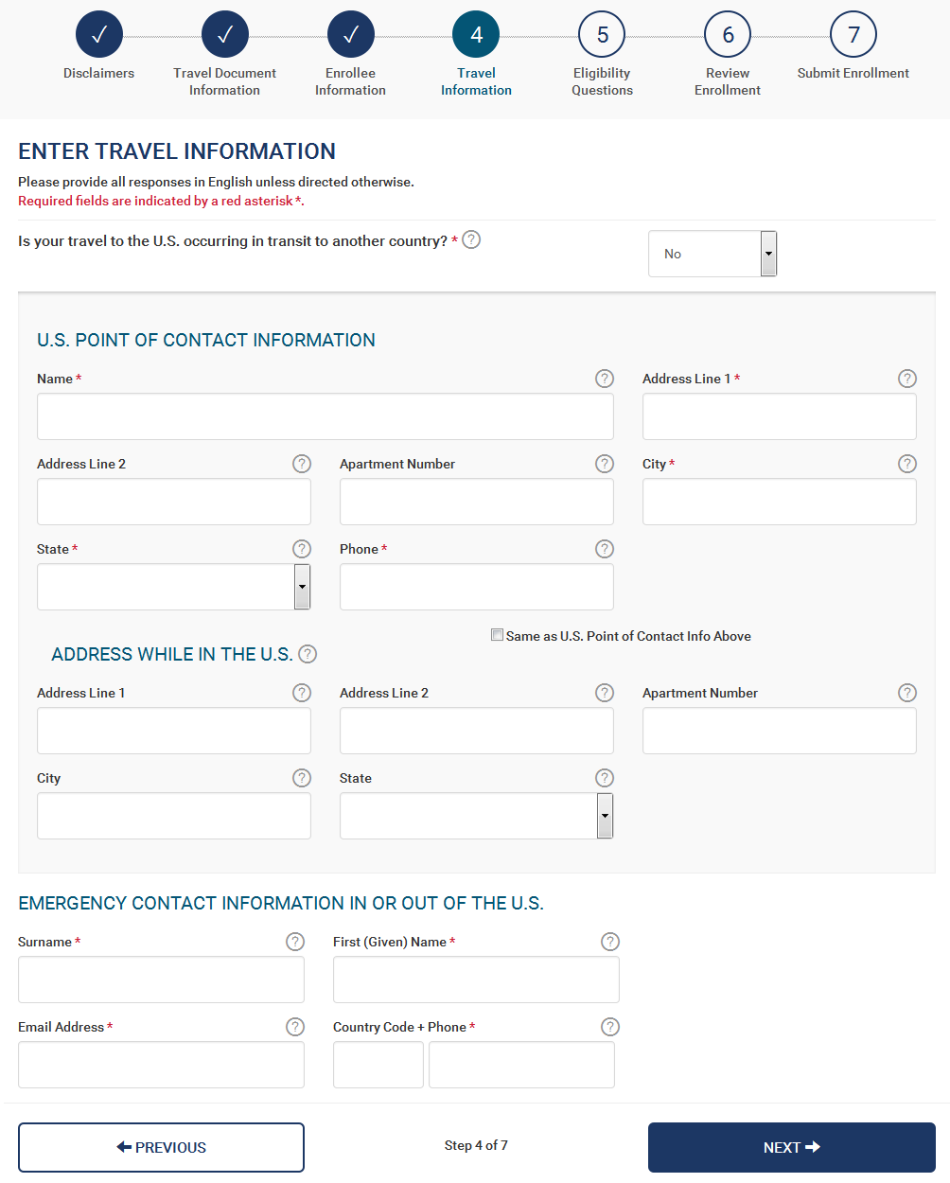
Travel Information
On the fourth screen, the enrollee will be asked to enter their travel information.

Slide 13
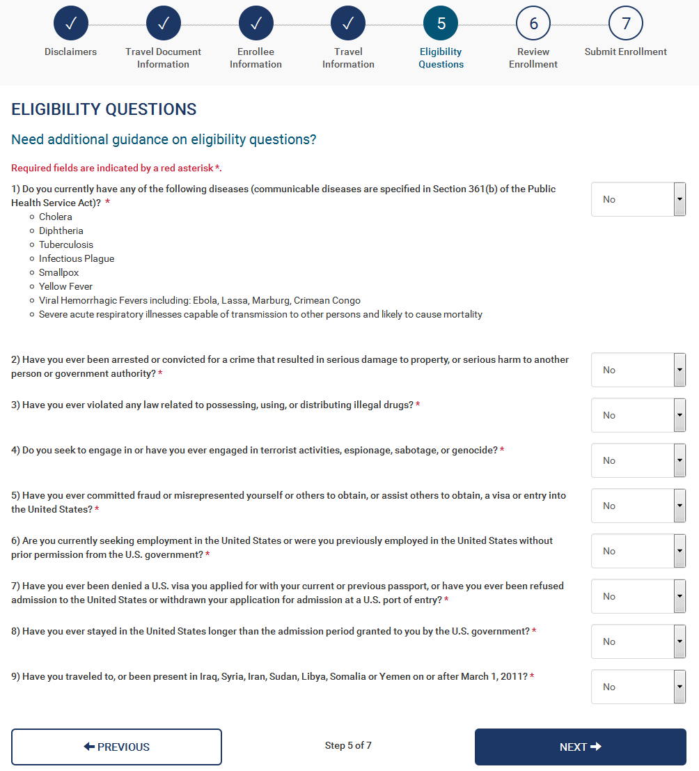
Eligibility Questions and Waiver of Rights
On the fifth screen the enrollee will be asked a series of eligibility questions. This page includes a drop down menu where the enrollee can select Yes or No to each question.

Slide 14
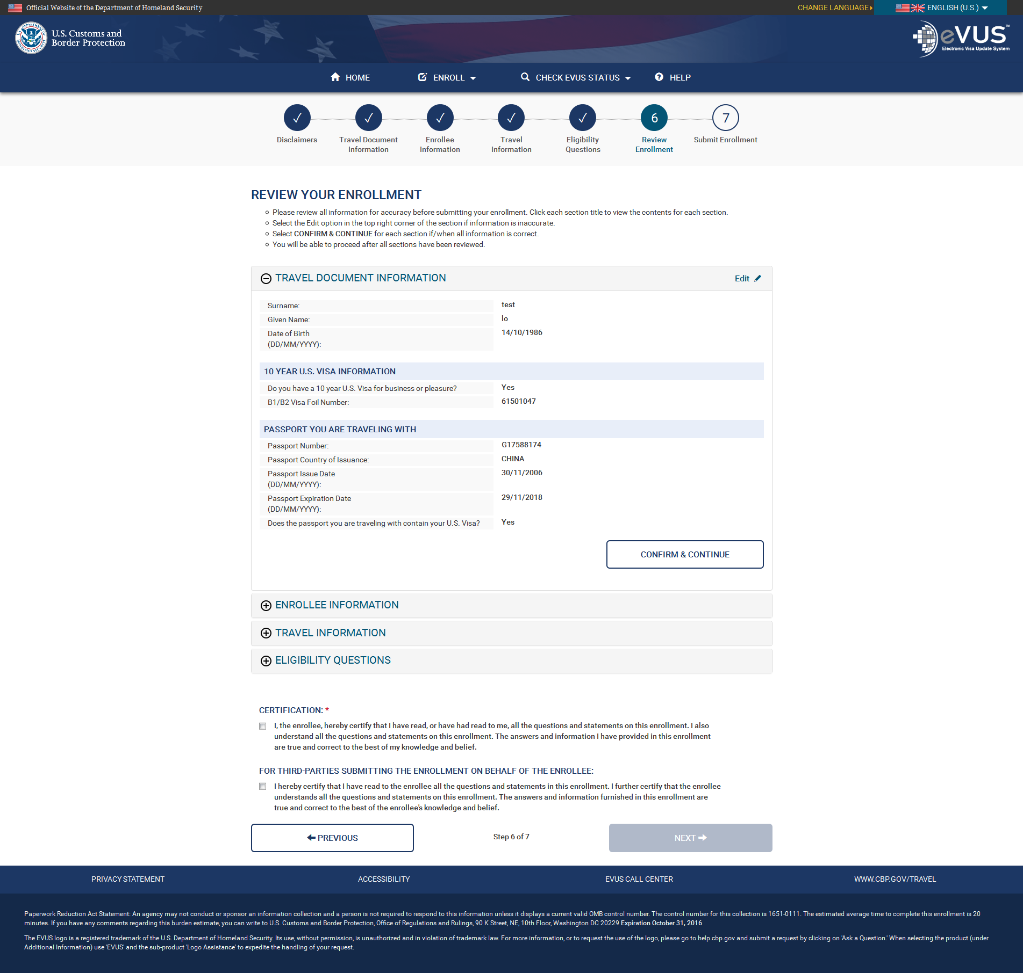
Review- Travel Document Information
On the final page the enrollee will be given the option to review and edit enrollment before submitting. To complete this part of the enrollment the enrollee must select the “Confirm & Continue” icon on each section. The enrollee will also be given the option to edit each portion of their application.

Slide 15
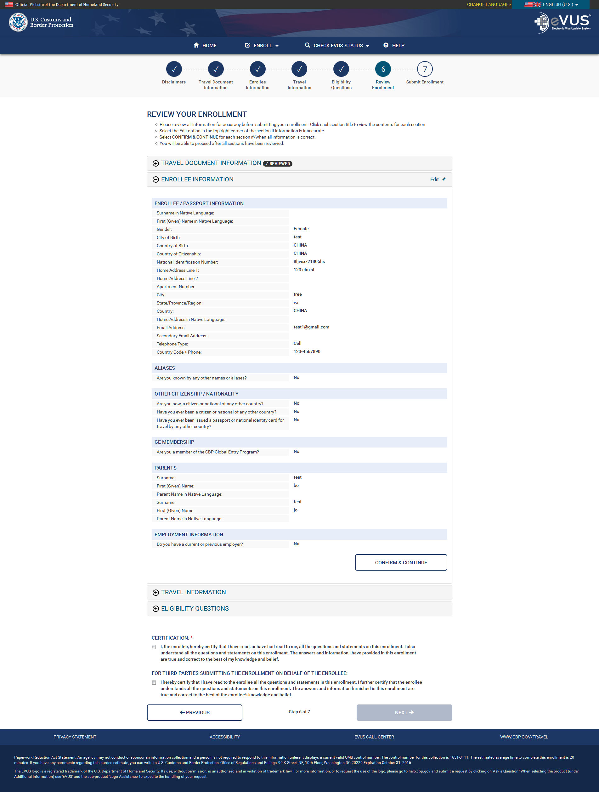
Review- Enrollee Information

Slide 16
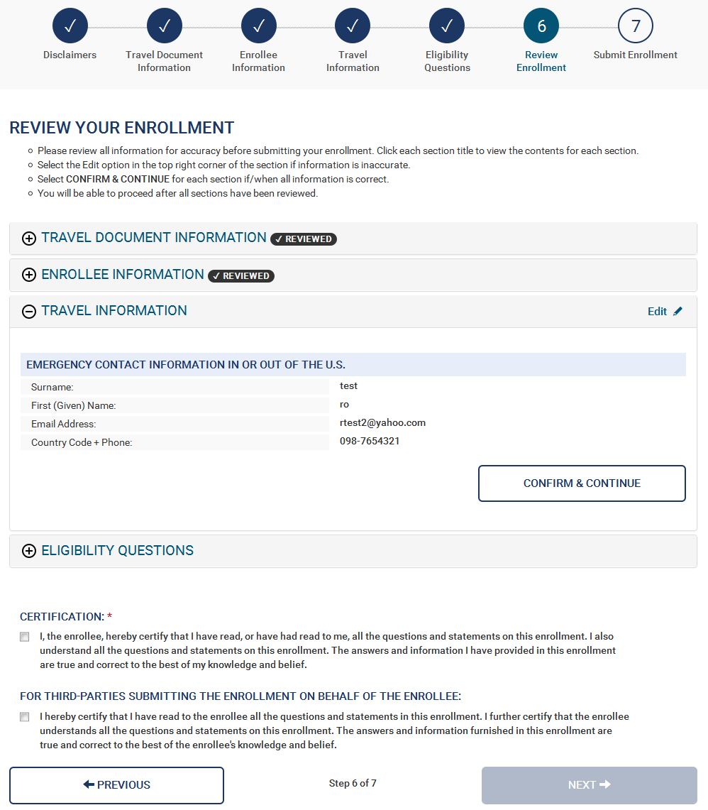
Review- Travel Information

Slide 17
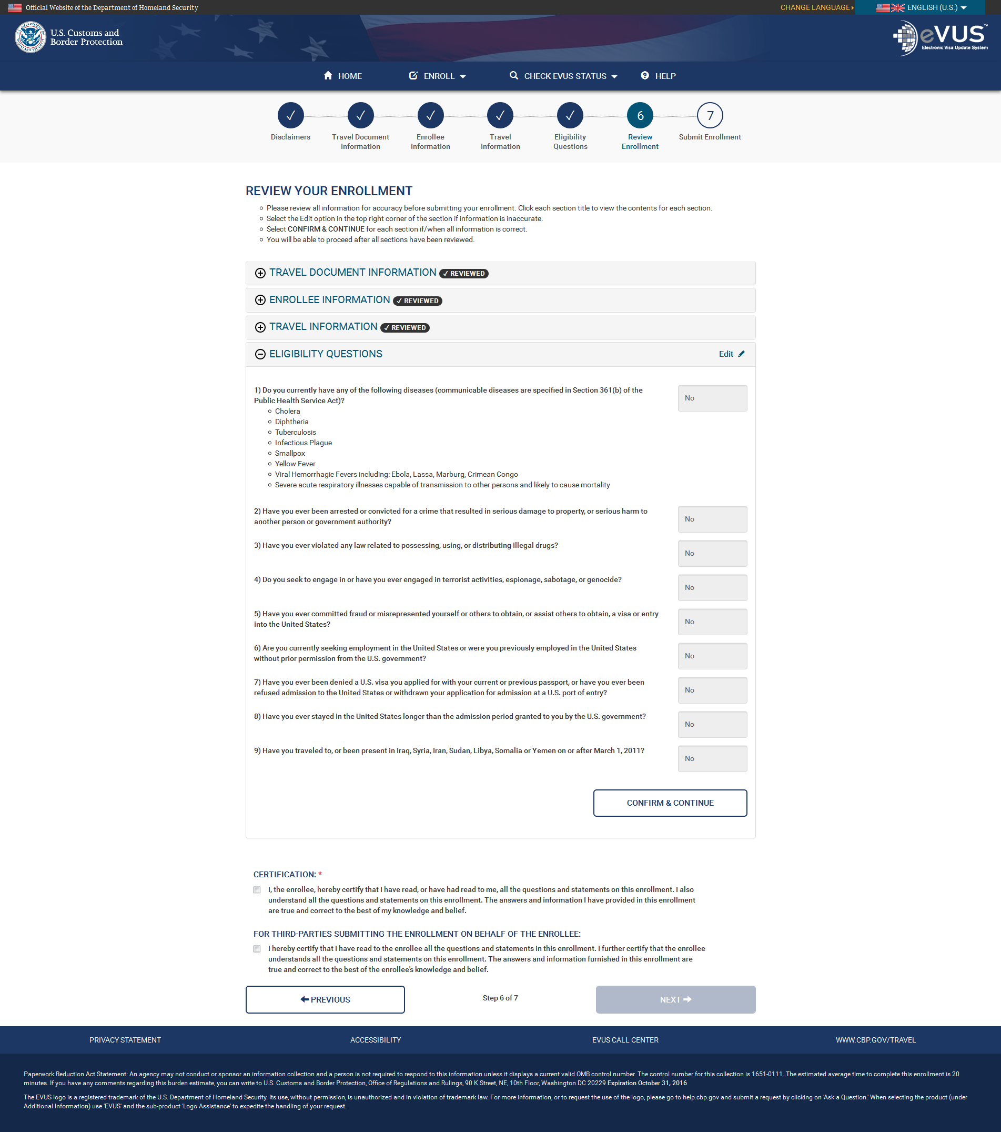
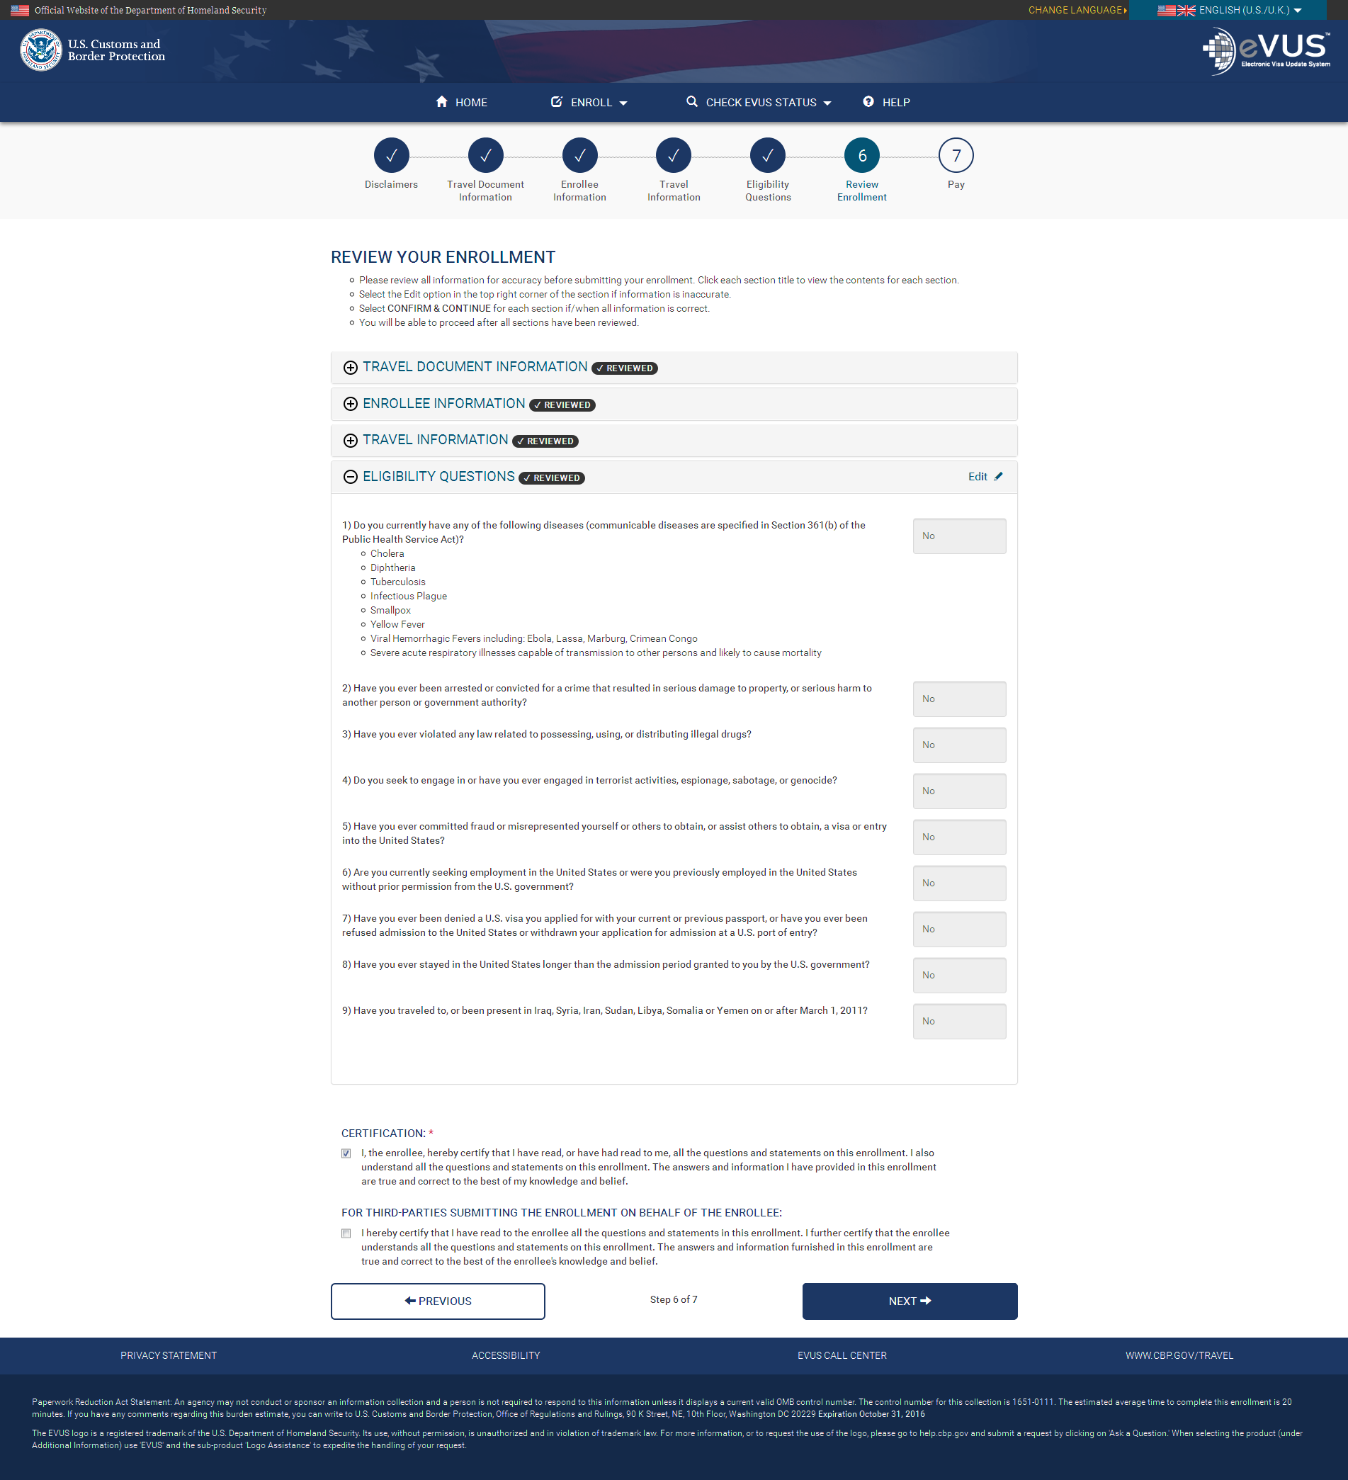
Review- Eligibility Questions
At the end of the review process, the enrollee needs to click the Certification check box before they can submit their enrollment request.

Slide 18
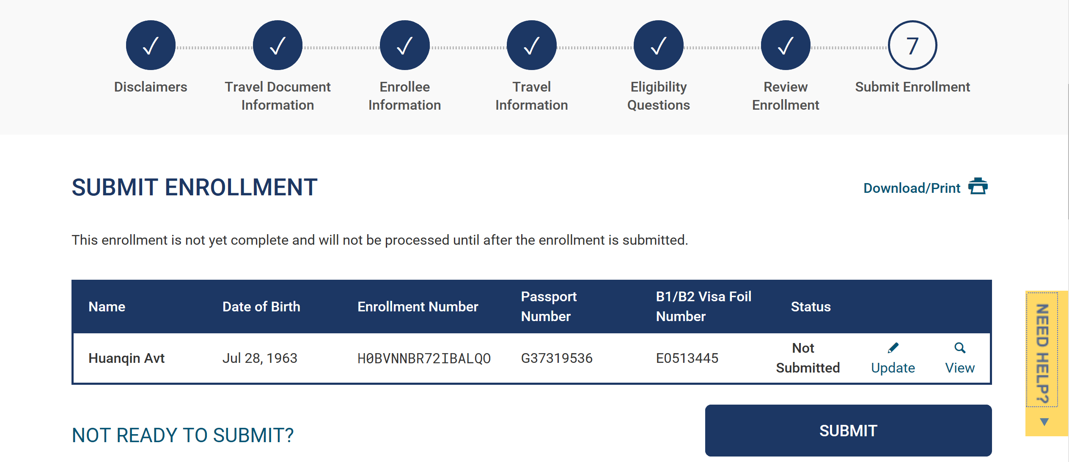
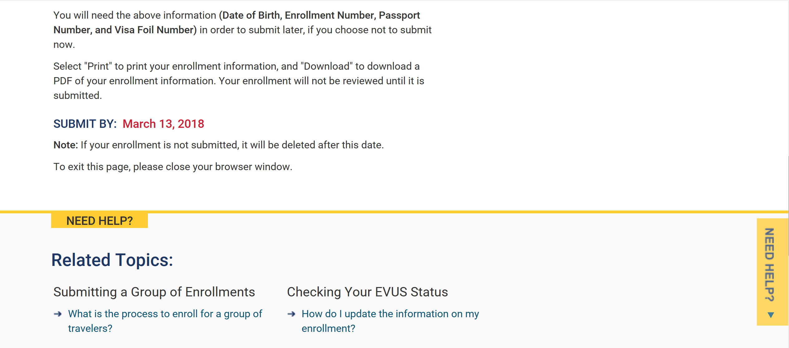
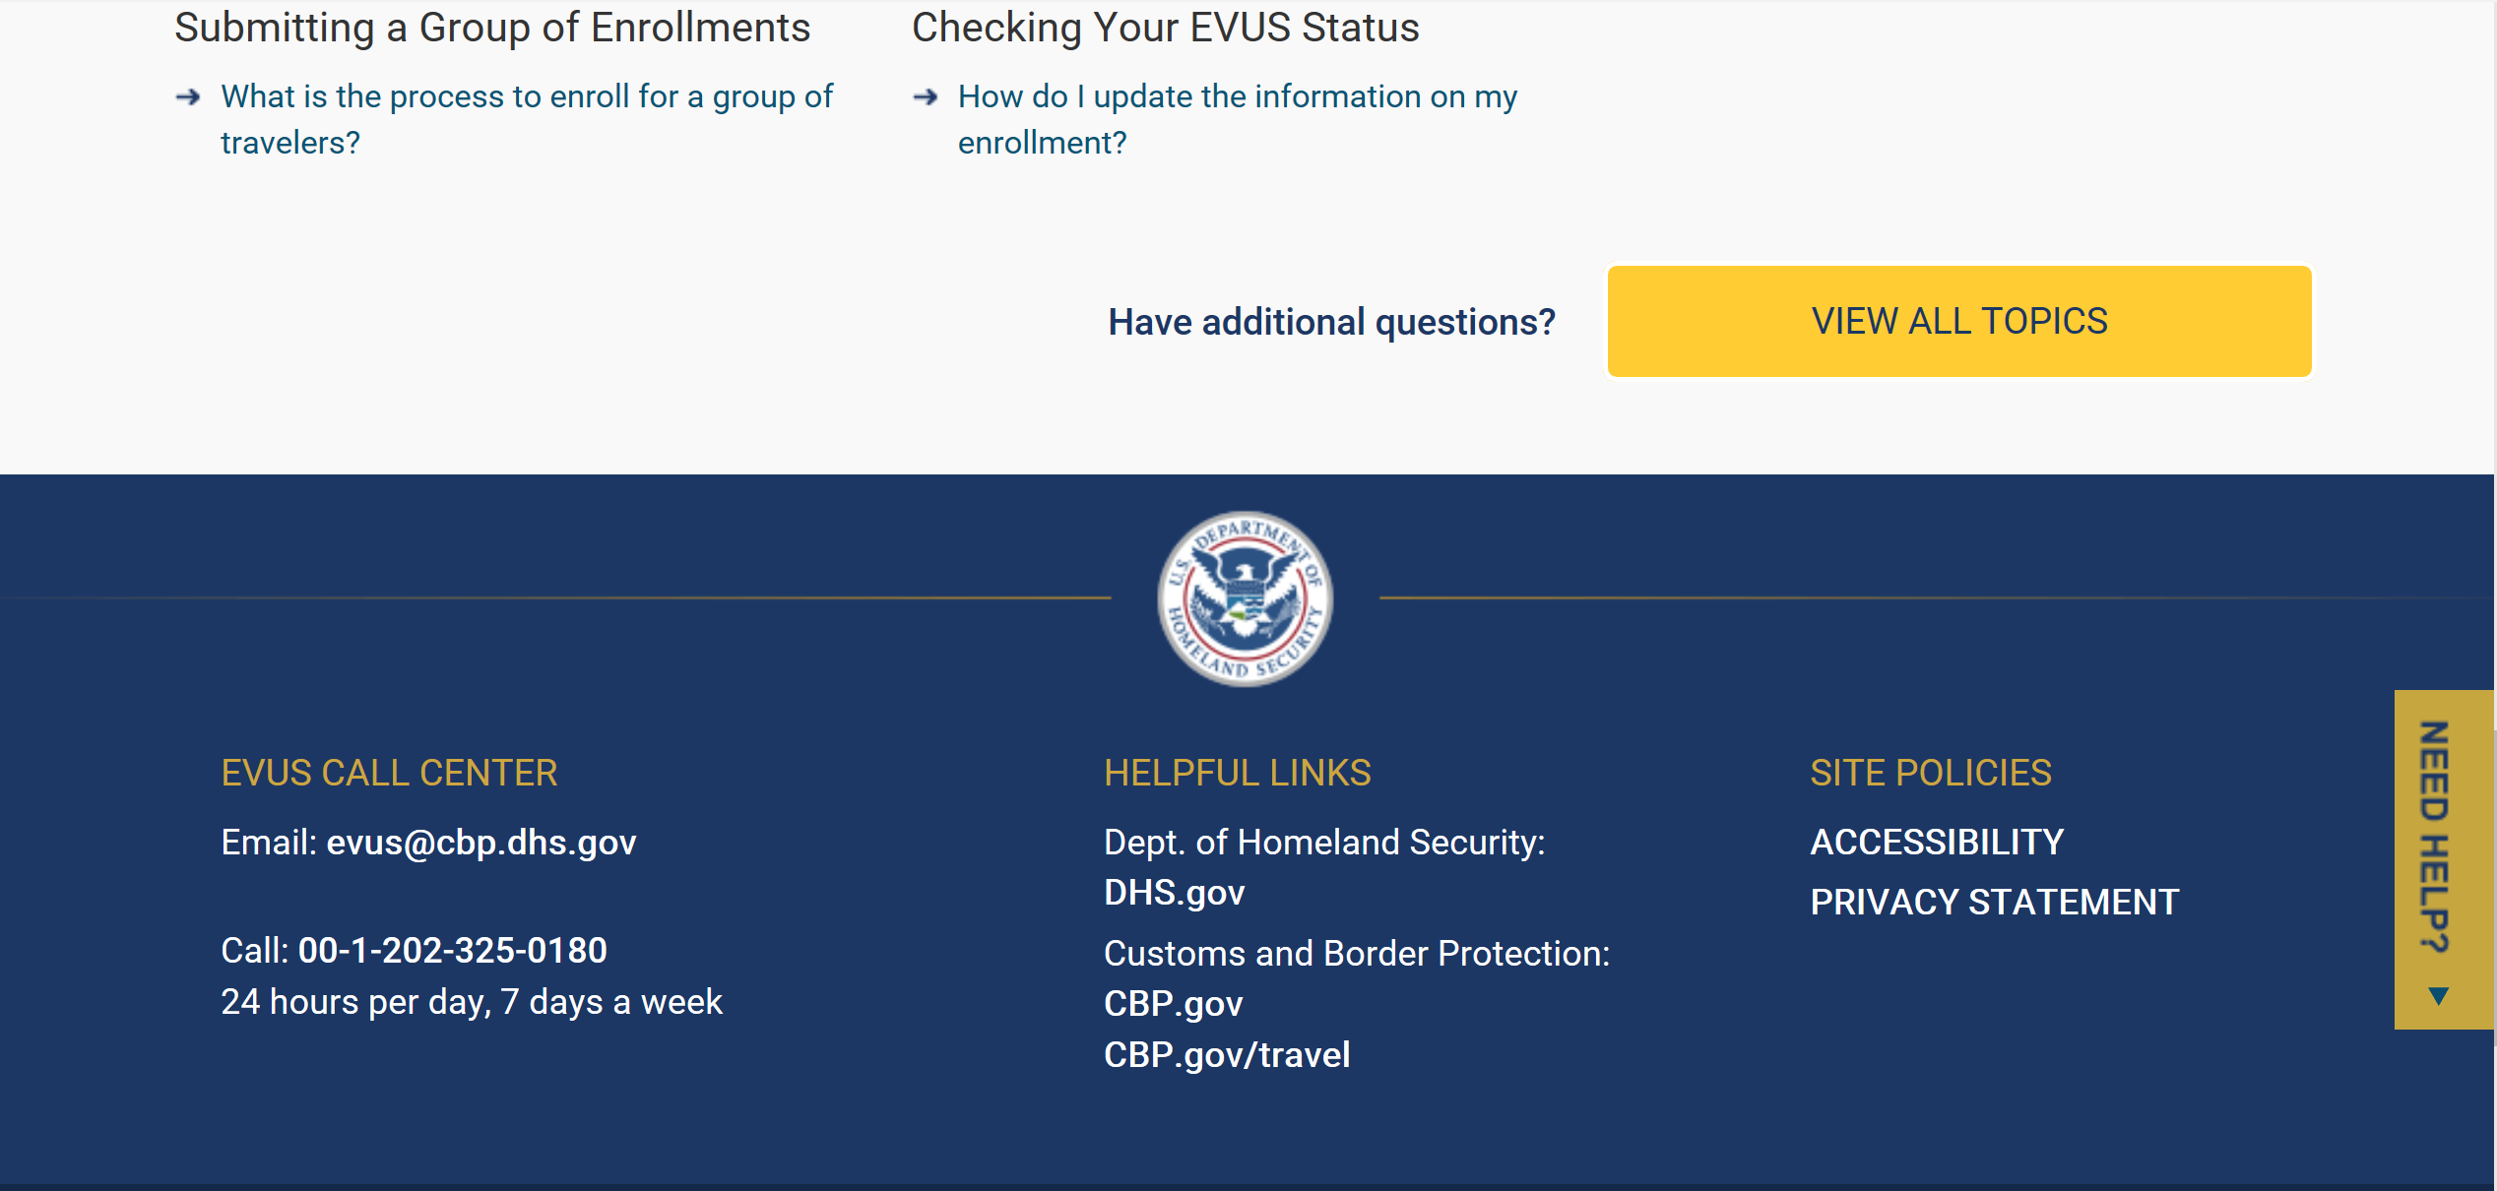
Enrollment Status Page (Single)
After selecting “Confirm and Continue”, each drop down menu on the Enrollment Review page will take the user to Enrollment submission page. From this page, the enrollee can print, view, or update their enrollment. User must click on ‘Submit’ to continue with the enrollment.

Slide 19
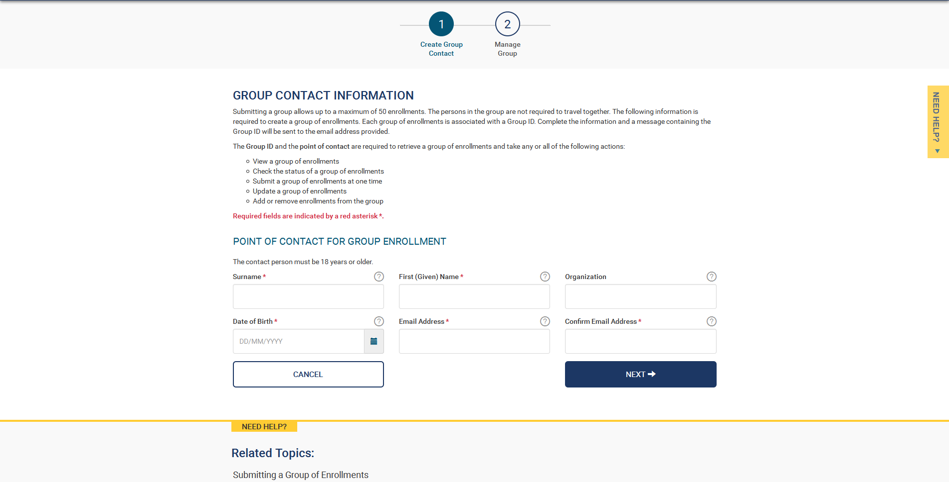
Creating a Group (Step 1)
Submitting an enrollment for multiple individuals is similar to enrolling for an individual except that the enrollee would select “Group of Enrollments” instead of “Individual Enrollment” on the main menu. When the group option is chosen, the enrollee will be asked to enter information for the group point of contact.

Slide 20
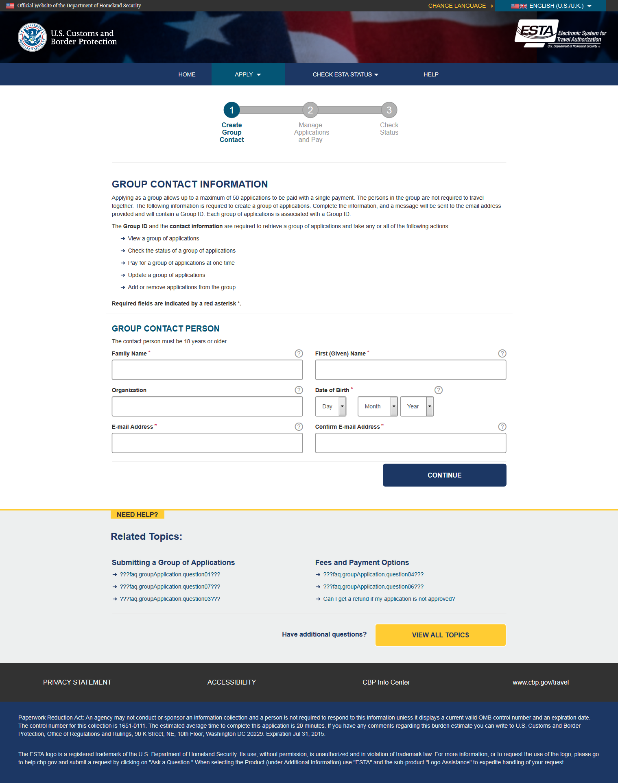
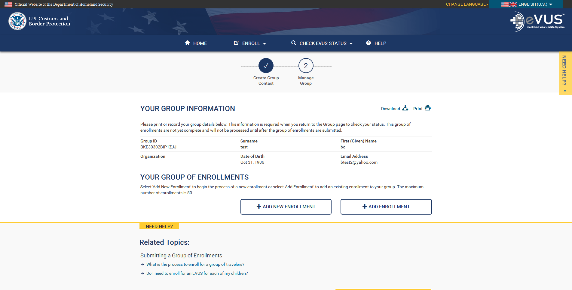
Creating a Group (Step 2)
After filling in the group point of contact information and selecting “Continue,” the group number will be displayed along with the group point of contact information. This page can be printed for future reference.

Slide 21
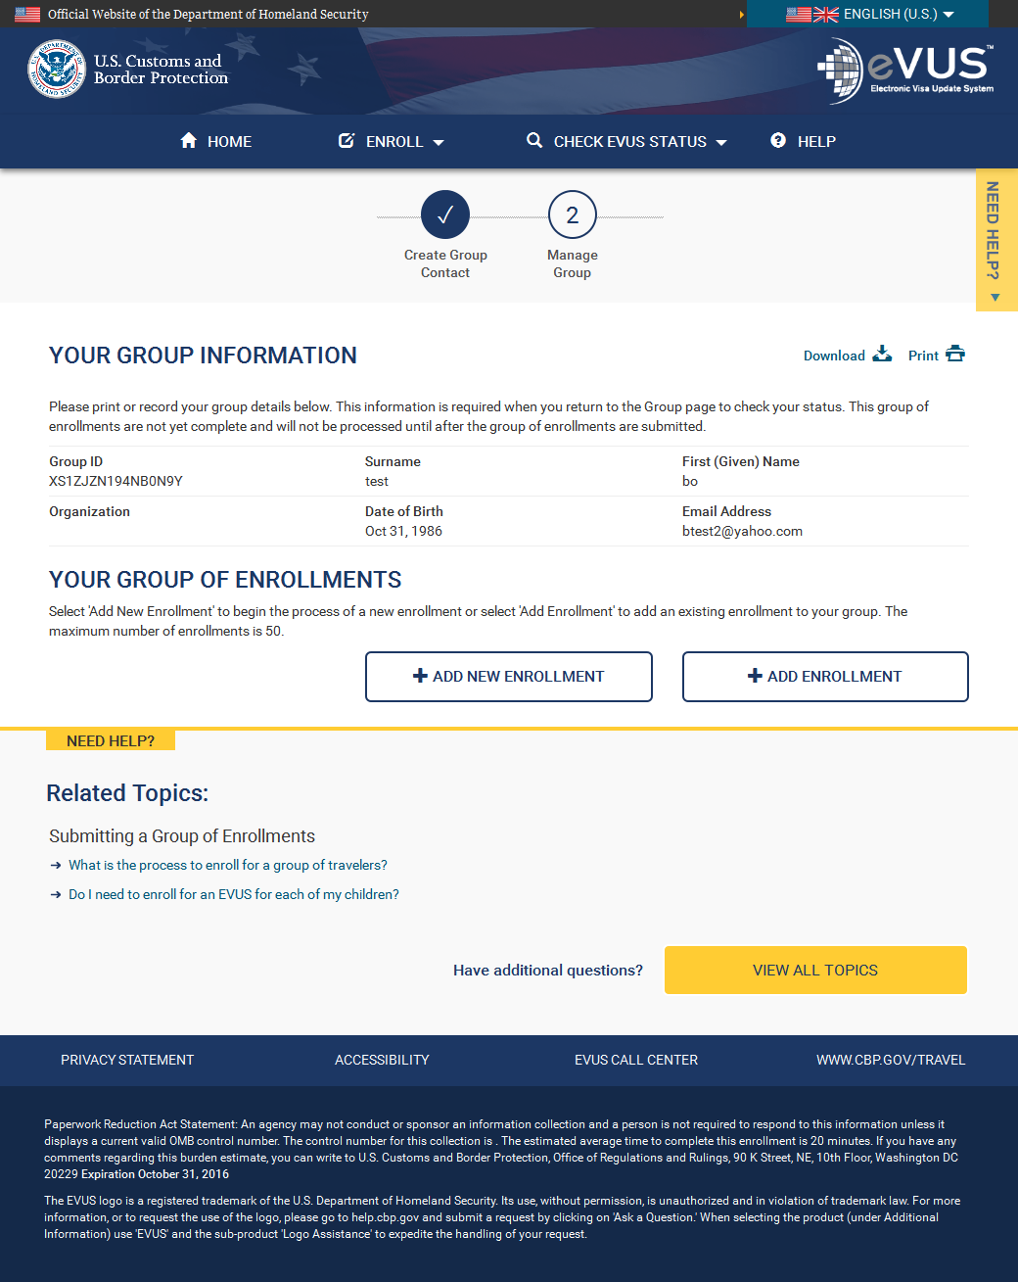
Creating a Group by adding a New Enrollment
To add a new enrollment to the group, the enrollee would select “Add New Enrollment”. From here, the enrollee will be taken to the beginning of the enrollment process.

Slide 22
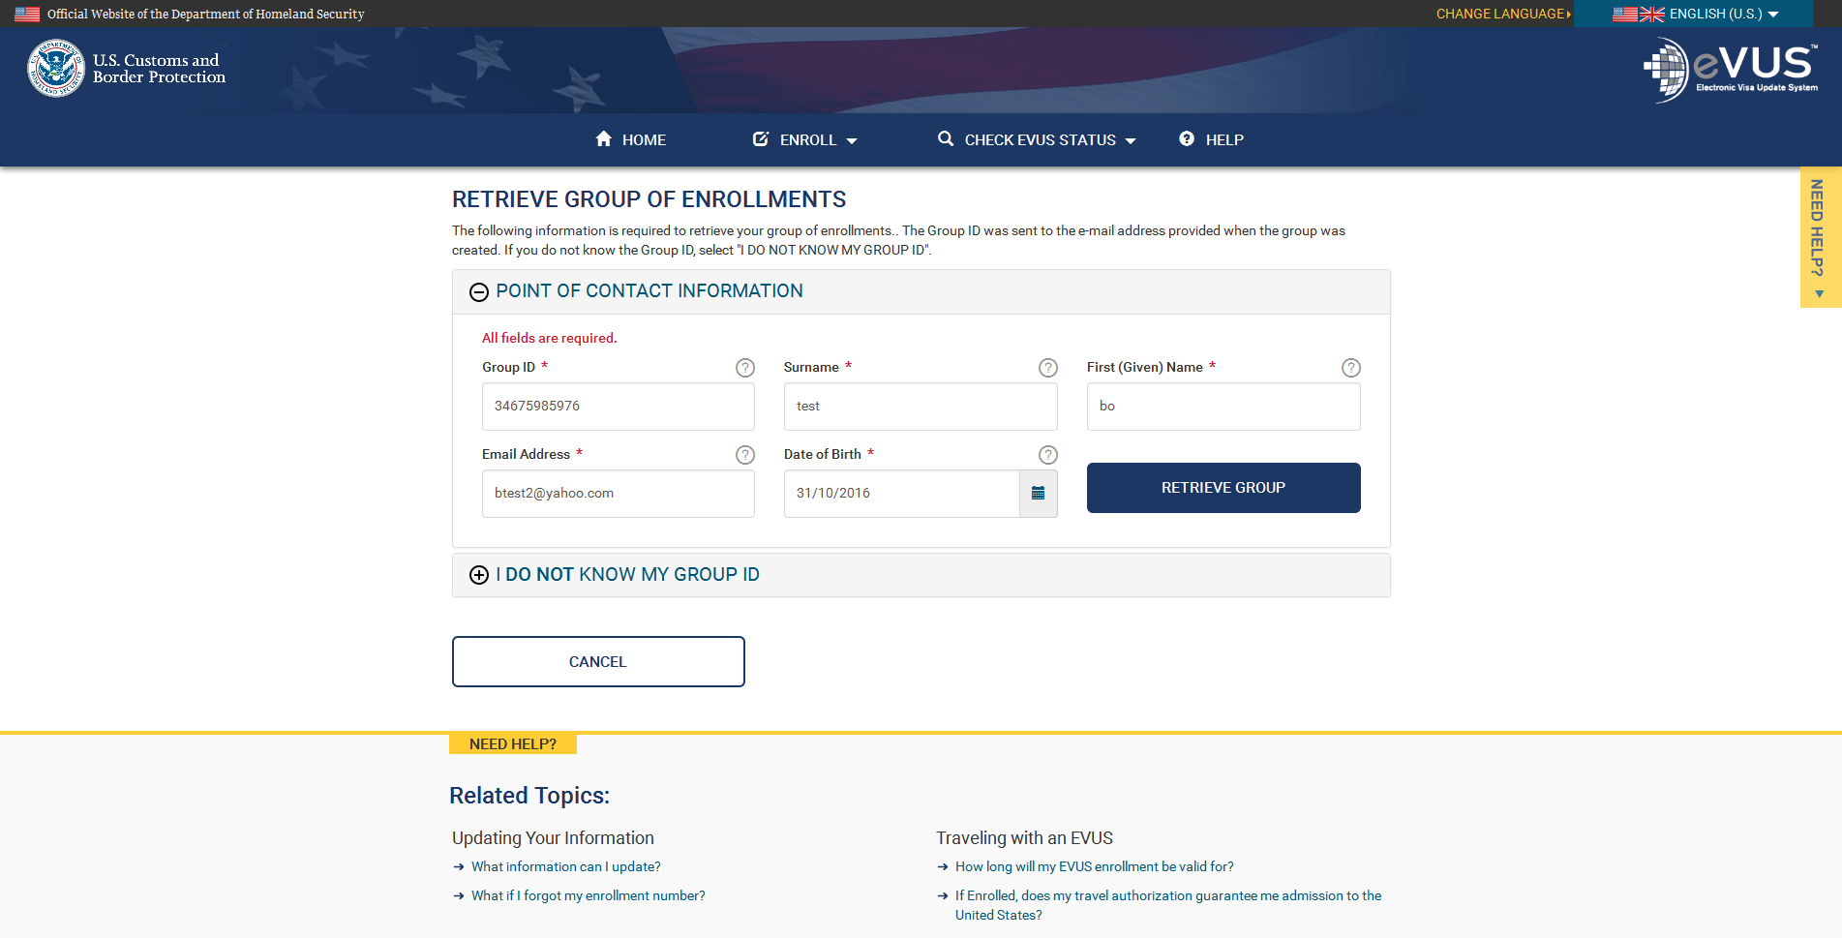
Creating a Group by adding an existing Enrollment
To add an existing enrollment to the group, the applicant would select “Add Enrollment”. From here, the enrollee will be directed to retrieve an existing enrollment by entering their personal data. If the enrollee does not know the enrollment number, they can retrieve it by entering in the enrollee’s passport information. After these actions are taken, the “Retrieve Enrollment” icon should be selected.
22

Slide 23
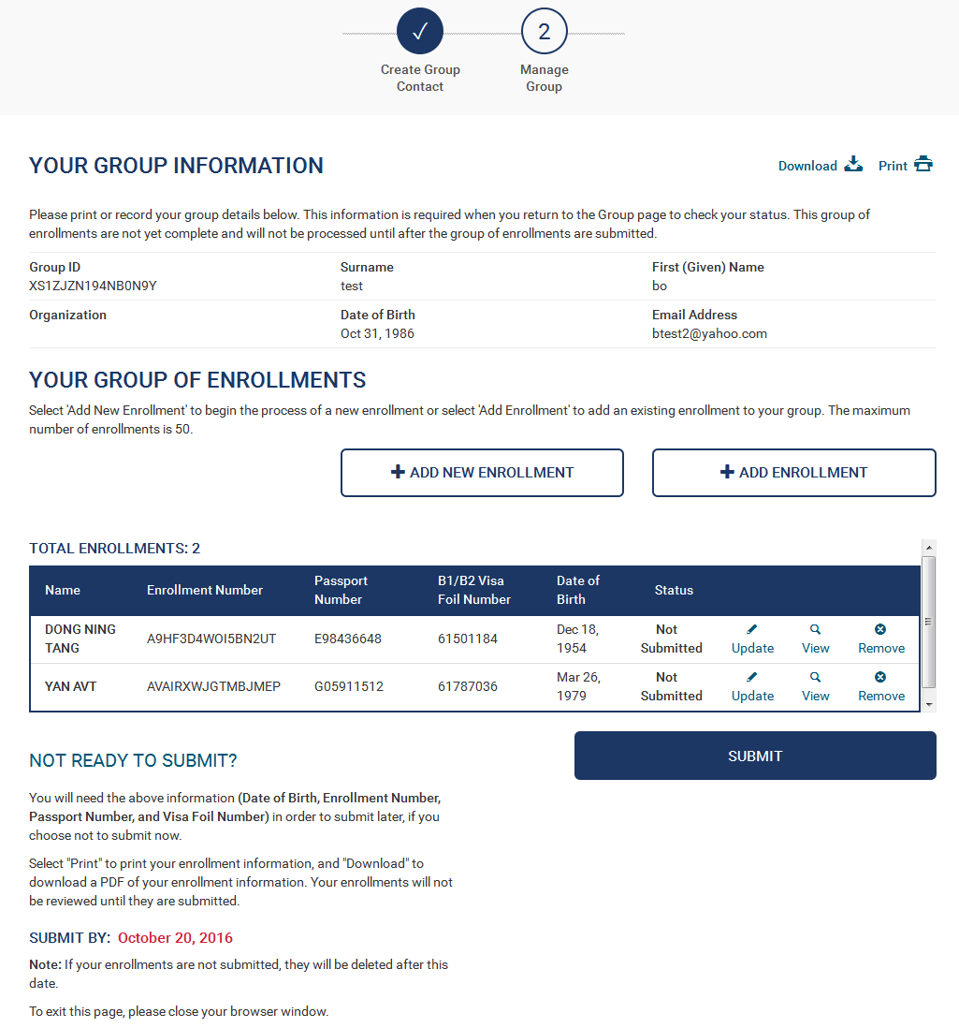
Enrollment Status Page (Group)
After adding an enrollment to a group, the enrollee will be able to add additional enrollments to the group before submitting their applications.

Slide 24
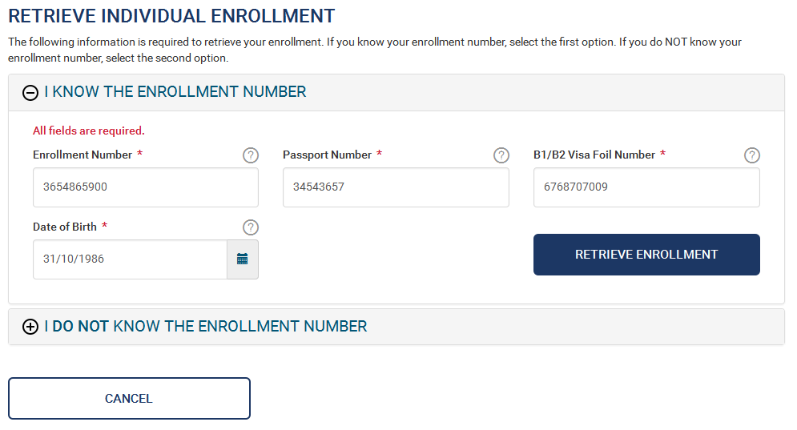
Retrieve one Enrollment
An enrollee can check the status of an existing individual enrollment by selecting “Check Individual Status” under the “Check EVUS Status” menu button on the main page. The enrollee will then be asked to enter in data related to the desired enrollment. After the requested data is entered, they will select “Retrieve Enrollment”. If they do not know their enrollment number, they can select the below option “I Do Not Know The Enrollment Number,” where they will be asked additional information so the system can retrieve their information.

Slide 25

Retrieve a Group of Enrollments
An enrollee can check the status of a group of enrollments by selecting “Check Group Status” under the “Check EVUS Status” menu button on the main page. The enrollee will then be asked to enter the group POC information. After the requested data is entered, they will select “Retrieve Group”. If they do not know their enrollment number, they can select the below option “I Do Not Know My Group ID” option where they will be asked additional information so the system can retrieve their group ID.

Slide 26
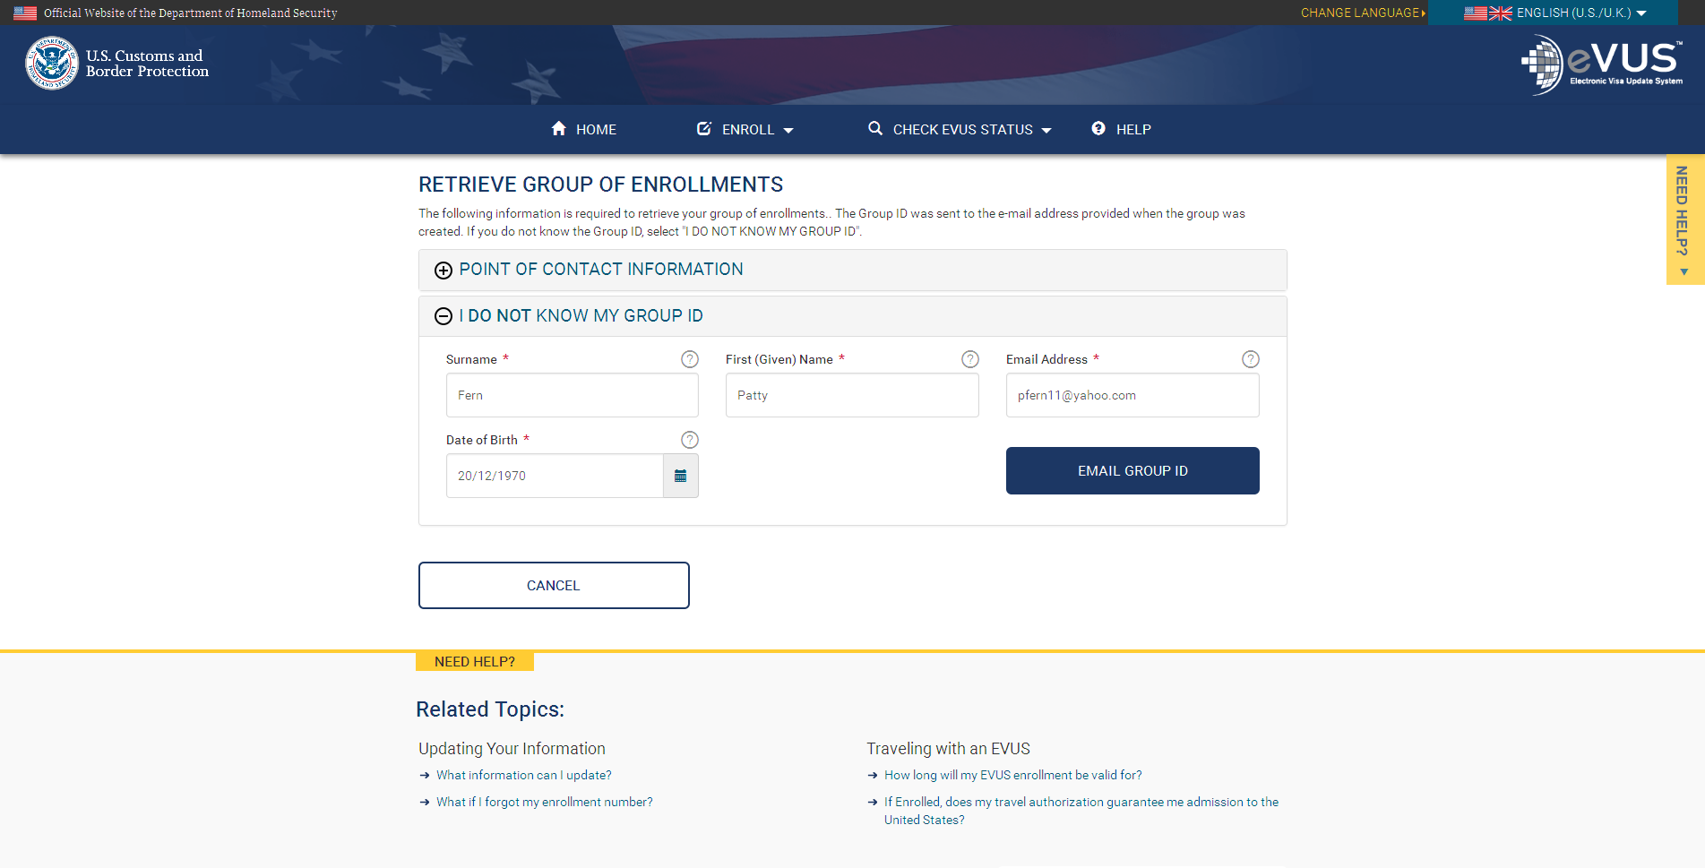
Retrieving Group ID
If a group point of contact forgets their group ID, they can retrieve it by selecting “I do not know my Group ID”. Upon selecting this option ,they will be asked to enter in the group point of contact’s information. After the requested data is entered, they will click “Email Group ID”, which will prompt the system to send the group owner their group ID.

Slide 27
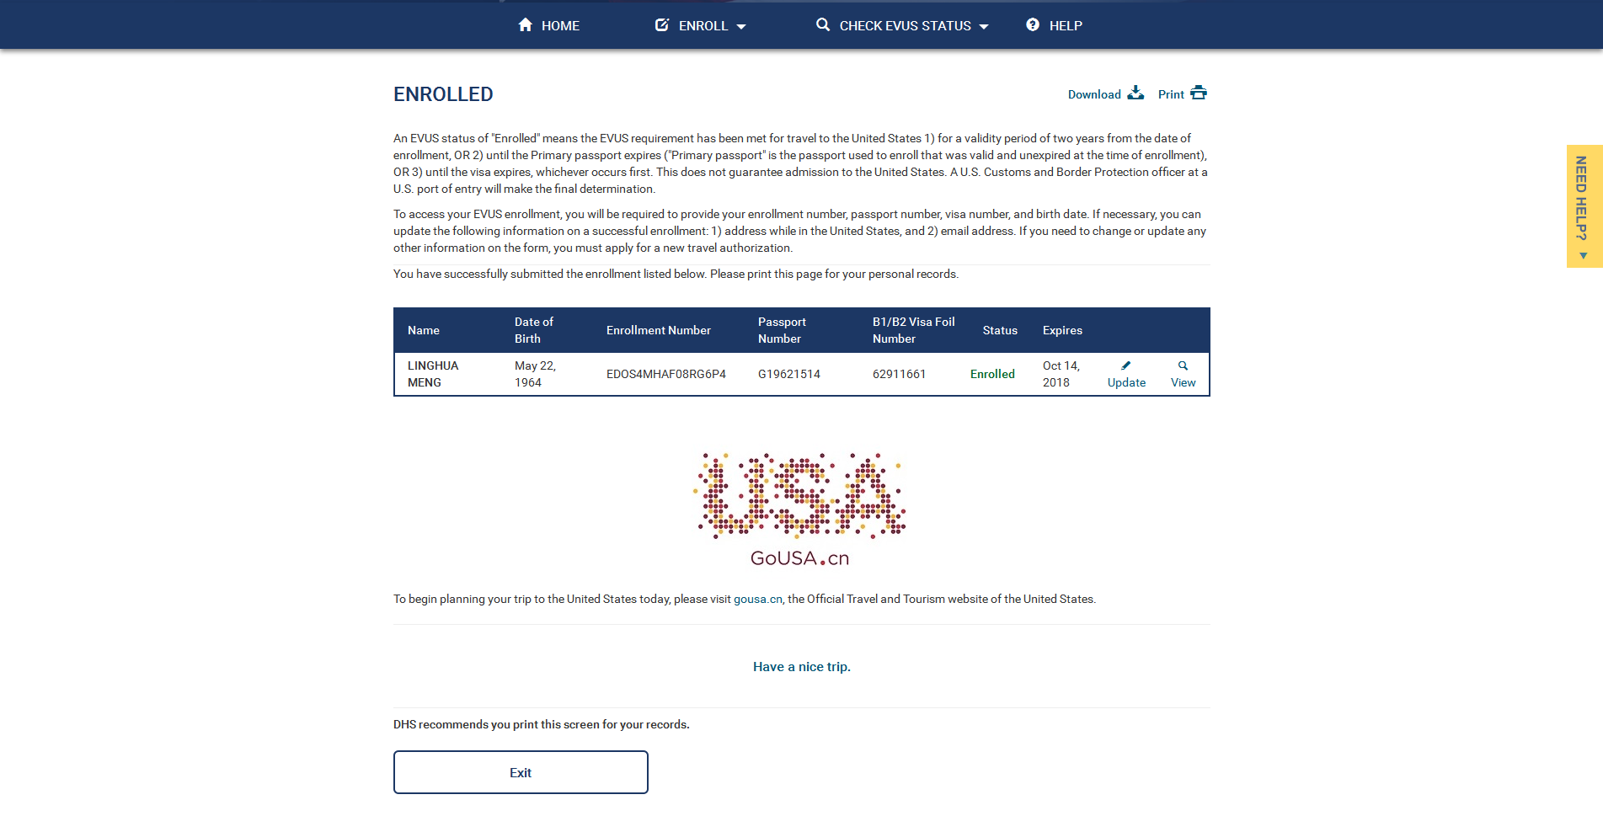
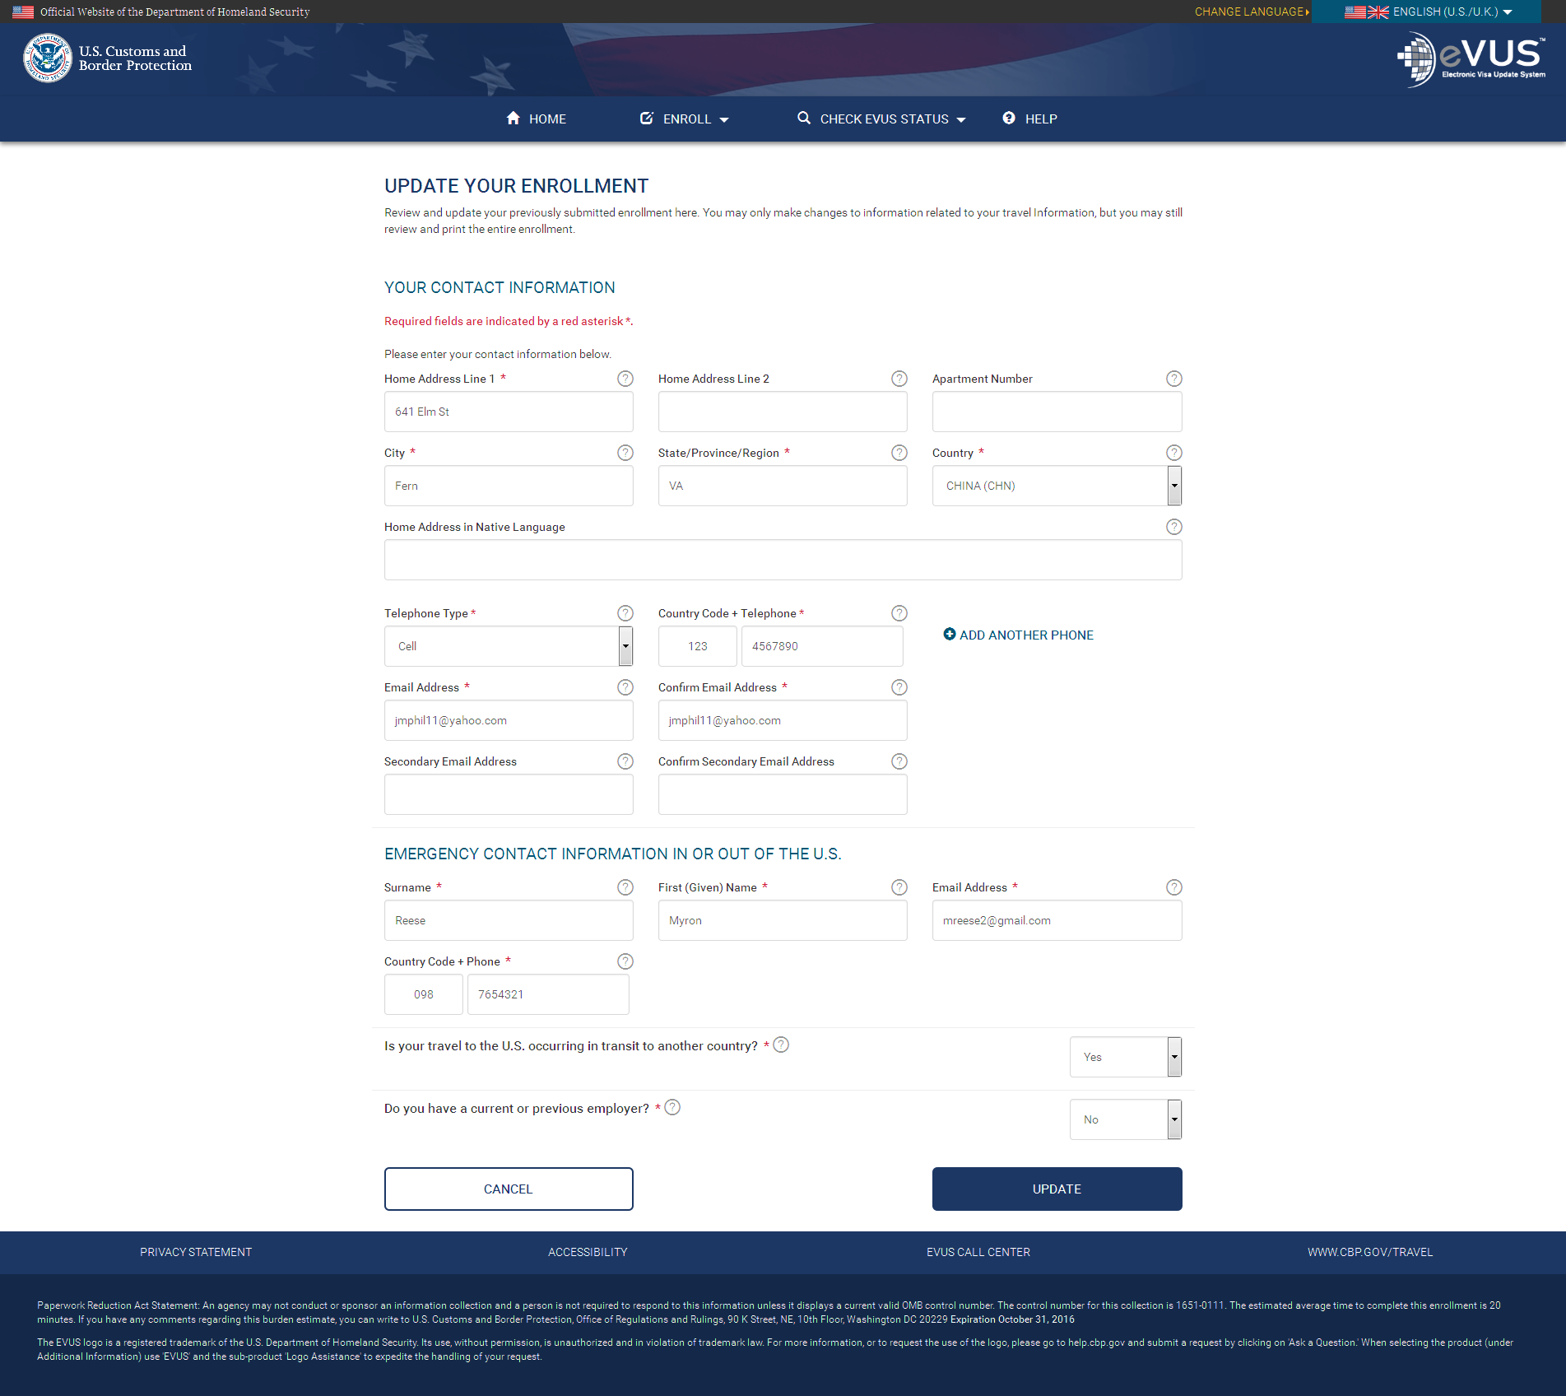
Updating Enrollment
From the Enrollment Status page for an individual or group of enrollments, the enrollee has the option to update each submission. This can be done by selecting the “Update” icon located next to each enrollment.

Slide 28
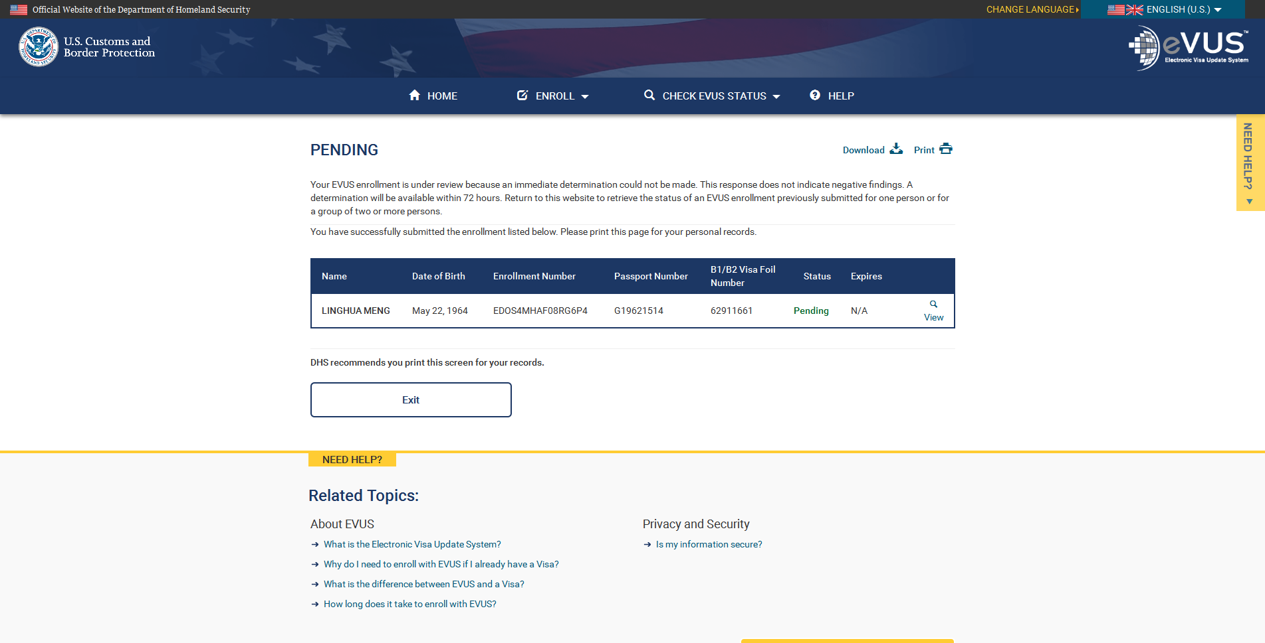
Status- Pending
When an enrollment is pending review, they will see the above image when they check their enrollment status.

Slide 29
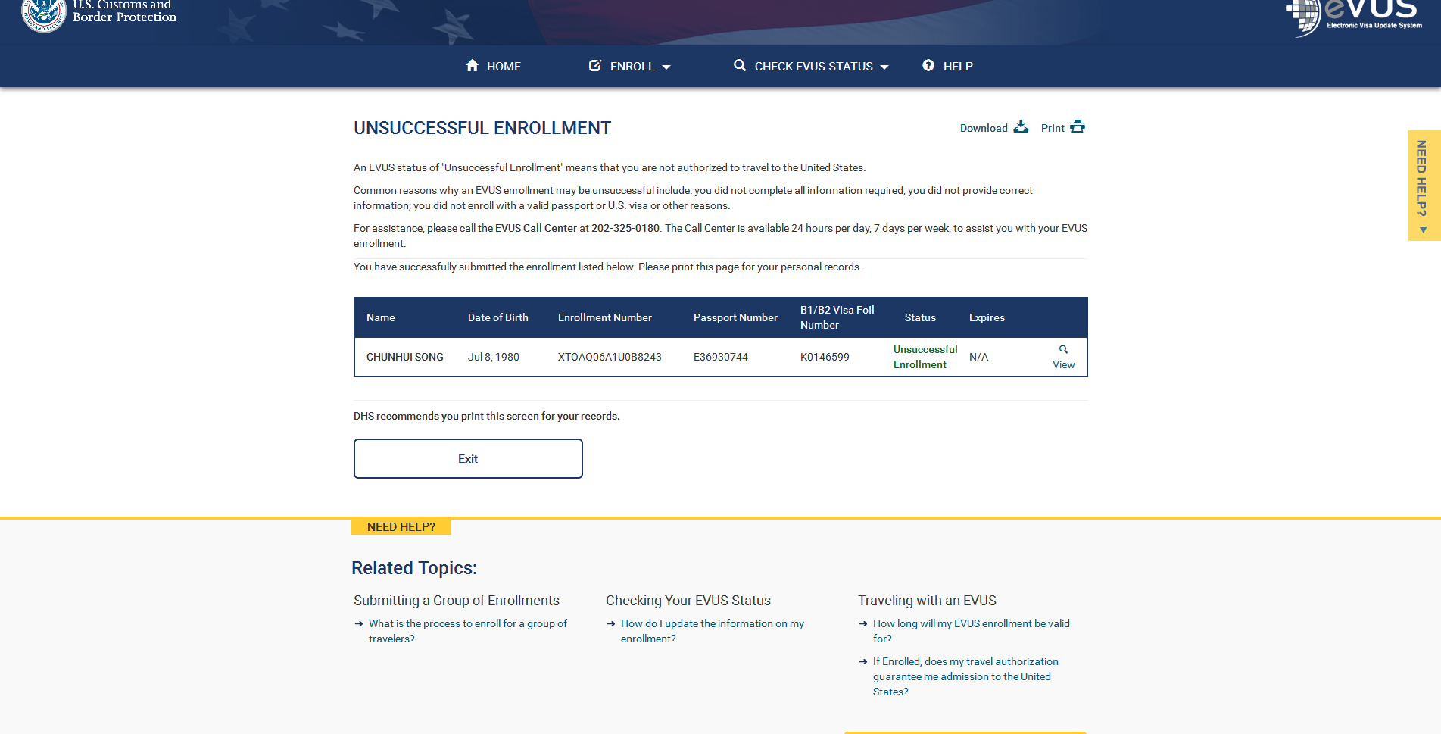
Status- Unsuccessful Enrollment
When the enrollment is unsuccessful, they will see this image when they check their enrollment status.

Slide 30
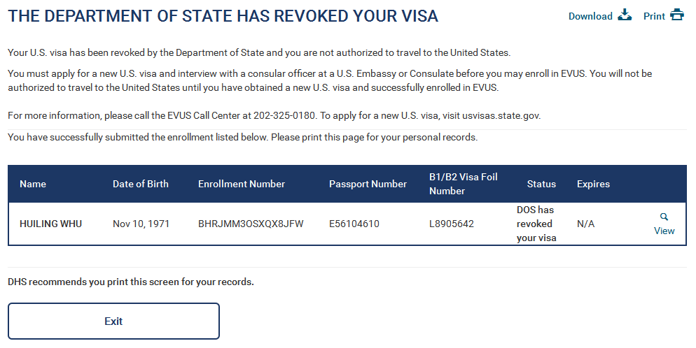
Status- DOS Has Revoked Your Visa
If the enrollee’s visa has been revoked, they will see this image when they check their enrollment status.

Slide 31
Status- Enrolled
When a enrollment is successful, they will see this image when they check their enrollment status.

Slide 32
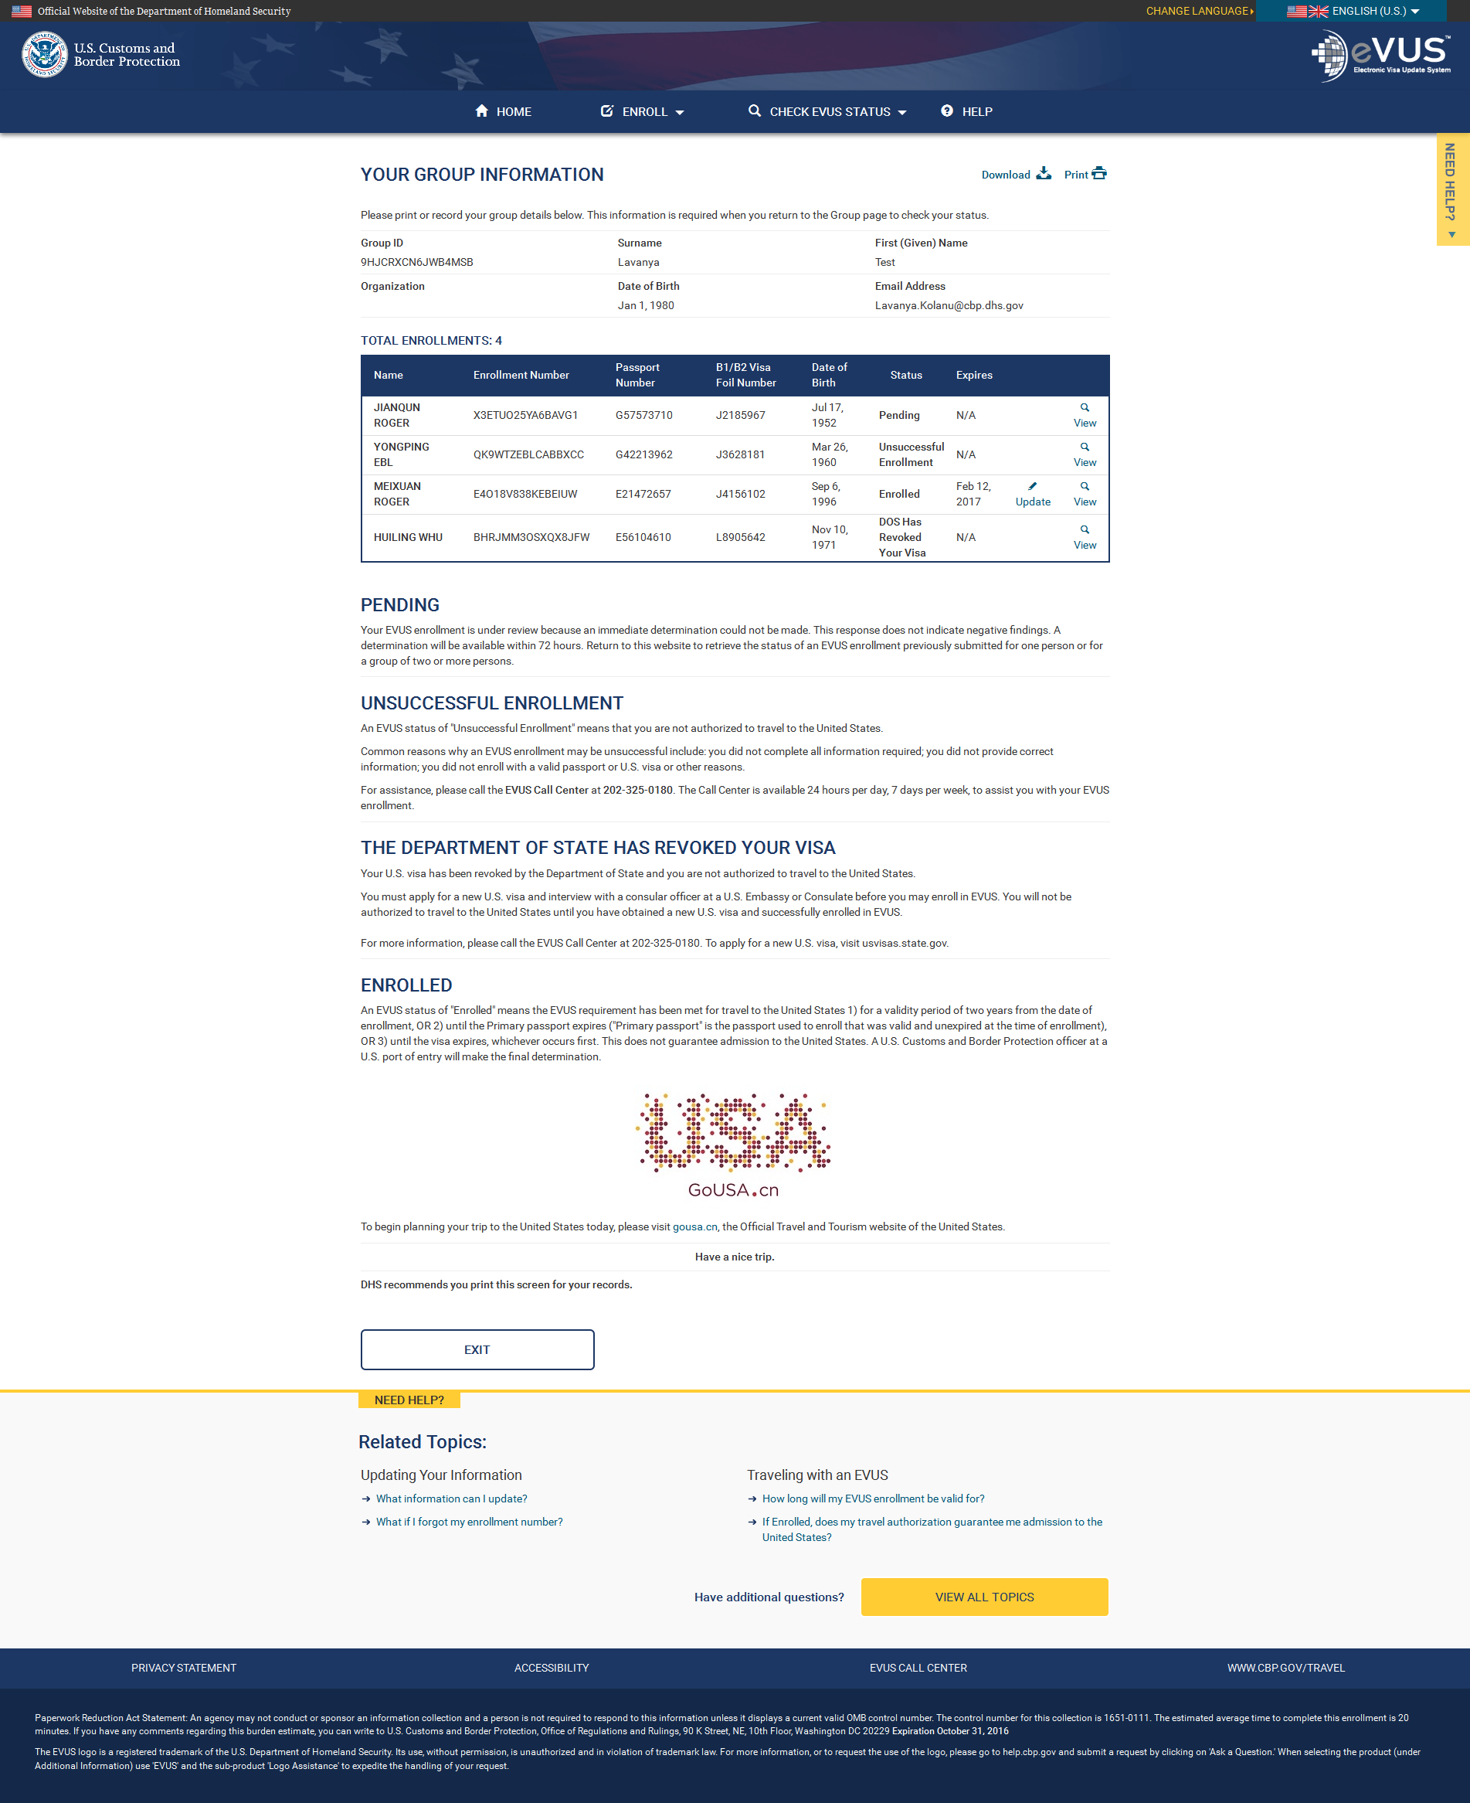
Status-Enrolled/
Unsuccessful Enrollment
Each enrollment in a group will be adjudicated individually, so each enrollment could have a different status, as shown here.

Slide 33
UPON CONGRESSIONAL ACTION, EVUS WOULD COLLECT A USER FEE FOR THE SERVICE

Slide 34
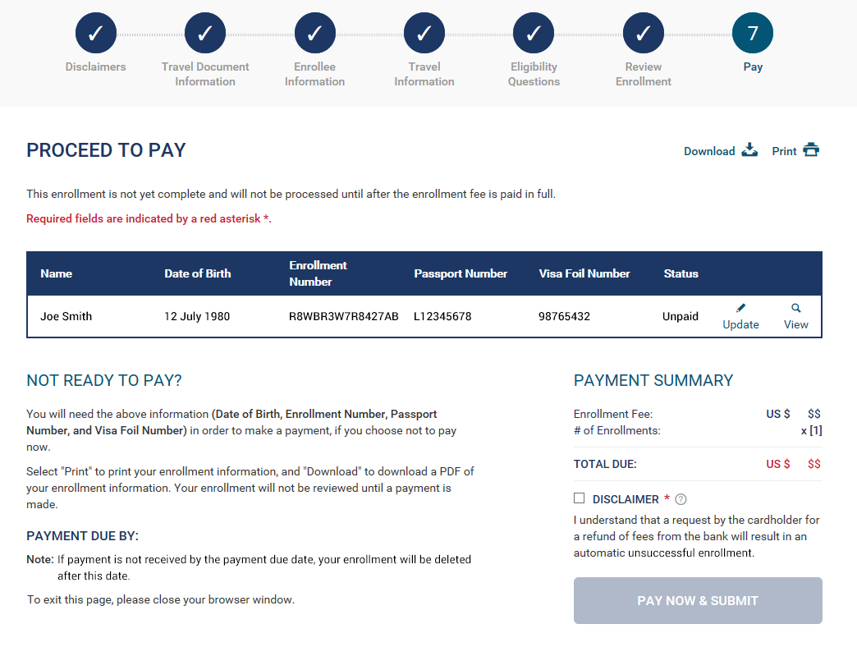
Individual Enrollment
Step 7: Pay
Enrollees can submit payment by checking the Disclaimer and clicking the “Pay Now & Submit” button.

Slide 35
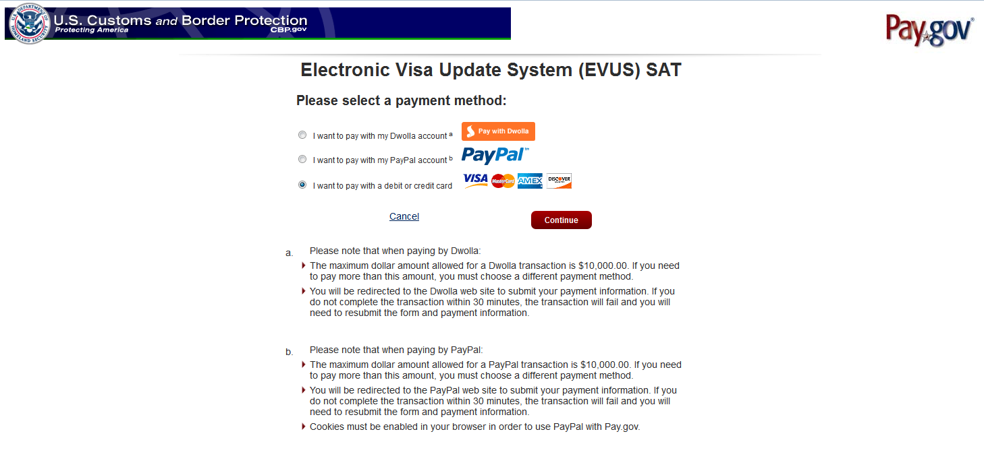
Individual Enrollment
Step 7: Pay
When the enrollee clicks “Pay Now & Submit”, they are directed to the Pay.gov EVUS payment site, where they can choose a payment method.

Slide 36
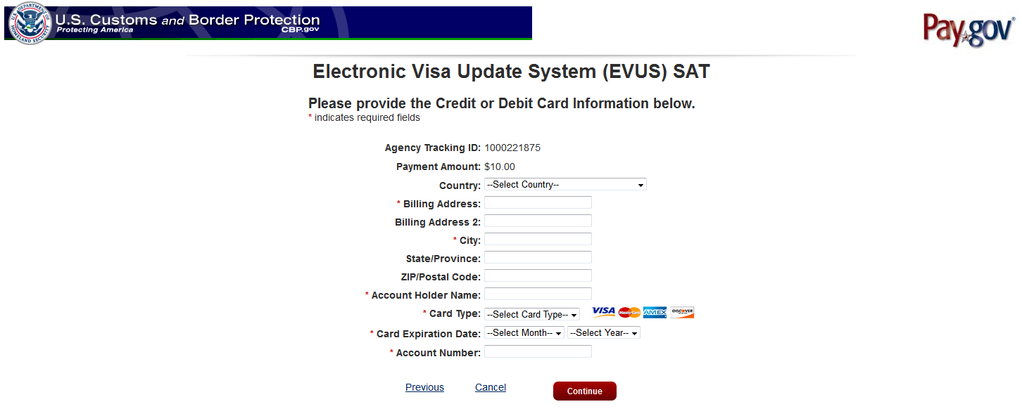
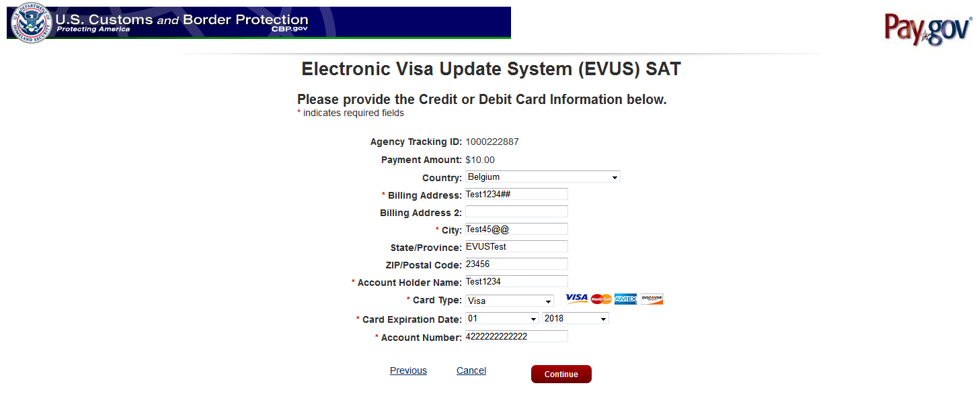
Individual Enrollment
Pay.gov
When they choose to pay with a credit or debit card, they will be asked to enter their card information.
The traveler has the option to cancel or continue with the payment.

Slide 37
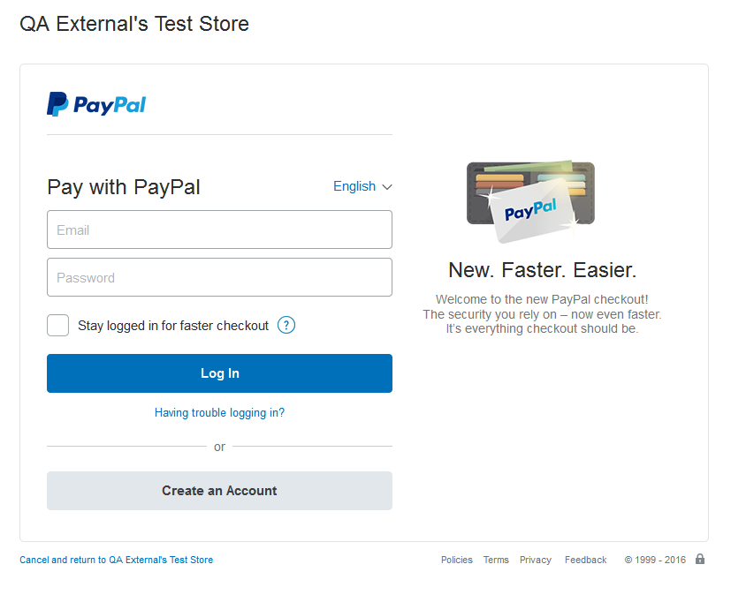
Individual Enrollment
PayPal
When the enrollee chooses to pay with PayPal, they will be directed to PayPal Log In page.

Slide 38
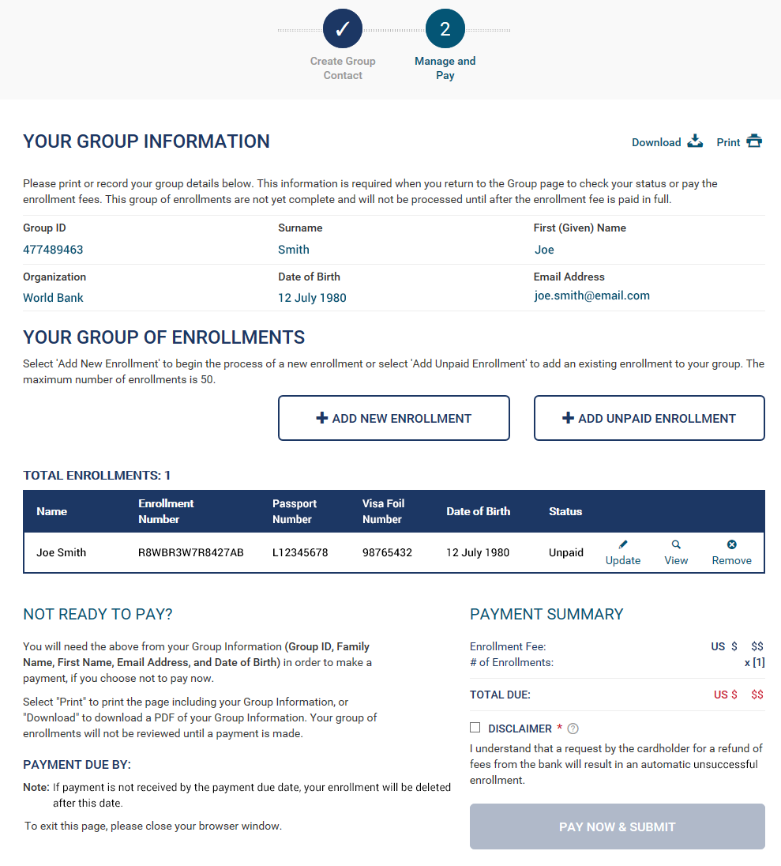
Group of Enrollments
Manage & Pay
After adding an enrollment to a group, the enrollee will be able to add additional enrollments to the group before making payment.

Slide 39


