Slide 1
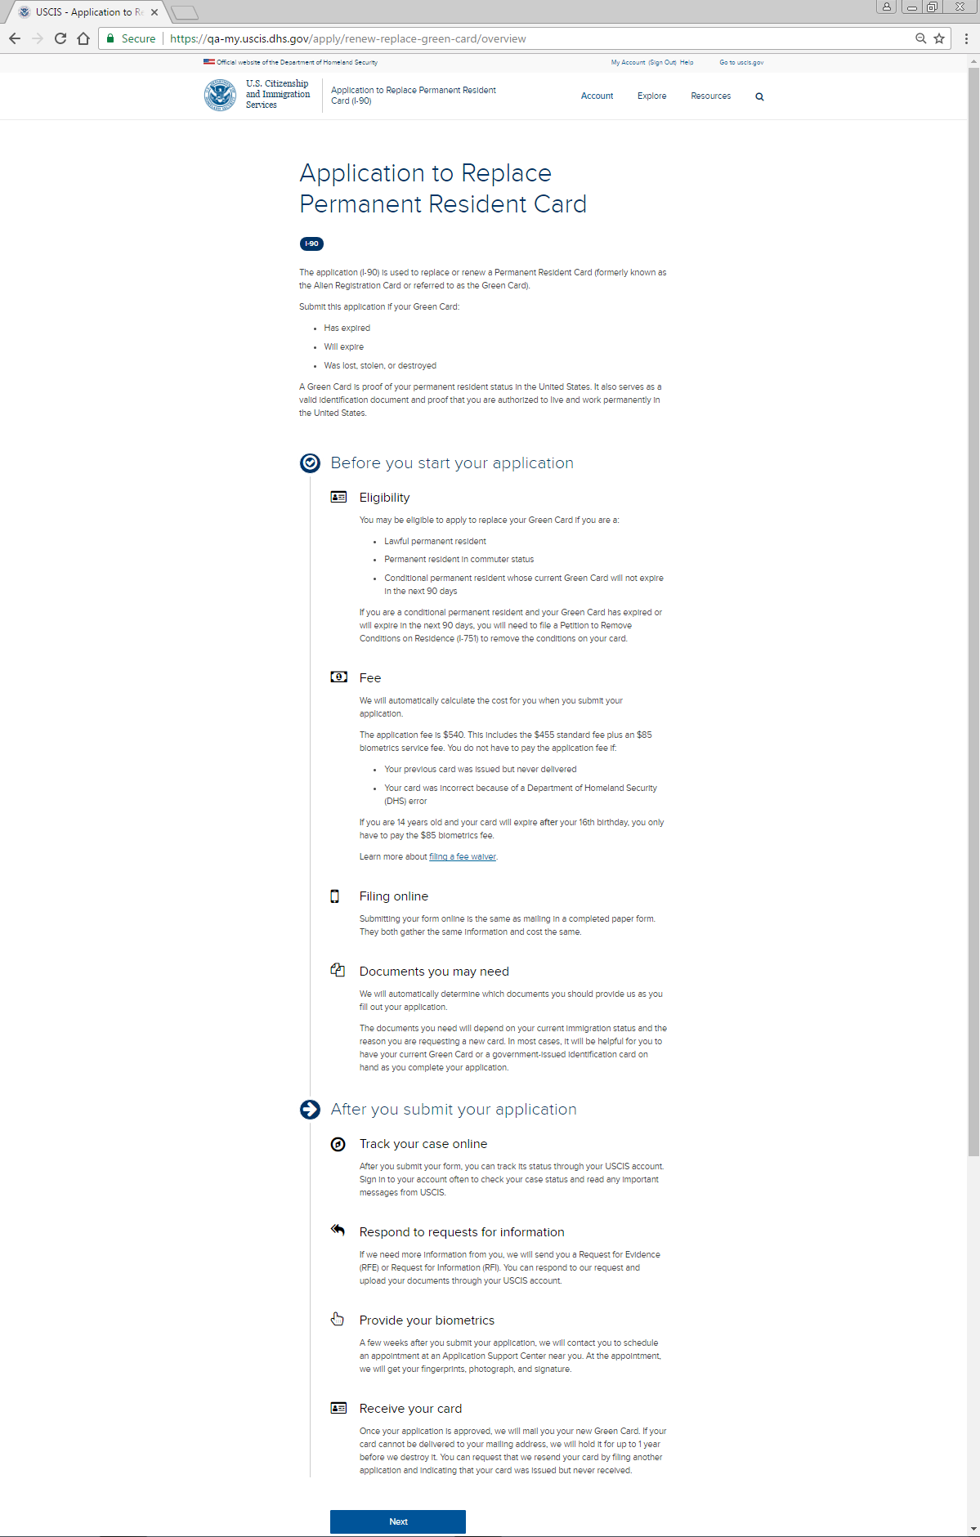
I-90 Application Overview: Page One

Slide 2
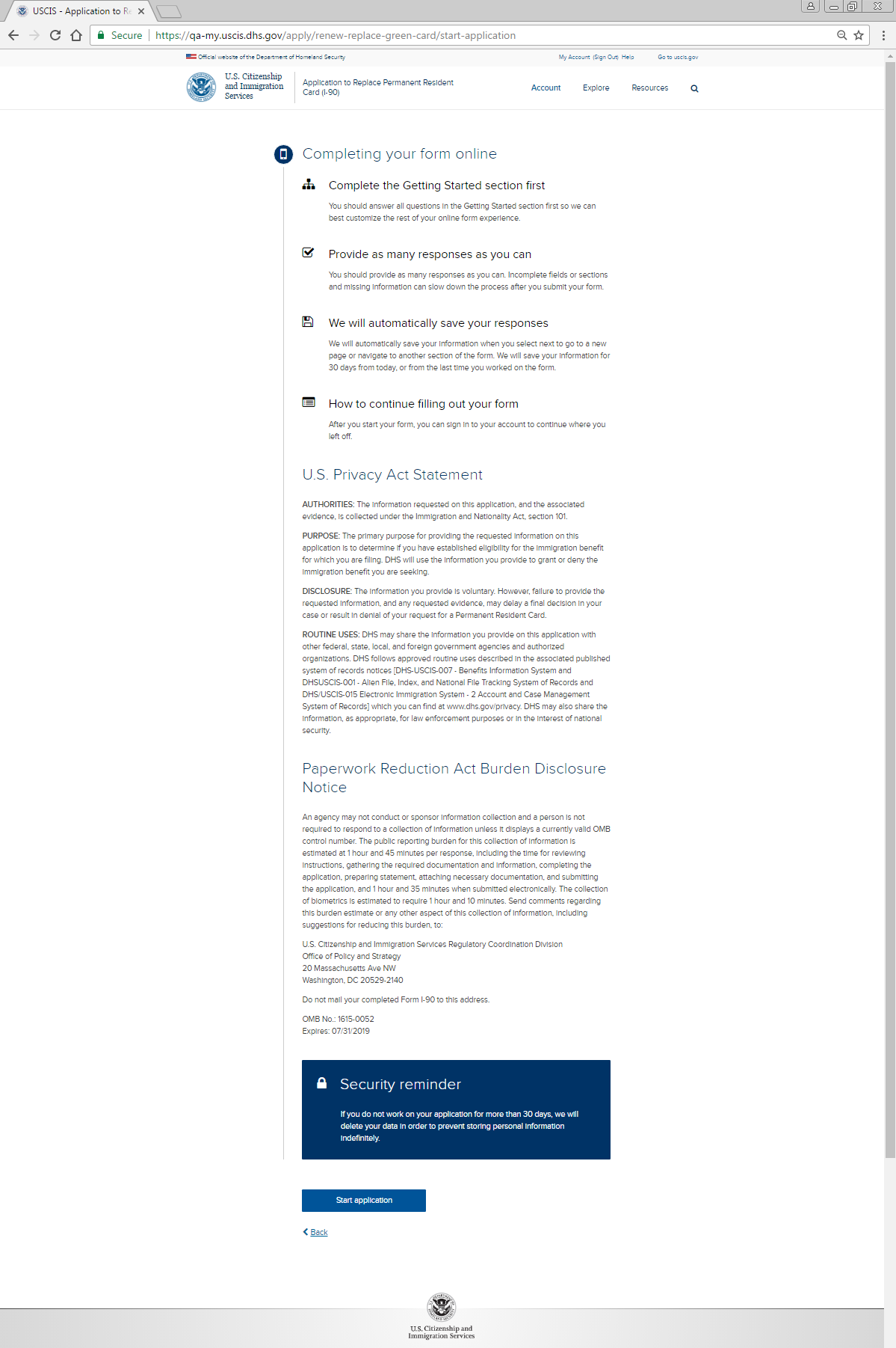
I-90 Application Overview: Page Two

Slide 3
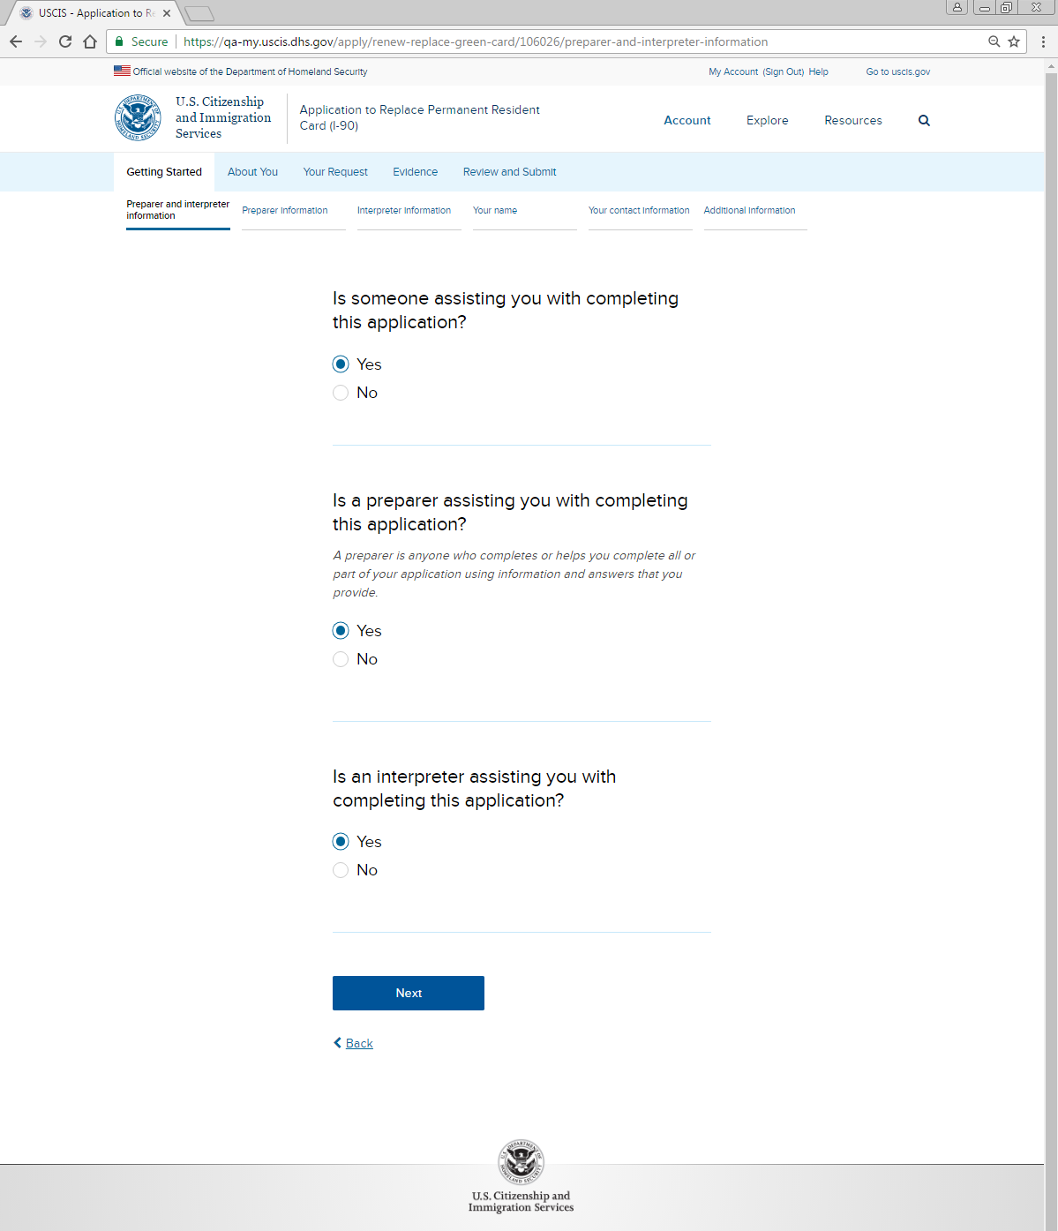
Getting Started: Preparer and interpreter information

Slide 4
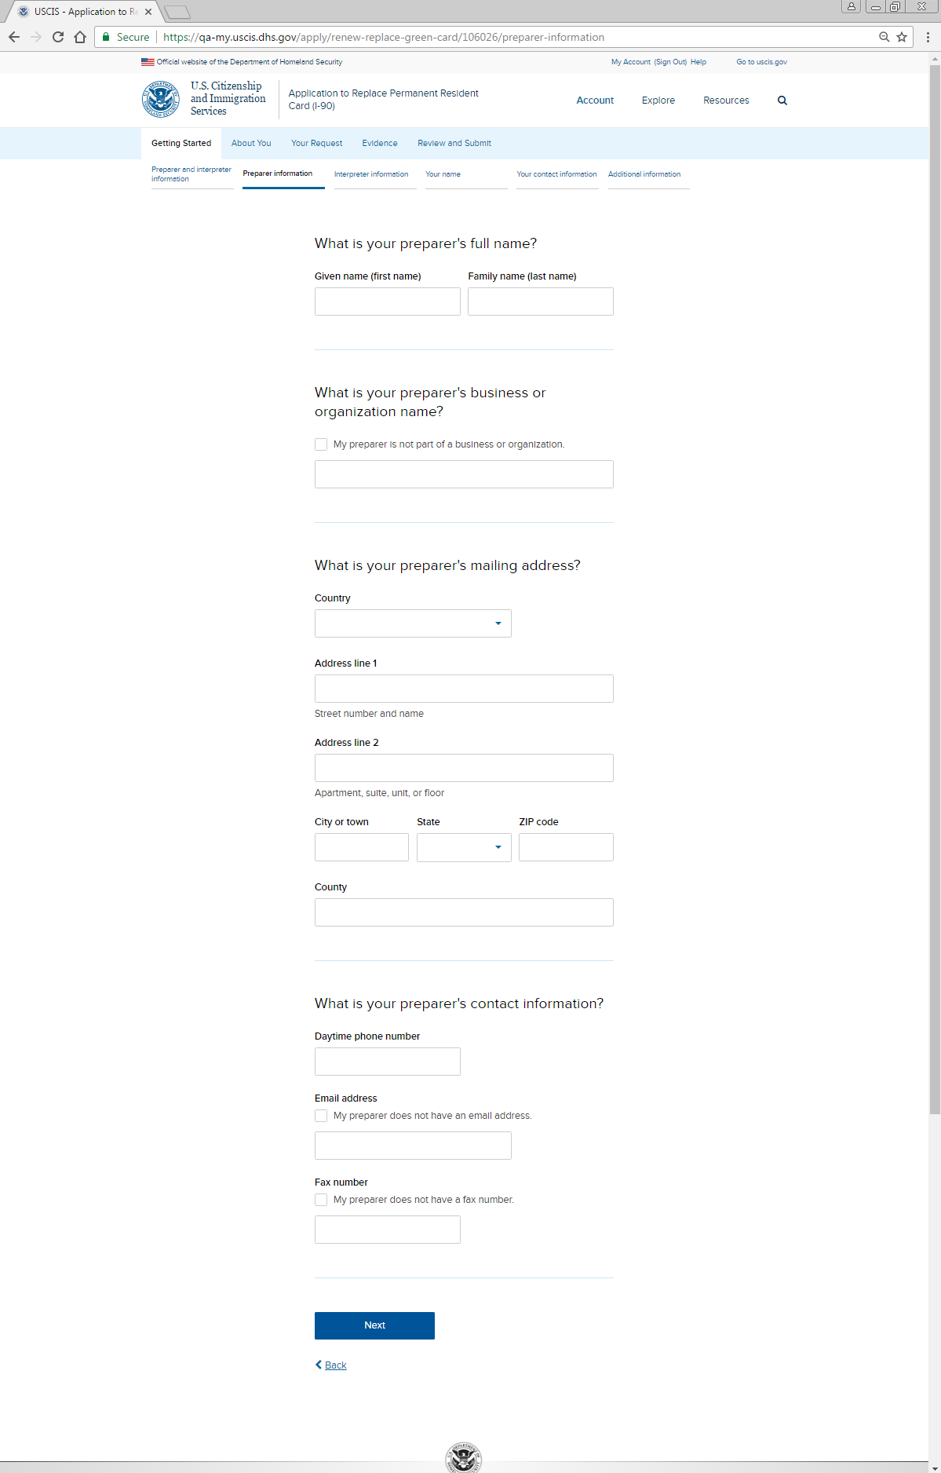
Getting Started: Preparer information

Slide 5
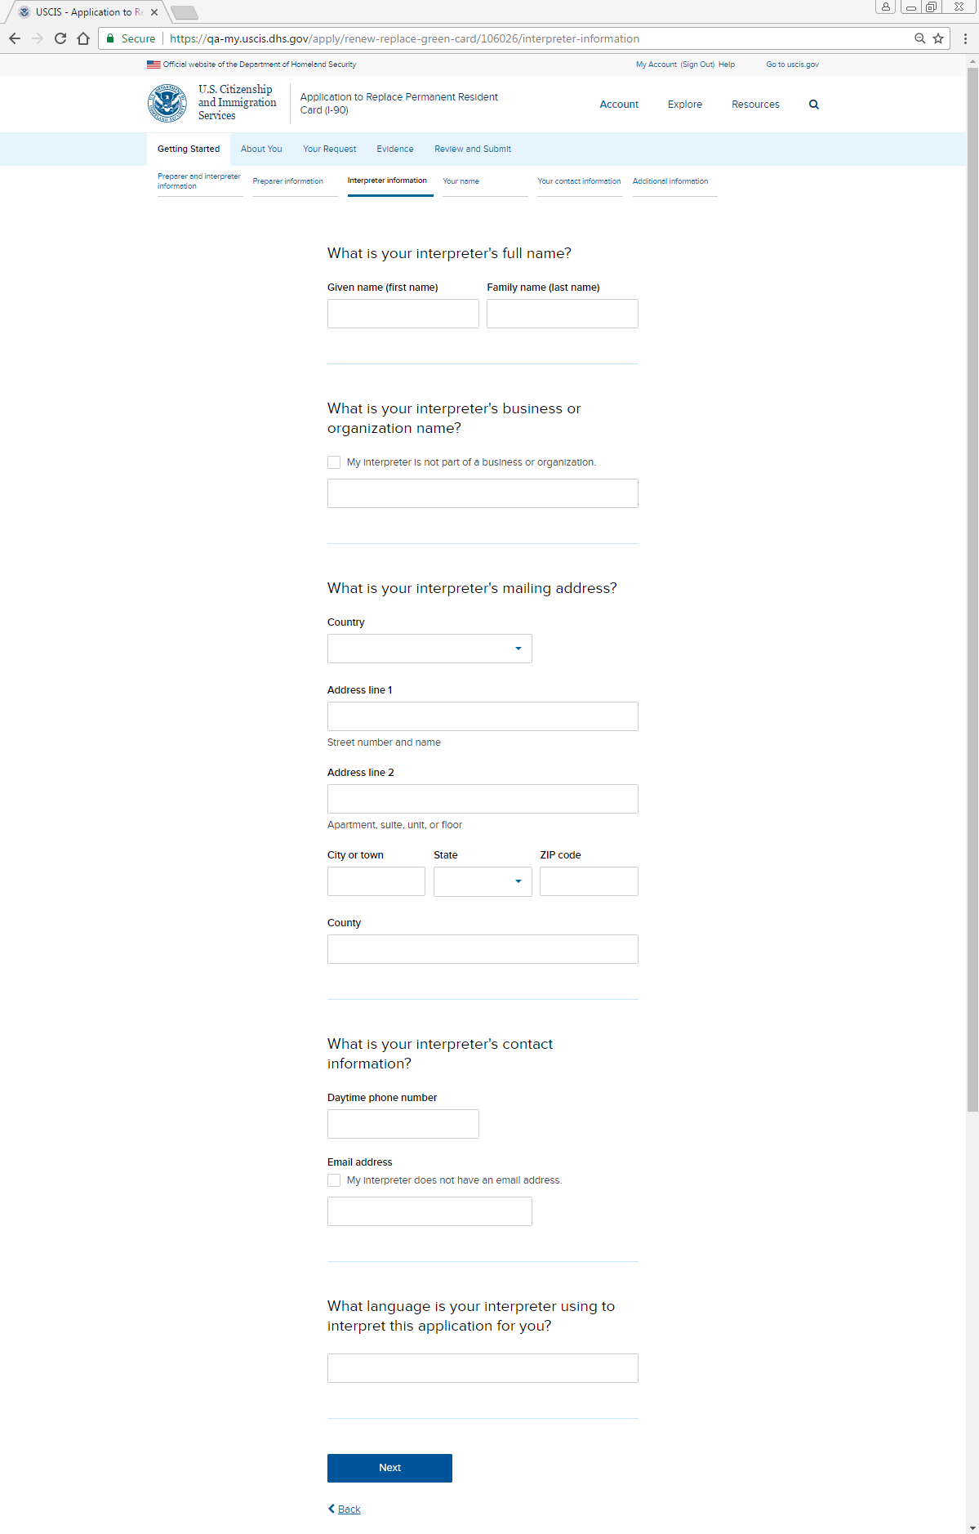
Getting Started: Interpreter information

Slide 6
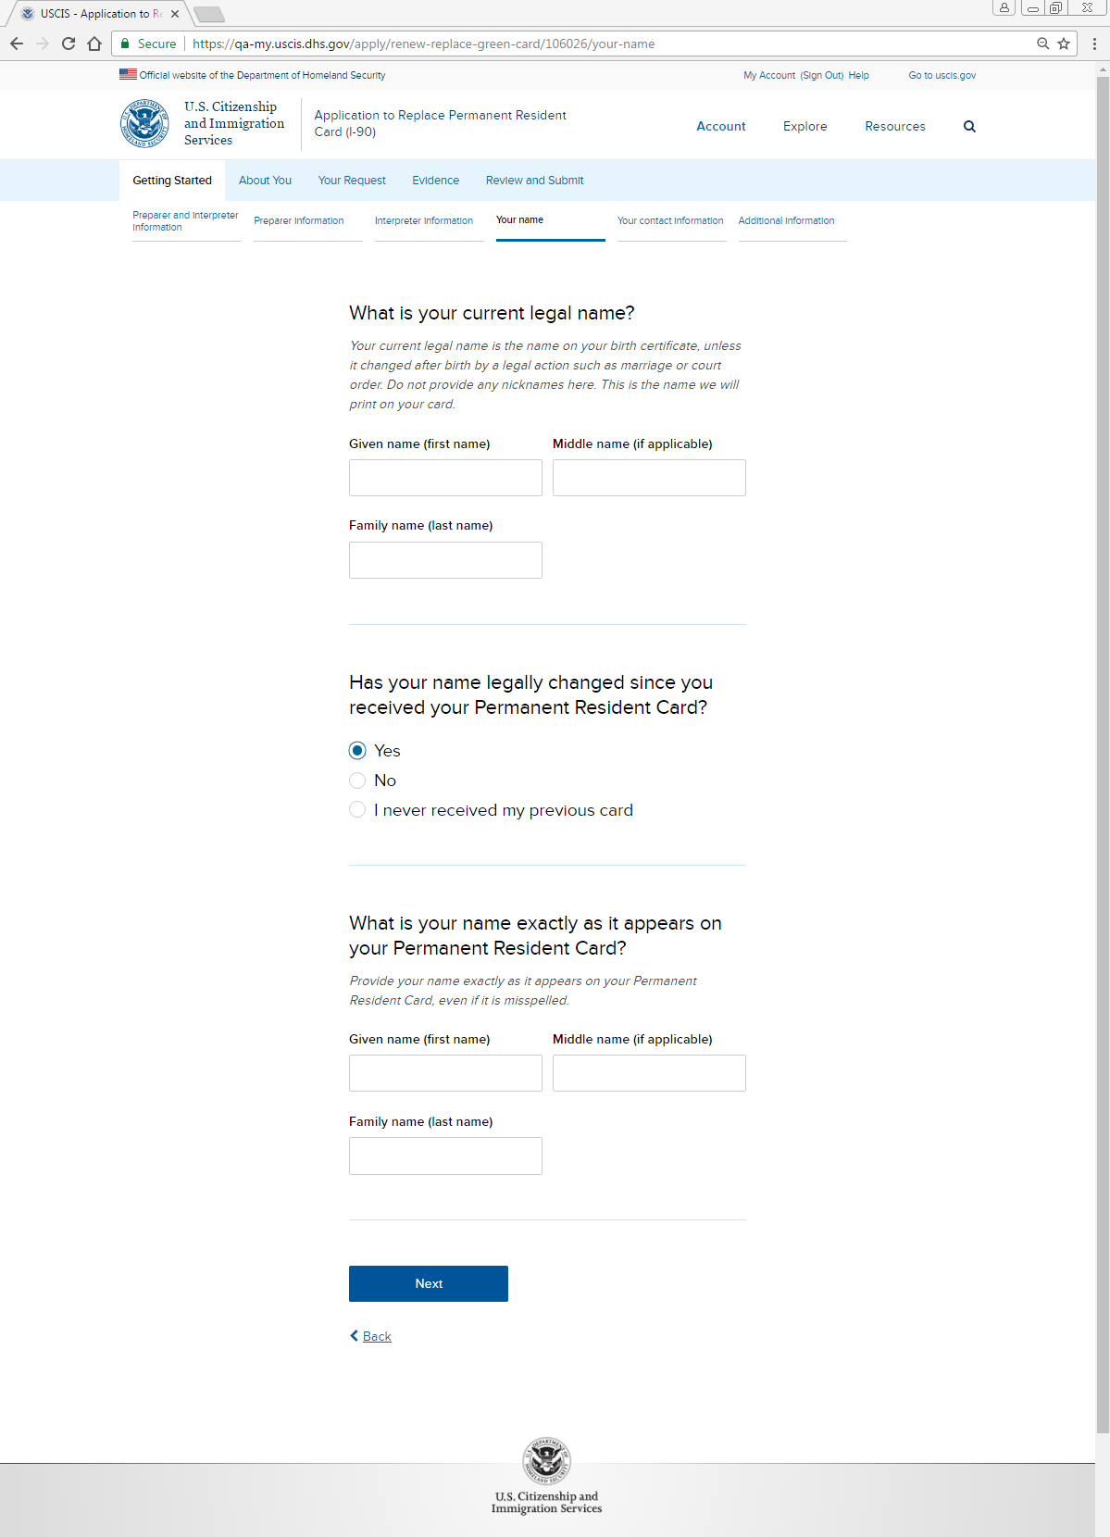
Getting Started: Your name

Slide 7
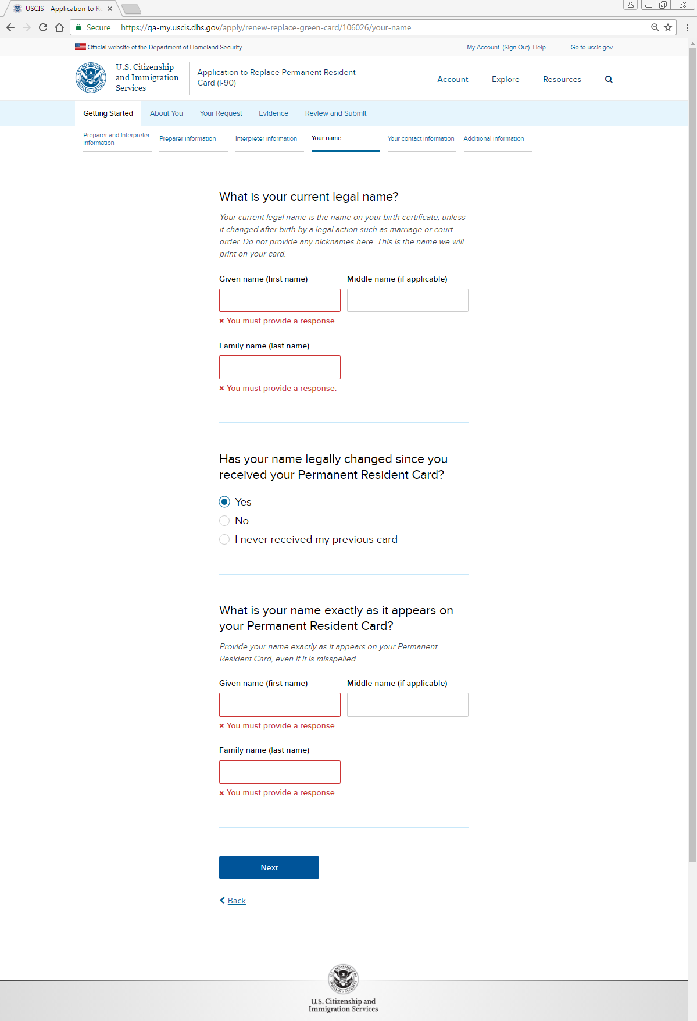
Getting Started: Your name - Alert

Slide 8
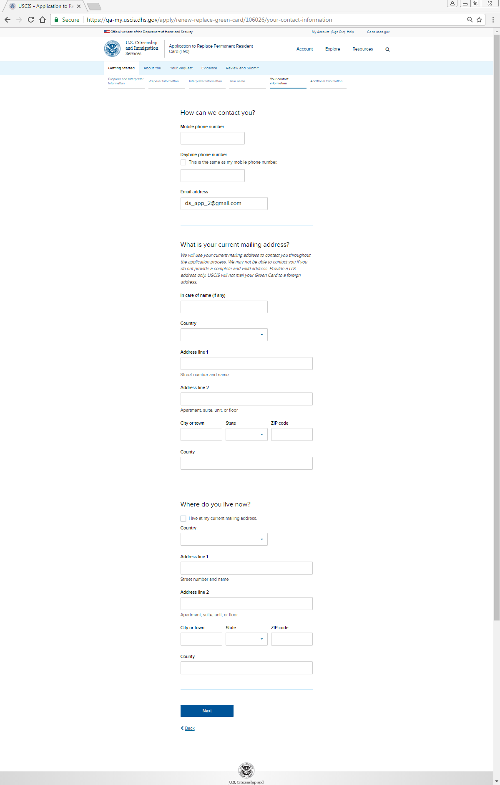
Getting Started: Your contact information

Slide 9
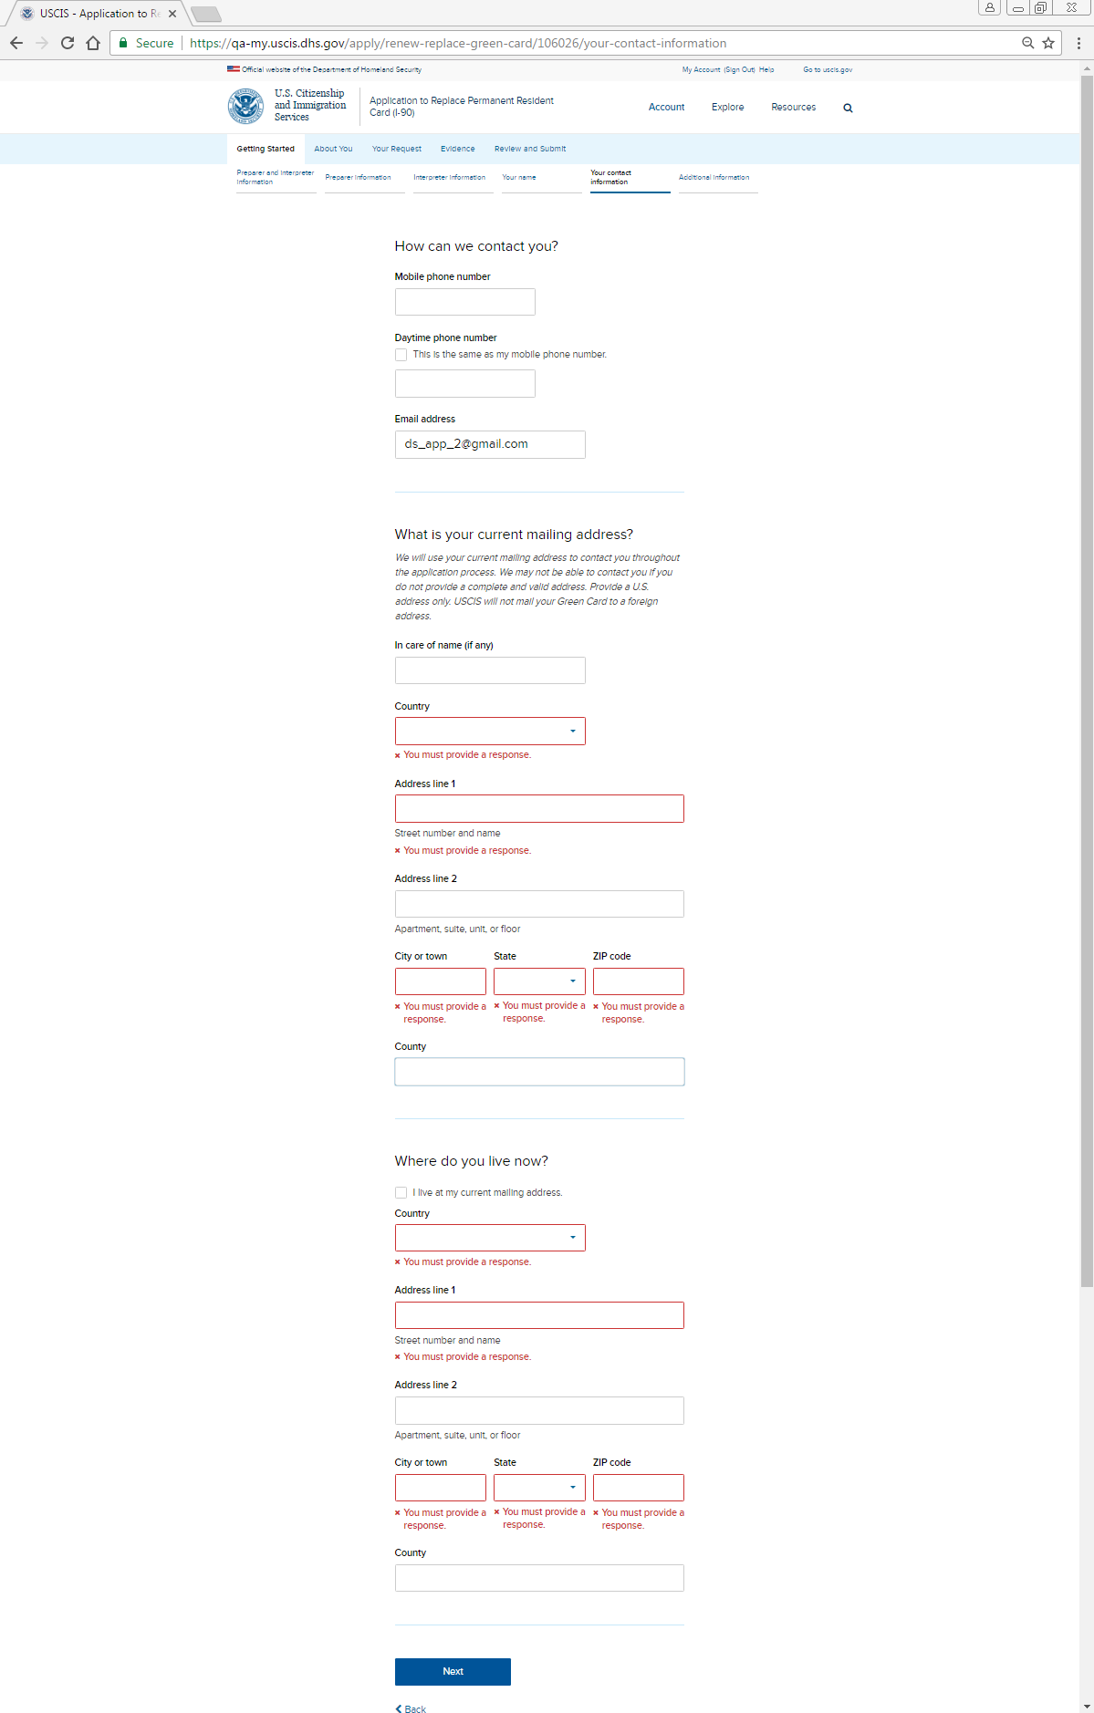
Getting Started: Your contact information - Alert

Slide 10
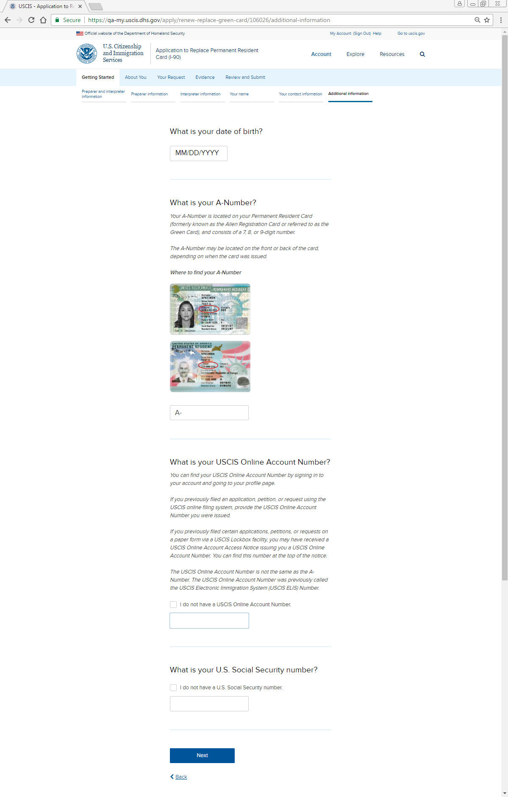
Getting Started: Additional information

Slide 11
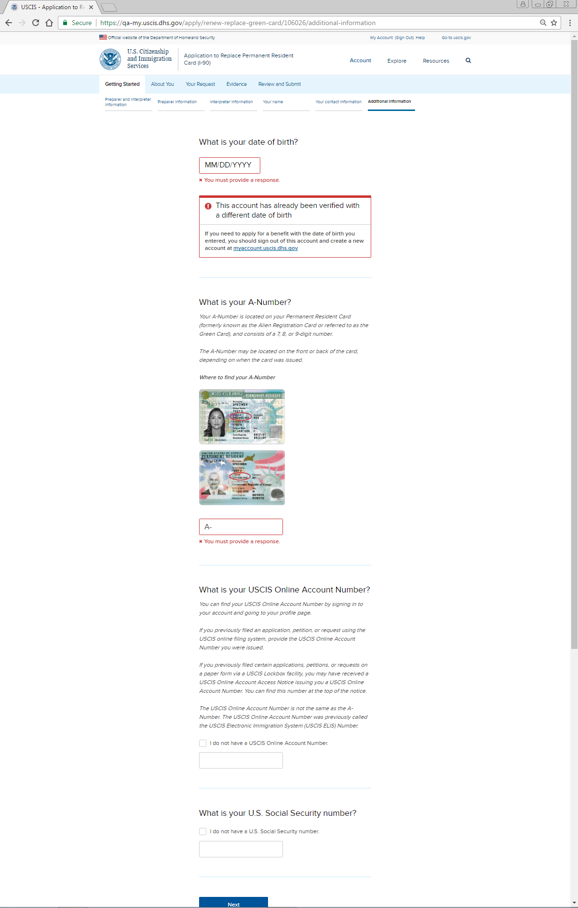
Getting Started: Additional information - Alert

Slide 12
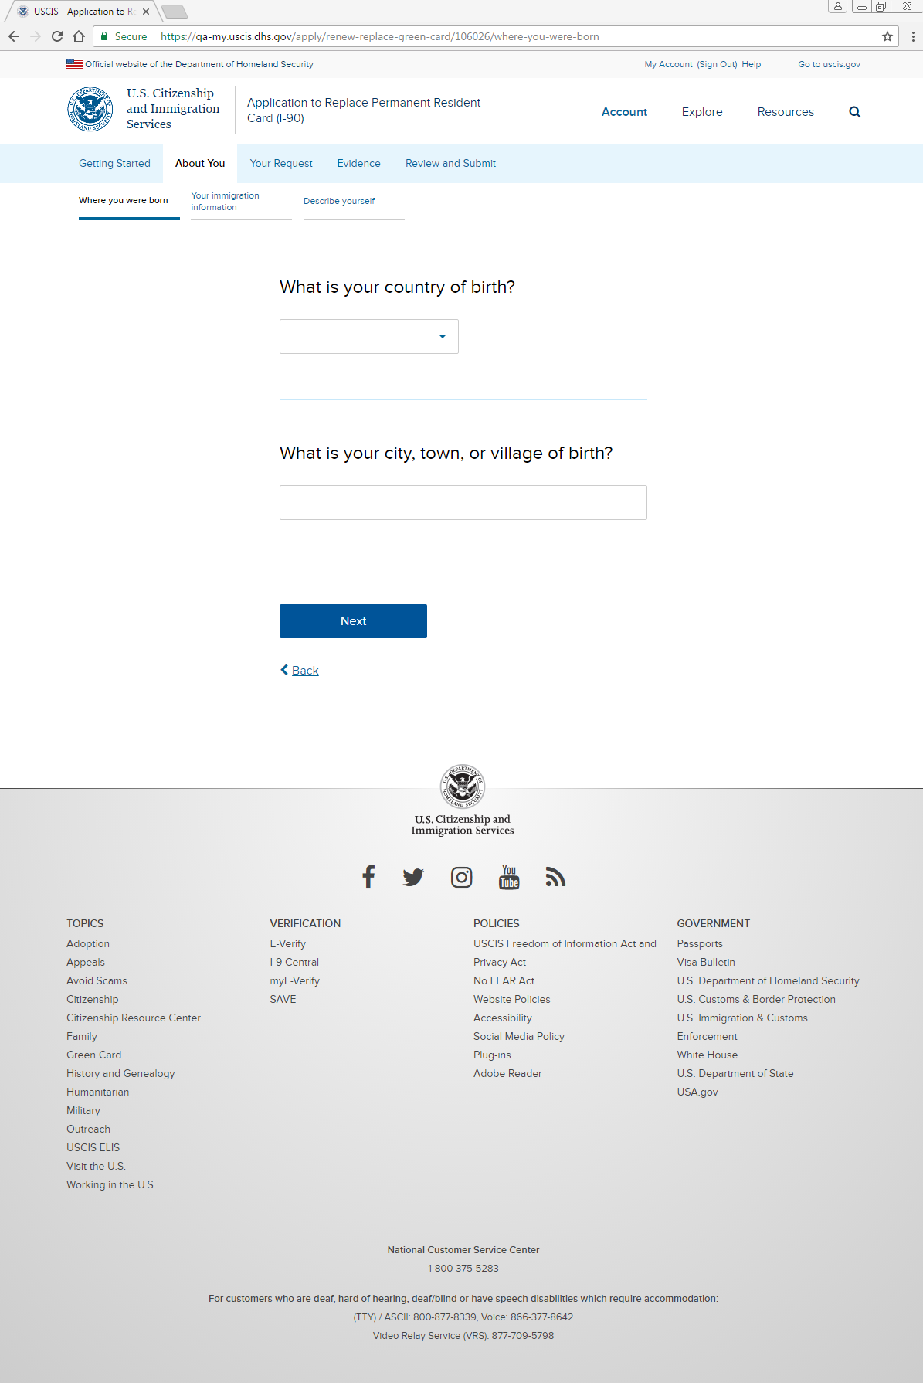
About You: Where you were born: Place of birth

Slide 13
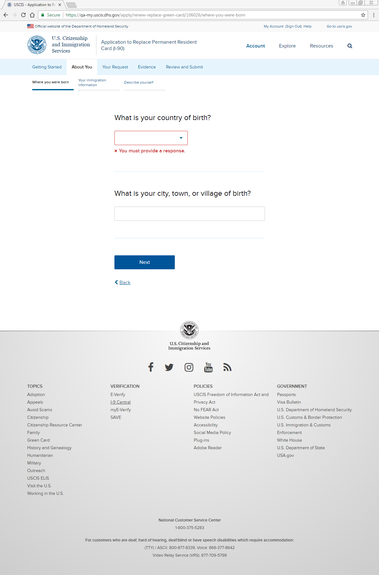
About You: Where you were born: Place of birth - Alert

Slide 14
About You: Where you were born: Mother’s and father’s names

Slide 15
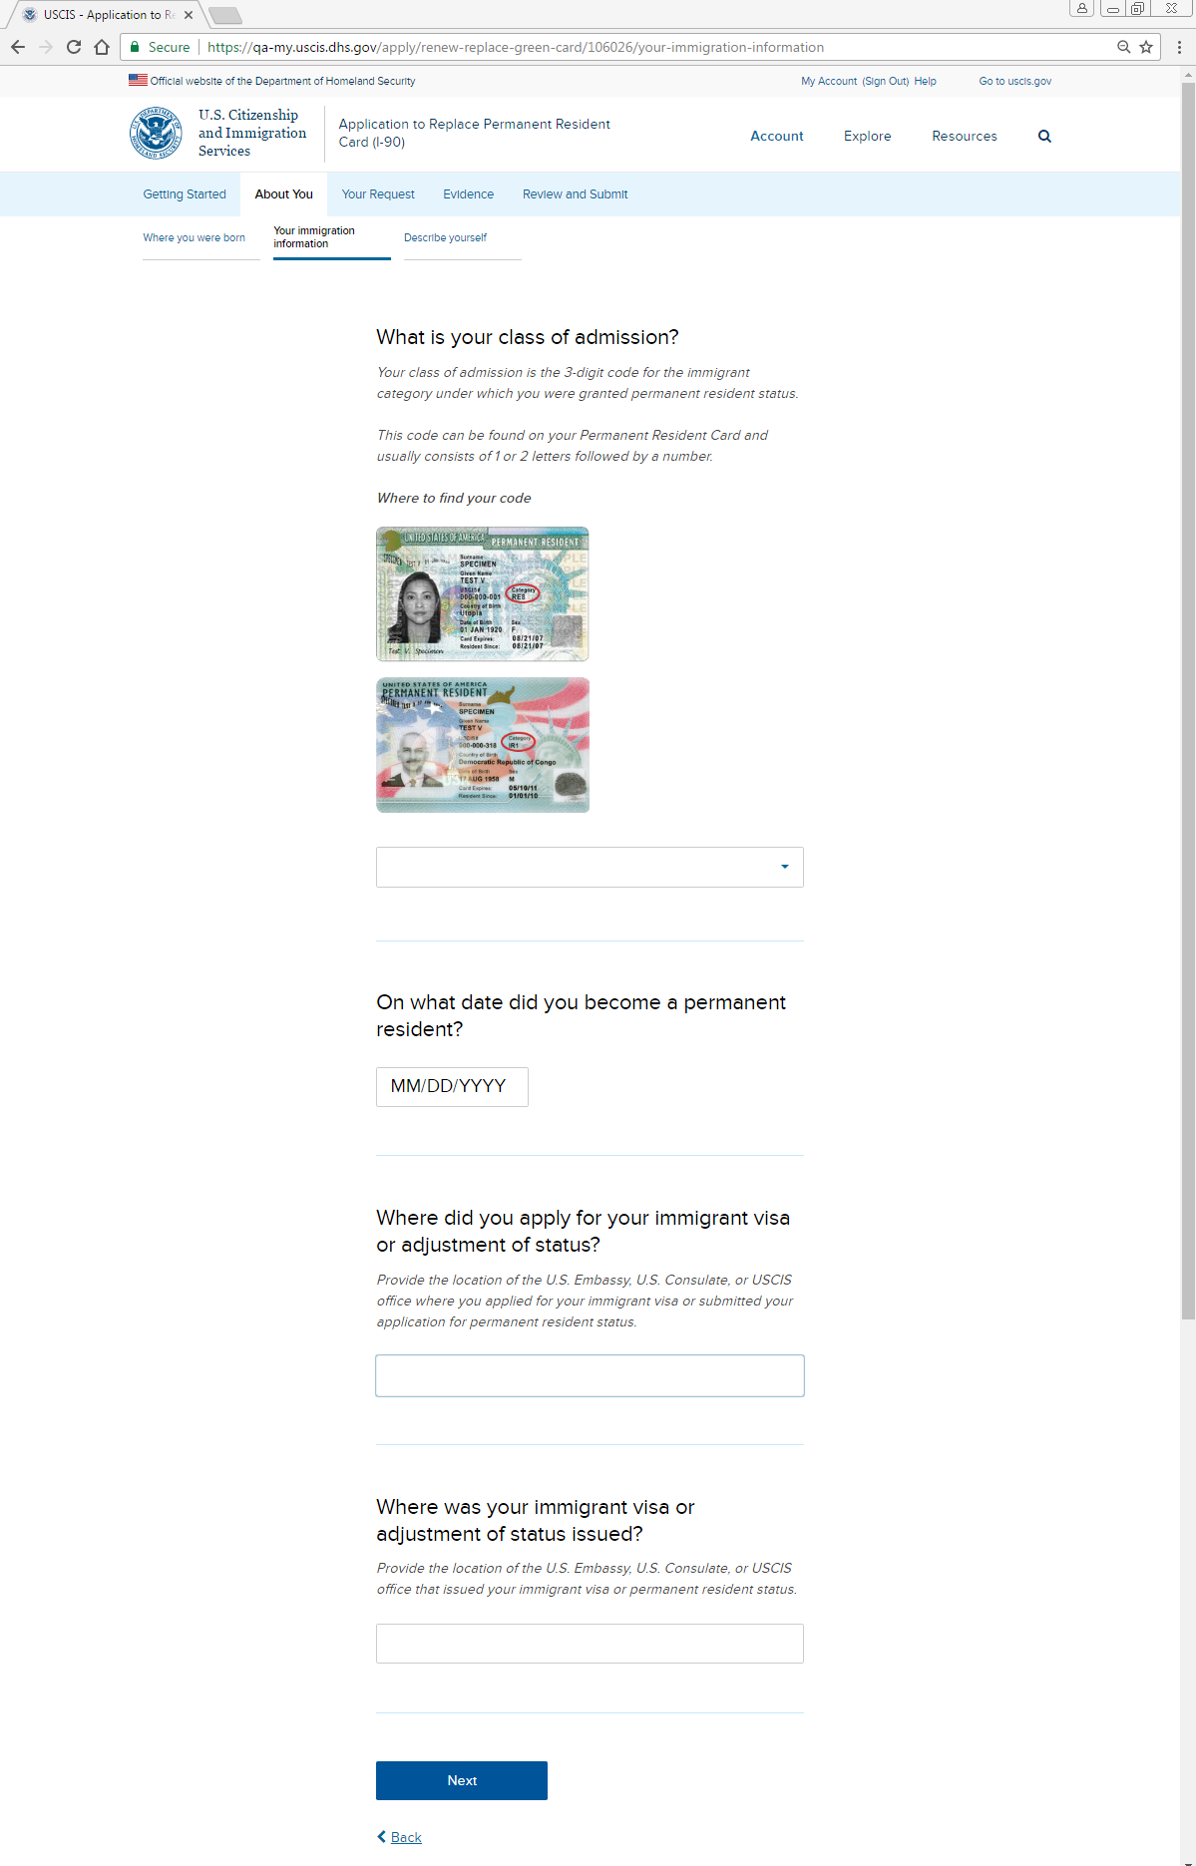
About You: Your immigration information: Class of admission

Slide 16
About You: Your immigration information: Class of admission - Alert

Slide 17
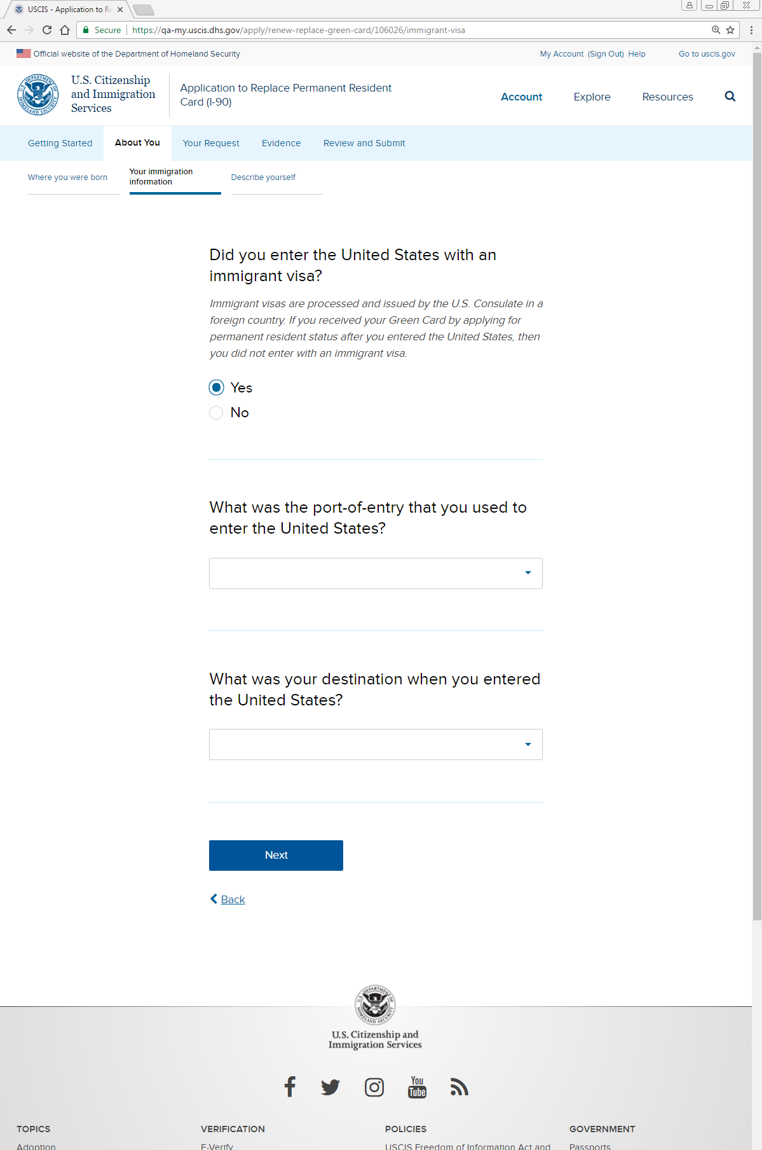
About You: Your immigration information: U.S. entry

Slide 18
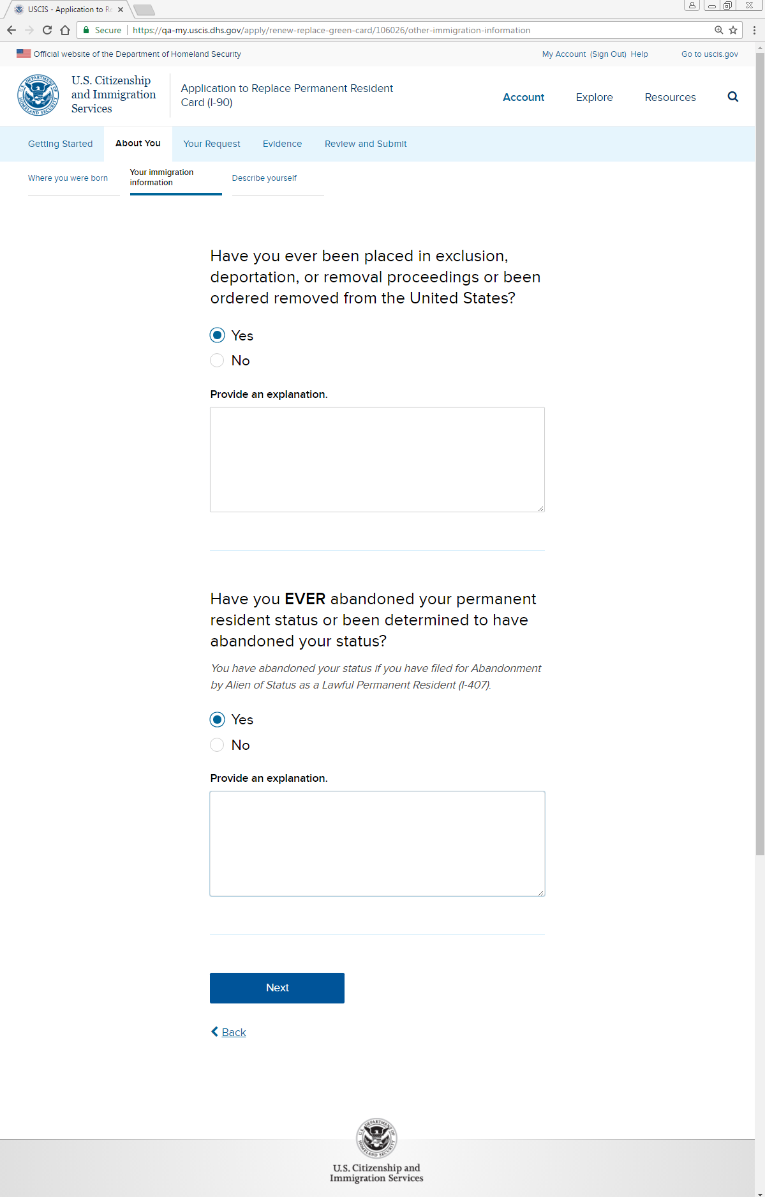
About You: Your immigration information: Removal, abandonment

Slide 19
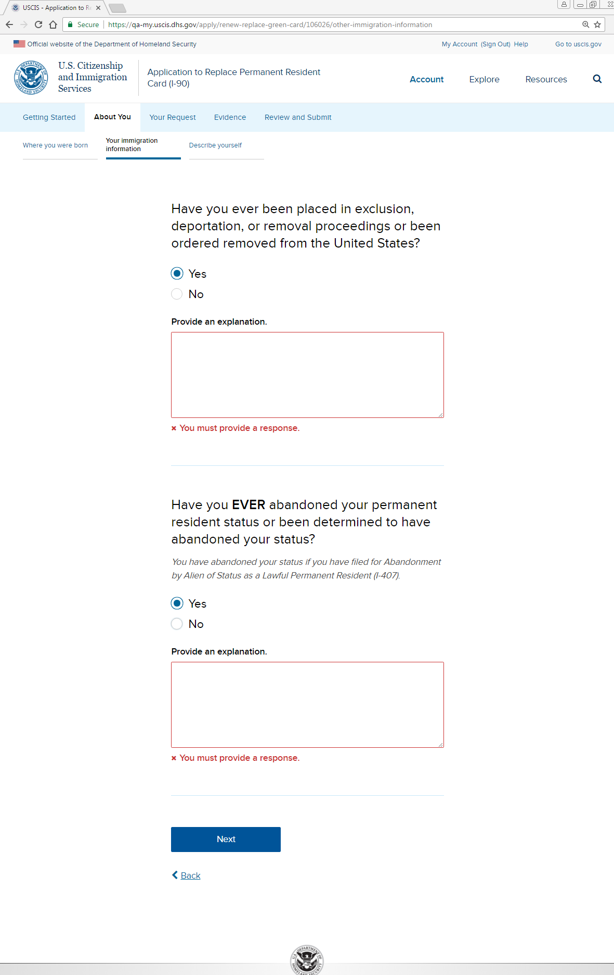
About You: Your immigration information: Removal, abandonment - Alert

Slide 20
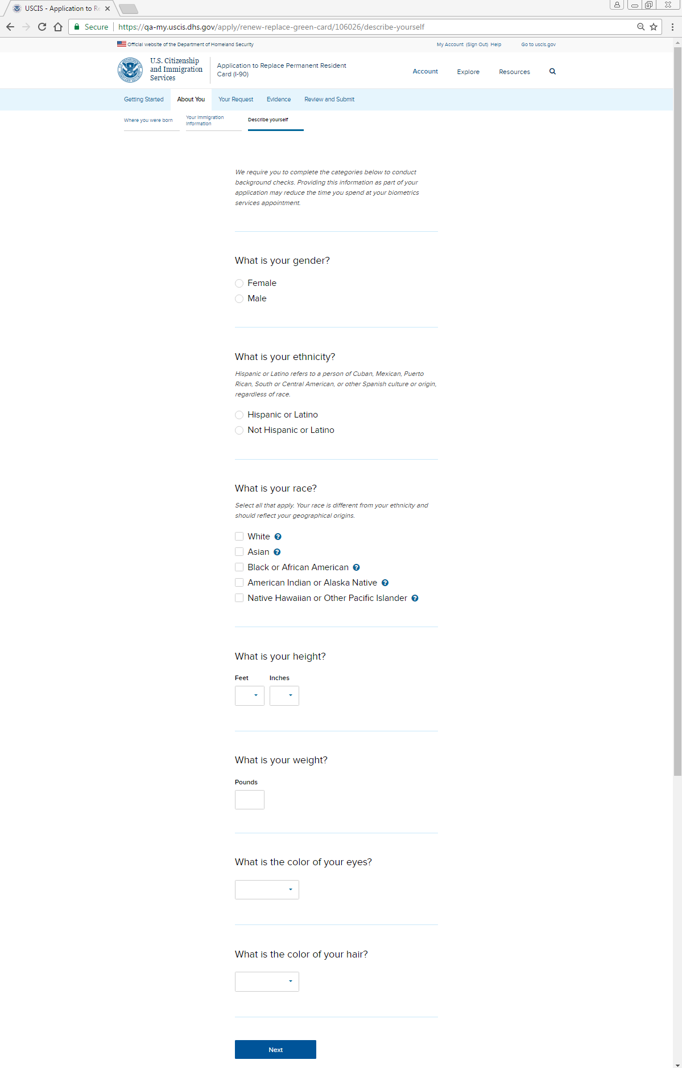
About You: Describe yourself

Slide 21
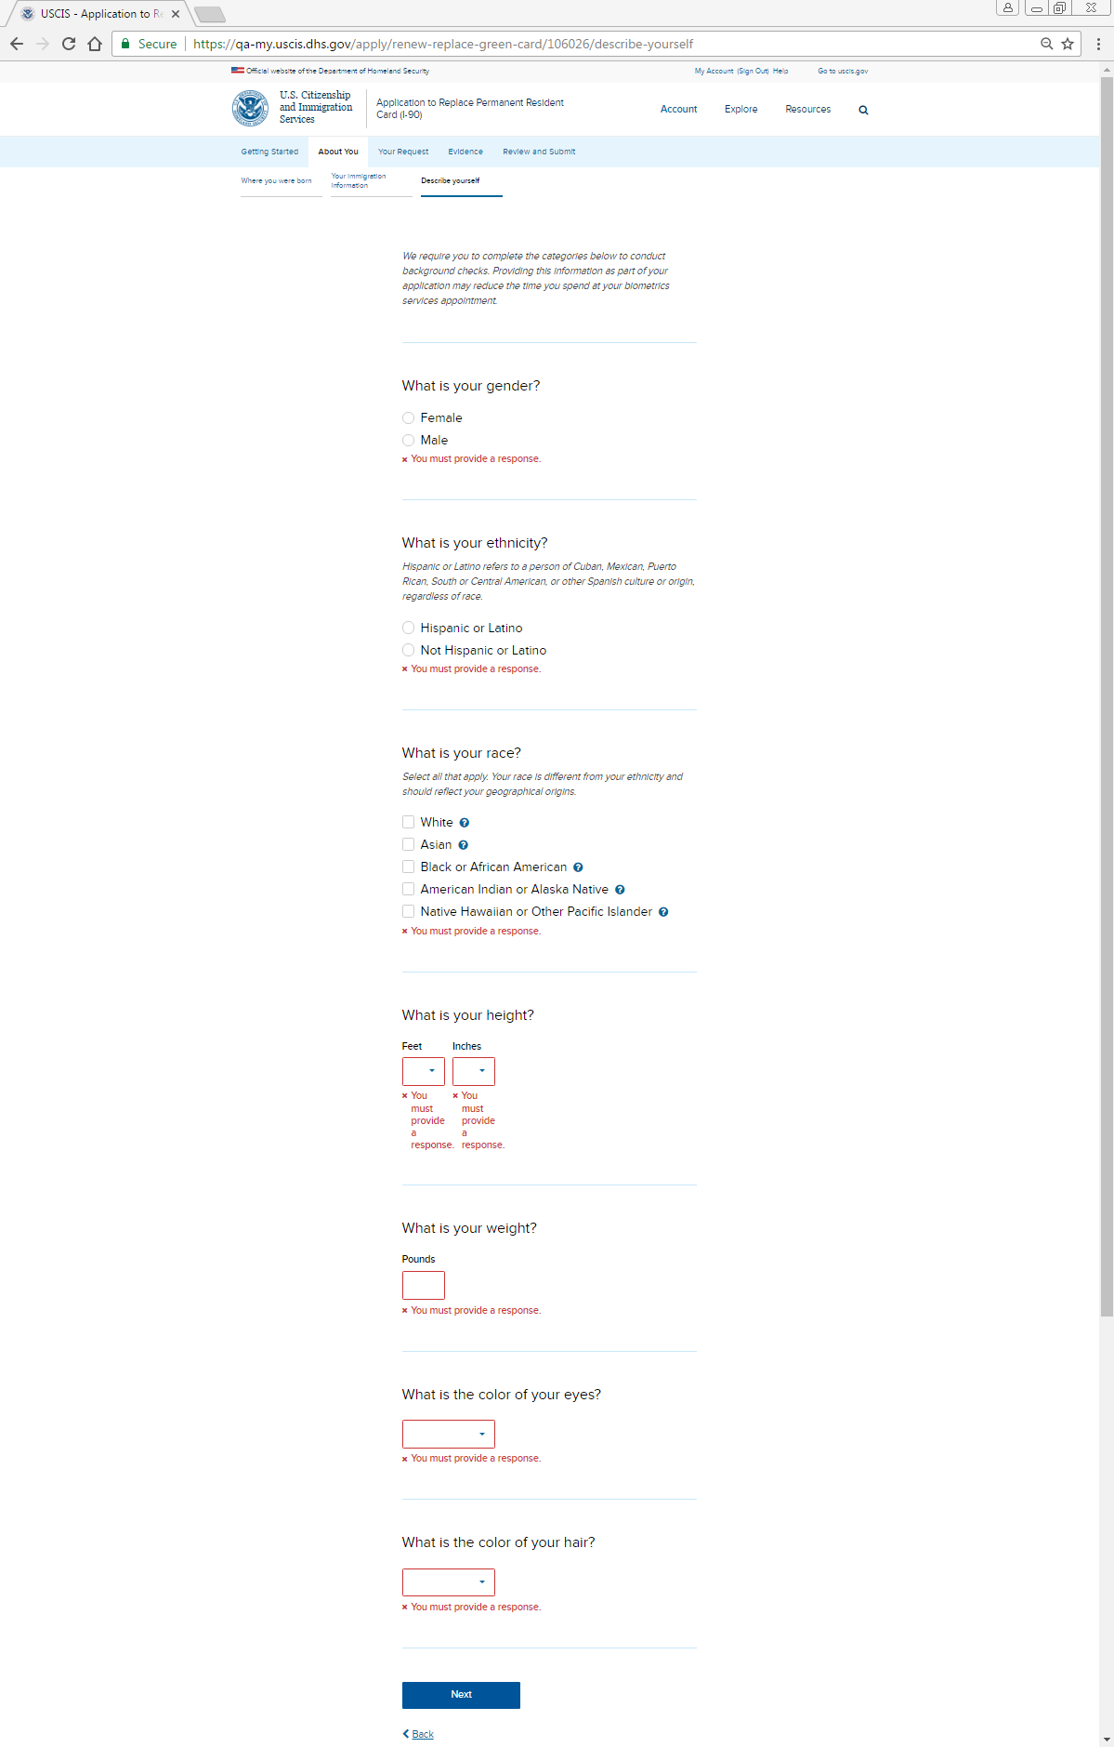
About You: Describe yourself - Alert

Slide 22
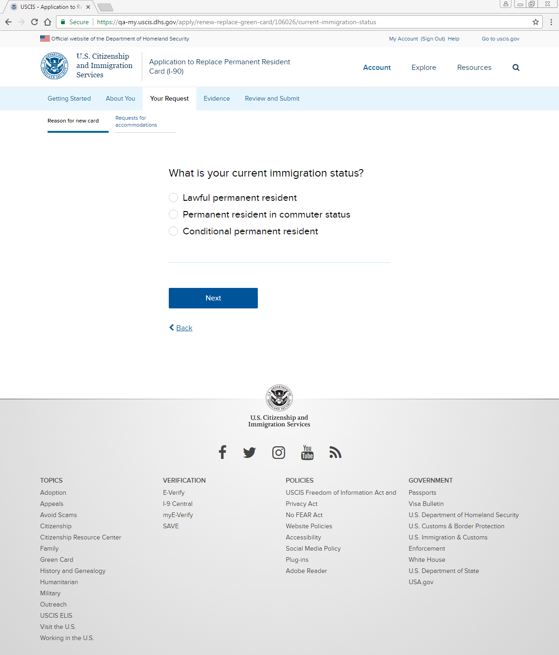
Your Request: Reason for new card: Your status

Slide 23
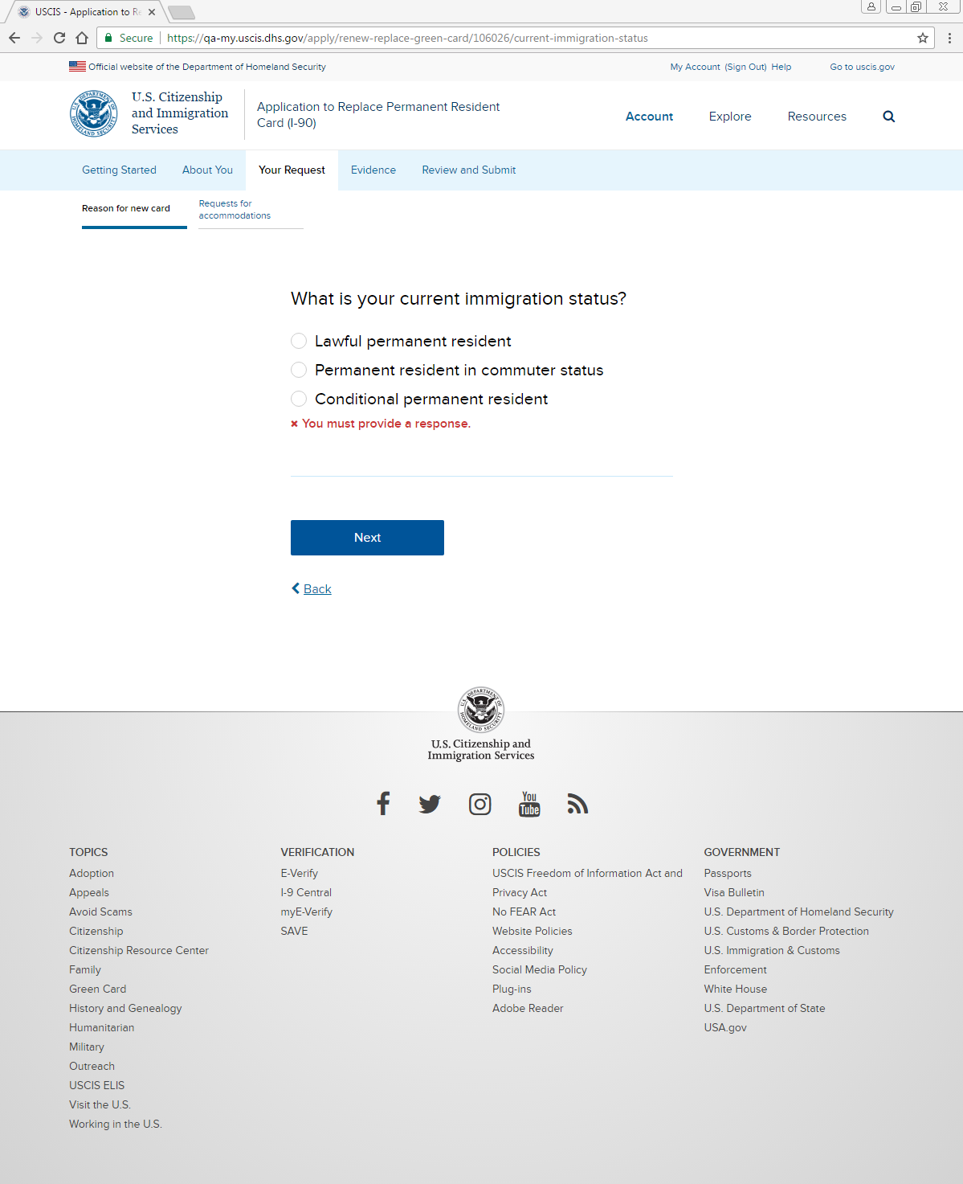
Your Request: Reason for new card: Your status - Alert

Slide 24
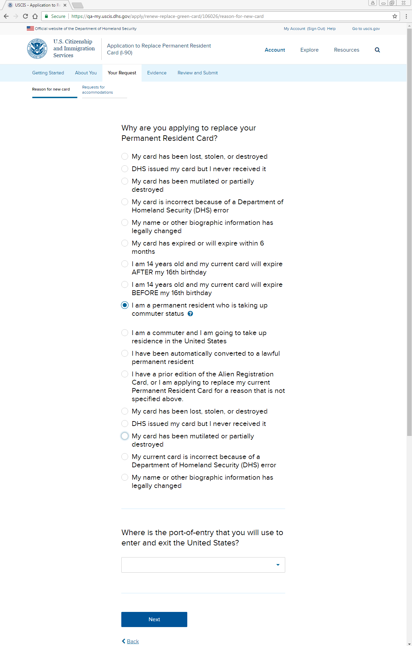
Your Request: Reason for new card: Reason for application

Slide 25
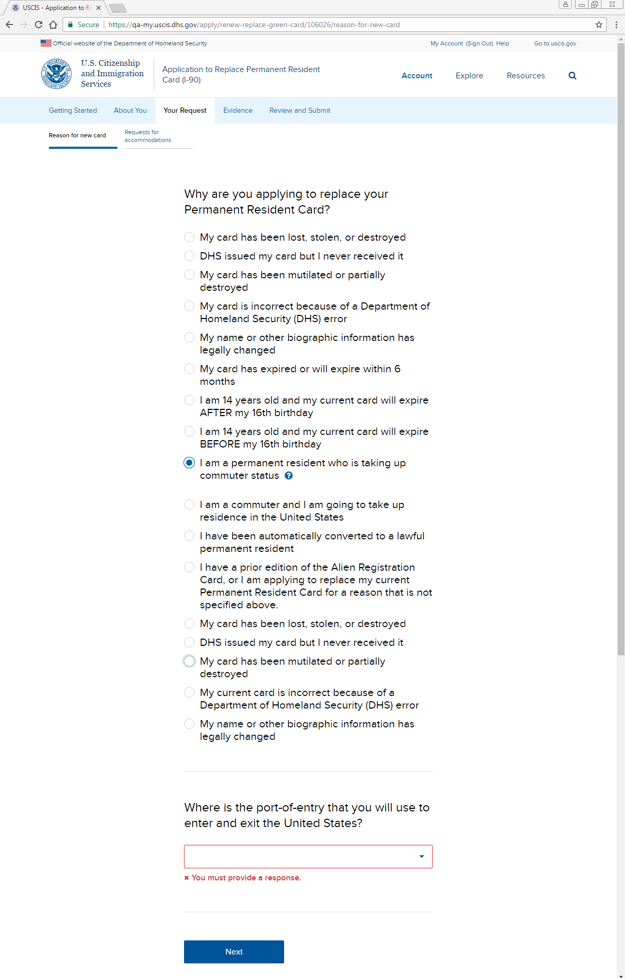
Your Request: Reason for new card: Reason for application - Alert

Slide 26
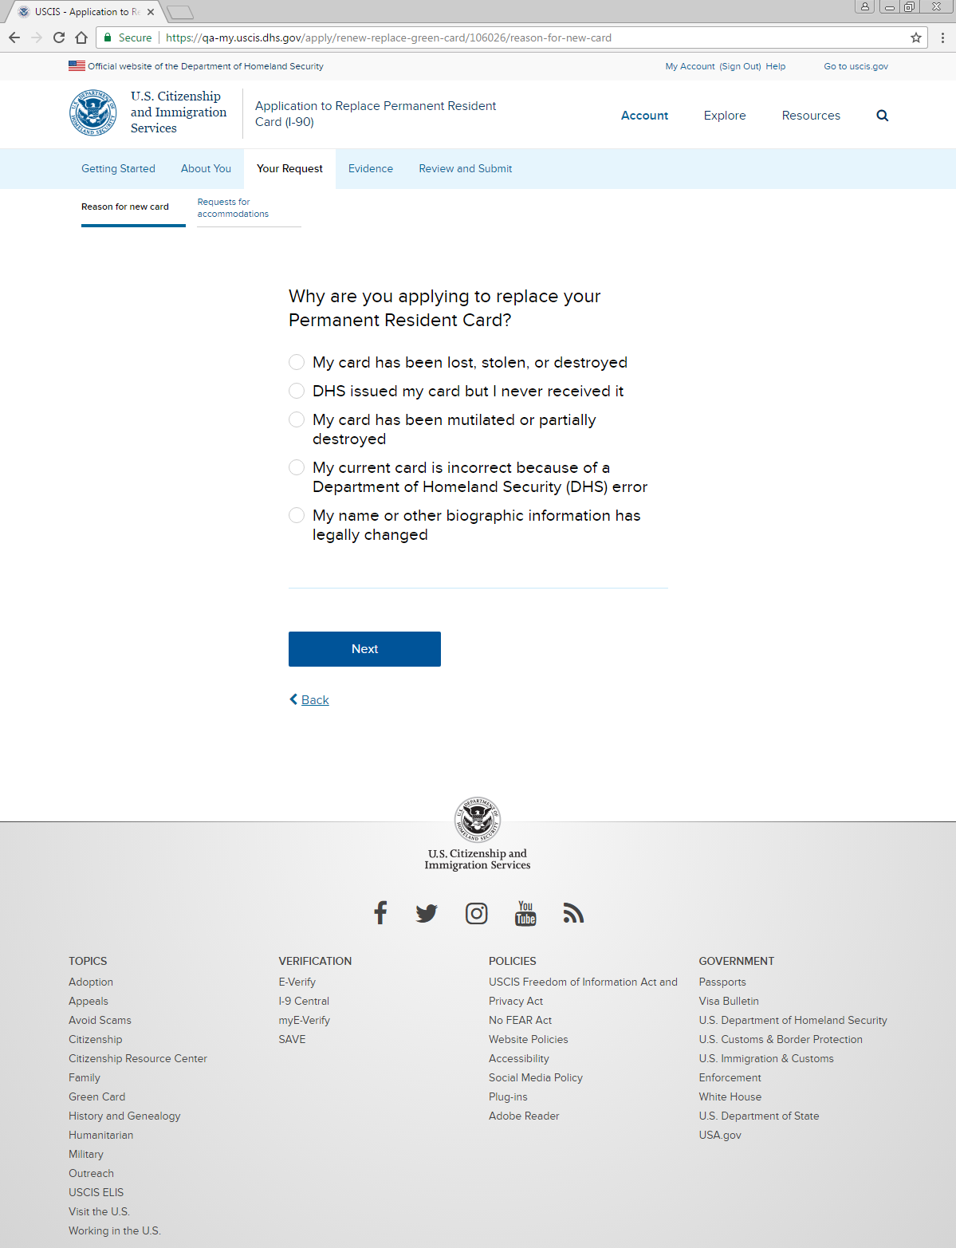
Your Request: Reason for new card: Reason for application (conditional)

Slide 27
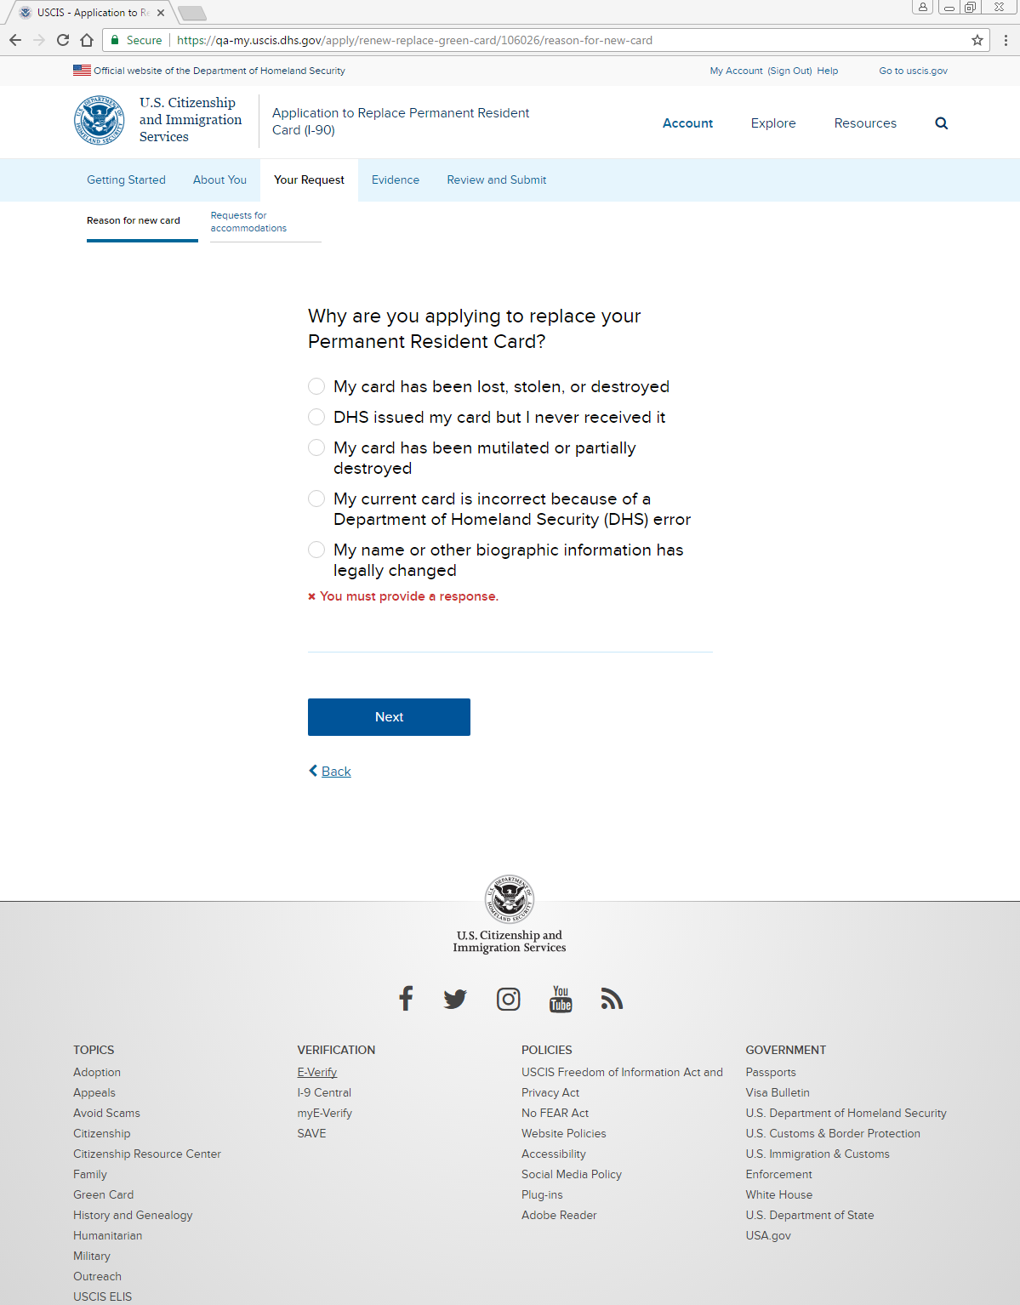
Your Request: Reason for new card: Reason for application (conditional) - Alert

Slide 28
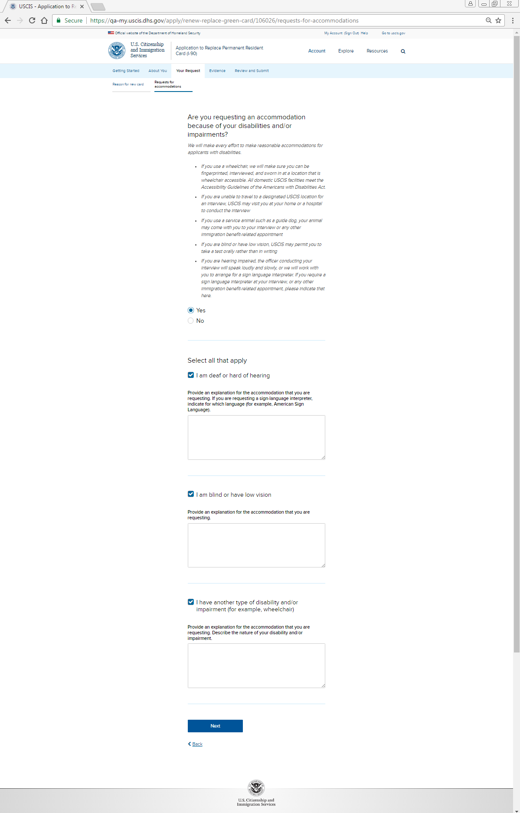
Your Request: Reason for new card: Request for accommodations

Slide 29
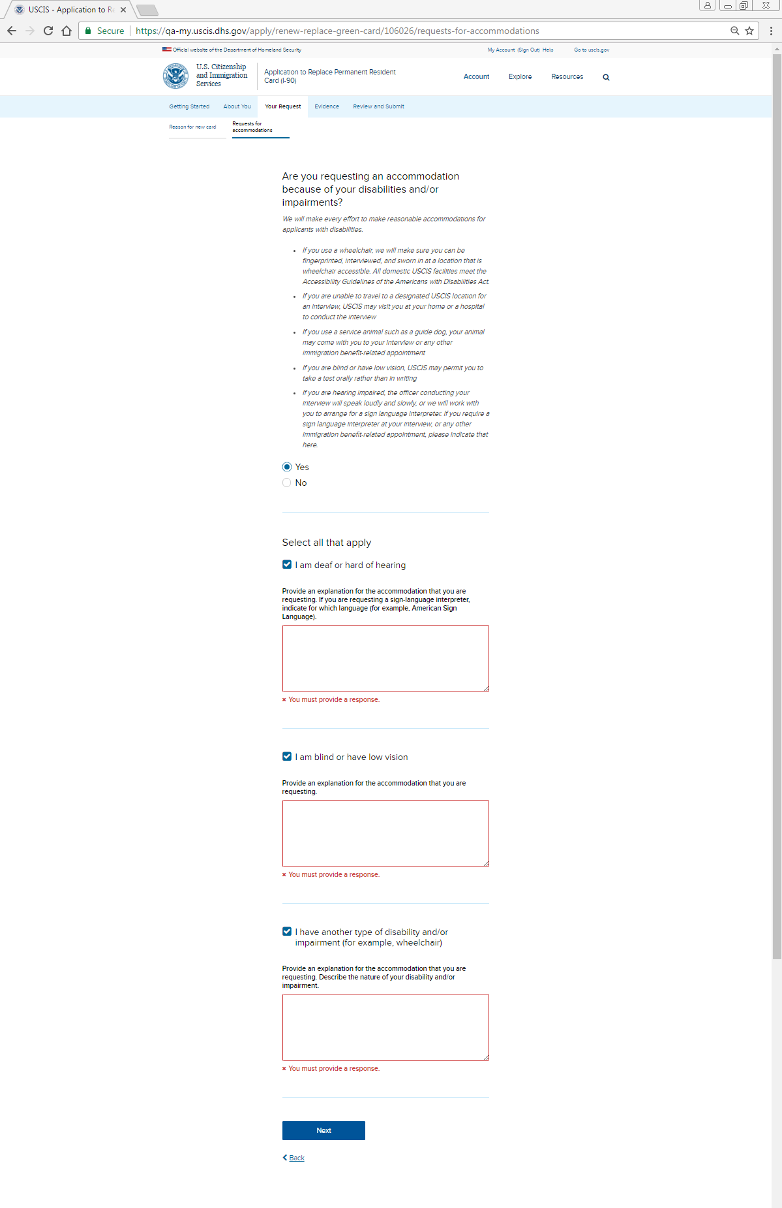
Your Request: Reason for new card: Request for accommodations - Alert

Slide 30
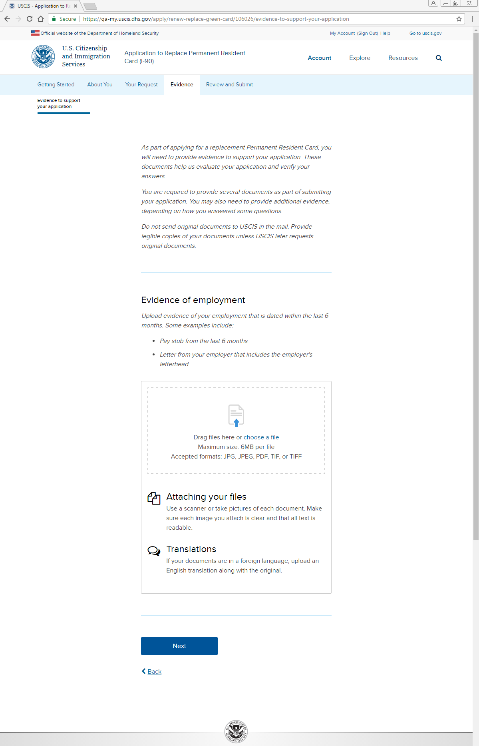
Evidence: Evidence of employment uploader

Slide 31
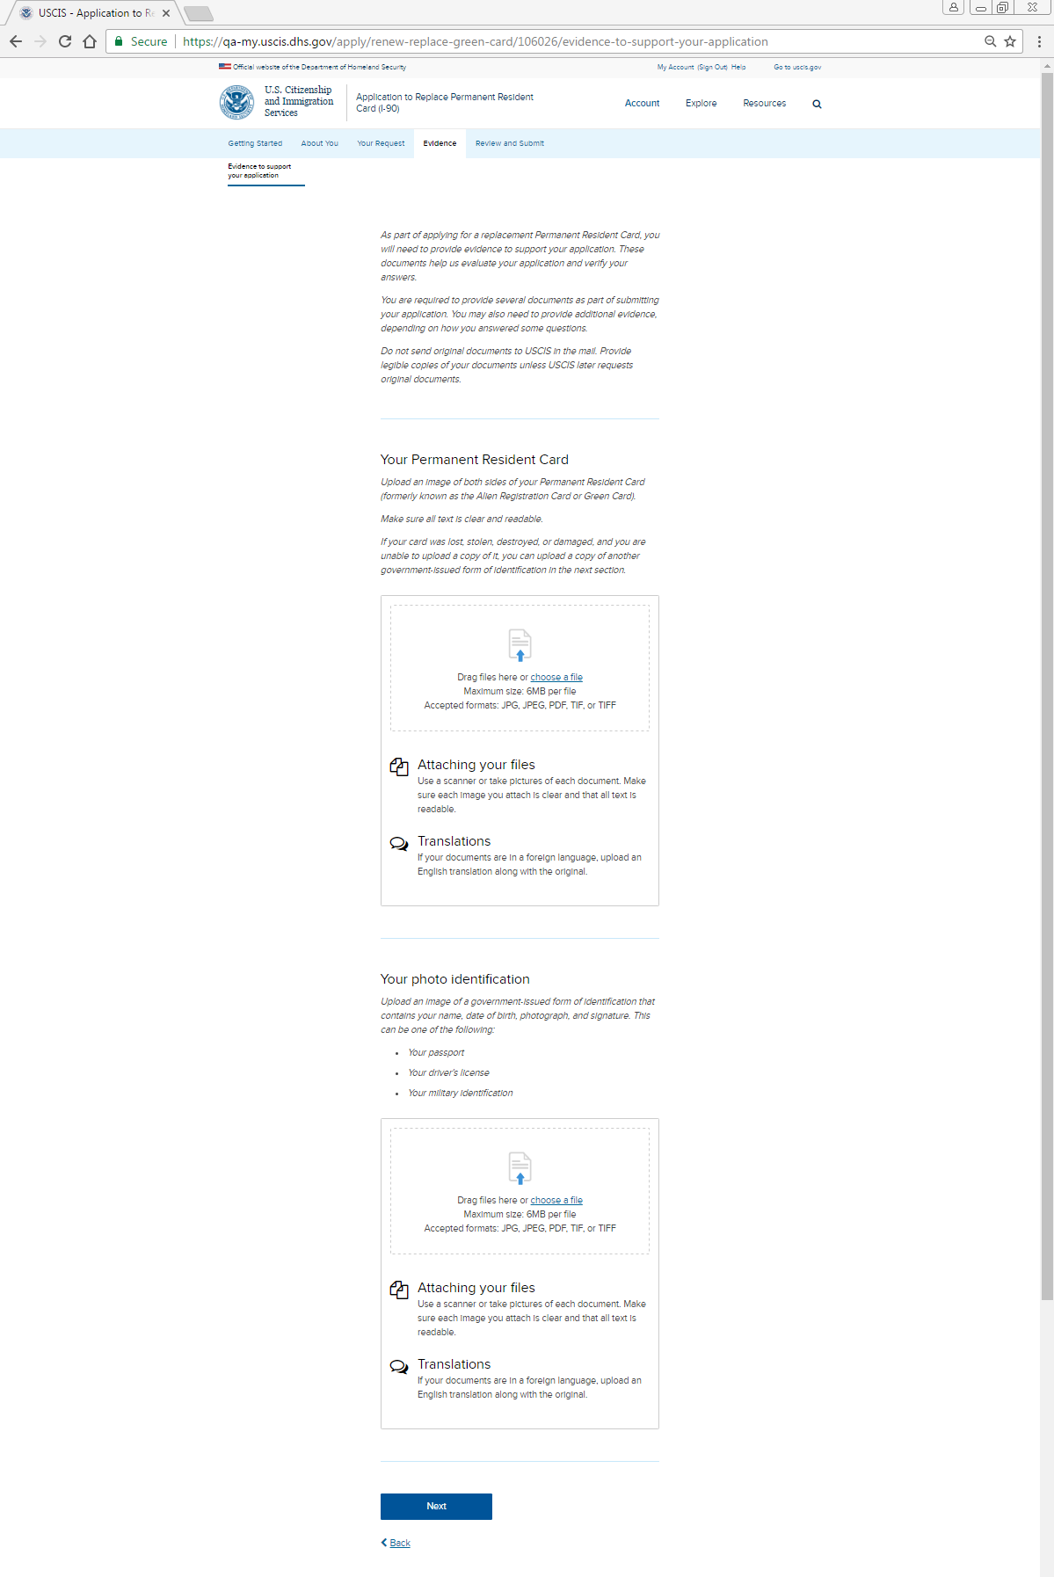
Evidence: Your permanent resident card, Your photo identification uploaders

Slide 32
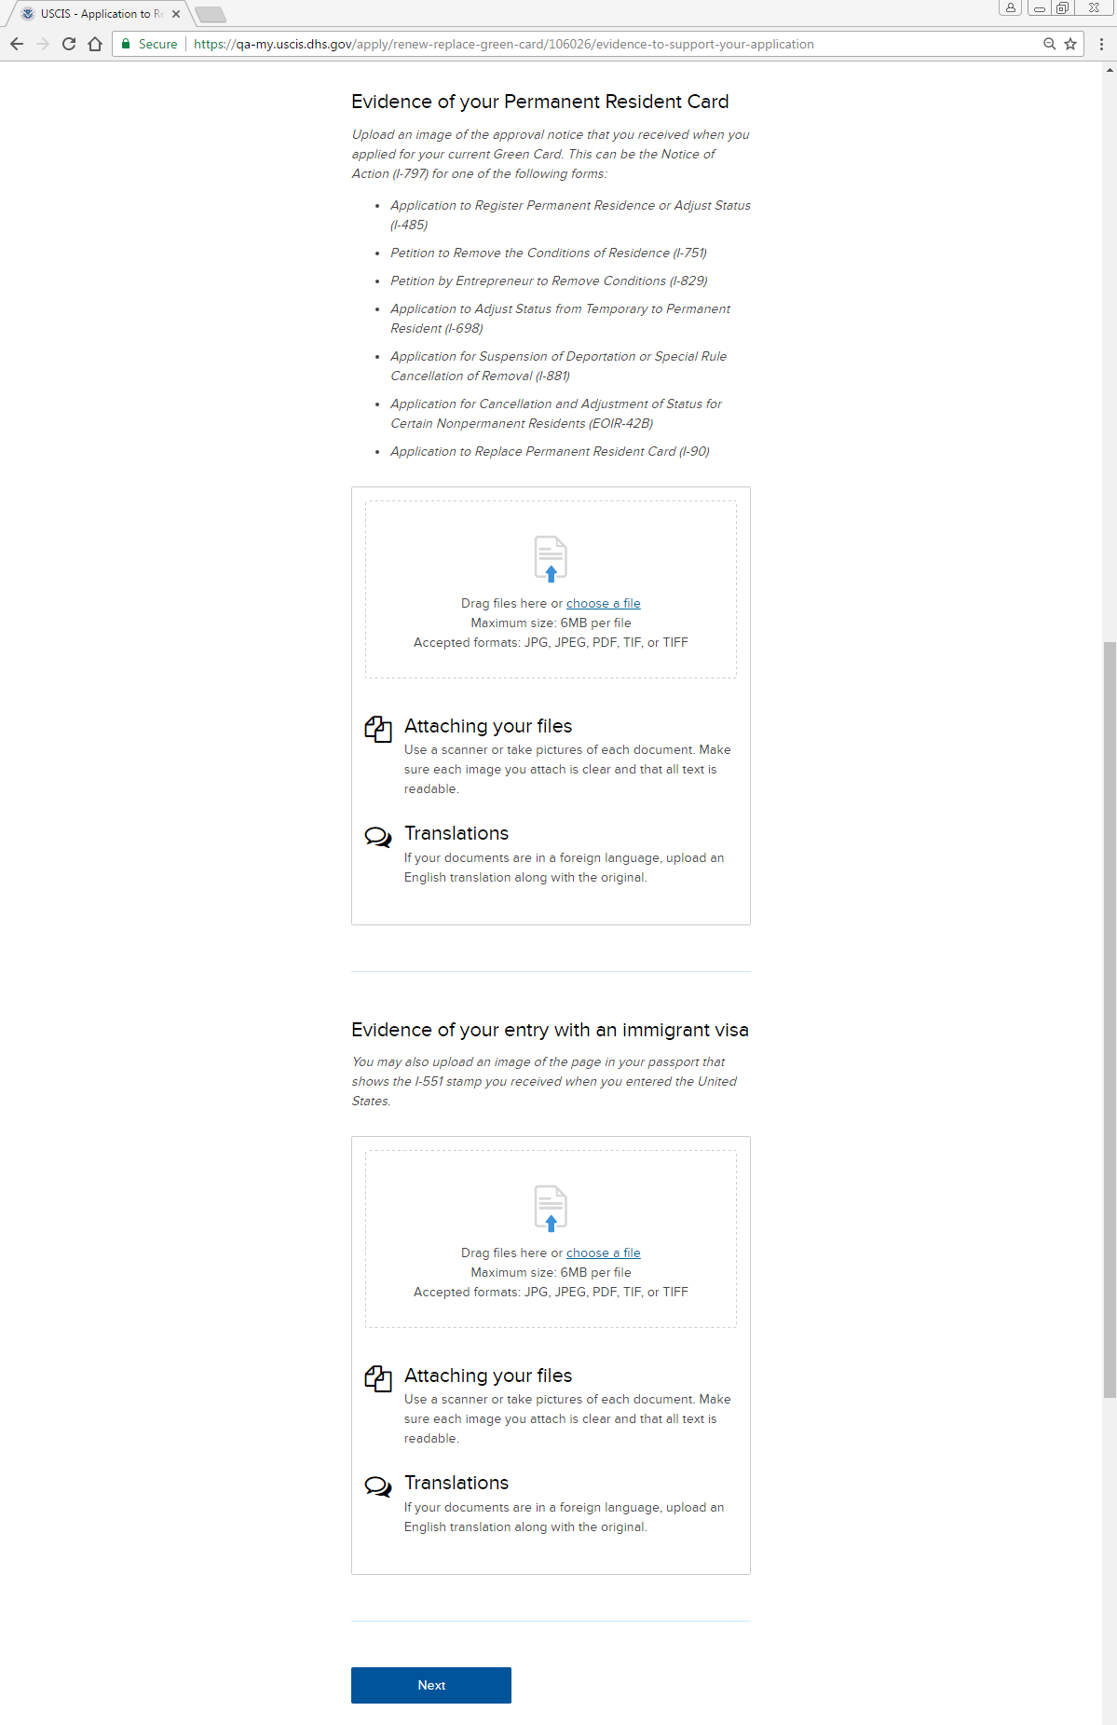
Evidence: Evidence of permanent resident card, Evidence of entry with immigrant visa

Slide 33
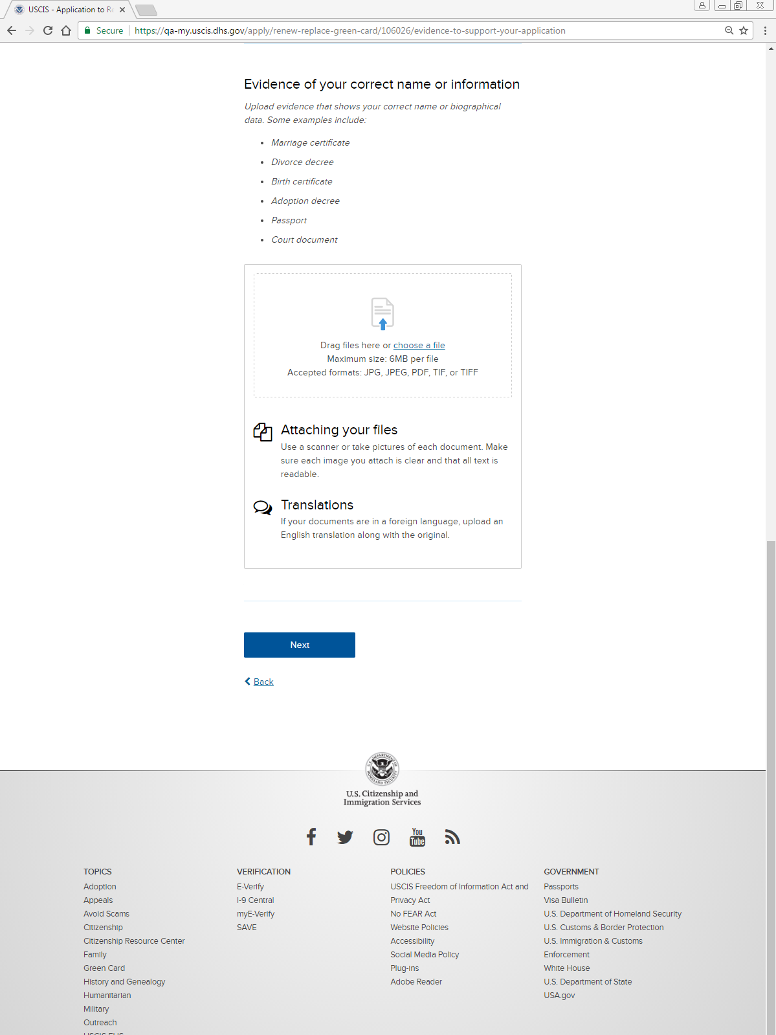
Evidence: Evidence of correct name or information uploader

Slide 34
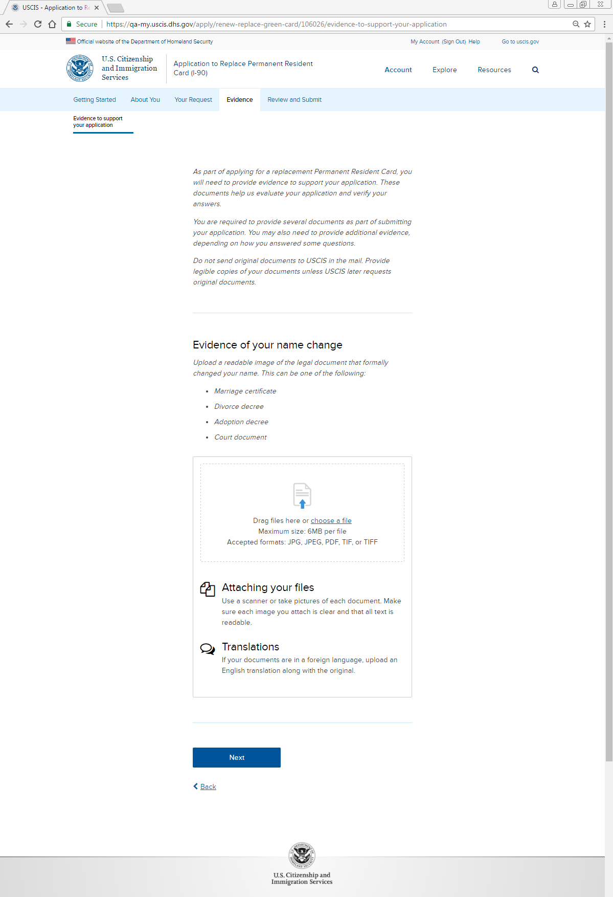
Evidence: Evidence of your name change uploader

Slide 35
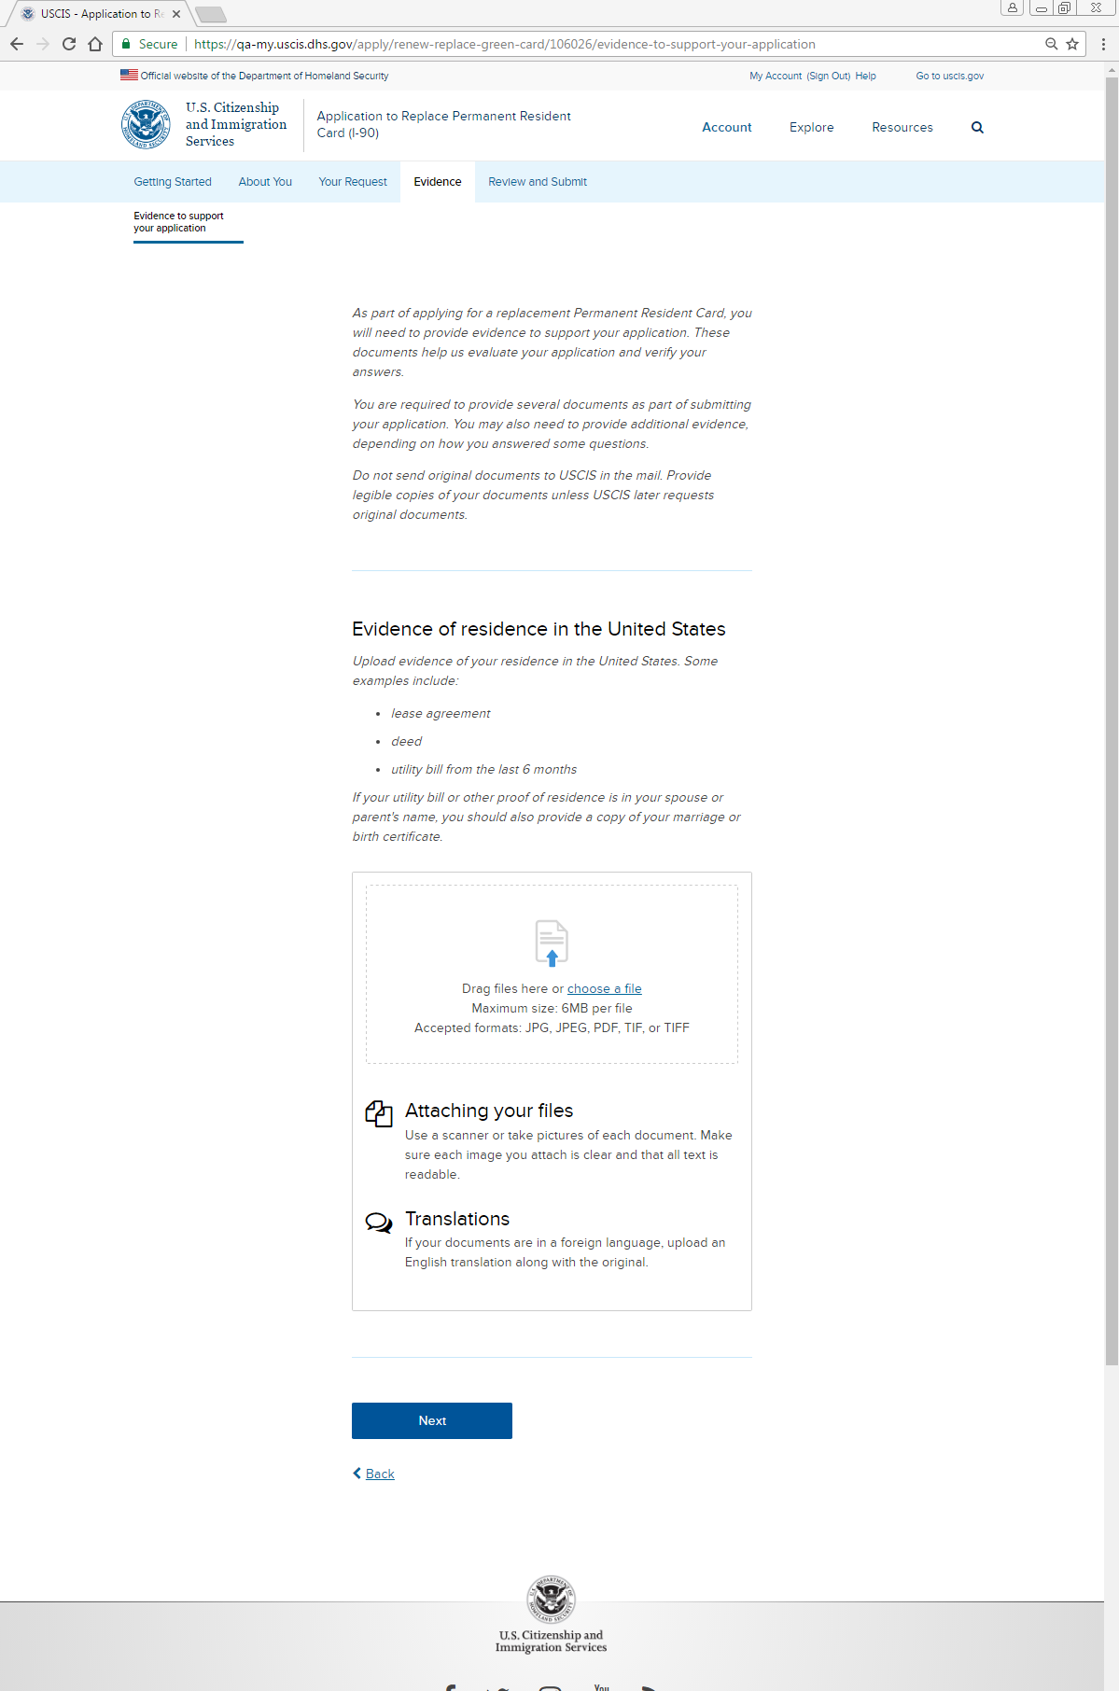
Evidence: Evidence of residence in the United States uploader

Slide 36
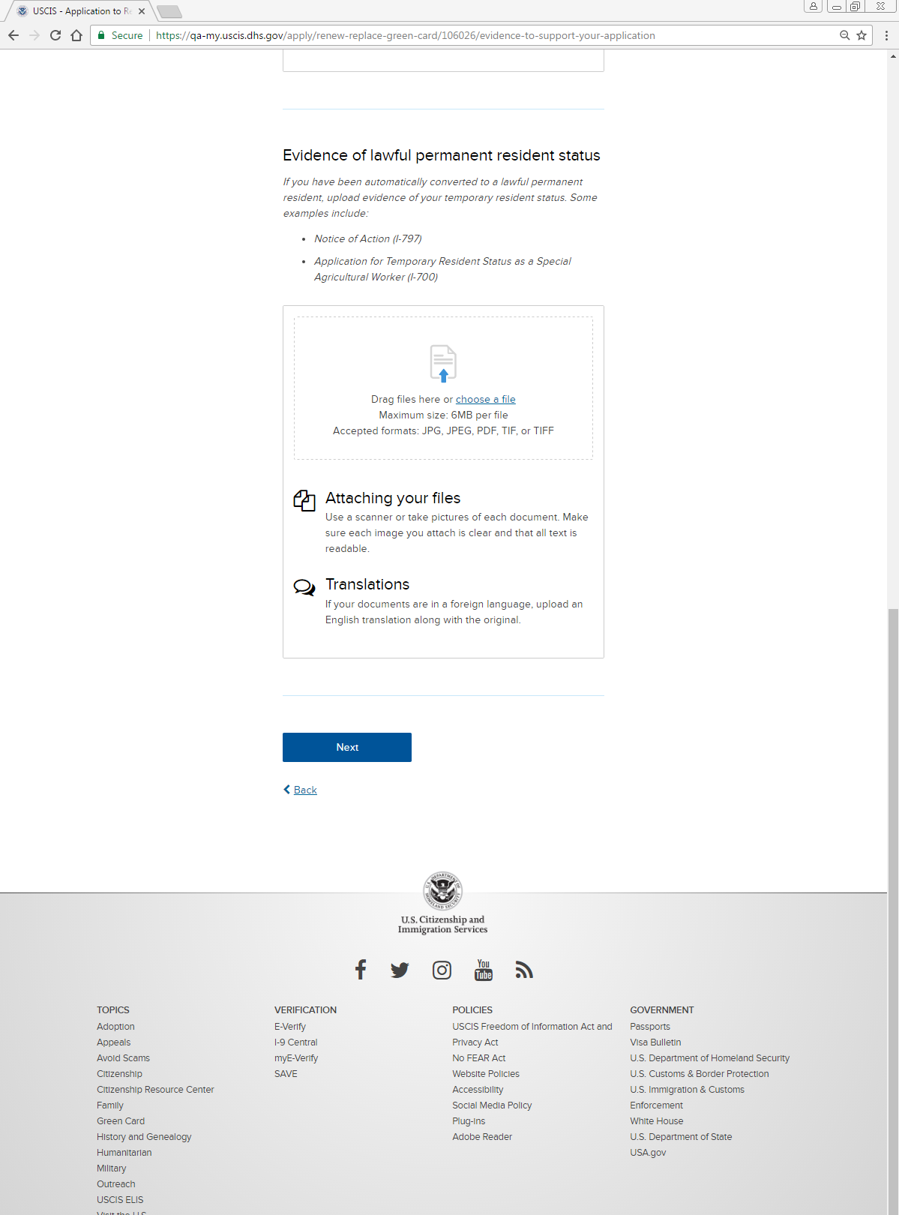
Evidence: Evidence of lawful permanent resident status uploader

Slide 37
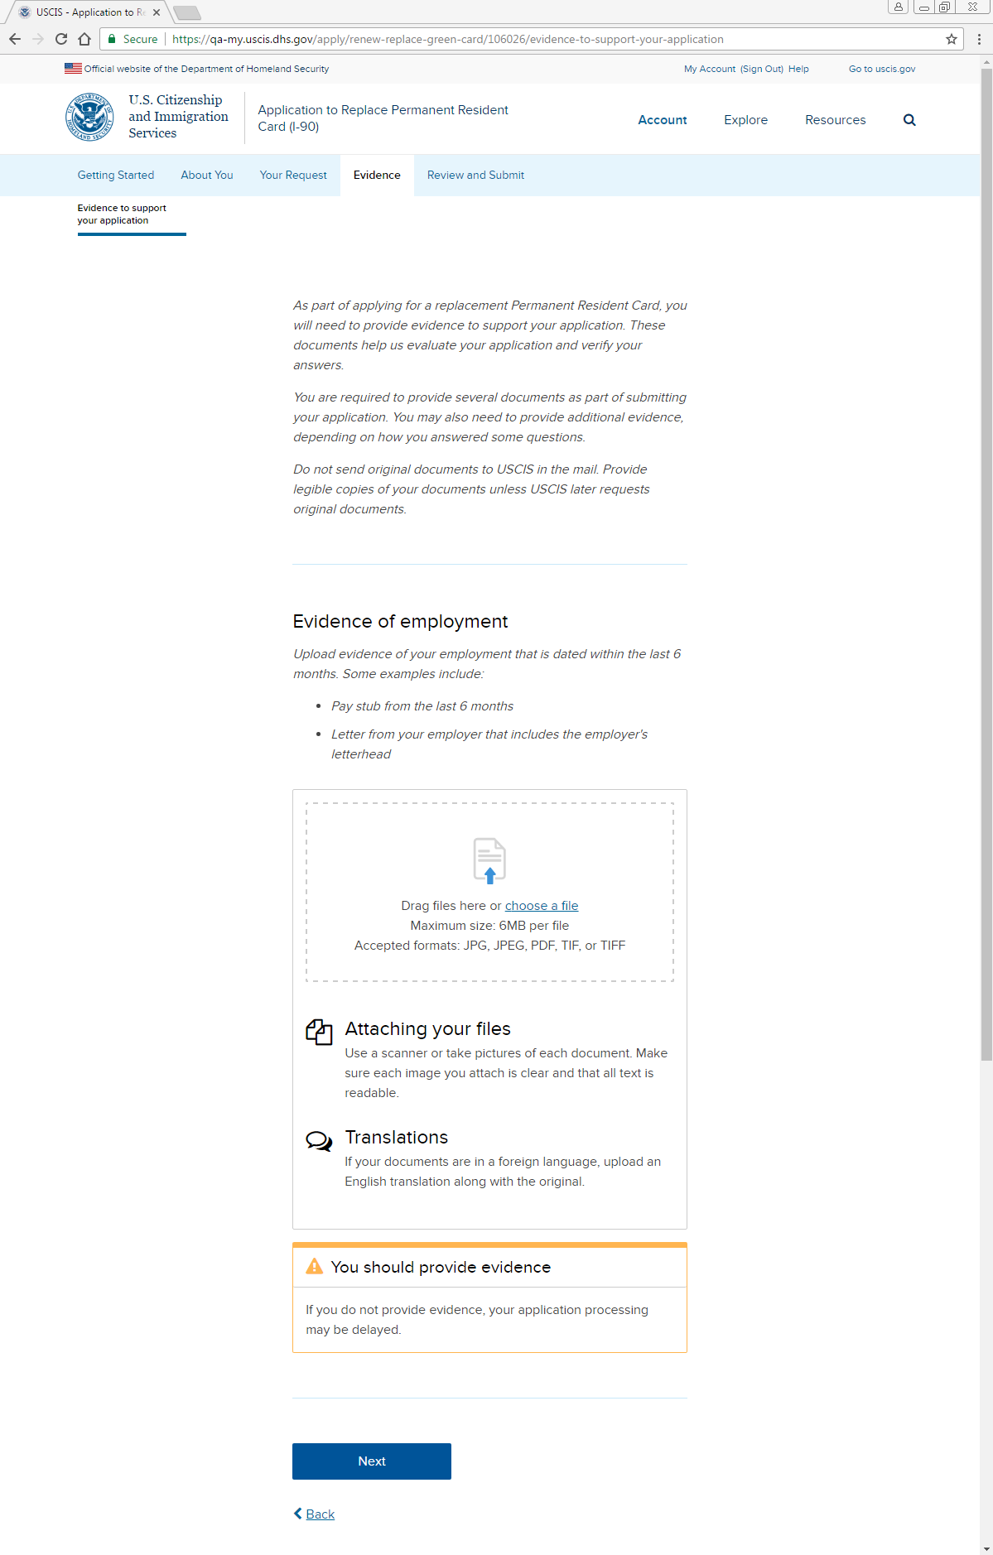
Evidence: Alert box (applies to all uploaders)

Slide 38
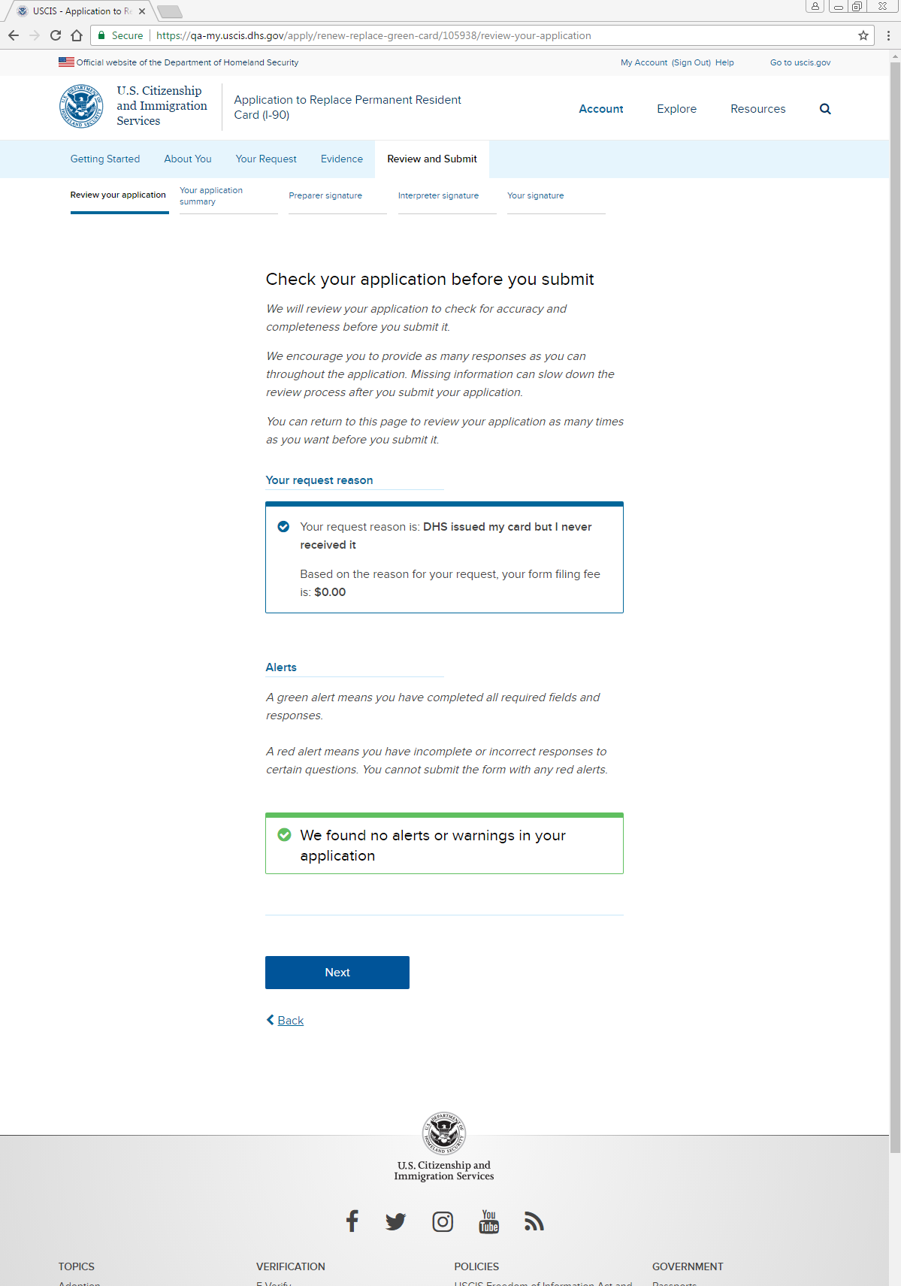
Review and Submit: Review your application

Slide 39
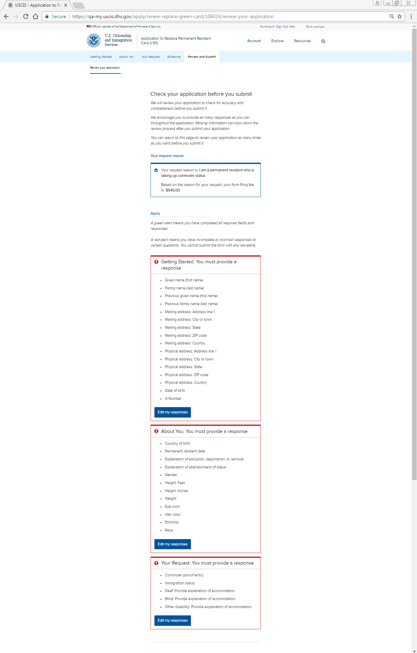
Review and Submit: Review your application – Alerts (applicant cannot proceed)

Slide 40
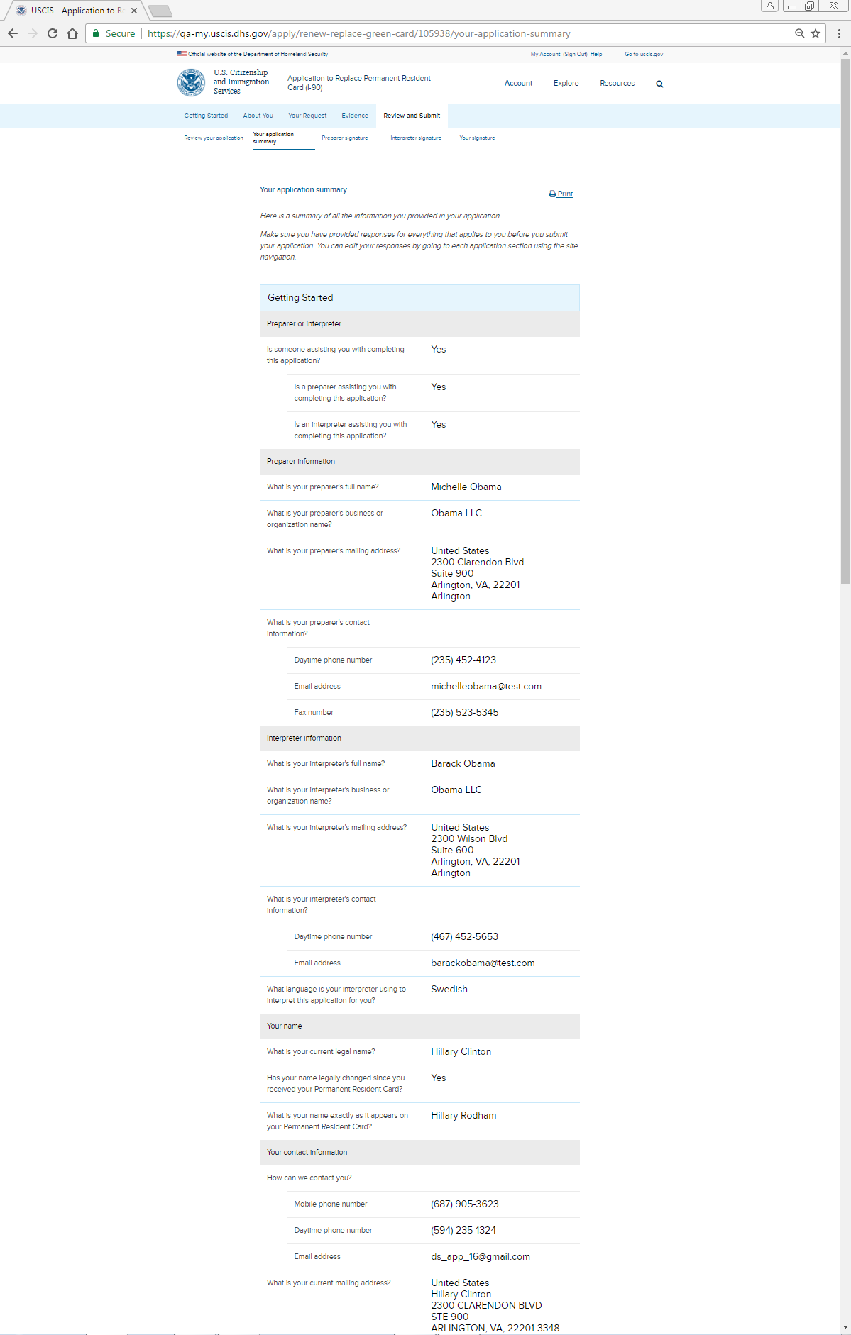
Review and Submit: Your application summary (screenshot 1)

Slide 41
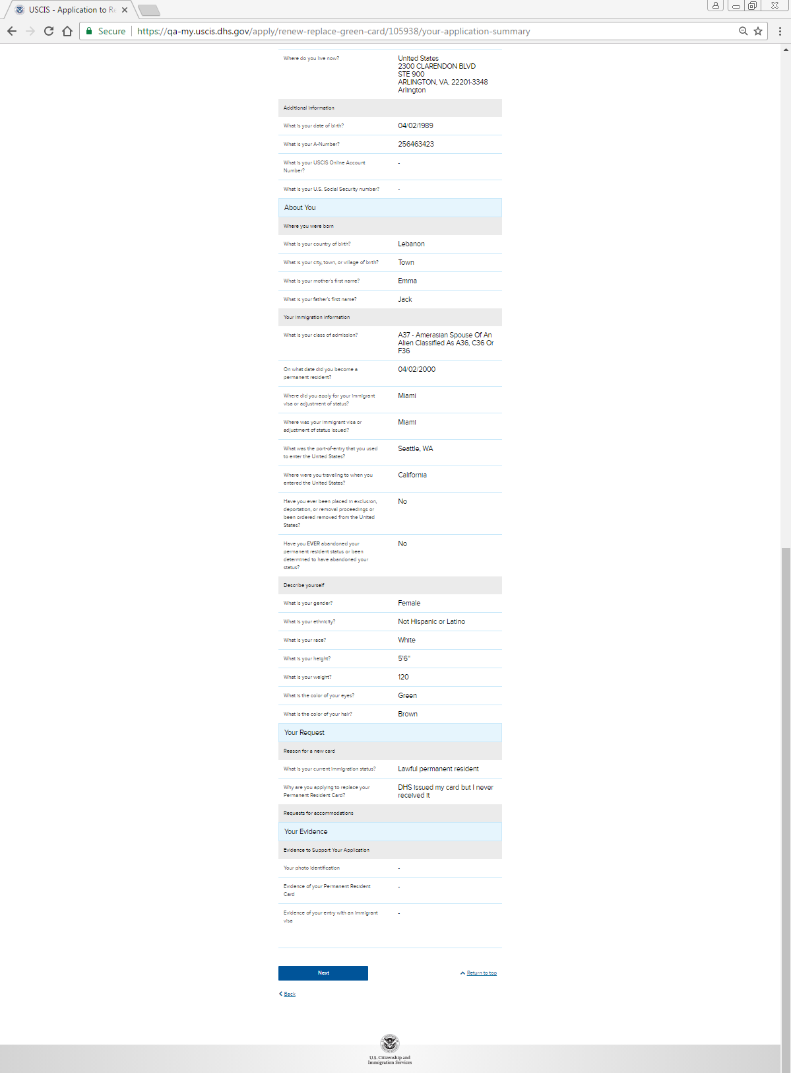
Review and Submit: Your application summary (screenshot 2)

Slide 42
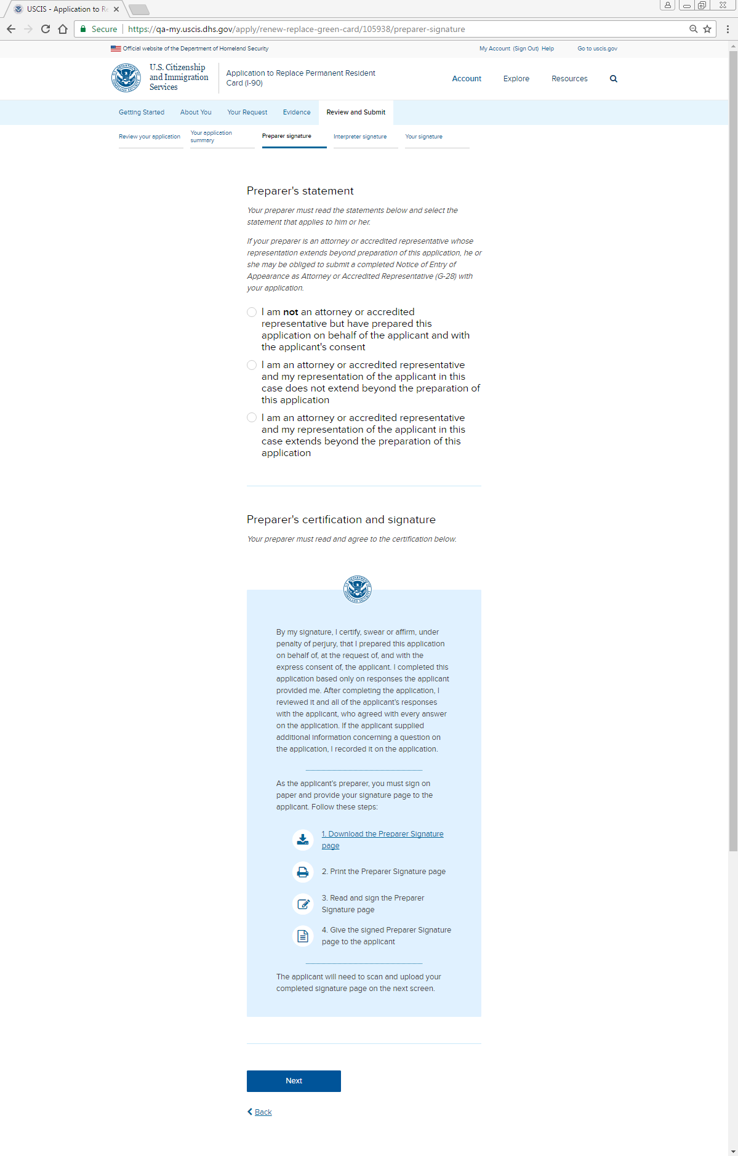
Review and Submit: Preparer signature

Slide 43
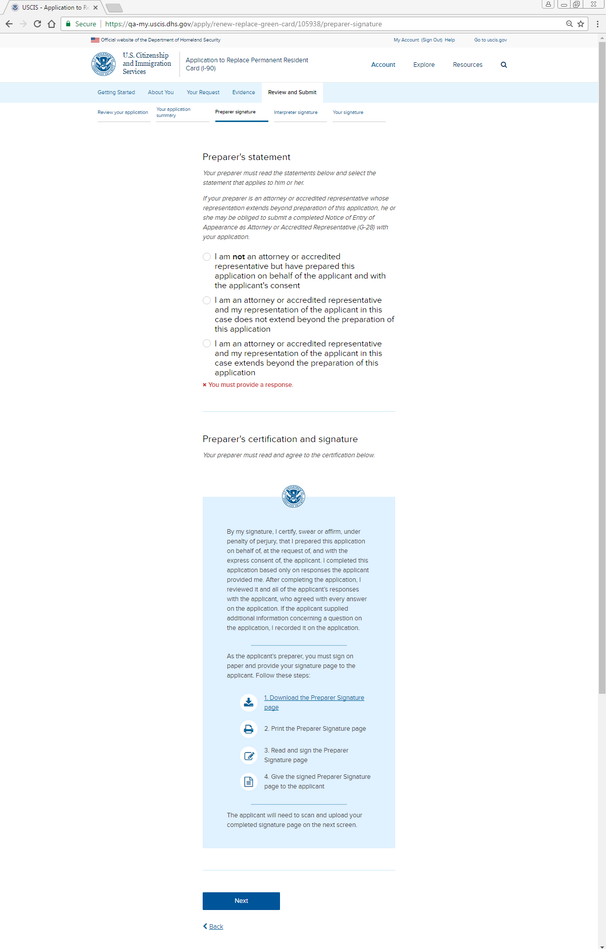
Review and Submit: Preparer signature - Alert

Slide 44
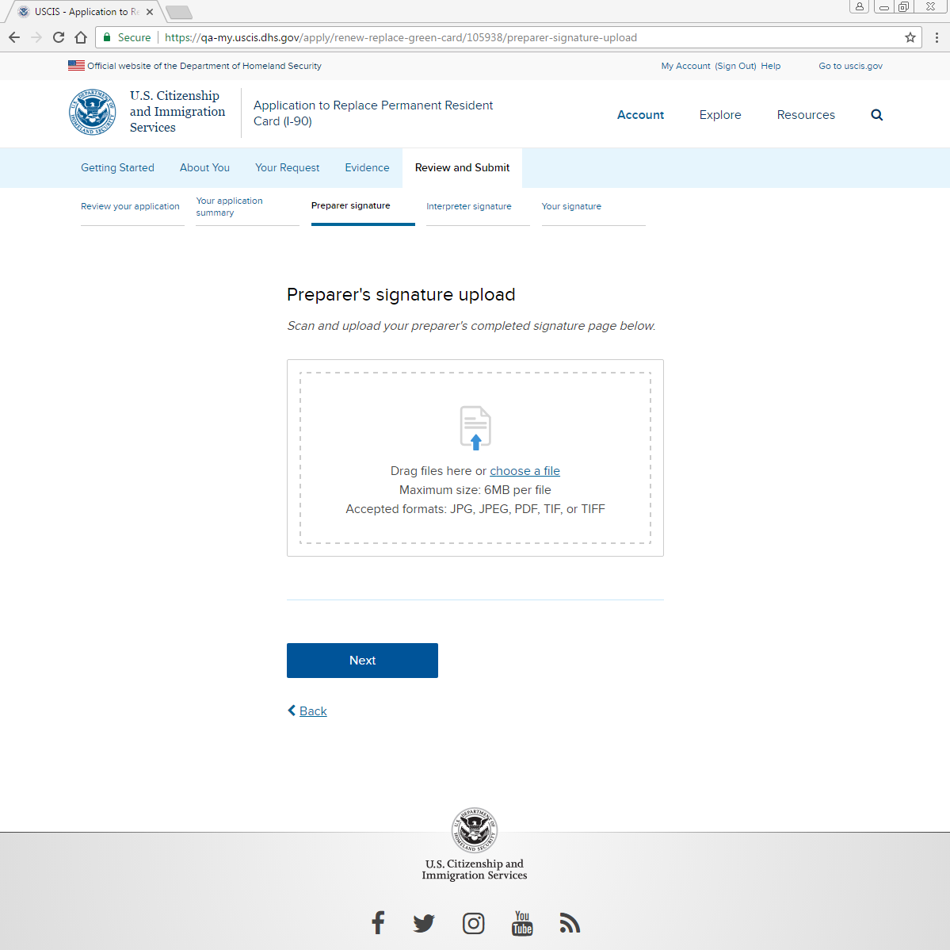
Review and Submit: Preparer signature: Upload

Slide 45
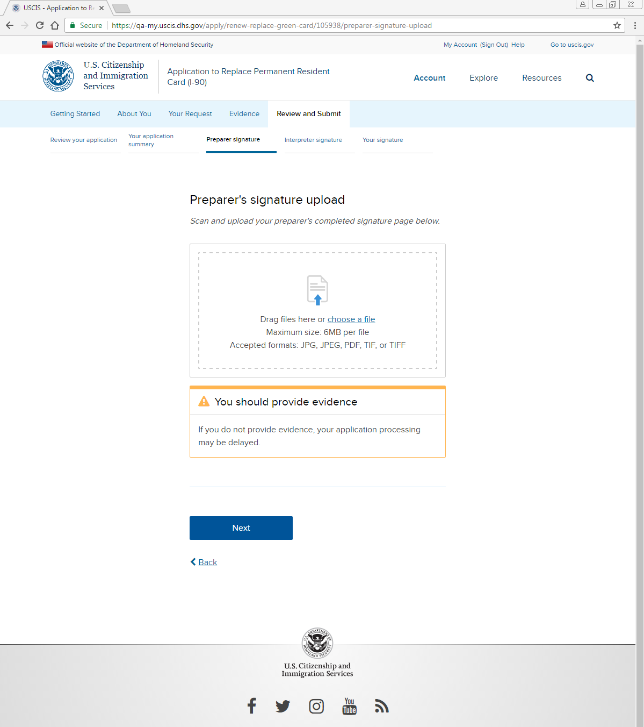
Review and Submit: Preparer signature: Uploader alert

Slide 46
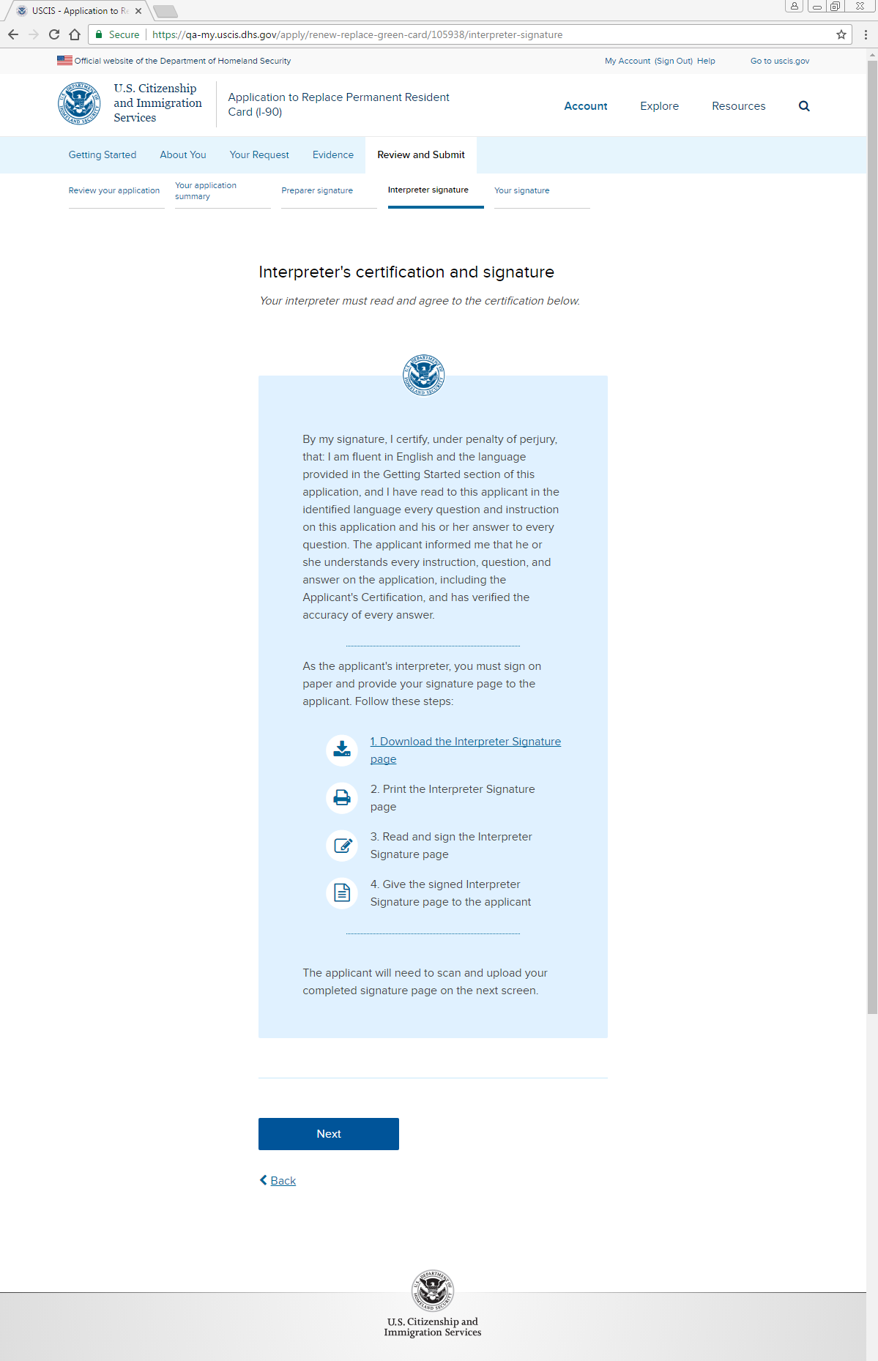
Review and Submit: Interpreter signature

Slide 47
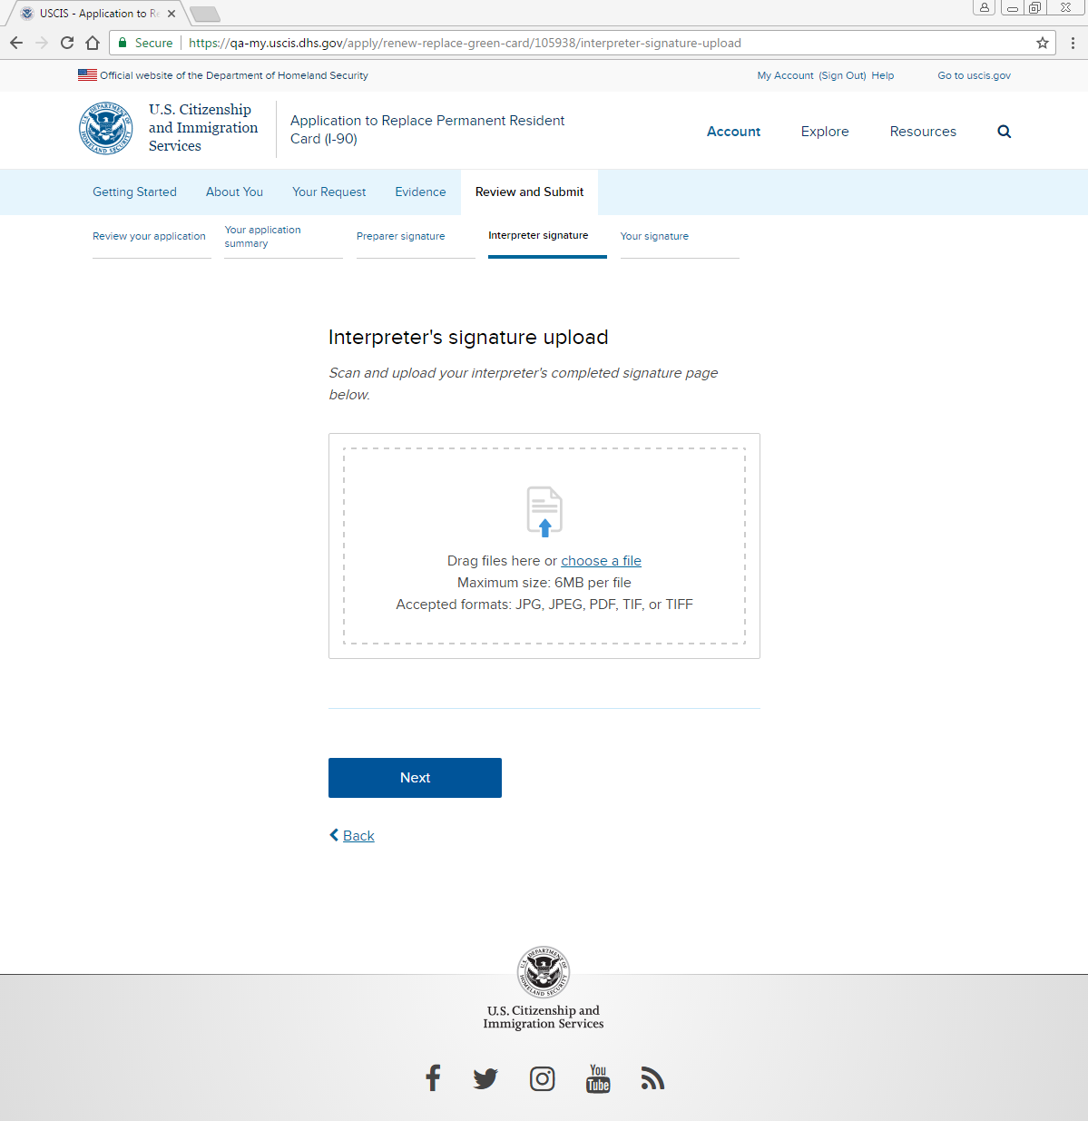
Review and Submit: Interpreter signature: Upload

Slide 48
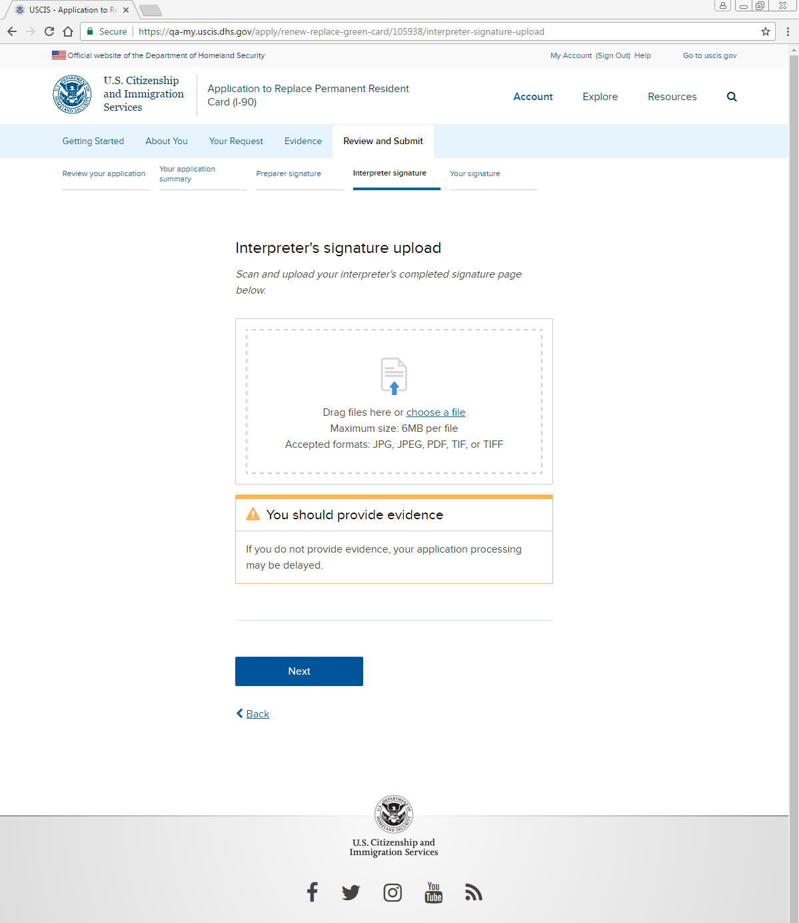
Review and Submit: Interpreter signature: Uploader alert

Slide 49
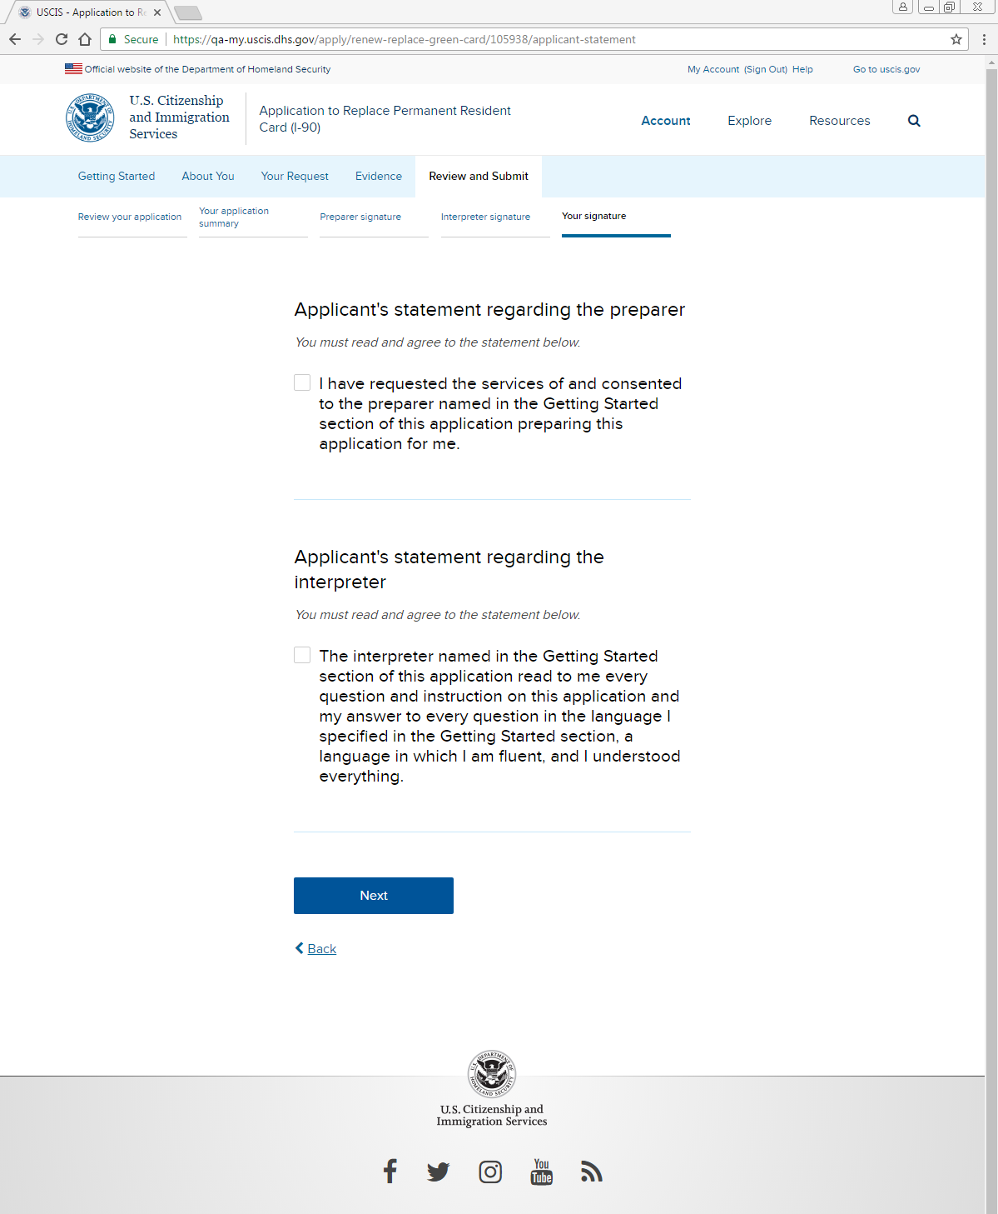
Review and Submit: Your signature: Statements regarding preparer, interpreter

Slide 50
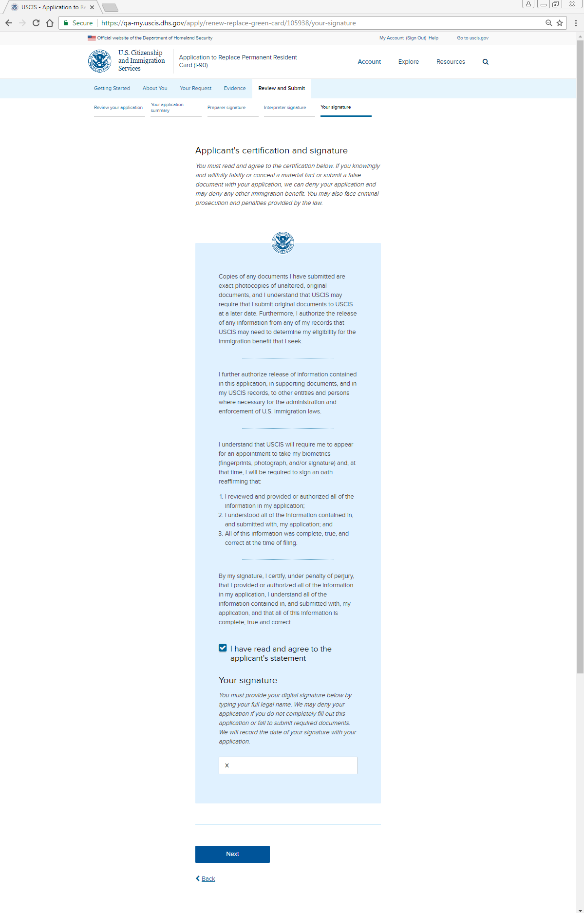
Review and Submit: Your signature: Applicant certification and signature

Slide 51
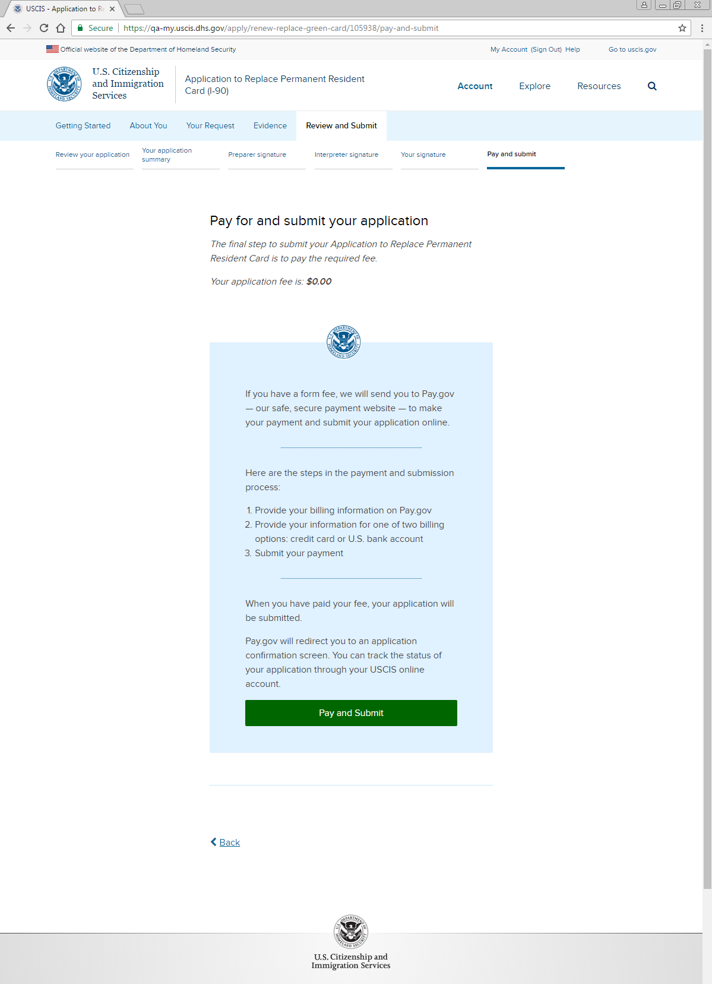
Review and Submit: Pay and Submit

