Slide 1
OMB No. 0910-0497
Expires 10/31/2020
Stylized Text
Postage Stamp
NFL Check
Organic Inspired
Circle Icon
Version A

Slide 2
OMB No. 0910-0497
Expires 10/31/2020
Stylized Text
Postage Stamp
NFL Check
Organic Inspired
Circle Icon
Version B - FDA

Slide 3
OMB No. 0910-0497
Expires 10/31/2020
Stylized Text
Postage Stamp
NFL Check
Organic Inspired
Circle Icon
Version C – Meets FDA

Slide 4
OMB No. 0910-0497
Expires 10/31/2020
Stylized Text
Postage Stamp
NFL Check
Organic Inspired
Circle Icon
Version D – Food groups

Slide 5
OMB No. 0910-0497
Expires 10/31/2020
MyPlate

Slide 6
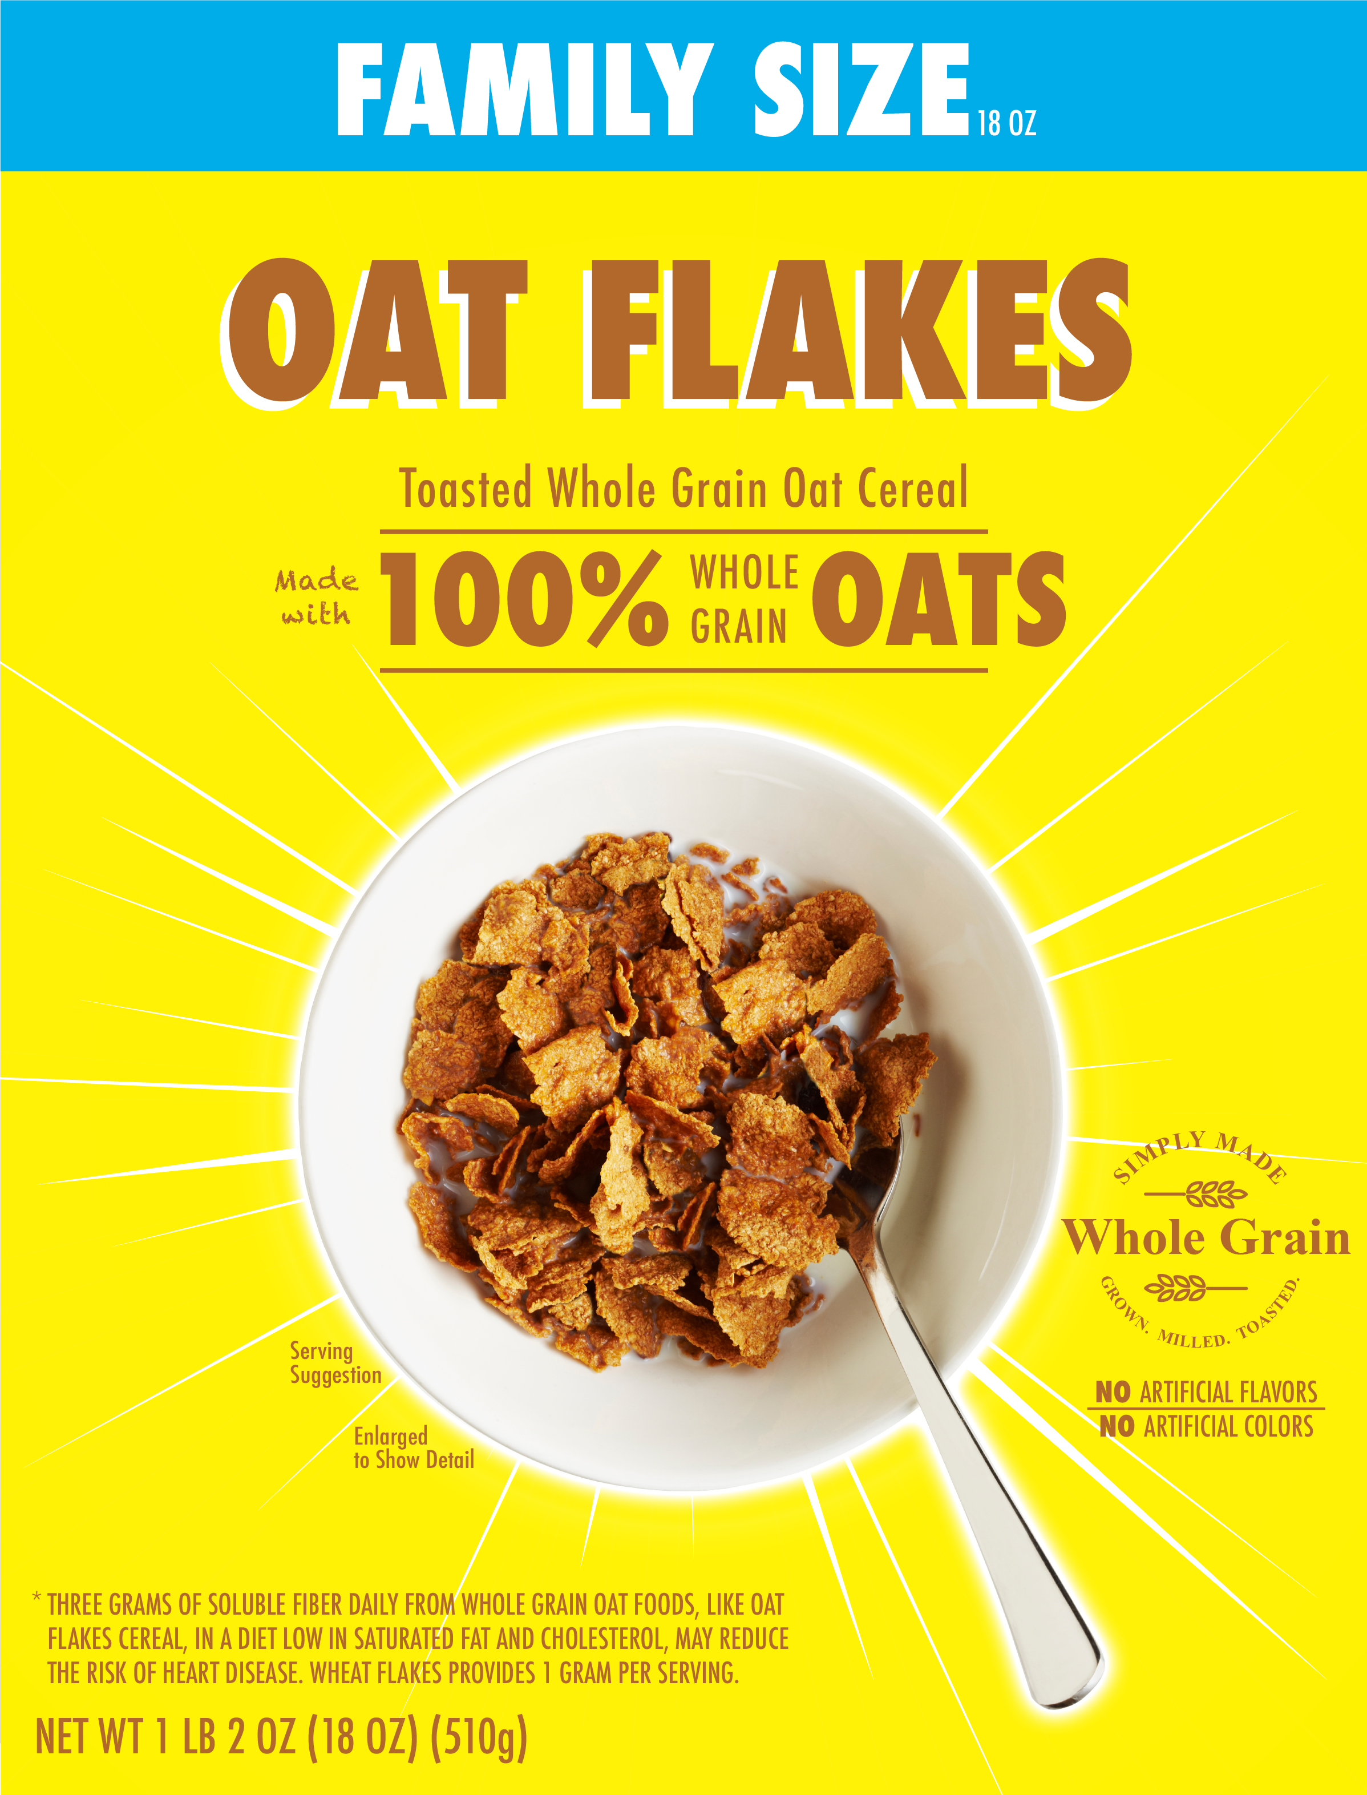
OMB No. 0910-0497
Expires 10/31/2020

Slide 7
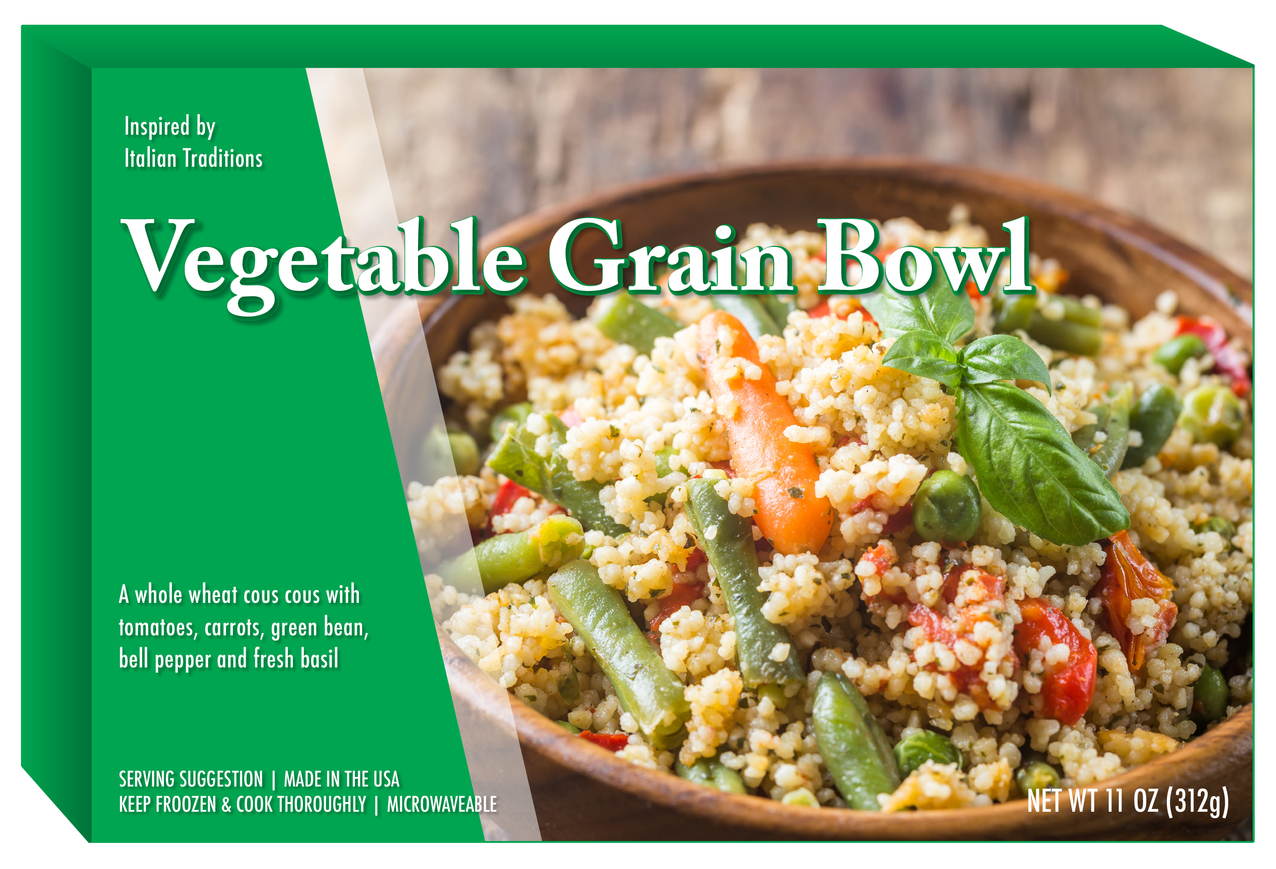
OMB No. 0910-0497
Expires 10/31/2020

Slide 8
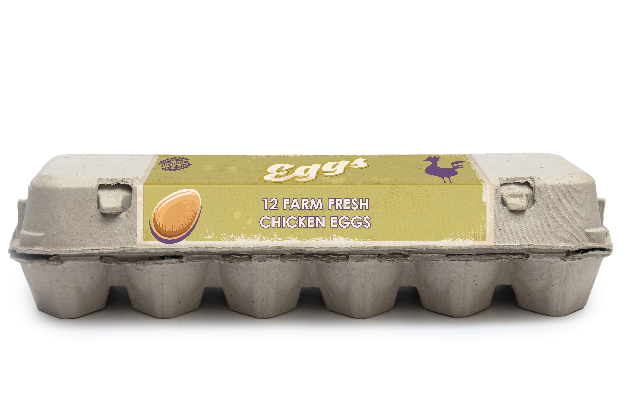
OMB No. 0910-0497
Expires 10/31/2020

