Slide 1
Evaluating a structured reporting template to increase transparency and reduce review time for healthcare database studies

Slide 2
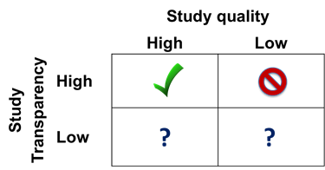
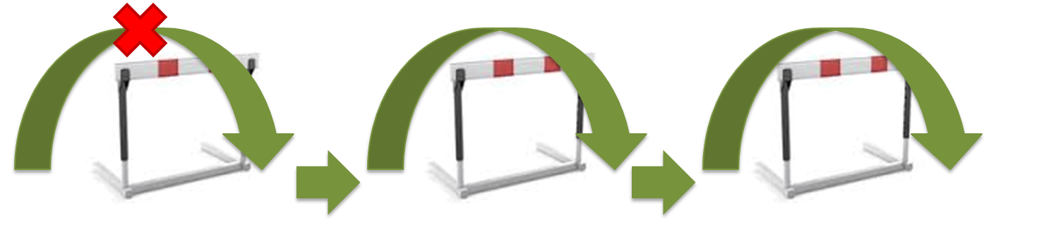
Importance of transparency for RWE from databases
Quality and rigor of database studies are variable…
Broad dismissal of database studies as inferior, less valid
Lack of transparency is an important barrier to use of
‘real world’ evidence from databases for decision making
Without transparency, unable to assess validity/relevance
Transparent & Reproducible
Robust &
Transportable
Decision about Benefit/Harm/Value
Notes:
Want to make a regulatory, reimbursement or other decision about benefit/harm/value
Do we have confidence in the scientific approach and consistency of evidence?
Do we have clarity about how the evidence was generated? Assess validity.

Slide 3

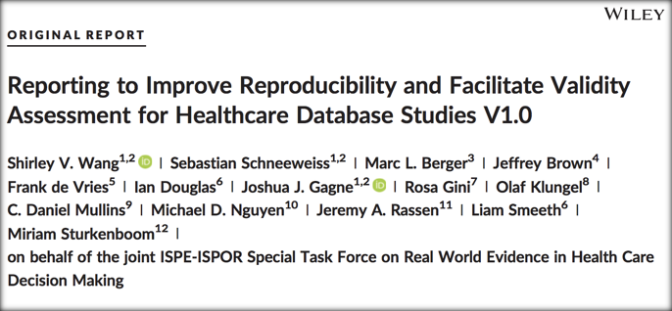
Steps to increase transparency about how RWE is generated
The International Society for Pharmacoeconomics and Outcomes Research (ISPOR)/
International Society for Pharmacoepidemiology (ISPE)
Joint Task Force on Real World Evidence for Healthcare Decision-Making
transparency in process for database studies (e.g. “what did you plan to do?”)
transparency in study execution (e.g. “what did you actually do?)
Notes:
Shirley starts

Slide 4
Steps to increase transparency about how RWE is generated
The International Society for Pharmacoeconomics and Outcomes Research (ISPOR)/
International Society for Pharmacoepidemiology (ISPE)
Joint Task Force on Real World Evidence for Healthcare Decision-Making
transparency in process for database studies (e.g. “what did you plan to do?”)
transparency in study execution (e.g. “what did you actually do?)
Notes:
Shirley starts

Slide 5
Specific reporting to improve transparency and reproducibility and facilitate validity assessment
DATA SOURCE
EXPOSURE DEFINITION
Data provider
Data extraction date (DED)*
Data sampling
Source data range (SDR)*
Type of data
Data linkage, other supplemental data
Data cleaning
Data model conversion
Type of exposure
Exposure risk window (WRW)
Induction period
Stockpiling
Bridging exposure episodes
Exposure extension
Switching/add on z
Codes, frequency and temporality of codes, diagnosis position, care setting
Exposure Assessment Window (EAW)*
DESIGN
Design diagram
FOLLOW UP TIME
Follow-up window (FW)*
Censoring criteria
INCLUSION/EXCLUSION CRITERIA
Study entry date (SED)*
Person or episode level study entry
Sequencing of exclusions
Enrollment window (EW)*
Enrollment gap
Inclusion/Exclusion definition window
Codes
Frequency and temporality of codes
Diagnosis position (if relevant/available)
Care setting
Washout for exposure
Washout for outcome
OUTCOME DEFINITION
Event date (ED)*
Validation
Codes, frequency, and temporality of codes, diagnosis position, care setting
COVARIATE DEFINITIONS
Covariate assessment window (CW)*
Comorbidity/risk score
Healthcare utilization metrics
Codes, frequency, and temporality of codes, diagnosis position, care setting
CONTROL SAMPLING
Sampling strategy
Matching factors
Matching ratio
STATISTICAL SOFTWARE
Statistical software program used
* key temporal anchors

Slide 6

Specific reporting to improve transparency and reproducibility and facilitate validity assessment
DATA SOURCE
EXPOSURE DEFINITION
Data provider
Data extraction date (DED)*
Data sampling
Source data range (SDR)*
Type of data
Data linkage, other supplemental data
Data cleaning
Data model conversion
Type of exposure
Exposure risk window (WRW)
Induction period
Stockpiling
Bridging exposure episodes
Exposure extension
Switching/add on z
Codes, frequency and temporality of codes, diagnosis position, care setting
Exposure Assessment Window (EAW)*
DESIGN
Design diagram
FOLLOW UP TIME
Follow-up window (FW)*
Censoring criteria
INCLUSION/EXCLUSION
CRITERIA
OUTCOME DEFINITION
Event date (ED)*
Validation
Codes, frequency and temporality of codes, diagnosis position, care setting
Study entry date (SED)*
Person or episode level study entry
Sequencing of exclusions
Enrollment window (EW)*
Enrollment gap
Inclusion/Exclusion definition window
Codes
Frequency and temporality of codes
Diagnosis position (if relevant/available)
Care setting
Washout for exposure
Washout for outcome
COVARIATE DEFINITIONS
Covariate assessment window (CW)*
Comorbidity/risk score
Healthcare utilization metrics
Codes, frequency, and temporality of codes, diagnosis position, care setting
CONTROL SAMPLING
Sampling strategy
Matching factors
STATISTICAL SOFTWARE
Matching ratio
Statistical software program used
* key temporal anchors

Slide 7
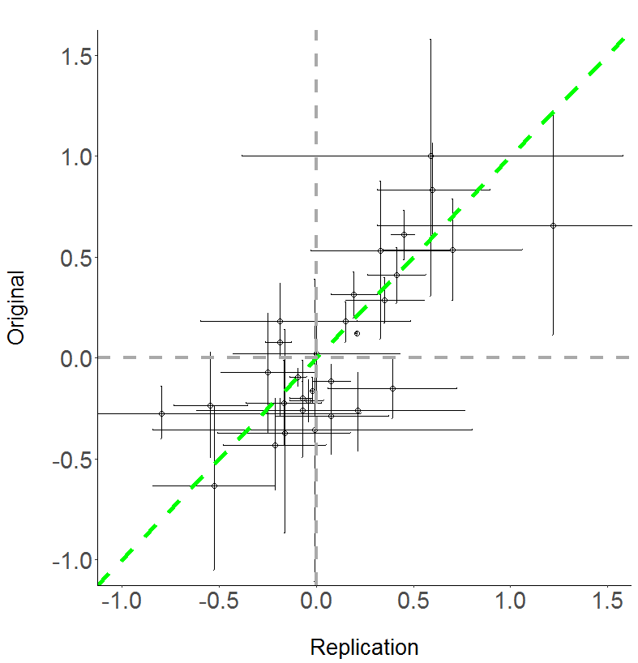
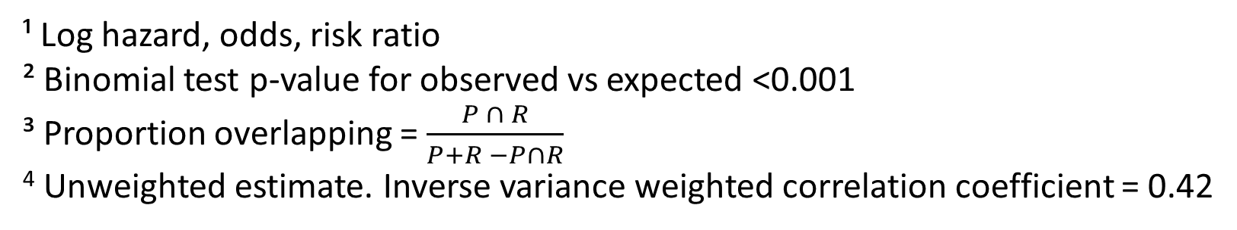
Interim results from large scale replication of peer-reviewed database studies Calibration of effect estimates¹ for publication versus direct replication
Take home points:
Correlation coefficient: 0.62 (moderate)
Point estimate on same side of null and
p-value on same side of 0.05: 54%
Glass half full | Glass half empty
74% of effect estimates on same side of null | 26% of effect estimates on opposite side of null
88% of CI had any overlap² | 12% of CI had no overlap²
If CI overlapped, 40% of CI range was shared³ | If CI overlapped, 60% of CI range was not shared³
Original
Replication
¹ Log hazard, odds, risk ratio
² Binomial test p-value for observed vs expected <0.001
³ Proportion overlapping = $\frac{P ∩ R}{P+R −P∩R}$
⁴ Unweighted estimate. Inverse variance weighted correlation coefficient = 0.42

Slide 8
Go to structured template

Slide 9
Example from JAMA Internal Medicine
Abstract:
We identified participants as those newly diagnosed as having atrial fibrillation (AF) from October 1, 2010, through October 31, 2011, and who initiated dabigatran or warfarin treatment within 60 days of initial diagnosis.
Methods:
We identified patients who were newly diagnosed as having AF from October 1, 2010, through October 31, 2011, by using the CMS Chronic Condition Warehouse indicator that traced the first diagnosis date back to January 1, 1999. The diagnosis of AF was defined as having 1 inpatient or 2 outpatient claims with primary or secondary International Classification of Diseases, Ninth Revision (ICD-9), code 427.31. We also required that individuals in our study sample had filled an outpatient prescription for either dabigatran or warfarin within 2 months of the first diagnosis (N = 9562). Those who filled prescriptions for dabigatran and warfarin during the first 2 months after diagnosis were excluded (N = 158). We followed up each individual from the first prescription of dabigatran or warfarin until discontinuation of use for more than 60 days, switch of anticoagulants, death, or December 31, 2011. Our final overall study sample included 1,302 dabigatran users and 8,102 warfarin users.
No attrition table or design diagram was provided.

Slide 10
Example from JAMA Internal Medicine
New Atrial Fibrillation Diagnosis
“We identified patients who were newly diagnosed as having AF from October 1, 2010, through October 31, 2011”
Time

Slide 11
Example from JAMA Internal Medicine
New Atrial Fibrillation Diagnosis
Cohort Entry Date
First Rx for dabigatran or warfarin
Day 0*
INCL1
(Rx within 60 days)
[-60, 0]
“We required… an outpatient prescription for either dabigatran or warfarin within 2 months of the first [atrial fibrillation] diagnosis.”
Time

Slide 12
Example from JAMA Internal Medicine
New Atrial Fibrillation Diagnosis
Cohort Entry Date
First Rx for dabigatran or warfarin
Day 0*
New Atrial Fibrillation Diagnosis
INCL1
(Rx within 60 days)
[-60, 0]
“We required… an outpatient prescription for either dabigatran or warfarin within 2 months of the first [atrial fibrillation] diagnosis.”
INCL1
(Rx within 60 days)
[0, 60]
INCL1
(Rx within 60 days)
[60, 60]
Time

Slide 13
Example from JAMA Internal Medicine
New Atrial Fibrillation Diagnosis
Cohort Entry Date
First Rx for dabigatran or warfarin
Day 0*
INCL1
(Rx within 60 days)
[-60, 0]
EXCL1
Dispensing of both dabigatran AND warfarin
Days [AF Dx, AF Dx + 60]
“Those who filled prescriptions for dabigatran and warfarin during the first 2 months after diagnosis were excluded.”
Time

Slide 14
Example from JAMA Internal Medicine
New Atrial Fibrillationª Diagnosis
Cohort Entry Date
First Rx for dabigatran or warfarin
Day 0*
INCL1
(Rx within 60 days)
[-60, 0]
EXCL1
Dispensing of both dabigatran AND warfarin
Days [AF Dx, AF Dx + 60]
Covariate Assessment Window
(Age, sex, race, Medicaid eligibility)
Days [0, 0]
“We defined the use of NSAIDs as having at least one prescription for [NSAIDs] after treatment initiation. Use of antiplatelet agents was defined as having at least one pharmacy claim … after treatment initiation.”
Covariate Assessment Window
(Baseline conditions^{b})
Days [-365, -1]
Covariate Assessment Window
(NSAIDs, antiplatelets)
Days [1, ?]
Follow-up Window
Days [0, Censor^{d}]
Follow up Window
Days [0, Censor^{c}]
Time
Atrial Fibrillation (AF) was defined as having 1 inpatient or 2 outpatient claims with primary or secondary diagnosis position of ICD-9 code 427.31.
Baseline conditions included: Metastatic cancer, CHADS2 score, Chronic kidney disease, Hypertension, Previous stroke or TIA, Acute MI, Diabetes, Congestive heart failure, Acquired hypothyroidism, History of bleeding, History of hospitalization, # of CMS priority comorbidities categorical, Use of NSAIDs, and Use of antiplatelets.
Earliest of: discontinuation of initial drug, switching of study drugs, death, end of study period (12/31/11), disenrollment.

Slide 15
Example from JAMA Internal Medicine
New Atrial Fibrillationª Diagnosis
Cohort Entry Date
First Rx for dabigatran or warfarin
Day 0*
Notice anything missing?
INCL1
(Rx within 60 days)
[-60, 0]
EXCL1
Dispensing of both dabigatran AND warfarin
Days [AF Dx, AF Dx + 60]
Covariate Assessment Window
(Age, sex, race, Medicaid eligibility)
Days [0, 0]
“We defined the use of NSAIDs as having at least one prescription for [NSAIDs] after treatment initiation. Use of antiplatelet agents was defined as having at least one pharmacy claim … after treatment initiation.”
Covariate Assessment Window
(Baseline conditions^{b})
Days [-365, -1]
Covariate Assessment Window
(NSAIDs, antiplatelets)
Days [1, ?]
Follow-up Window
Days [0, Censor^{d}]
Follow up Window
Days [0, Censor^{c}]
Time
Atrial Fibrillation (AF) was defined as having 1 inpatient or 2 outpatient claims with primary or secondary diagnosis position of ICD-9 code 427.31.
Baseline conditions included: Metastatic cancer, CHADS2 score, Chronic kidney disease, Hypertension, Previous stroke or TIA, Acute MI, Diabetes, Congestive heart failure, Acquired hypothyroidism, History of bleeding, History of hospitalization, # of CMS priority comorbidities categorical, Use of NSAIDs, and Use of antiplatelets.
Earliest of: discontinuation of initial drug, switching of study drugs, death, end of study period (12/31/11), disenrollment.

Slide 16
Example from JAMA Internal Medicine
New Atrial Fibrillationª Diagnosis
Cohort Entry Date
First Rx for dabigatran or warfarin
Day 0*
Notice anything missing?
Prior enrollment requirement?
Washout for new use?
INCL1
(Rx within 60 days)
[-60, 0]
EXCL1
Dispensing of both dabigatran AND warfarin
Days [AF Dx, AF Dx + 60]
Covariate Assessment Window
(Age, sex, race, Medicaid eligibility)
Days [0, 0]
“We defined the use of NSAIDs as having at least one prescription for [NSAIDs] after treatment initiation. Use of antiplatelet agents was defined as having at least one pharmacy claim … after treatment initiation.”
Covariate Assessment Window
(Baseline conditions^{b})
Days [-365, -1]
Covariate Assessment Window
(NSAIDs, antiplatelets)
Days [1, ?]
Follow-up Window
Days [0, Censor^{d}]
Follow up Window
Days [0, Censor^{c}]
Time
Atrial Fibrillation (AF) was defined as having 1 inpatient or 2 outpatient claims with primary or secondary diagnosis position of ICD-9 code 427.31.
Baseline conditions included: Metastatic cancer, CHADS2 score, Chronic kidney disease, Hypertension, Previous stroke or TIA, Acute MI, Diabetes, Congestive heart failure, Acquired hypothyroidism, History of bleeding, History of hospitalization, # of CMS priority comorbidities categorical, Use of NSAIDs, and Use of antiplatelets.
Earliest of: discontinuation of initial drug, switching of study drugs, death, end of study period (12/31/11), disenrollment.

Slide 17
Example from JAMA Internal Medicine

Slide 18
Discussion Questions
Impressions
1) What did you think about the template and user guide, overall?
2) How does this differ or converge with you or your organization’s typical process, with respect to technical/statistical analysis protocols and public reporting of methods for a study?
3) How would you describe the clarity and usability of the template?
4) Would you anticipate any benefits of developing study protocols or reporting on study implementation using such a template?
5) What are the main challenges you would foresee in using this template as a researcher or a reviewer?
6) Based on the challenges described earlier, how could this template be improved to better fit your use cases?
7) How likely would it be for you to use or recommend using the template to others in the future?
8) What strategies would you suggest to widely educate and encourage adoption of use of a structured protocol and reporting template?
Challenges
Suggestions
Adoption

