Slide 1
SAC Visitor Request Form
&
Foreign National Vetting Request

Slide 2
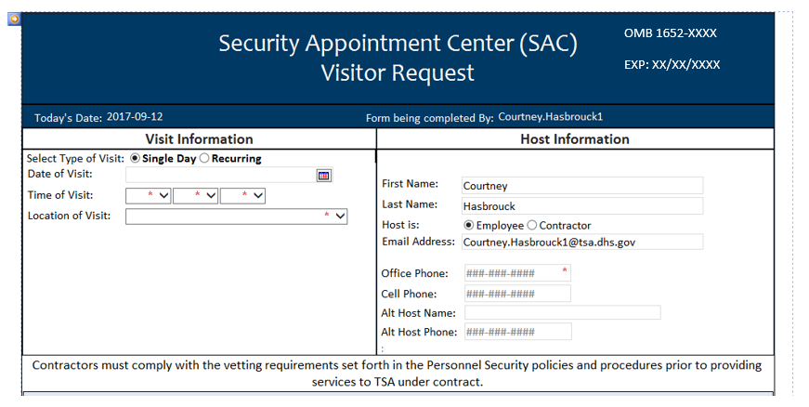

Slide 3
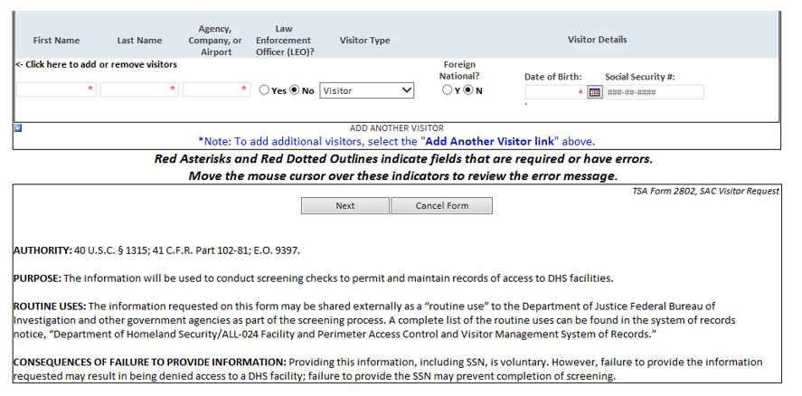
Voluntary
§
Consequences of Failure to Provide Information

Slide 4
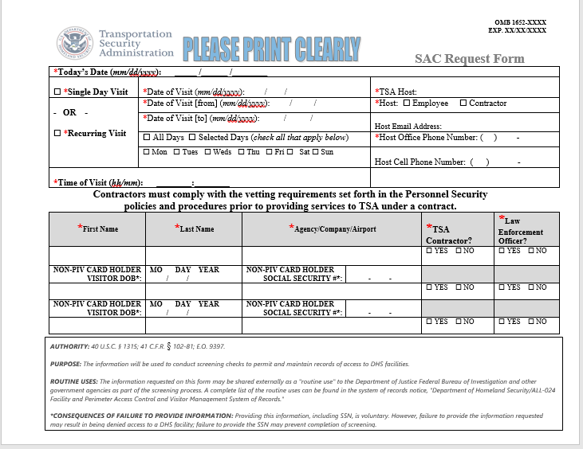

Slide 5
Privacy Act Statement:
AUTHORITY: 40 U.S.C. § 1315; 41 C.F.R. §102-81; E.O. 9397.
PURPOSE: The information will be used to conduct
screening checks to permit and maintain records of
access to DHS facilities.
ROUTINE USES: The information requested on this
form may be shared externally as a "routine use" to
the Department of Justice Federal Bureau of
Investigation and other government agencies as part
of the screening process. A complete list of the routine
uses can be found in the system of records notice,
"Department of Homeland Security/ALL-024 Facility
and Perimeter Access Control and Visitor
Management System of Records."
CONSEQUENCES OF FAILURE TO PROVIDE
INFORMATION: Providing this information, including
SSN, is voluntary. However, failure to provide the
information requested may result in being denied
access to a DHS facility; failure to provide the SSN may
prevent completion of screening.

Slide 6
Paperwork Reduction Act Statement: Through this voluntary information collection, TSA is gathering information to facilitate your request for access to TSA facilities. It is estimated that the total average burden per response associated with this collection is approximately 0.01667 hours. An agency may not conduct or sponsor, and a person is not required to respond to, a collection of information unless it displays a valid OMB control number. The control number assigned to this collection is OMB 1652-xxxx, which expires XX/XX/XXXX. Send comments regarding this burden estimate or any other aspect of this collection of information including suggestions for reducing this burden to TSA PRA Officer, 601 S. 12th Street, Arlington, VA 20598-6011. ATTN: PRA 1652-xxxx.

Slide 7
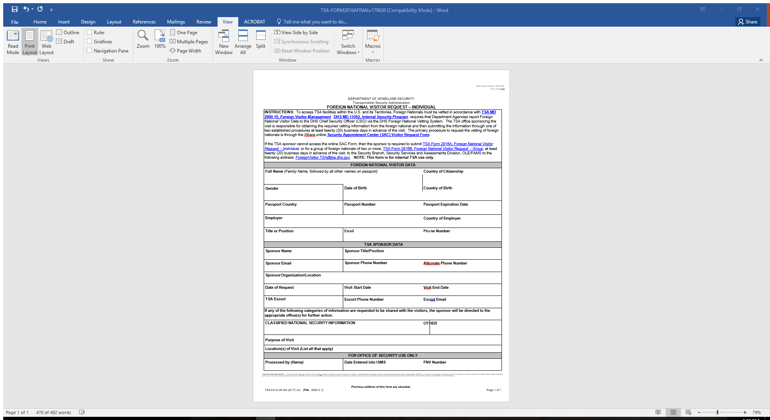

Slide 8
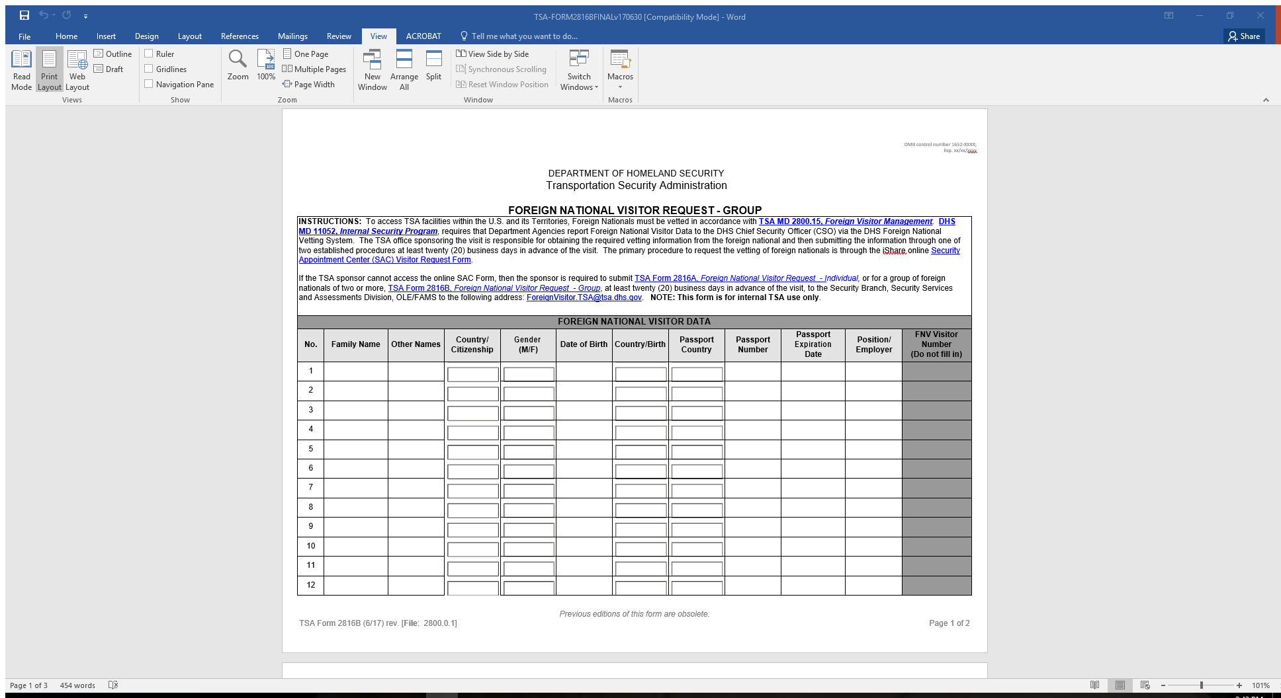

Slide 9
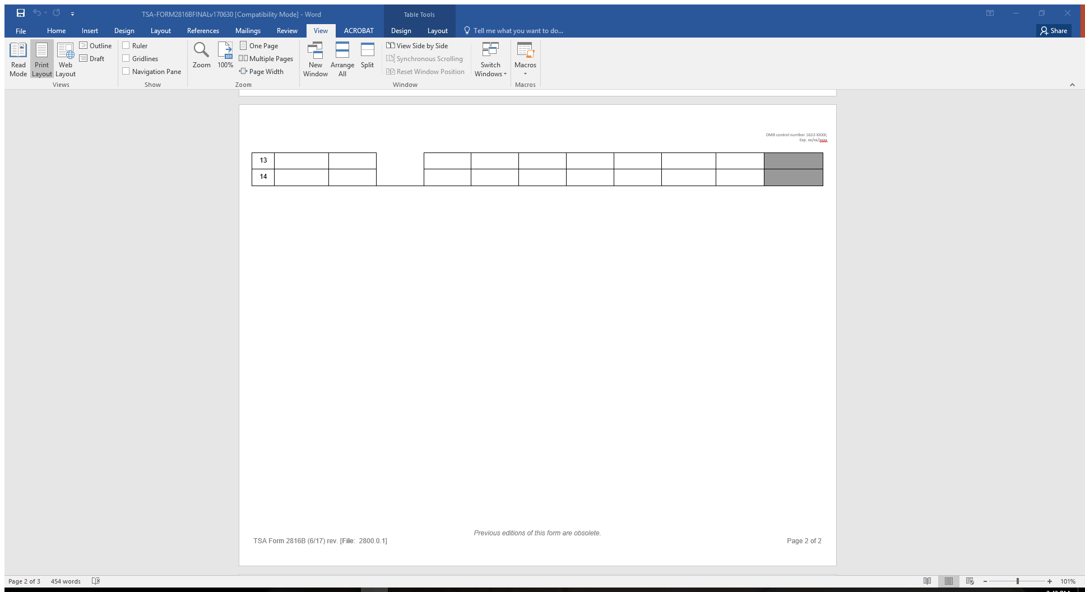

Slide 10
