Slide 1
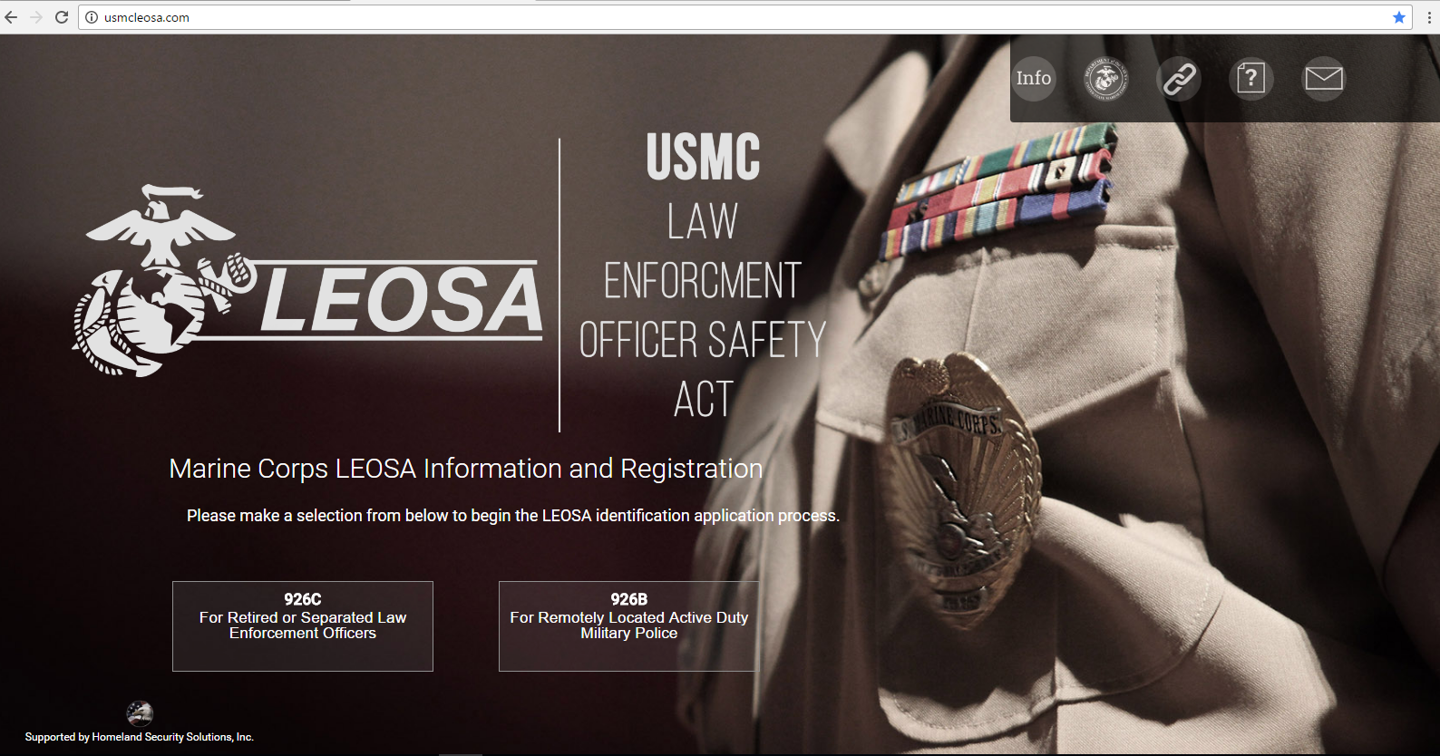
LEOSA Application Process
FINAL
Overall Classification of this brief is: UNCLASSIFIED//FOUO

Slide 2
926C Website Process: Step 1.
Click on 926C button (for retired/separated applicants)

Slide 3
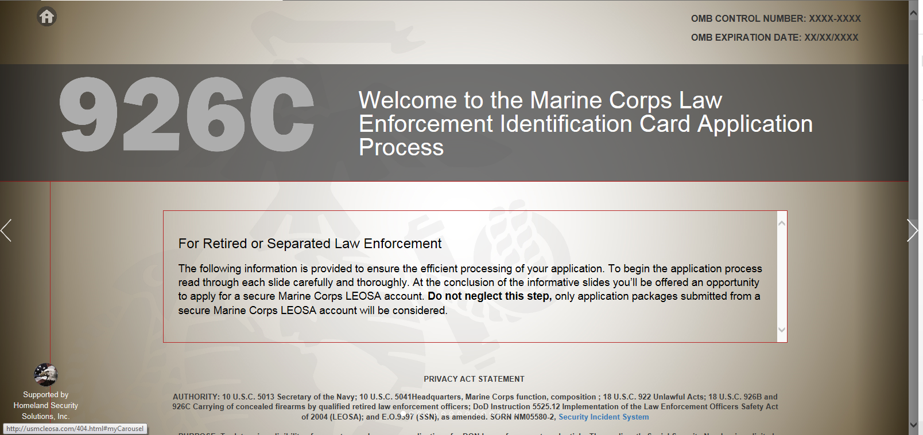
Step 2
Click arrow to proceed to next page

Slide 4
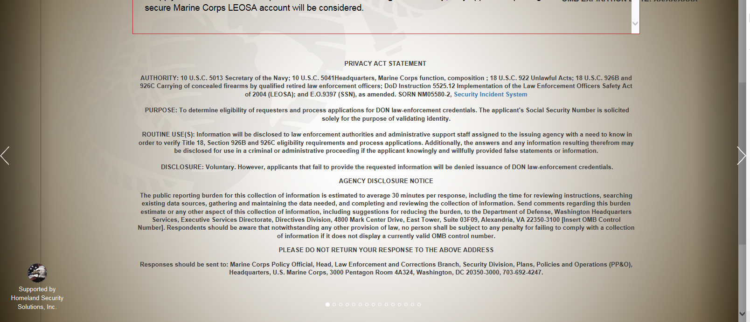
Step 2 continued
Click arrow to proceed to next page

Slide 5
Step 3
Click arrow to proceed to next page

Slide 6
Step 4
Click arrow to proceed to next page

Slide 7
Step 5
Click arrow to proceed to next page

Slide 8
Step 6
Click arrow to proceed to next page

Slide 9
Step 7
Click arrow to proceed to next page

Slide 10
Step 8
Click arrow to proceed to next page

Slide 11
Step 9
Click arrow to proceed to next page

Slide 12
Step 10
Click arrow to proceed to next page

Slide 13
Step 11
Click arrow to proceed to next page

Slide 14
Step 12
Click arrow to proceed to next page

Slide 15
Step 13
Click arrow to proceed to next page

Slide 16
Step 14
Click arrow to proceed to next page

Slide 17
Step 15
Click button to begin application process

Slide 18
Step 16
Fill in requested fields
Click “Submit” button after filling in requested information to proceed to next page

Slide 19
Final online page
Applicant will receive a email to the provided email address for secure access

Slide 20
Application Process: Step 1
Applicant will receive the above email for secure access
Read email and follow instructions
Click on link provided

Slide 21
Step 2
joe.marine@gmail.com
Applicant will be redirected to the above secure access registration page

Slide 22
Step 3
joe.marine@gmail.com
Fill in requested fields
Click “Register” after completing requested fields
Applicant will be rerouted to secure inbox

Slide 23
Step 4
Applicant will receive the above message in their secure inbox

Slide 24
Step 5
Applicant will receive the above second message in their secure inbox with documents to complete and instructions.
Click on LEOSA Application
Notes:
Welcome to the Marine Corps Law Enforcement Officers Safety Act (LEOSA) Application process. By establishing this account you’ll be able to communicate with the Marine Corps’ LEOSA project management team as we guide you through the remainder of the 926C Identification card application process.
Before we begin, the account that you have established is specifically designed to support qualified retired or separated Marine Corps Military Police (MP) and civilian police officers. If you are currently an active duty MP or civilian police officer assigned to a Provost Marshal Office, Marine Corps Police Department or Law Enforcement Battalion please refer to your chain of command for credentialing support. If you are an active duty MP or civilian police officer currently not assigned to an MP unit/command please let us know so we can direct you to the appropriate application area.
Application Requirements. Prior to issuing a LEOSA 926C identification card we must validate that the applicant meets the Title 18 U.S.C, Section 926C definition of qualified retired/separated law enforcement officer. To accomplish this you’ll be required to complete several forms, as well as provide personal documents to validate your identity, criminal history, and law enforcement experience. All required application forms are included in Attachment 1 “926C Application” and Attachment 2 “926C Certificate of Eligibility.” Attachment 3 “926C Application Instructions” provides clarifying guidance on the remaining application requirements.
Submission. To ensure prompt, efficient service we encourage applicants to complete application packages electronically and submit them via the secure Marine Corps LEOSA email account that you’ve just established. Hard copy application packages are accepted; however, they may result in processing delays. Only complete application packages will be processed; so please be sure to thoroughly review your package and all related instructions prior to submission.
Information Security. All transfers of information shall occur through secure encrypted email to ensure personal information is properly safeguarded.
Assistance. For the fastest response please direct all questions/concerns to the LEOSA Project Management Team using your LEOSA email account.
Thank you,
LEOSA Project Manager

Slide 25
Step 6 LEOSA Application
Completely fill in requested fields

Slide 26
Step 7
Click on Certificate of Eligibility
Notes:
Welcome to the Marine Corps Law Enforcement Officers Safety Act (LEOSA) Application process. By establishing this account you’ll be able to communicate with the Marine Corps’ LEOSA project management team as we guide you through the remainder of the 926C Identification card application process.
Before we begin, the account that you have established is specifically designed to support qualified retired or separated Marine Corps Military Police (MP) and civilian police officers. If you are currently an active duty MP or civilian police officer assigned to a Provost Marshal Office, Marine Corps Police Department or Law Enforcement Battalion please refer to your chain of command for credentialing support. If you are an active duty MP or civilian police officer currently not assigned to an MP unit/command please let us know so we can direct you to the appropriate application area.
Application Requirements. Prior to issuing a LEOSA 926C identification card we must validate that the applicant meets the Title 18 U.S.C, Section 926C definition of qualified retired/separated law enforcement officer. To accomplish this you’ll be required to complete several forms, as well as provide personal documents to validate your identity, criminal history, and law enforcement experience. All required application forms are included in Attachment 1 “926C Application” and Attachment 2 “926C Certificate of Eligibility.” Attachment 3 “926C Application Instructions” provides clarifying guidance on the remaining application requirements.
Submission. To ensure prompt, efficient service we encourage applicants to complete application packages electronically and submit them via the secure Marine Corps LEOSA email account that you’ve just established. Hard copy application packages are accepted; however, they may result in processing delays. Only complete application packages will be processed; so please be sure to thoroughly review your package and all related instructions prior to submission.
Information Security. All transfers of information shall occur through secure encrypted email to ensure personal information is properly safeguarded.
Assistance. For the fastest response please direct all questions/concerns to the LEOSA Project Management Team using your LEOSA email account.
Thank you,
LEOSA Project Manager

Slide 27
Step 8 Certificate of Eligibility
Read, initial, print name, sign, and date in requested fields

Slide 28
Step 9
Click on Marine Corps LEOSA 926C Checklist
Notes:
Welcome to the Marine Corps Law Enforcement Officers Safety Act (LEOSA) Application process. By establishing this account you’ll be able to communicate with the Marine Corps’ LEOSA project management team as we guide you through the remainder of the 926C Identification card application process.
Before we begin, the account that you have established is specifically designed to support qualified retired or separated Marine Corps Military Police (MP) and civilian police officers. If you are currently an active duty MP or civilian police officer assigned to a Provost Marshal Office, Marine Corps Police Department or Law Enforcement Battalion please refer to your chain of command for credentialing support. If you are an active duty MP or civilian police officer currently not assigned to an MP unit/command please let us know so we can direct you to the appropriate application area.
Application Requirements. Prior to issuing a LEOSA 926C identification card we must validate that the applicant meets the Title 18 U.S.C, Section 926C definition of qualified retired/separated law enforcement officer. To accomplish this you’ll be required to complete several forms, as well as provide personal documents to validate your identity, criminal history, and law enforcement experience. All required application forms are included in Attachment 1 “926C Application” and Attachment 2 “926C Certificate of Eligibility.” Attachment 3 “926C Application Instructions” provides clarifying guidance on the remaining application requirements.
Submission. To ensure prompt, efficient service we encourage applicants to complete application packages electronically and submit them via the secure Marine Corps LEOSA email account that you’ve just established. Hard copy application packages are accepted; however, they may result in processing delays. Only complete application packages will be processed; so please be sure to thoroughly review your package and all related instructions prior to submission.
Information Security. All transfers of information shall occur through secure encrypted email to ensure personal information is properly safeguarded.
Assistance. For the fastest response please direct all questions/concerns to the LEOSA Project Management Team using your LEOSA email account.
Thank you,
LEOSA Project Manager

Slide 29
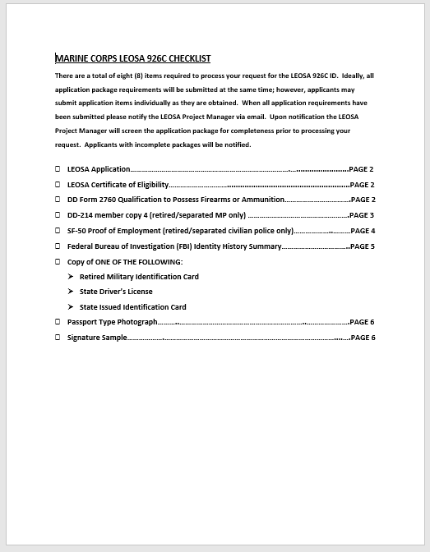
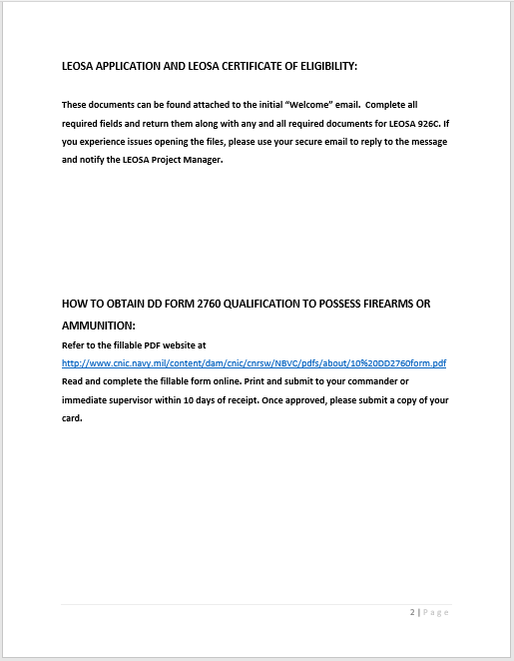
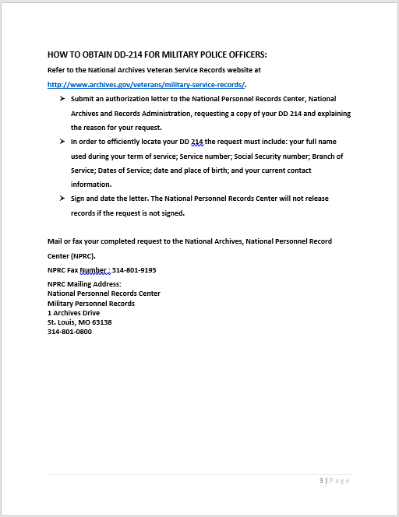
Step 10 Checklist
Checklist provides a detail list of required documents and where applicants can obtain documents
Instructions for how to obtain documents are provided on the checklist
Addresses and contact numbers for obtaining documents are provided on the checklist

Slide 30
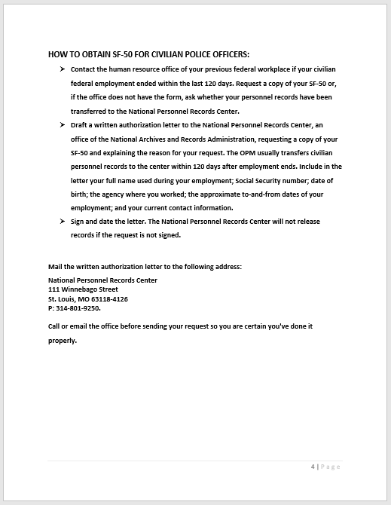
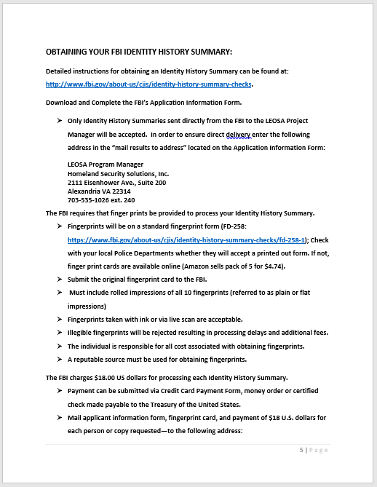
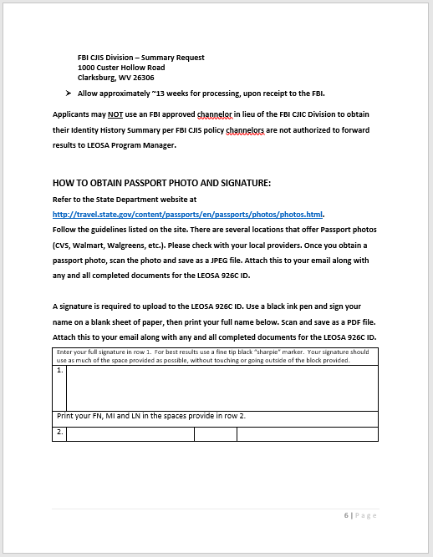
Step 10 Checklist continued
Checklist provides a detail list of required documents and where applicants can obtain documents
Instructions for how to obtain documents are provided on the checklist
Addresses and contact numbers for obtaining documents are provided on the checklist

Slide 31
Step 11 Package Submission
Applicant will send a message from their secure inbox with attached documents for review and approval

Slide 32
Step 12 Receipt of Package
Applicant will receive receipt of package in their secure inbox

Slide 33
Step 13 Status Notification
Applicant will receive notification of the status of their LEOSA 926C application package in their secure inbox
Notification will indicate if the package has been approved or disapproved
If package is approved applicant will be notified that credentials are being mailed
If package is disapproved applicant will be informed as to the reasons why

Slide 34
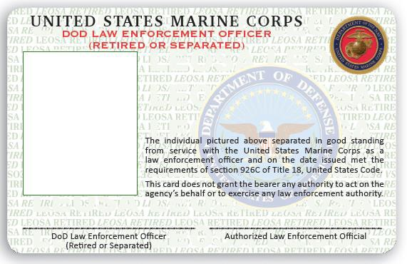
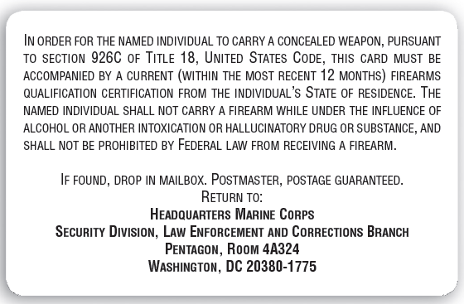
Example 926C Credential
Front
Back
EXAMPLE
EXAMPLE

Slide 35
Application Process Questions
Click button for questions regarding application process
Applicant will be redirected to another page

Slide 36
Step 1
Applicant will be redirected to the above program contact page on the website

Slide 37
Step 2
Fill in requested fields
Click “Send email” after completing requested fields
Applicant will be rerouted to next website page

Slide 38
Final online page
Applicant will receive a email to the provided email address for secure access

Slide 39
Application Question: Step 1
Applicant will receive the above email for secure access
Read email and follow instructions
Click on link provided

Slide 40
Step 2
joe.marine@gmail.com
Applicant will be redirected to the above secure access registration page

Slide 41
Step 3
joe.marine@gmail.com
Fill in requested fields
Click “Register” after completing requested fields
Applicant will be rerouted to secure inbox

Slide 42
Step 4
Applicant will receive the above message in their secure inbox

Slide 43
Step 5
Applicant will receive a reply to question in their secure inbox

