Slide 1
Self Service – Visit Creation

Slide 2
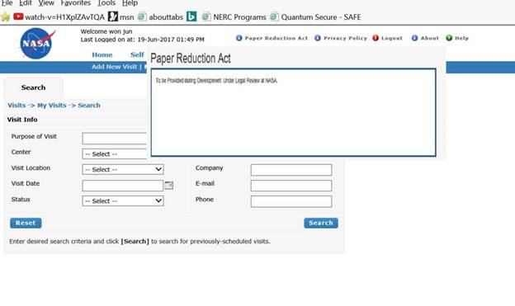
PRA Link pop-up
Paperwork Reduction Act
This information collection meets the requirements of 44 U.S.C. § 3507, as amended by section 2 of the Paperwork Reduction Act of 1995. You do not need to answer these questions unless we display a valid Office of Management and Budget (OMB) control number. The OMB control number for this collection is 2700-XXXX and expires on dd/mm/yyyy. We estimate that it will take five (5) minutes to read the instructions, gather the facts, and answer the questions. Send only comments regarding the time estimate to: james.p.nicholas@nasa.gov

Slide 3
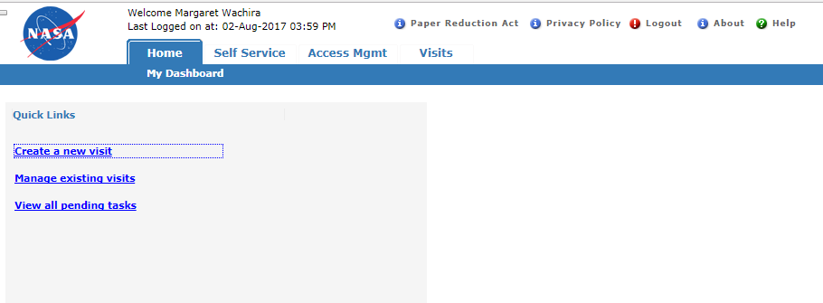
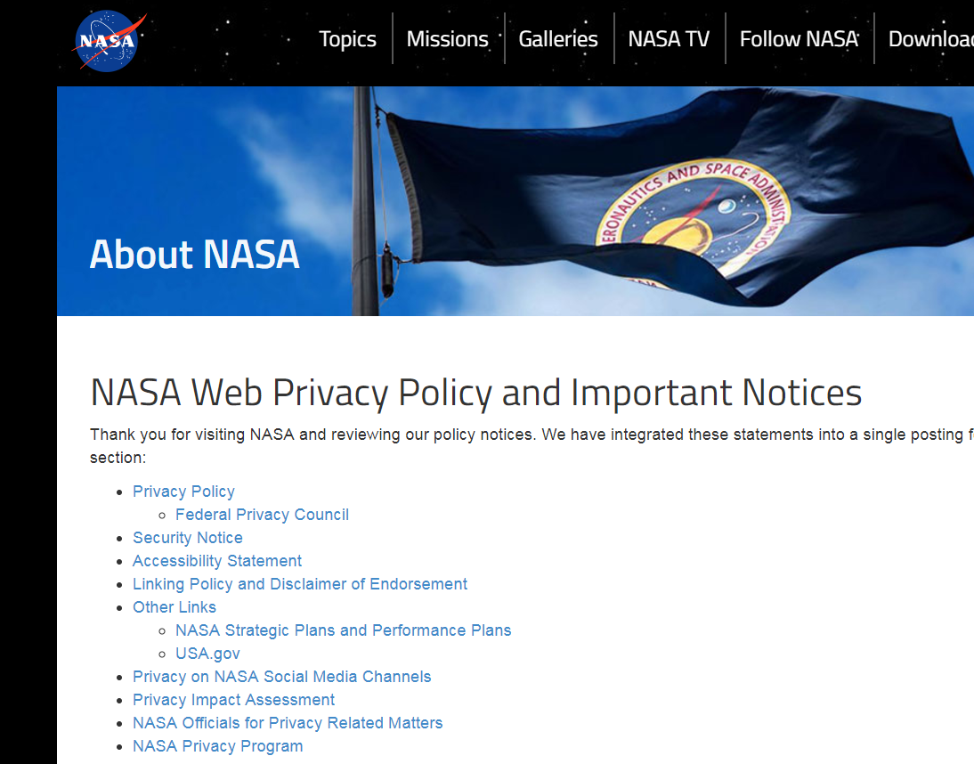
Privacy Policy link

Slide 4
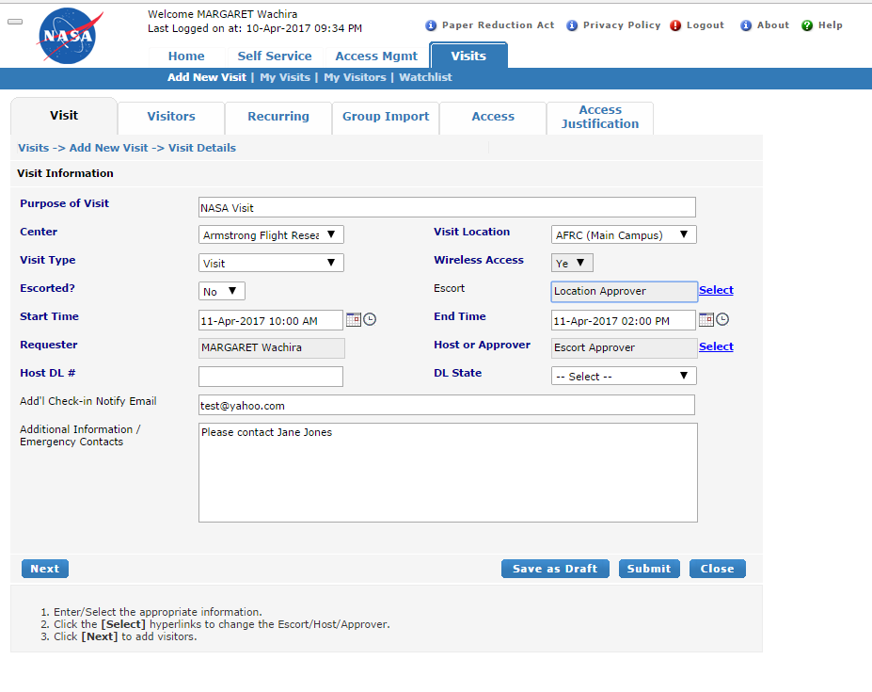
Visit Tab
Requestor creates the visit
Drop down information
  Visit Location
    See back-up slides
  Center
    See back-up slides
  Visit Type
    Visit
    Special Event
  Escorted
    No
    Yes
  Wireless Access
    Yes – Default
  Host DL# and DL State
    AFRC Only

Slide 5
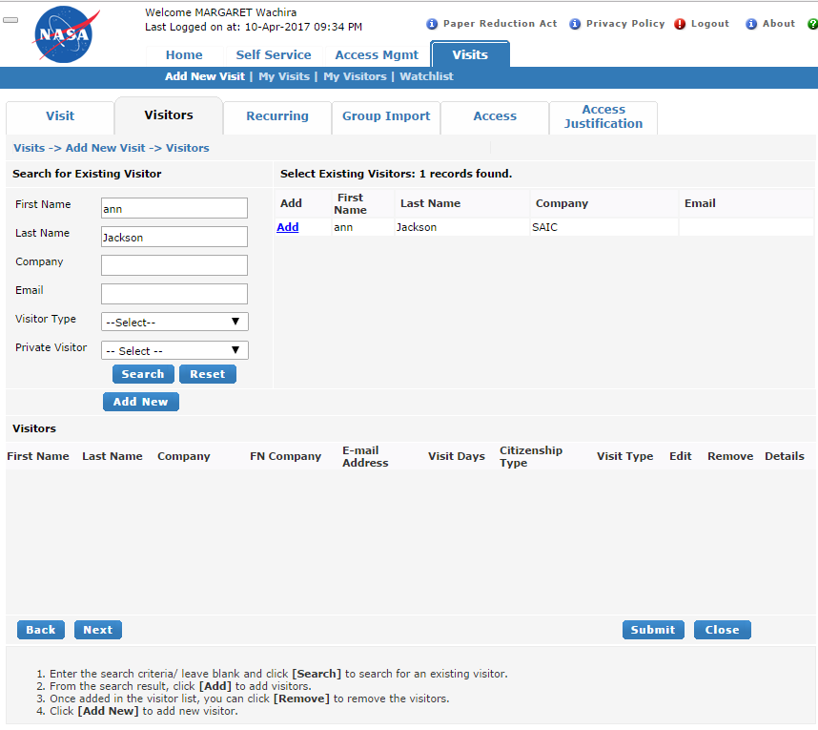
Existing Visitor Search
Requester searches for existing visitors to add to visit
  Visitor Type
    Visitor
    Students
    Minor
    Construction
    Day Construction
    Delivery – Vendor
    Support
    Retiree
    Retired Alumni
    Former Astronaut
    Suspended Driver
    Limited Access
    Employee
  Private Visitor
    Yes
    No

Slide 6
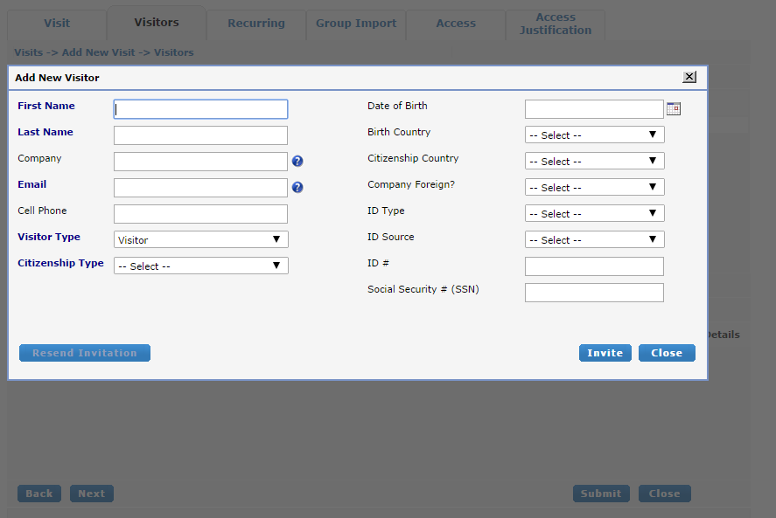
New Visitor Search
If Visitor does not exist, the Requestor adds a new visitor to the system
Required fields: Last Name, First Name, Email, Citizenship Type, Visitor Type.
A link is then sent to the visitor to complete the rest of their information
Visitor Type
  Visitor
  Students
  Minor
  Construction
  Day Construction
  Delivery – Vendor
  Support
  Retiree
  Retired Alumni
  Former Astronaut
  Suspended Driver
  Limited Access
  Employee
Citizenship Type
  U.S. Citizen
  Non-U.S. Citizen (If selected, Requestor is notified that FN cannot currently be entered through this system)
  Lawful Permanent Resident

Slide 7
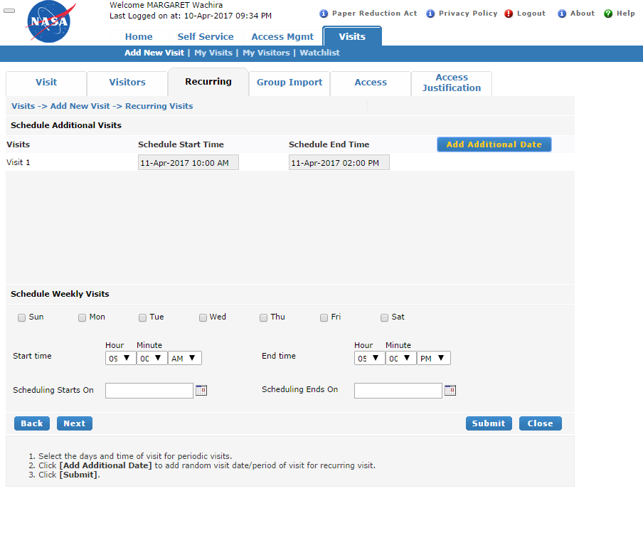
Recurring visit tab

Slide 8
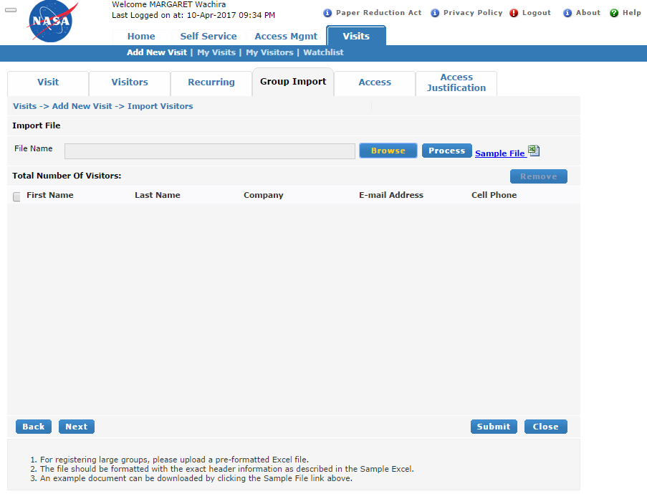
Group Import tab

Slide 9
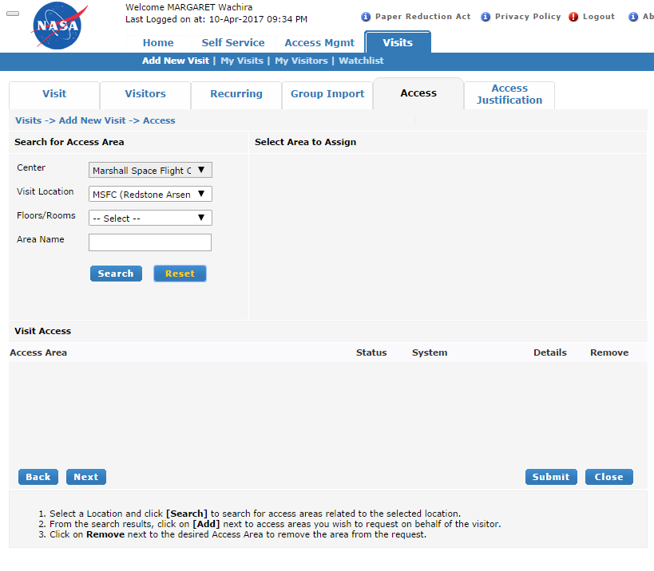
Access tab

Slide 10
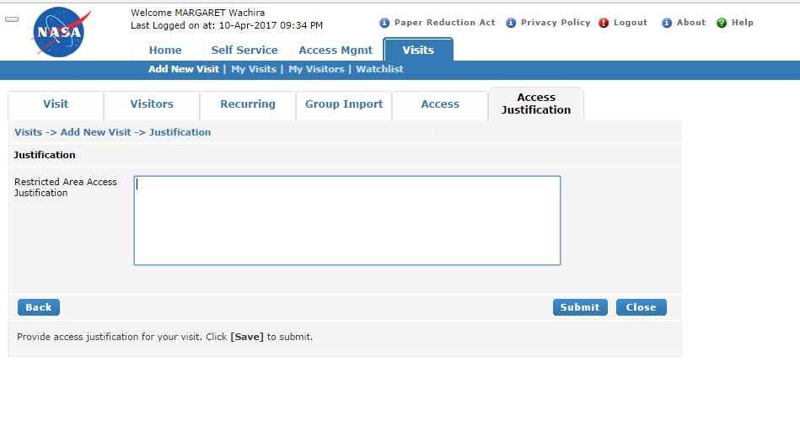
Access Justification tab

Slide 11
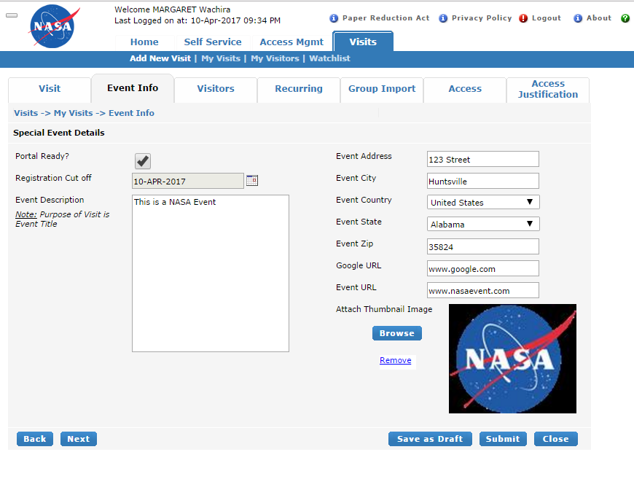
Events tab
Special Events Coordinator creates an event
  Fields
    Event Registration Cut off
    Event description
    Event Address
    Event City
    Country
    Google URL
    Event URL
    Attach Event Email
    Event photo

Slide 12
Special Events Portal

Slide 13
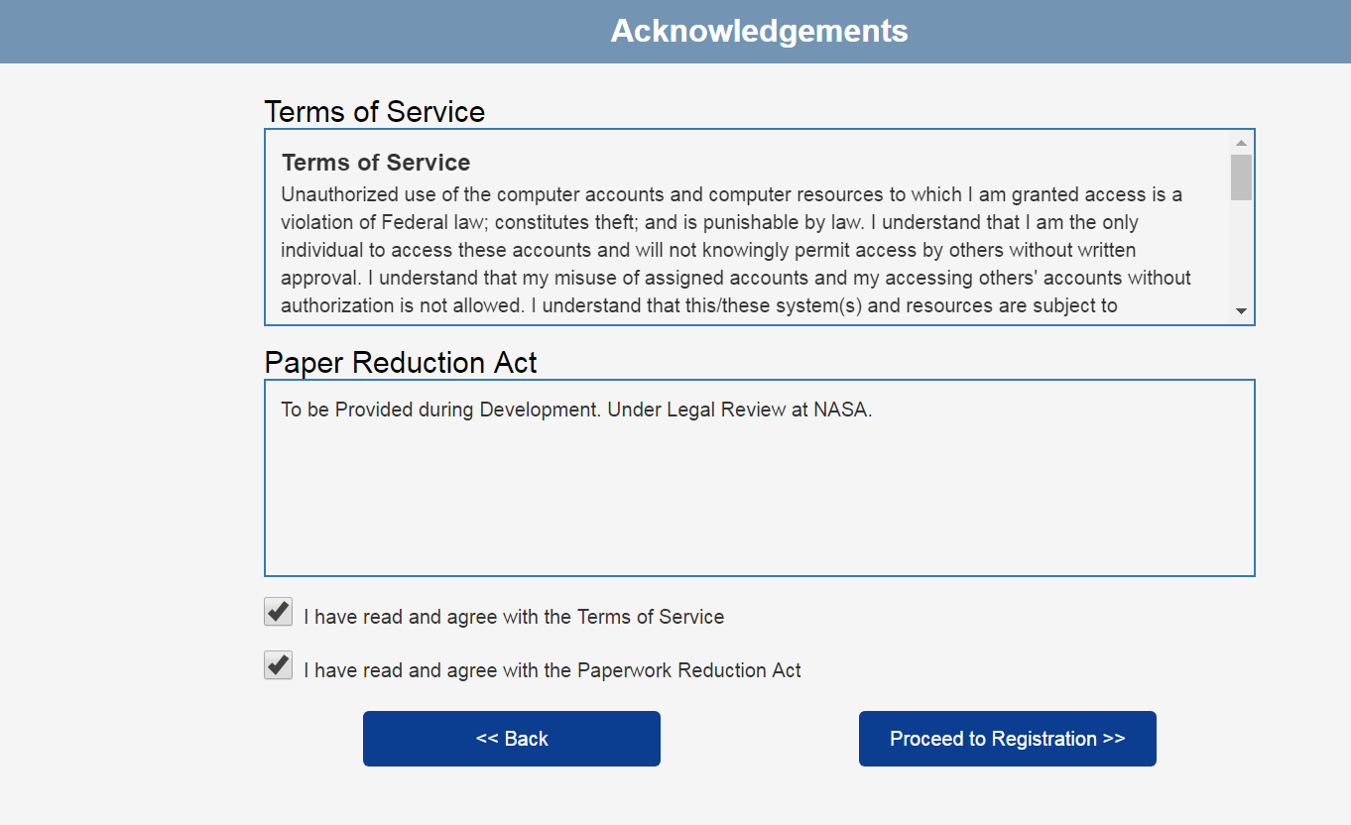
Terms of Service
Paperwork Reduction Act
This information collection meets the requirements of 44 U.S.C. § 3507, as amended by section 2 of the Paperwork Reduction Act of 1995. You do not need to answer these questions unless we display a valid Office of Management and Budget (OMB) control number. The OMB control number for this collection is 2700-XXXX and expires on dd/mm/yyyy. We estimate that it will take five (5) minutes to read the instructions, gather the facts, and answer the questions. Send only comments regarding the time estimate to: james.p.nicholas@nasa.gov

Slide 14
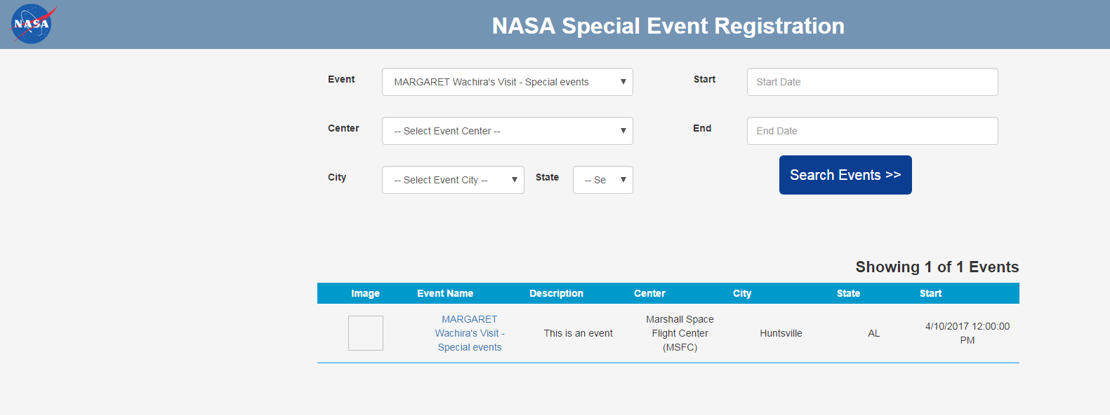
Events Search Screen

Slide 15
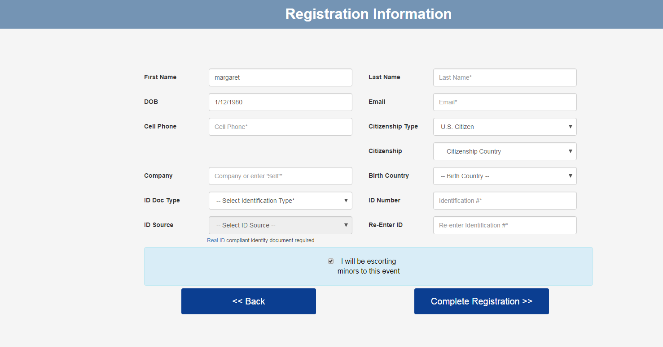
Registration Screen

Slide 16
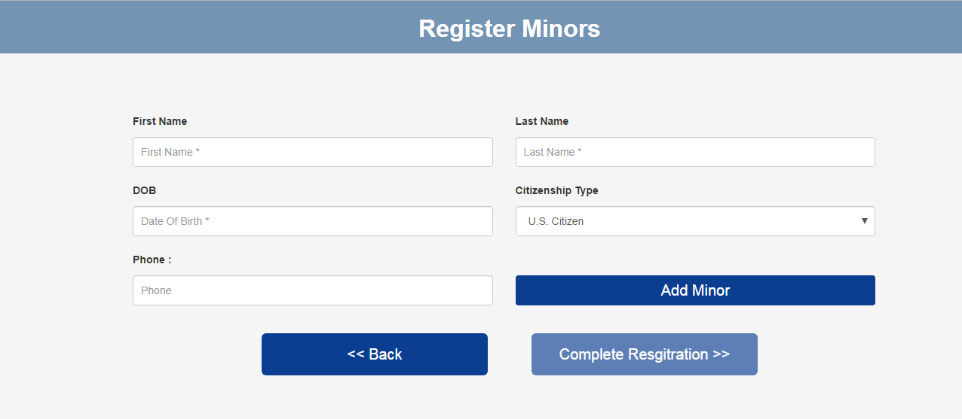
Minor’s Registration Screen

Slide 17
Visitor Invitation Portal

Slide 18
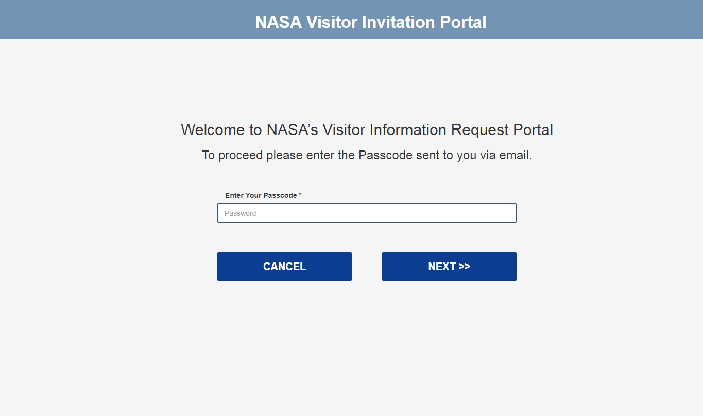
Passcode entry

Slide 19
Terms of Service
Paperwork Reduction Act
This information collection meets the requirements of 44 U.S.C. § 3507, as amended by section 2 of the Paperwork Reduction Act of 1995. You do not need to answer these questions unless we display a valid Office of Management and Budget (OMB) control number. The OMB control number for this collection is 2700-XXXX and expires on dd/mm/yyyy. We estimate that it will take five (5) minutes to read the instructions, gather the facts, and answer the questions. Send only comments regarding the time estimate to: james.p.nicholas@nasa.gov

Slide 20
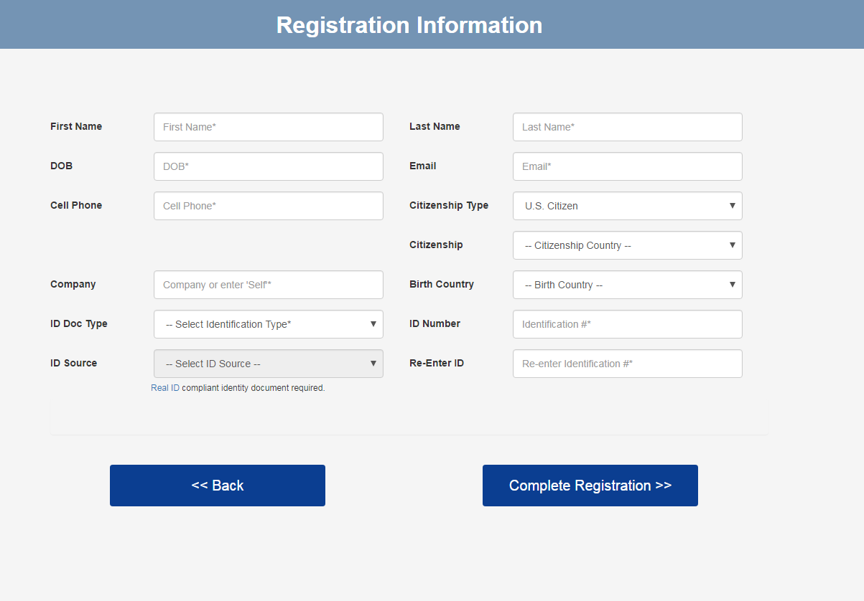
Registration Screen

Slide 21
Admin Side

Slide 22
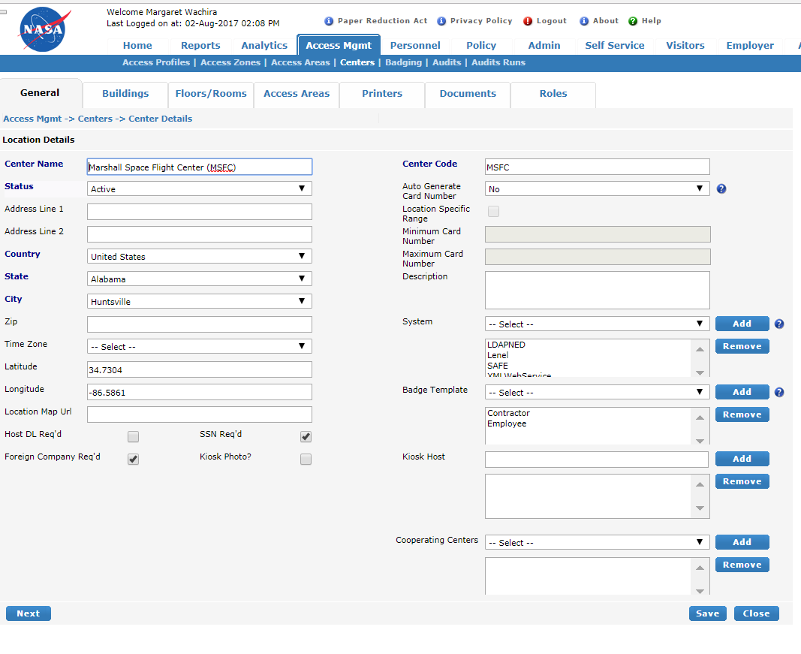
Access Management - Centers

Slide 23
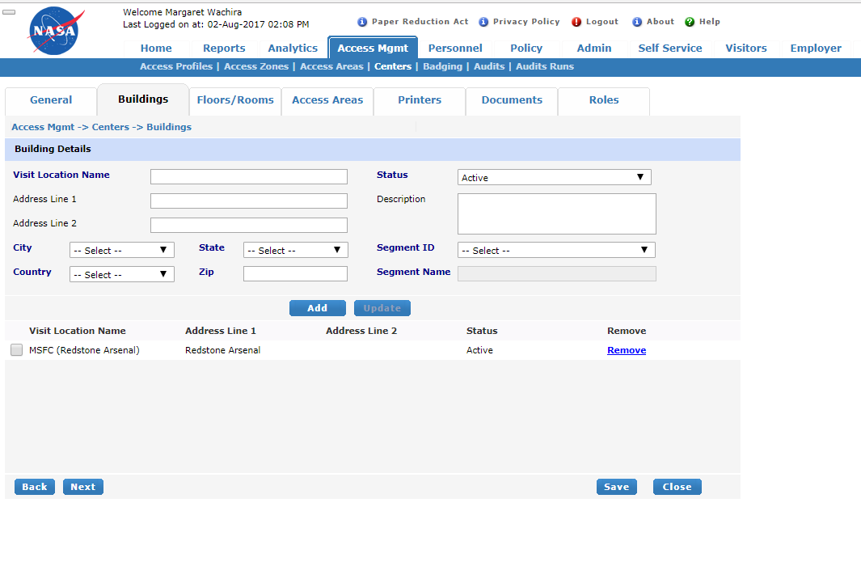
Access Management -Buildings

Slide 24
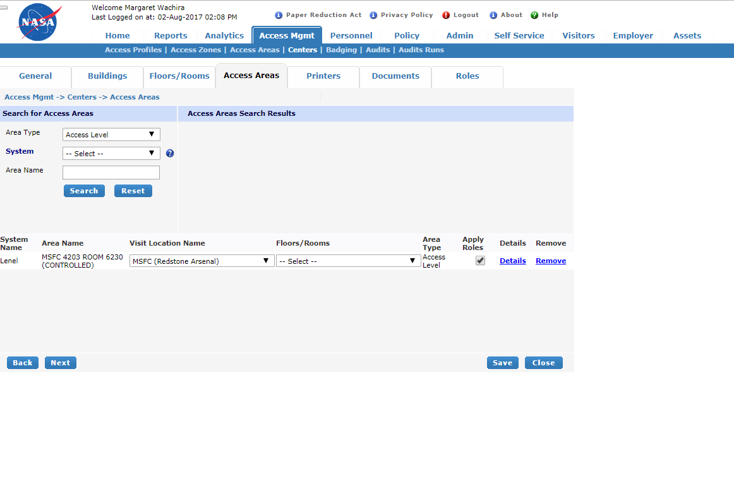
Access Management –Access Areas

Slide 25
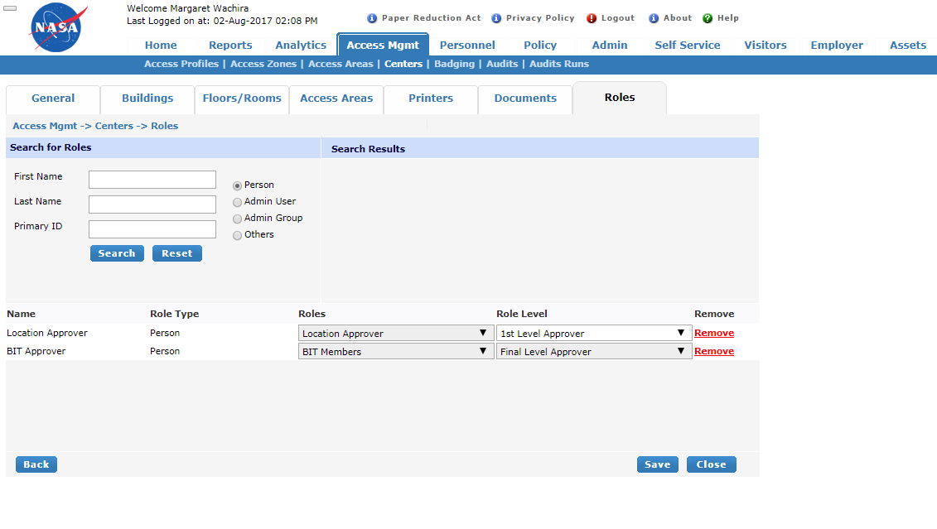
Access Management –Roles

Slide 26
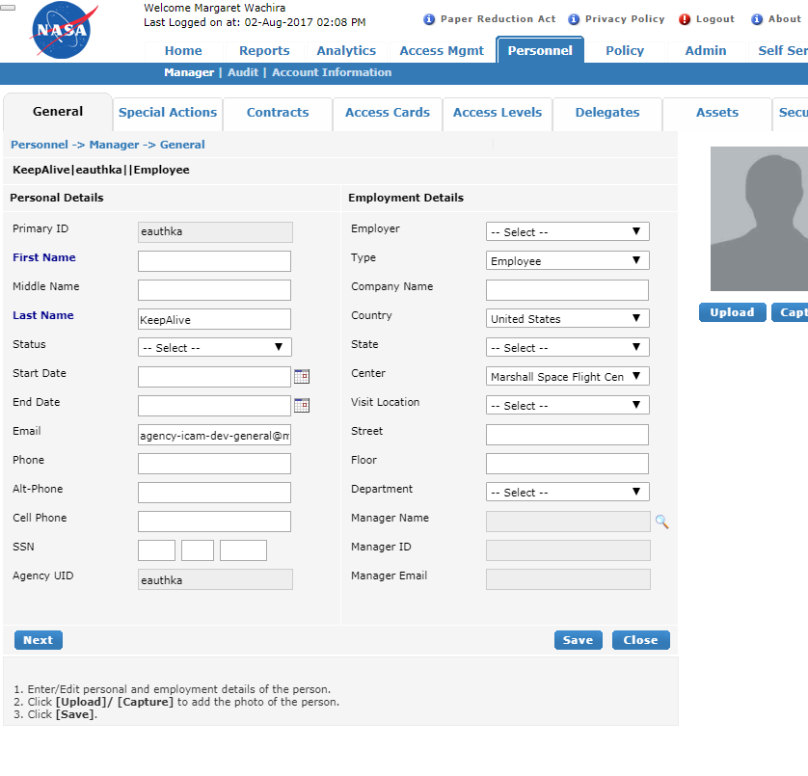
Personnel - Identity

Slide 27
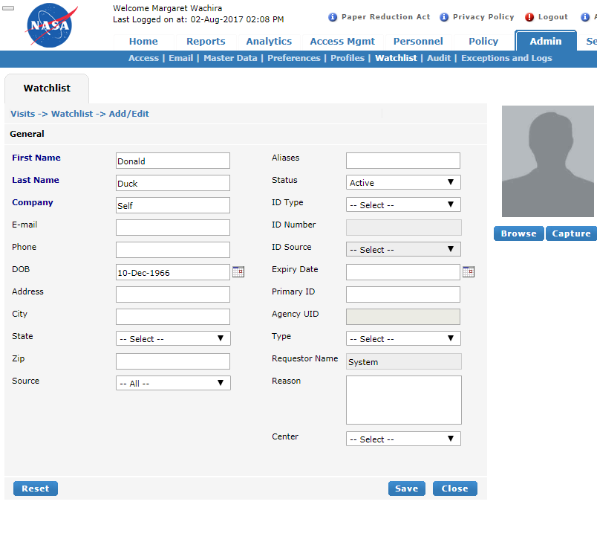
Watchlist

Slide 28
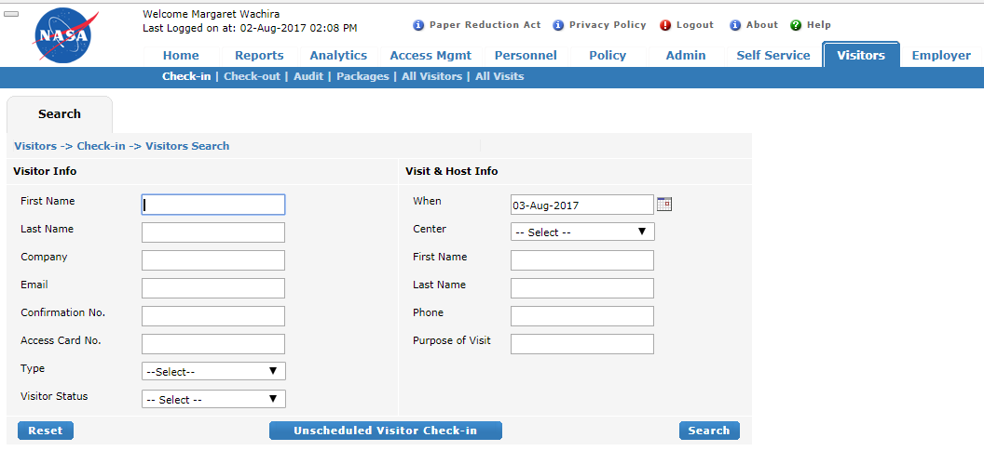
Visitor Search

Slide 29
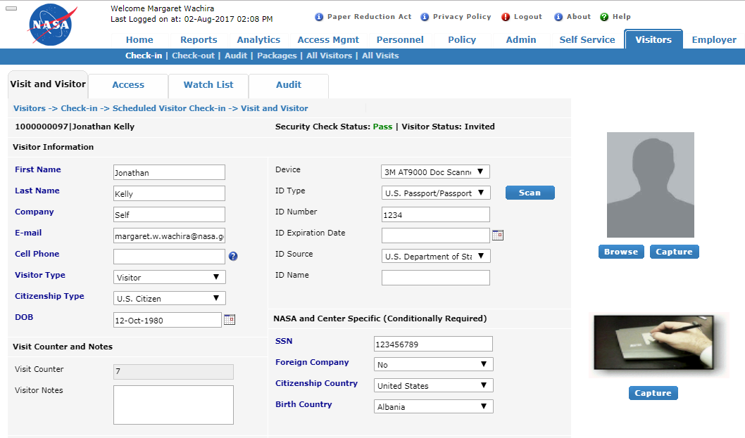
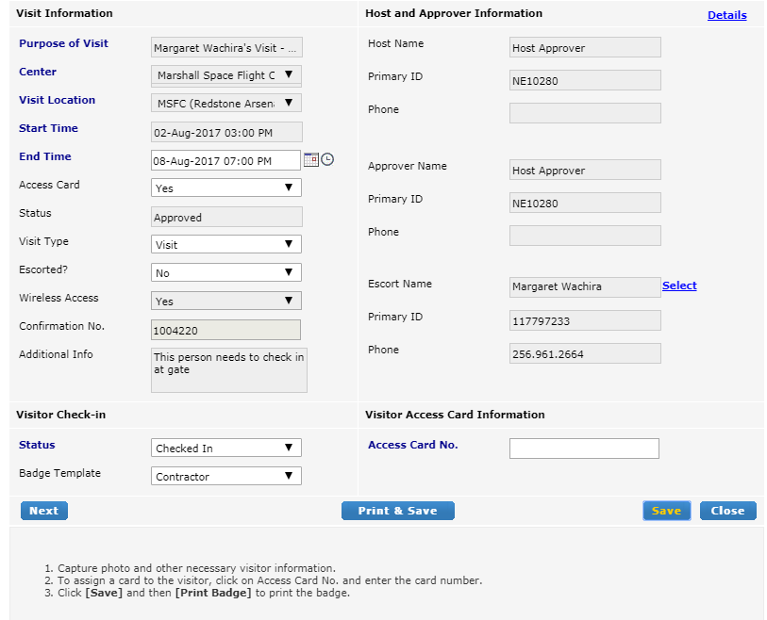
Visitor check-in

Slide 30
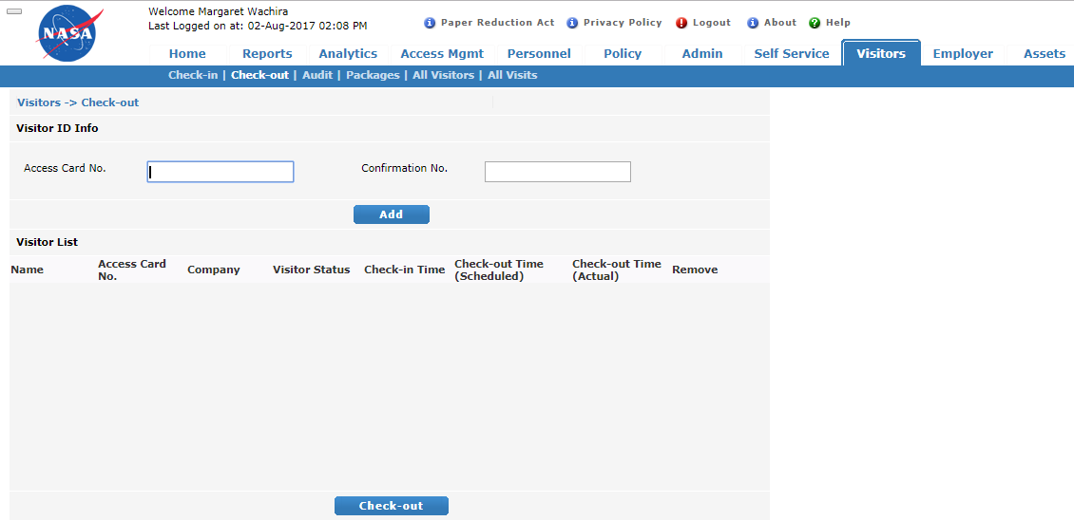
Visitor check-out

Slide 31
Kiosk

Slide 32
Please enter any one search criteria and click Next
OPTION 1: Email Address
OPTION 2: Confirmation Email
Enter Your Email Address
Enter the Confirmation number or scan Barcode
Cancel
Next

Slide 33
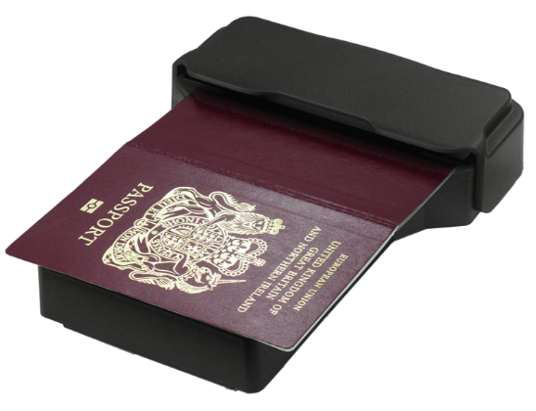
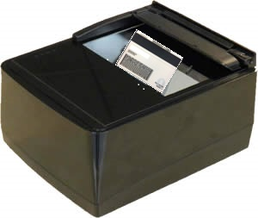
ID Type
--Select ID Type--
Place your Document on the Scanner as Shown
Scan Document
or
Cancel
If you have an alternate document not listed as an ID type, please Cancel and proceed to the Visitor Desk

Slide 34
Provide Information
Agency UID
Agency UID (AUID)*
Example: jsmith
Please Cancel and Proceed to the Visitor Desk if:
You do not have your Driver’s License
Your permanent Badge is Lost, Stolen, or Damaged
Cancel
Next

Slide 35
Back up

Slide 36
Center and Location Drop Down
Center | Locations available per Center
AFRC | AFRC
ARC | ARC
HQ | HQ | GSFC (Greenbelt)
JSC | JSC | WSTF | El Paso
WSTF | WSTF | JSC | El Paso
LaRC | LaRC
MAF | MAF
MSFC | MSFC
JPL | JPL
KSC | KSC
GRC | GRC | Plum Brook Station
SSC | SSC | NSSC
NSSC | NSSC | SSC
GSFC | GSFC | IV&V | GISS | WFF
IV&V | IV&V | GSFC | GISS | WFF
GISS | GISS | GSFC | IV&V | WFF
WFF | WFF | GSFC | IV&V | GISS
WSC | WSC

Slide 37
Birth and Citizenship Country drop downs
ANDORRA | CUBA | INDONESIA | MAURITANIA | SLOVENIA
UNITED ARAB EMIRATES | CAPE VERDE | IRELAND | MONTSERRAT | SVALBARD AND JAN MAYEN
AFGHANISTAN | CHRISTMAS ISLAND | ISRAEL | MALTA | SLOVAKIA
ANTIGUA AND BARBUDA | CYPRUS | ISLE OF MAN | MAURITIUS | SIERRA LEONE
ANGUILLA | CZECH REPUBLIC | INDIA | MALDIVES | SAN MARINO
ALBANIA | GERMANY | BRITISH INDIAN OCEAN TERRITORY | MALAWI | SENEGAL
ARMENIA | DJIBOUTI | IRAQ | MEXICO | SOMALIA
NETHERLANDS ANTILLES | DENMARK | IRAN, ISLAMIC REPUBLIC OF | MALAYSIA | SURINAME
ANGOLA | DOMINICA | ICELAND | MOZAMBIQUE | SAO TOME AND PRINCIPE
ANTARCTICA | DOMINICAN REPUBLIC | ITALY | NAMIBIA | EL SALVADOR
ARGENTINA | ALGERIA | JERSEY | NEW CALEDONIA | SYRIAN ARAB REPUBLIC
AMERICAN SAMOA | ECUADOR | JAMAICA | NIGER | SWAZILAND
AUSTRIA | ESTONIA | JORDAN | NORFOLK ISLAND | TURKS AND CAICOS ISLANDS
AUSTRALIA | EGYPT | JAPAN | NIGERIA | CHAD
ARUBA | WESTERN SAHARA | KENYA | NICARAGUA | FRENCH SOUTHERN TERRITORIES
ALAND ISLANDS | ERITREA | KYRGYZSTAN | NETHERLANDS | TOGO
AZERBAIJAN | SPAIN | CAMBODIA | NORWAY | THAILAND
BOSNIA AND HERZEGOVINA | ETHIOPIA | KIRIBATI | NEPAL | TAJIKISTAN
BARBADOS | FINLAND | COMOROS | NAURU | TOKELAU
BANGLADESH | FIJI | SAINT KITTS AND NEVIS | NIUE | TIMOR-LESTE
BELGIUM | FALKLAND ISLANDS (MALVINAS) | KOREA, DEMOCRATIC PEOPLE'S REPUBLIC OF | NEW ZEALAND | TURKMENISTAN
BURKINA FASO | MICRONESIA, FEDERATED STATES OF | KOREA, REPUBLIC OF | OMAN | TUNISIA
BULGARIA | FAROE ISLANDS | KUWAIT | PANAMA | TONGA
BAHRAIN | FRANCE | CAYMAN ISLANDS | PERU | TURKEY
BURUNDI | GABON | KAZAKHSTAN | FRENCH POLYNESIA | TRINIDAD AND TOBAGO
BENIN | UNITED KINGDOM | LAO PEOPLE'S DEMOCRATIC REPUBLIC | PAPUA NEW GUINEA | TUVALU
BERMUDA | GRENADA | LEBANON | PHILIPPINES | TAIWAN
BRUNEI DARUSSALAM | GEORGIA | SAINT LUCIA | PAKISTAN | TANZANIA, UNITED REPUBLIC OF
BOLIVIA | FRENCH GUIANA | LIECHTENSTEIN | POLAND | UKRAINE
BRAZIL | GUERNSEY | SRI LANKA | SAINT PIERRE AND MIQUELON | UGANDA
BAHAMAS | GHANA | LIBERIA | PITCAIRN | UNITED STATES MINOR OUTLYING ISLANDS
BHUTAN | GIBRALTAR | LESOTHO | PUERTO RICO | URUGUAY
BOUVET ISLAND | GREENLAND | LITHUANIA | PALESTINIAN TERRITORY, OCCUPIED | UZBEKISTAN
BOTSWANA | GAMBIA | LUXEMBOURG | PORTUGAL | HOLY SEE (VATICAN CITY STATE)
BELARUS | GUINEA | LATVIA | PALAU | SAINT VINCENT AND THE GRENADINES
BELIZE | GUADELOUPE | LIBYAN ARAB JAMAHIRIYA | PARAGUAY | VENEZUELA
CANADA | EQUATORIAL GUINEA | MOROCCO | QATAR | VIRGIN ISLANDS, BRITISH
COCOS (KEELING) ISLANDS | GREECE | MONACO | RÉUNION | VIRGIN ISLANDS, U.S.
CONGO, THE DEMOCRATIC REPUBLIC OF THE | SOUTH GEORGIA AND THE SOUTH SANDWICH ISLANDS | MOLDOVA, REPUBLIC OF | ROMANIA | VIET NAM
CENTRAL AFRICAN REPUBLIC | GUATEMALA | MONTENEGRO | SERBIA | VANUATU
CONGO | GUAM | MADAGASCAR | RUSSIAN FEDERATION | WALLIS AND FUTUNA
SWITZERLAND | GUINEA-BISSAU | MARSHALL ISLANDS | RWANDA | SAMOA
CÔTE D'IVOIRE | GUYANA | MACEDONIA, THE FORMER YUGOSLAV REPUBLIC OF | SAUDI ARABIA | YEMEN
COOK ISLANDS | HONG KONG | MALI | SOLOMON ISLANDS | MAYOTTE
CHILE | HEARD ISLAND AND MCDONALD ISLANDS | MYANMAR | SEYCHELLES | SOUTH AFRICA
CAMEROON | HONDURAS | MONGOLIA | SUDAN | ZAMBIA
CHINA | CROATIA | MACAO | SWEDEN | ZIMBABWE
COLOMBIA | HAITI | NORTHERN MARIANA ISLANDS | SINGAPORE
COSTA RICA | HUNGARY | MARTINIQUE | SAINT HELENA

Slide 38
Identity Type and ID Source Drop Downs
Identification Document drop down | Identification Source drop down
U.S. Passport or U.S. Passport Card | U.S. Department of State
U.S. Permanent Resident Card or Alien Registration Receipt Card (Form I-551) | United States Citizenship and Immigration Services
Foreign Passport | Country List - See slide 7
Employment Authorization Document (Form I-766) | Department of Homeland Security
State Driver’s License or ID Card | District of Columbia, All States List - See Slide 9
Government Issued ID Card (with photo) | Federal State Local
PIV Card | Federal Agency
U.S. Military ID or Draft Record | Department of Defense
U.S. Military dependent’s ID Card | Department of Defense
U.S. Coast Guard Mariner Card | U.S. Coast Guard
Global Entry | U.S. Customs and Border Protection
School ID (with Photo) | N/A

Slide 39
Identity Source – DL States
Alaska | Mississippi
Alabama | Montana
Arkansas | Nebraska
American Samoa | North Carolina
Arizona | North Dakota
California | New Hampshire
Colorado | New Jersey
Connecticut | New Mexico
District of Columbia | Nevada
Delaware | New York
Florida | Ohio
Federated States of Micronesia | Oklahoma
Georgia | Oregon
Guam | Pennsylvania
Hawaii | Puerto Rico
Iowa | Palau
Idaho | Rhode Island
Illinois | South Carolina
Indiana | South Dakota
Kansas | Tennessee
Kentucky | Texas
Louisiana | Utah
Massachusetts | Virginia
Maryland | Virgin Islands (U.S.)
Maine | Vermont
Marshall Islands | Washington
Michigan | Wisconsin
Minnesota | West Virginia
Missouri | Wyoming
Mariana Islands

