Slide 1
1. What is your primary purpose for flying?
1 - Leisure
2 - Business
2. How many roundtrips do you have every year? (within the United states, or internationally from the United States)
1 - None
2 - 1 to 2
3 - 3 to 6
4 - 7 to 10
5 – 11 to 15
6 – 16 to 30
7 – Over 31
Which security lane do you use most often?
1 – Standard
2 – TSA Pre✓®
How satisfied are you with the overall airport security experience? (Rank 1-5, 1 for Very Dissatisfied to 5 for Very Satisfied, 6 for N/A)

Slide 2
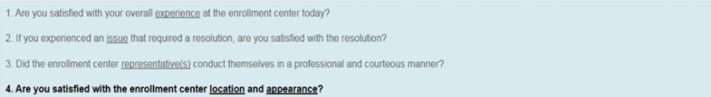
5.

