Slide 1
eLibrary Web Search Modernization
May 2019
Federal Energy
Regulatory Commission (FERC)

Slide 2
Modernization Objectives
5
Increase Trust in the Accuracy of Search Results
Reduce Redundancy
Improve Navigation
Improve User Experience
Remove Features that Provide Limited Value or Are No Longer Supported

Slide 3
Increase Trust in the Accuracy of Search Results
By design, three of the five searches used different logic to retrieve results. The business need for these different searches was not apparent to the user. The differing results confused some users and reduced their confidence in the accuracy of the data

Slide 4
Reduce Redundancy
Three of the search forms used the same logic for data retrieval but used different controls for the same fields
Help and Accessible Help contained the same information. Both were accessible
There were two sets of “Submit” buttons on the Advanced Search form when only one was needed that indicates the function to be performed (i.e. “Search”) per Section 508 Compliance label recommendation

Slide 5
Improve Navigation
Navigation links could better match the screen labels and not shift locations depending on the page. Better labelling could eliminate confusion and the selection of the wrong link
Login redirected users to a different screen requiring them to navigate back to the launch point
Search forms required the user to scroll to submit the form
Table navigation controls did not allow the user to readily control the number of rows per page or skip pages

Slide 6
Improve User Experience
Many primary functions such as zipping files for download, sorting the search result, and managing the display of content was hidden under the fold at the bottom of the table of results. Many users were not aware that the feature was available
The ability to zip large files required the user to navigate to another page to download
Filenames were not provided in the search result, requiring users to navigate to the File List screen to differentiate files
The results screen was cluttered and columns were merged preventing sorting
Links to FERC.GOV and FERC.Online were obscured under banner images

Slide 7
Remove Features that Provide Limited Value or Are No Longer Supported
The Guest Login was not functional
The Request List was no longer supported and lacked the ability to charge for printing services
The View Files feature was considered of limited value. Users reported never having used it
The Summary field was considered redundant with the Description field which was more comprehensive

Slide 8
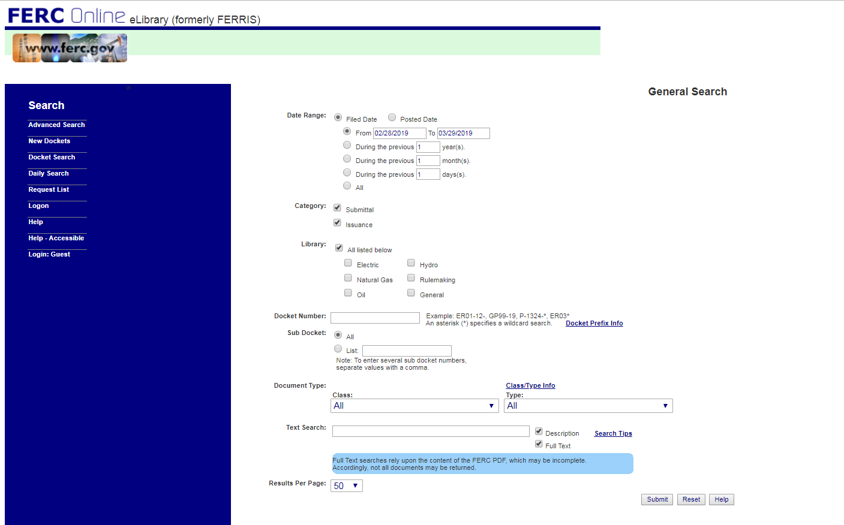
General Search
Objective: Increase Trust
Consolidate search screens sharing same query logic. Add a tooltip to explain what each search does

Slide 9
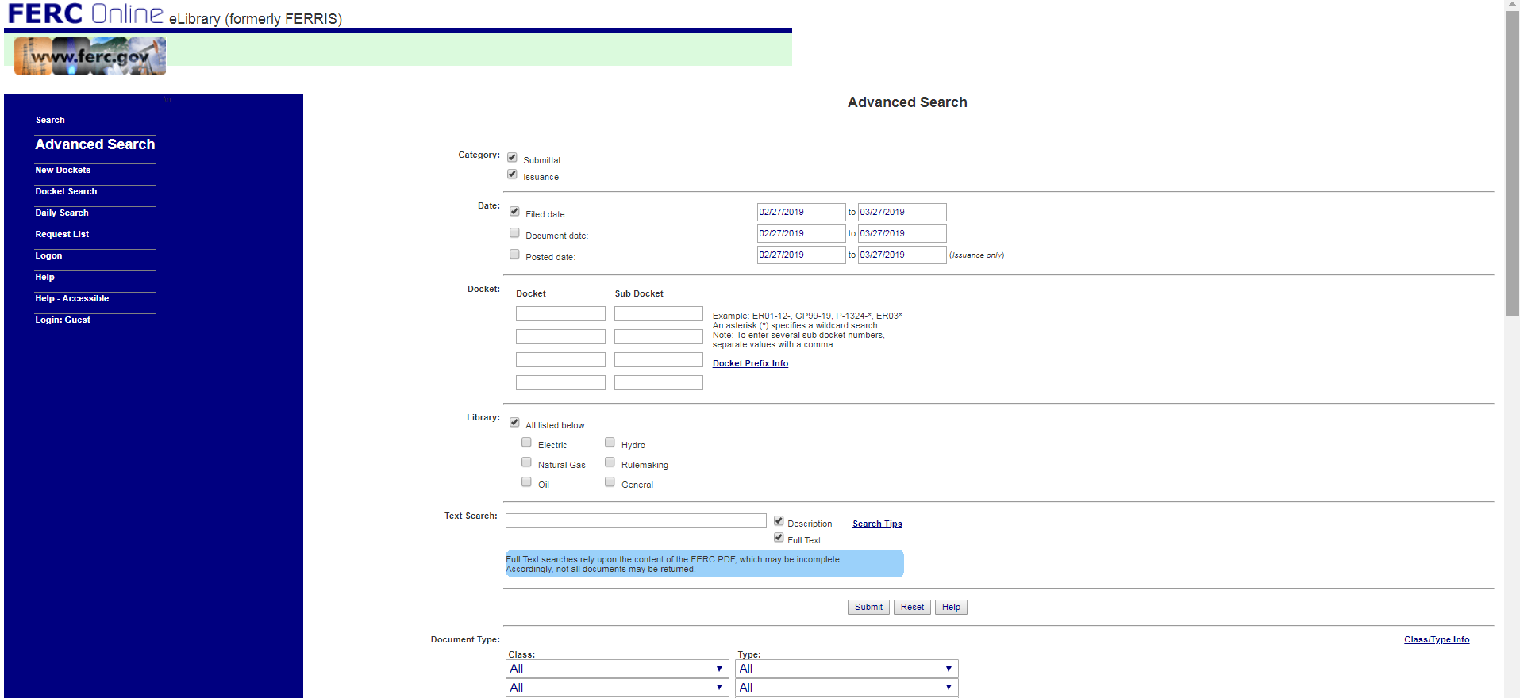
Advanced Search
Objective: Reduce Redundancy
Consolidate Help Features.
Remove redundant fields and buttons. Use the same Date Range controls for all search forms

Slide 10
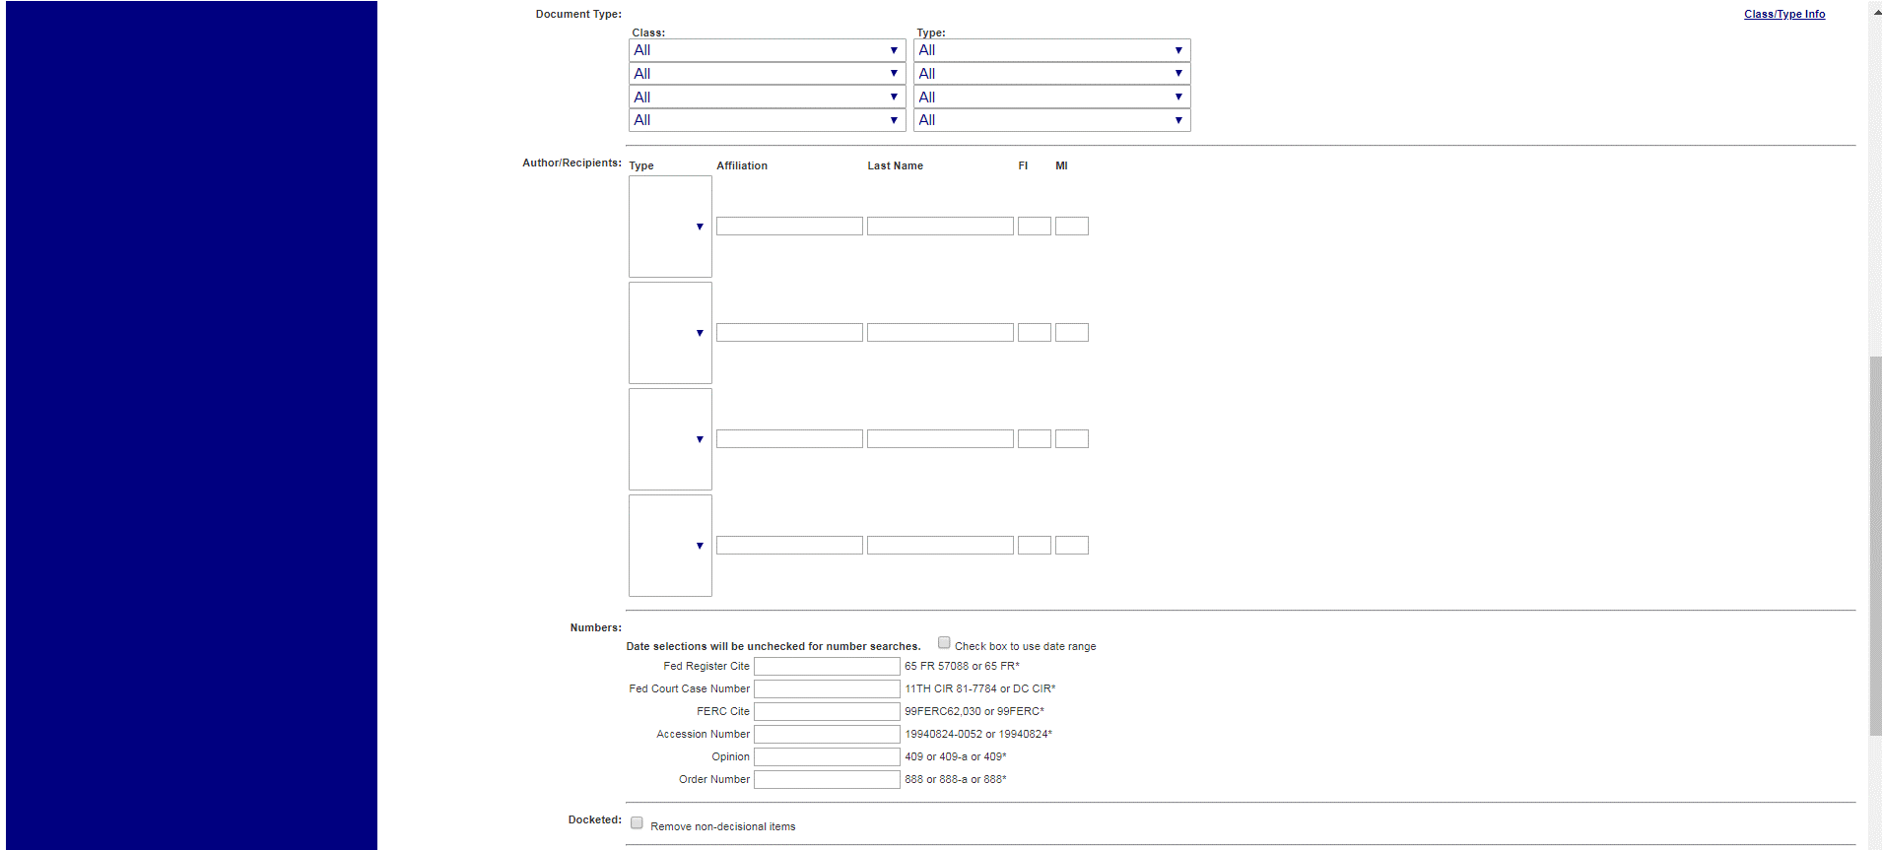
Advanced Search (cont’d) scrolling….
Objectives: Reduce Redundancy/Improve Navigation
Enable access to navigation links by making them visible at all times. Move all controls above the fold so that scrolling is not needed. Remove unused redundant fields
No navigation links visible
Scrolling required to view form.

Slide 11
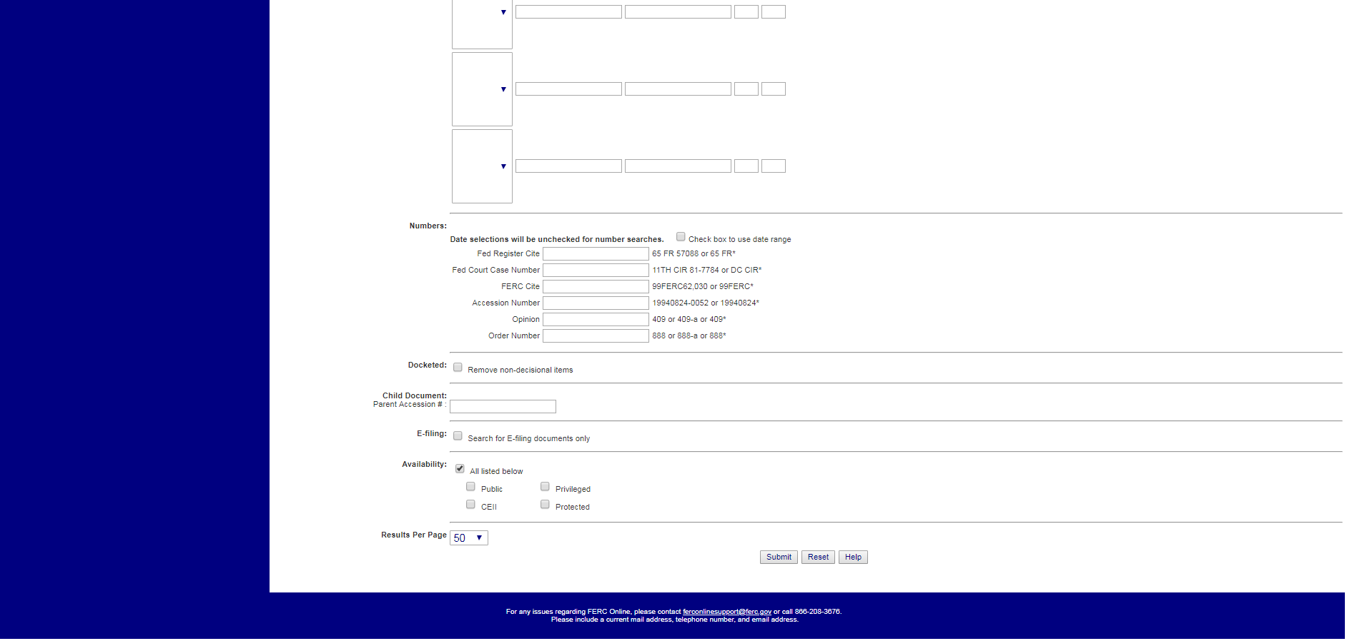
Objective: Remove Features that Provide Limited Value
Advanced Search (cont.) scrolling….
Remove criteria that are not found of value to users

Slide 12
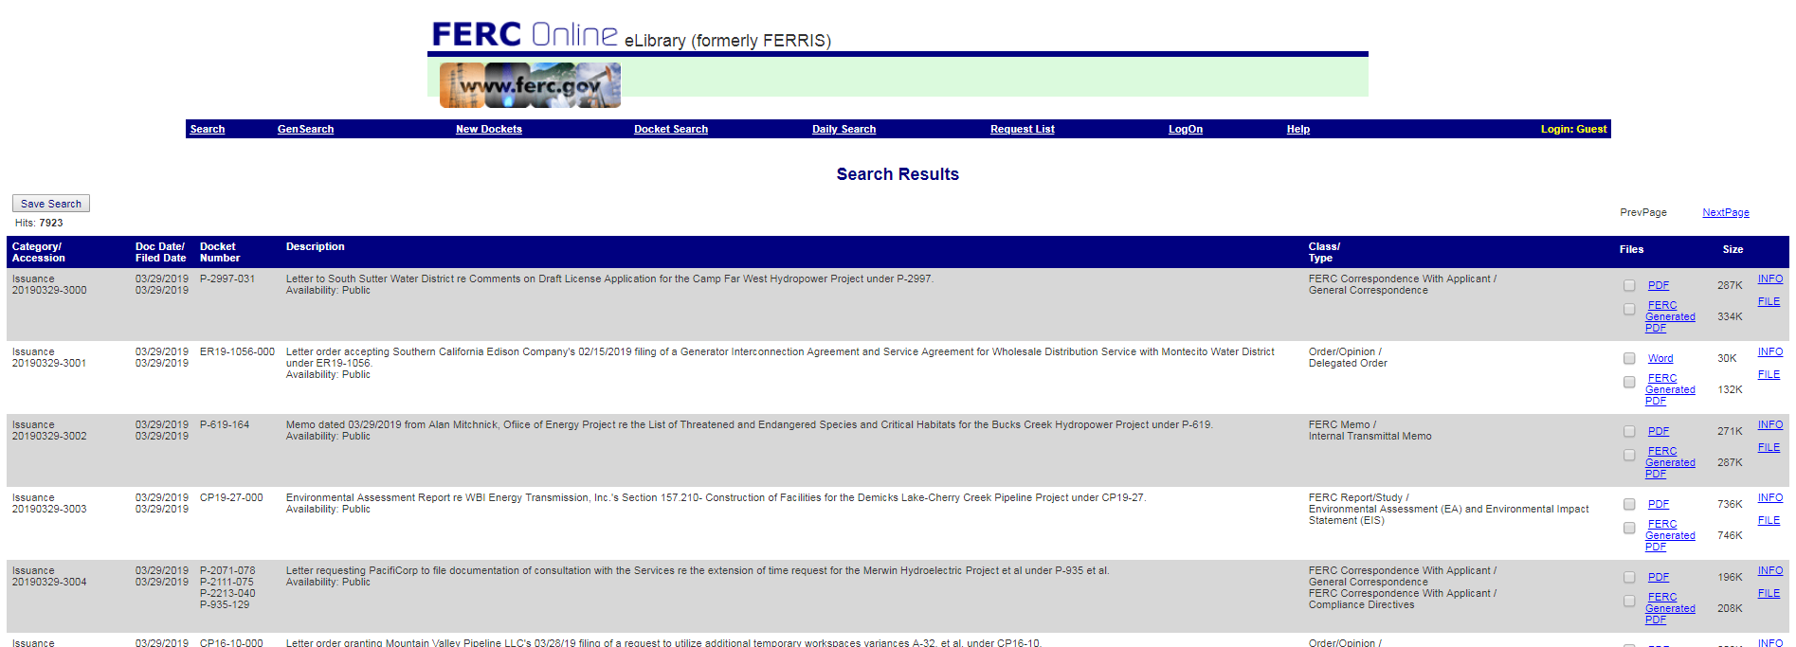
General & Advanced Search Results
Objective: Improve Navigation
Move search criteria to the top of the screen. Move important controls needed for sorting, filtering and navigating the table. Allow user to control the number of rows per page and jump to any page easily

Slide 13
General & Advanced Search Results
Objective: Improve User Experience
Decouple data to allow sorting. Display filenames instead of just the file types.
Allow the user to easily group and zip files for download

Slide 14
General & Advanced Search Results
Objective: Remove Features that Provide Limited Value
Remove the View and the Display Summary features which are not in use. Remove checkbox clutter

Slide 15
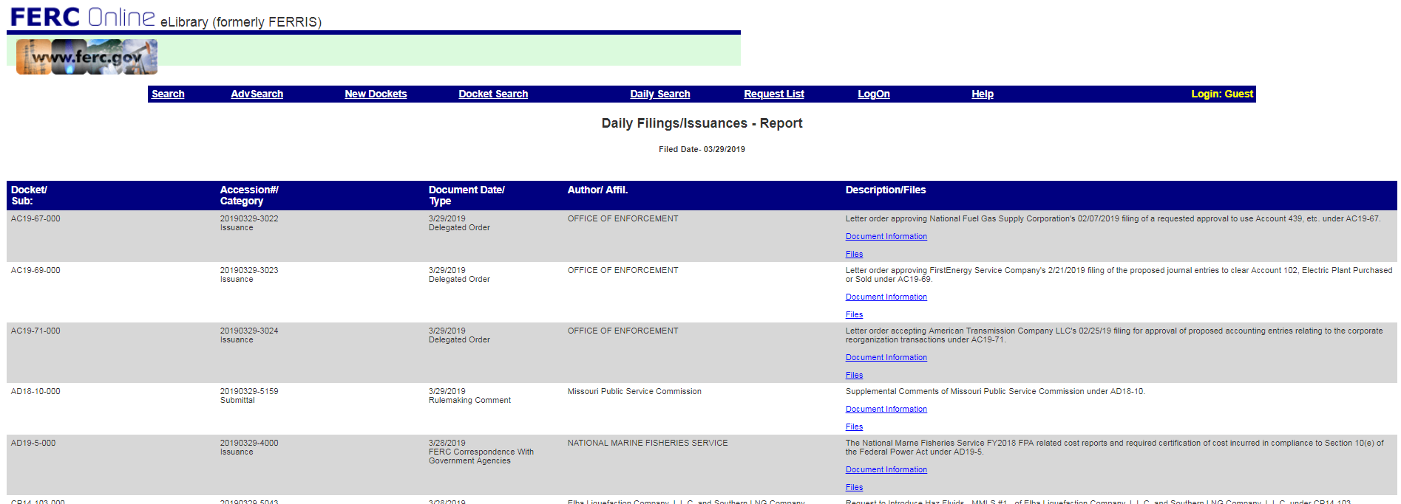
Daily Search Results
Objective: Increase Trust
Consolidate the Daily search results with the Advanced and General Search results since the logic and search criteria overlap

Slide 16
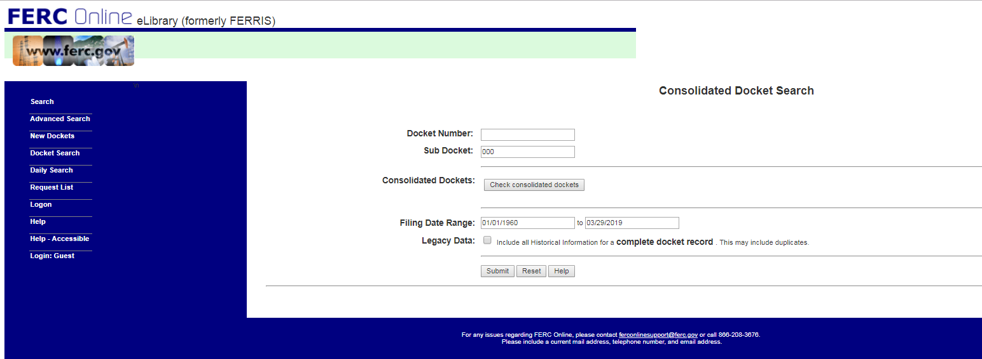
Consolidated Docket Search
Objective: Remove Features that Provide Limited Value
Remove Consolidated search which is no longer supported

Slide 17
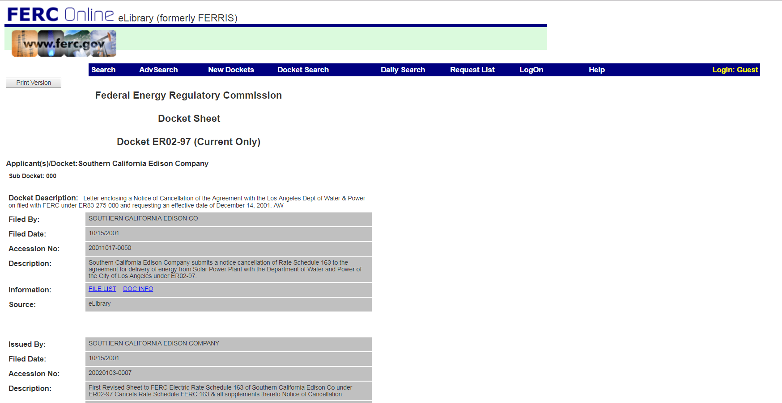
Docket Search Results
Objective: Improve the User Experience
Increase contrast and reduced the need to scroll. Enable the user to compare table information and navigate the table as in other screens

Slide 18
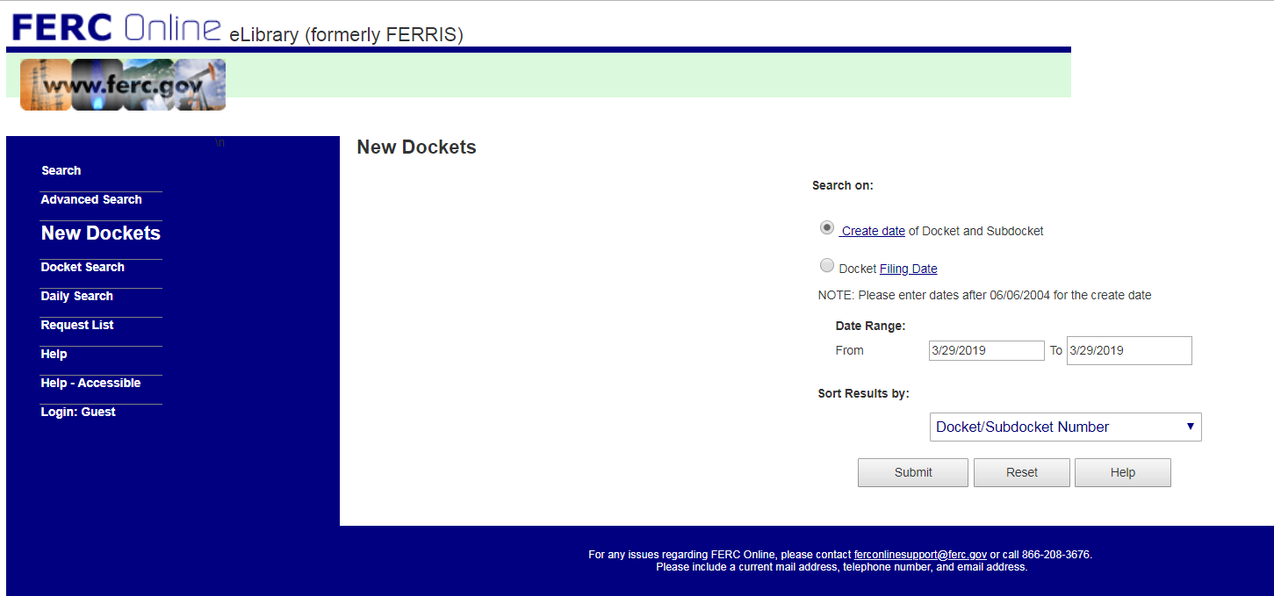
New Docket Search
Objective: Improve the User Experience
Reduce wasted space

Slide 19
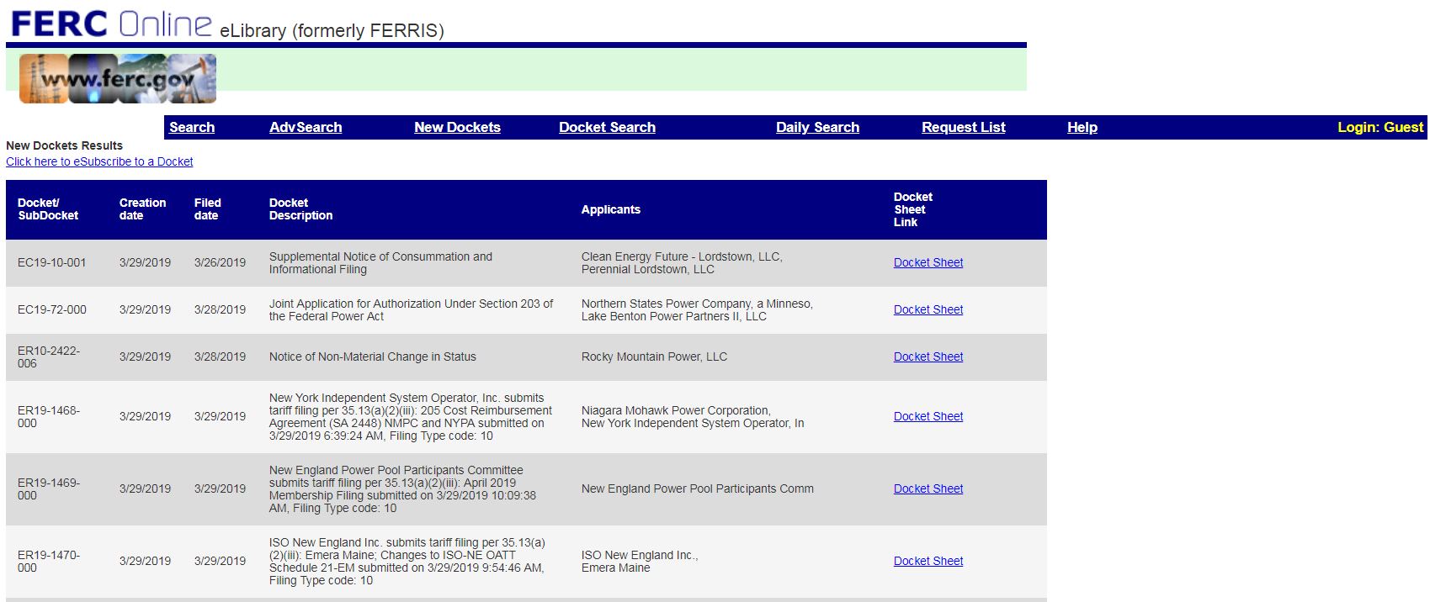
New Docket Search Results
Objective: Improve the User Experience
Increase contrast and reduced the need to scroll. Enable the user to navigate the table as in other screens

Slide 20
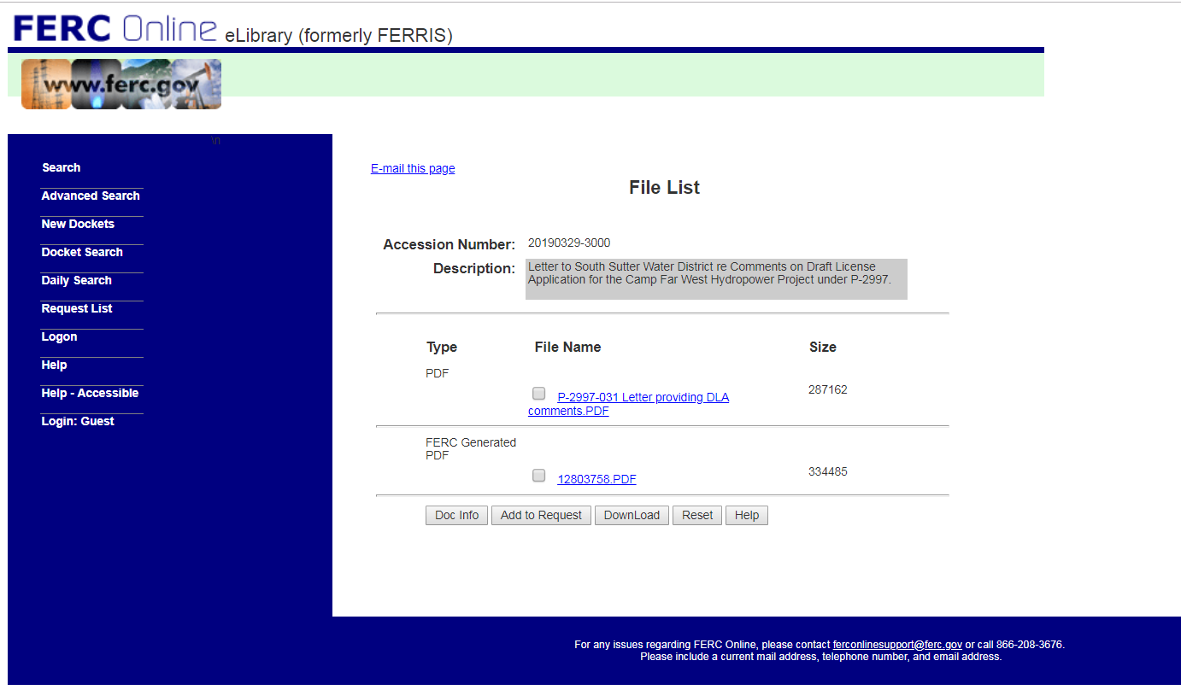
File List
Improve Usability
Objective: Improve the User Experience
Increase contrast. Enable the user to see file availability information and navigate the table as in other screens. Provide an immediate warning to the user if they try to download a file without authorization

Slide 21
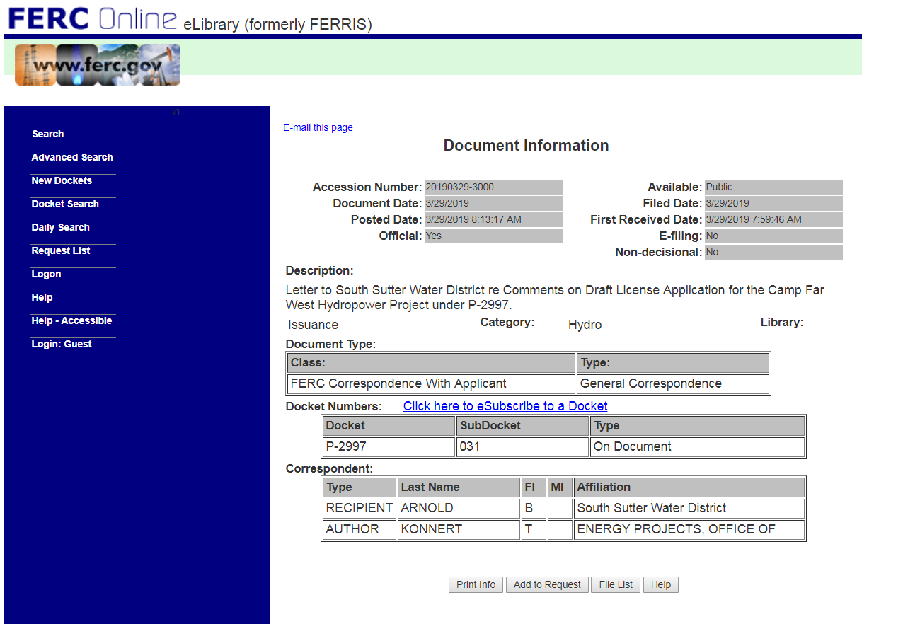
Document Info
Objective: Improve the User Experience
Increase contrast and improve layout. Locate links in a consistent place

Slide 22
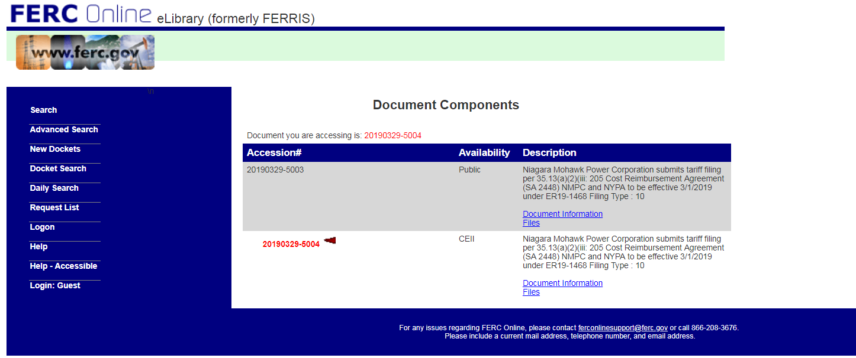
Component Document
Objective: Improve the User Experience
Increase contrast and improve layout. Locate links in a consistent place. Do not solely use color or obscure icons to impart information

Slide 23
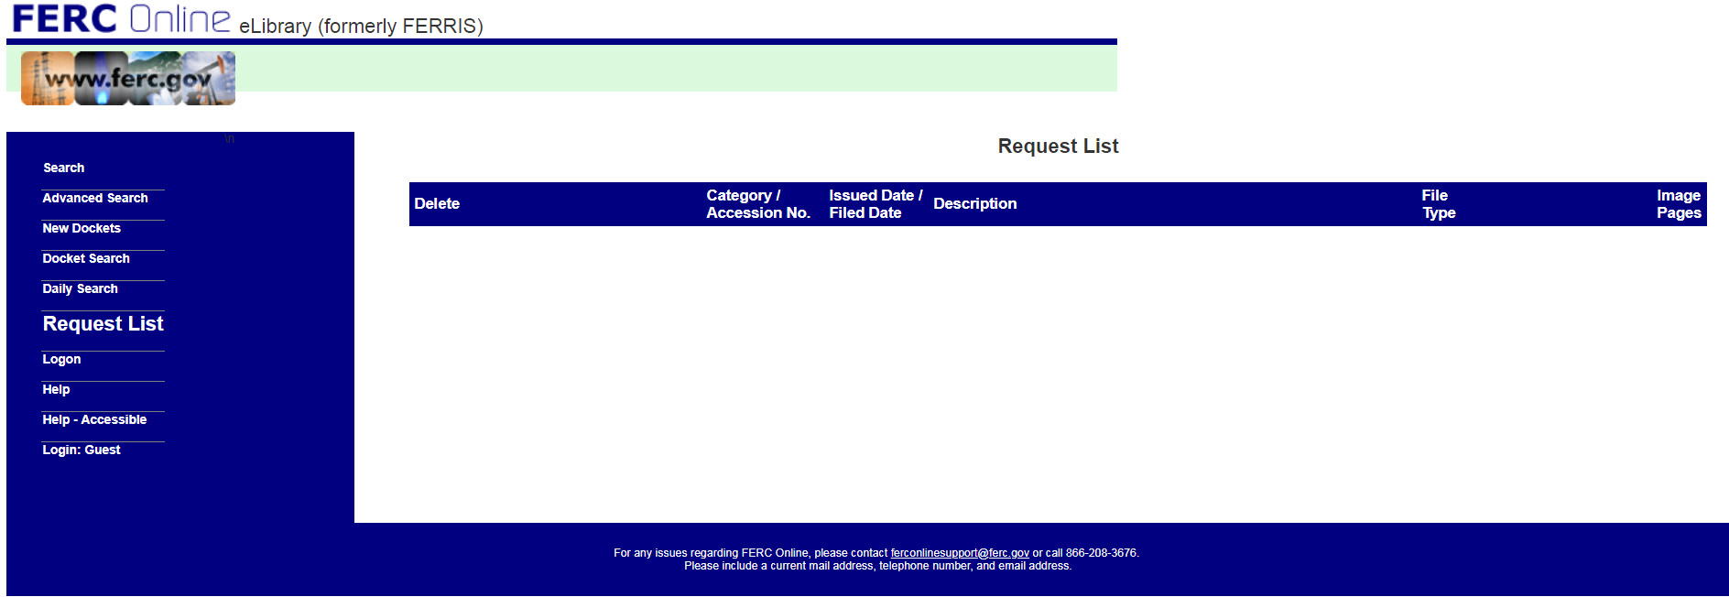
Request List
Objective: Remove Features that Provide Limited Value
Remove this page and all its logic. Reduces operations and maintenance for this page and its functions

Slide 24
Coming Soon! The New eLibrary

Slide 25
Enhancements to Search
Five Search Screens are consolidated into one
No scrolling is required to submit the search form
A primary button allows the user to submit the query by hitting Enter
Controls are simplified to better adapt to changes in resolution and screen size
Keyword search is enhanced to return or refine matches
Data relationships in the search criteria are enforced to reduce human error
The new sub docket multi-select lookup selector simplifies the selection process

Slide 26
Enhancements to Search Results
Files can be consolidated into a PDF and downloaded with one menu selection
Files can be zipped with one click of an icon or a menu selection
All screen clutter was removed
The new Preferences feature allows users to customize the search result
The new Column Selection feature allows the user to add or remove columns from the search result
The new Sortable columns make it easier to sort results

Slide 27
Enhancements to Search Results
The new indexing feature allows the user to refine the search result without performing a new query
Search results can be organized based on relevance to the search criteria
Filenames are displayed to makes file selection easier
Advanced table pagination controls and row management makes navigating a large search result easier
Rows per page selector makes reviewing data a breeze
New table expansion capabilities reduce the need for drilling down to sub-screens
Rules are applied when downloading the zip to protect against performance issues related to large files
User can control whether the result is organized by accession or docket number

Slide 28
Enhancements to Security
Links to Non-public files are disabled for unauthorized users
The login link which authorizes users to access non-public files is hidden from unauthorized users.
The system checks for session status and authentication prior to initiating file downloads
The new User Interface layout makes the availability status files readily apparent
Future Releases: Single Sign On may be implemented to improve security and support an better user experience

Slide 29
Removal of Undesired Features
Both Help features were consolidated into one simplified, downloadable document
The Guest Login feature was removed
The file Request List feature was removed
The View Files feature which increased complexity and added little value was removed

Slide 30
Enhancements to Navigation
All navigation links and screen labels match
All navigation elements are in a fixed location on all screens to facilitate recognition
The login screen was changed to a pop-up to eliminate the need for the user to navigate away from their current screen in order to login

Slide 31
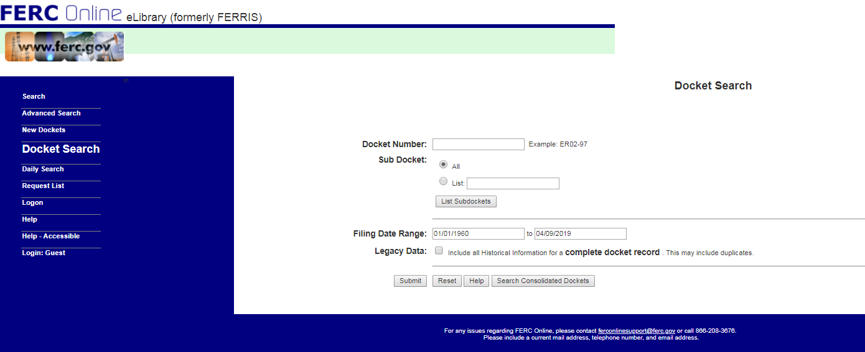
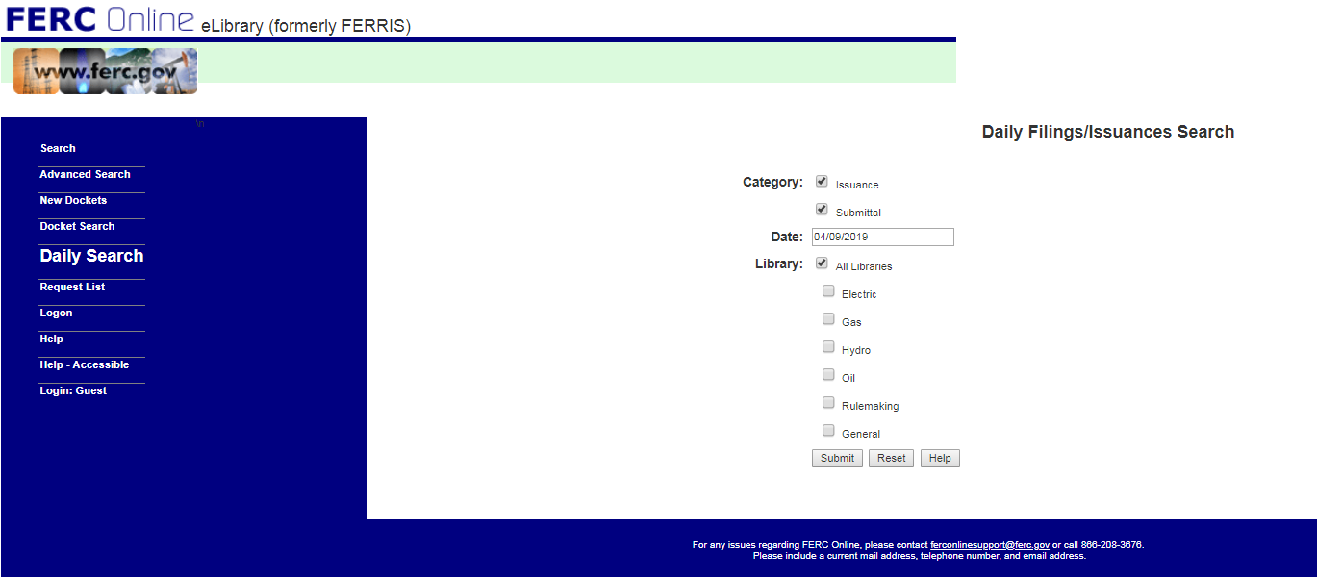
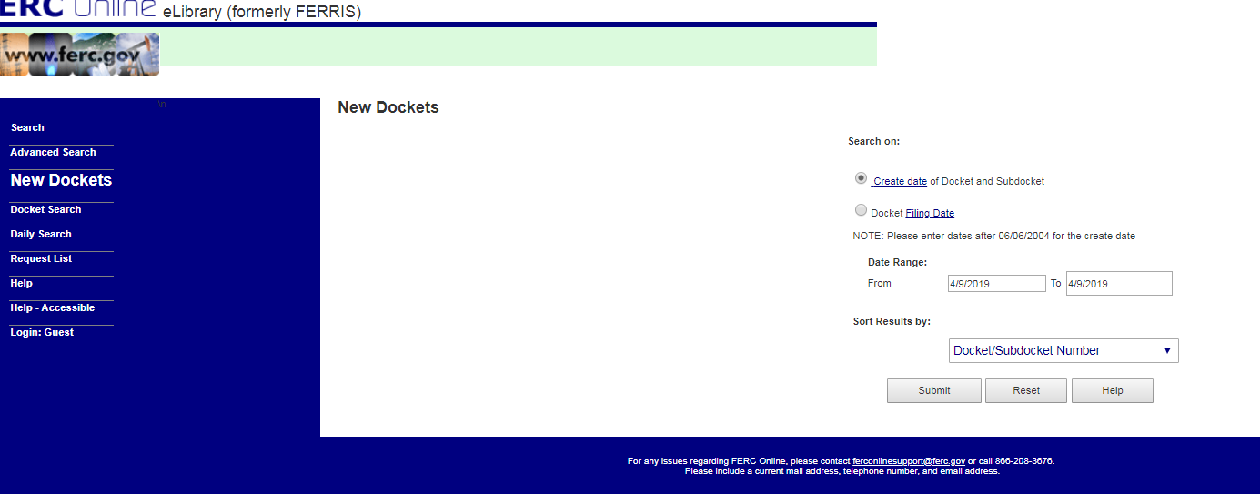
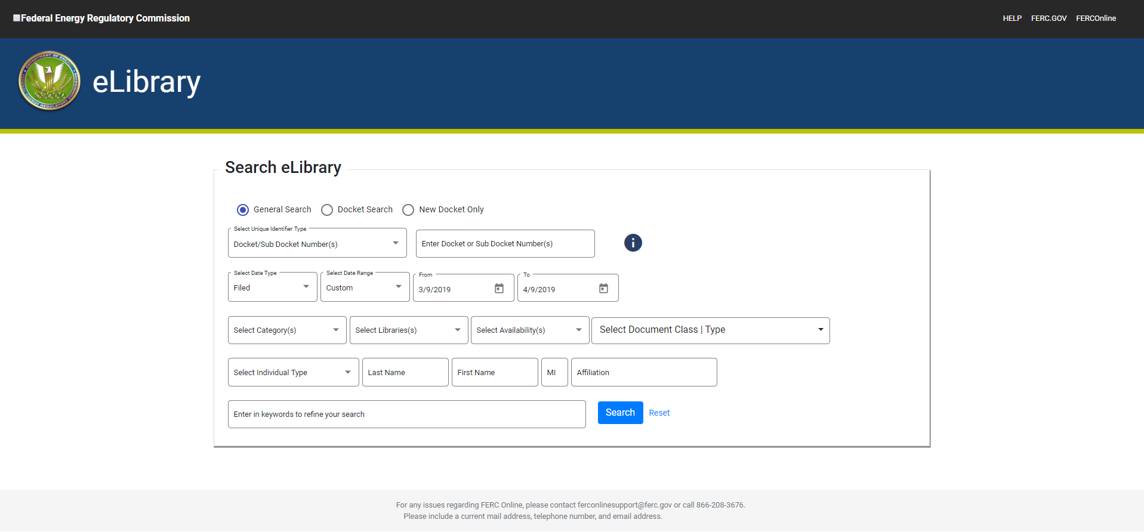
Consolidated Search Screen

Slide 32
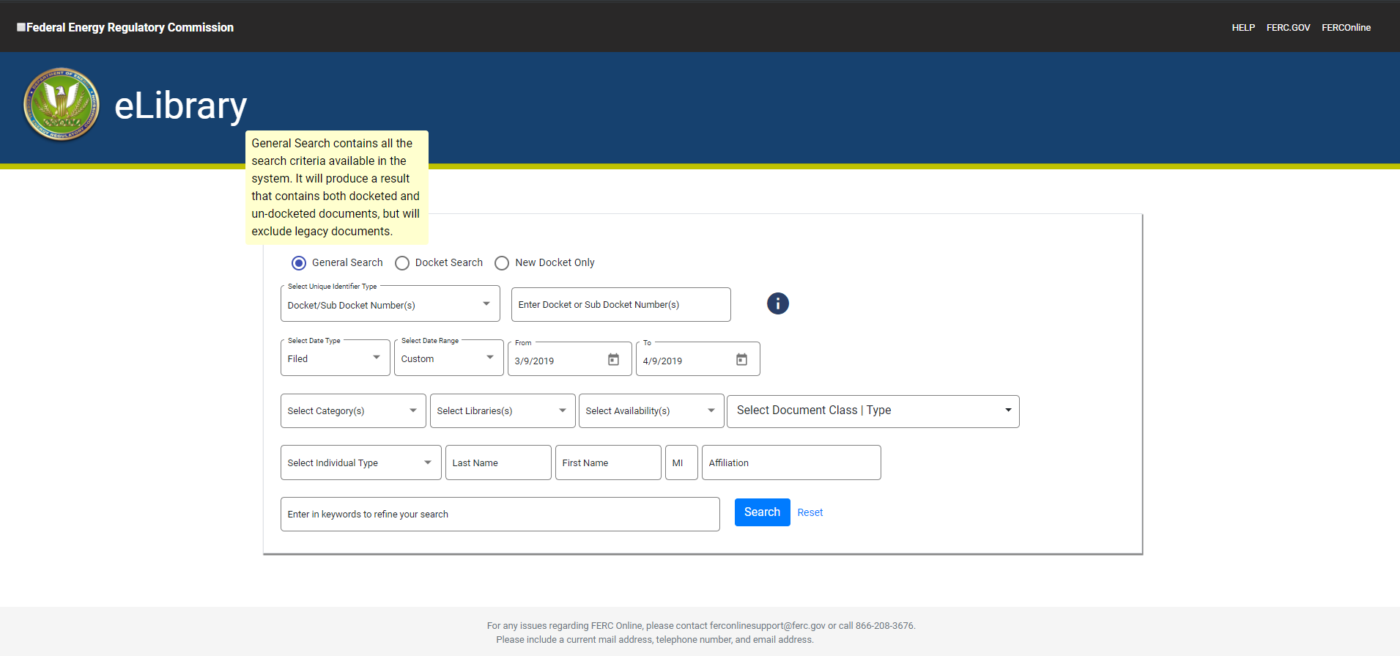
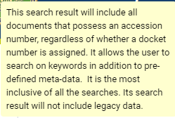
Improved Field Level Help Features

Slide 33
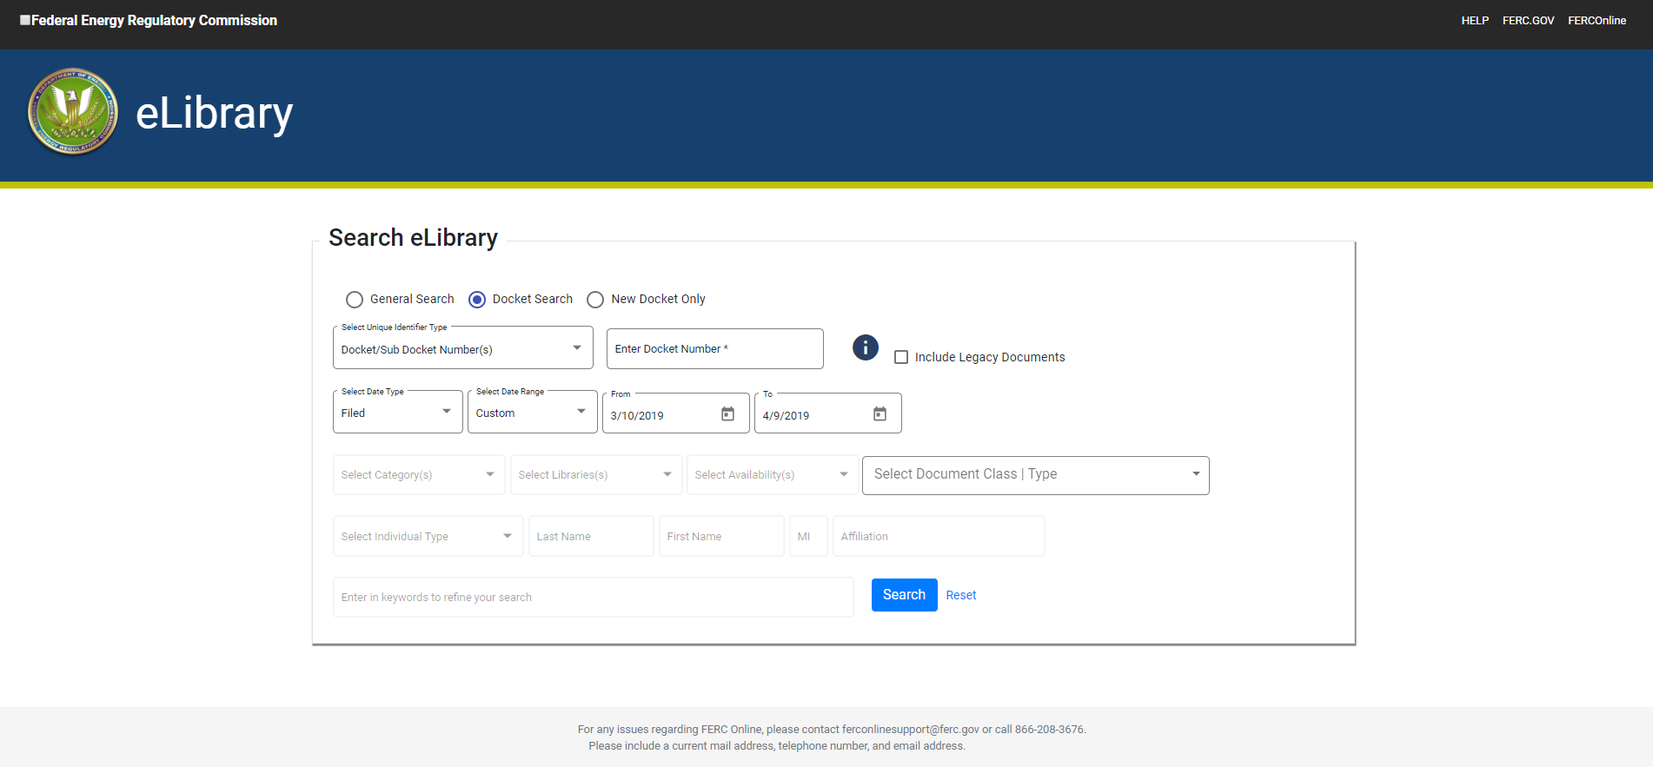
Docket Search

Slide 34
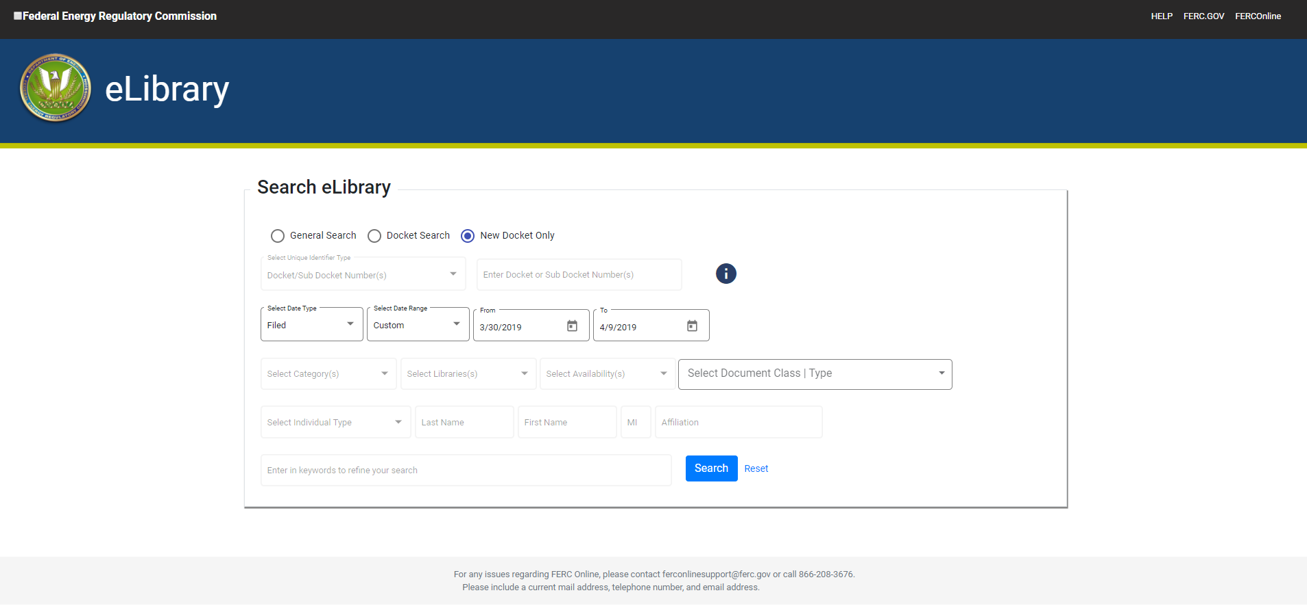
New Docket Search

Slide 35
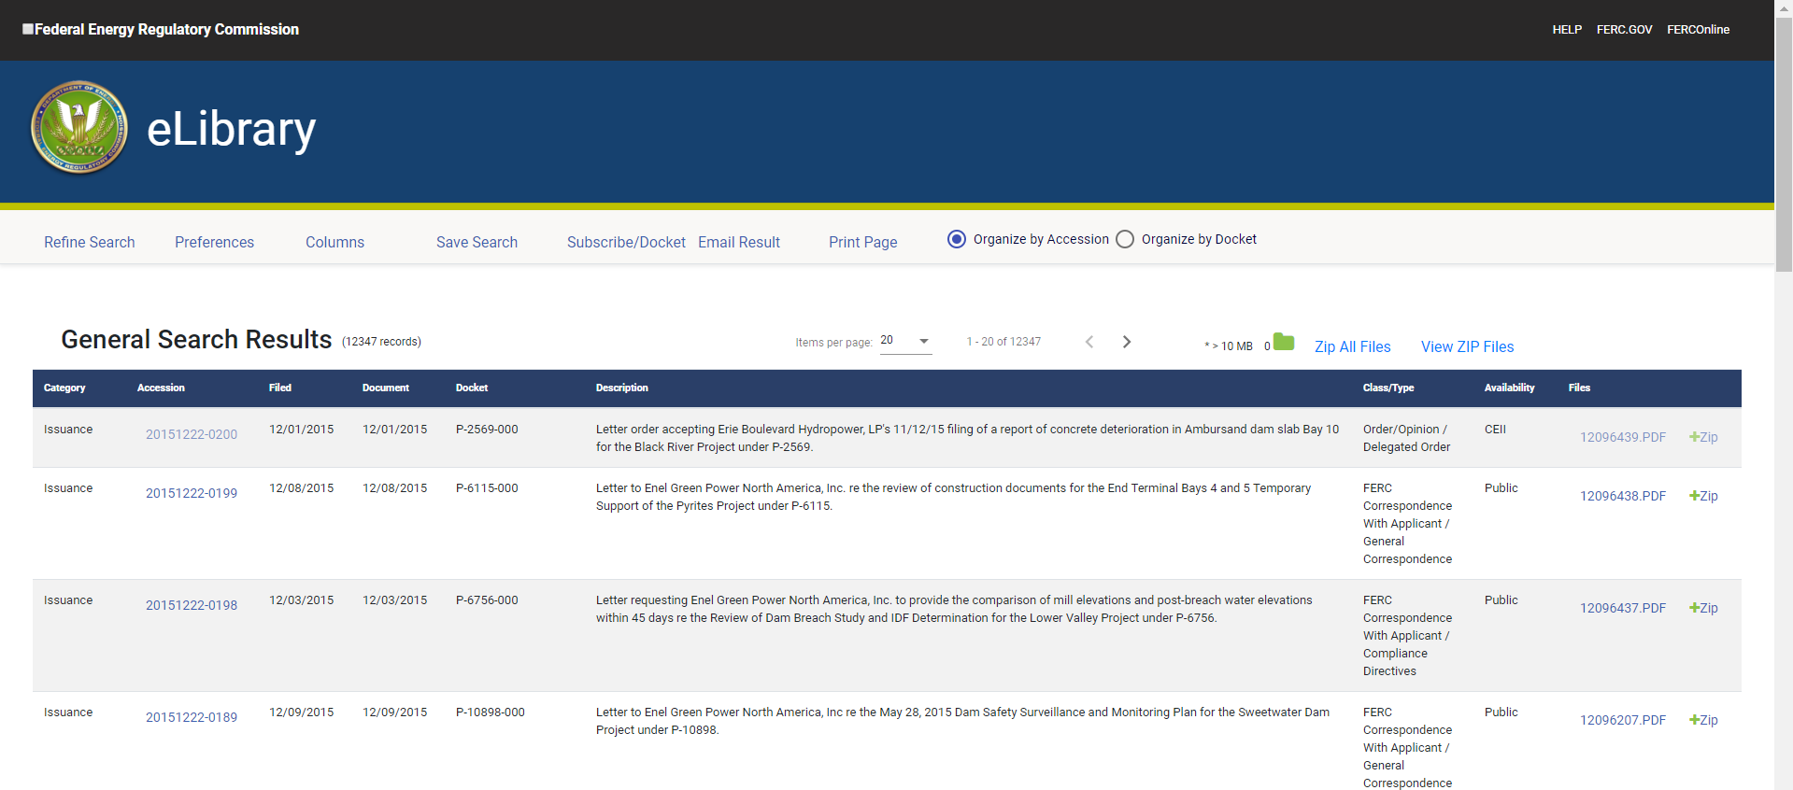
General Search Result

Slide 36
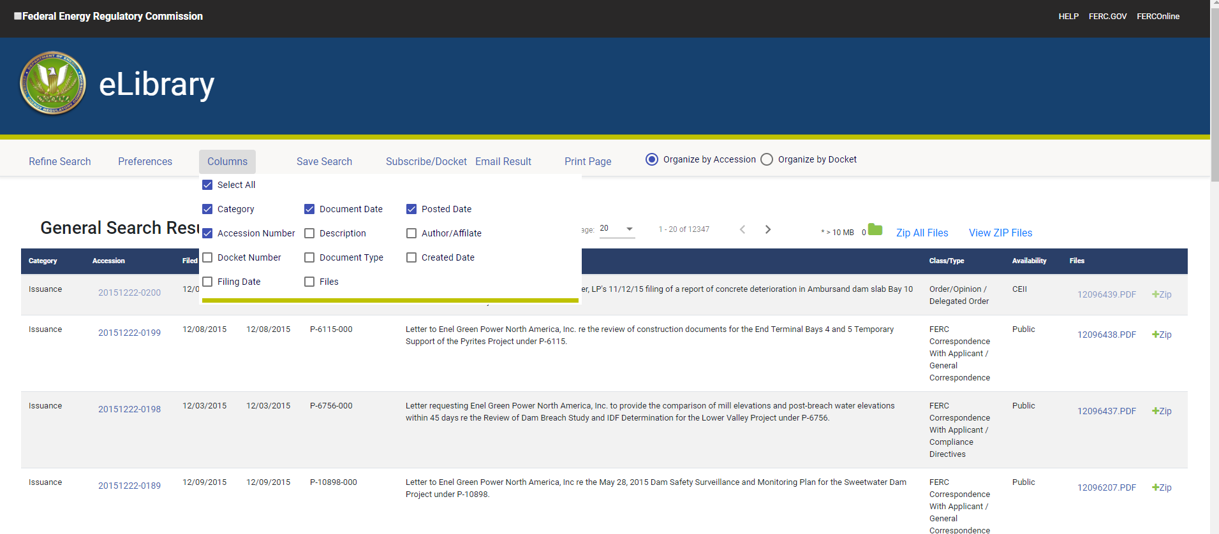
New Column Selection Feature

Slide 37
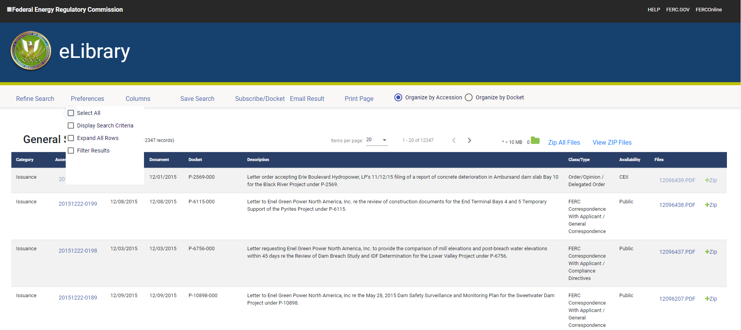
New Preferences Feature

Slide 38
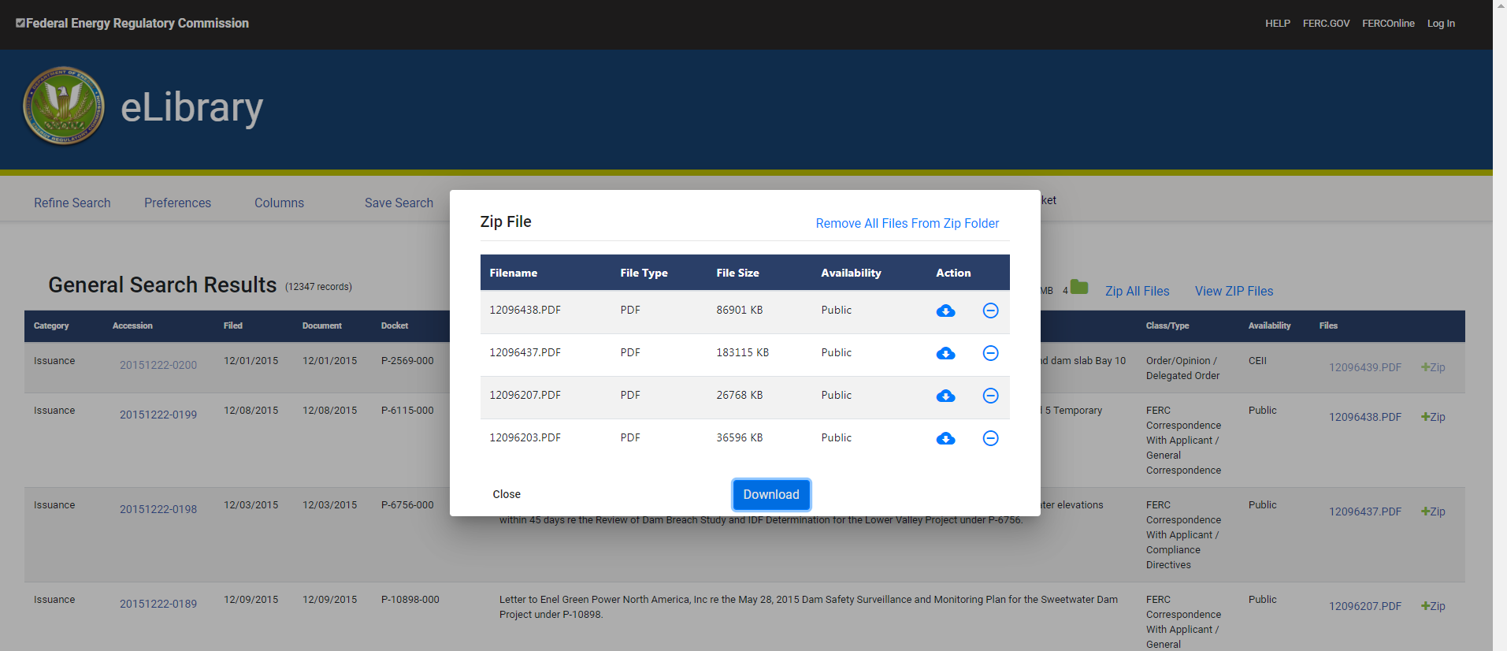
New Zip Folder

Slide 39
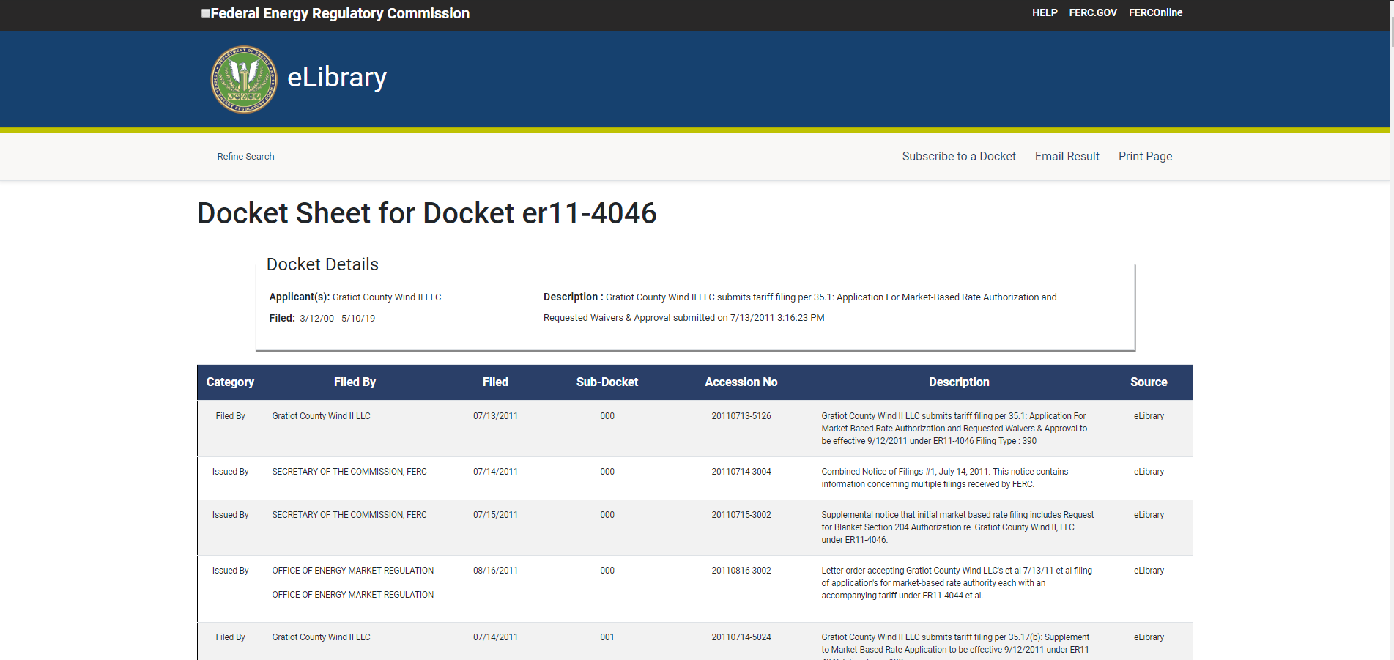
Docket Sheet

Slide 40
We hope you like the new eLibrary. Please take a moment to provide feedback here

