Slide 1
eLibrary Web Search Modernization
May 2019
Federal Energy
Regulatory Commission (FERC)

Slide 2
eLibrary Web Search Modernization
Fast
Fast search results
1-click download, zip files or pdf creation
Easy
Search screens are consolidated
Look and feel is clean and modern
Navigation is simpler
Reliable
Less Downtime
Reliable PDF Conversion
Enhanced Security
Customizable
Select the number of rows per page
Select which data appears in the search result
Organize search results by docket number or accession number

Slide 3
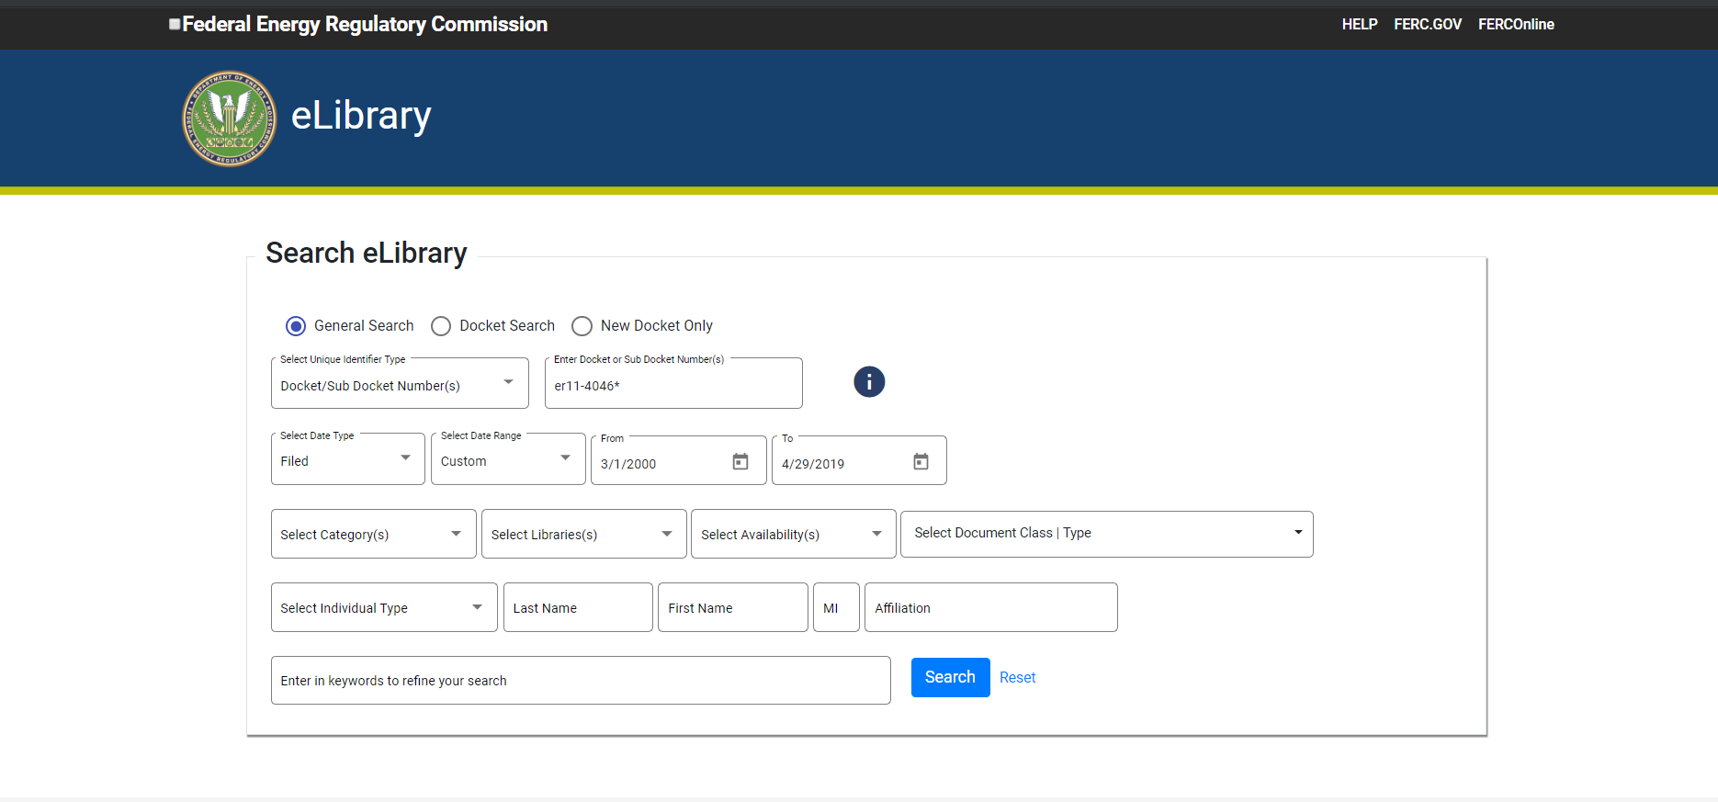

Slide 4
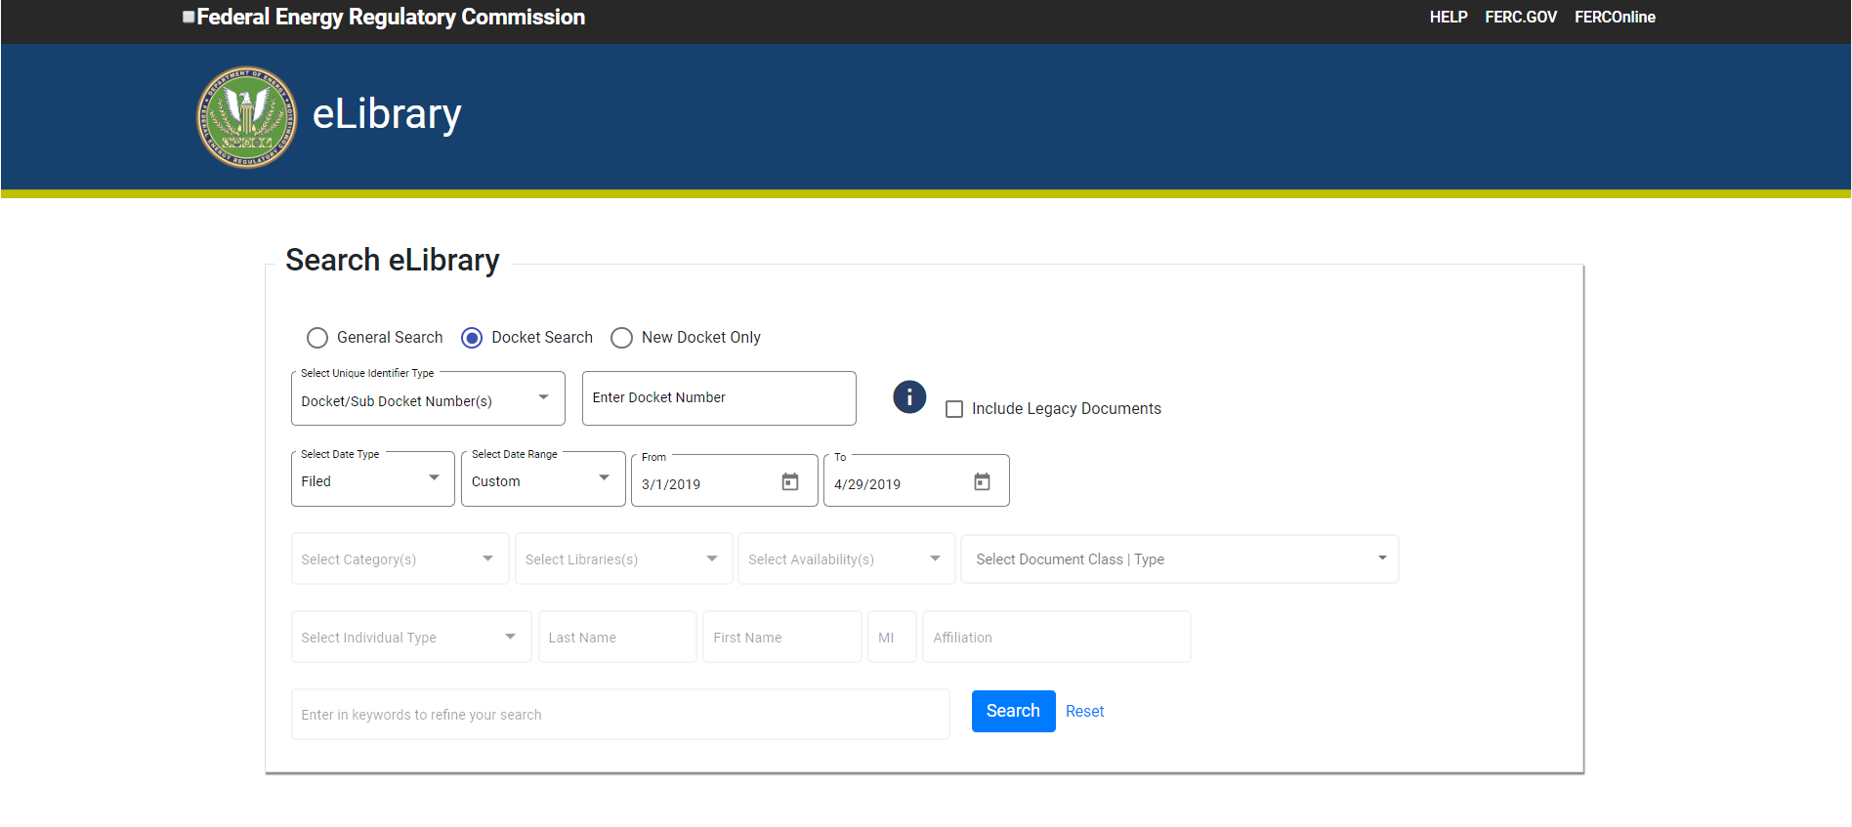

Slide 5
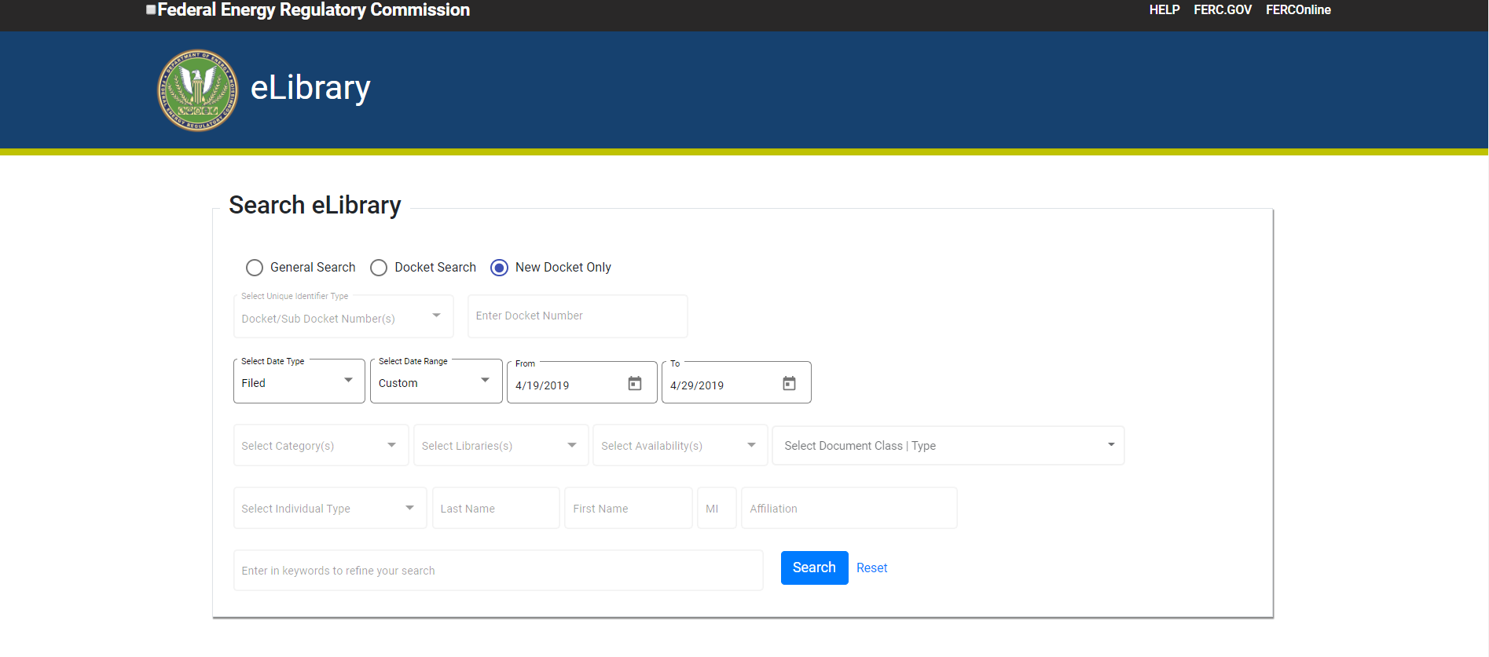

Slide 6
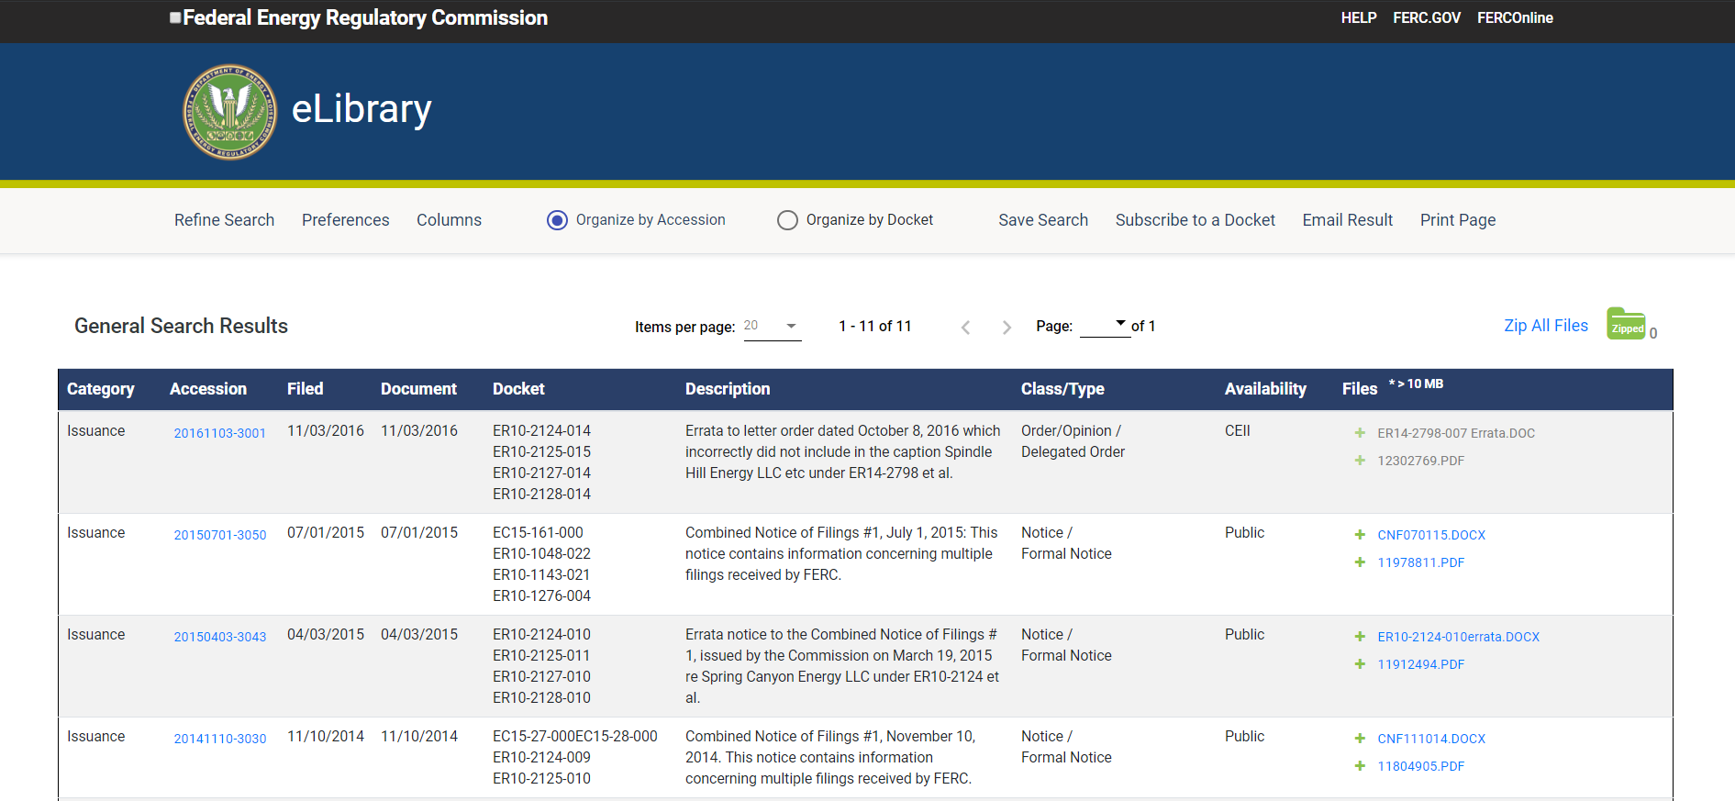

Slide 7
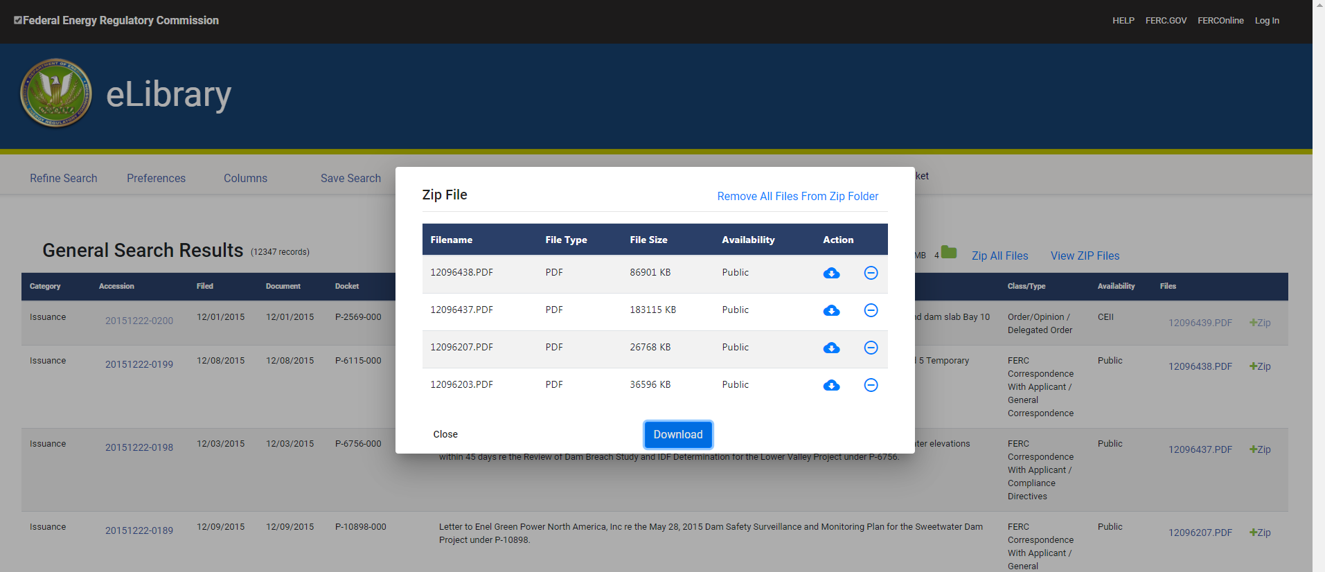

Slide 8
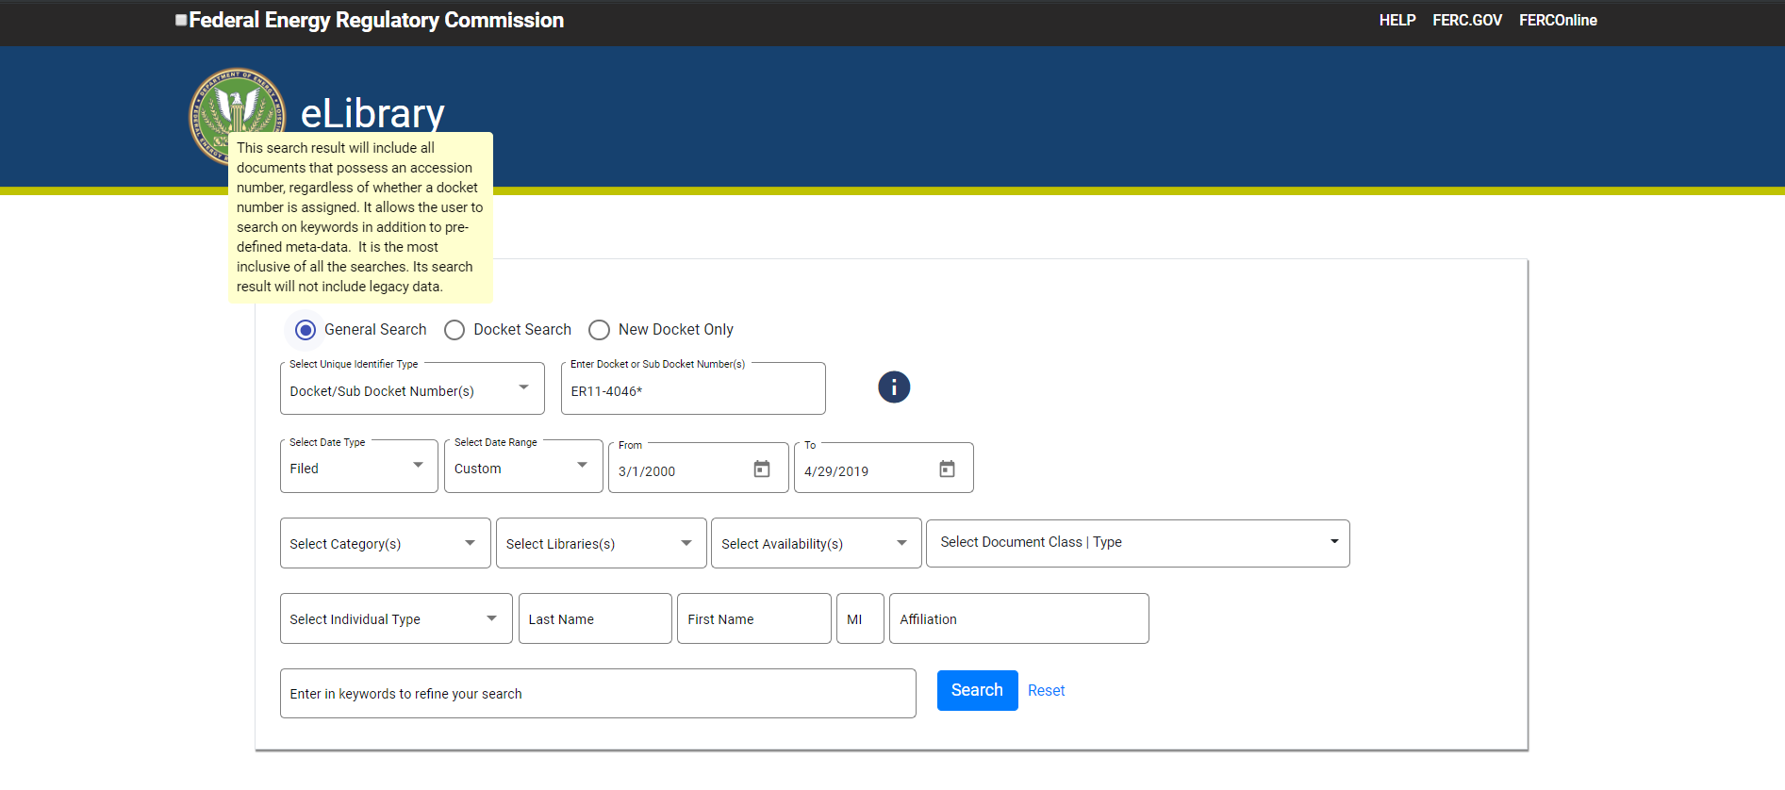

Slide 9
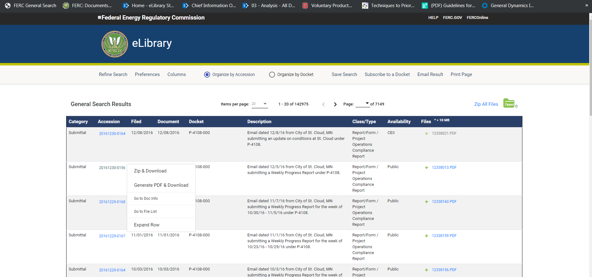

Slide 10
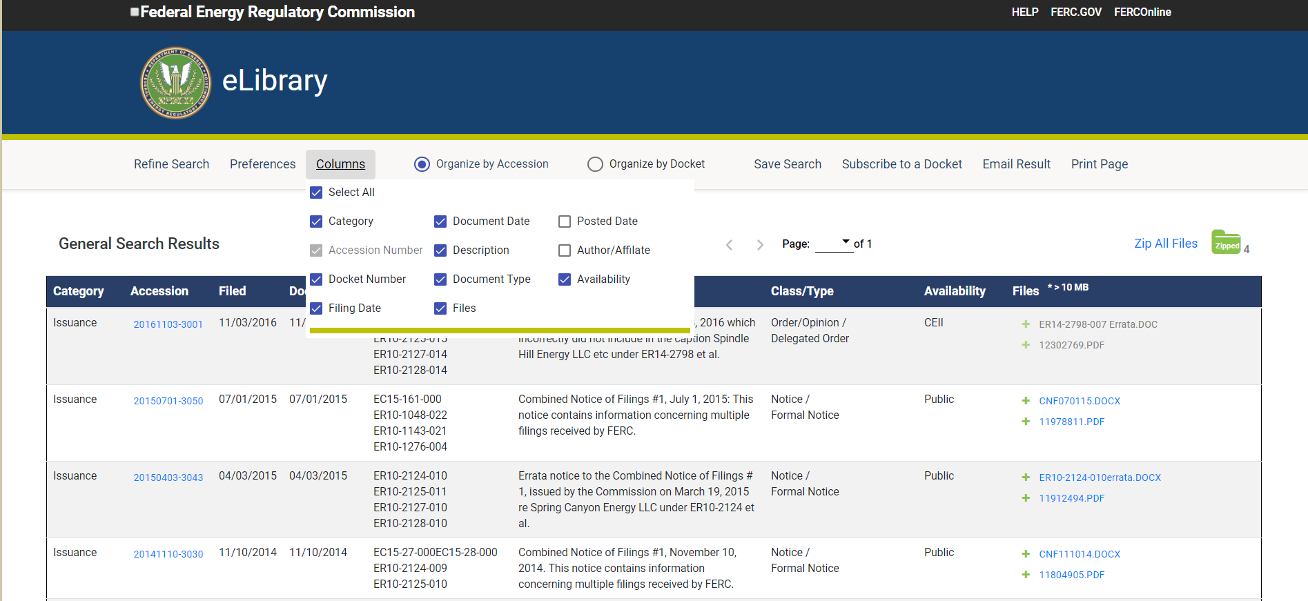

Slide 11
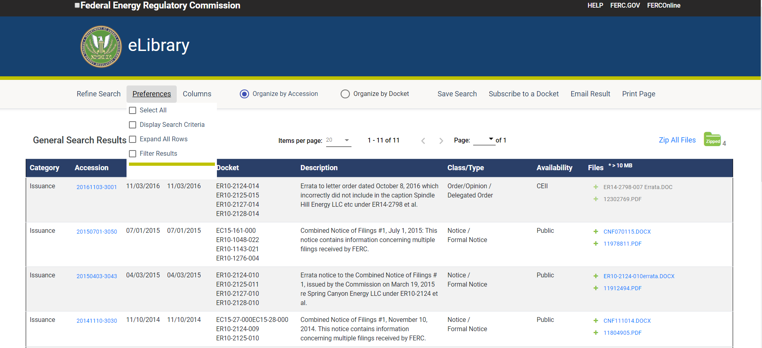

Slide 12
eLibrary Web Search Modernization
We hope you like the new eLibrary! Please take a moment to provide feedback here
To see a more detailed overview contrasting the previous and new search and search results pages, click here

