Slide 1
EXIS
Screenshots
Online Exercises & Survey

Slide 2
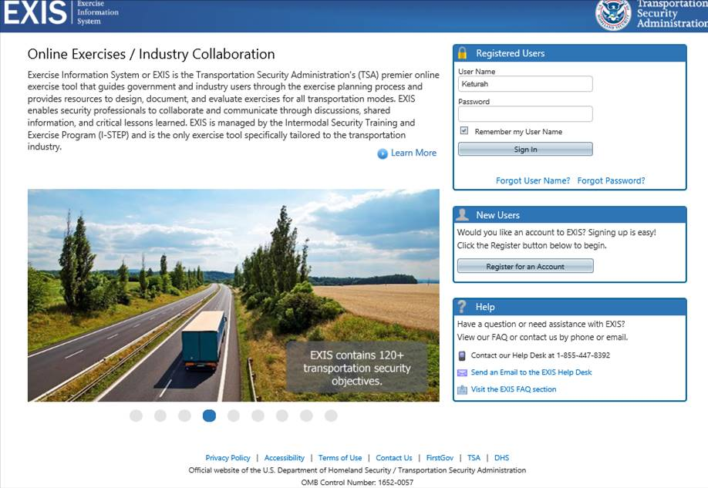

Slide 3
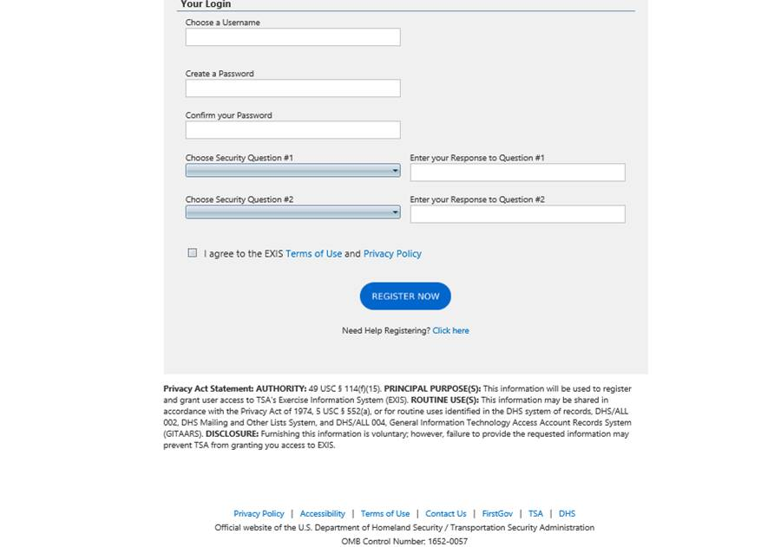
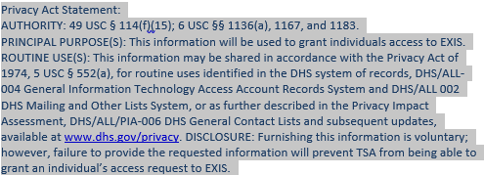

Slide 4
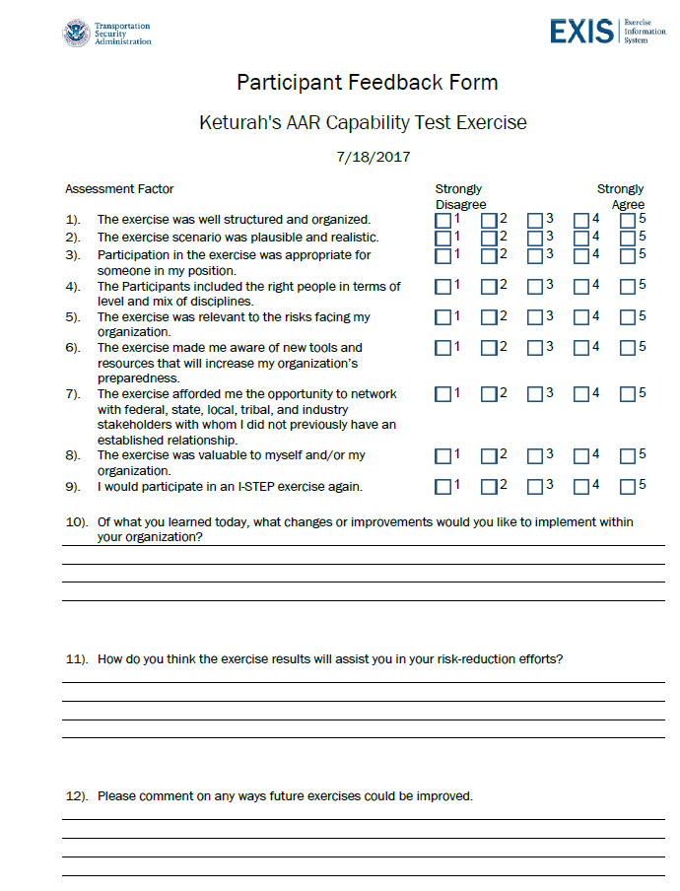
OMB Control No: 1652-0057
Exp.: 04/30/2018

Slide 5
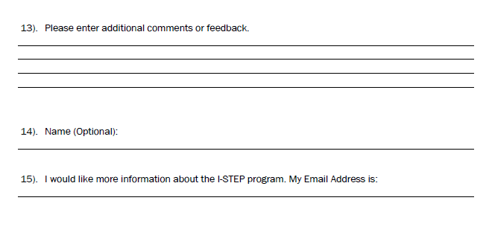
OMB Control No: 1652-0057
Exp.: 04/30/2018

Slide 6
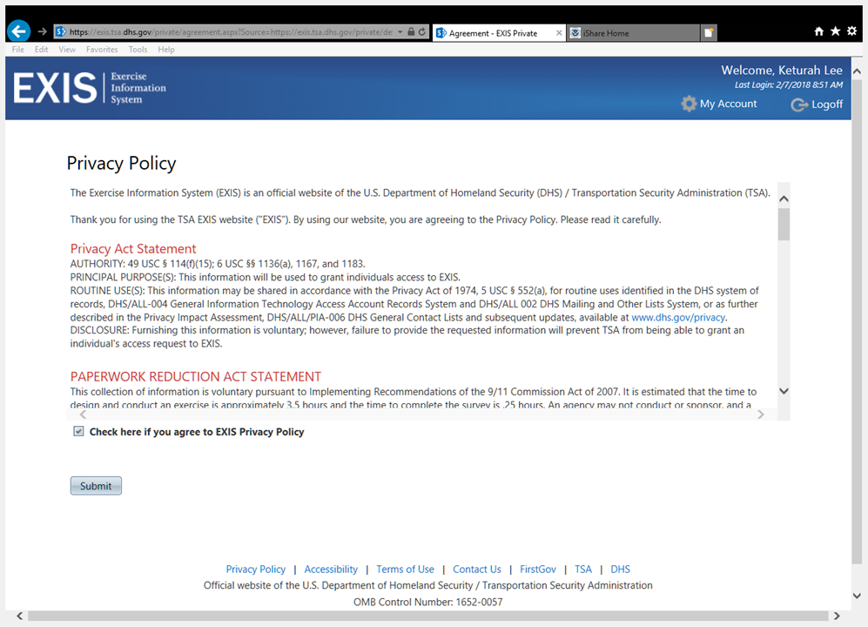
OMB Control No: 1652-0057
Exp.: 04/30/2018

Slide 7
