Slide 1
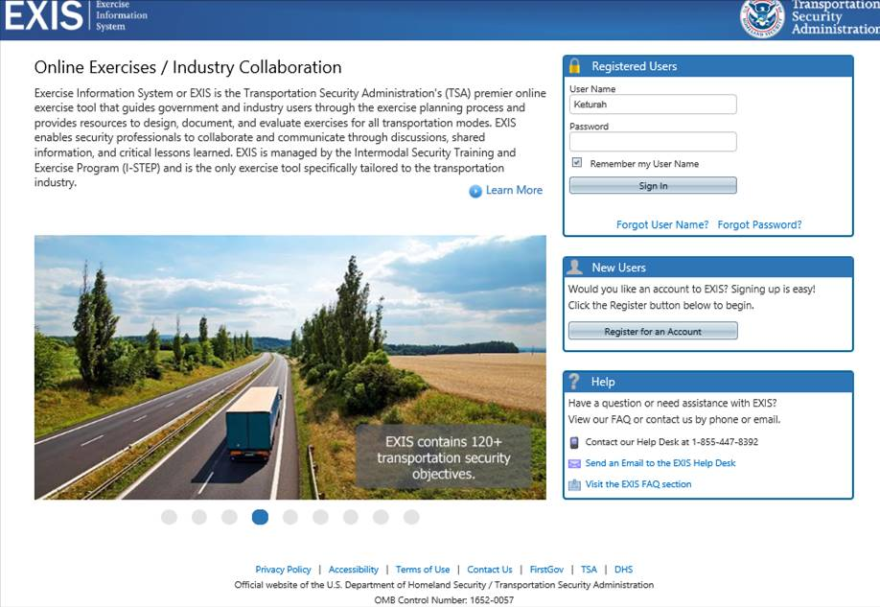

Slide 2
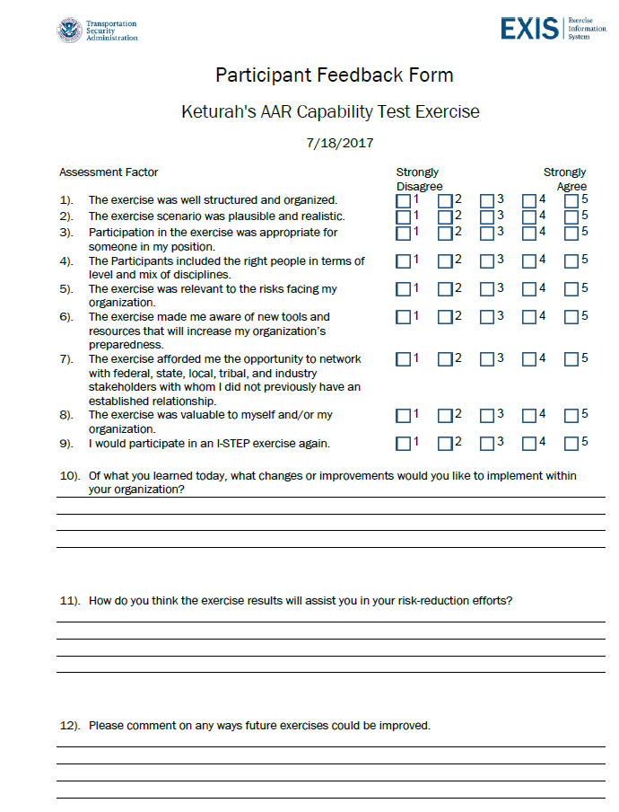
OMB Control No: 1652-0057
Exp.: 04/30/2018

Slide 3
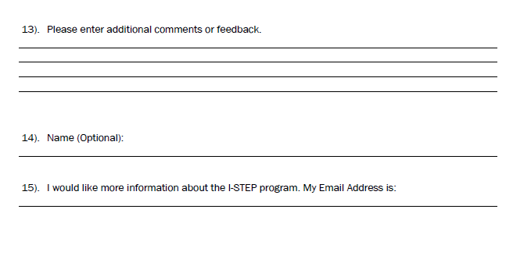
OMB Control No: 1652-0057
Exp.: 04/30/2018

Slide 4
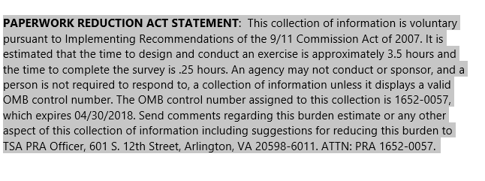

Slide 5
Privacy Act Statement:
AUTHORITY: 49 USC § 114(f)(15); 6 USC §§ 1136(a), 1167, and 1183.
PRINCIPAL PURPOSE(S): This information will be used to grant individuals access to EXIS.
ROUTINE USE(S): This information may be shared in accordance with the Privacy Act of
1974, 5 USC § 552(a), for routine uses identified in the DHS system of records, DHS/ALL-
004 General Information Technology Access Account Records System and DHS/ALL 002
DHS Mailing and Other Lists System, or as further described in the Privacy Impact
Assessment, DHS/ALL/PIA-006 DHS General Contact Lists and subsequent updates,
available at www.dhs.gov/privacy. DISCLOSURE: Furnishing this information is voluntary;
however, failure to provide the requested information will prevent TSA from being able to
grant an individual’s access request to EXIS.

