Slide 1
The FEMA Operations Center Presents:
ENS!
New Creator (POC) training course

Slide 2
PRIVACY ACT STATEMENT
AUTHORITY: The Homeland Security Act of 2002; the Robert T. Stafford Disaster Relief and Emergency Assistance Act as amended, 42 U.S.C. § 5121–5207; National Security Presidential Directive (NSPD)-51/Homeland Security Presidential Directive (HSPD)-20; Federal Continuity Directive (FCD)-1; and FEMA Directive 262-3.
PURPOSE(S): This information is being collected to enable DHS/FEMA to send notifications, alerts, and/or activations and to relay critical updates and guidance to DHS personnel, other federal departments, and other agencies or non-governmental organizations in response to an emergency scenario or exercise.
ROUTINE USE(S): The information on this form may be disclosed as generally permitted under 5 U.S.C. § 552a(b) of the Privacy Act of 1974, as amended. This includes using this information as necessary and authorized by the routine uses published in DHS/ALL-014 - Department of Homeland Security Emergency Personnel Location Records System of Records October 17, 2008, 73 FR 61888.
DISCLOSURE: The disclosure of information on this form is voluntary; however, failure to provide accurate information may delay or prevent the individual from receiving notifications in the event of an emergency.

Slide 3
For those that are POCs within ENS, we must provide you with the following, which you must provide to all of your users:
VERBAL PRIVACY NOTICE (EN SYSTEM)
“We are required by law to provide the following Privacy Notice to you. The information that you give the Department of Homeland Security, Federal Emergency Management Agency, is collected under the Homeland Security Act of 2002, the Robert T. Stafford Disaster Relief and Emergency Assistance Act, and other authorities. It will be used to send notifications, alerts, and/or activations and to relay critical updates and guidance to DHS personnel, other federal departments, and other agencies or non-governmental organizations in response to an emergency scenario or exercise. DHS/FEMA may share this information outside the agency upon written request, by agreement, or as required by law. Furnishing the requested information is voluntary, but failure to provide accurate information may delay or prevent the individual from receiving notifications in the event of an emergency.”

Slide 4
Expectations from this course
A general understanding of ENS
Adding and editing:
    Contacts
    Groups
When this course is finished you should have good working knowledge of ENS, be able to create new, or edit existing, contacts and groups.

Slide 5
ENS Capabilities
ENS is capable of notifying people via:
Telephone: Work, home, cell
Email
SMS
Qualification methods are available through Email and Telephone.
Automated Reports are sent to contacts at any given time during a scenario.

Slide 6
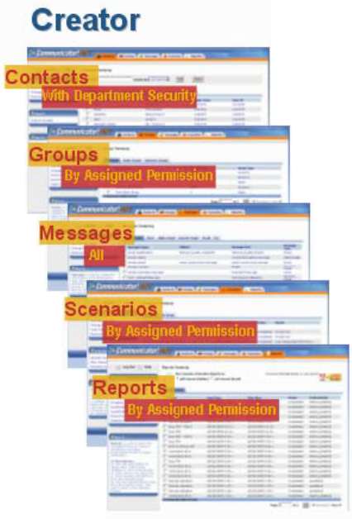
Creator
Creators have rights similar to that of a User, but with a little more. These roles are given mostly to POCs, with rights to their groups and their department, this way they can manage their own people. A creator is able to see the following tabs:
Contacts
Groups
Other tabs are viewable, but should not be modified by a Creator with the POC role.

Slide 7
Creators are the security role we typically give to Point of Contacts in ENS. Each Creator is given specific rights to contacts and groups based on their needs.
For the Contacts tab, Creators are given rights to their departments, which gives them to ability to modify basic information on a contact.
Much like the Contacts tab, access to the groups tab will only include the groups that a Creator has rights to. They are able to modify the members, or requirements, for the groups they are given rights.
The messages tab is fully open to Creators, but we ask they don’t modify any messages.
The Scenarios and Reports tab are also viewable as a Creator, but you should not access them as a POC.

Slide 8
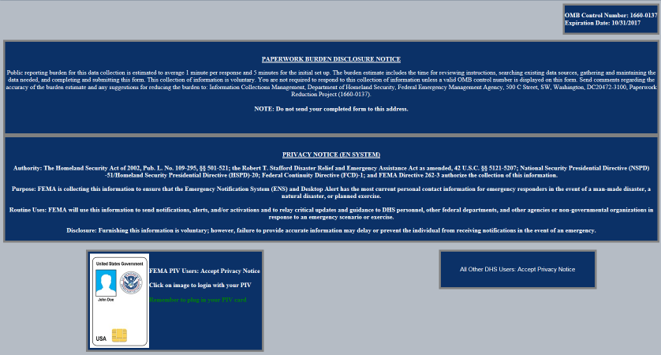
Login Page
This is the login page for ENS. It is the same for all three servers, so before logging in it is important to note the URL.
https://ens1auth.dhs.gov/
Logging into either ENS2 or 3 during unauthorized times will break Datasync.

Slide 9
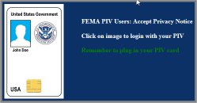

FEMA users must click on PIV image and all other users must click on “All Other DHS Users” image.
FEMA users must click on PIV image
All Other DHS Users must click on “All Other Users” image

Slide 10
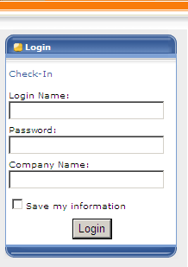
Only “All Other DHS Users” will see this login screen. FEMA users will login with PIV.
Login Name: Typically first initial of the first name and entire last name, a number may be included if there is a duplicate.
Password: Complex password decided by the user.
Company Name: Agency database you will log in to your company (ex. DHS, USCIS, CBP, etc.)
Note: Login credentials will not work the same for all companies.

Slide 11
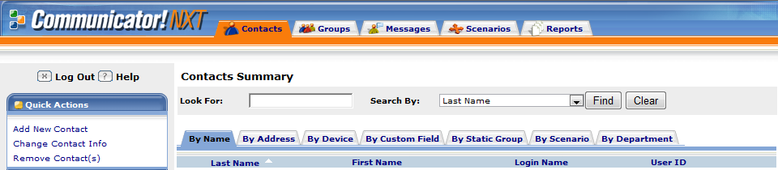

Contacts Tab
The contacts tab is where you can find all the contacts that are entered into ENS. As a Creator you will see contacts based on which department you are given rights to manage.
Each sub-tab gives different options on how to search for a contact. These are the available options for the “By Name” Sub-tab.

Slide 12
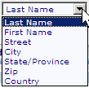
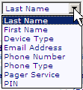

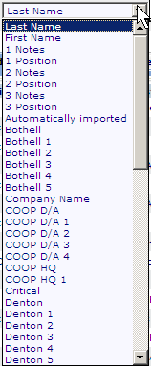


Other search methods are available in ENS, such as:
By address:
By device:
By group:
By custom field:
By scenario:
By department:
Each category has their own unique set of search criteria.
You can also search using wild cards. By adding a %
at the beginning and end of your search value ENS
will provide a list of contacts similar to what you’ve searched for. These wild cards can be used throughout the search functions in ENS.

Slide 13
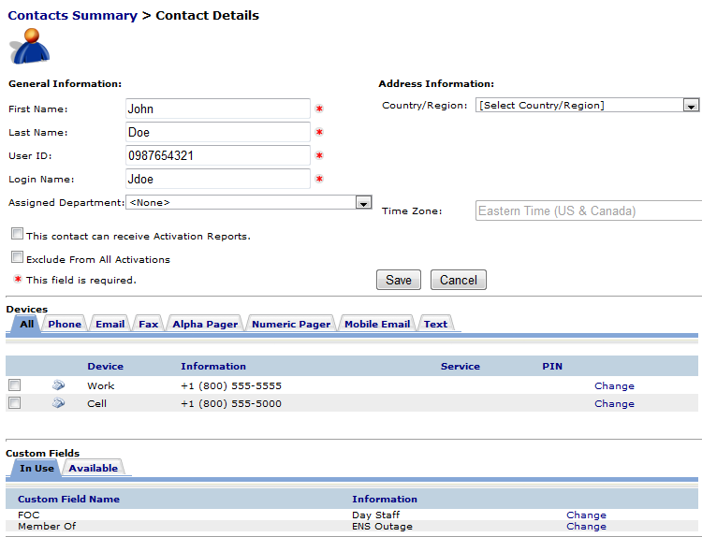
Contact information
This is the basic layout for contact information. The top section is the users general information. The middle section is where the contact devices are maintained. The bottom section is for custom fields, which are associated with dynamic groups, and will be discussed more in the groups section.
In the following section we will be going over the contact information section in detail.

Slide 14
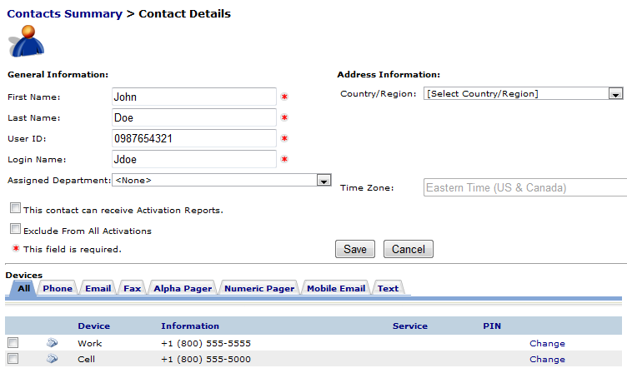
Users have a set of basic information that must be filled out to be in ENS.
First Name
Last Name
User ID
Login Name
User IDs are typically a user’s phone number (Home, Cell, or Work in that order)
Login Name is a user’s first name initial followed by the last name, and if that is already taken then a number is added to the end.
Devices are the way in which a user is contacted by ENS during a scenario. Typical devices include:
Phones (Work, Cell, Home)
Email
SMS
Numeric or Alpha Pagers

Slide 15


From the Devices section of the Contact Information page you will see tabs for each of the devices ENS can contact. By clicking on the tab it will bring up a section to add new device information.
From here you can select the type of phone device, the phone number and extension if needed, and then add it to your contact information. It will show up below in the Devices once added.
Email is added in a similar fashion. Simply enter your email address and click Add.
If you entered any of the information incorrectly you can always change it by clicking the change link to the right of the device.
After the change has been made, click the save link.

Slide 16

SMS devices fall under the Text tab within a contact’s devices. Adding a new SMS device is simple. Click the Text tab, select the Cassidian SMS Gateway from the drop down, enter the number of the SMS device, and click Add.
Once the device is added you will see something similar to the below image:
Note the header “SMS Opt State” marked as NO. This means the SMS device has not gone through the Opt-in Process yet. To Opt-in a new SMS device send a text from the device to 34292 with the message “Join FEMASMS”. You will receive a confirmation text which looks like this:
“Verify code-URKGHSHOQC (StdRate). Max 30 alerts/month. Msg&DataChrgs may apply. Reply STOP to end, HELP for info. T&C:sms.plantcml-eads.com”.
Allow 24 hours before Opt-in process completes. To stop or Opt-out, text “Stop” to 34292. Standard texting fees apply.

Slide 17
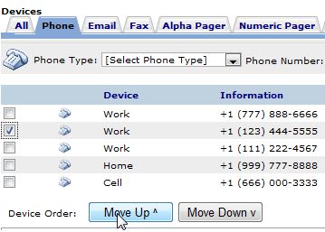
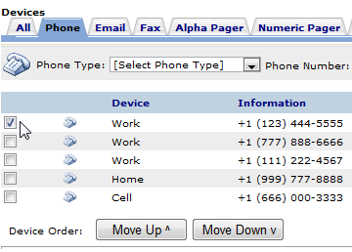
Contacts are able to change their device order in their contact information page. This allows a contact to determine which phone number or email (or other device type) they wish to be contacted by in the event they have multiple numbers/addresses for the same device. For instance:
By clicking on the check box next to the device and clicking the Move Up button, that work phone was moved ahead of the others. This means that if a scenario contacts by work phone, the top work phone will be contacted first. This does not change the scenario device order, which is still set up in the scenarios.
As a creator in the system you are also able to perform these functions within a contact’s devices.

Slide 18
Mobile Email is an option for sending messages as well. These work a lot like an SMS message. These are simply short messages that are sent out from ENS through email, then changed over to a text message as it arrives at the contacts phone. With that in mind you have restrictions similar to SMS (160 character limit which includes the subject line).
When you add a mobile email to your contact information you need to add the correct extension for your service provider. Below is a quick look at a couple of providers and the extensions they use for mobile email.
AT&T: 65587549273@txt.att.net
Verizon: 34816759434@vtext.com
These values are added into ENS just like an email, but they must have the correct extension to work properly.
Also it is important to note that phones are beginning to pick up on emotion icons, and since the email is converted to a text be sure to avoid using certain combinations of symbols and letters. ( :), :(, :P, :D, =D, =P, etc…)

Slide 19
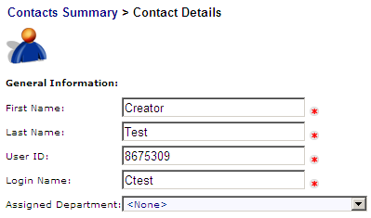
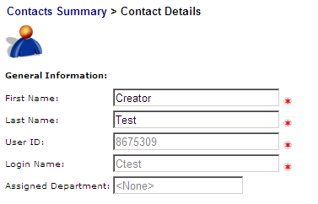
Once a contact has been set up in the system, with an email in their devices, it may take up to 24 hours for them to become a Roster User. These are users that are able to change their own basic contact information in ENS.
When the system automatically makes a contact a roster user the system will contact them with their login information for the system. The system will automatically create a password for them, and use the login name you gave them.
As a Creator you are able to change that information as well, but once they become a Roster User you will no longer be able to change their User ID or Login Name. These are issues that will have to get passed up to an Administrator. Also as a Creator you will be unable to change passwords for your contacts, that will have to be done by an Administrator.
Before becoming a roster user
After becoming a roster user

Slide 20
Groups tab
Groups are utilized by ENS to include different contacts in a scenario. The only way a person can be contacted by ENS is by being a member of a group.
There are 2 basic types of groups we will be discussing: Static and Dynamic. Below is some basic information on each type.
Static groups:
Typically used for on the fly activations
Allows for calling in order of importance, it can call a supervisor before the rest of the contacts
Very intuitive and easy to add and remove users
Dynamic groups:
Great for grouping users with a common value, such as location or shift
Able to add users quickly during an import of new contacts
Removal of contacts from the group requires a change to their contact information

Slide 21
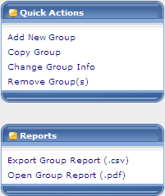
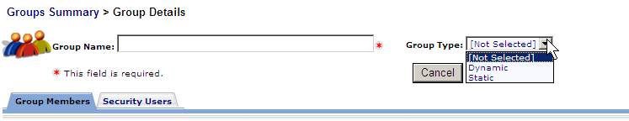
This is the quick actions menu that you will find on the left hand side of the groups tab. Here you can select the different options available to you when working with groups.
Below that is the reports you can generate from a selected group. They can be generated as either a pdf file or a csv file.
When you click on the Add new group option from the quick actions you will be brought to the following screen, where you add a name to the group and select the type.
We will start by working with a Static group, showing you how to create one, add and remove contacts, and some information on the security users option.

Slide 22
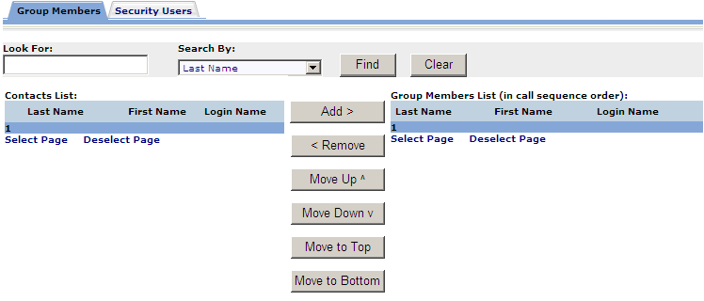
Static Groups
Static groups are the more basic of groups available in ENS. They allow for quick adding and removing of contacts, plus ease of use.
Once we have selected a static group type from the previous menu it will become populated with more information, such as the list of available contacts that can be added to the group, a search function, and a list of the group members. Below is a view of what a static group looks like.

Slide 23
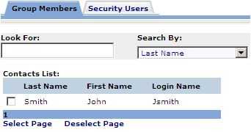


This section of the static group is the contacts list. This is where you search through the list of available contacts and select which ones you would like to add. From the search by box there is a wide variety of methods you can search for a contact.
Once a contact is selected you click on the add button to have them moved to the group members list on the right hand side.
Now that this user is on the group members list they are a member of that group, and can be contacted if this group is added to a scenario. It’s as simple as that!
To remove a user you have to select one from the group members list and click remove. Once they are removed from the group members list, they will not be a part of that group.

Slide 24
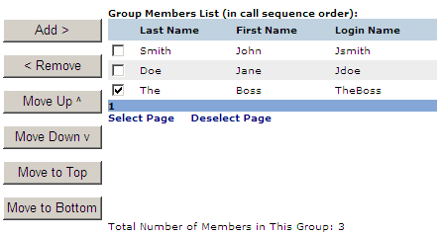
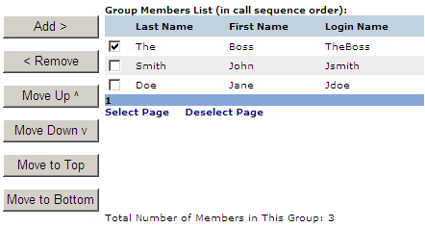
Another feature to static groups is the ability to move users around in the call order. As you can see The Boss is at the bottom of this group right now. By selecting them and clicking any of the “Move” buttons we can situate this user in the group.
By clicking on the “Move to Top”, we were able to move The Boss to the top of the group, and he will be contacted first out of this group.
With static groups we are able to set the call order so that the people that need to know first can be contacted first.
This is how you would create, add and remove users, and order them in a calling sequence.

Slide 25
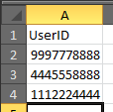
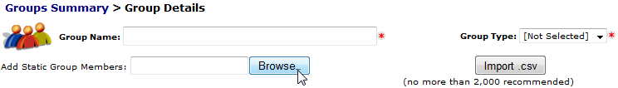
Alternatively, before selecting a Static group or Dynamic group there is a section that will allow you to add static group members via a CSV file. To do this though you need to do it prior to selecting your type of group, otherwise this option disappears. To do this, you need to start with a CSV file containing all of the contacts you want to add to the group. The CSV file can be created in excel, it just has to be saved as a CSV, instead of xls or xlsx. As for the information within the CSV file, you only need the User ID’s of the individuals you are adding to the group. As you can see from the image below, you need a header which reads UserID, and the User Id’s of the individuals below that header. This is the required layout for the CSV file. All other information in the CSV file will be ignored on import.
Once the CSV is saved you will have to create a new group in ENS.
The new group screen will look blank except for what you see above. To add group members you simply browse for the CSV file you created and click the Import CSV button.

Slide 26
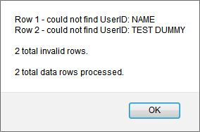
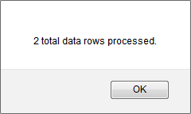
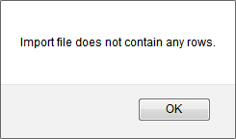
The program will process your csv file once you’ve clicked the Import CSV button and provide some input in the form of a pop up, such as:
Entered correctly
Entered Information in
columns instead of rows
Entered actual names
instead of User ID’s
Once it has completed you will see a static group containing the list of group members. At that point you can find any other contacts and add them as you desire, but you cannot import another list of static group members to that group. Group members you are looking to add via CSV must already be in ENS with an established User ID.
As stated prior, you can only do this on new groups. Once a group has been given a group type you cannot import group members.

Slide 27
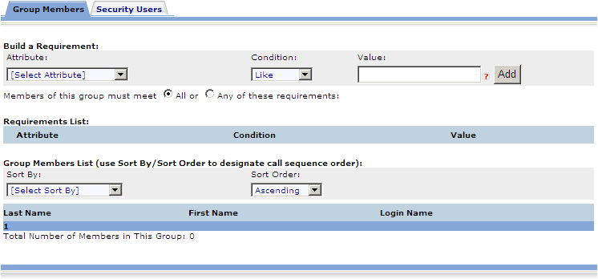
Dynamic Groups
Dynamic groups are the other available group type, and widely used within ENS. The function of a dynamic group is to group contacts based on a common value. This is done through the use of custom fields, or a contact’s information, which you may have seen while working with the contact tab.
Once you select the group type for dynamic, when creating a new group, you will see this populate the screen:

Slide 28
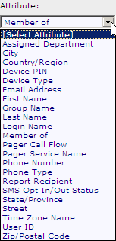


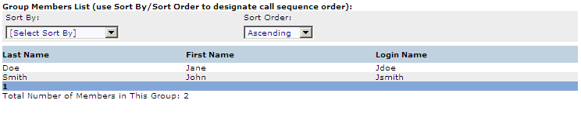
When working with a dynamic group you must select an attribute:
And a value which is common with the contacts you are trying to add.
As well as a condition that must be met.
Then by clicking Add the following will appear under Requirement list:
Any contacts with this value in that specific attribute will be added to the group and appear as:

Slide 29

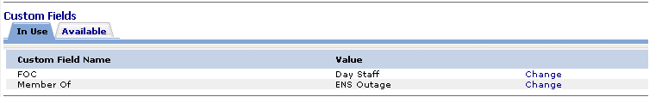
You can also sort the dynamic group which will allow for a different calling order.
The selection for Sort by is that of your available custom fields, and you can sort this list in Ascending or Descending order.
Custom fields are set up to go along with dynamic groups. A user can have information entered into this area that will assign them to a group. A certain value in a specific custom field name will make that user a member of a group, grouping based on a common set of values.
In the example above we could create a dynamic group that looks for users with a value of “ENS Outage” in the Member of attribute, and it will grab every contact with that value in that specific attribute, making them a member of that dynamic group.

Slide 30
Questions?
Contact your ENS POC, or the ENS Admin team at ENS-Admin@fema.dhs.gov with any questions you may have.

