Slide 1
The FEMA Operations Center Presents:
ENS!
New Roster User training course

Slide 2
PRIVACY ACT STATEMENT
AUTHORITY: The Homeland Security Act of 2002; the Robert T. Stafford Disaster Relief and Emergency Assistance Act as amended, 42 U.S.C. § 5121–5207; National Security Presidential Directive (NSPD)-51/Homeland Security Presidential Directive (HSPD)-20; Federal Continuity Directive (FCD)-1; and FEMA Directive 262-3.
PURPOSE(S): This information is being collected to enable DHS/FEMA to send notifications, alerts, and/or activations and to relay critical updates and guidance to DHS personnel, other federal departments, and other agencies or non-governmental organizations in response to an emergency scenario or exercise.
ROUTINE USE(S): The information on this form may be disclosed as generally permitted under 5 U.S.C. § 552a(b) of the Privacy Act of 1974, as amended. This includes using this information as necessary and authorized by the routine uses published in DHS/ALL-014 - Department of Homeland Security Emergency Personnel Location Records System of Records October 17, 2008, 73 FR 61888.
DISCLOSURE: The disclosure of information on this form is voluntary; however, failure to provide the information requested may delay or prevent the individual from receiving disaster assistance.

Slide 3
Expectations from this presentation
A general understanding of ENS
The ability to edit your contact information
How to respond to activations
Where to find your Point of Contact for ENS
When this course is finished you should have good working knowledge of ENS, be able to edit your contact information, and respond to scenarios when activated.

Slide 4
ENS Capabilities
ENS is capable of notifying people via:
Telephone: Work, home, cell or other
Email
SMS/Mobile Email
Qualification methods are available through Email and Telephone.
Automated Reports are sent to specific individuals, such as supervisors, at any given point during an activation.

Slide 5
How to find ENS

Slide 6
Login Page
This is the login page for ENS. It is the same for all three servers, so before logging in it is important to note the URL.
https://ens1auth.dhs.gov/
Logging into either ENS2 or 3 during unauthorized times will break Datasync.

Slide 7
FEMA users must click on PIV image and all other users must click on “All Other DHS Users” image.
FEMA users must click on PIV image
All Other DHS Users must click on “All Other Users” image

Slide 8
Only “All Other DHS Users” will see this login screen. FEMA users will login with PIV.
Login Name: Typically first initial of the first name and entire last name, a number may be included if there is a duplicate.
Password: Complex password decided by the user.
Company Name: Agency database you will log in to your company (ex. DHS, USCIS, CBP, etc.)
Note: Login credentials will not work the same for all companies.

Slide 9
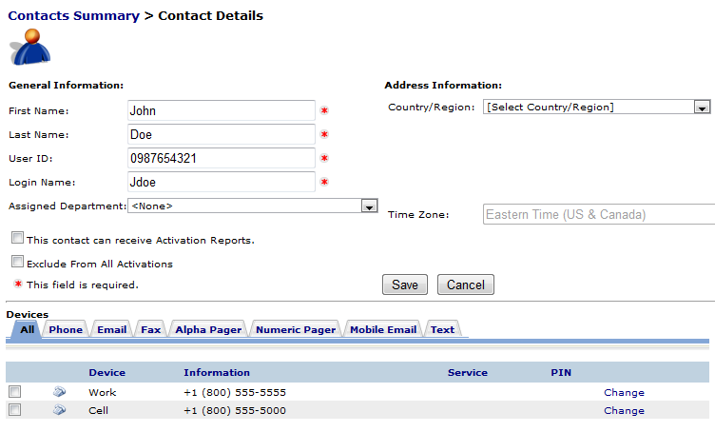
Roster Users
Roster users are the very basic users. They only have access to their own contact information and nothing more.
Once a roster user is entered into the system the most they can make changes to is their name, location, or devices. All other information is handled by the POCs.

Slide 10
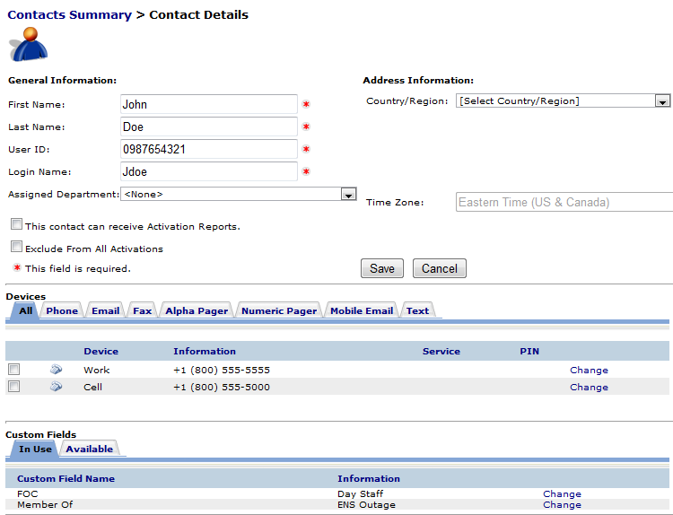
Contact information
This is the basic layout for contact information. The top section is the contacts general information. The middle section is where the contact devices are maintained. The bottom section is for custom fields, which are associated with dynamic groups. We ask that you do not modify any of this information as it affects your ability to be notified.
In the following section we will be going over the contact information section in detail.

Slide 11
Contacts have a set of basic information that must be filled out to be in ENS.
First Name
Last Name
User ID
Login Name
User IDs are typically a user’s phone number (Home, Cell, or Work in that order)
Login Name is a user’s first name initial followed by the last name, and if that is already taken then a number is added to the end.
Devices are the way in which a roster user is contacted by ENS during a scenario. Typical devices include:
Phones (Work, Cell, Home)
Email
SMS/Mobile email
Numeric or Alpha Pagers

Slide 12
From the Devices section of the Contact Information page you will see tabs for each of the devices ENS can contact. By clicking on the tab it will bring up a section to add new device information.
From here you can select the type of phone device, the phone number and extension if needed, and then add it to your contact information. It will show up below in the Devices once added.
Email is added in a similar fashion. Simply enter your email address and click Add.
If you entered any of the information incorrectly you can always change it by clicking the change link to the right of the device.
After the change has been made, click the save link.

Slide 13
SMS devices fall under the Text tab within a contact’s devices. Adding a new SMS device is simple. Click the Text tab, select the Cassidian SMS Gateway from the drop down, enter the number of the SMS device, and click Add.
Once the device is added you will see something similar to the below image:
Note the header “SMS Opt State” marked as NO. This means the SMS device has not gone through the Opt-in Process yet. To Opt-in a new SMS device send a text from the device to 34292 with the message “Join FEMASMS” (Enter your company in place of ****. For instance, You log in to the FEMA company to access ENS, so you would type Join FEMASMS into the text.) You will receive a confirmation text which looks like this:
“Verify code-URKGHSHOQC (StdRate). Max 30 alerts/month. Msg&DataChrgs may apply. Reply STOP to end, HELP for info. T&C:sms.plantcml-eads.com”.
Allow 24 hours before Opt-in process completes. To stop or Opt-out, text “Stop” to 34292. Standard texting fees apply.

Slide 14
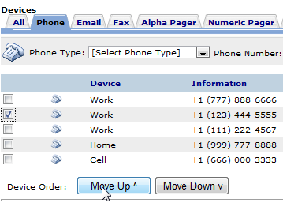
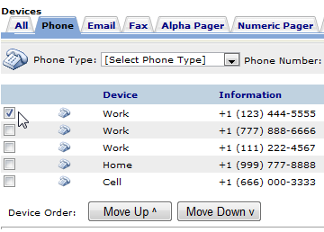
You are able to change your device order in your contact information page. This allows a you to determine which phone number or email (or other device type) you wish to be contacted by in the event you have multiple numbers/addresses for the same device. For instance:
By clicking on the check box next to the device and clicking the Move Up button, that work phone was moved ahead of the others. This means that if a scenario contacts by work phone, the top work phone will be contacted first. This does not change the scenario device order, which is still set up in the scenarios.

Slide 15
Mobile Email is an option for sending messages as well. These work a lot like an SMS message. These are simply short messages that are sent out from ENS through email, then changed over to a text message as it arrives at the contacts phone. With that in mind you have restrictions similar to SMS (160 character limit which includes the subject line).
When you add a mobile email to your contact information you need to add the correct extension for your service provider. Below is a quick look at a couple of providers and the extensions they use for mobile email.
AT&T: 65587549273@txt.att.net
Verizon: 34816759434@vtext.com
These values are added into ENS just like an email, but they must have the correct extension to work properly.
Also it is important to note that phones are beginning to pick up on emotion icons, and since the email is converted to a text be sure to avoid using certain combinations of symbols and letters. ( :), :(, :P, :D, =D, =P, etc…)
Once you’ve made changes to your contact information in the system be sure to click Save.

Slide 16
How to respond
During all activations you will be expected to respond to the message, either through email or phone.
To respond to the email instructions are provided with every activation:
As it states in the beginning of the email, “To respond to this notification, reply with YES in the top of this email.”
DO NOT change the subject line or anything below the first line of the email. Simply click reply, type YES, and hit send.

Slide 17
To respond via phone you can either respond to the call coming to you, or you can call into the system.
When responding to an incoming phone call from ENS you must speak a clear greeting into the phone, such as Hello. This confirms that an individual is on the line rather than an answering machine or voicemail. Once the system recognizes a person is on the line it will follow through the call. Simply follow through the prompts, enter your user ID if necessary, acknowledge the receipt of the message and stay on the line. The system will hang up on you when the call is finished. If you hang up early it may contact you again.
When calling back into the system you will have to enter in your user ID and follow through the prompts. Much like the incoming call you must listen to the whole message and acknowledge receipt of the message, otherwise the system may not count you as qualified for the activation. The phone number to call into ENS is usually provided in the email.

Slide 18
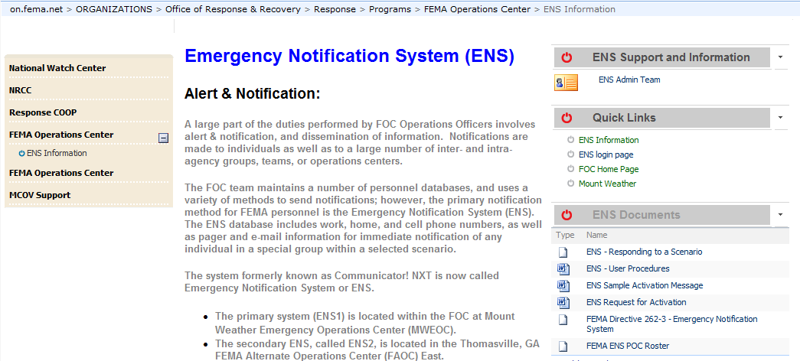
Additional resources
For ENS POC information:
http://on.fema.net/components/orr/response/foc/Pages/ENS_info.aspx
Be sure to contact your POC for concerns or issues with your contact information or with the program. We also have documents on our page for how to respond to activations and how to change your contact information.
If you have any questions you may contact the ENS-Admin group at ENS-Admin@fema.dhs.gov.

Slide 19
Questions?
Contact your ENS POC, or the ENS Admin team at ENS-Admin@fema.dhs.gov with any questions you may have.

