Slide 1
Task 1 – Familiarity with OTC Brands
We are interested in knowing which name brands people are familiar with. I'm going to ask you some questions about products you may have used, heard of, and maybe some you have never heard of. If you don't know the answer, don't worry, we can move on to the next question.
Please review this list of common brand names for over-the-counter medication products. For each medication, tell me if you have heard of or seen the brand name before?

Slide 2

















Slide 3
Common Symptoms:
Common Active Ingredients:
Allergies
Cold/Flu
Constipation
Cough
Diarrhea
Fever
Headache
Migraine
Motion sickness
Nausea
Pain
Heartburn
Indigestion
Sleep aid
Upset stomach
Urinary tract infection
Yeast infection
Acetaminophen
Aluminum hydroxinde
Anhydrous citric acid
Antacid
Aspirin
Bisacodyl
Bismuth subsalicylate
Calcium carbonate
Cetrizine
Chlorphoeniramine maleate
Dextromethorphan
Dextromenthorphn Hdryobromide
Diphenhydramine
Doxylamine Succinnate
Fexofenadine
Guaifenesin
Ibuprofen
Lansoprazole
Loratidine
Loperaminde hydroxide
Magnesium hydroxide
Meclizine
Naproxen
Neomycin Sulfate
Omeprazole magnesium
Phenazopyridine
Phenylephrine Bitartrate
Phenylephrine hydrochloride
Polymyxin B
Sodium bicarbonate

Slide 4
Task 2 Product Selection
For this part of the interview, pretend you are at the pharmacy. I will show you several over the counter products and ask you which ones would be appropriate for you to take if you had a specific symptom or set of symptoms. You may choose as many as you think apply. Keep in mind that there may be more than one possible answer. We would like you to do whatever you normally do at the pharmacy when choosing medicines.

Slide 5
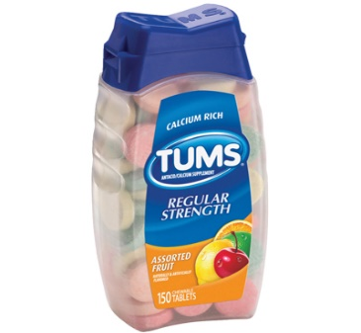
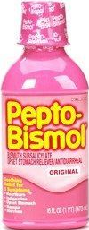
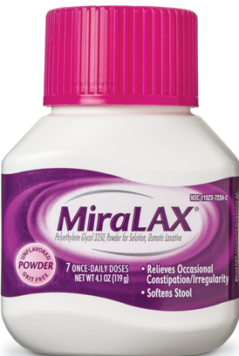
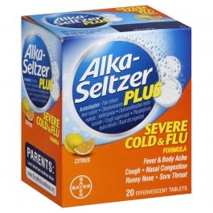
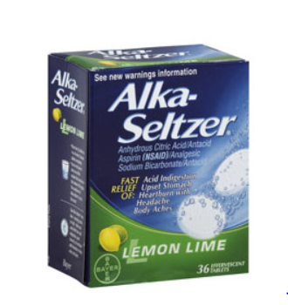
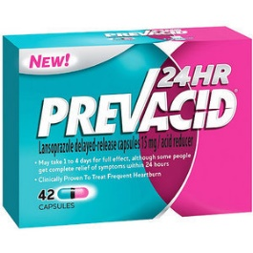
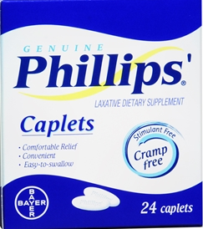
Which of these products could you take if you had heartburn?
Correct | Error - BE | Correct | Correct | Correct | Error | Error

Slide 6

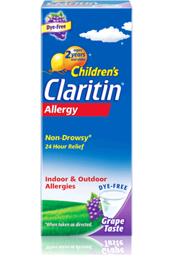
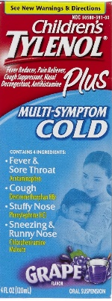
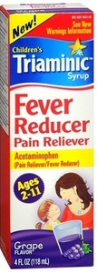
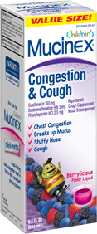
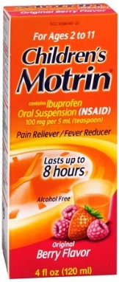
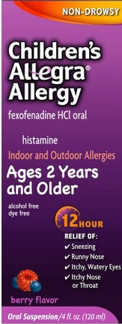
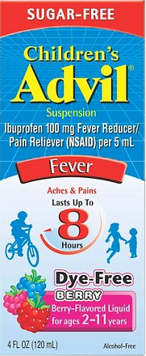
Which of these products could you give your child if they had a runny nose AND a cough.
Correct | Error | Correct | Correct | Error | Error - BE | Error | Error

Slide 7
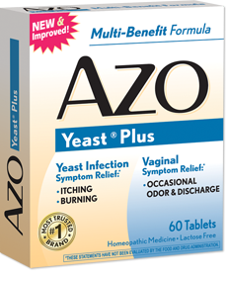
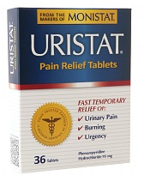
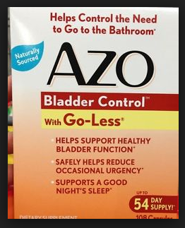
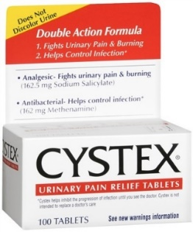
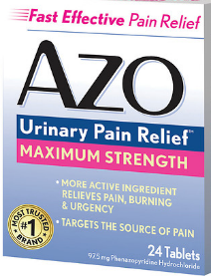
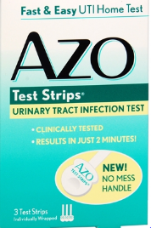
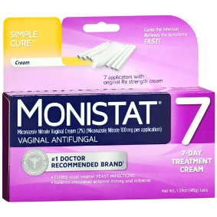
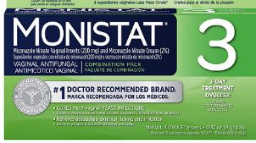
Imagine your friend asks you to go to the store and pick up a product to help her urinary tract infection symptoms. Which of these products could you pick?
Error – BE | Correct | Error | Correct | Correct | Error | Error | Error

Slide 8
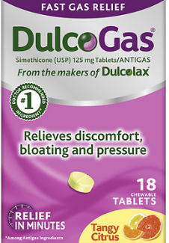
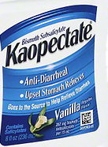
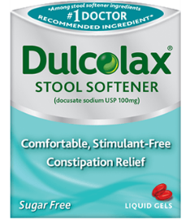
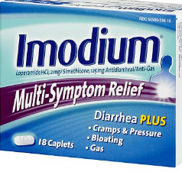
Imagine your doctor tells you to take a laxative for constipation. Which of these products could you take?
Correct | Error | Error | Error | Error | Error | Correct | Error – BE

Slide 9
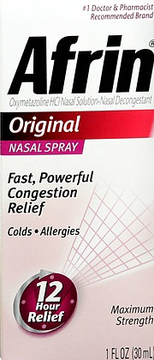
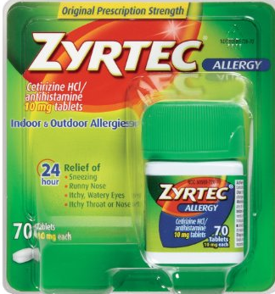
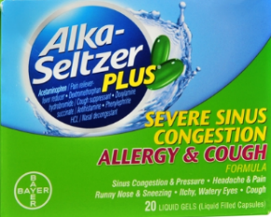
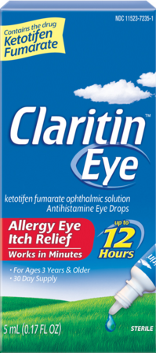
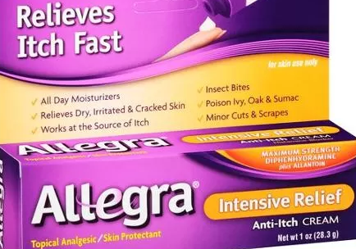
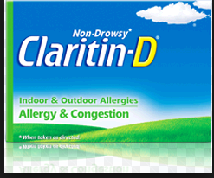
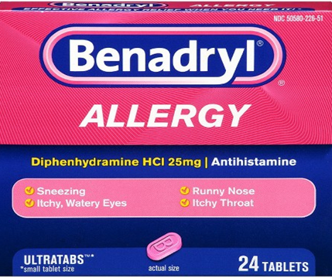
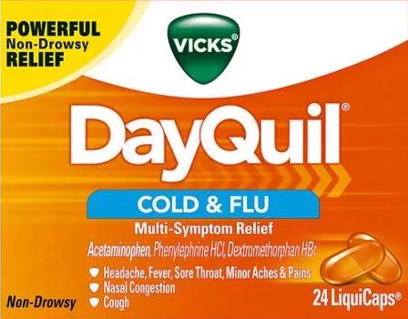
Imagine you have seasonal allergies. Your doctor tells you to take one allergy medicine every day to treat all your symptoms (sneezing, runny nose and itchy eyes). Which of these products could you take to treat all your symptoms?
Correct | Error – BE | Correct | Error | Correct | Error – BE | Correct | Error

Slide 10
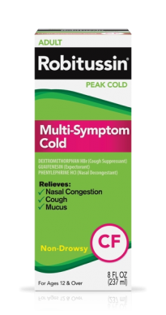
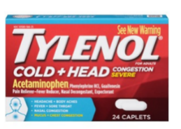

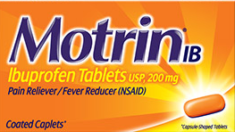
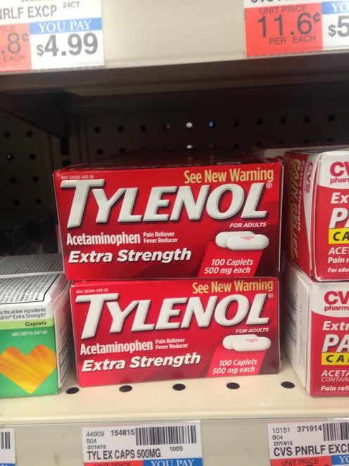
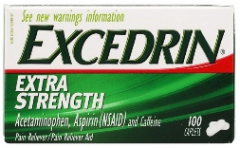
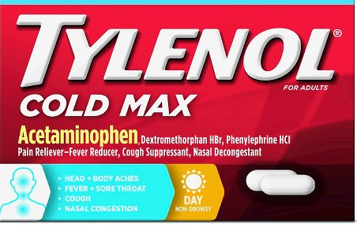
Imagine you have a cold and take Dayquil. You take it and it seems to work but you still have a headache. Which of the following products could you take to help your headache?
Correct | Correct | Error – DD | Error – DD | Error – DD | Error – DD | Incorrect | Error – DD

Slide 11
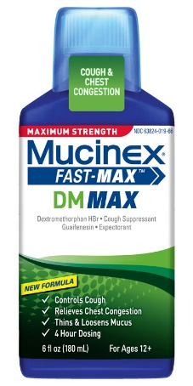
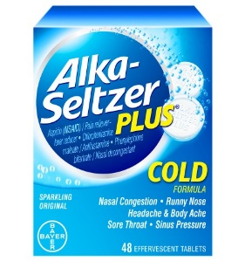
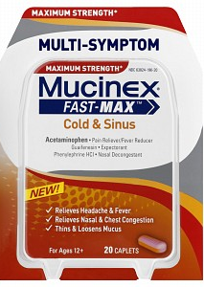
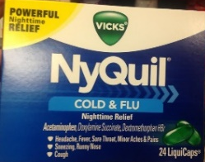
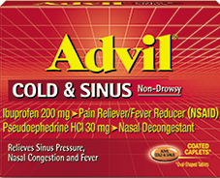
Imagine you have long standing knee pain and you take Tylenol everyday. You then develop cold and cough symptoms, which of the following could you take to help your cold symptoms?
Error - DD | Incorrect | Correct | Error - DD | Correct | Error - DD | Correct | Error - DD

Slide 12
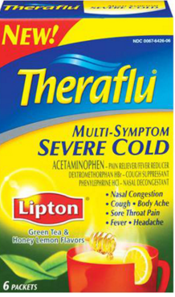
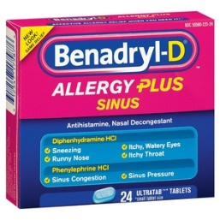
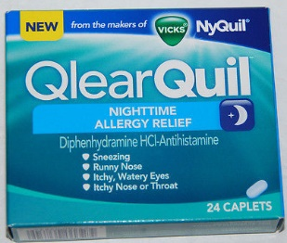
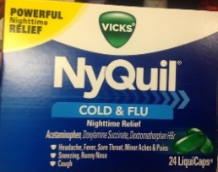

Imagine you have allergies and you take Benadryl everyday. Which of the following products could you take to for cold symptoms?
Correct | Correct | Error - DD | Correct | Error - DD | Correct | Incorrect | Error – DD

Slide 13

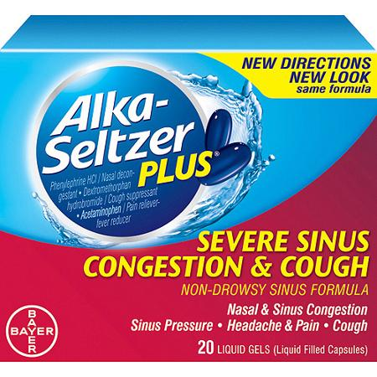
Imagine you have a heartburn and congestion. You take Sudafed PE for congestion but you still have heratburn, which of the following could you take?
Correct | Correct | Error - DD | Error-DD | Error - DD | Correct | Correct

Slide 14
Task 3 Product Comparison
Now I'm going to show you two products at a time and ask you to tell us what is the same or different about them

Slide 15
Task 3 Product Comparison
Now I'm going to show you two products at a time and ask you to tell us what is the same or different about them

Slide 16



Slide 17



Slide 18



Slide 19



Slide 20



Slide 21



Slide 22



Slide 23



Slide 24


Slide 25



Slide 26


Group A Tylenol Manipulation 1

Slide 27
Group B Tylenol Manipulation 2

Slide 28

Group C Tylenol Manipulation 3

Slide 29

Group D Tylenol Manipulation 4

Slide 30


Group A Midol Manipulation 1

Slide 31

Group B Midol Manipulation 2

Slide 32

Group C Midol Manipulation 3

Slide 33
Group D Midol Manipulation 4

