Slide 1






Slide 2


Building Bridges and Bonds (B3)
A rigorous, multi-site study of innovative services offered by Responsible Fatherhood/ReFORM (RF) programs
Unique opportunity for the program and research communities to produce new evidence about specific service approaches
OFA and other stakeholders are involved in helping B3 to set priorities

Slide 3

Why B3?
Fathers play a distinct role in children’s lives
However, they often face barriers to positive economic and emotional involvement with their children
Improving outcomes for low-income fathers and children is a high priority for policymakers
A number of promising approaches are emerging, but there is a limited evidence base

Slide 4

Study goals
Provide evidence about strategies that
  Are feasible in RF program context
  Improve outcomes
  Have the potential to change practice
Build knowledge in three areas
  Employment
  Parenting and co-parenting
  Participant recruitment and engagement

Slide 5


Study team
Sponsored by the Administration for Children and Families’ Office of Planning, Research and Evaluation within the U.S. Department of Health and Human Services
Conducted by
  MDRC, in partnership with
  MEF Associates
  Abt SRBI
  Leading experts in the field

Slide 6
Federal Evaluations and the grant application and award process
Approximately 6 RF and 6 HM sites will be chosen for the federal evaluations
The B3 and STREAMS selection process is separate from the grant selection process
  Selection for the evaluation will take place after grants are awarded
  The B3 and STREAMS teams have no role in grant decisions
  No additional points will be awarded for including mentioned approaches in funding proposals
  The study teams may not work with programs on grant applications

Slide 7

A RESEARCH-PRACTICE PARTNERSHIP
B3 is planning ongoing communication with the entire range of stakeholders
  January 2015 meeting: Heard views from several current grantees and fatherhood researchers about potential priorities for B3
  Newsletter and at RFHM grantee conferences: Continue the dialogue
  Ongoing: Will work closely with sites throughout recruitment, random assignment, and implementation
7
Notes:
7

Slide 8

Complementary studies
B3 is one of several studies providing new evidence for RF field
Others include
  Local evaluations from next cohort of RF grantees
  Parents and Children Together (PACT)
  Fatherhood Research and Practice Network
B3 complements these studies with its focus on individual program components and implementation features

Slide 9

what we know
Fathers in PACT report that their participation is motivated by
  Employment
  Better relationships with their children
RF programs are
  Important to local communities
  Strong partners to other organizations
  A forum for men to discuss their roles as fathers and support each other’s efforts
  Like other federal programs, increasingly focused on evidence of effectiveness

Slide 10

Key questions addressed in B3
What outcomes do the services affect? (Impact analysis)
  Examine effects of program components, including program approaches and implementation factors
  Measure impacts using random assignment
How are impacts achieved? (Implementation analysis)
  Give context to impact findings
  Describe how component was delivered, staff/participant views of services, and challenges and solutions

Slide 11

High-Priority employment services
Challenge
  Help men find and maintain better jobs with higher earnings than they can find on their own
Promising approaches
  Active job development
  Services informed by cognitive behavioral principles
  Wage subsidies
  Industry-specific training

Slide 12

High-priority parenting services
Challenges
  Build parenting skills of dads even if not living with children
  Increase conflict management skills and reduce co-parenting conflict for both parents
Promising approaches
  Parenting curricula involving the child
  Co-parenting sessions involving the mother
  Parenting curricula with some evidence

Slide 13

Program recruitment & engagement
Participant recruitment, engagement, and retention are a central issue for many programs
B3 seeks to
  Work with programs to identify and test new approaches in this area
  Apply learnings from “behavioral economics”
The study team will help sites
  Identify current challenges
  Test multiple strategies
  Assess and refine enhancements

Slide 14
Random assignment
The most rigorous and reliable method for demonstrating program effects
Program participants are randomly assigned to one of two groups
  Group 1: Receives program services, including the component intervention being tested
  Group 2: Receives program services, but not the component intervention being tested
The difference in the outcomes of the two groups shows the intervention’s impact

Slide 15

Random assignment
Individuals are assigned to the groups randomly
The two groups will have similar characteristics on average, at enrollment
We can be confident that any differences in outcomes are attributable to the program

Slide 16
Desired Study site characteristics
Funded through OFA Responsible Fatherhood grants and/or other sources
Demonstrated experience running a fatherhood program
Operating a high-priority strategy or willing to implement new program enhancements
Capacity to recruit and serve approximately 500 fathers over 15-18 months

Slide 17

Benefits of participation
May provide additional funds to support programming and study participation, for example, to support enhancements to services
Expert technical assistance on
  Participant recruitment and engagement
  Program service being tested
  Study procedures
Specific results for your program
Contribute to growing evidence base
Increased visibility as part of a national study

Slide 18
B3 Study team responsibilities
Maintain close communication with organizations, including visits, to learn about program operations, hear your interests, and brainstorm study options
Facilitate meetings to plan study implementation
Provide funding and other resources to support program enhancements and research activities
Train and support program staff on study procedures
Provide ongoing technical assistance to achieve high-quality program enhancement and research procedures
Analyze data, share lessons, and publish reports

Slide 19

Study timeline
2015-2016: Site recruitment
2016-2017: Enroll participants into the study
2016-2018: Sites receive study support
2017-2019: Share lessons with RF field
2017: Implementation reports
2018: Impact reports
2019: Final synthesis reports

Slide 20
Contact information
MDRC (research contractor)
www.mdrc.org/b3
b3@mdrc.org
OPRE (federal office)
Anna Solmeyer
Anna.Solmeyer@acf.hhs.gov
202-401-4055
NOTE: The Paperwork Reduction Act Statement: This collection of information is voluntary and will be used to gather preliminary information about the fatherhood field and explore with fatherhood programs the research questions that are of interest and the design options that are feasible. Public reporting burden for this collection of information is estimated to average 108 minutes per response, including the time for reviewing instructions, gathering and maintaining the data needed, and reviewing the collection of information. An agency may not conduct or sponsor, and a person is not required to respond to, a collection of information unless it displays a currently valid OMB control number. Send comments regarding this burden estimate or any other aspect of this collection of information, including suggestions for reducing this burden to Anna Solmeyer; anna.solmeyer@acf.hhs.gov; Attn: OMB-PRA (0970-0356).

Slide 21
Additional Materials

Slide 22
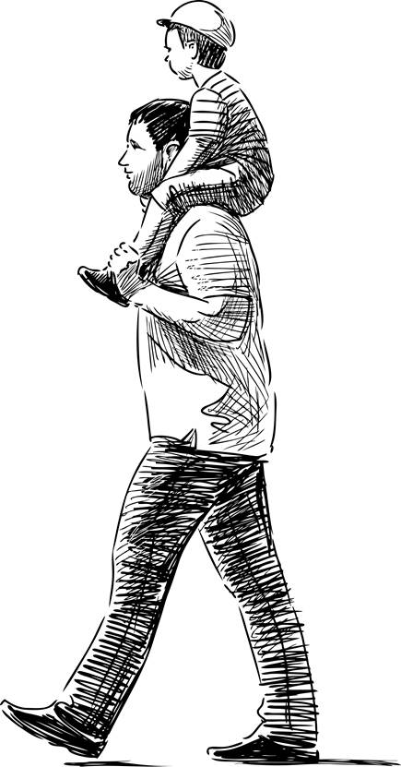
Impact analysis
Sample research questions
  Does a focused co-parenting model help fathers spend more and better time with their children?
  Do enhanced employment services increase work and earnings?
  Can behavioral interventions increase participant engagement in program services?
Sample data sources
  Participant surveys
  Federal administrative data (new hires, child support)
  Program management information systems (MIS) data

Slide 23
Implementation analysis
Sample research questions
  What are the characteristics of participating fathers?
  What services are offered and to what extent are they used?
  How are services perceived by participants and staff or partners in the community?
Sample data sources
  Program management information systems (MIS) data
  On-site interviews with program staff and participants
  Participant surveys

Slide 24
Study implementation
Sample designs
  Site already implementing strategy to be studied
    Program recruits additional participants to a second group that gets some services but not the strategy being tested
  Site not yet implementing strategy to be studied
    Program provides half their participants with the intervention services as an enhancement to their existing program
Study sites will be provided with resources to expand recruitment and/or add enhancements

Slide 25
Random assignment
Placeholder for suggested chart/graph to explain random assignment
Impact of enhanced intervention
Earnings
Enhanced intervention
Standard intervention
Enrollment
Month 2
Month 4
Month 6
Month 8

Slide 26
Random assignment
Placeholder for suggested chart/graph to explain random assignment
Without a comparison, Method 3 might appear to be the most effective.

Slide 27
Random assignment procedures
Participants meet program criteria
Participants give consent
Placeholder – to be updated as study team learns more about program flows
Baseline data collected
Random Assignment
Group 1
Program services including component intervention being tested
Group 2
Program services excluding component intervention being tested

Slide 28
Example: co-parenting intervention
Participants enroll
Placeholder example – example of interventions to be updated as the study design process progresses
Parenting workshop during group sessions PLUS intensive co-parenting curriculum
Fatherhood workshop covering multiple topics

