Slide 1
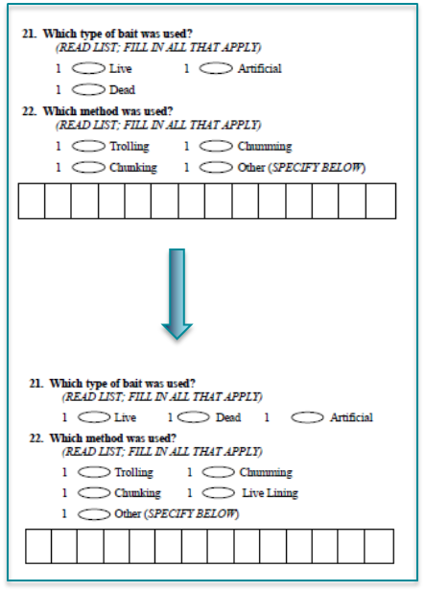
LPIS questions 21 and 22
LPBS samples collected ovals
Current (2017)
2018?

