Slide 1
1652-0030
Complaint Form: Civil Rights and/or Civil Liberties

Slide 2
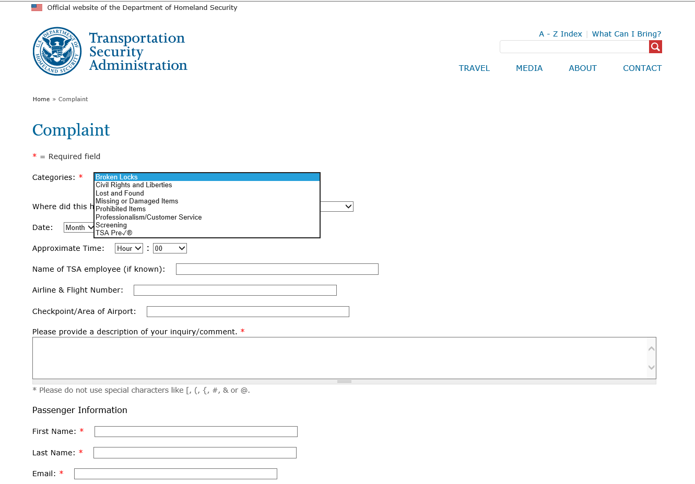

Slide 3
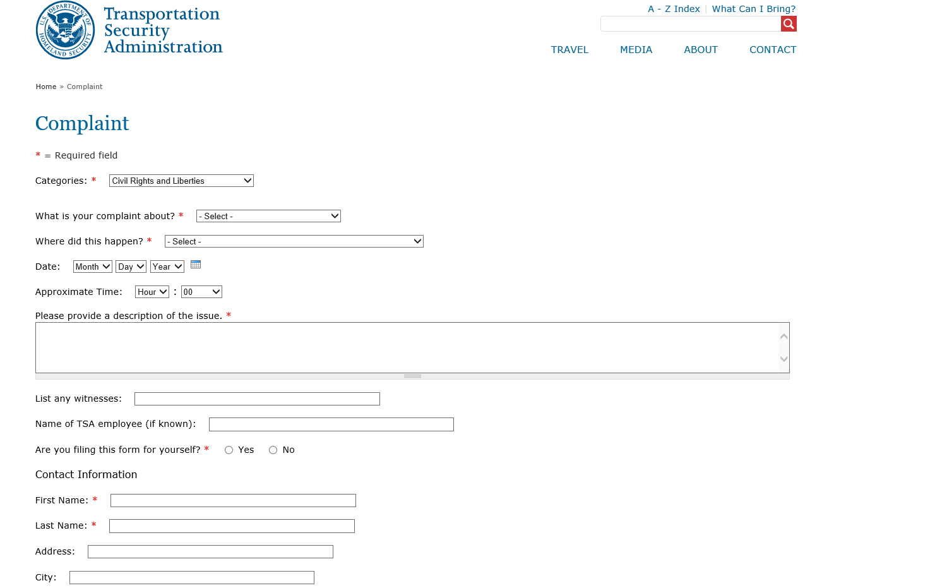

Slide 4
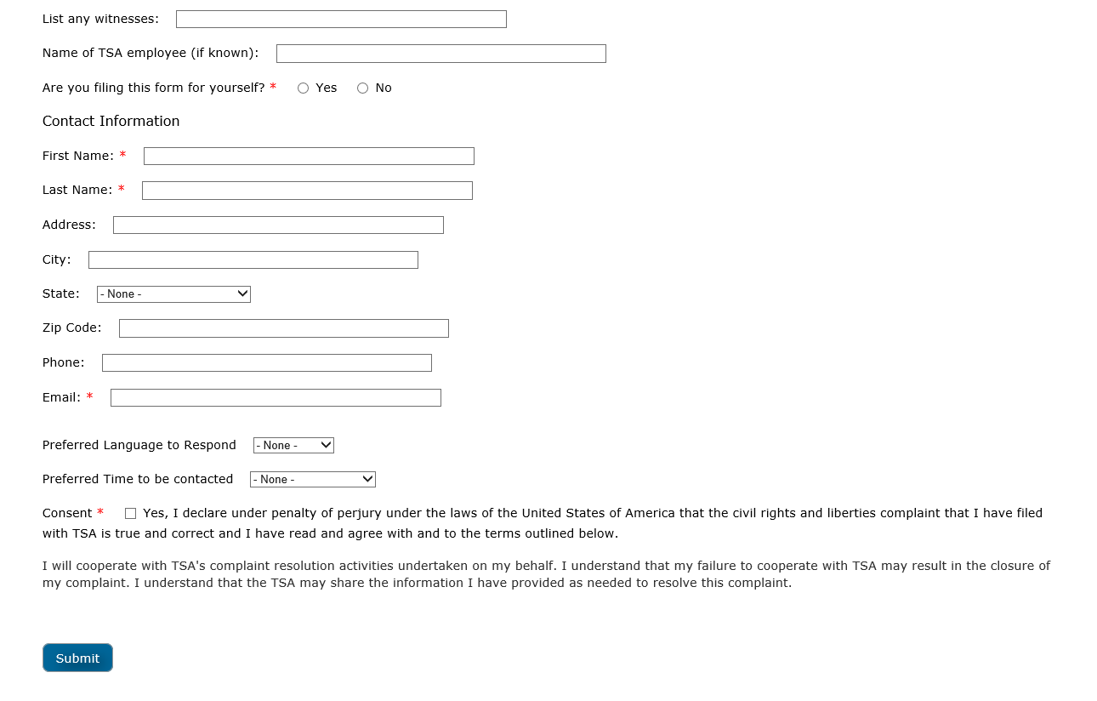

Slide 5
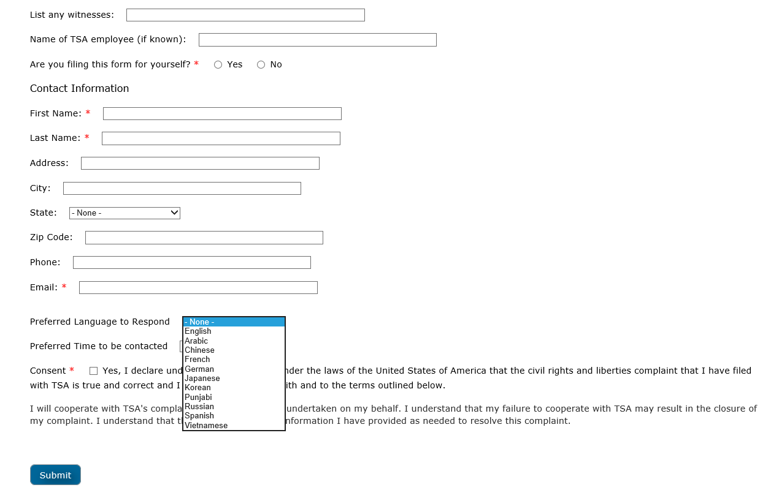

Slide 6
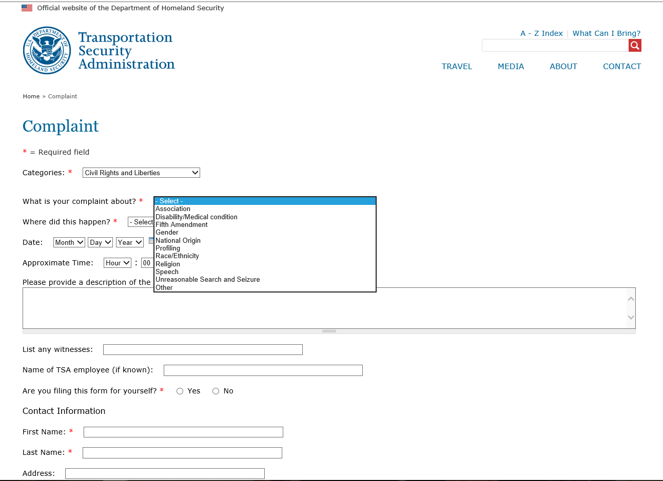

Slide 7
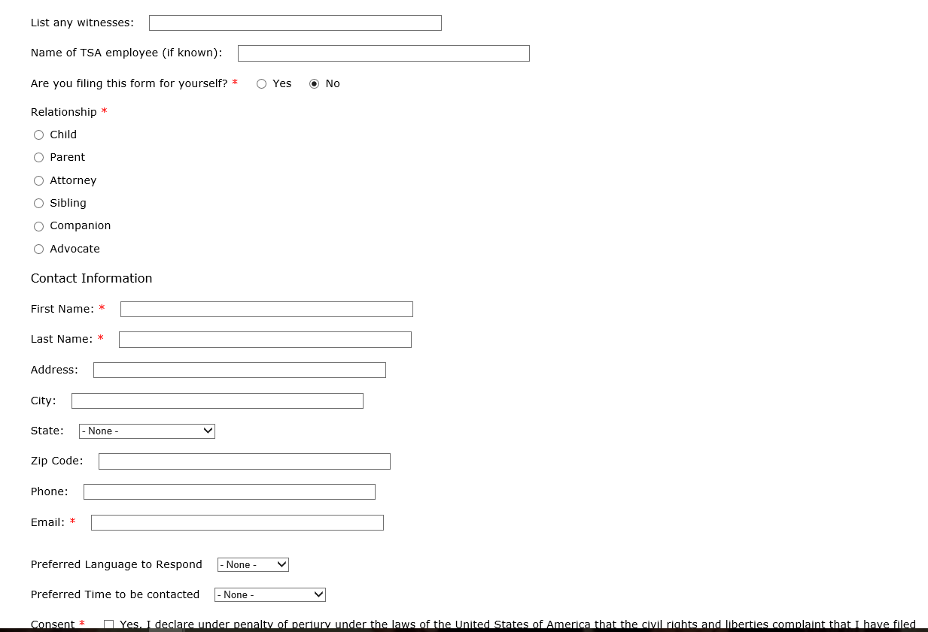

Slide 8
Privacy Act & Paperwork Reduction Act Statements
Privacy Act Statement:
AUTHORITY: 49 USC § 114(f)(15). PRINCIPAL PURPOSE(S): This information will be used to manage and respond to traveler inquiries or complaints. ROUTINE USE(S): This information may be shared in accordance with the Privacy Act of 1974, 5 USC § 552(a), for routine uses identified in the TSA system of records, DHS/TSA-006 Correspondence and Matters Tracking Records, or as further described in the Privacy Impact Assessment DHS/TSA/PIA-046 TSA Contact Center, and subsequent updates, available at www.dhs.gov/privacy. DISCLOSURE: Furnishing this information is voluntary; however, failure to provide the requested information may prevent TSA from being able to respond to a traveler’s inquiry or complaint.
Paperwork Reduction Act Statement:
TSA will use the information to improve customer service and may share it with airport operators for this purpose. This is a voluntary collection. It is estimated that the total annual burden per response associated to this collection is approximately 10 minutes. An agency may not conduct or sponsor, and a person is not required to respond to a collection of information, unless it displays a valid OMB control number. The control number assigned to this collection is OMB-1652-0030, which expires 4/30/2018. Send comments regarding this burden estimate or any other aspect of this collection of information including suggestions for reducing this burden to TSA PRA Officer, 601 S. 12th Street, Arlington, VA 20598-6011. ATTN: PRA 1652-0030.

