Slide 1
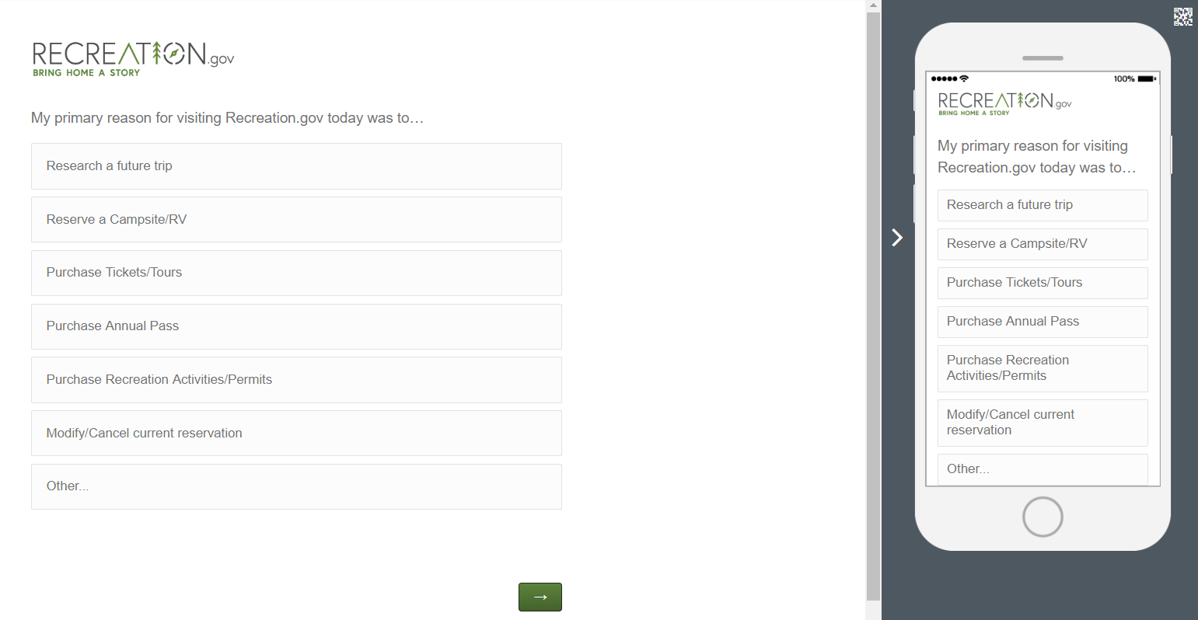
Q1:

Slide 2
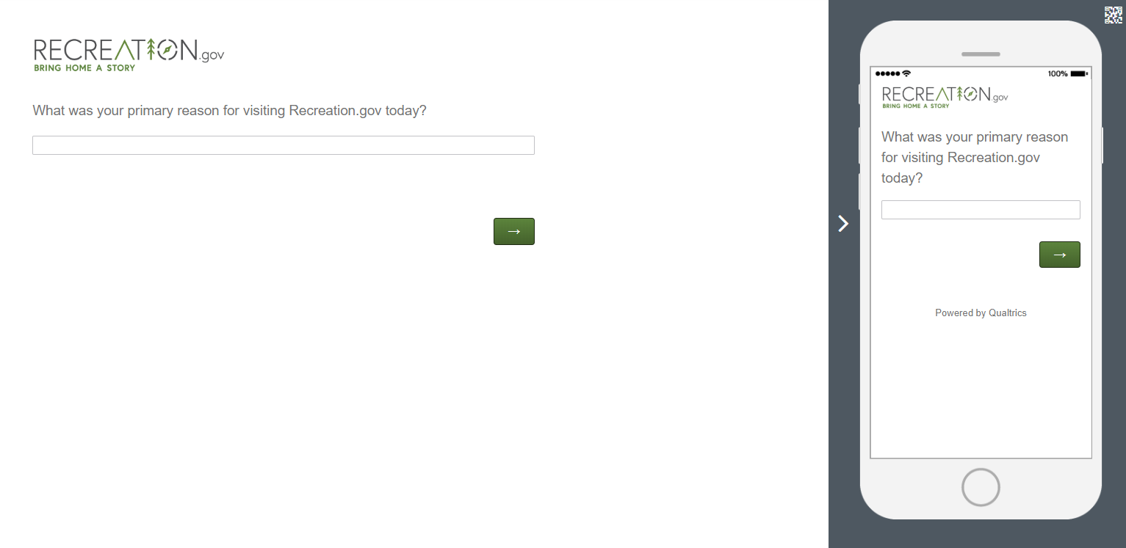
Q1-a: If “Other…” is selected from Q1

Slide 3
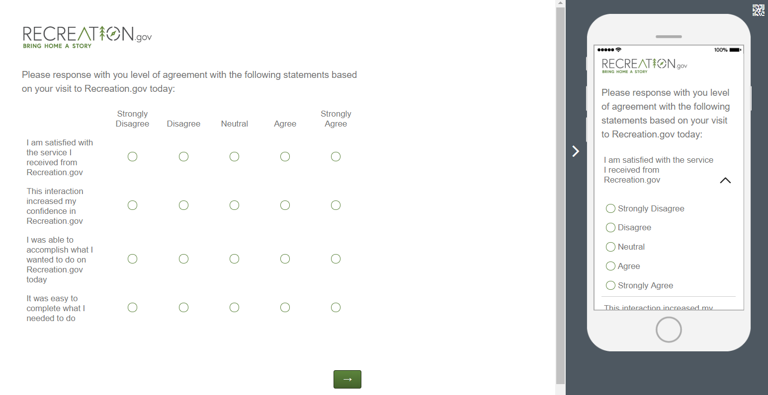
Q2:
Q2-a
Q2-b
Q2-c
Q2-d

Slide 4
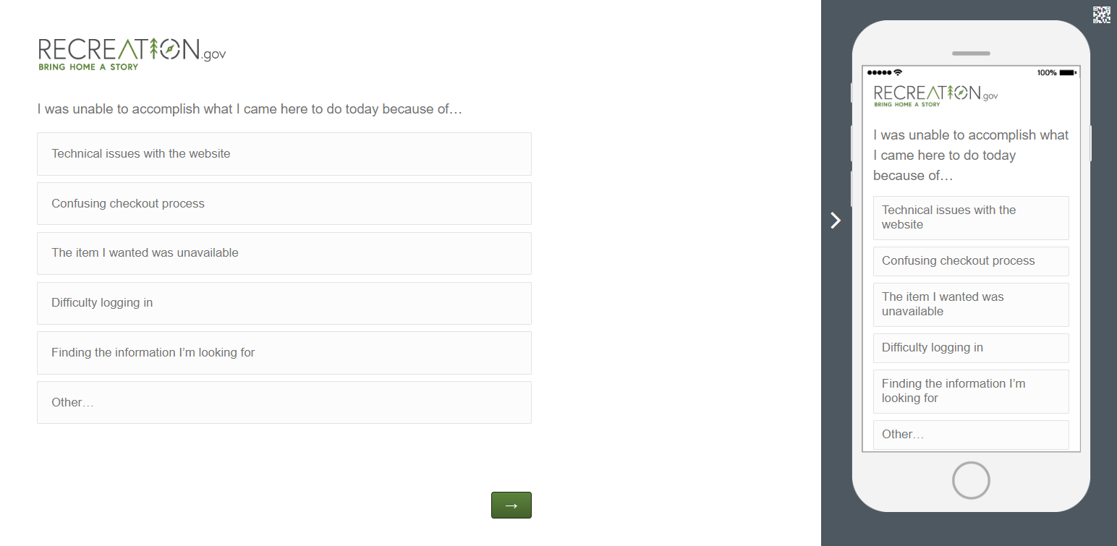
Q2-e: If “Strongly Disagree,” “Disagree,” or “Neutral” are selected in response to Q2-c.

Slide 5
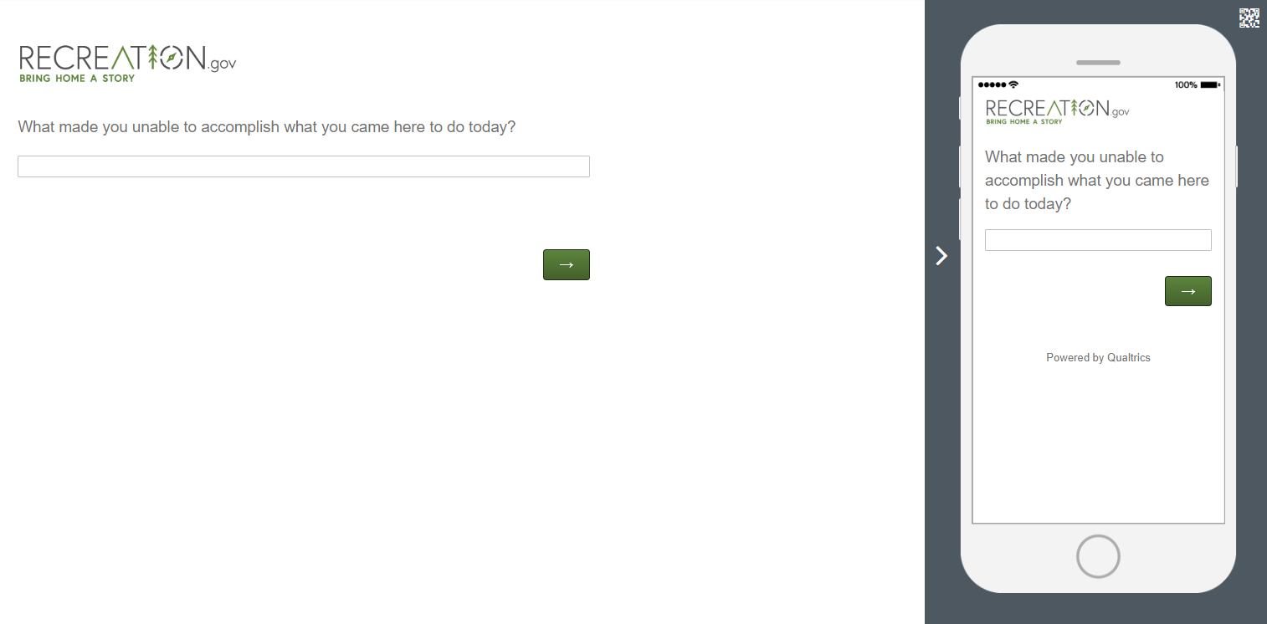
Q2-f: If “Other…” is selected in response to Q2-e.

Slide 6
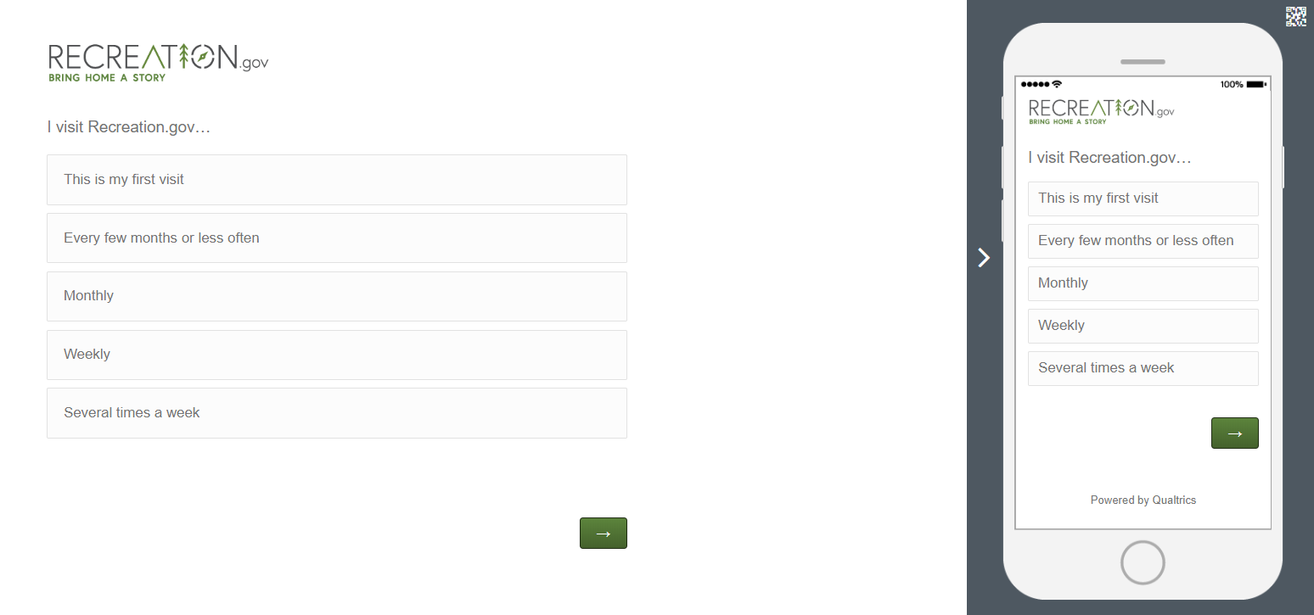
Q3:

Slide 7
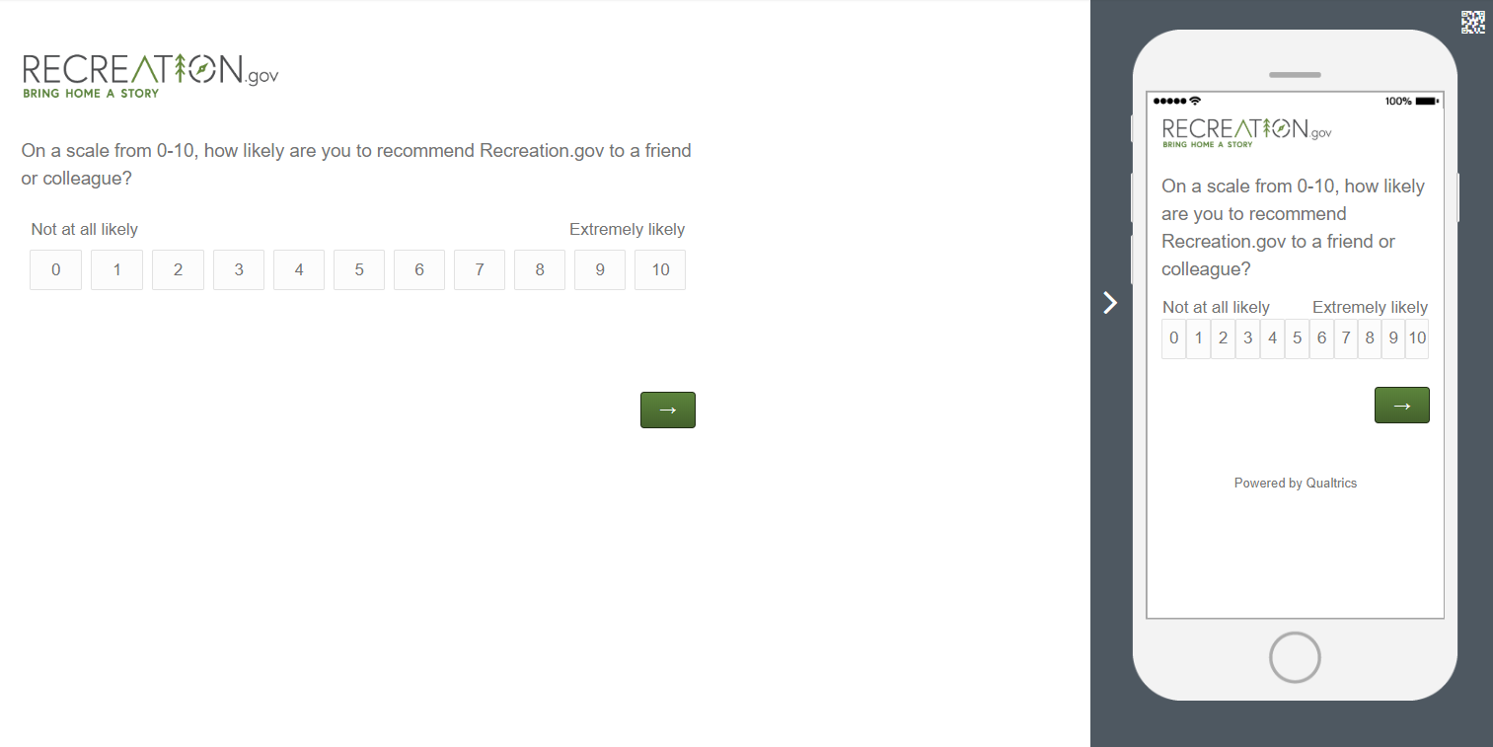
Q4:

Slide 8
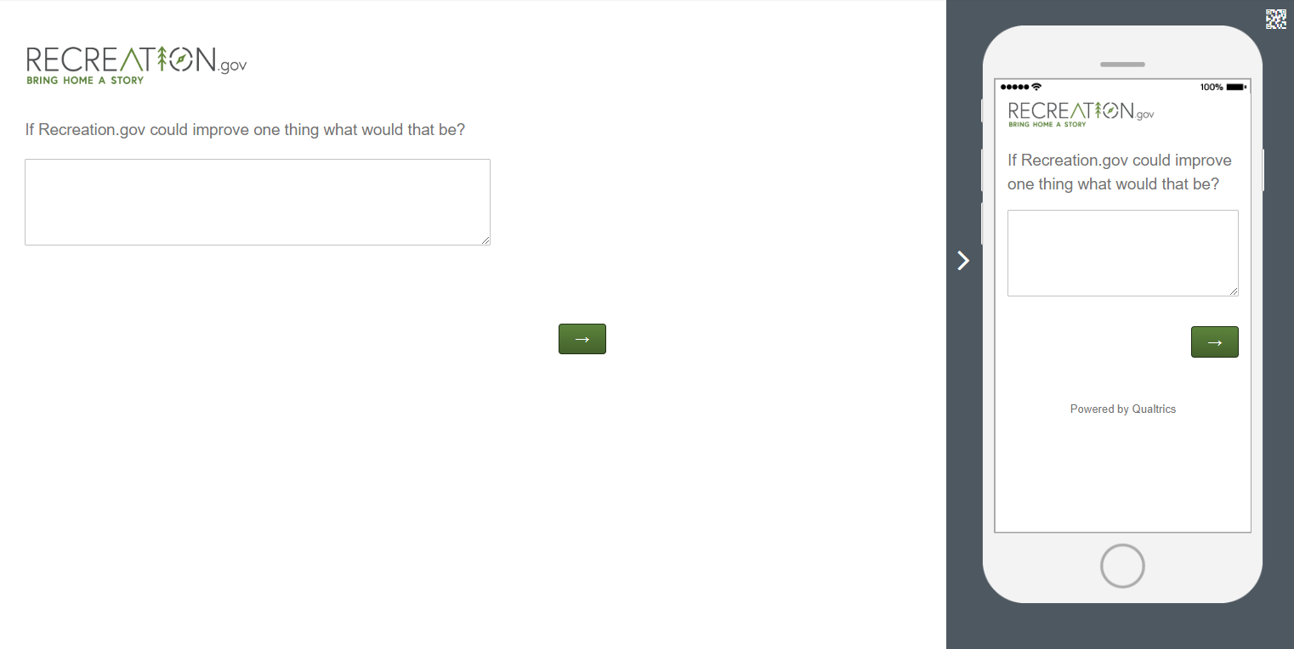
Q5:

