Slide 1
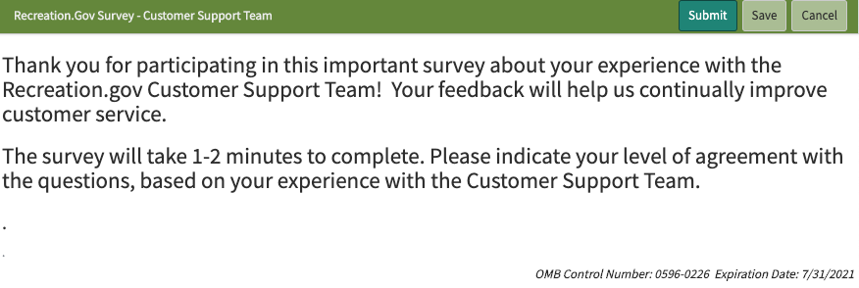
INTRODUCTION

Slide 2
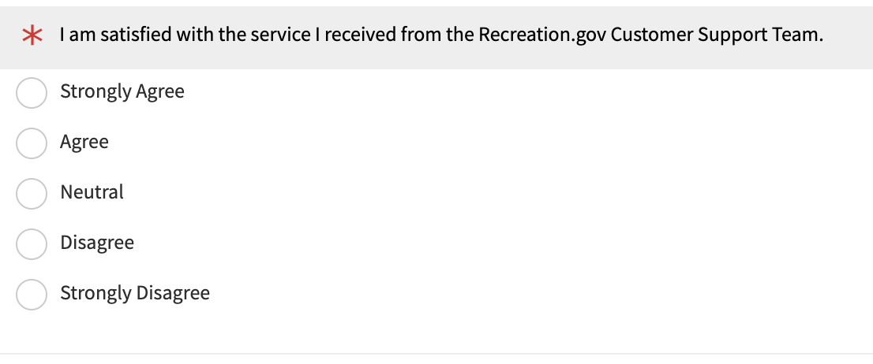
Q1: Satisfaction

Slide 3
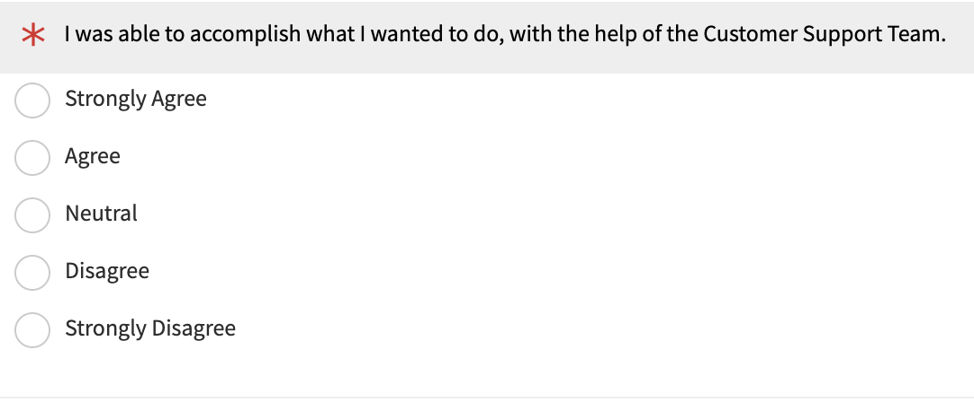
Q2: Success

Slide 4
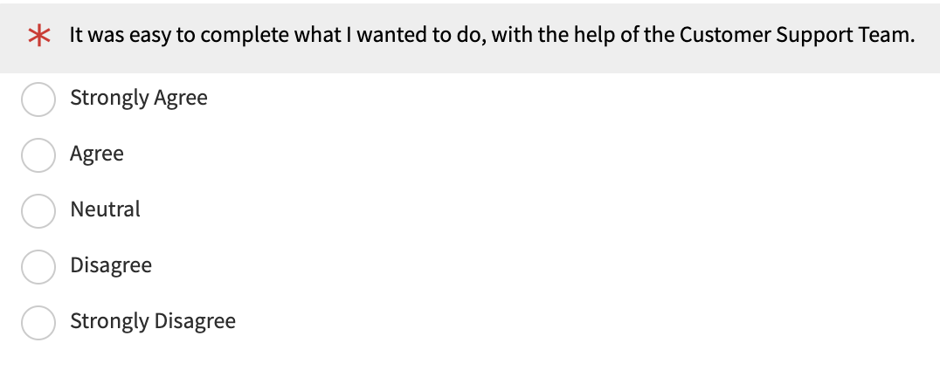
Q3: Ease of Use

Slide 5
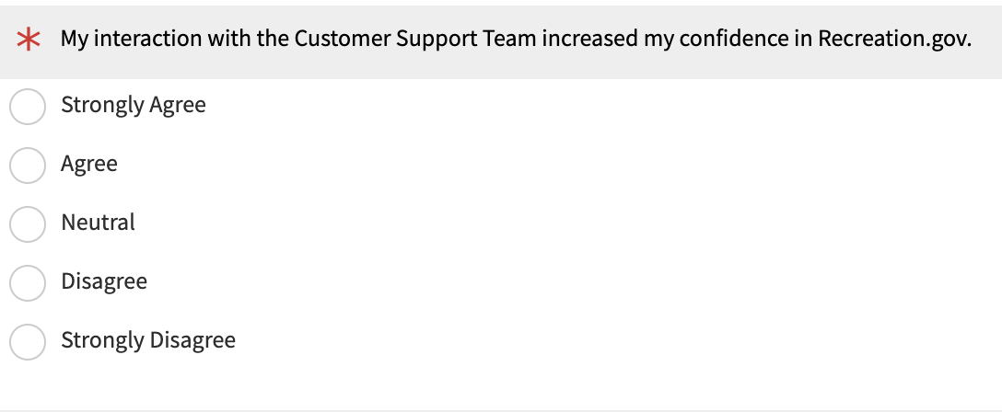
Q4: Confidence

Slide 6
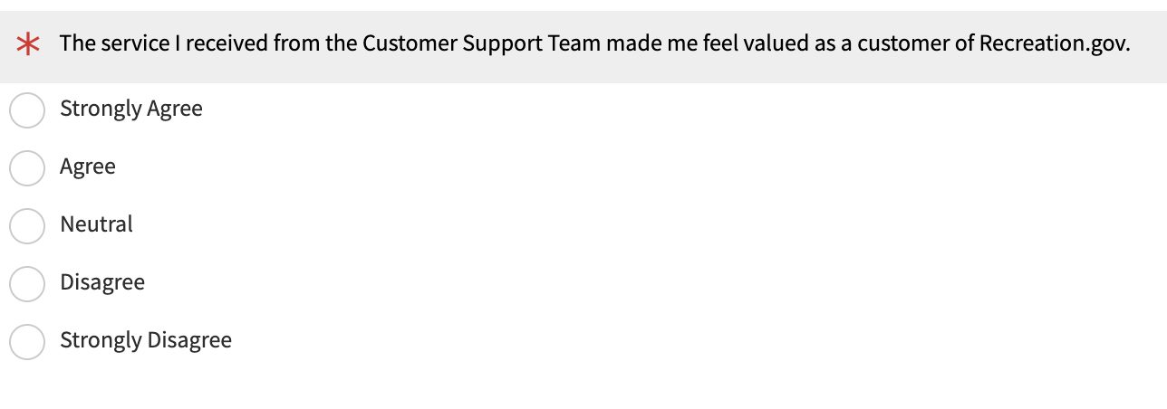
Q5: Feeling Valued as a Customer

Slide 7
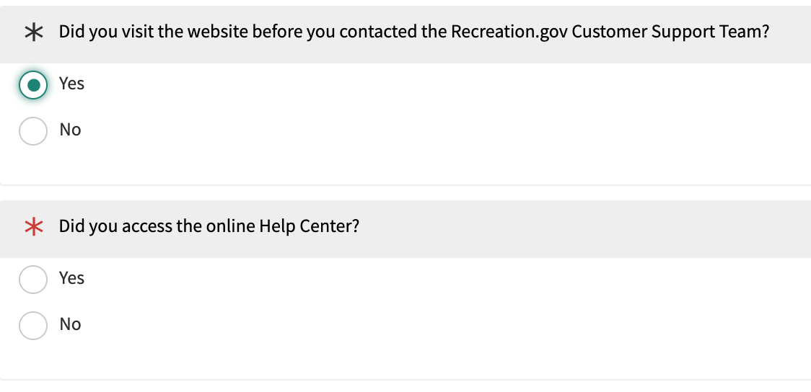
Q6a: Use of Website (where customer selects “Yes”)

Slide 8
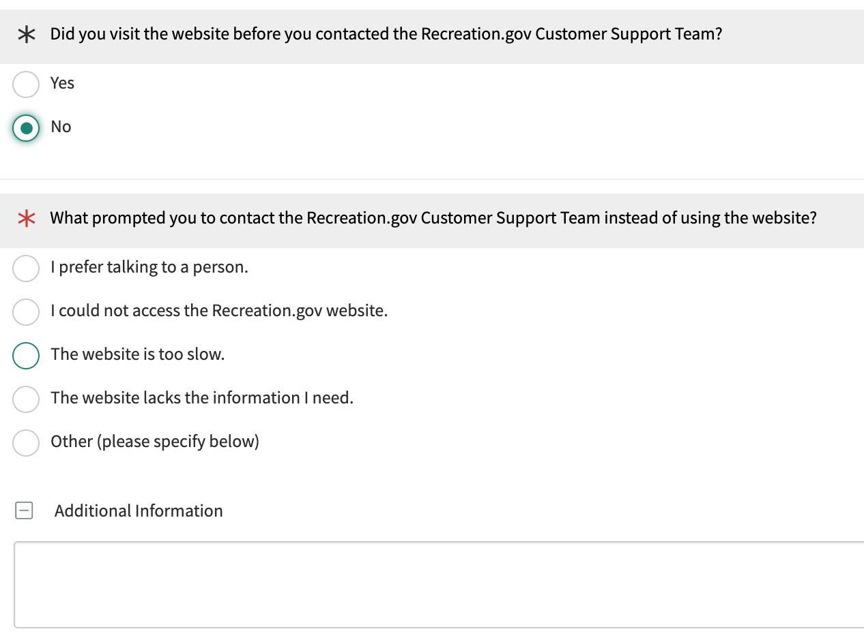
Q6b: Use of Website (where customer selects “No”)

Slide 9
Q7: Comments (open-ended and optional)

Slide 10
THANK YOU

