Slide 1
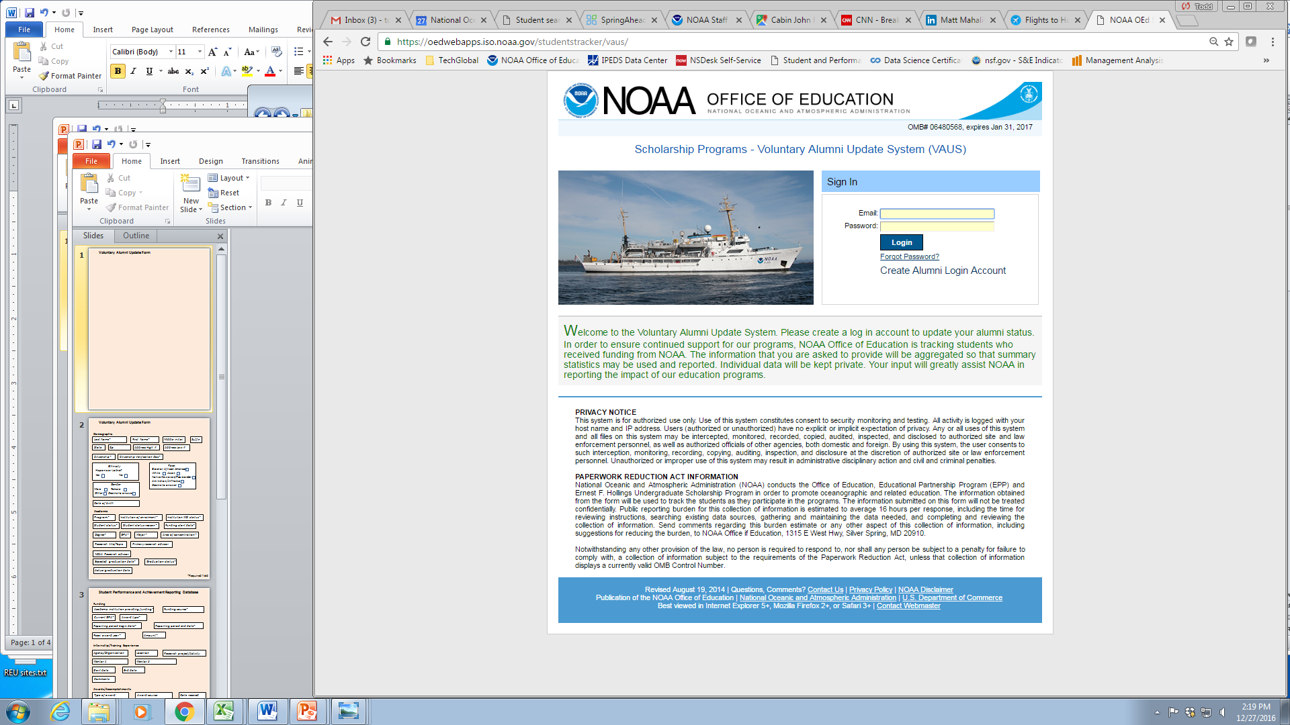
Voluntary Alumni Update Form

Slide 2
Demographic
First Name
Last Name
Gender
Female
Male
Other
Decline to answer
Ethnicity
Hispanic or Latino?
Yes
No
Race
Black or African American
White
Asian
Native Hawaiian/Pac Islander
Am Indian/AK Native
Decline to answer
Scholarship Program Information
Program
Institution
Institution State
Degree
Expected graduation date
Actual graduation date
Graduation status
NOAA-Related Field
I work in a field related to NOAA’s mission
I use my STEM degree in my current position but it is not related to NOAA’s mission
I do not use my STEM degree in my current position

Slide 3
Current Work Status Information
Area of work
Are you seeking employment?
Yes
No
Seeking employment in (field)
Current employer
Add/Update
Please create separate entries for each degree earned or professional position held, including current position.
Occupation
Industry Sector
Employer/Institution
Job title/Academic Major
Field of work/study
Hired/Start date
Please verify the information before clicking the submit button. There are no opportunities to edit the information after clicking the submit button. If modifications are required after clicking the submit button, please send an email to oed.alumni.info@noaa.gov
Submit
Make Changes

