Slide 1
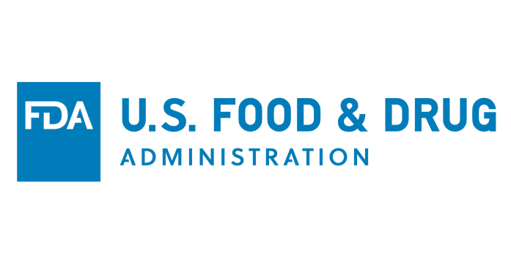
Cost Savings and generic substitution of oral contraceptives (OCPs)

Slide 2
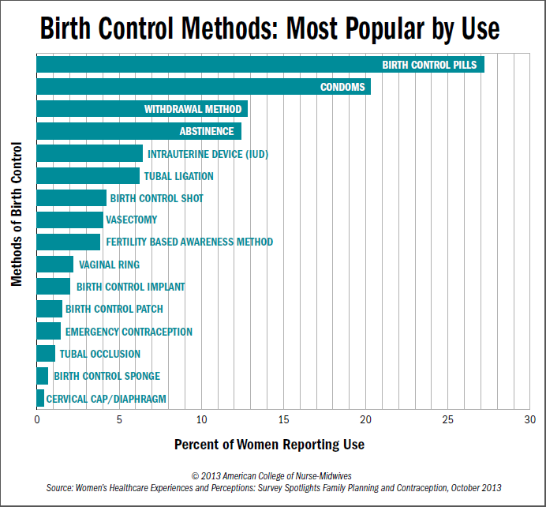
OCPs Commonly Used
25% of reproductive age women report using OCPs
Low failure rates¹
Almost all available as generic²
Notes:
http://www.flowersfertility.com/flowersfertility/2014/6/4/what-fertility-awareness-based-methods-fabms-are-not-the-least-popular-form-of-birth-control
Is this graph more appropriate given the slide content?

Slide 3
Concerns About Generic OCPs Overblown
ACOG committee opinion supported requests for brand OCPs due to concerns about packaging and adherence³
Multiple studies show increased adherence with generic drugs
OR 1.62 of adherence in analysis of claims data primarily looking at OCPs⁴
Health policy implications of lower cost of generic OCPs

Slide 4
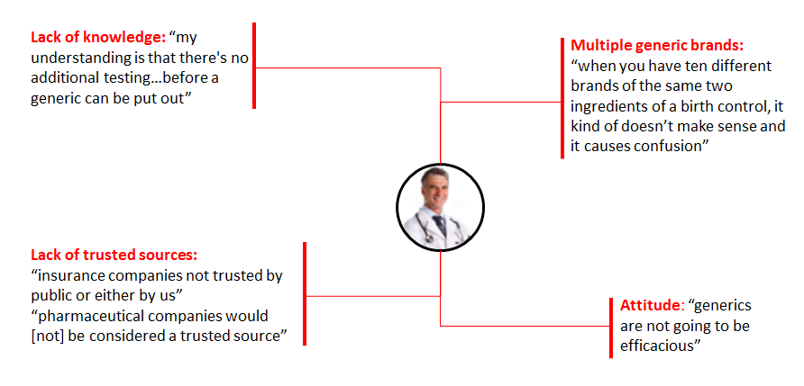
Barriers to Prescribing Generics Exist
Focus group data from ACP & AANP meetings identified barriers to prescribing generic OCPs:
attitude & knowledge regarding generics, lack of trusted sources, multiple generic brands for OCPs

Slide 5
Generic Skepticism Decreasing But Still Exists
Generic skepticism: lack of agreement that generics are as effective as, as safe as, or do not cause more adverse events than their brand counterparts.
Kesselheim, et al. JAMA IM 2016
Notes:
Generic skepticism of safety & efficacy of generic drugs is declining but still exists among clinicians across multiple disciplines.

Slide 6
Remember: Generics are Therapeutically Equivalent!
The FDA considers generic and brand OCPs Therapeutically Equivalent
This means they are both
Phamaceutical Equivalent: Same active ingredients, dosage form, route of administration, strength/concentration
Bioequivalent: No significant difference in rate or degree to which the active ingredient in a pharmaceutically equivalent drug product becomes available at the site of action, when administered at same molar dose

Slide 7
FDA Approval Process Rigorous
All generics go through rigorous testing before approval
Manufacturers of generics must prove their drug is “therapeutically equivalent” to brand name
Adverse events closely monitored for generic drugs
www.FDA.gov/GenericDrugs

Slide 8
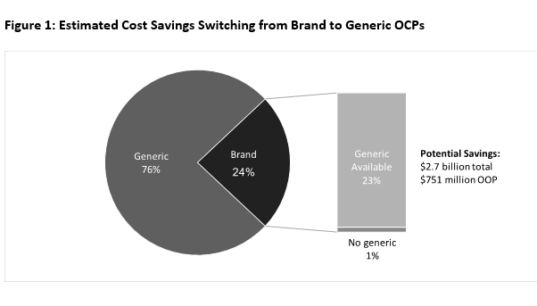
Cost Savings from OCPs Substantial
Usage and cost of OCPs derived from the 2010-2014 Medical Expenditure Panel Survey (MEPS)⁵
Estimated total brand name OCP expenditure: $916 million
$171 million out-of-pocket
Estimated total avoidable cost opportunity: $456 million
$37 million out-of-pocket
Chee, et al. JAMA IM 2018

Slide 9
Cost Savings Translated to Patients
The estimated total out-of-pocket savings
$751 million between 2010-2015
OCP Type | Average OOP Cost Per Year | Average Total Cost Per Year
Brand | $117.15 | $427.06
Generic | $59.53 | $163.24
Potential Savings of Switching | $57.62 | $263.82
Chee, et al. JAMA IM 2018

Slide 10
Having a Discussion With Your Patient Matters
Patients who reported having a discussion with their clinicians were 5x more likely to switch to a drug of lower cost⁹
Generic Drugs
Medication Adherence
Better Outcomes
Medication adherence is suboptimal
A big reason for this is cost
A simple solution is generics
Why are we focusing on OCPs?
Commonly prescribed drug with more skepticism than other drugs
Offer a window for highlighting need to support generic prescribing in other classes of drugs which translate into mortality benefit and huge savings
Notes:
Reduce OOP costs by half
Societal savings
In other commonly prescribed drug classes, like statins, where adherence is suboptimal, generic drugs are associated with better adherence and better health outcomes. ^{10,11}

Slide 11
References
Trussell J. Contraceptive failure in the United States. Contraception. 2011;83(5):397-404. doi:10.1016/j.contraception.2011.01.021.
Hall KS, Trussell J. Types of combined oral contraceptives used by US women. Contraception. 2012;86(6):659-665.
American College of Obstetricians and Gynecologists Committee on Gynecologic Practice,. ACOG Committee Opinion No. 375.; 2007:447-448.
Shrank WH, Hoang T, Ettner SL, et al. The implications of choice: Prescribing generic or preferred pharmaceuticals improves medication adherence for chronic conditions. Arch Intern Med. 2006;166(3):332-337.
Agency for Healthcare Research and Quality. Medical Expenditure Panel Survey (MEPS). Rockville, MD https://meps.ahrq.gov/mepsweb/index.jsp.
Bioequivalence between brand-name and generic OCs. Contracept Rep 2002; 13(2):6-9.
G. Evans, E.L. Sutton. Oral contraception. Med Clin North Am, 99 (2015), pp. 479-503
Kesselheim, A. S., Gagne, J. J., Eddings, W., Franklin, J. M., Ross, K. M., Fulchino, L. A., & Campbell, E. G. (2016). Prevalence and predictors of generic drug skepticism among physicians: results of a national survey. JAMA internal medicine, 176(6), 845-847.
Wilson, I. B., Schoen, C., Neuman, P., Strollo, M. K., Rogers, W. H., Chang, H., & Safran, D. G. (2007). Physician–Patient Communication About Prescription Medication Nonadherence: A 50-state Study of America’s Seniors. Journal of General Internal Medicine, 22(1), 6–12. http://doi.org/10.1007/s11606-006-0093-0
Joshua J. Gagne, Niteesh K. Choudhry, Aaron S. Kesselheim, Jennifer M. Polinski, David Hutchins, Olga S. Matlin, et al. Comparative Effectiveness of Generic and Brand-Name Statins on Patient Outcomes: A Cohort Study. Ann Intern Med. 2014;161:400–407. doi: 10.7326/M13-2942
William H. Shrank, Tuyen Hoang, Susan L. Ettner, Peter A. Glassman, Kavita Nair, Dee DeLapp, June Dirstine, Jerry Avorn, Steven M. Asch. The Implications of ChoicePrescribing Generic or Preferred Pharmaceuticals Improves Medication Adherence for Chronic Conditions. Arch Intern Med. 2006;166(3):332–337. doi:10.1001/archinte.166.3.332

