Slide 1
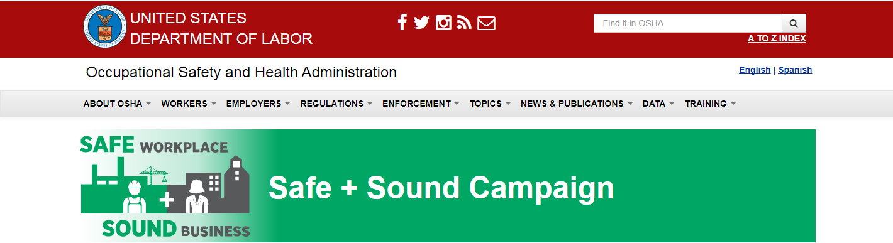


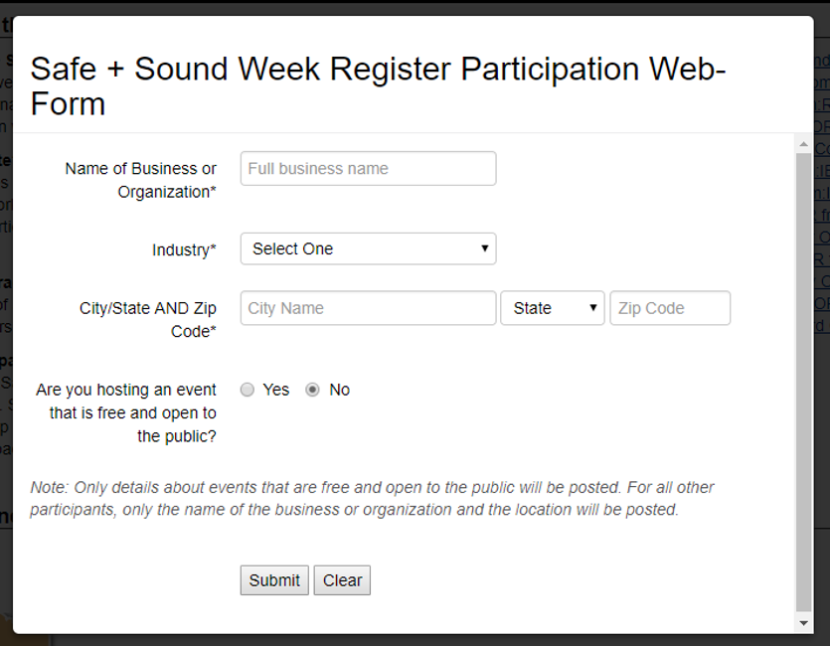
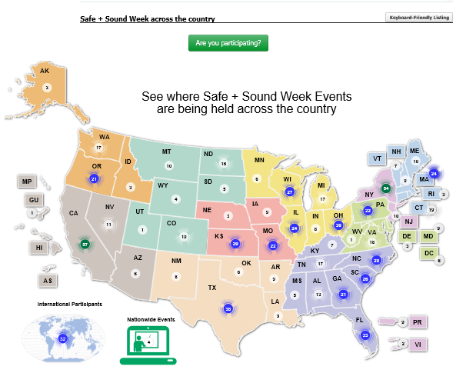

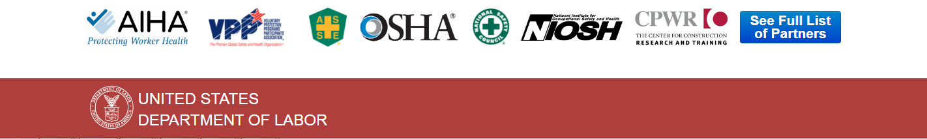
HOME
STEP 1: SELECT YOUR ACTIVITIES
STEP 2: PLAN & PROMOTE YOUR EVENTS
STEP 3: RECOGNIZE YOUR PARTICIPATION
EVENT ARCHIVE
SAFE + SOUND CAMPAIGN SUPPORTERS
CONTACT US
Safe + Sound Week Across the Country
Notes:
Can we make it so the menu stays visible at the top as you scroll down?
We added an Events Calendar as we had requests for that.
We can add the 3 Core Elements video if we get permission to use it and someone can update the logo.
If we receive responses from companies for short profiles, we will feature them on the home page and add a subpage where they will all be housed to the menu.

Slide 2
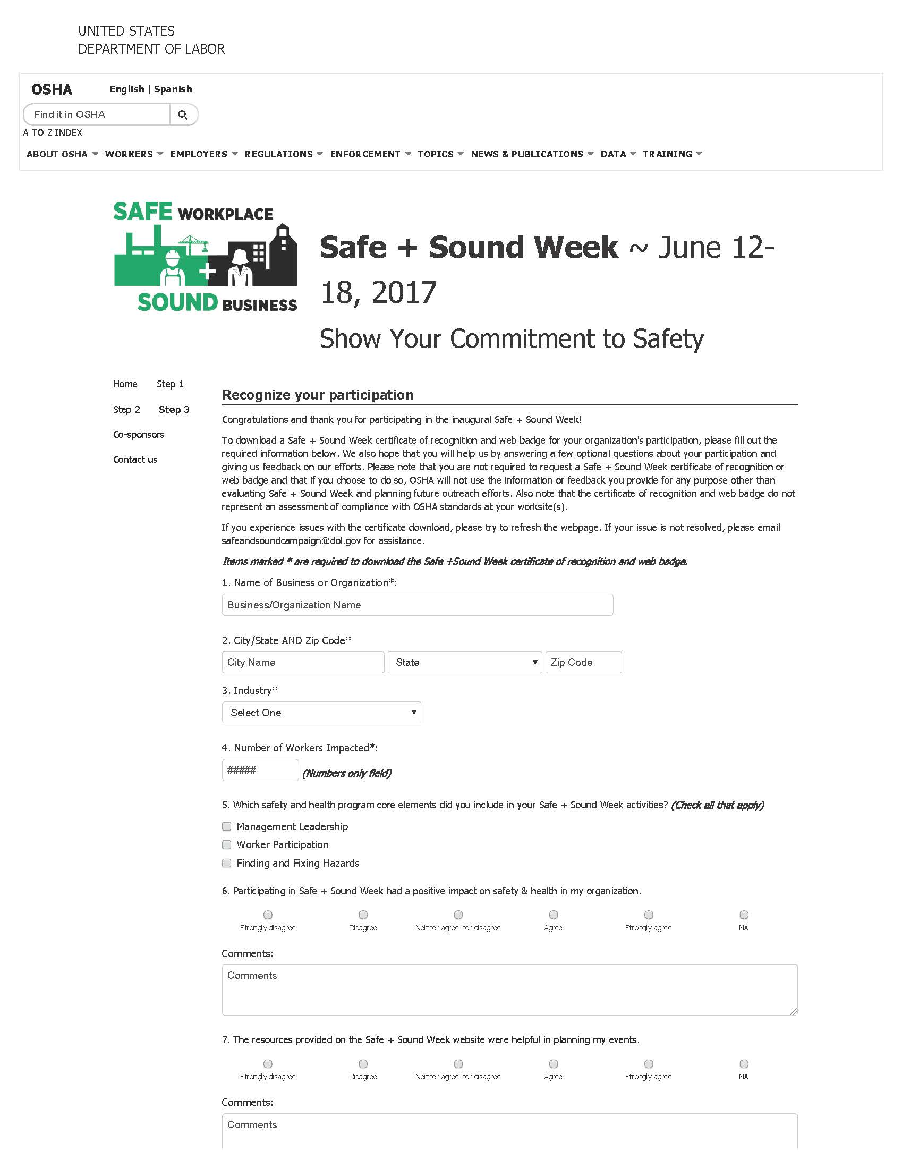
HOME
STEP 1: SELECT YOUR ACTIVITIES
STEP 2: PLAN & PROMOTE YOUR EVENTS
STEP 3: RECOGNIZE YOUR PARTICIPATION
EVENT ARCHIVE
SAFE + SOUND CAMPAIGN SUPPORTERS
CONTACT US
Notes:
Can we make it so the menu stays visible at the top as you scroll down?
We added an Events Calendar as we had requests for that.
We can add the 3 Core Elements video if we get permission to use it and someone can update the logo.
If we receive responses from companies for short profiles, we will feature them on the home page and add a subpage where they will all be housed to the menu.

