Slide 1
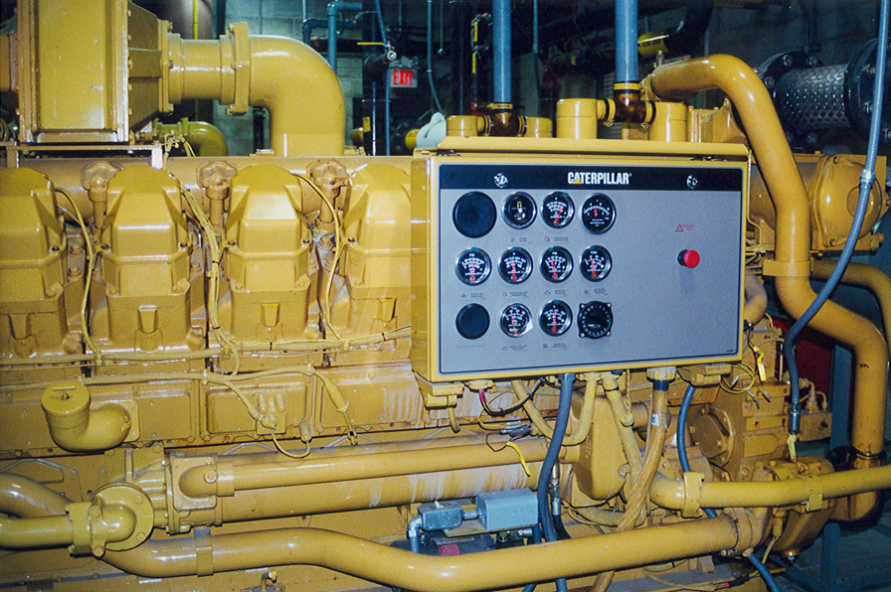
[NAME OF COMPANY]
OMB Control No. 2060-XXX
Expires XX/XX/XXXX
[Insert partner logo here]
[Segment(s) (e.g., if multiple segments, list as “Distribution and Transmission & Storage”] [Commitment Option (list either BMP or ONE Future Emissions Intensity)] Partner Since [Join Year]
Background
[Opportunity for company to provide relevant background and contextual information (e.g. general company information, overview of historic activities, overarching corporate policies, links to more information on company website, etc.) Character limit: 500]
Historical Highlights
[Name of Source/Activity #1]
[Include background, timeframe and significant outcomes, relevant technologies and/or practices employed that resulted in reduced emissions, reductions achieved, links to more information, etc.]
[Name of Source/Activity #2]
[Include background, timeframe and significant outcomes, relevant technologies and/or practices employed that resulted in reduced emissions, reductions achieved, links to more information, etc.]
SAMPLE [Insert picture or graph here]
EPA Form No. 5900-413

Slide 2
[NAME OF COMPANY] Historical Fact Sheet
OMB Control No. 2060-XXX
Expires XX/XX/XXXX
[Insert picture or graph here]
[Name of Source/Activity #3]
[Include background, timeframe and significant outcomes, relevant technologies and/or practices employed that resulted in reduced emissions, reductions achieved, links to more information, etc.]
[Insert picture or graph here]
[Name of Source/Activity #4]
[Include background, timeframe and significant outcomes, relevant technologies and/or practices employed that resulted in reduced emissions, reductions achieved, links to more information, etc.]
[Insert picture or graph here]
[Name of Source/Activity #5]
[Include background, timeframe and significant outcomes, relevant technologies and/or practices employed that resulted in reduced emissions, reductions achieved, links to more information, etc.]
An agency may not conduct or sponsor, and a person is not required to respond to, a collection of information unless it displays a currently valid OMB control number. The public reporting and recordkeeping burden for this collection of information is estimated to average 14 hours per response. Send comments on the Agency's need for this information, the accuracy of the provided burden estimates, and any suggested methods for minimizing respondent burden, including through the use of automated collection techniques to the Director, Collection Strategies Division, U.S. Environmental Protection Agency (2822T), 1200 Pennsylvania Ave., NW, Washington, D.C. 20460. Include the OMB control number in any correspondence. Do not send the completed form to this address.
Guidance for Partners: This form is intended to be a flexible template for Methane Challenge Partners to provide information of their choosing to highlight historical methane management activities prior to joining the Methane Challenge Program. Partners may highlight up to 5 historical actions/focal sources, and can adjust text length/photos as appropriate to each activity. Text should be no smaller than the existing Arial 11 font and content must not exceed 2 pages. EPA may make formatting adjustments to the submitted document, and will present to partner for final approval before posting on the Methane Challenge website.

