Slide 1
1652-0034 LEO _ FAT
Screenshots of webpage

Slide 2
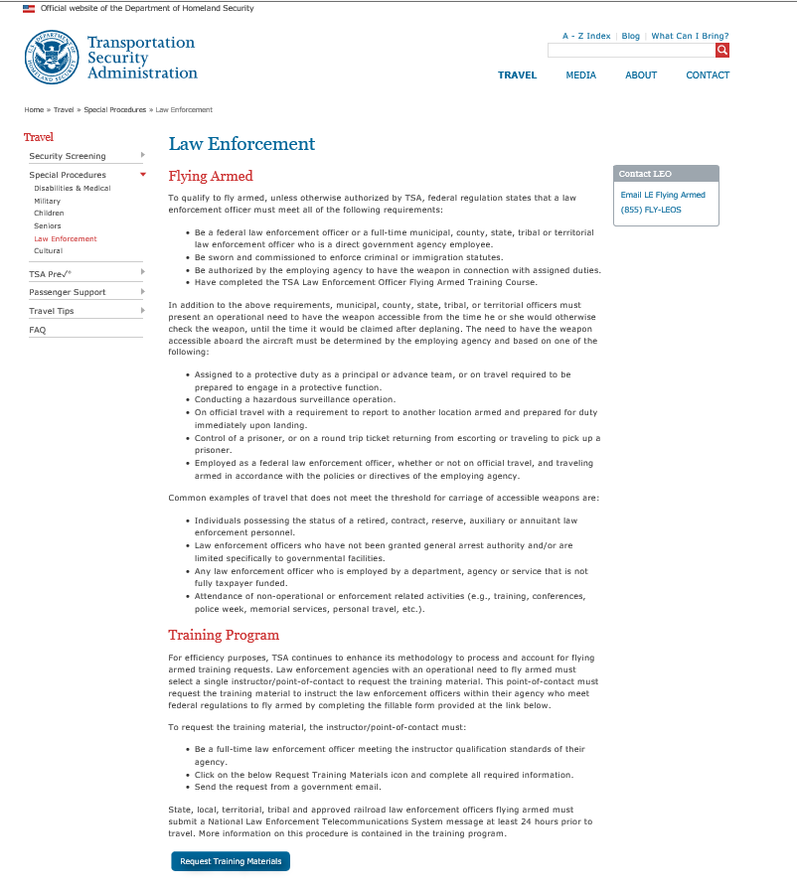

Slide 3
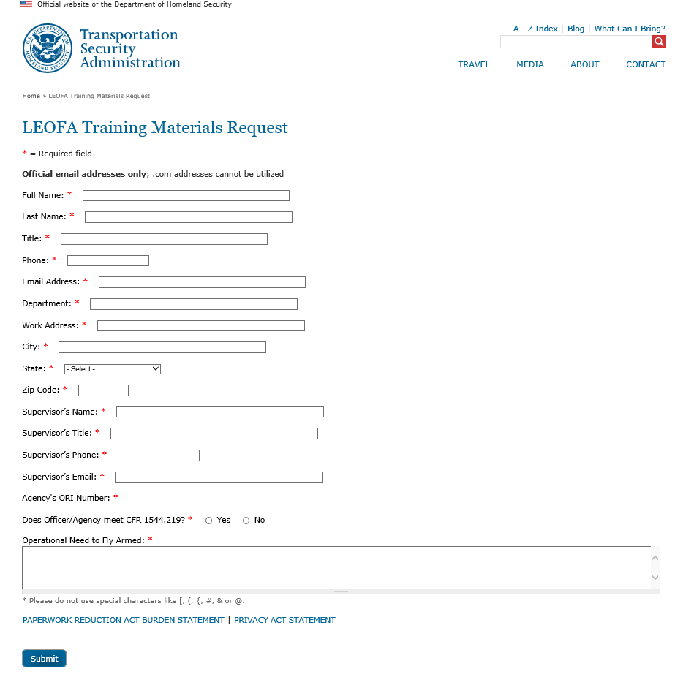

Slide 4


Slide 5
