Slide 1
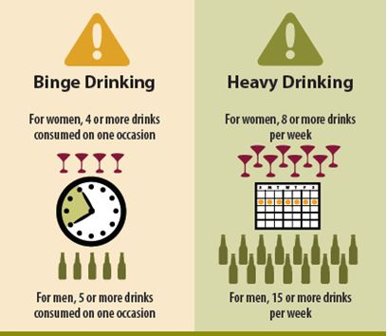
*An “occasion” is defined as period of two to three hours.

