Slide 1
Attachment 7 Communication Concepts Being Considered
1
HEAR HER
2
MOMENTS MATTER
3
BE THE ONE
4
STOP, LOOK, LISTEN

Slide 2
1
HEAR HER

Slide 3
1
HEAR HER

Slide 4
1
HEAR HER

Slide 5
2
MOMENTS MATTER

Slide 6
2
MOMENTS MATTER

Slide 7
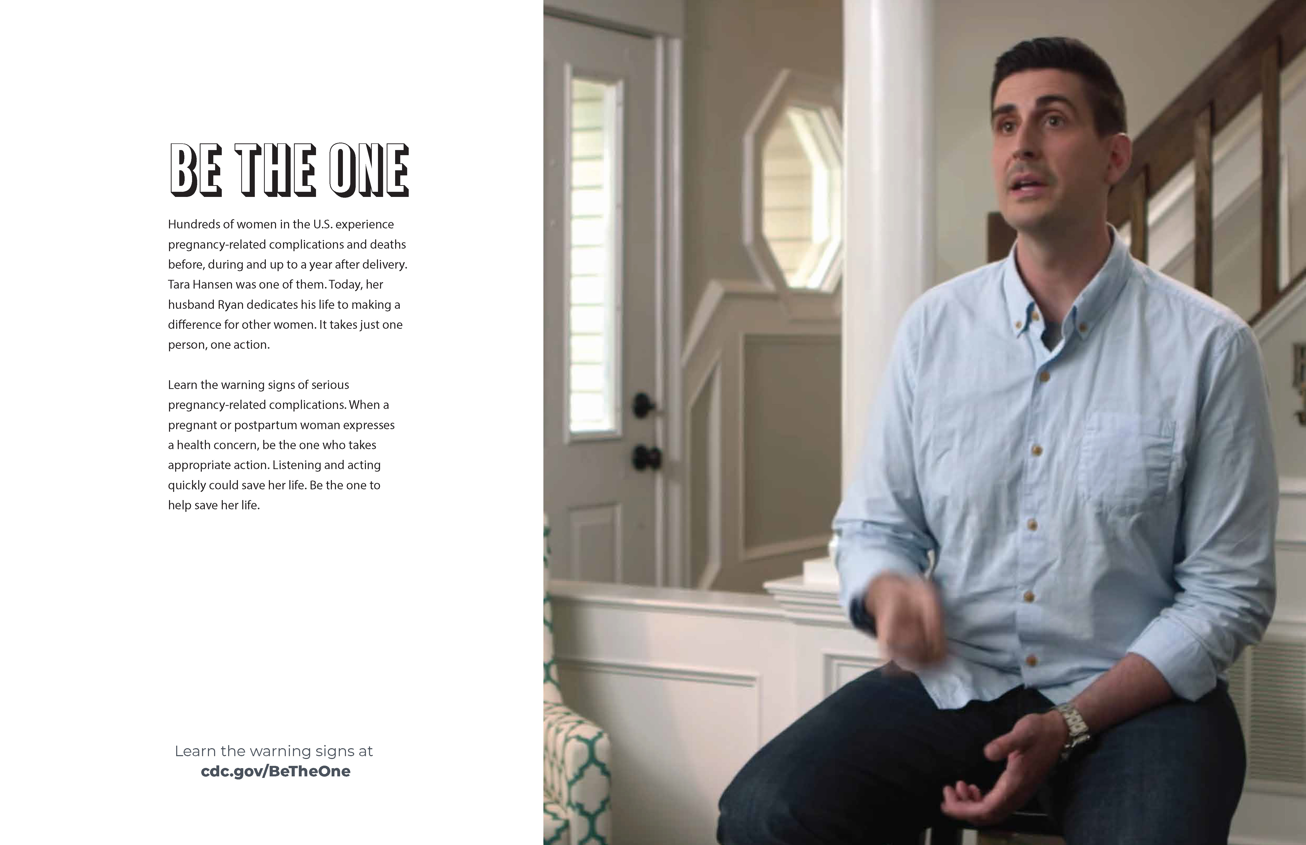
3
BE THE ONE

Slide 8
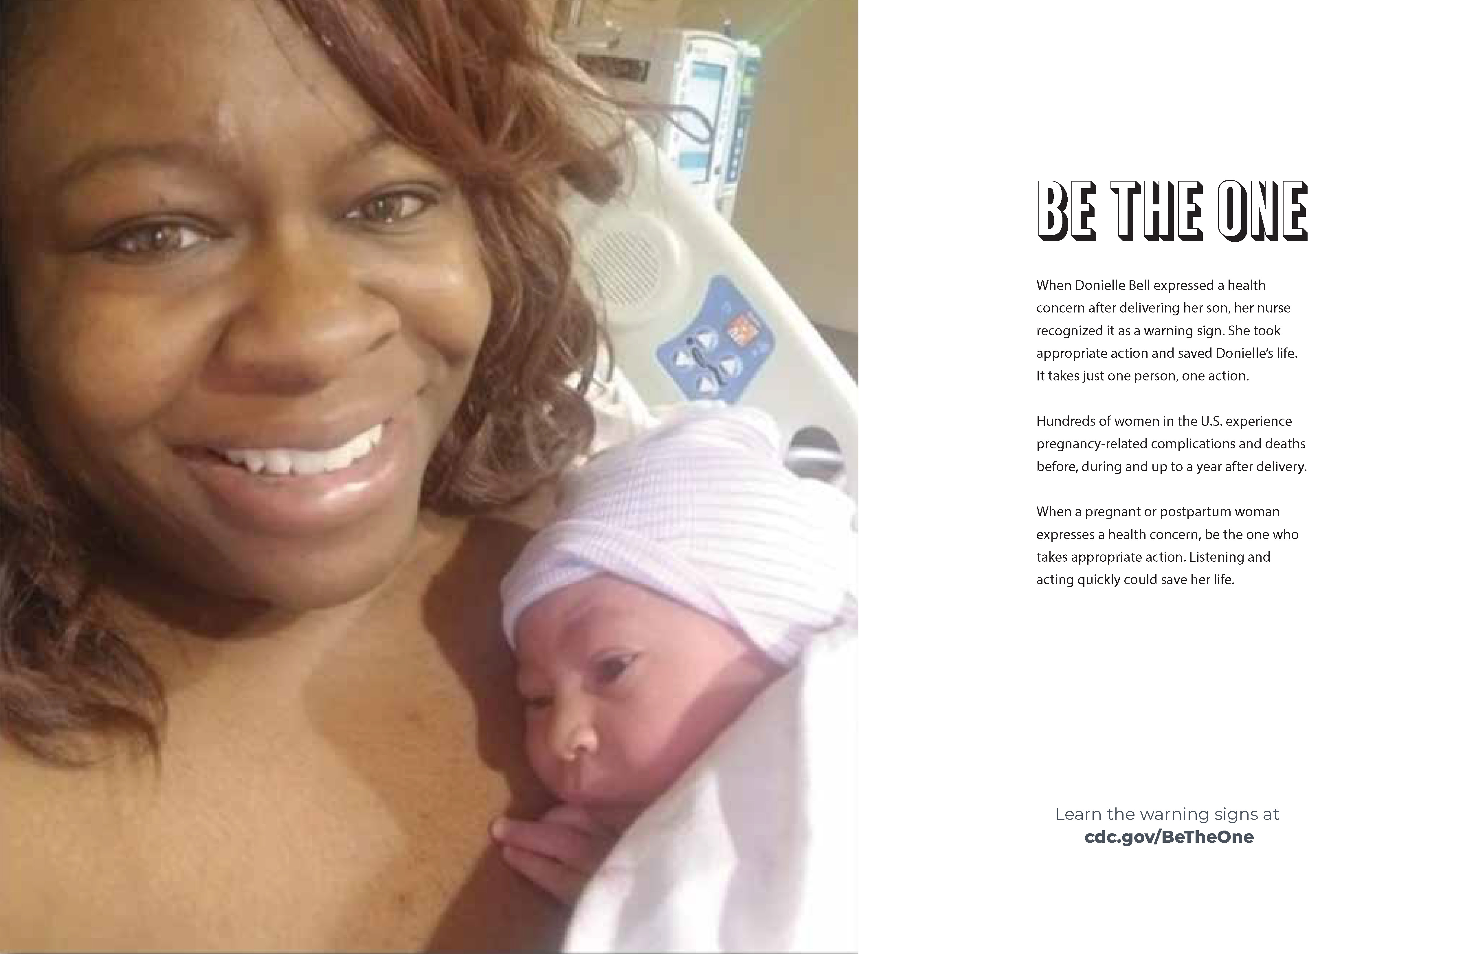
3
BE THE ONE

Slide 9
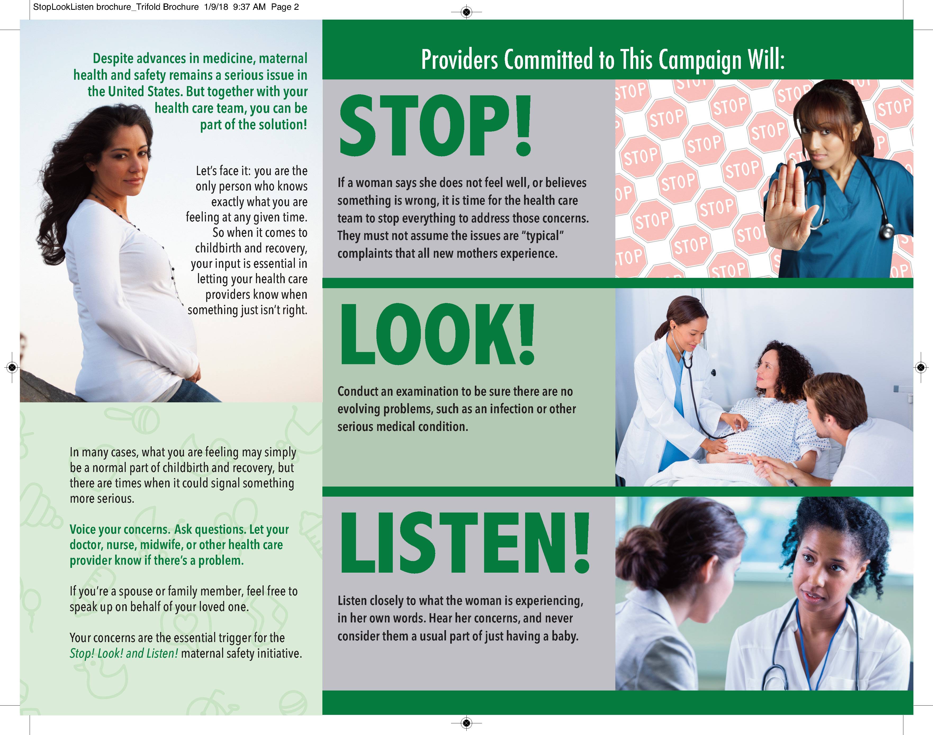
4
Stop, Look, Listen

