Slide 1
Import Petition – Import for Use Workflow

Slide 2
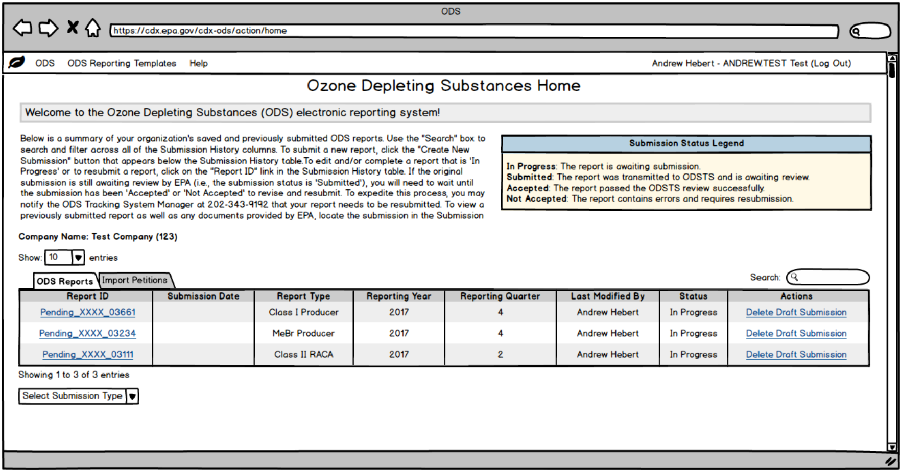
ODS Landing Page

Slide 3
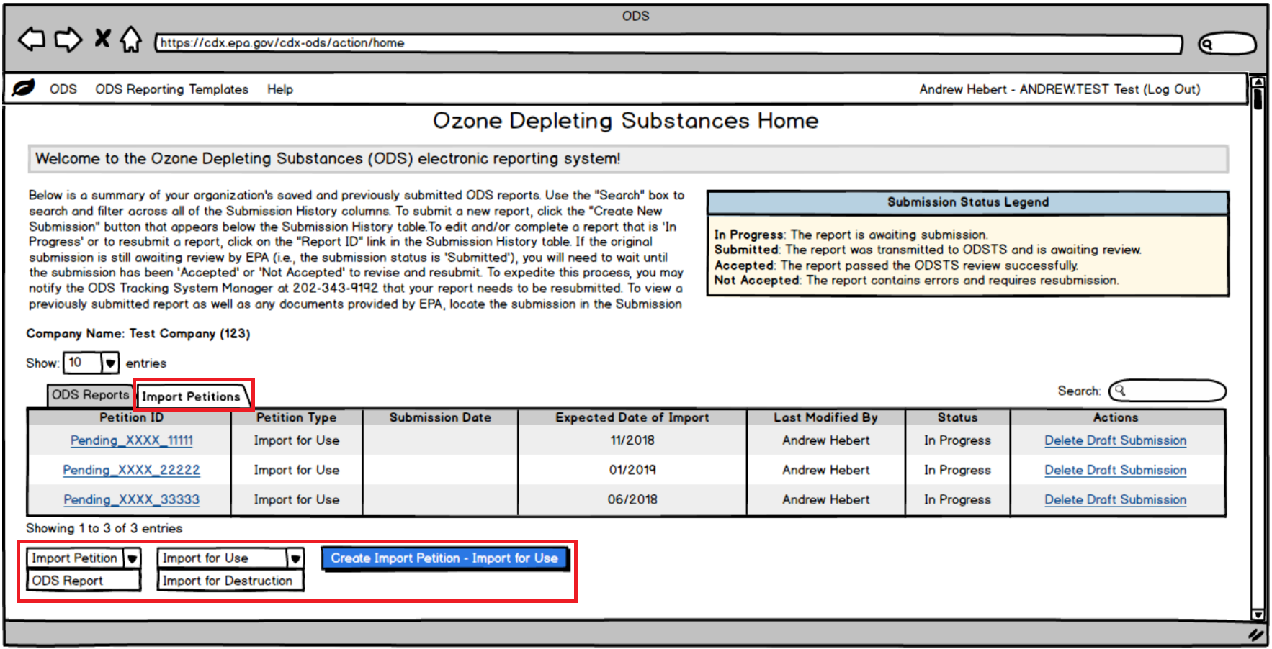
ODS Landing Page – Import Petition Tab and Dropdowns

Slide 4
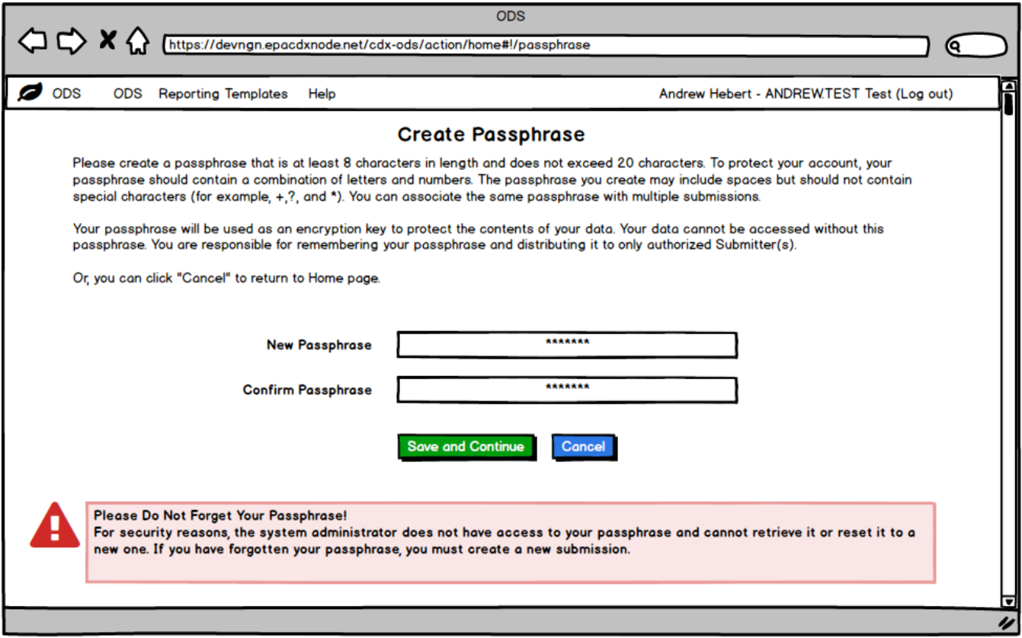
Create Passphrase

Slide 5
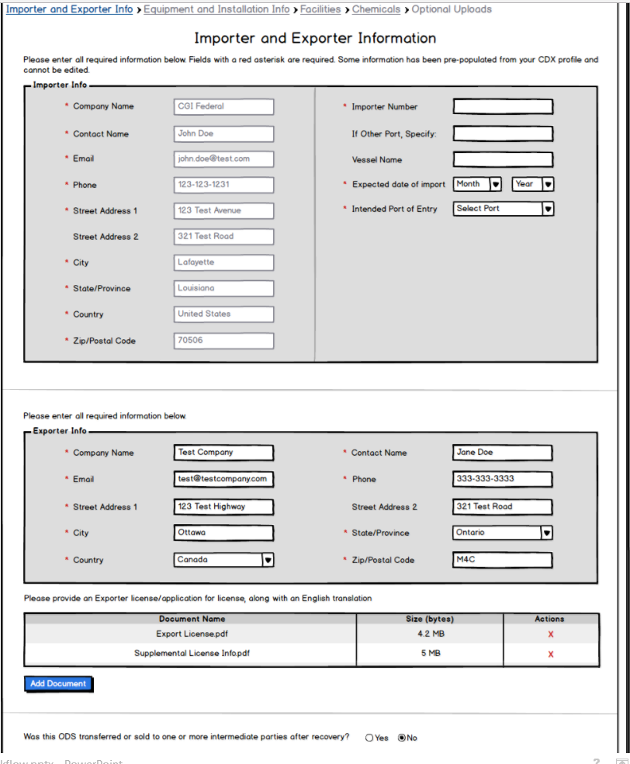
Importer and Exporter Info – Part 1

Slide 6
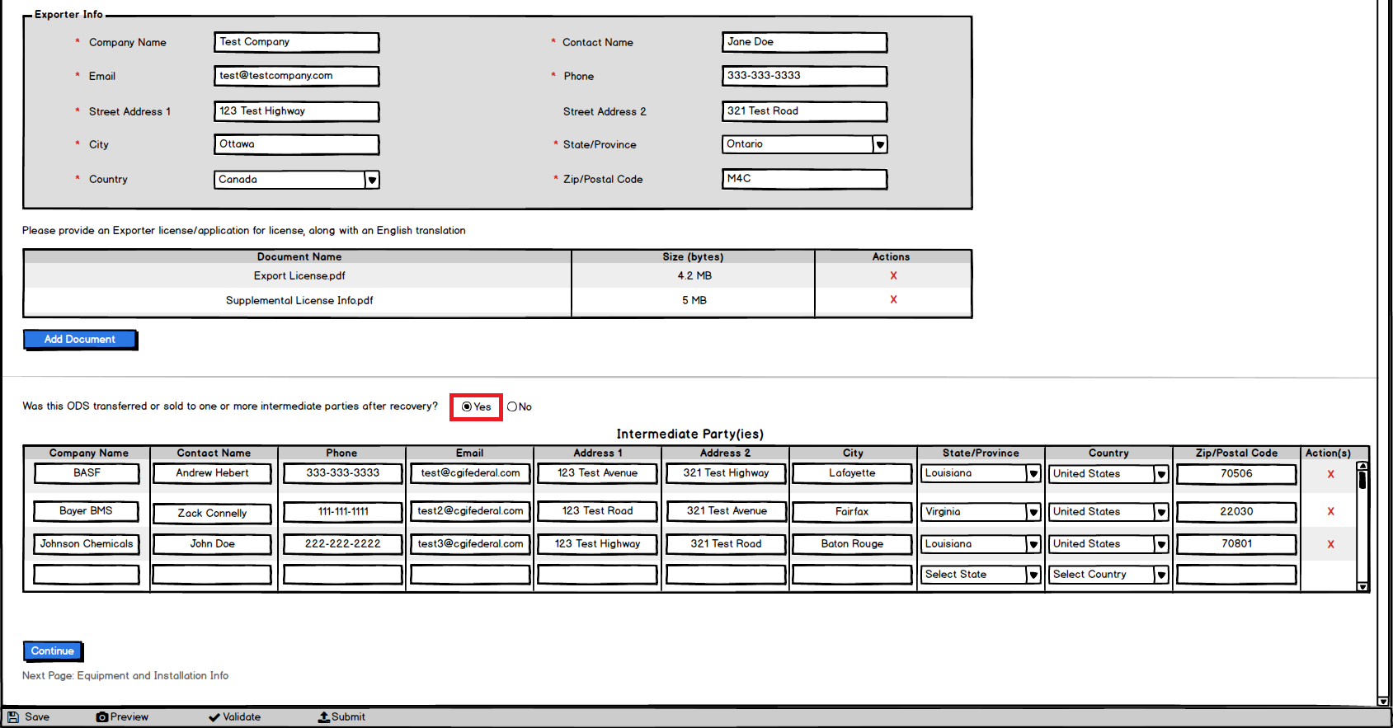
Importer and Exporter Info Expanded – Part 2

Slide 7
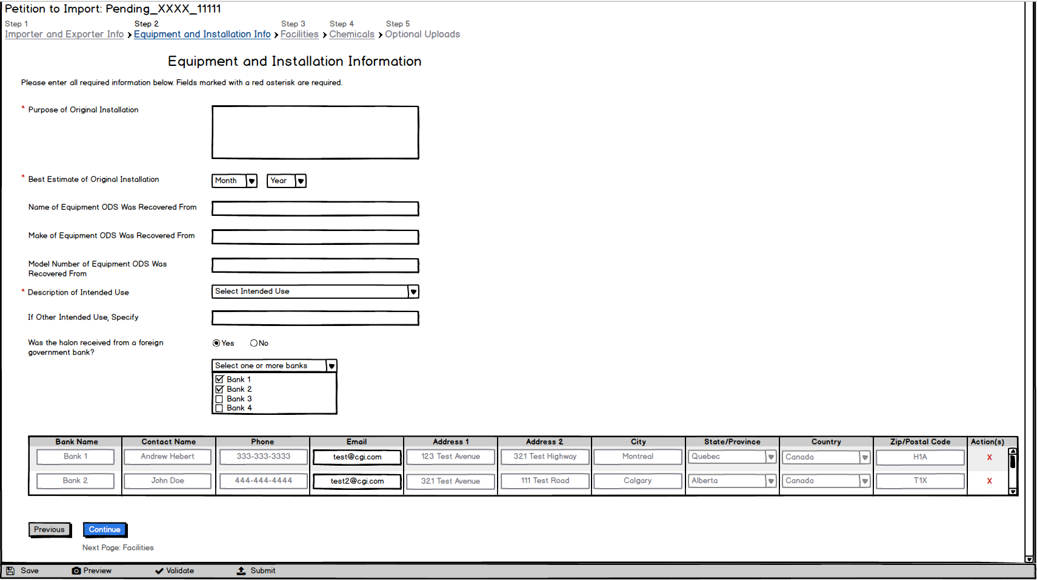
Equipment and Installation Info

Slide 8
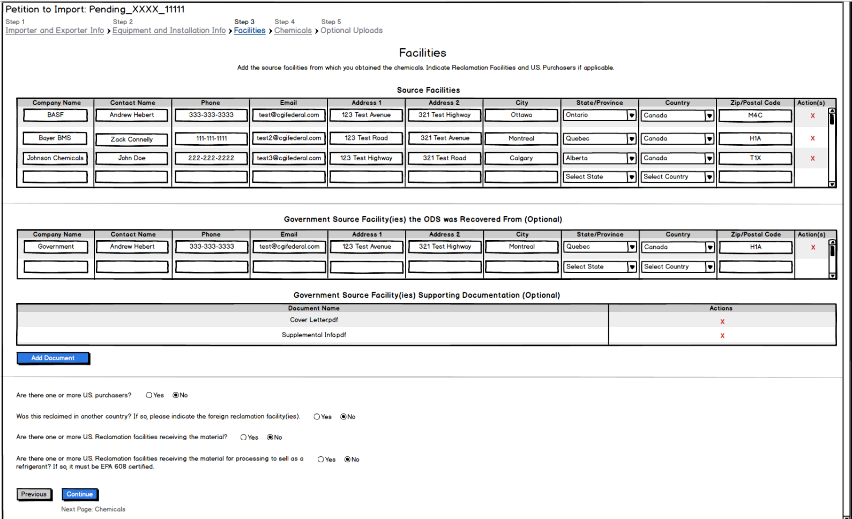
Facilities – Part 1

Slide 9
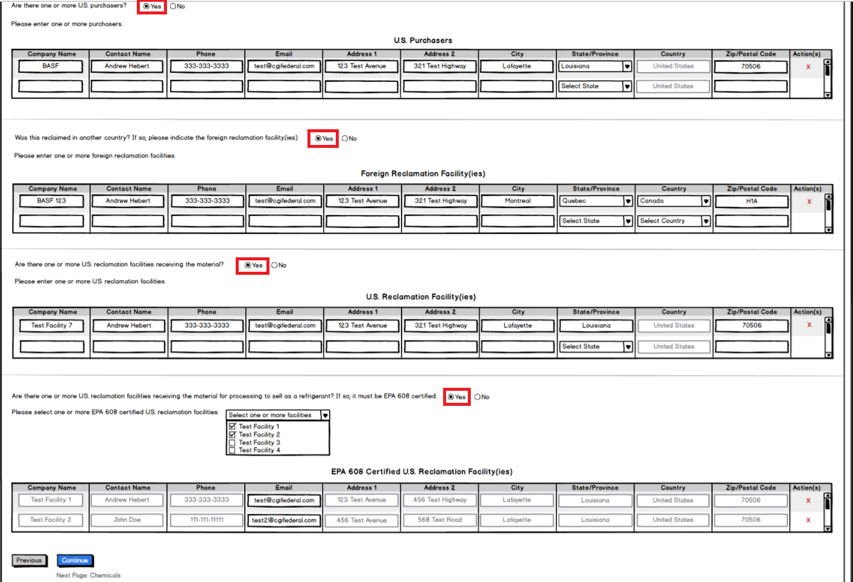
Facilities Expanded – Part 2

Slide 10
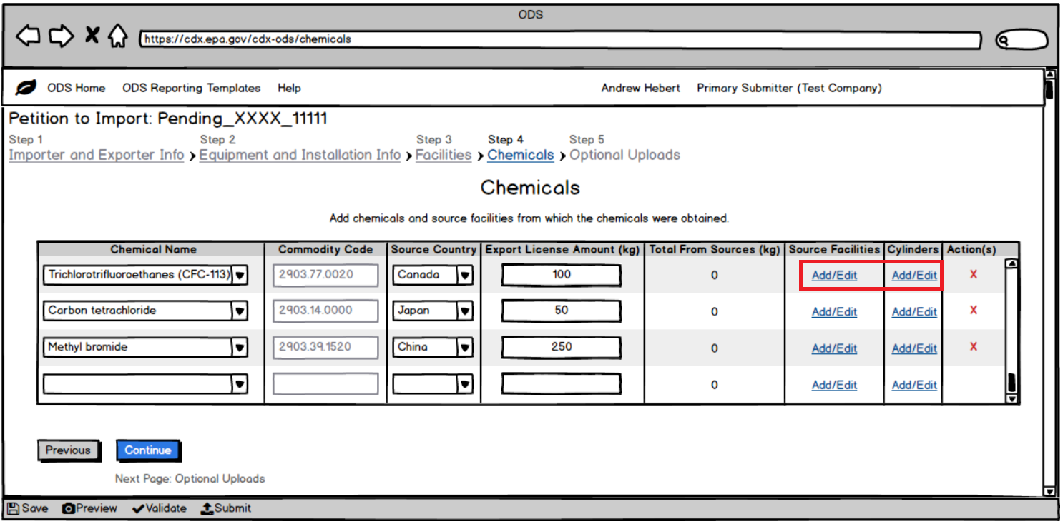
Chemicals

Slide 11
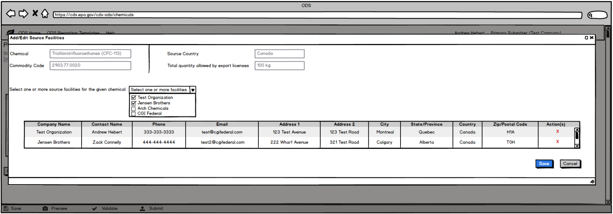
Chemicals – Add/Edit Source Facility Modal

Slide 12
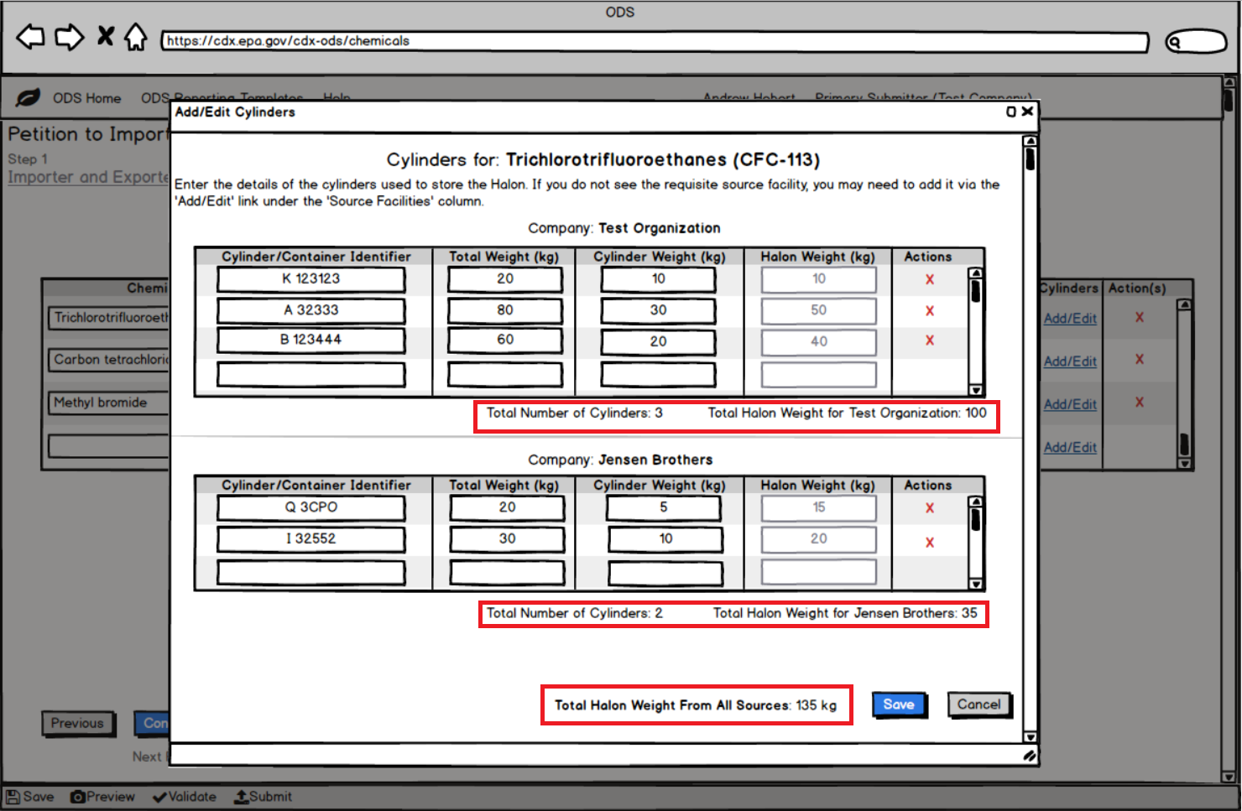
Chemicals – Add/Edit Cylinders Modal

Slide 13
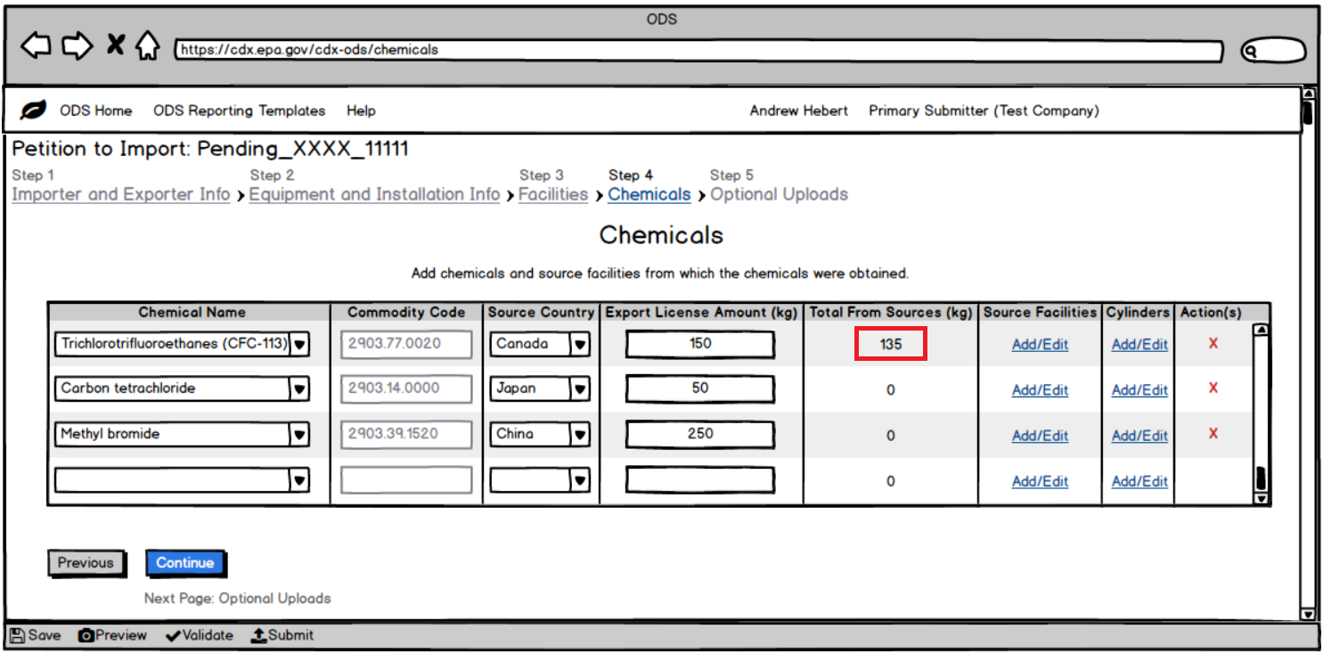
Chemicals – After Adding Source Facilities and Cylinders

Slide 14
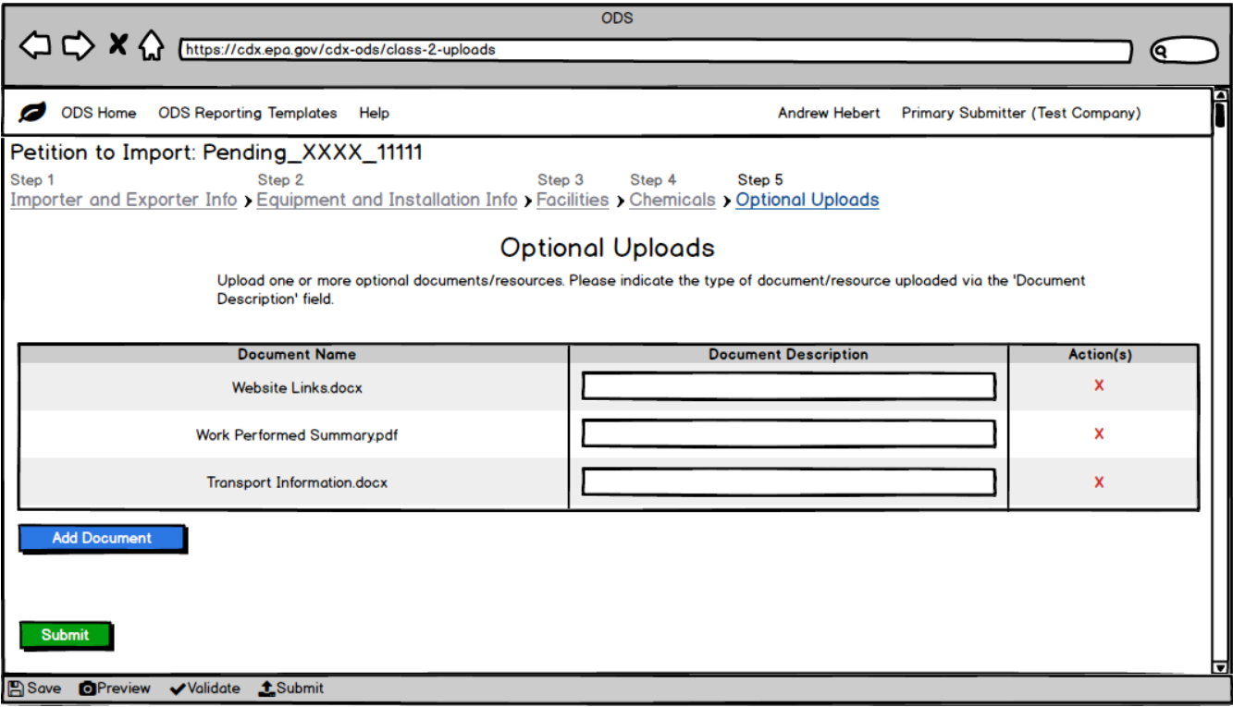
Optional Uploads

