Slide 1
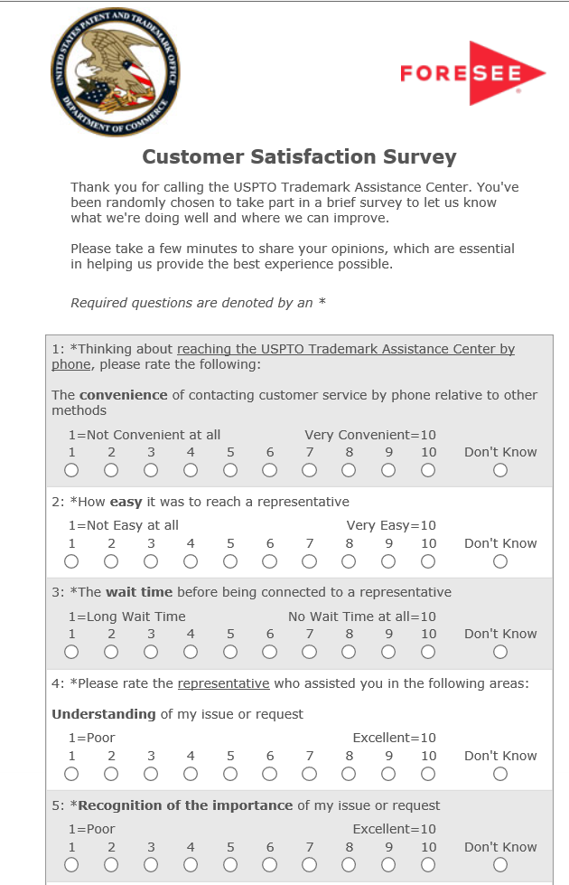
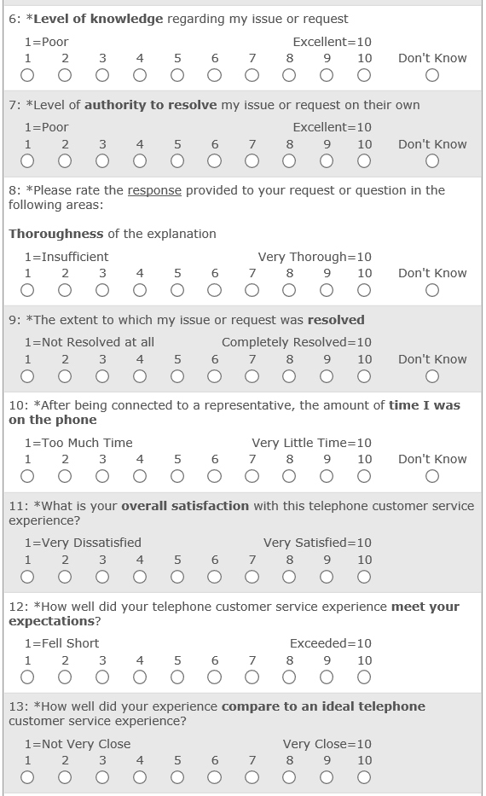
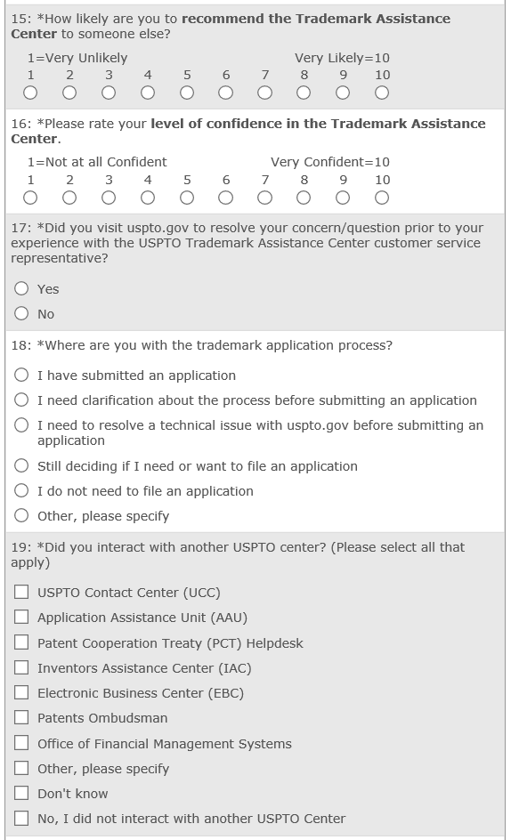
*
*Paired question: Please indicate your level of agreement with the following statement:
This interaction increased my confidence in the U.S. Patent and Trademark Office.

Slide 2
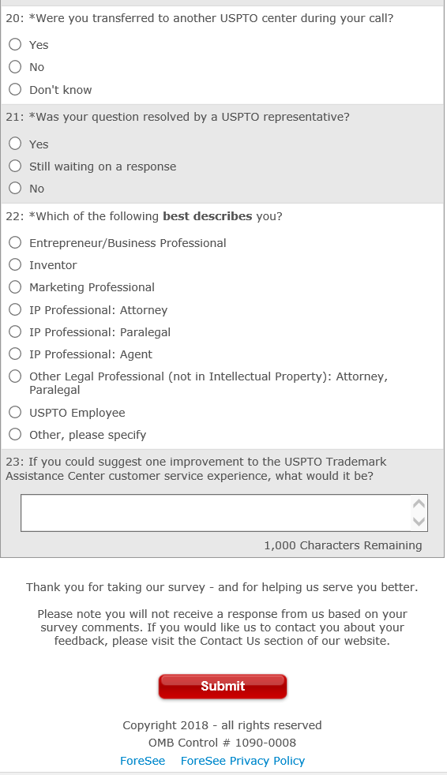
Question to be added regarding representatives:
Please indicate your level of agreement with the following statements: (Scale Note:: 1= strongly disagree and 10= strongly agree)
The Trademark Assistance Center representative I interacted with was helpful.
The Trademark Assistance Center representative I interacted with treated me fairly.
Strongly disagree
Strongly agree
Strongly disagree
Strongly agree

