Slide 1
Workstation Enrollment

Slide 2
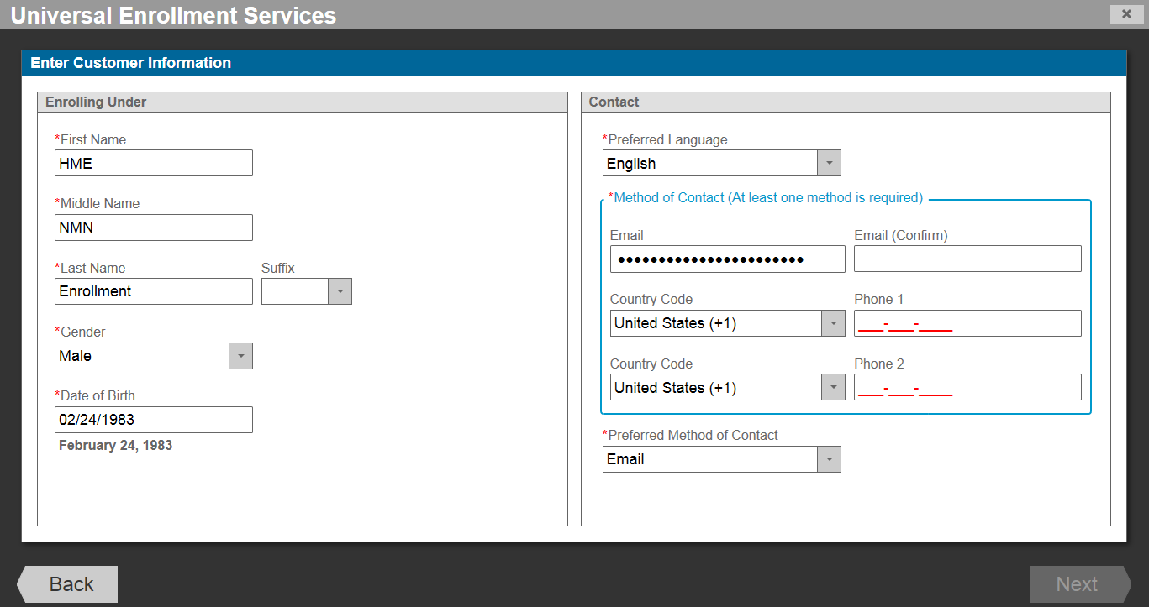

Slide 3
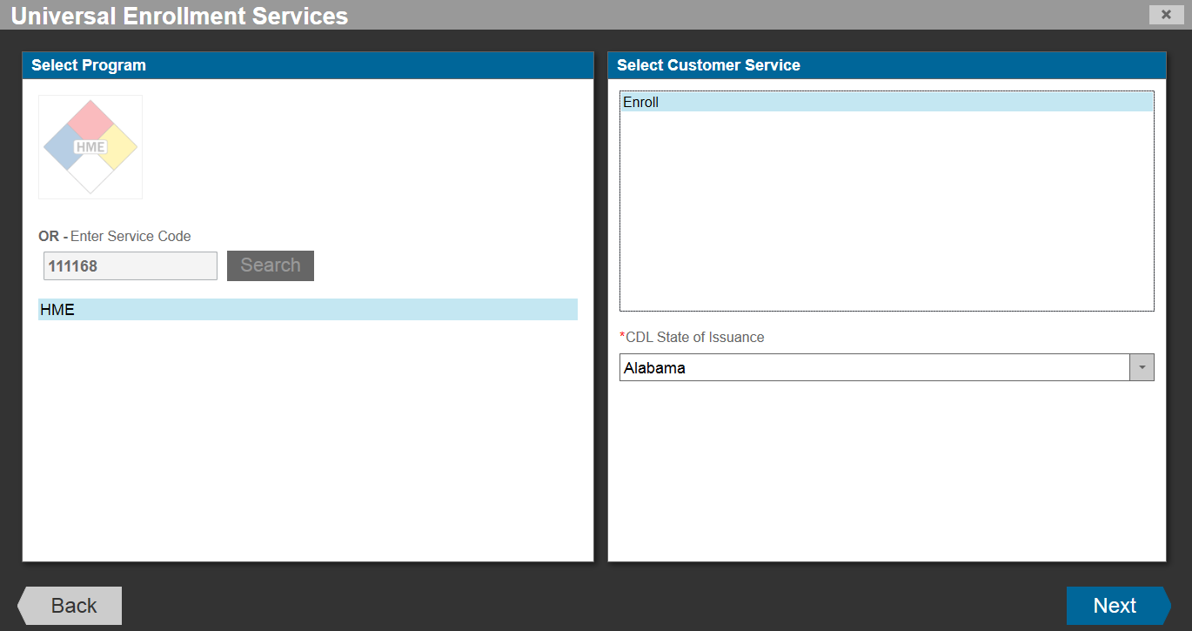

Slide 4
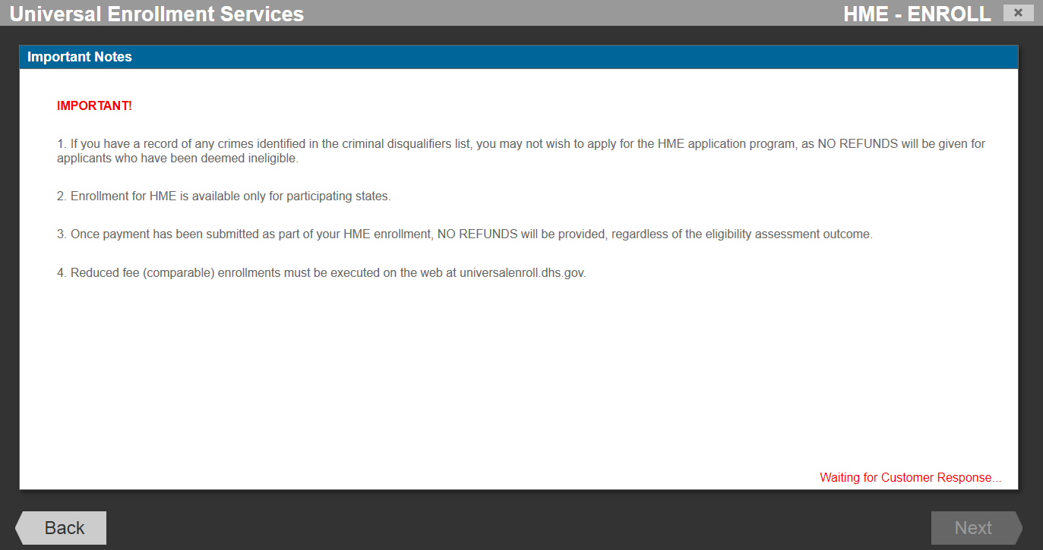

Slide 5
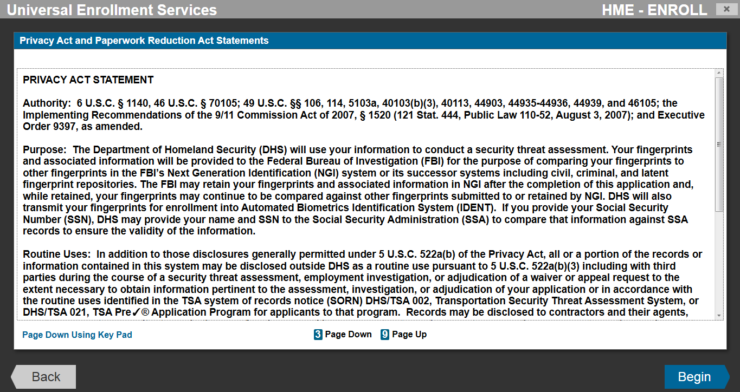

Slide 6
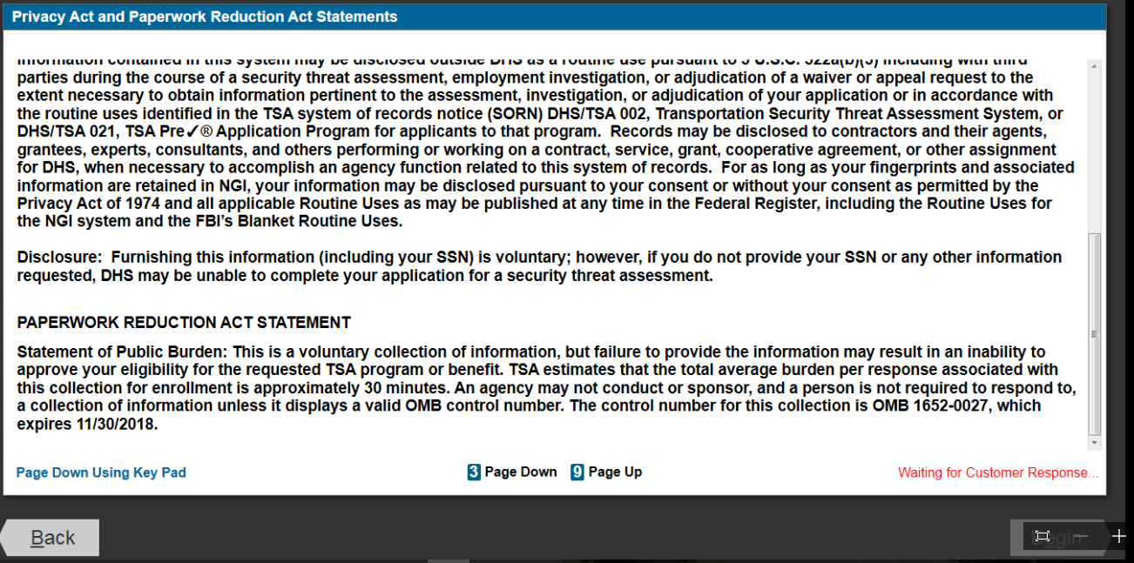
PAPERWORK REDUCTION ACT STATEMENT: This is a voluntary collection, but failure to provide the information may sesult in an inability to approve your eligibility for the requested TSA program or benefit. TSA estimates that the public burden for this collection of information is approximately 22 minutes. An agency may not conduct or sponsor, and a person is not required to respond to, a collection of information unless it displays a currently valid OMB control number. The OMB control number assigned to this collection is 1652-0027, which expires 11/30/2018. Send comments regarding this burden estimate or any other aspect of this collection of information including suggestions for reducing this burden to: TSA PRA Officer, 601 S. 12th Street, Arlington, VA 20598-6011. ATTN: PRA 1652-0027.

Slide 7
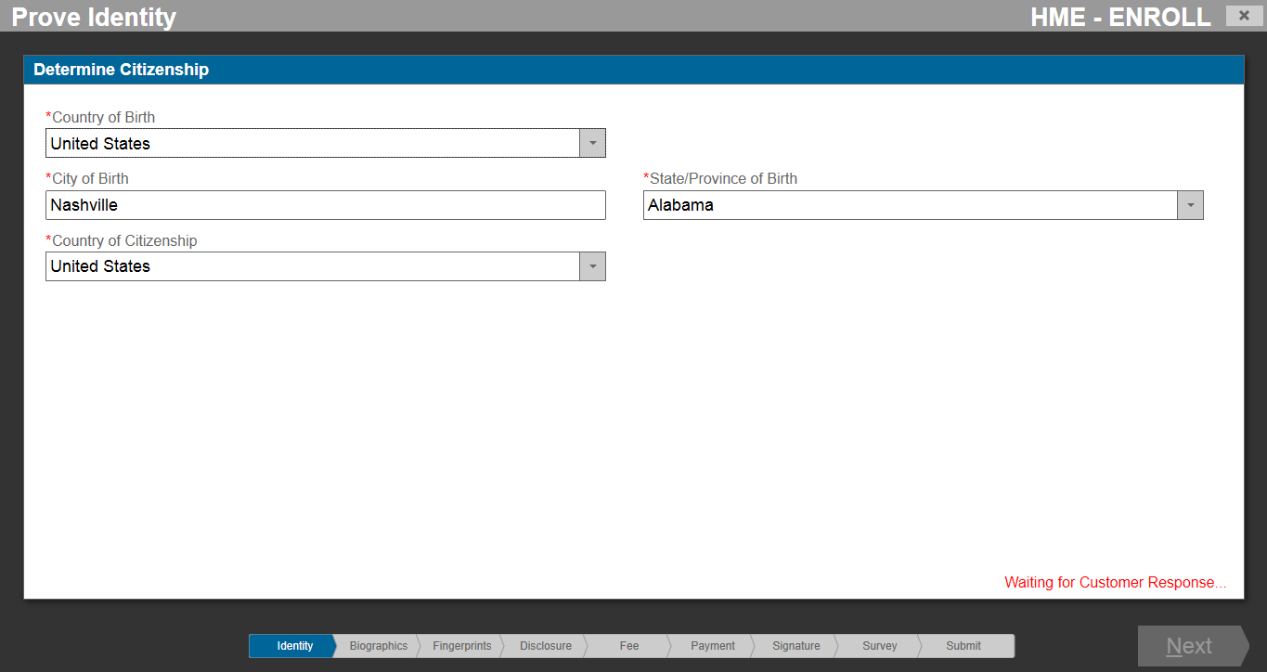

Slide 8
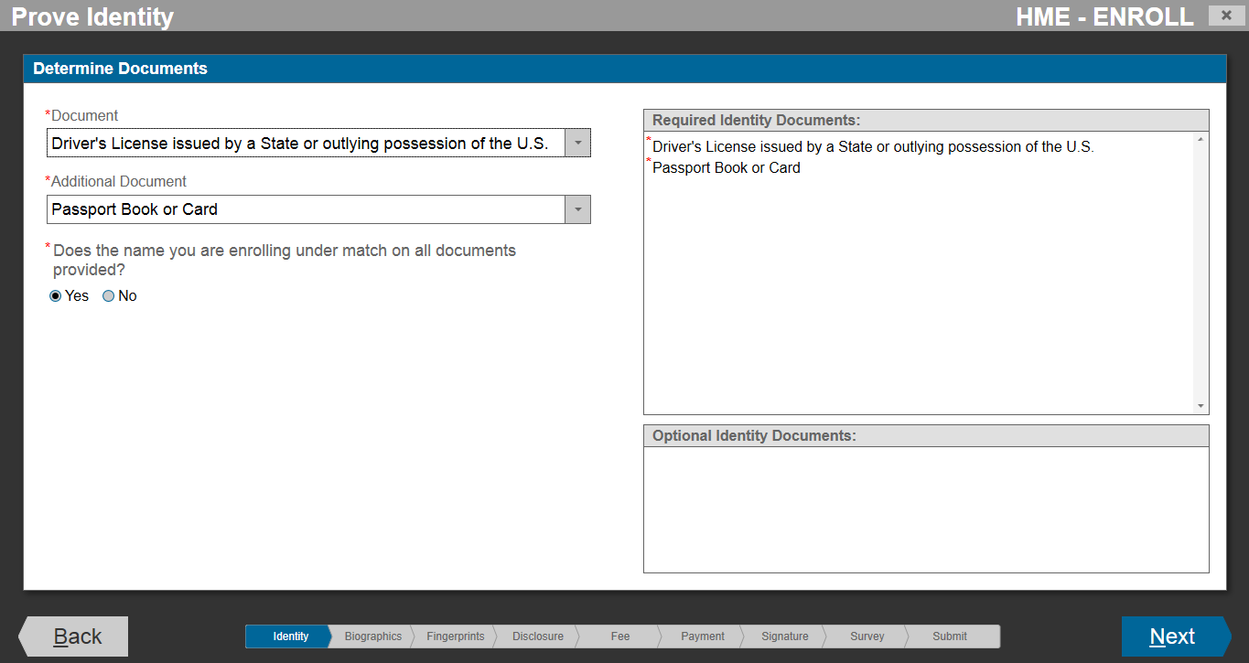

Slide 9
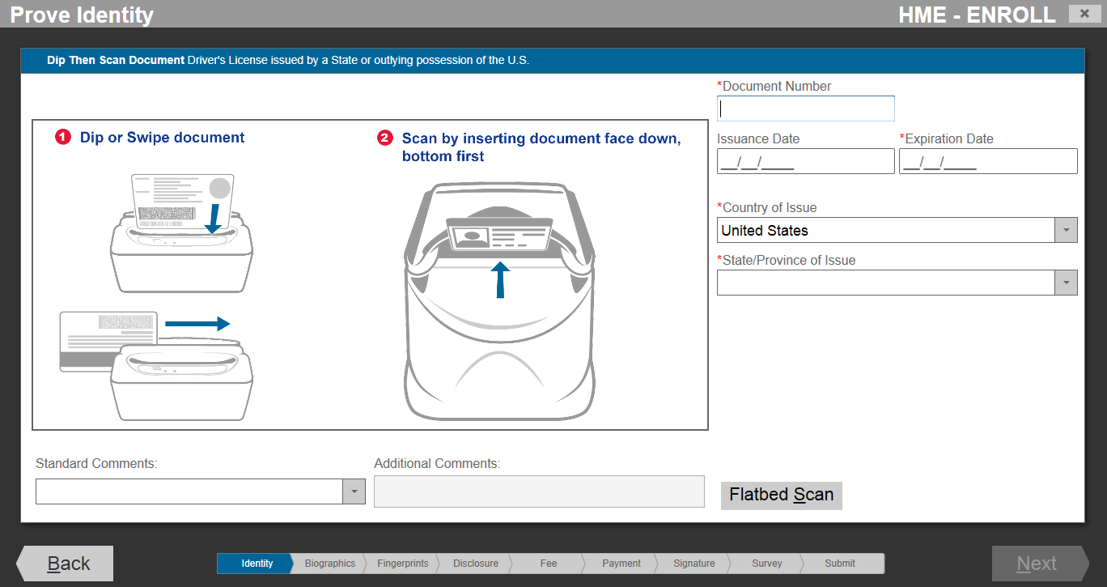

Slide 10
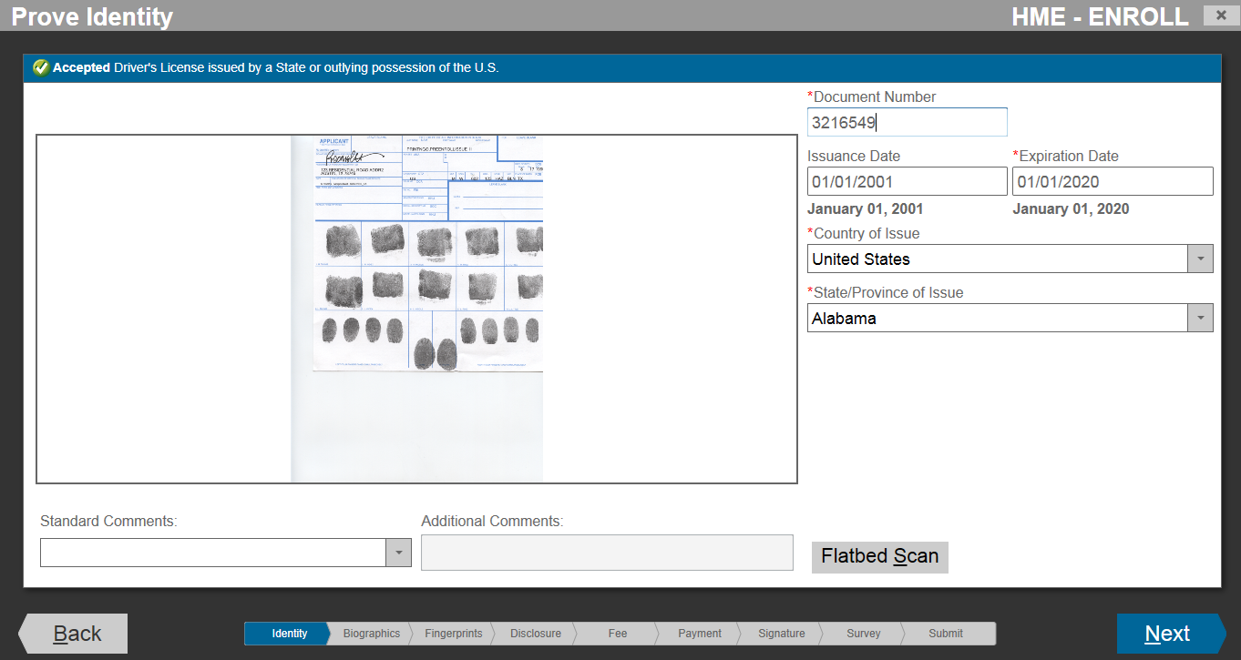

Slide 11
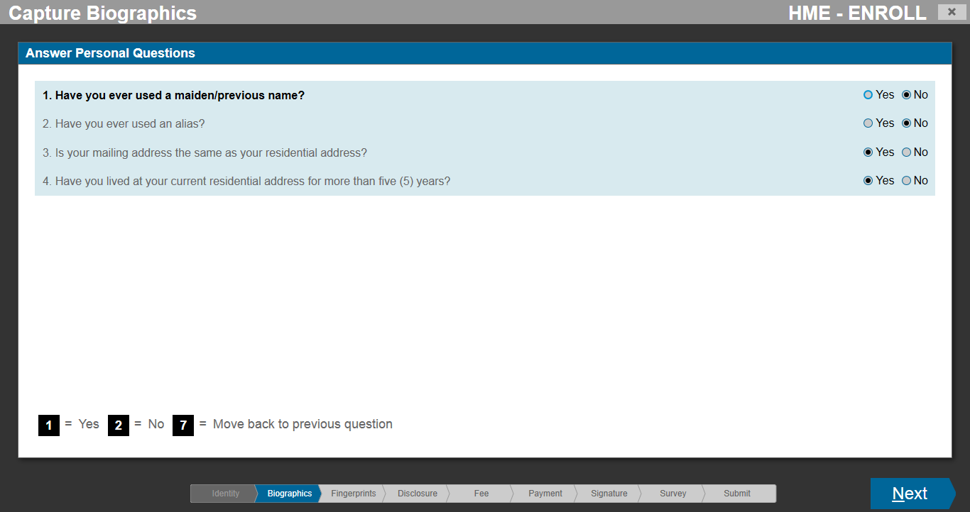

Slide 12
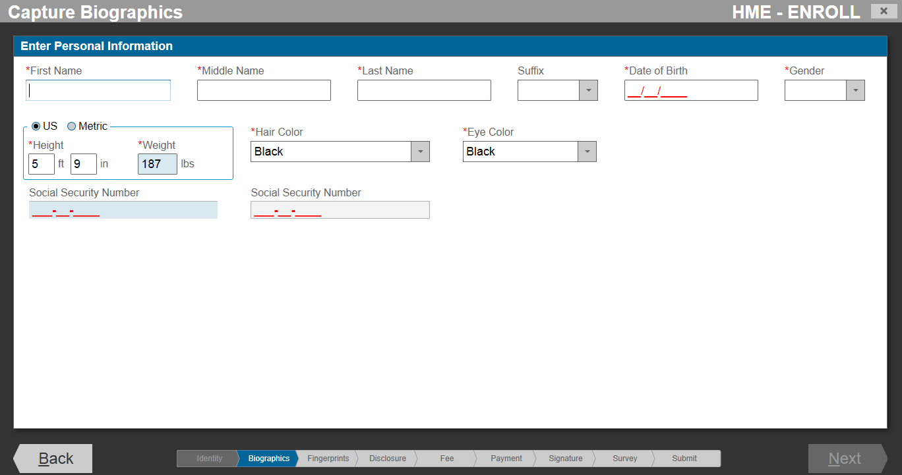

Slide 13
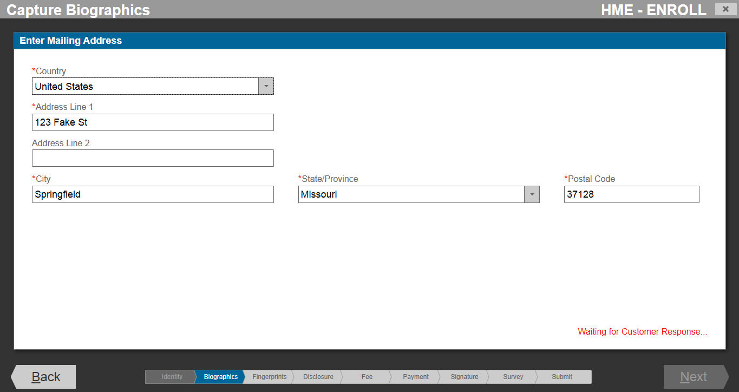

Slide 14
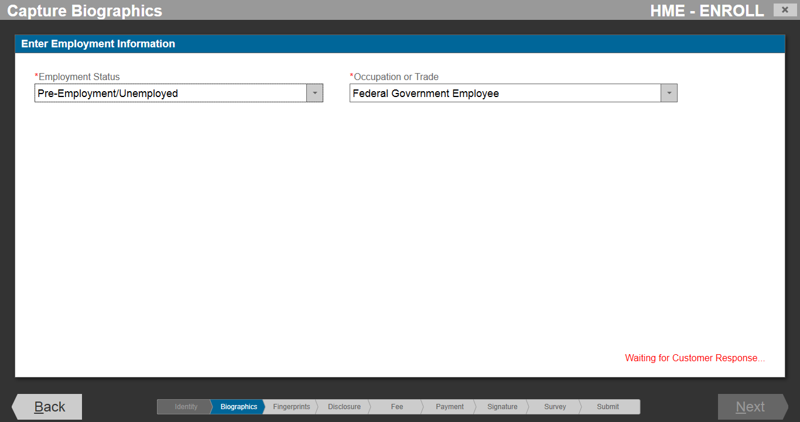

Slide 16
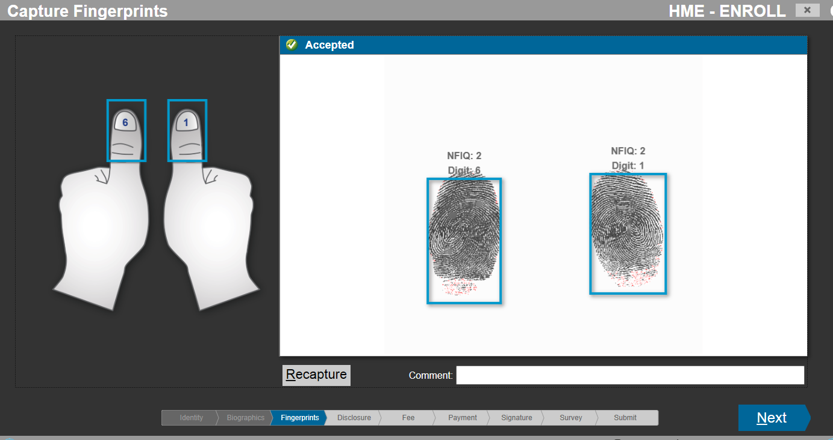

Slide 17
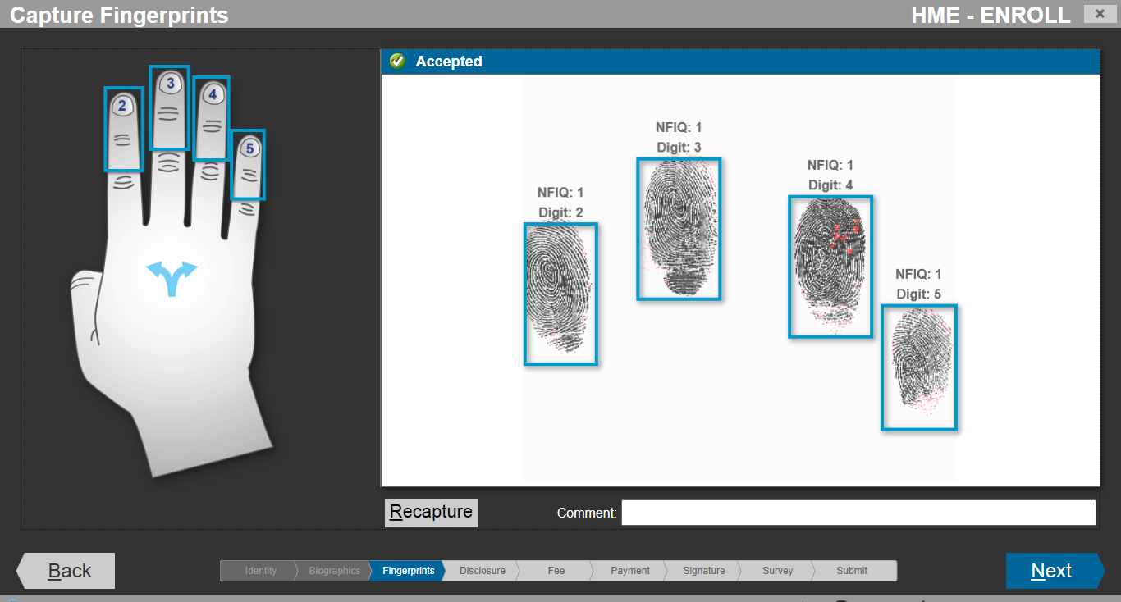

Slide 18
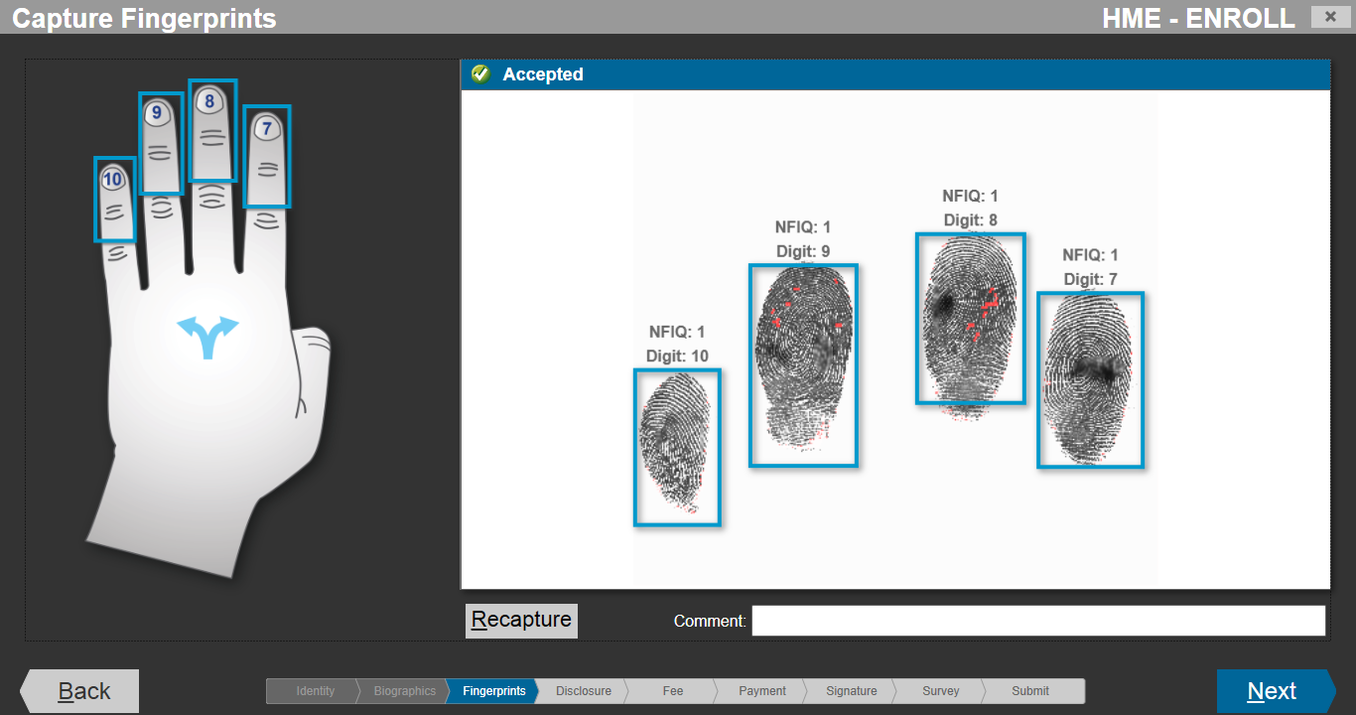

Slide 19
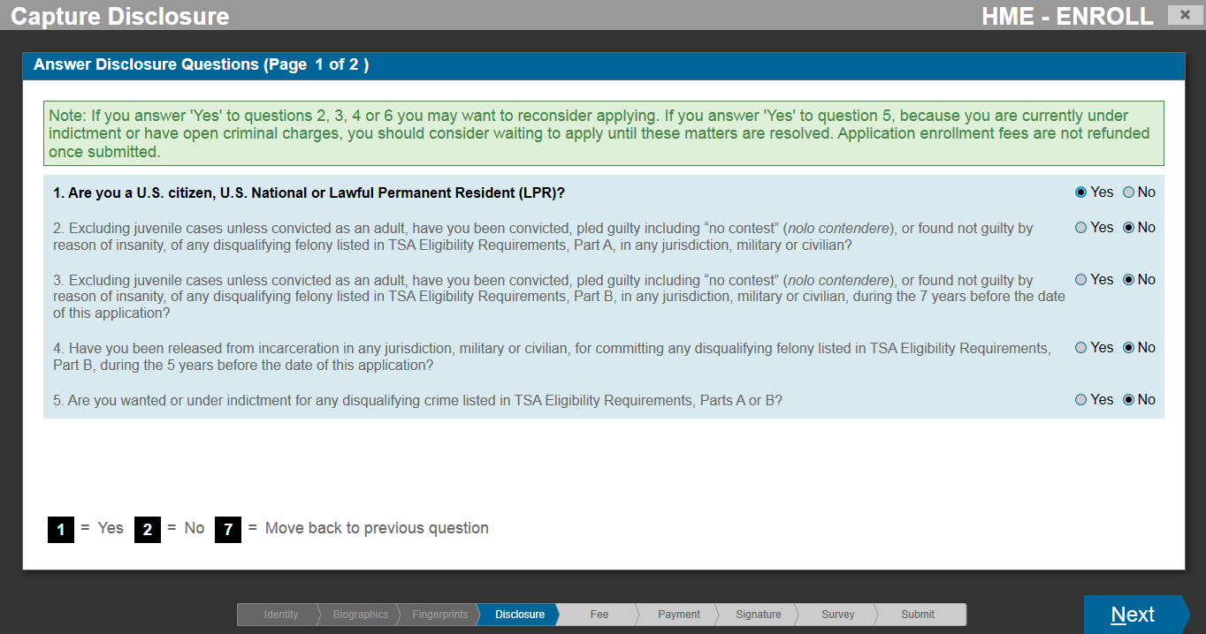

Slide 20
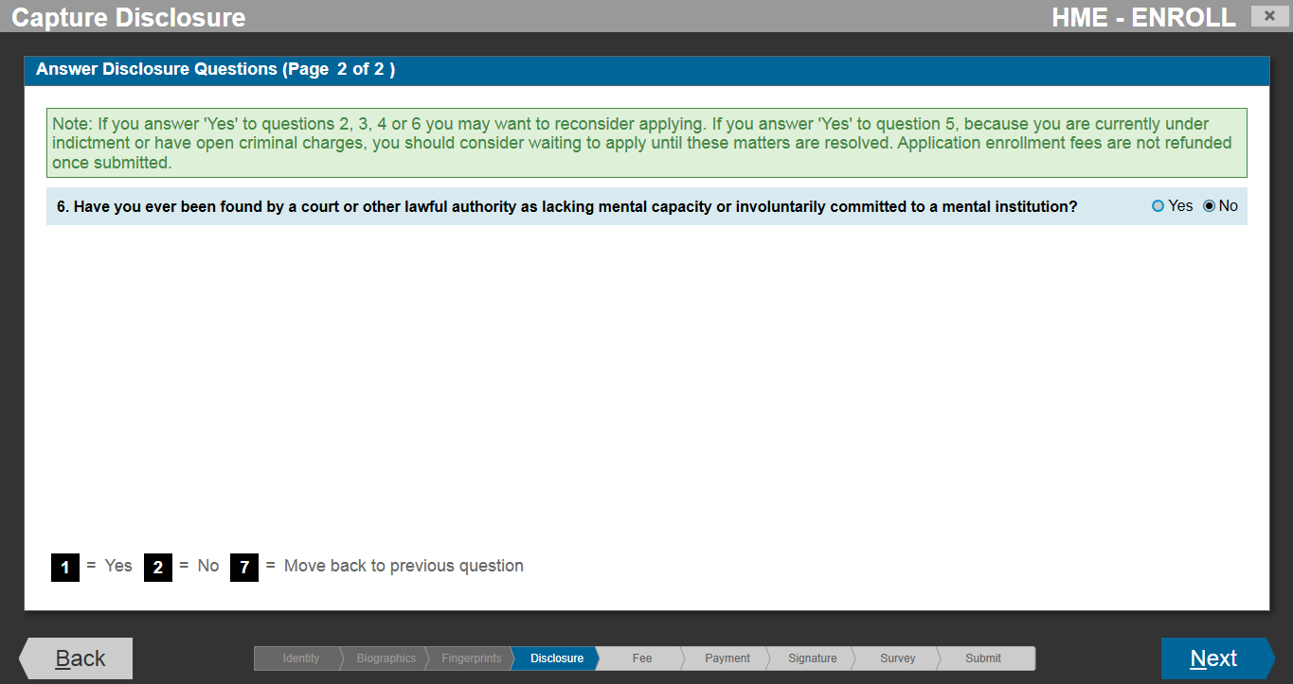

Slide 21
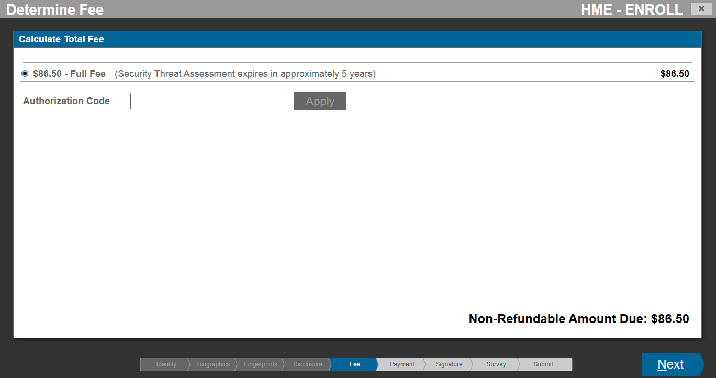

Slide 22
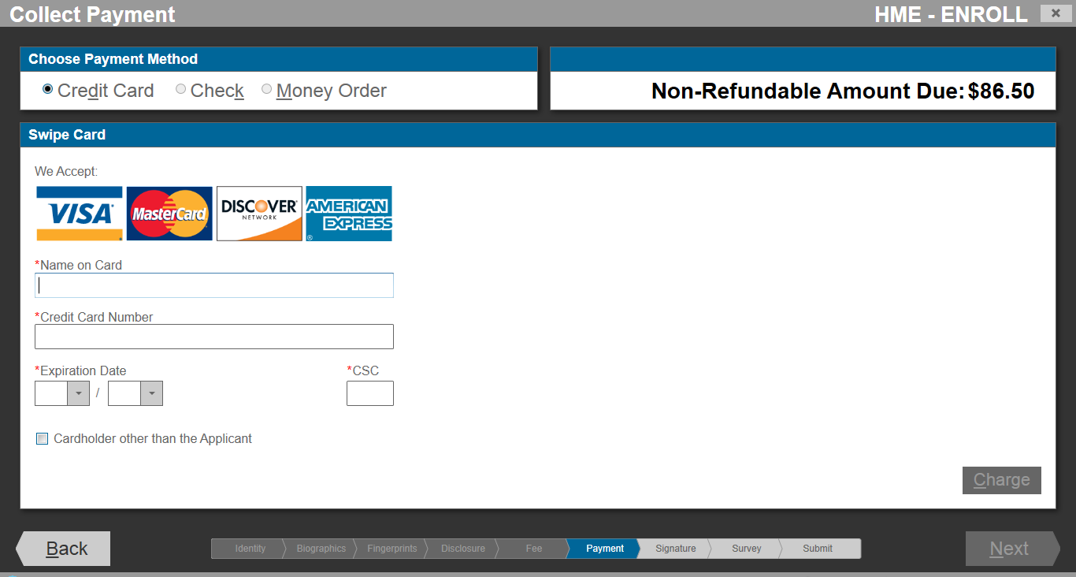

Slide 23
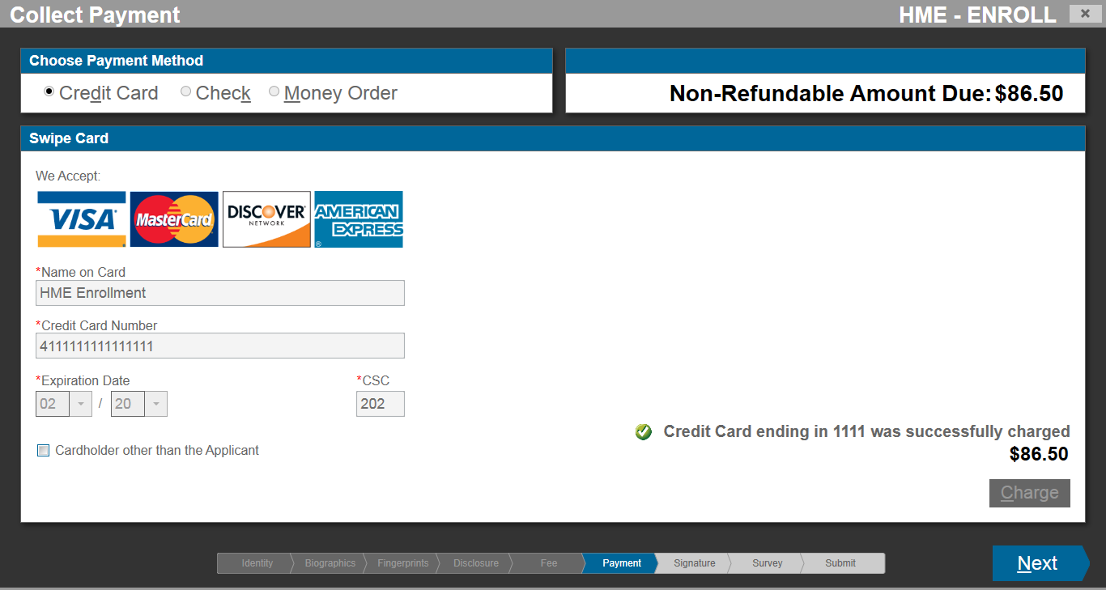

Slide 24
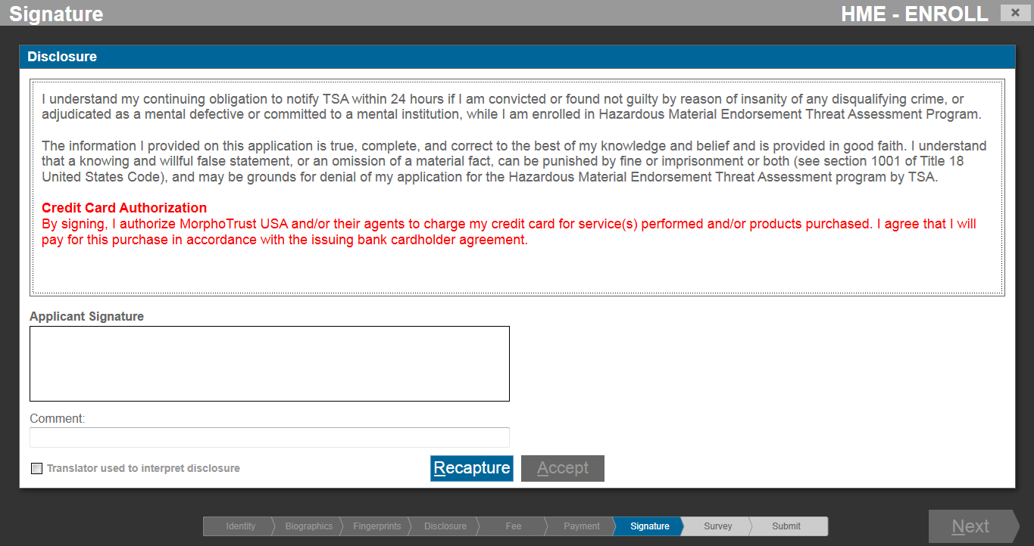

Slide 25
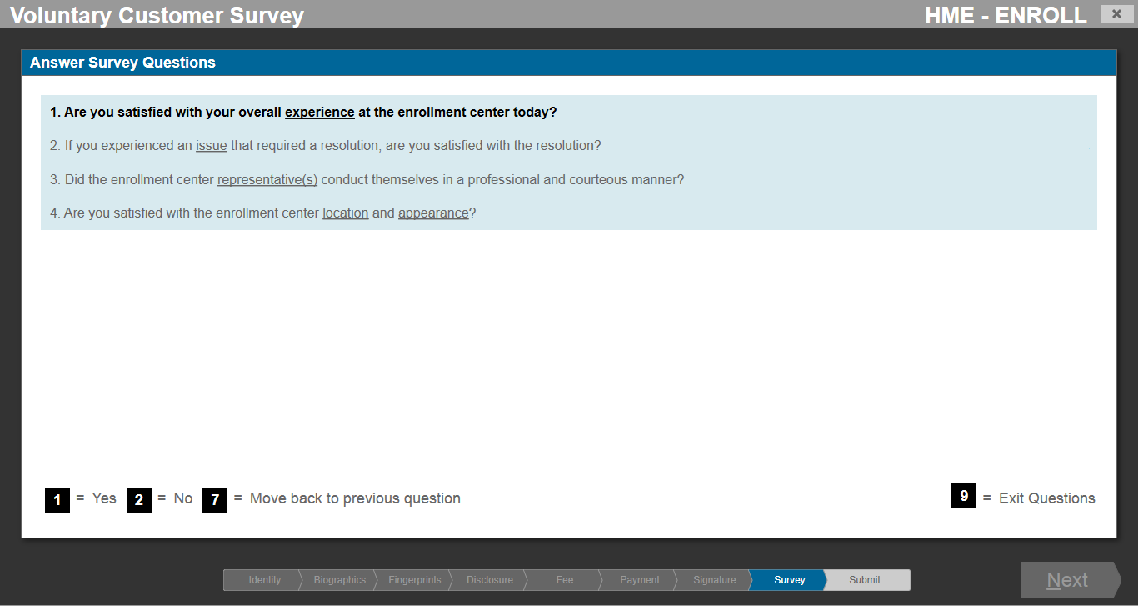

Slide 26
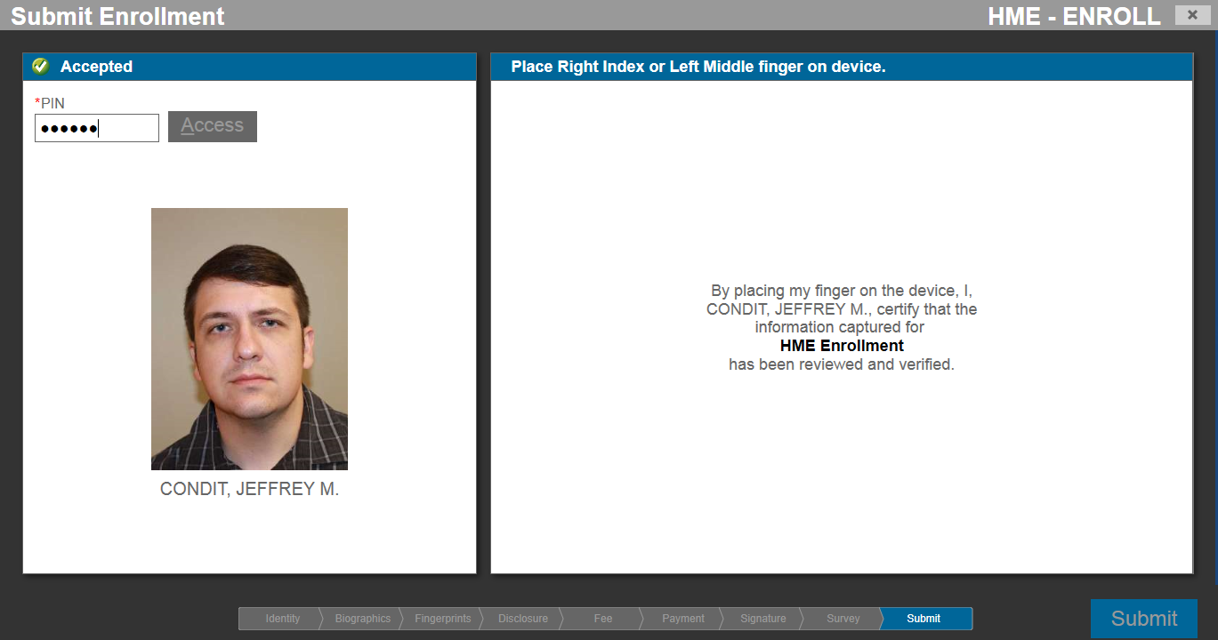

Slide 27
