Slide 1
HME
Survey Questions

Slide 2
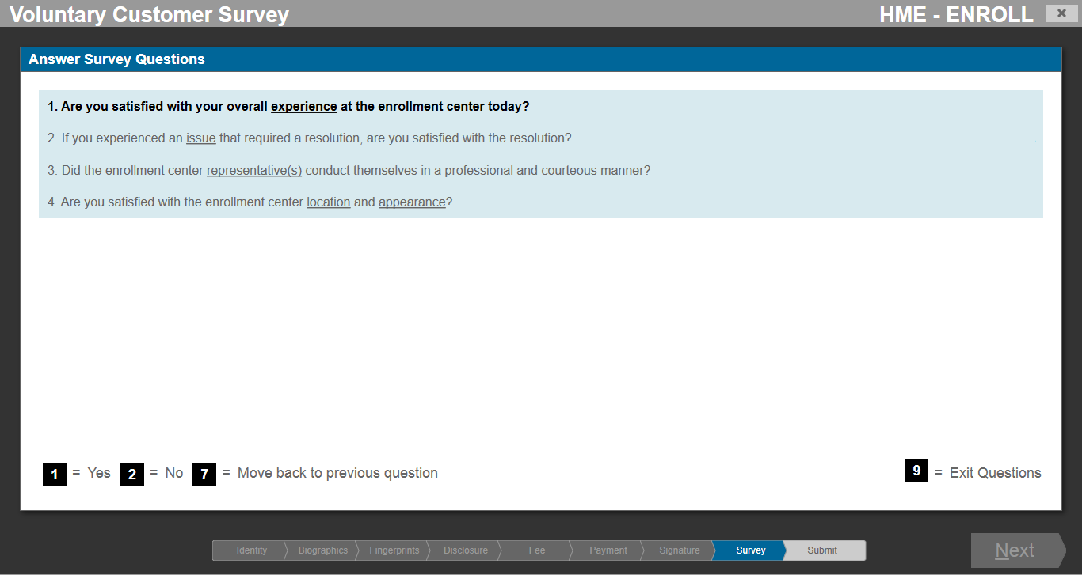

Slide 3
PAPERWORK REDUCTION ACT STATEMENT: TSA is gathering information to assess the HTAP applicant’s overall customer satisfaction with the service received at the enrollment center. The public burden for this voluntary collection of information is estimated to be 2.5 minutes. An agency may not conduct or sponsor, and a person is not required to respond to, a collection of information unless it displays a currently valid OMB control number. The OMB control number assigned to this collection is 1652-0027, which expires 11/30/2018. Send comments regarding this burden estimate or any other aspect of this collection of information including suggestions for reducing this burden to: TSA PRA Officer, 601 S. 12th Street, Arlington, VA 20598-6011. ATTN: PRA 1652-0027.

