Slide 1
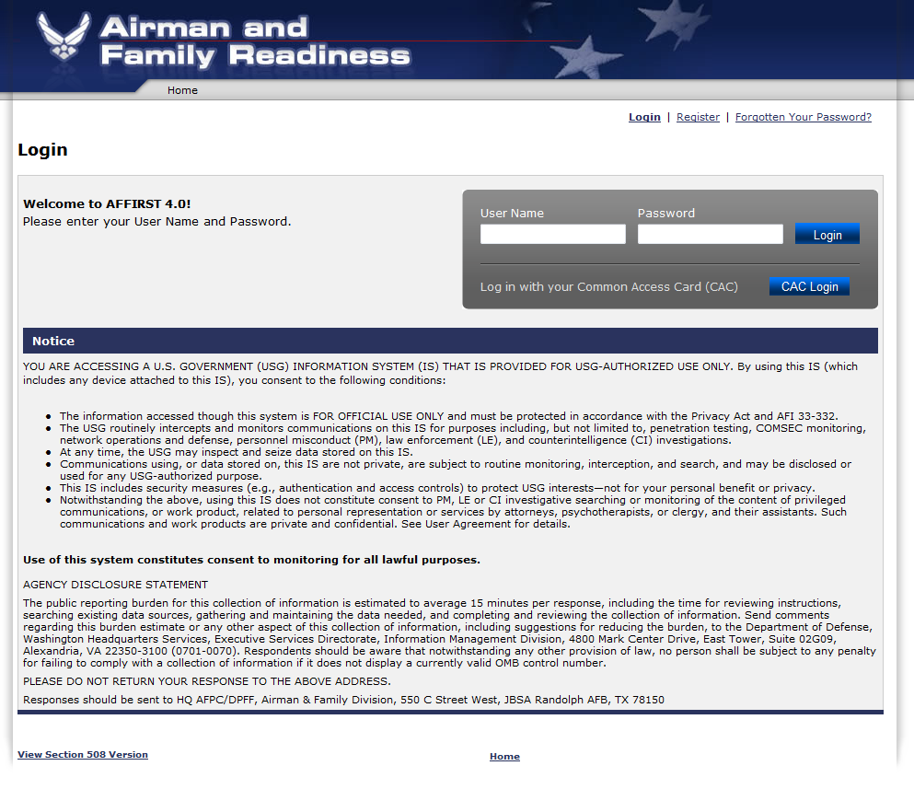
OMB Control No: 0701-0070
Exp. Date:

Slide 2
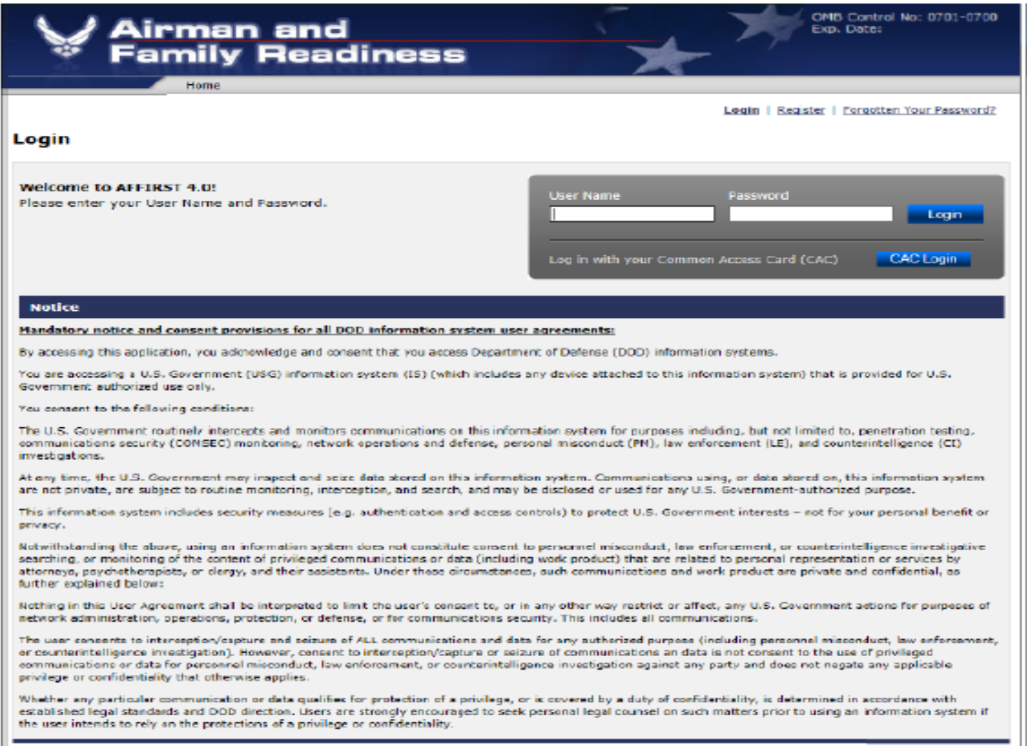

Slide 3
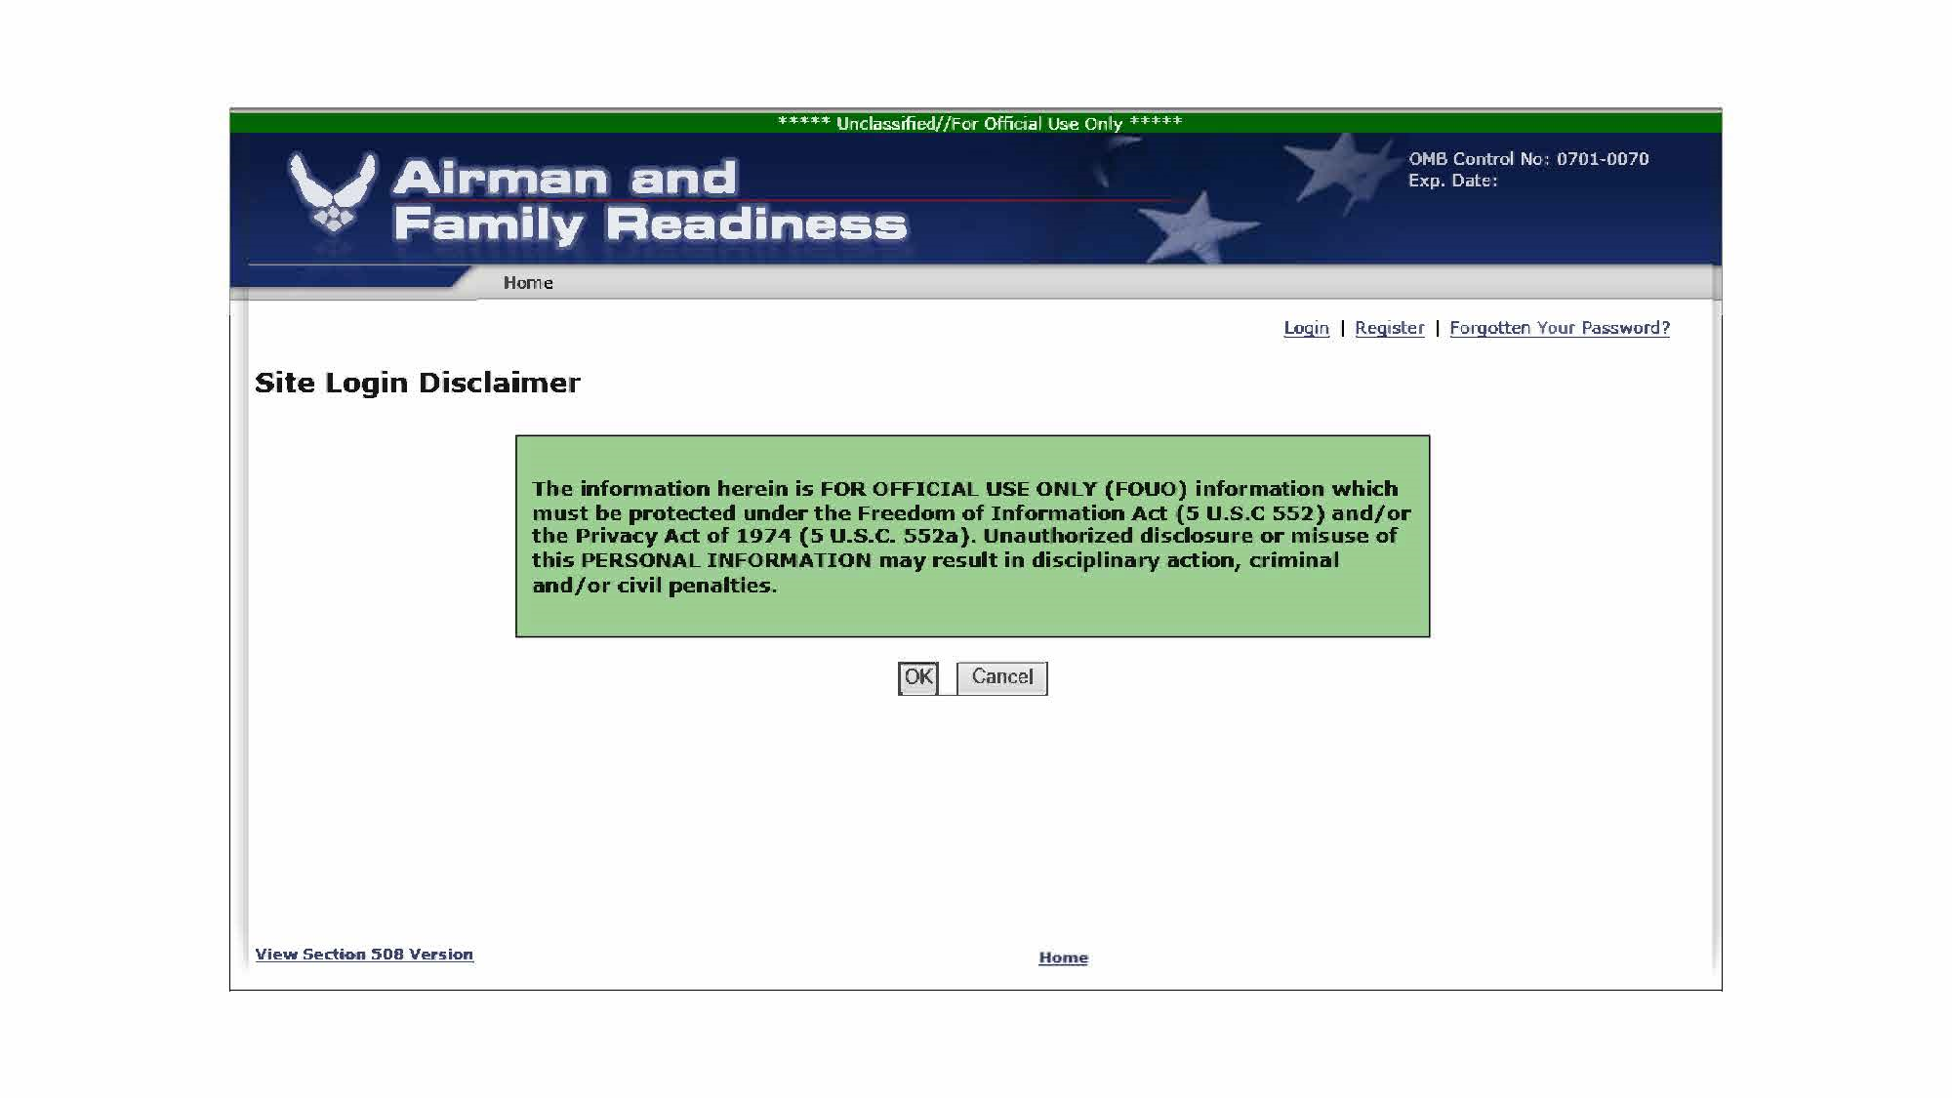

Slide 4
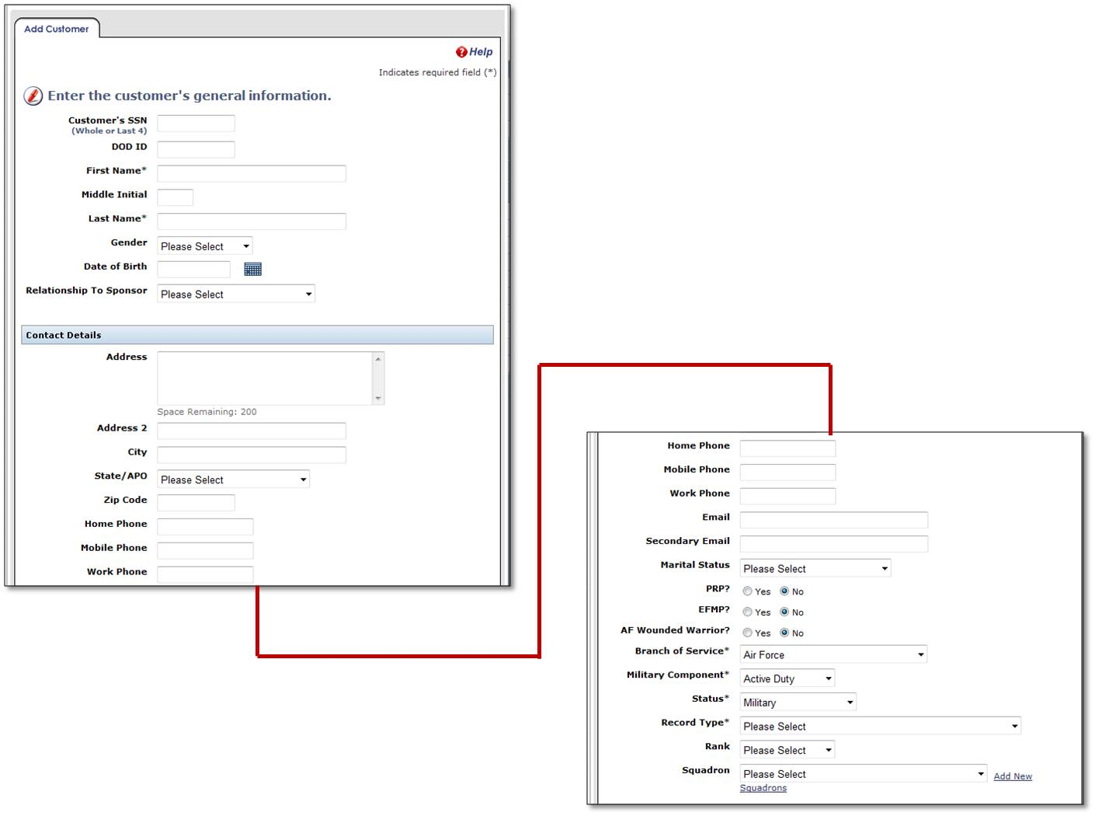

Slide 5
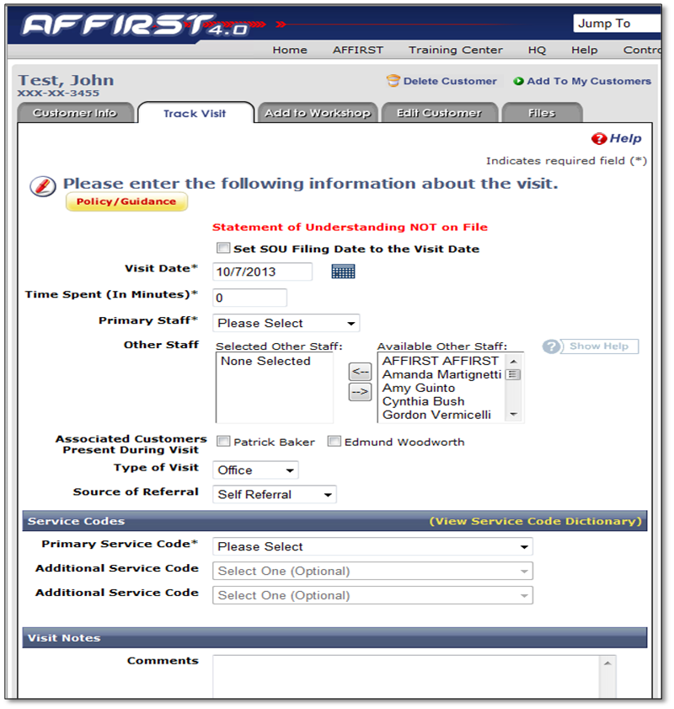

Slide 6
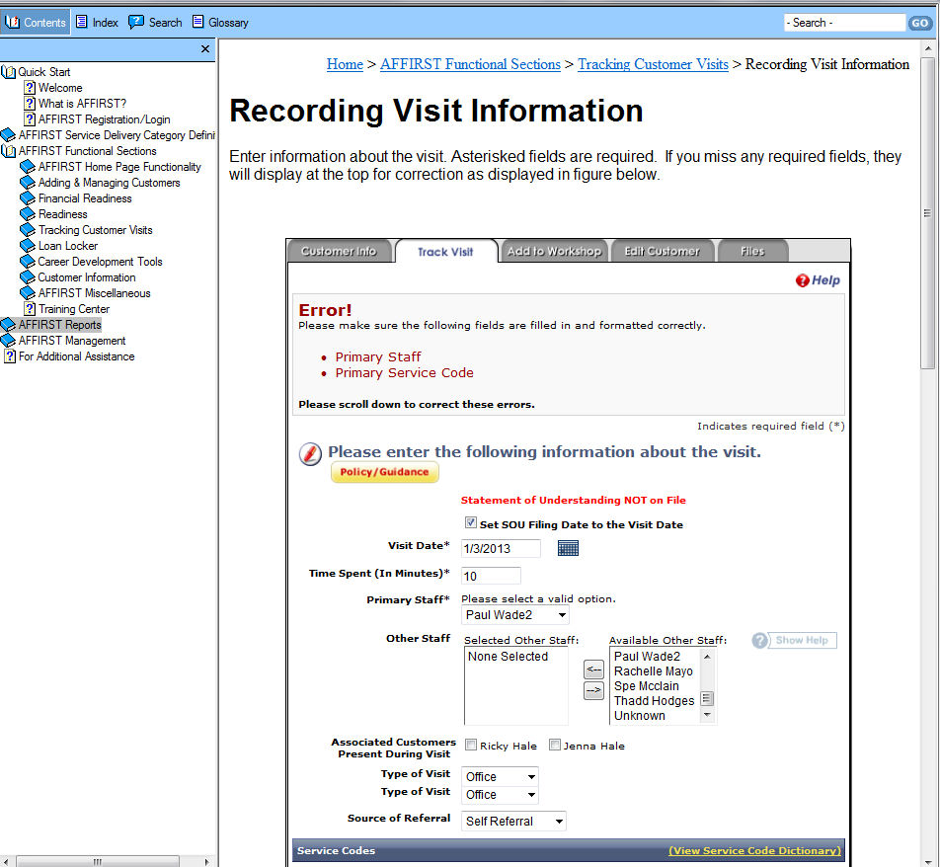
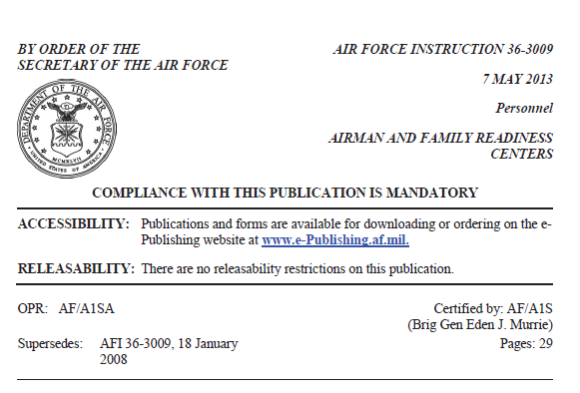
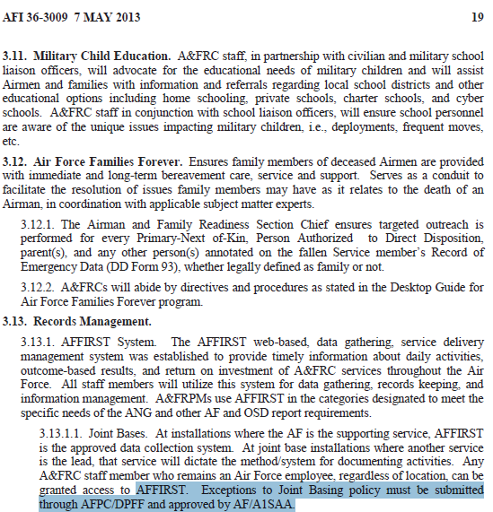
The Air Force Family Integrated Results & Statistical tracking (AFFIRST) system has an online user guide. AFFIRST
is only accessed by approved Airman & Family Readiness Center (A&FRC) employees and their MAJCOM/HHQ
Counterparts. Each A&FRC employee must have a user account and log in via their CAC Card certificate/pin. AFFIRST
has an approved SORN, PIA and Authority To Operate (ATO).

