Slide 1
MDP System
DUR Survey Tool
EE-YW-07-20-2018

Slide 2
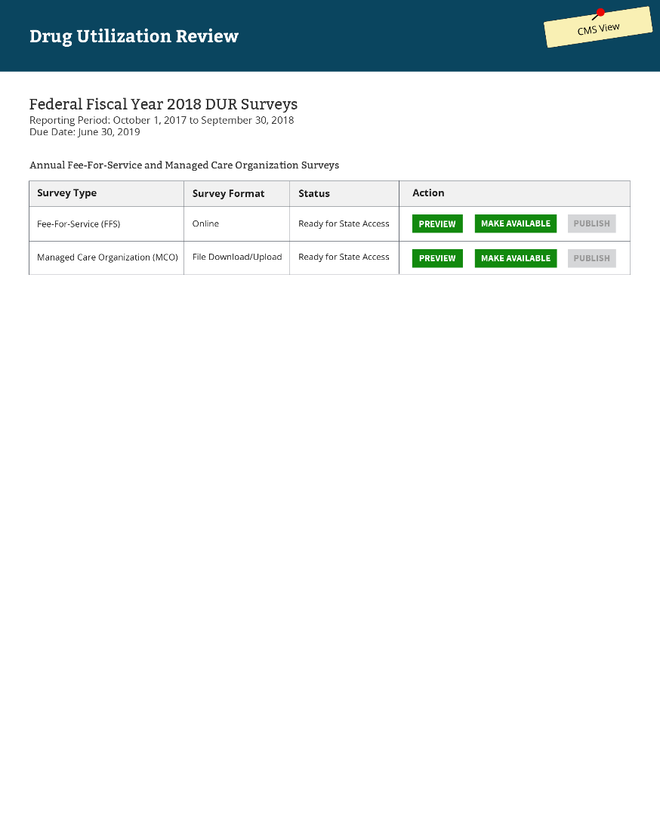
Landing Page

Slide 3
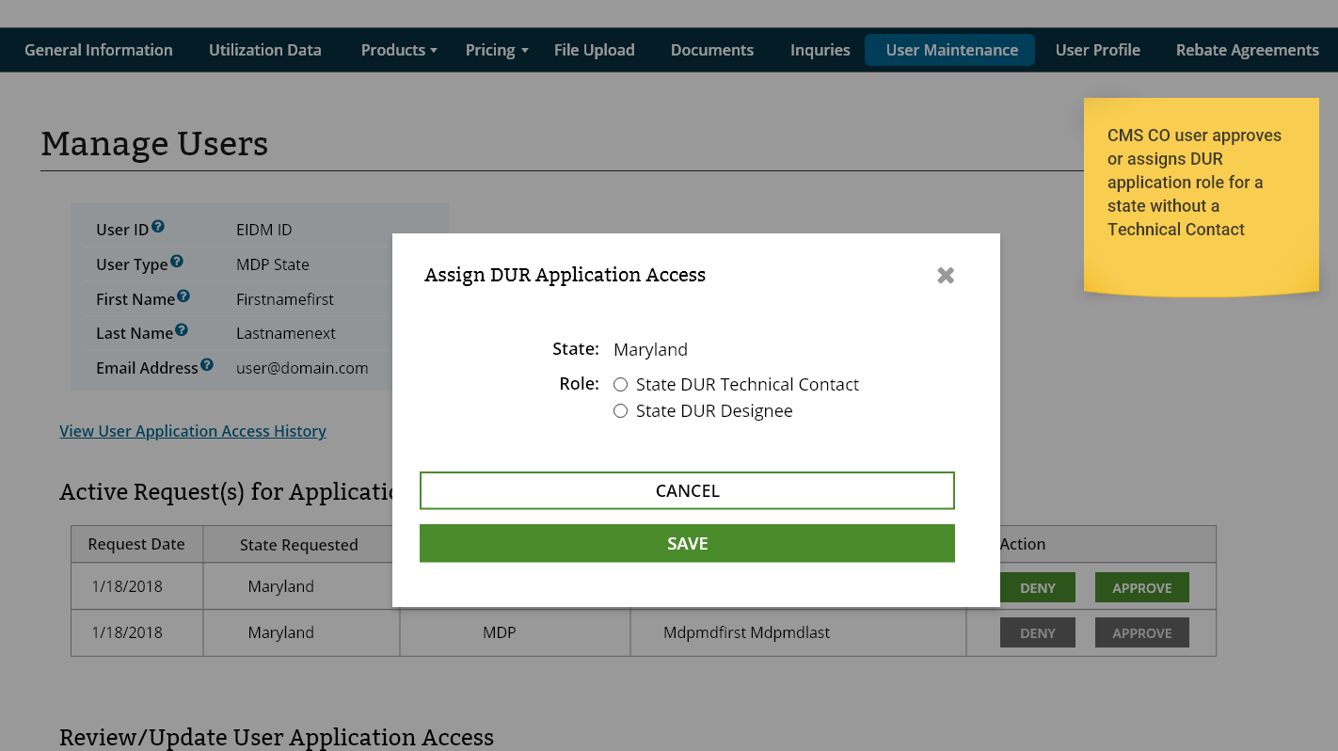
Assign DUR State Role

Slide 4
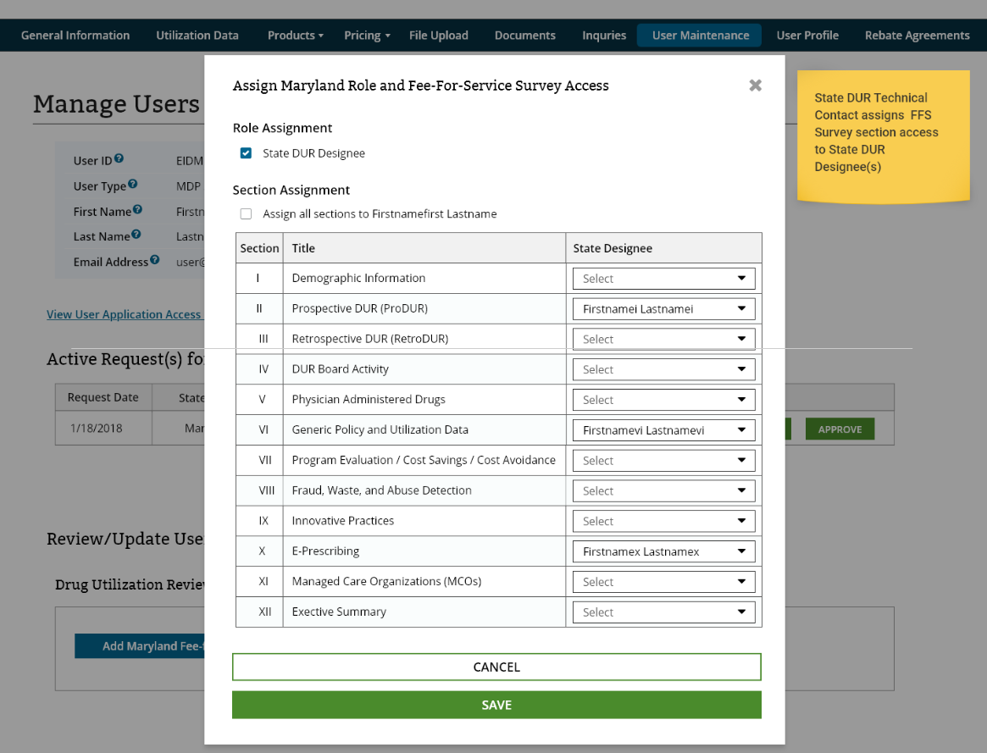
Assign State DUR Designee Survey Sections

Slide 5
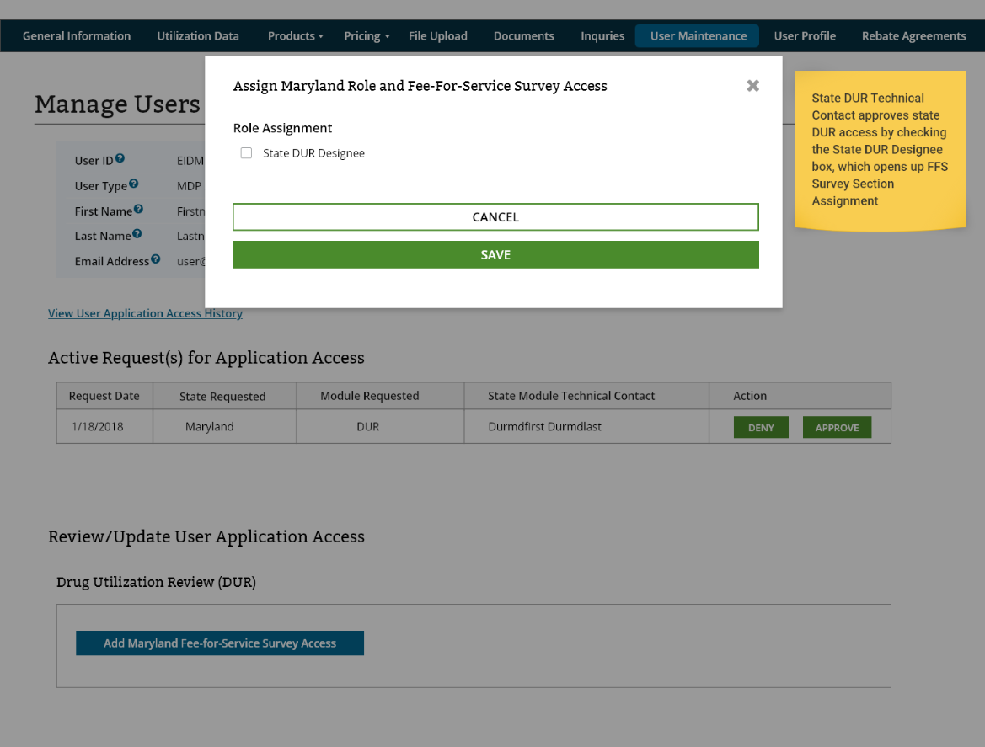
Assign DUR State Designee

Slide 6
MDP System – DUR FFS
Notes:
The reporting period covers the period October 1, 2017 to September 30,2018 and is due for submission to CMS by no later than June 30, 2019.

Slide 7
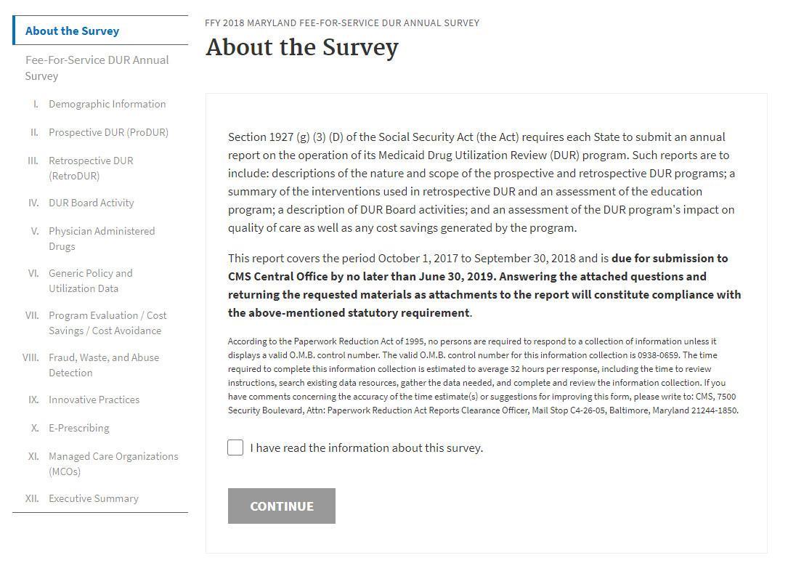
Survey Disclamer

Slide 8
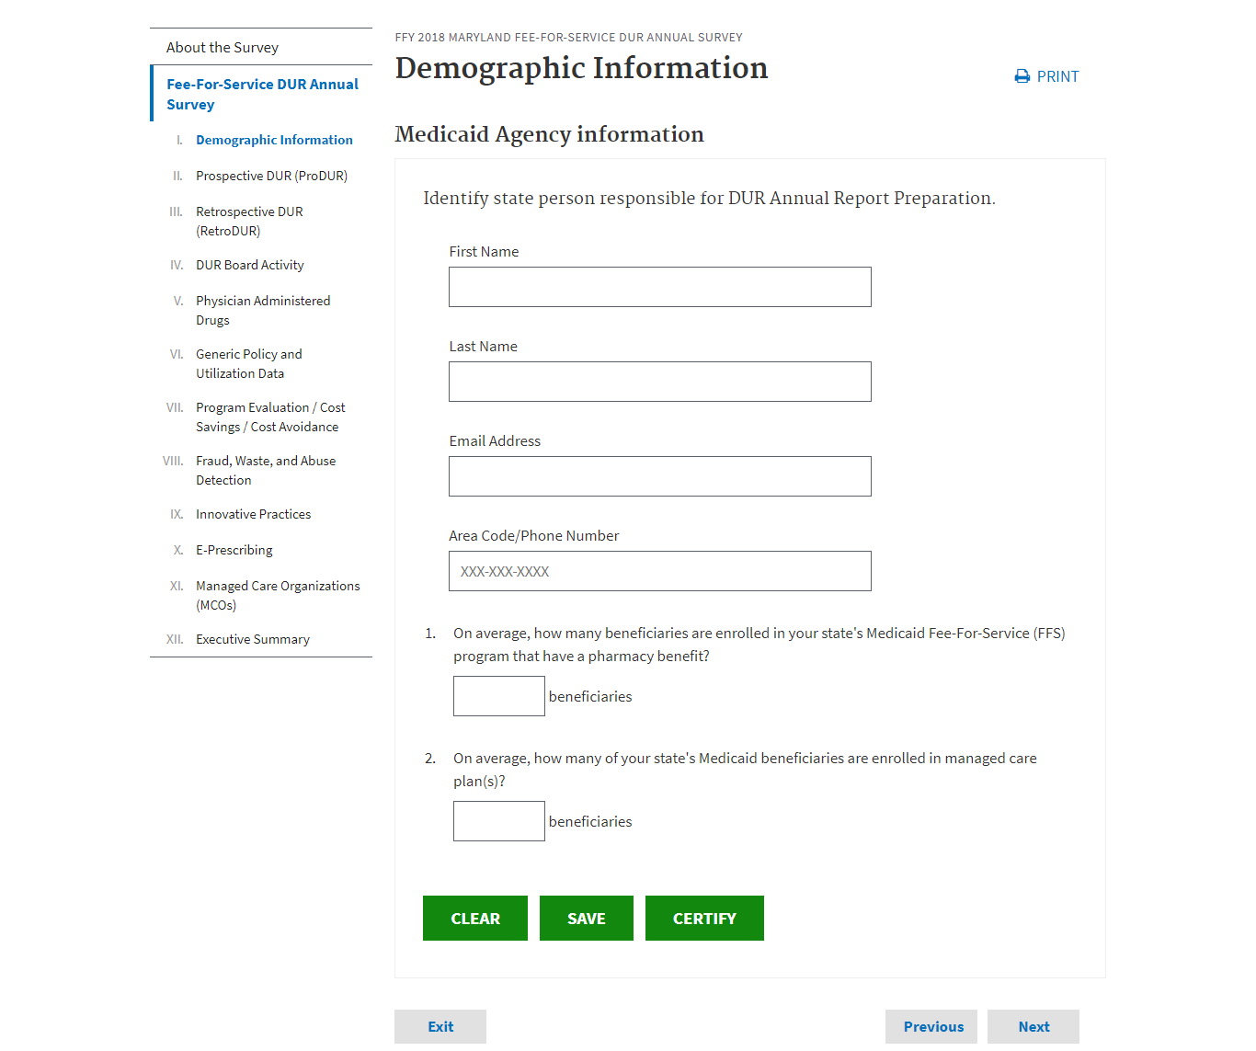
Demographic Information

Slide 9
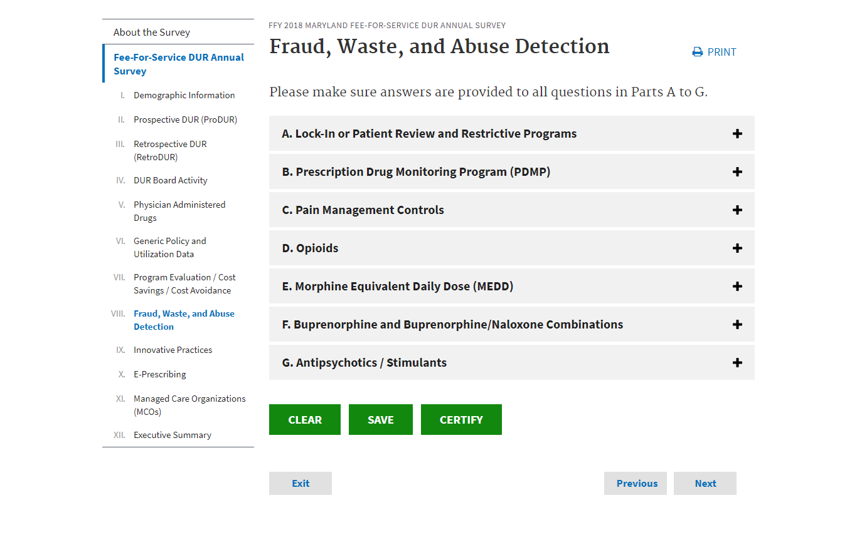
Section

Slide 10
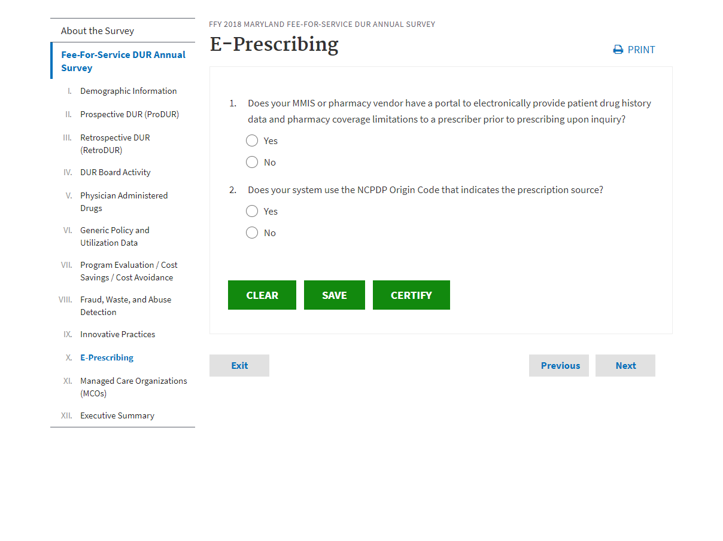
E-prescribing

Slide 11
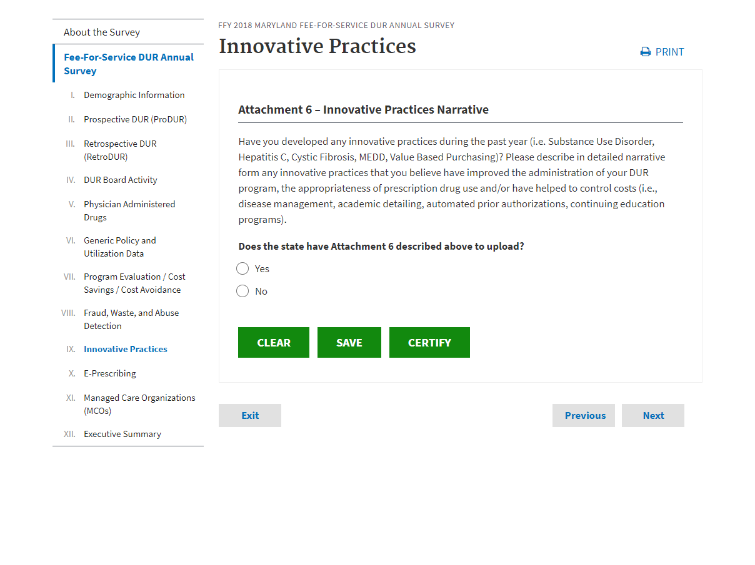
Innovative Practices

Slide 12
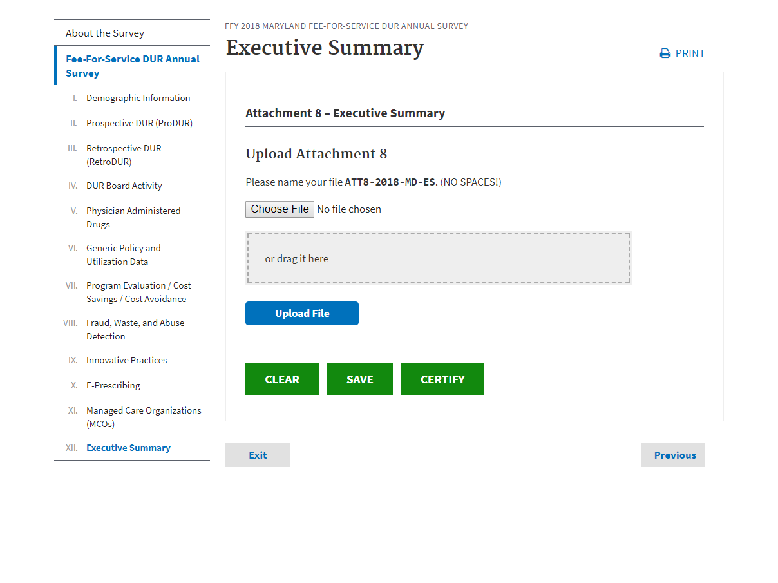
Executive Summary

Slide 13
MDP System – DUR FFS

Slide 14
MDP System - Dashboard

Slide 15
MDP System – DUR MCO

Slide 16
MDP System – DUR MCO

Slide 17
MDP System – DUR MCO
Completed Survey

