Slide 1
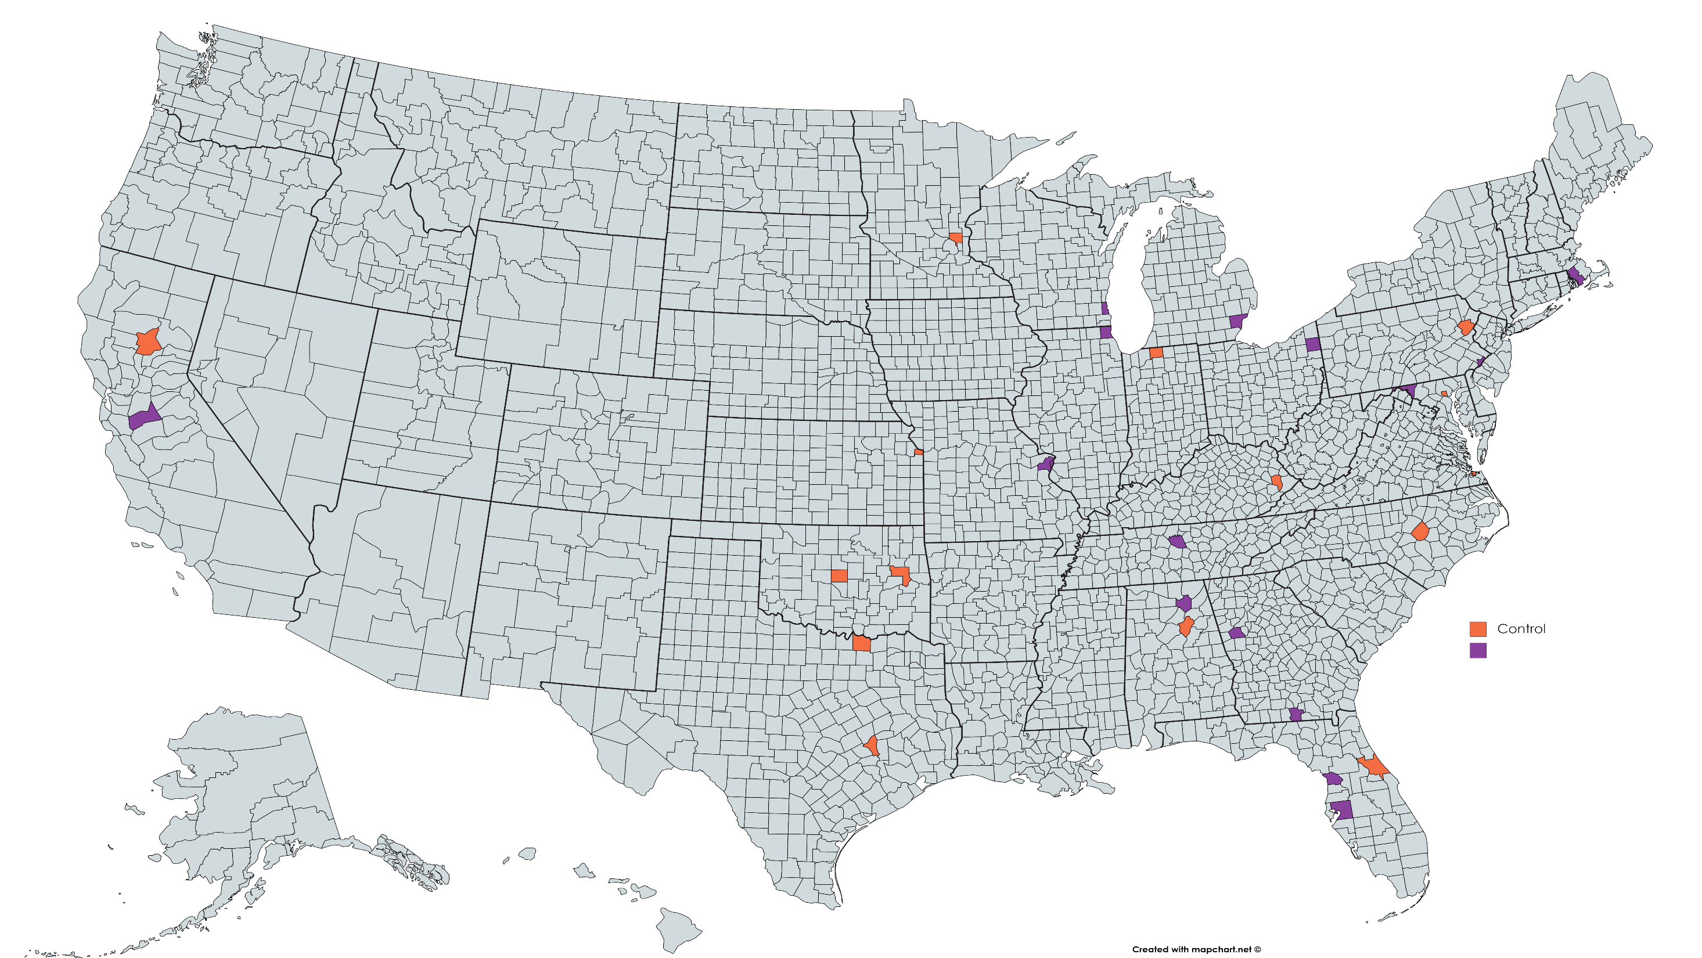
Anoka, MN
Bristol, MA
Milwaukee, WI
Wayne, MI
Butte, CA
Lake, IL
Trumbull, OH
Monroe, PA
St. Joseph, IN
Philadelphia, PA
Stanislaus, CA
Washington, MD
Baltimore City, MD
Wyandotte, KS
St. Louis, MO
Floyd, KY
Norfolk City, VA
Wilson, TN
Johnston County, NC
Oklahoma, OK
Muskogee, OK
Marshall, AL
Control
St. Clair, AL
Coweta, GA
Grayson, TX
Treatment
Lowndes, GA
Brazos, TX
Volusia, FL
Citrus, FL
Hillsborough, FL

Slide 2
Control
Treatment

Slide 3
Treatment Counties

Slide 4
Control Counties

