Slide 1
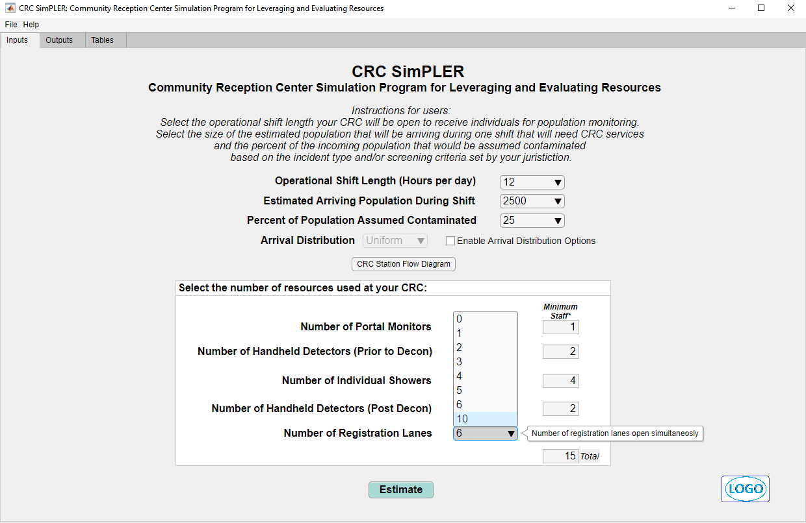
Attachment D.
CRC SimPLER Tool

Slide 2
