Slide 1
Electronic System for Travel Authorization (ESTA)
U.S. Customs and Border Protection
June 2018

Slide 2
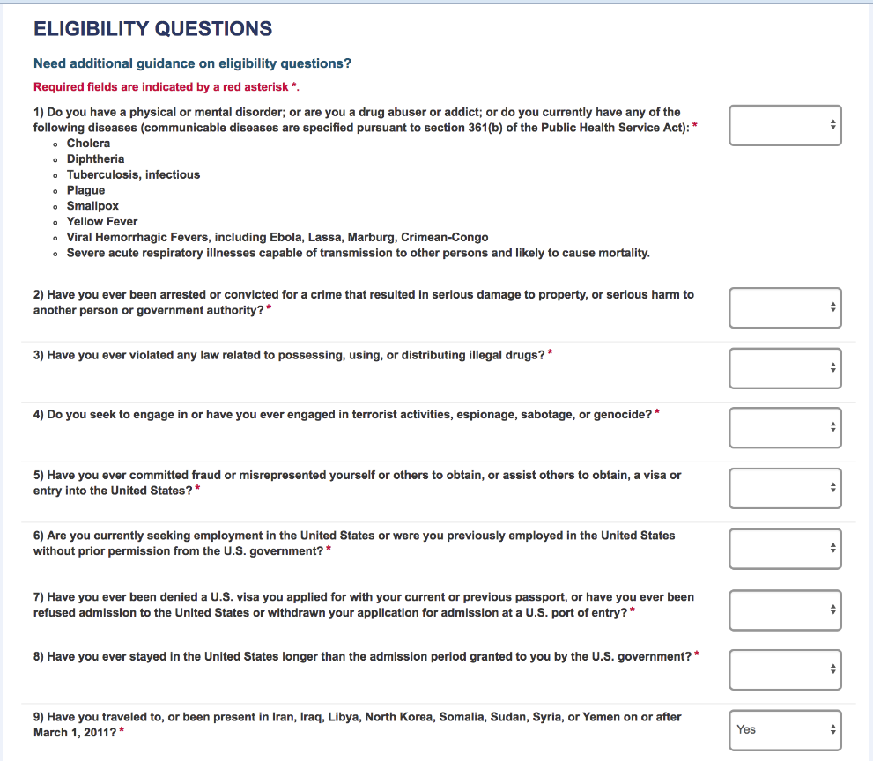
Eligibility Question 9 w/North Korea
On the fourth screen the applicant will be asked a series of eligibility questions. This page includes a drop down menu where the applicant can selection Yes or No to each question.
Notes:
Add North Korea added to question 9. The question will be Have you traveled to, or been present in Iraq, Syria, Libya, Somalia, Yemen, or North Korea on or after March 1, 2011?

Slide 3
Eligibility Question 9 w/North Korea
Eligibility question that asks if the applicant has traveled to Iran, Iraq, Libya, North Korea, Somalia, Sudan, Syria and Yemen has been added. If they answer “Yes” to this question they will be asked to select from the above options the primary reason for their trip. If they select certain options they will be asked to fill out an additional questionnaire. These additional fields can be seen on the next few slides. Per this change if an applicant selects North Korea as well they will also be asked to fill out the questionnaire.

Slide 4
Eligibility Question 9 w/North Korea
Notes:
Add North Korea added to the question and the Country drop down.

Slide 5
Help Text including North Korea
Notes:
Add North Korea to the tooltips.

Slide 6
Help Text including North Korea
Notes:
Add North Korea to the tooltips.

Slide 7
Alerts w/North Korea
After selecting one of the following Primary Reasons, the Alert popup message is displayed.
Primary Reason:
To carry out official duties as a full-time employee of the government of a Visa Waiver Program country.
To perform military service in the armed forces of a Visa Waiver Program country.
Notes:
Add North Korea to pop-up Alerts

Slide 8
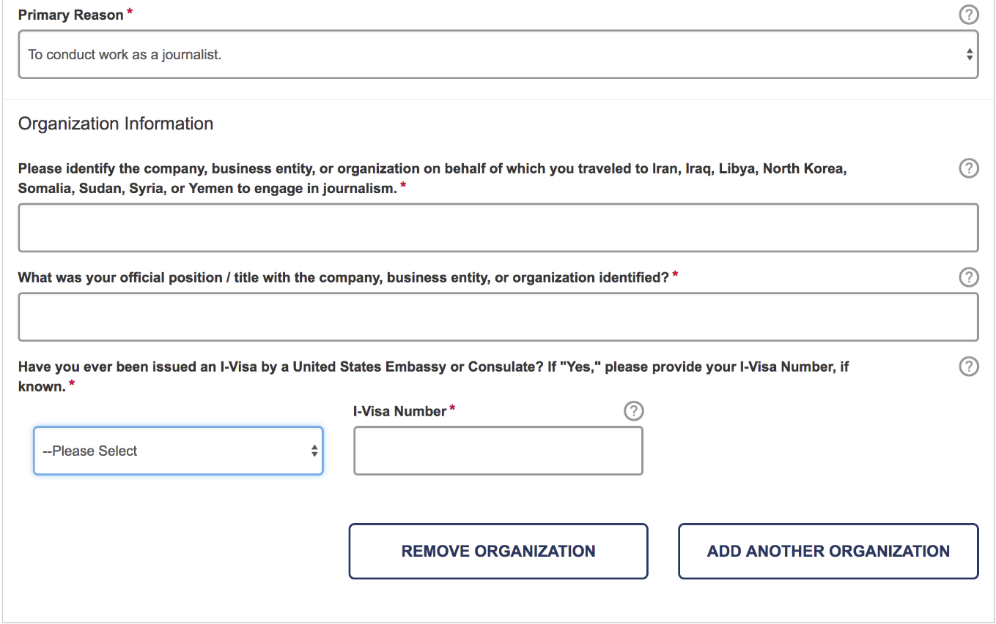
Additional Eligibility Questions: Journalist
If an applicant selects “To conduct work as a journalist” as their primary reason for travelling to Iran, Iraq, Libya, North Korea, Somalia, Sudan, Syria or Yemen they will be asked to identify the company they worked for; the position they held; and their I-Visa Number. The applicant can click question mark bubbles next to each question if they are unsure of how they should respond to each question. If needed, additional entries can be added by clicking “Add Another Organization” or “Add Another Travel”, this option is available under each drop down menu.
Notes:
Add North Korea added to the question and Country drop down. Have you traveled to or been present in Iraq, Syria, Iran, Sudan, or North Korea on or after March 1, 2011? Add North Korea to sub question under organization information.

Slide 9
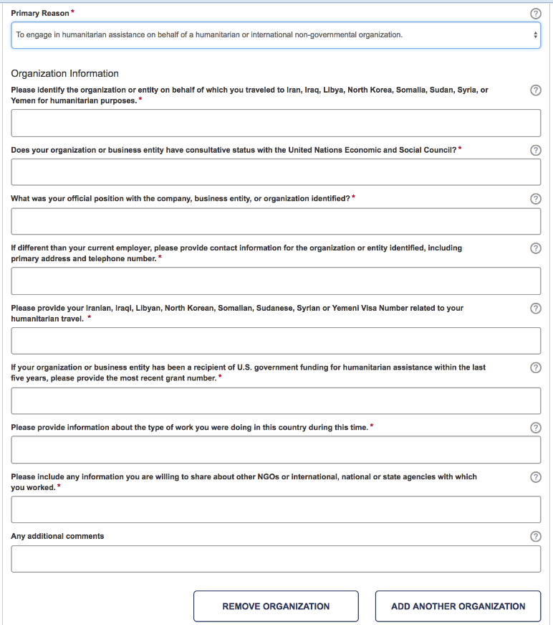
Additional Eligibility Questions: Humanitarian
If an applicant selects “To engage in humanitarian or international non-governmental organization” as their primary reason for travelling to Iran, Iraq, Libya, North Korea, Somalia, Sudan, Syria or Yemen they will be asked to identify the company they worked for; the position they held; they type of work they performed; the sources of funding for this organization; and their Visa Number. The applicant can click the question mark bubbles next to each question if they are unsure of how they should respond to the questions.
Notes:
Add North Korea to the question and the Country drop down. Add North Korea to relevant sub questions under organization information.

Slide 10
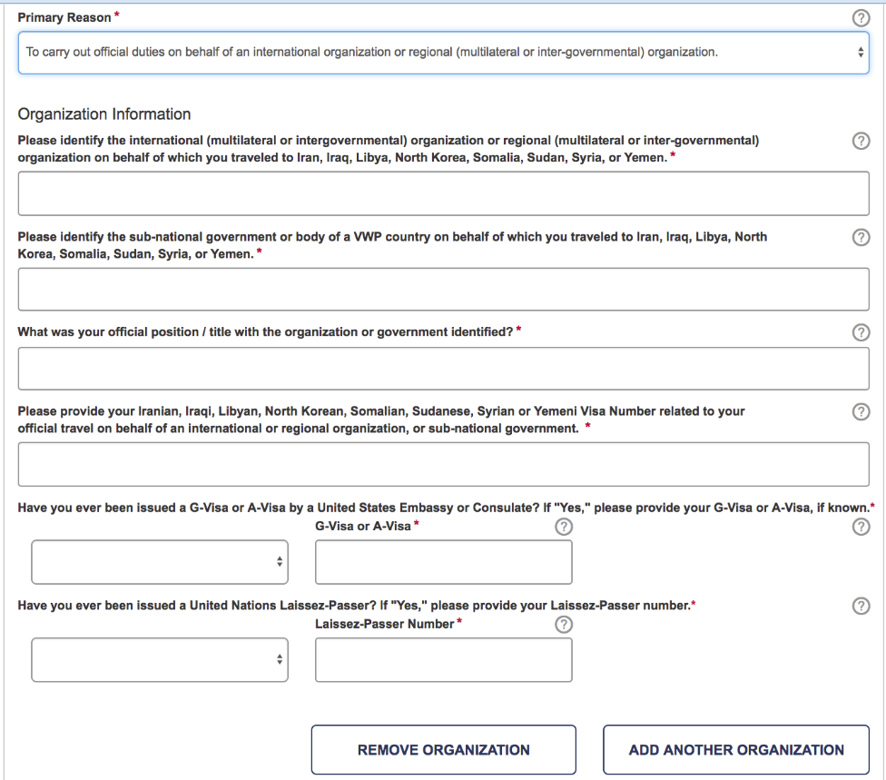
Additional Eligibility Questions: Government or International
If an applicant selects “To carry out official duties on behalf of an international organization or regional organization” as their primary reason for travelling to Iran, Iraq, Libya, North Korea, Somalia, Sudan, Syria or Yemen they will be asked to identify the company they worked for; the position they held; they type of work they performed; if they have ever been issued a Laissez-Passer from the United Nations; and their Visa Number. The applicant can click question mark bubbles next to each question if they are unsure of how they should respond to each question.
Notes:
Add North Korea to the question and the Country drop down. Add North Korea to all three sub questions under organization information.

Slide 11
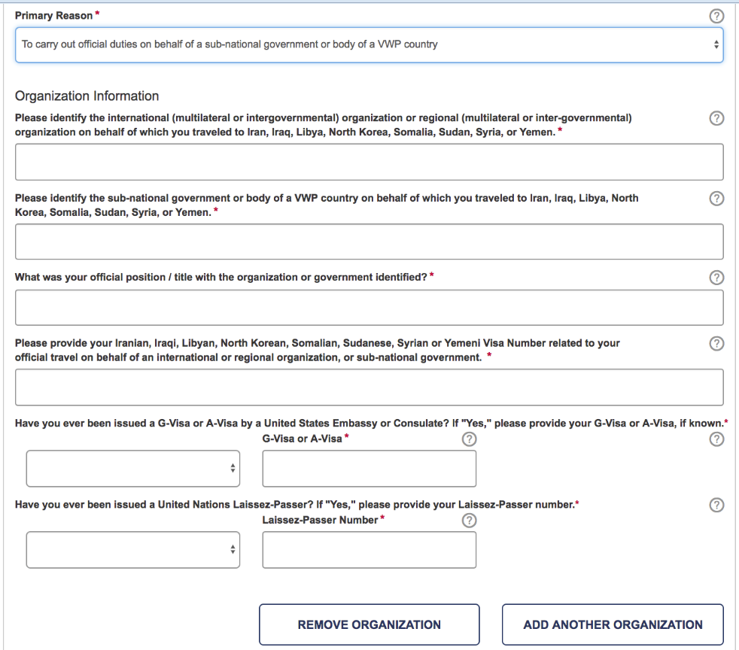
Additional Eligibility Questions- Sub-National or VWP
If an applicant selects “To carry out official duties on behalf of sub-national government body of a VWP country” as their primary reason for travelling to Iran, Iraq, Libya, North Korea, Somalia, Sudan, Syria or Yemen they will be asked to identify the company they worked for; the position they held; they type of work they performed; if they have ever been issued a Laissez-Passer from the United Nations; and their Visa Number. The applicant can click question mark bubbles next to each question if they are unsure of how they should respond to each question.
Notes:
Add North Korea to the question and the Country drop down. Add North Korea to all three sub questions under organization information.

