Slide 1
NISP Contract Classification System (NCCS)
Derrick Broussard
Program Manager/Functional Lead
1
DSS Industrial Security Field Operations

Slide 2
Back Up Slides

Slide 3
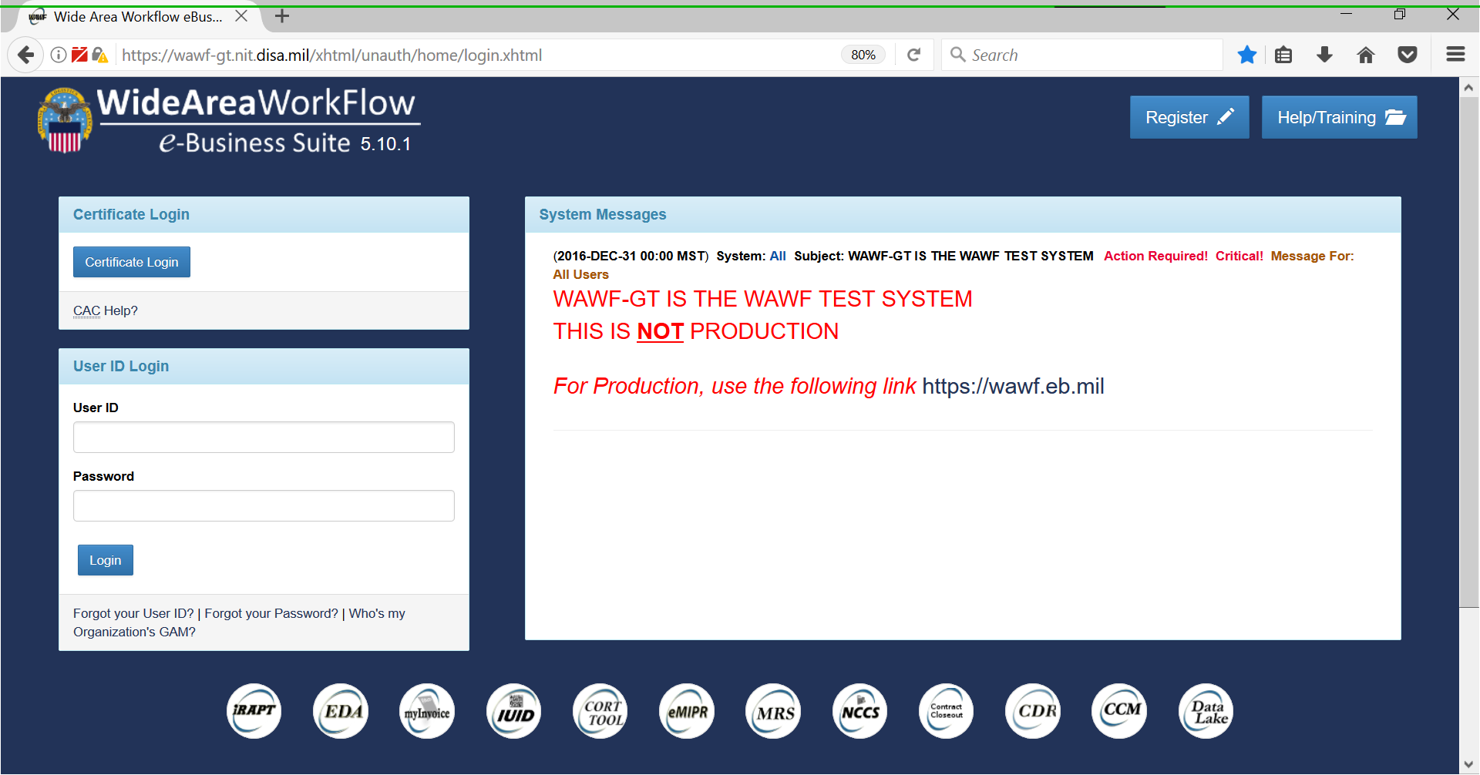
NCCS Welcome Page, Registration, Training

Slide 4
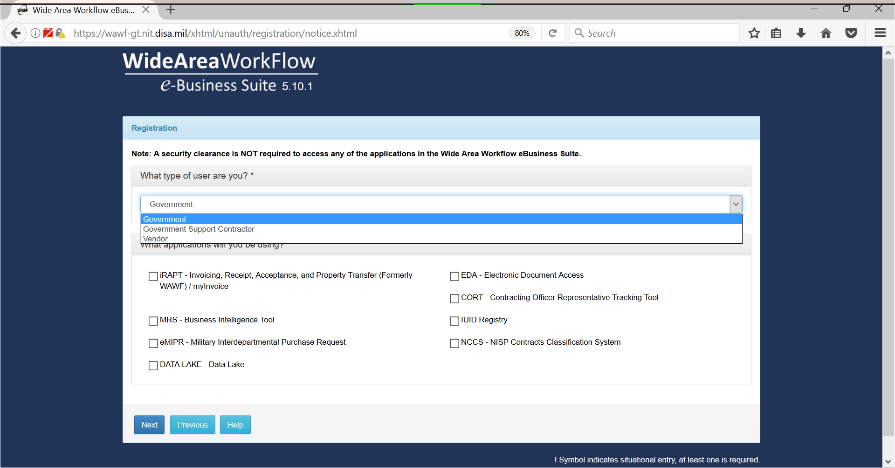
NCCS Registration Users and Applications

Slide 5
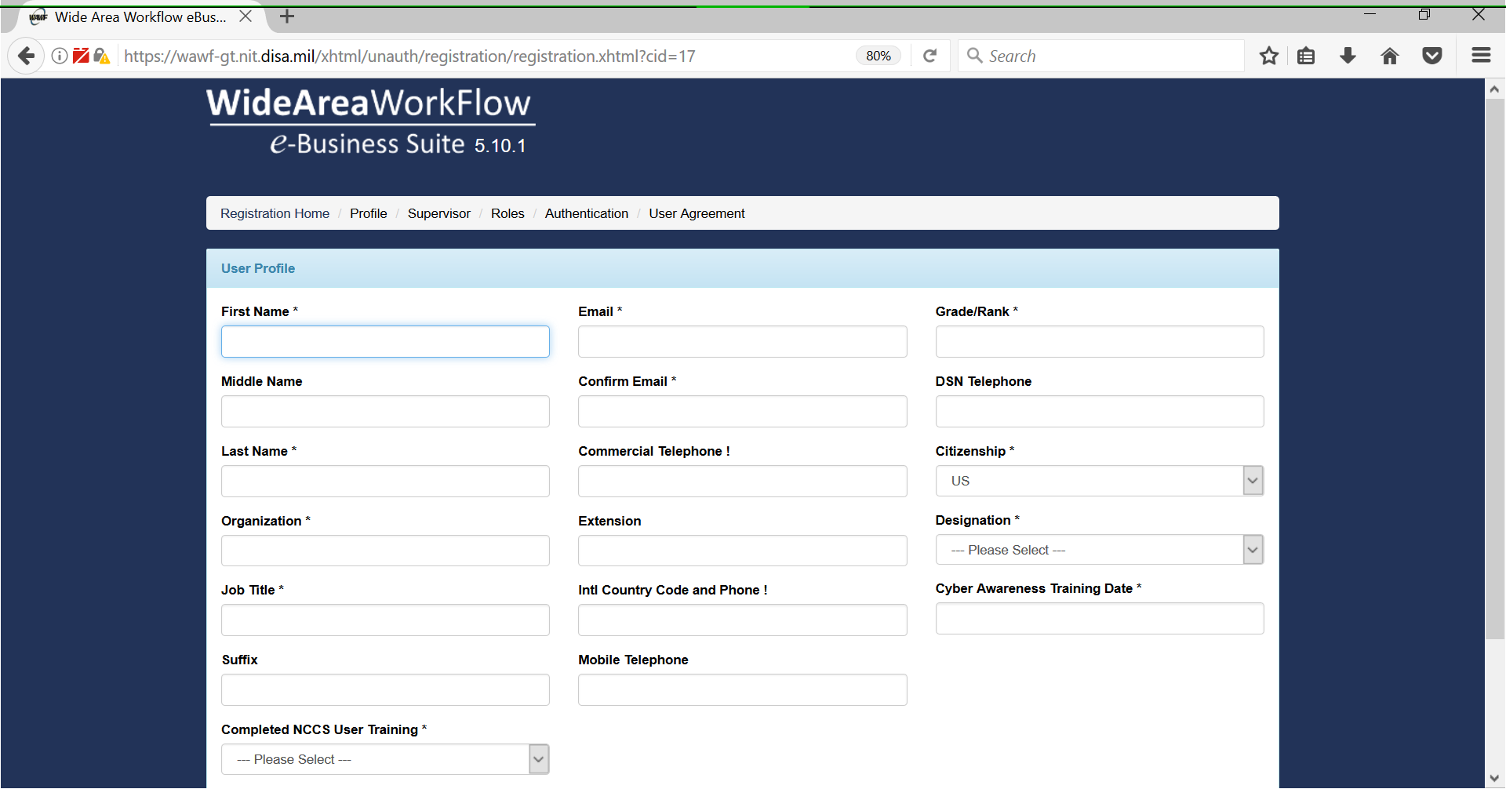
User Profile and Registration

Slide 6
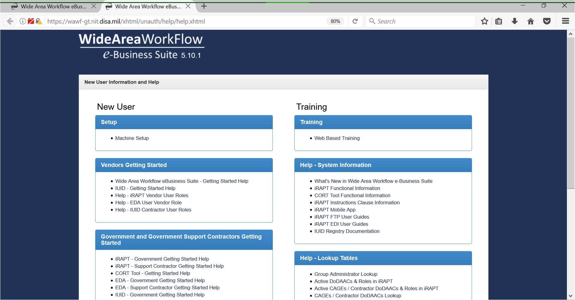
Machine Setup and Training

Slide 7
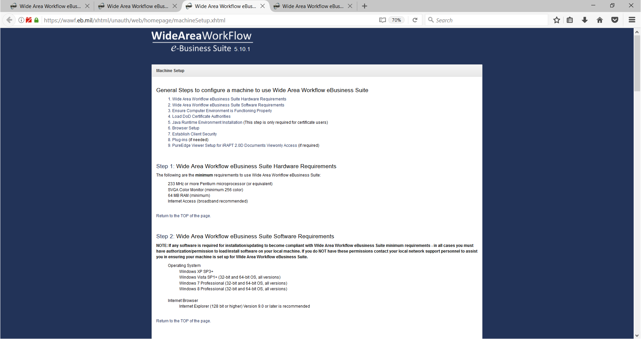
Machine Setup View

Slide 8
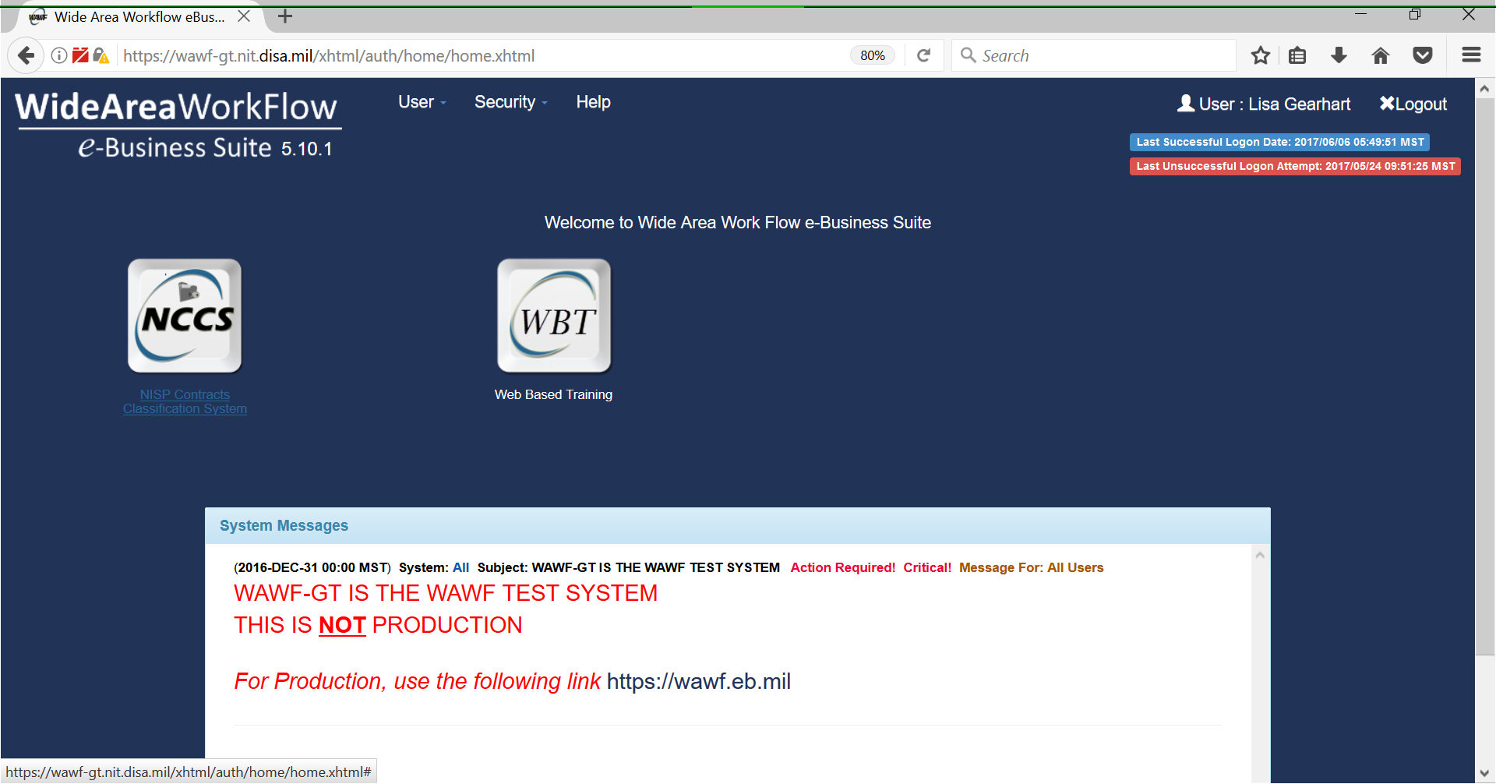
Welcome Page and NCCS Tab

Slide 9
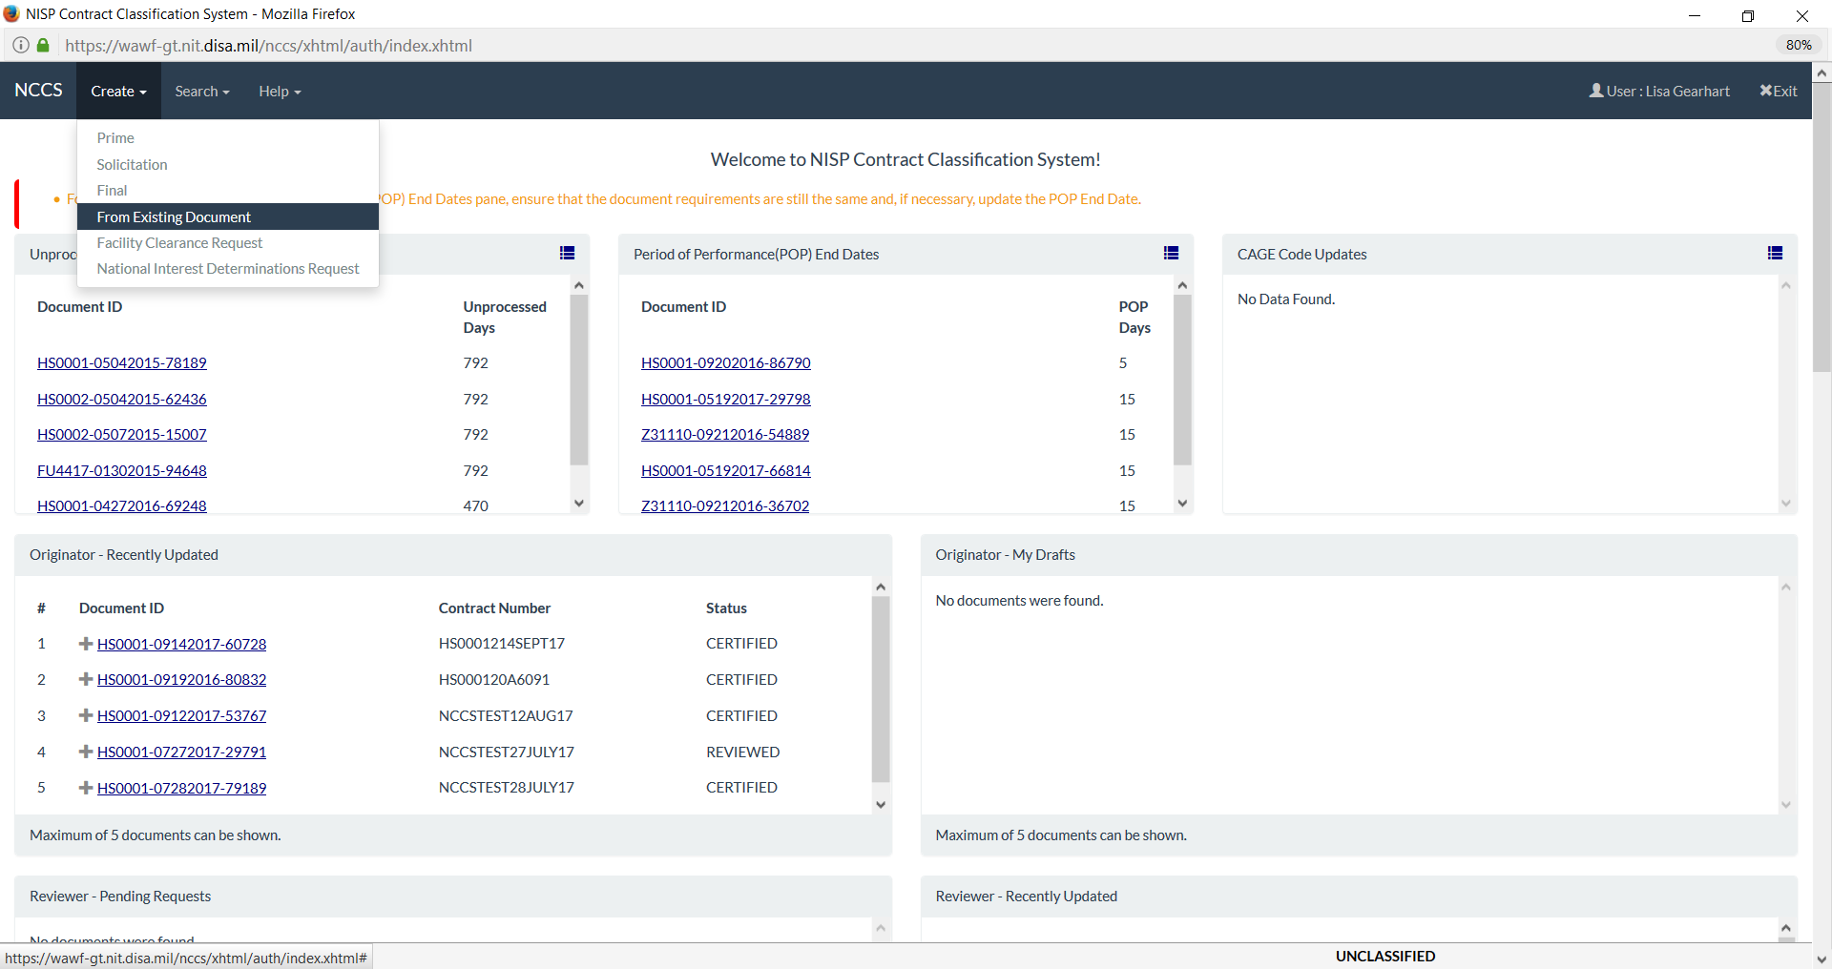
Government Dashboard, Functions

Slide 10
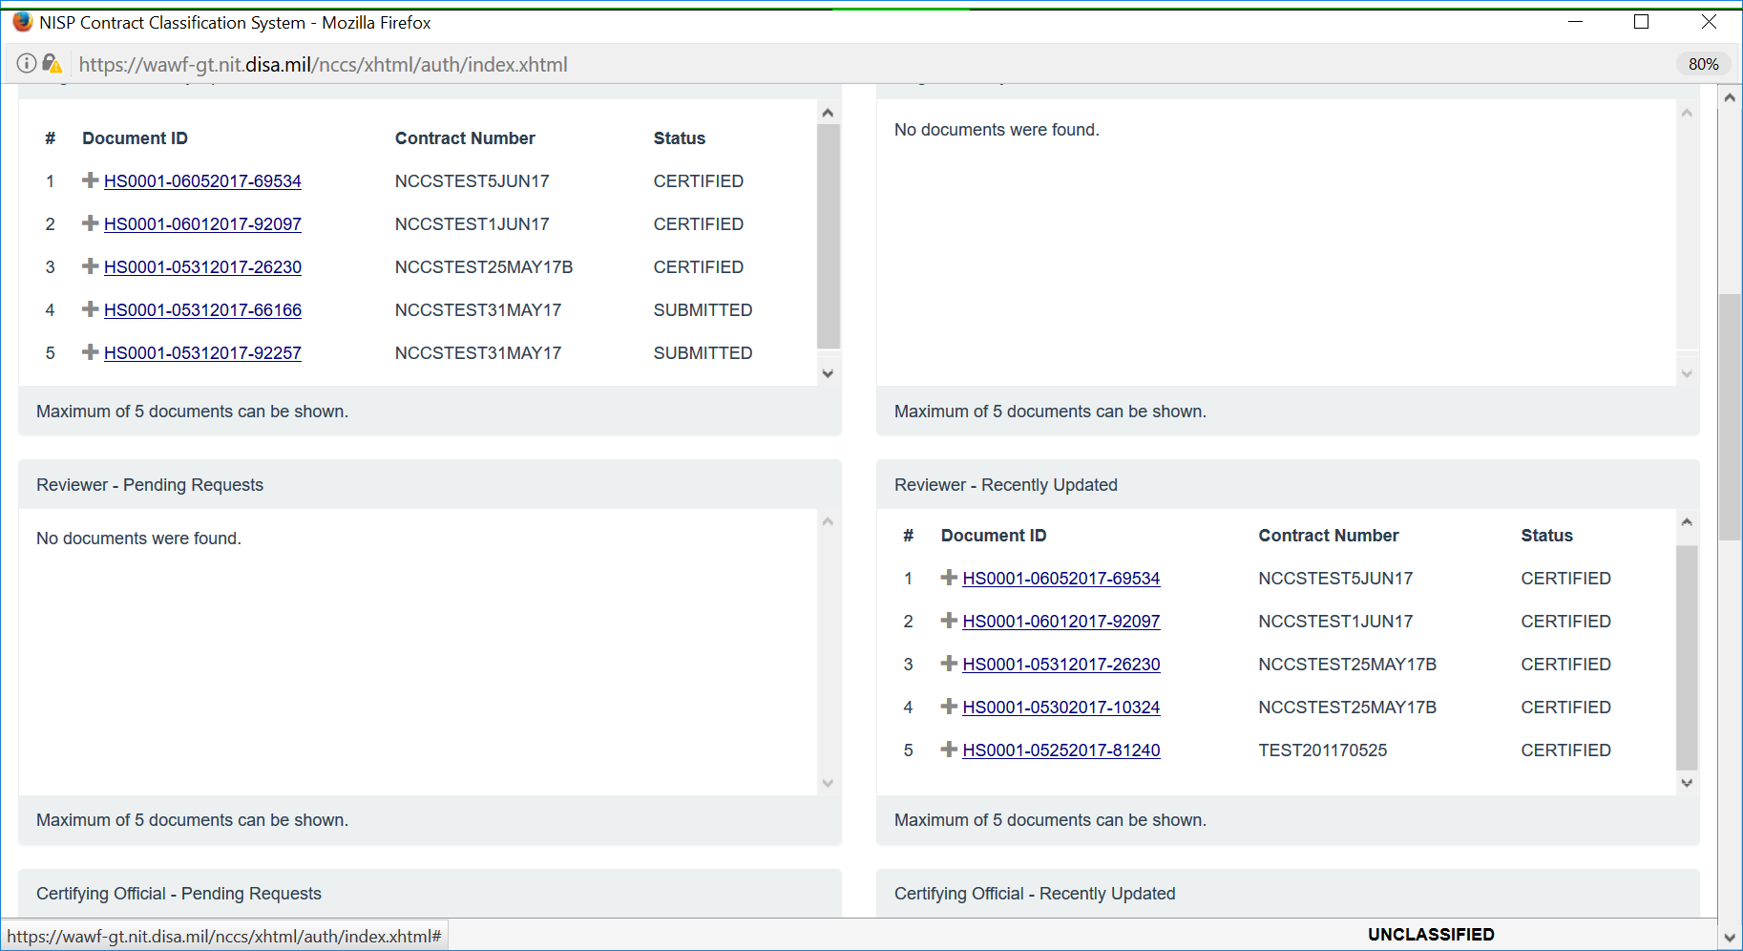
See Status for All Roles

Slide 11
Government Dashboard, Functions

Slide 12
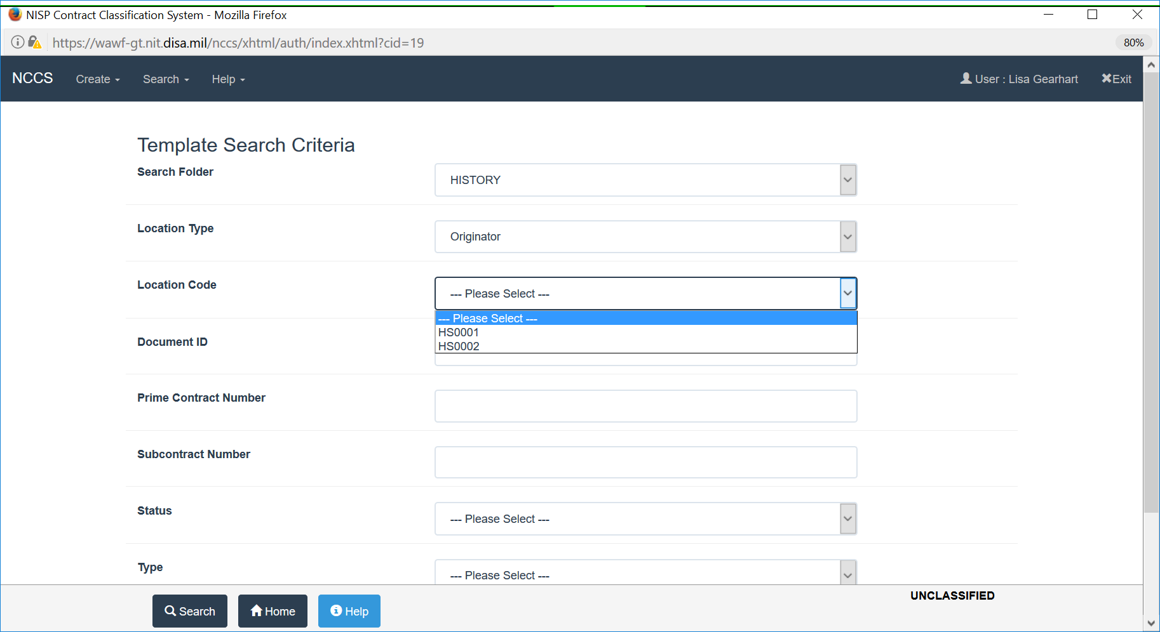
Search By Location Code

Slide 13
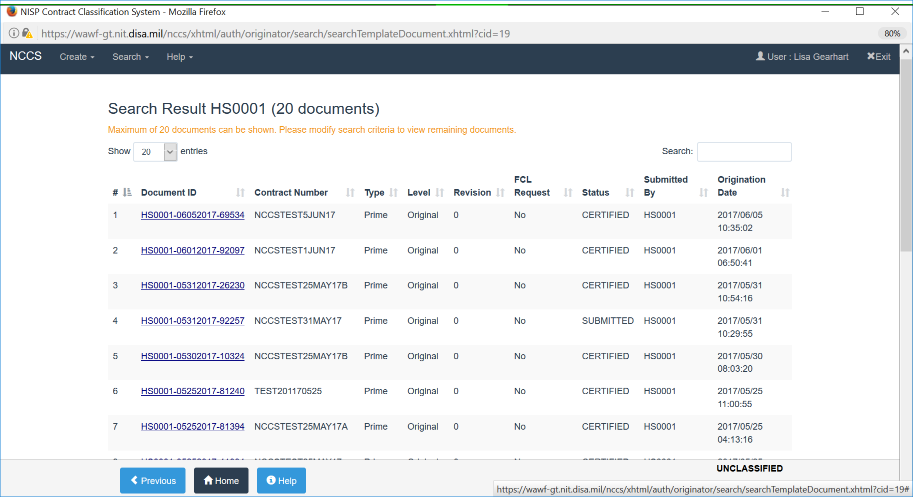
Search Data

Slide 14
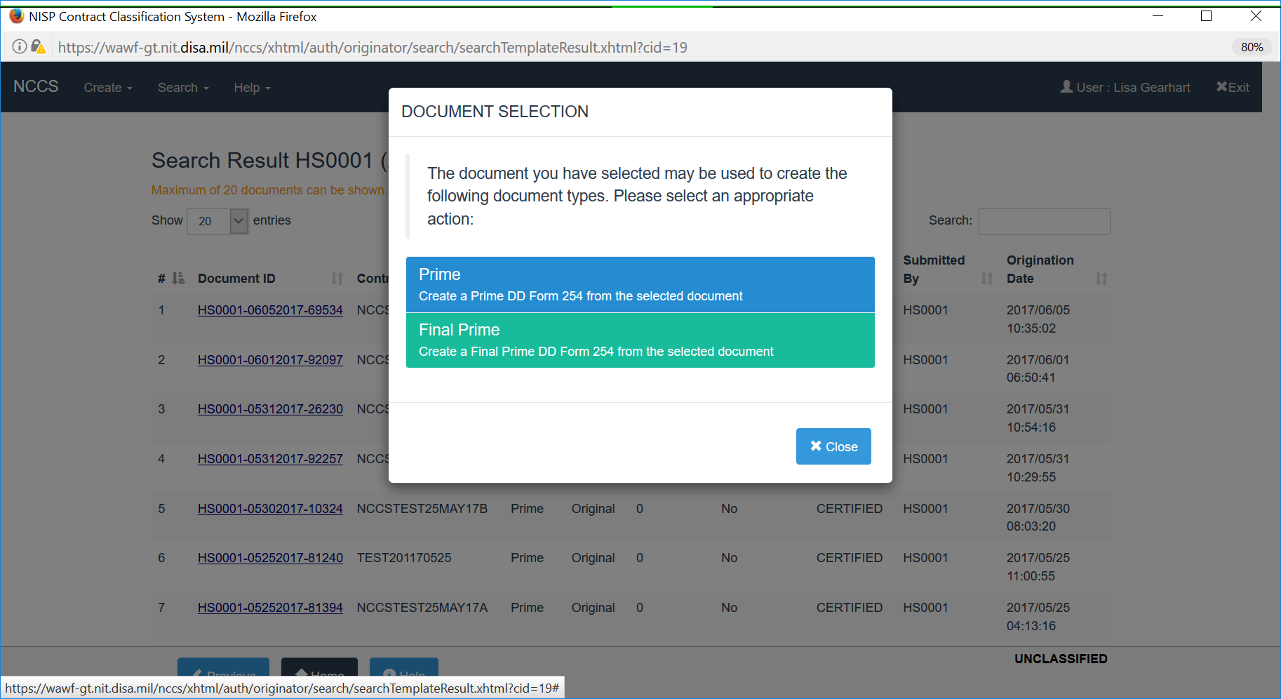
Document Selection

Slide 15
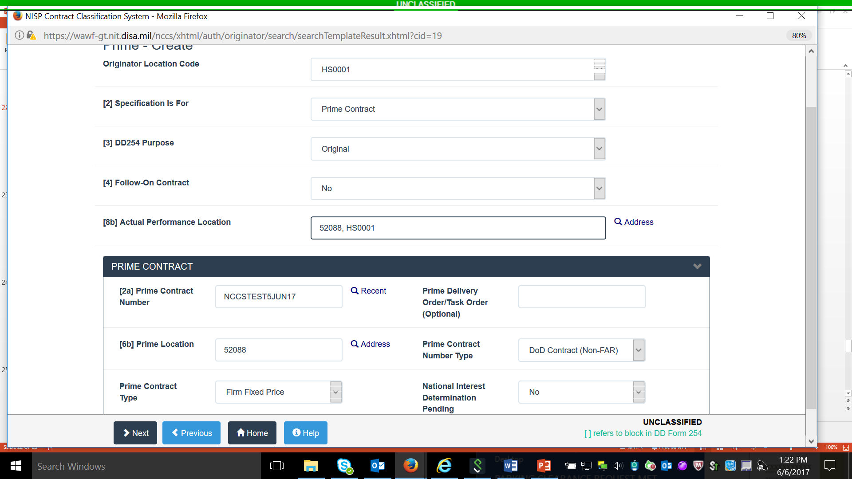
Completing the 254

Slide 16
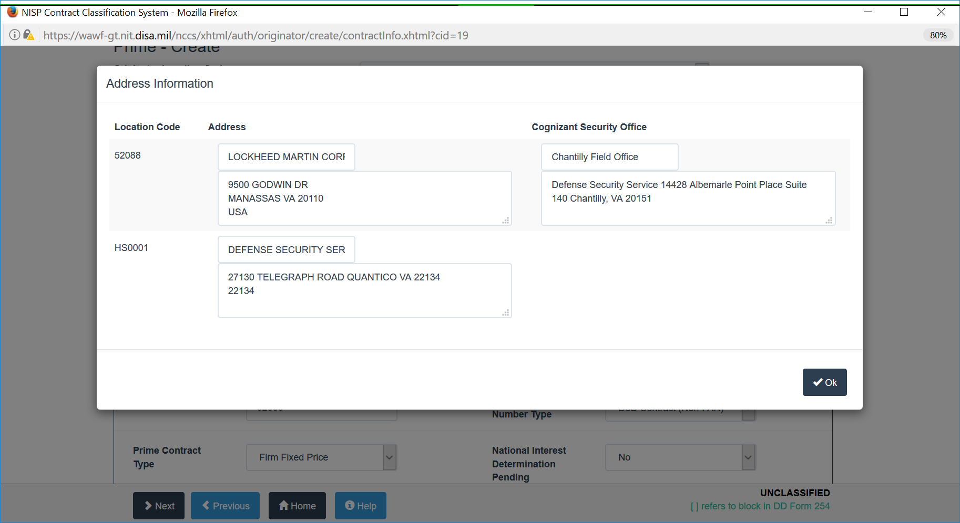
CAGE Code and CSO Blocks

Slide 17
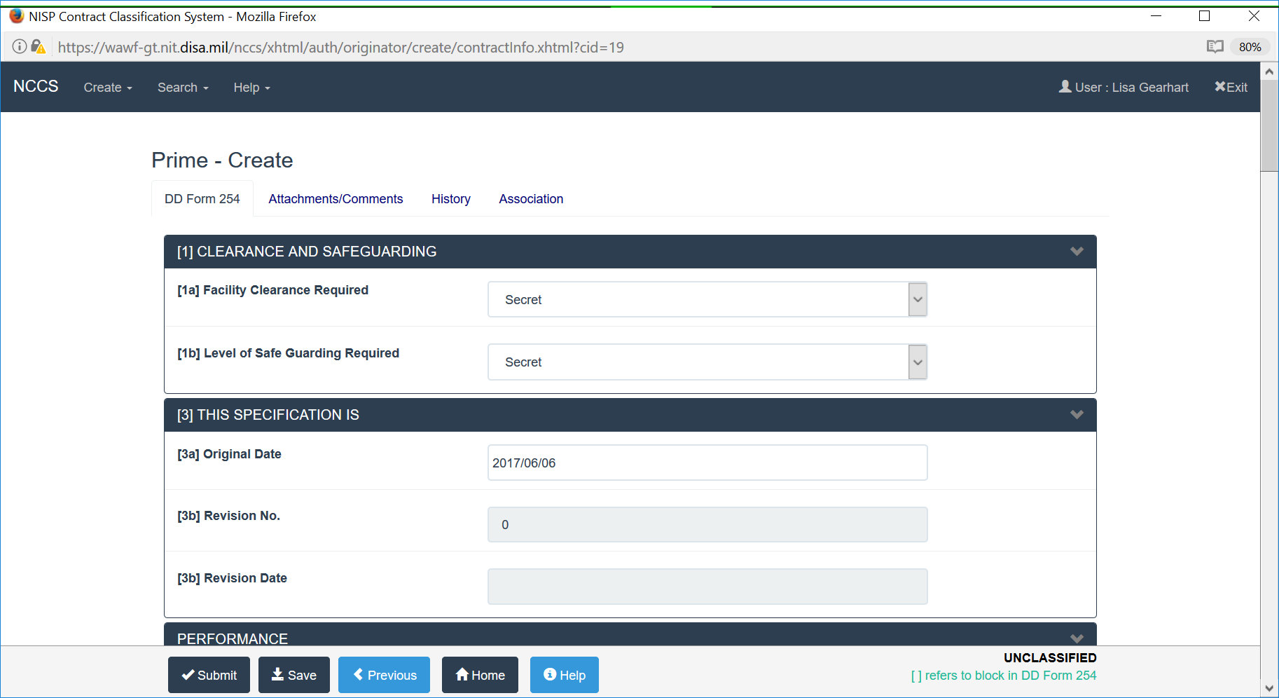
Completing the 254

Slide 18
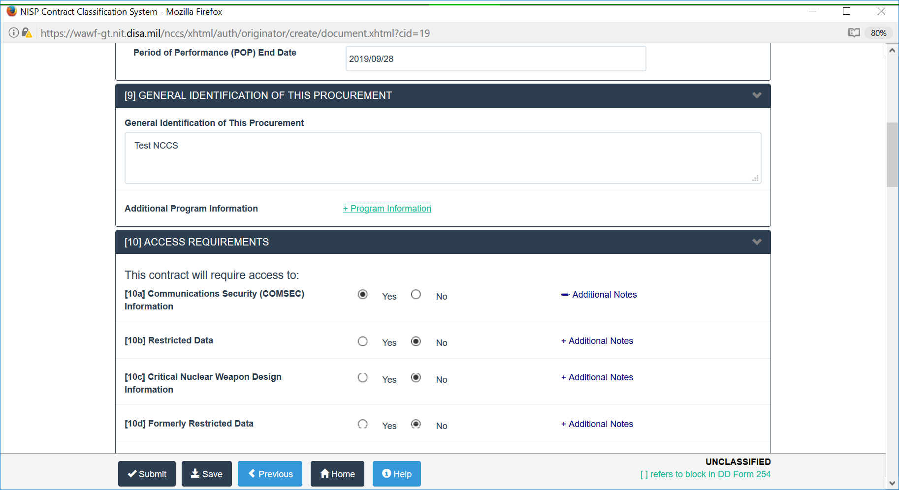
PoP Date and Program Information

Slide 19
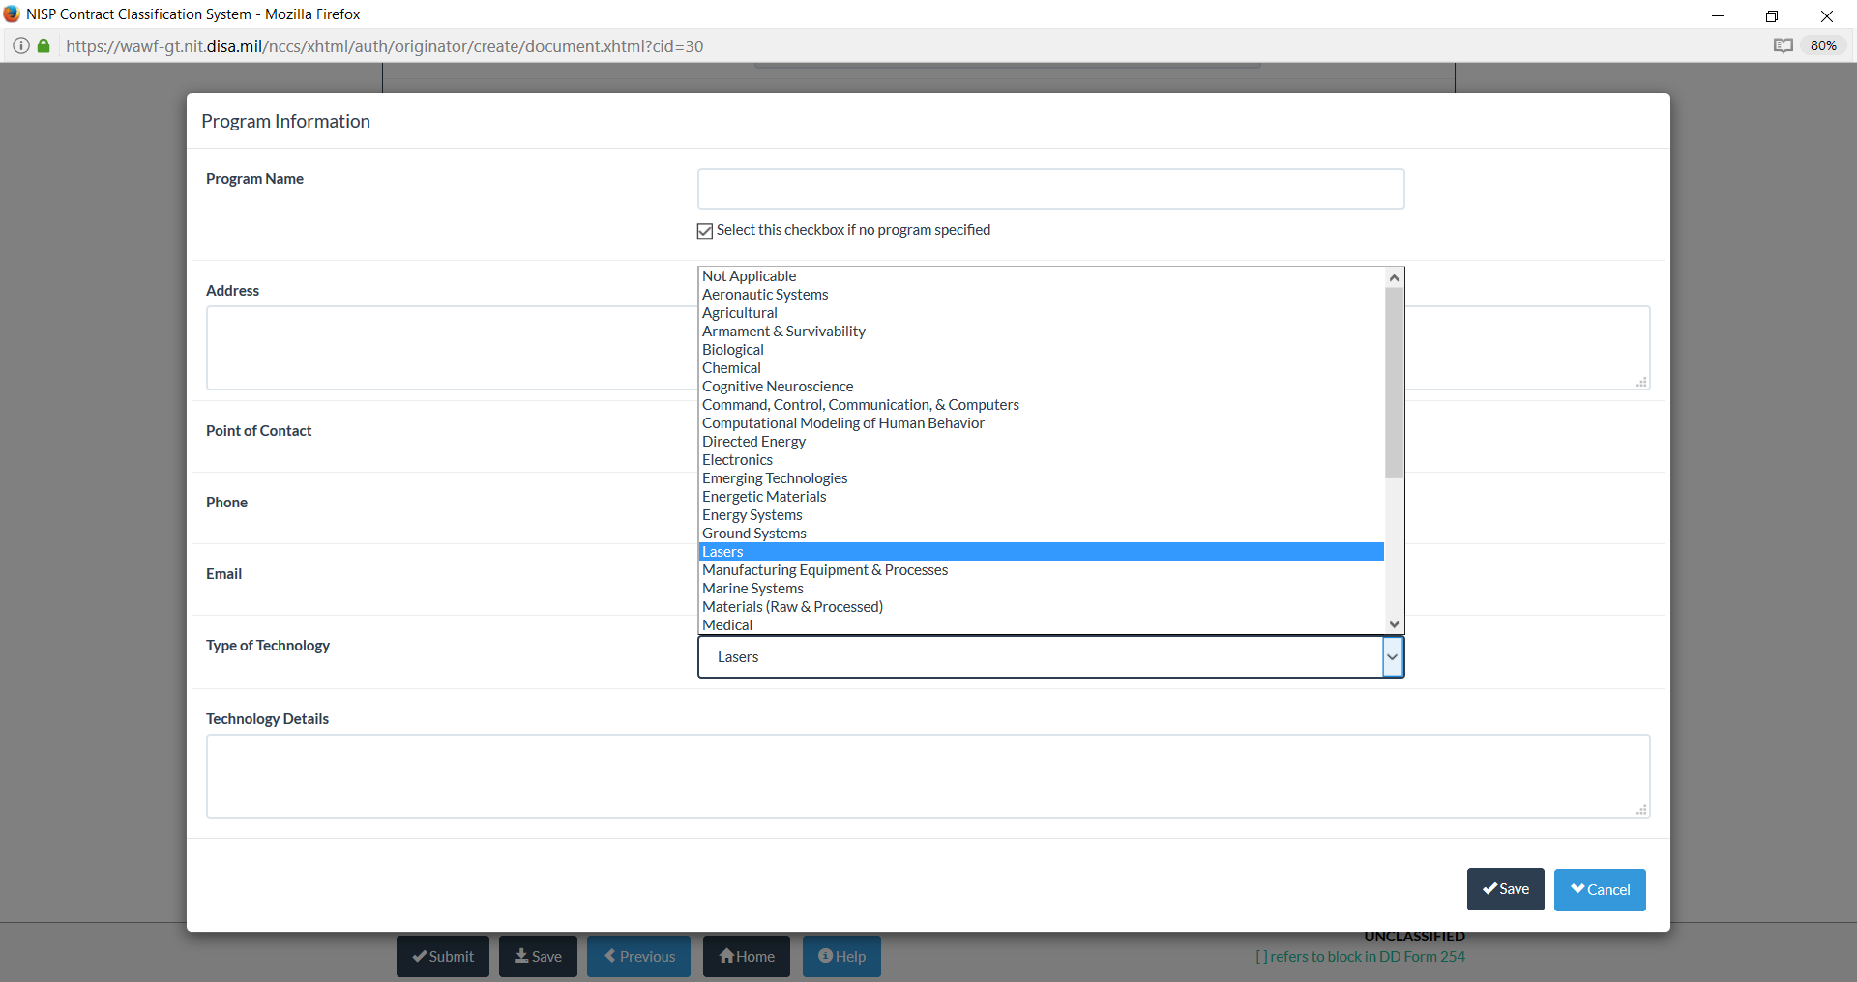
Program Information

Slide 20
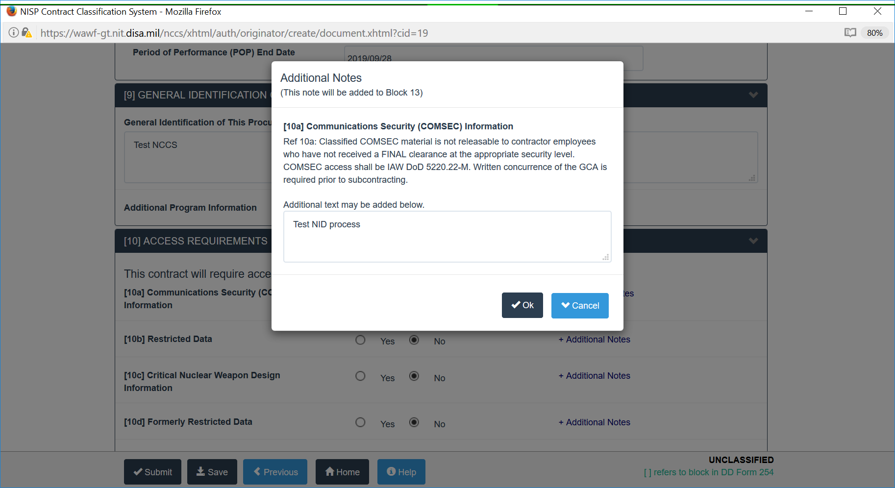
Block 10

Slide 21
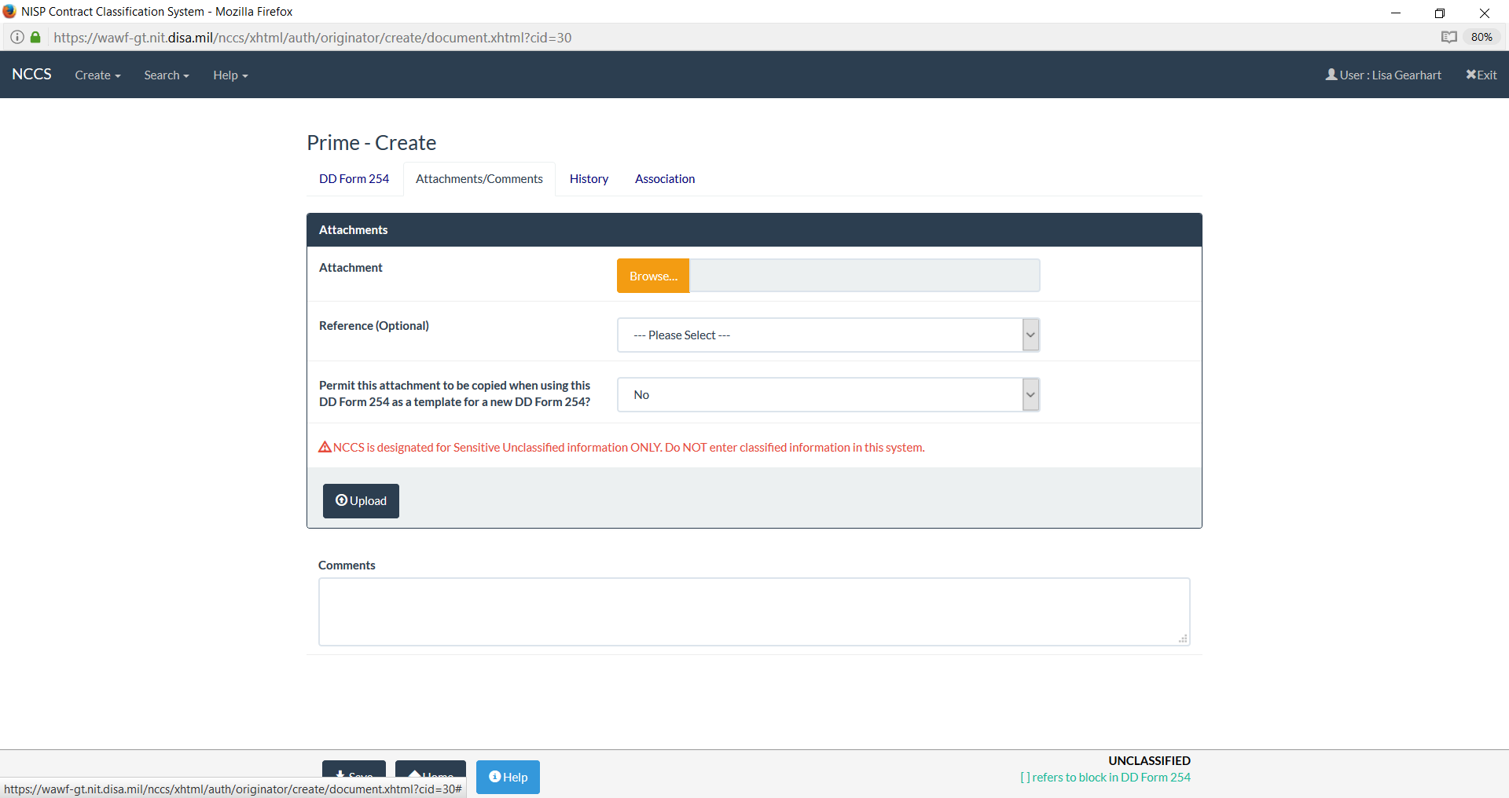
Attachments

Slide 22
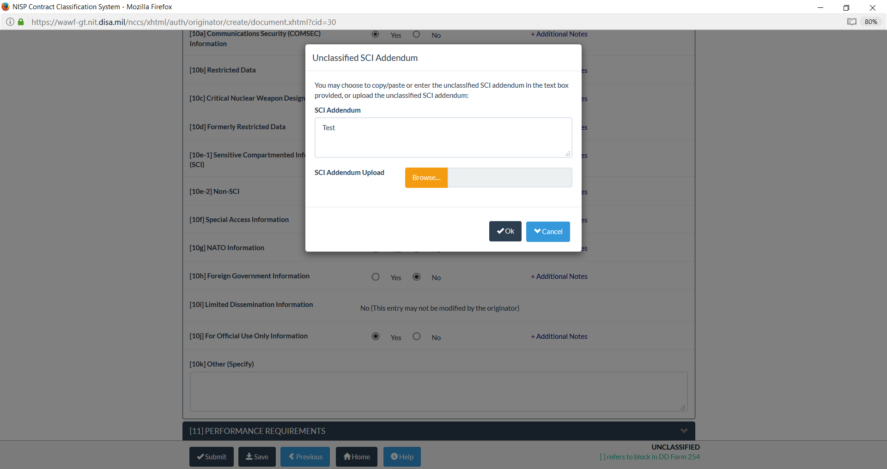
SCI and SAP Addendums

Slide 23
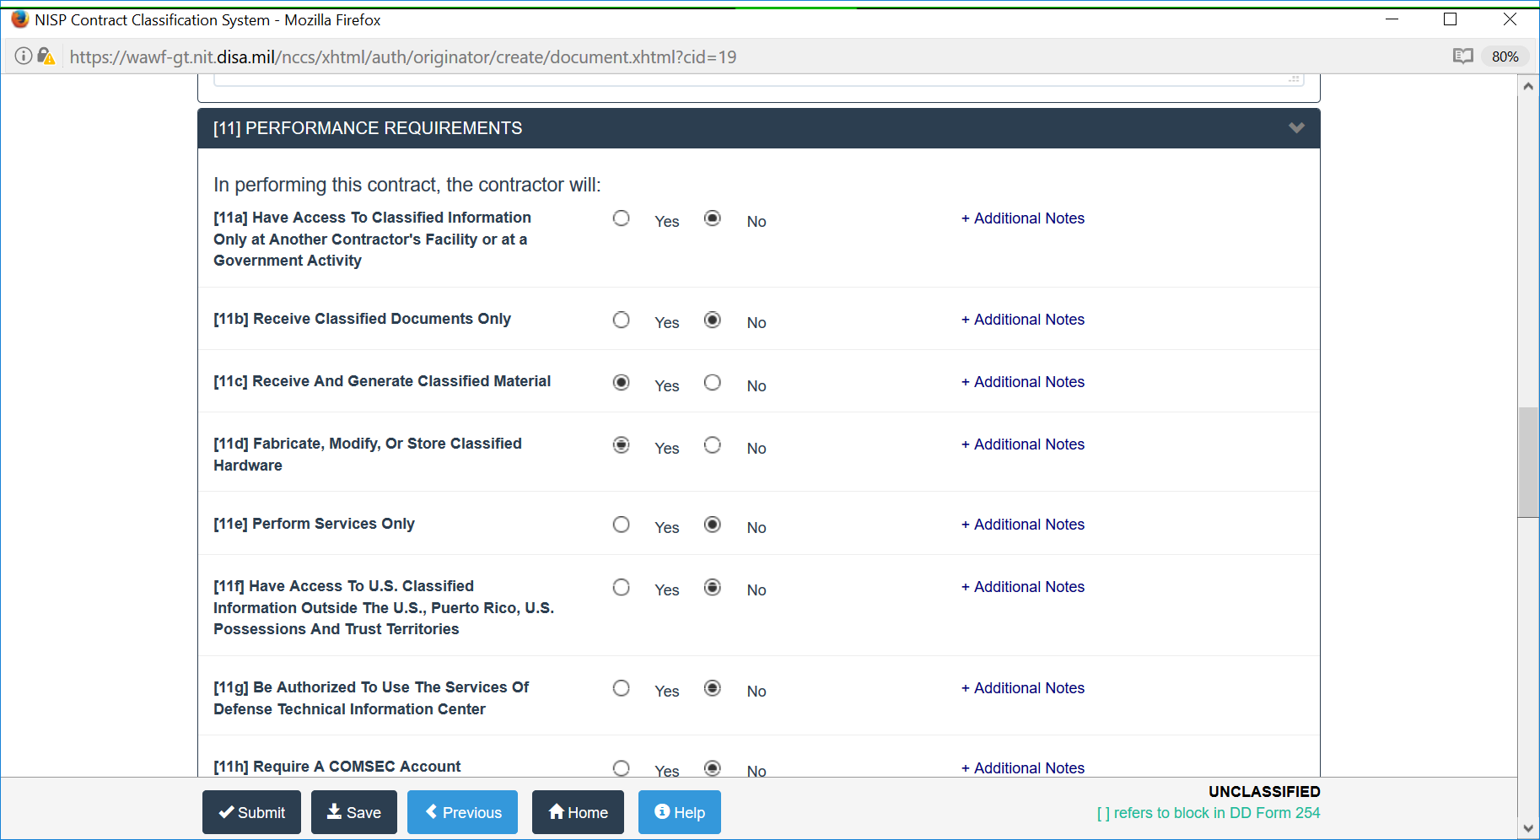
Block 11

Slide 24
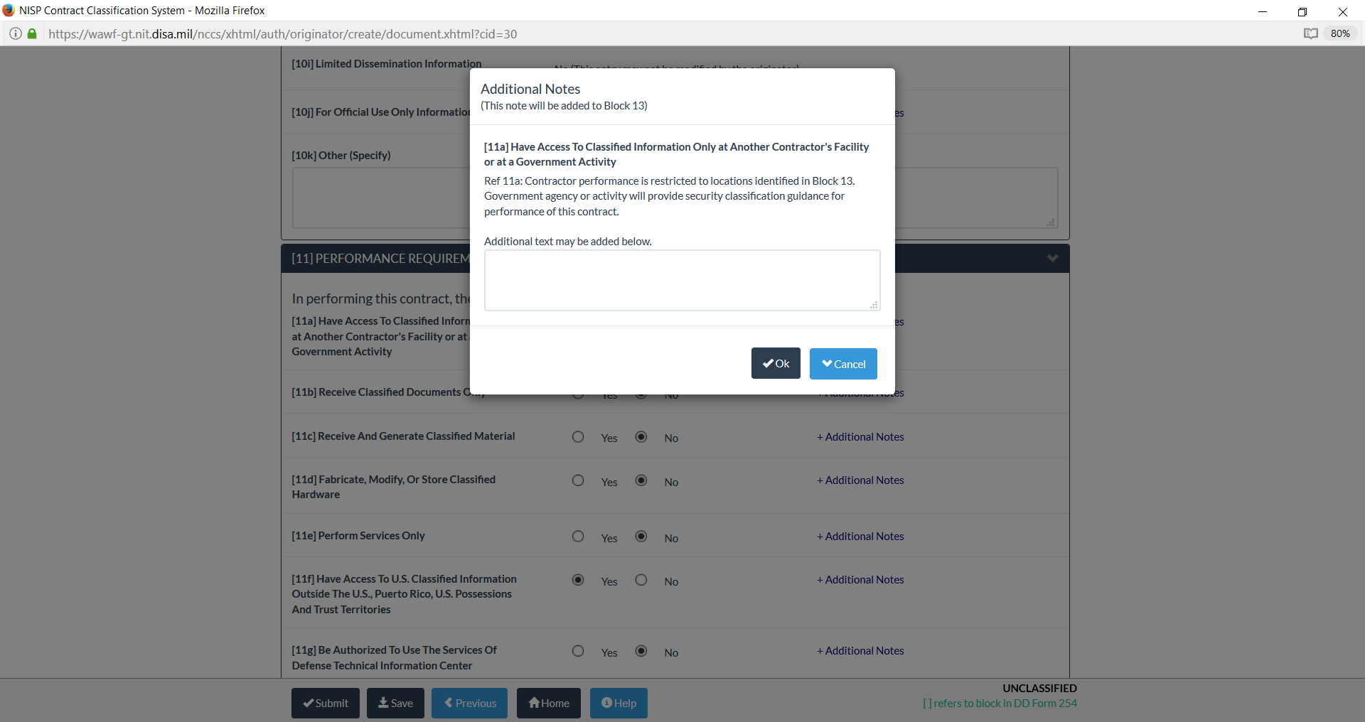
Block 11 Requirements

Slide 25
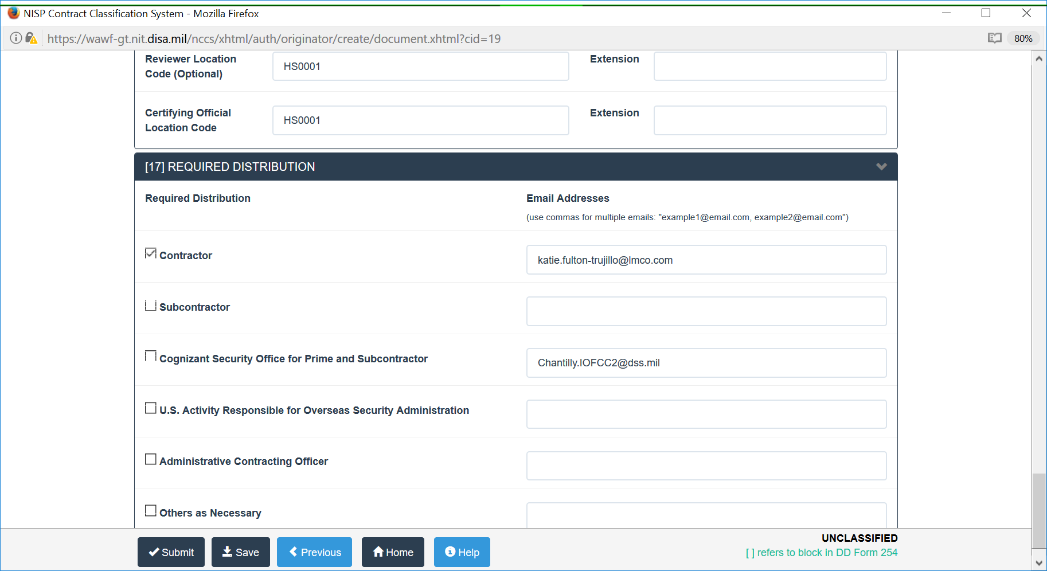
Certification and Distribution

Slide 26
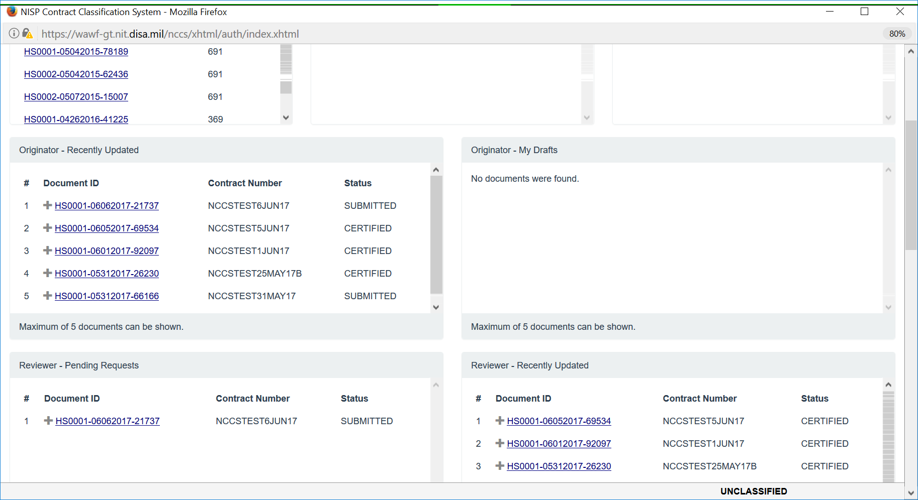
Dashboard

Slide 27
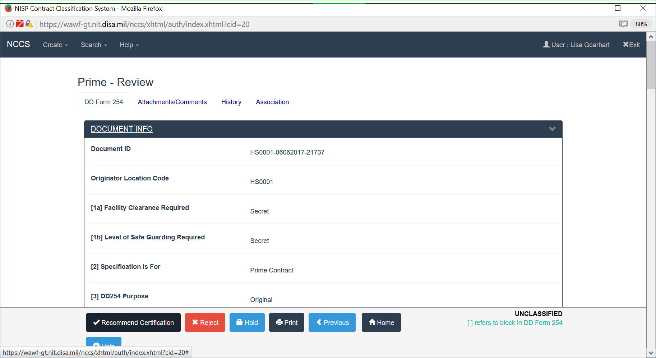
Reviewer Role (Optional)

Slide 28
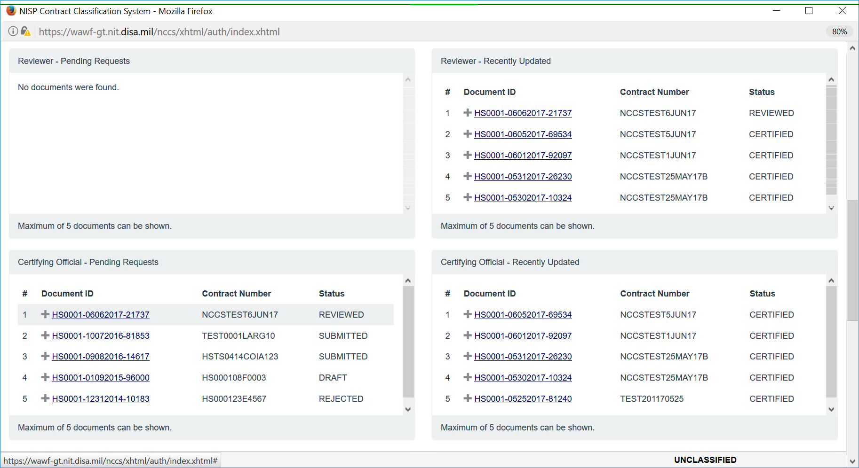
Dashboard

Slide 29
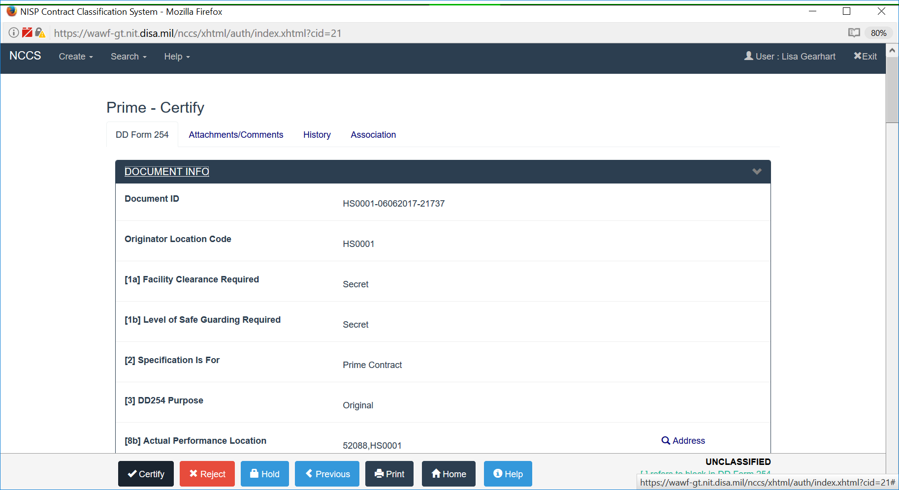
Certifying Official Role

Slide 30
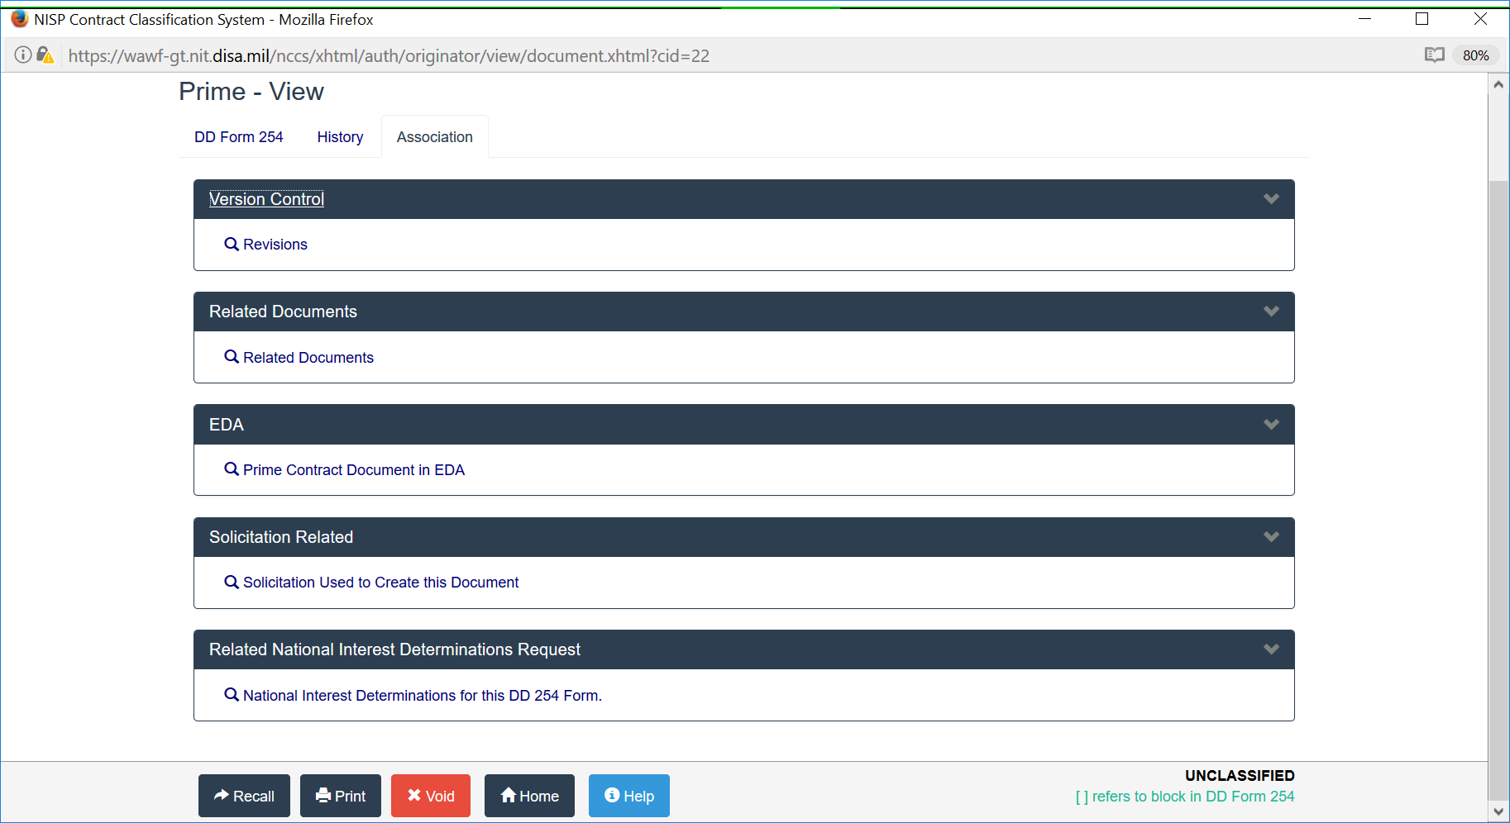
Association

Slide 31
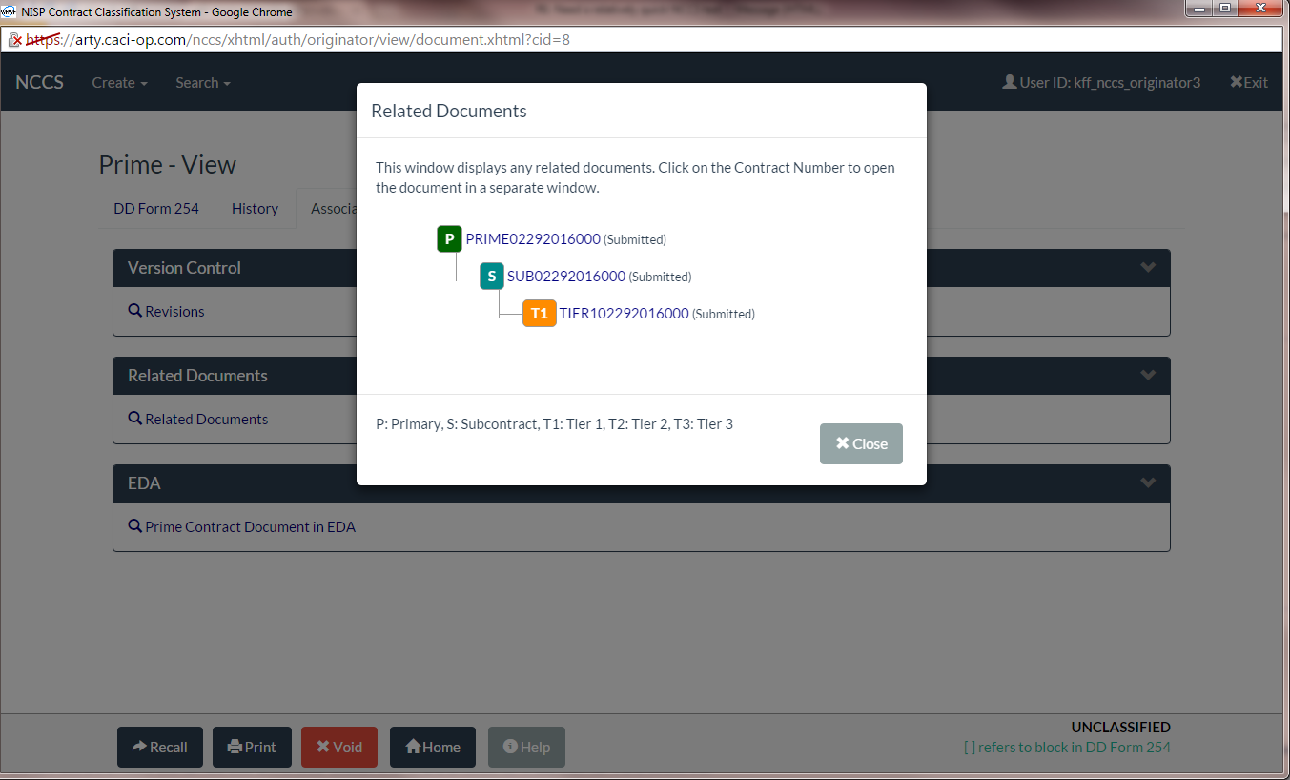
Supply Chain

Slide 32
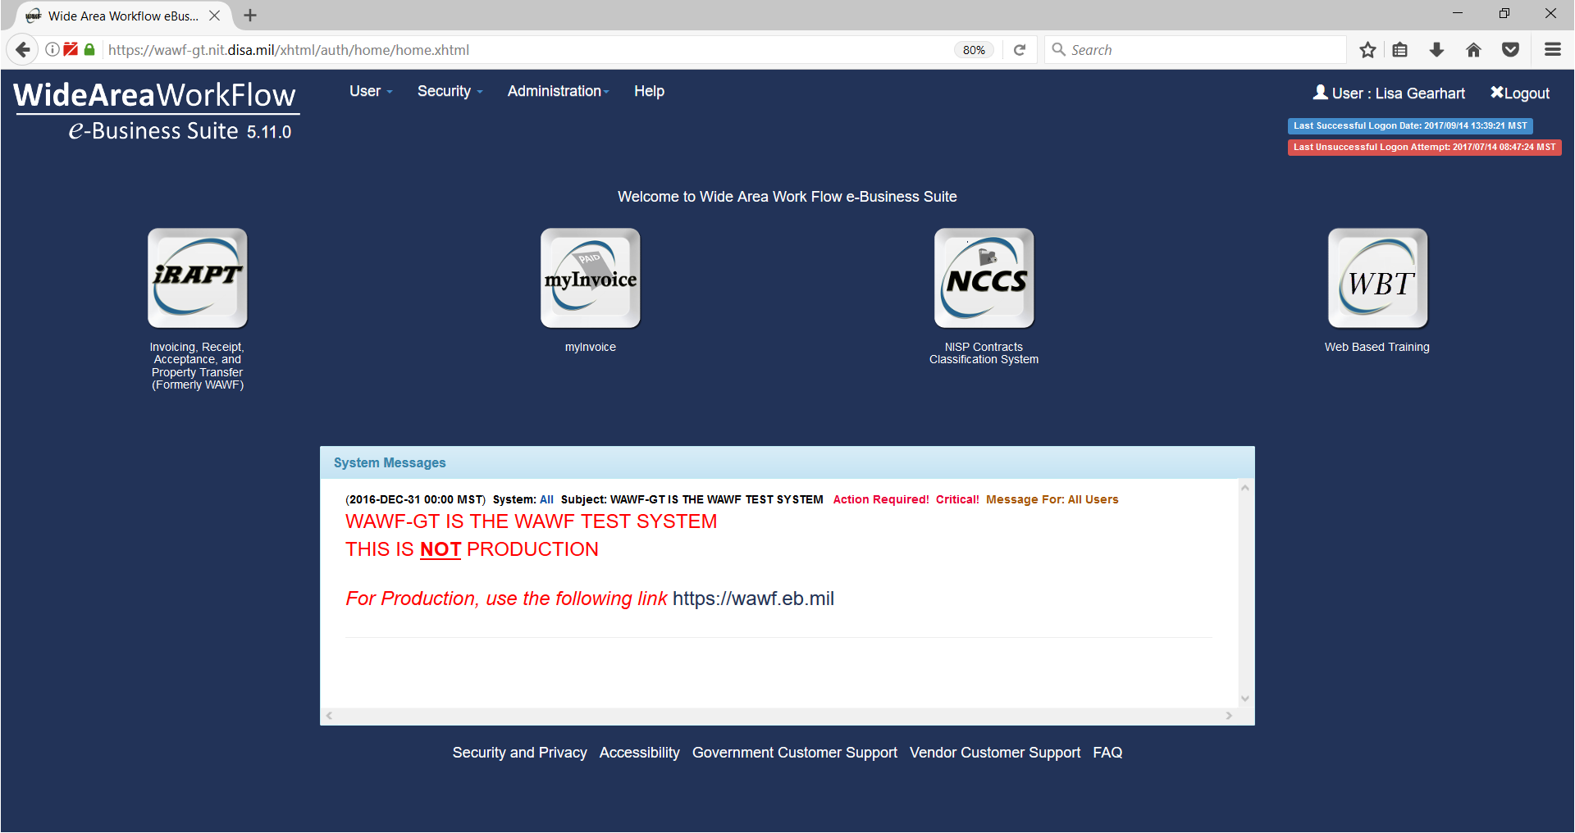
NCCS Vendor View
Notes:
Presenter
2017-03-22 18:04:10
--------------------------------------------
View of what the Government Originator can see in the dashboard.

Slide 33
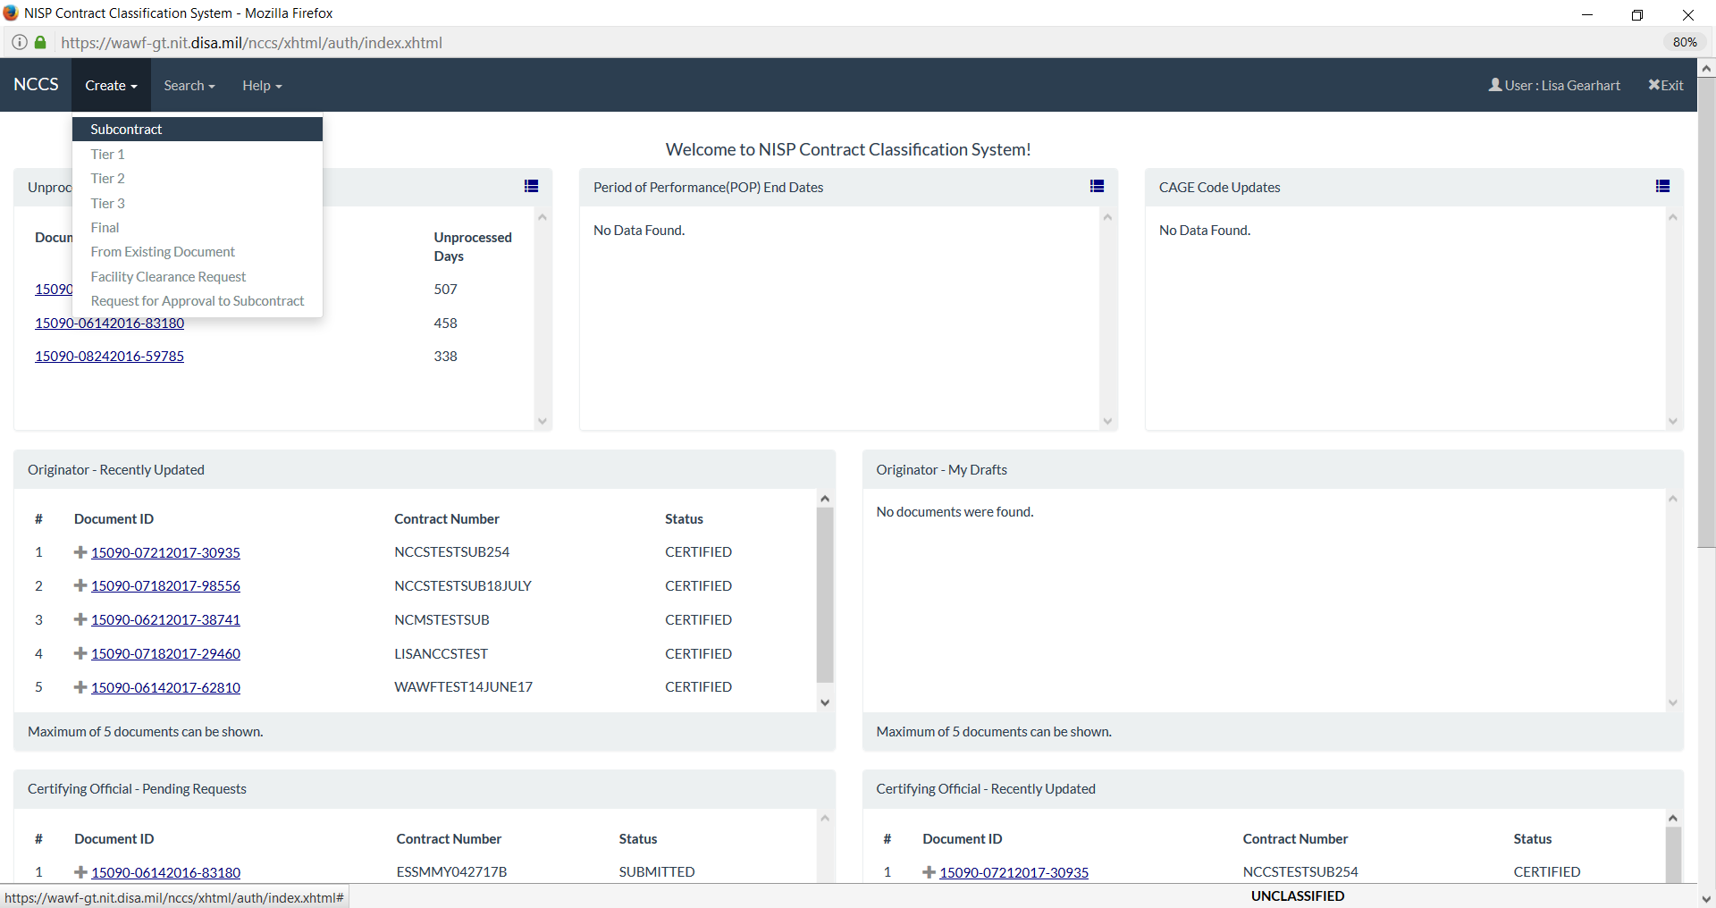
NCCS Vendor View Dashboard
Notes:
Presenter
2017-03-22 18:04:10
--------------------------------------------
View of what the Government Originator can see in the dashboard.

Slide 34
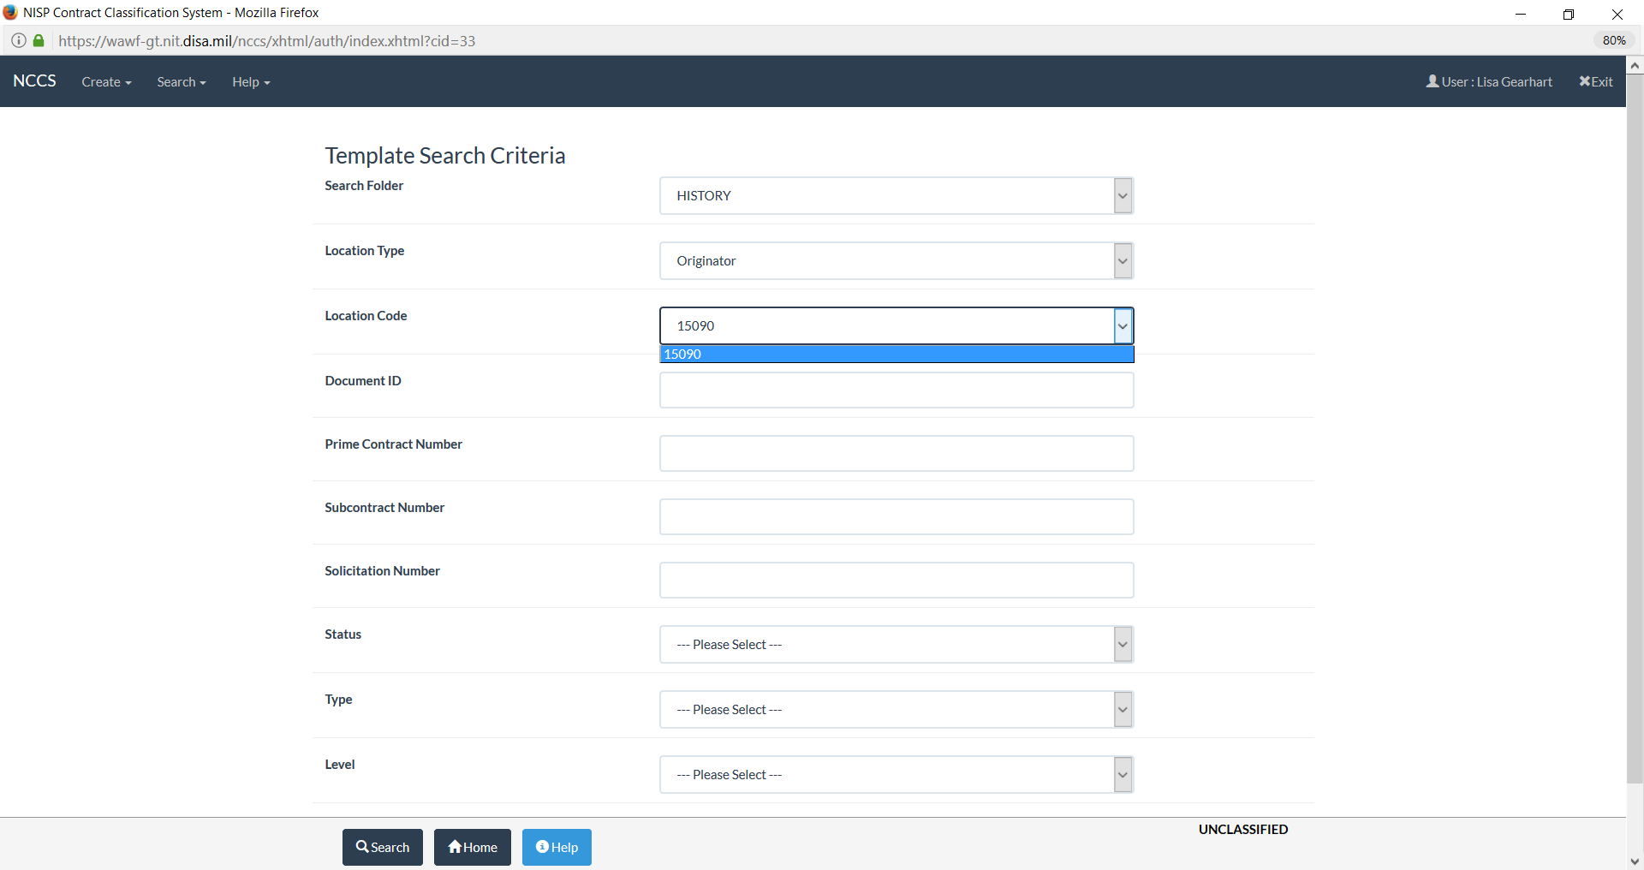
NCCS Vendor Search
Notes:
Presenter
2017-03-22 18:04:10
--------------------------------------------
View of what the Government Originator can see in the dashboard.

Slide 35
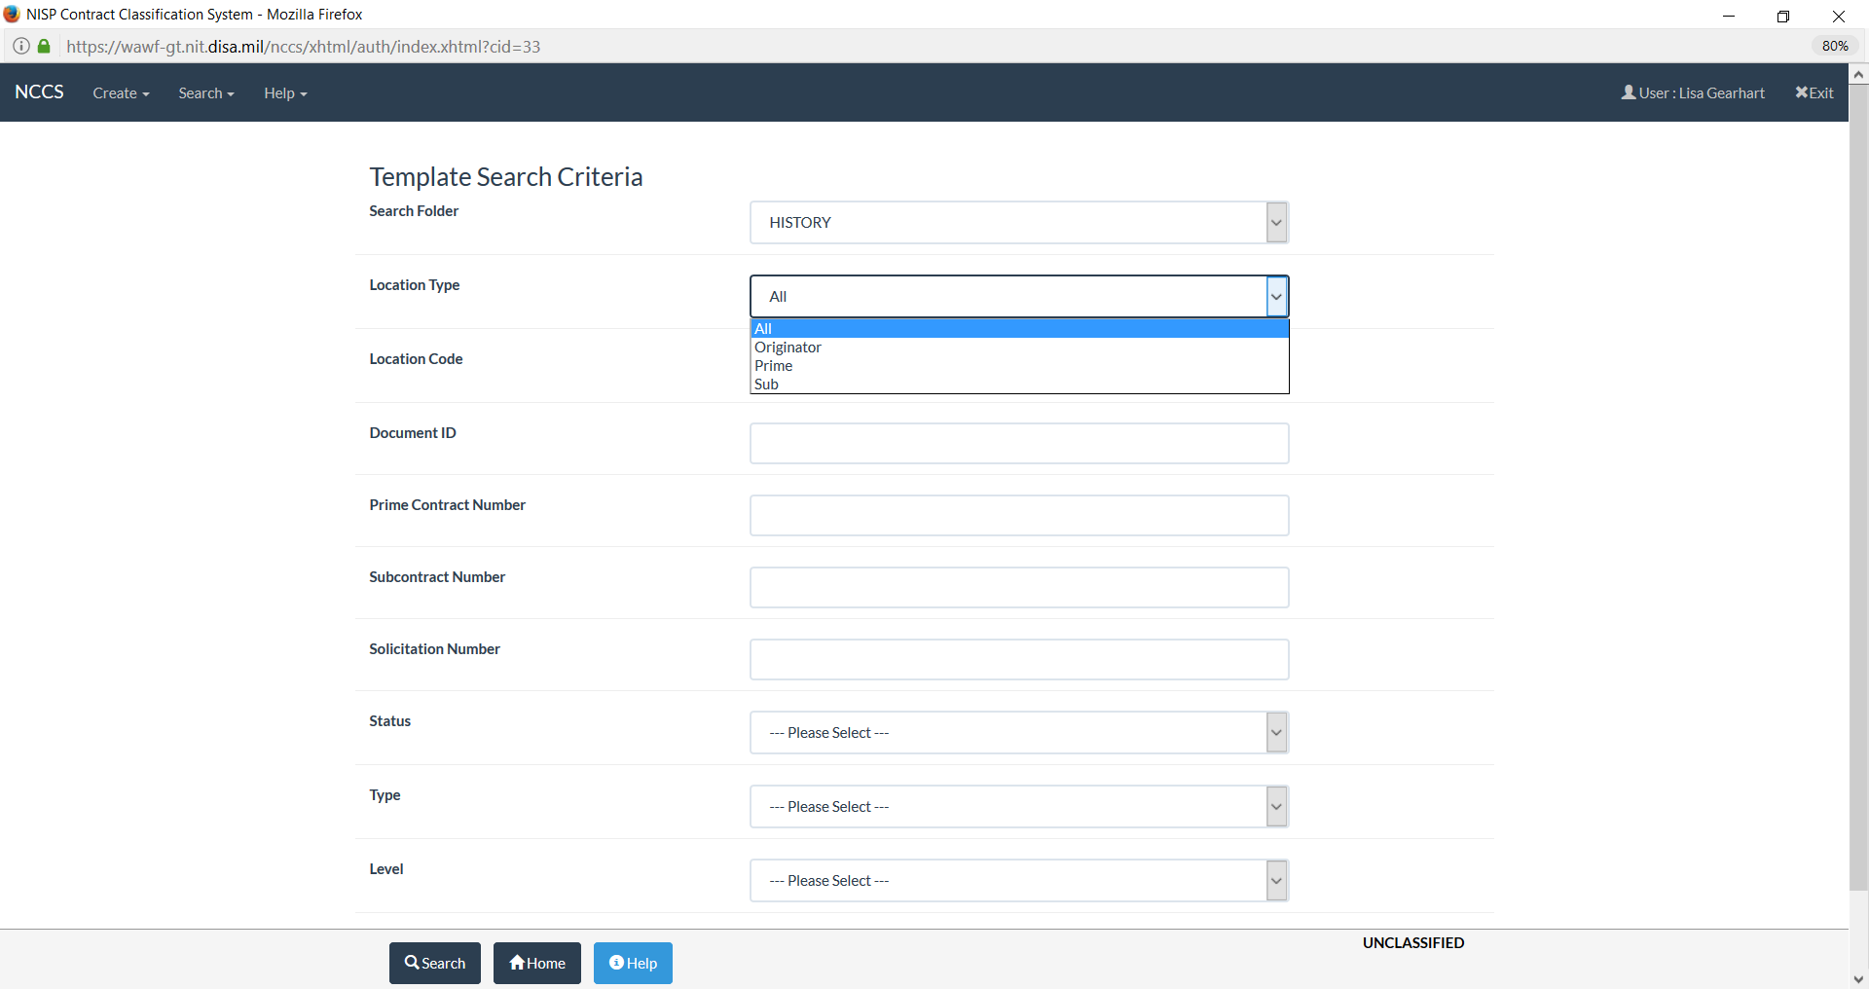
NCCS Vendor Search (cont)
Notes:
Presenter
2017-03-22 18:04:10
--------------------------------------------
View of what the Government Originator can see in the dashboard.

Slide 36
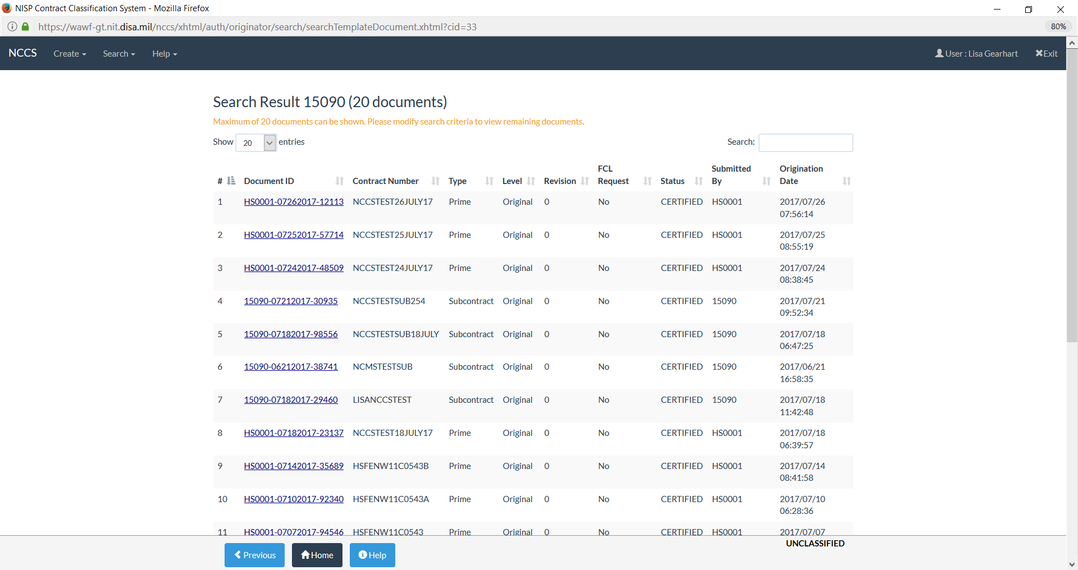
NCCS Vendor View
Notes:
Presenter
2017-03-22 18:04:10
--------------------------------------------
View of what the Government Originator can see in the dashboard.

Slide 37
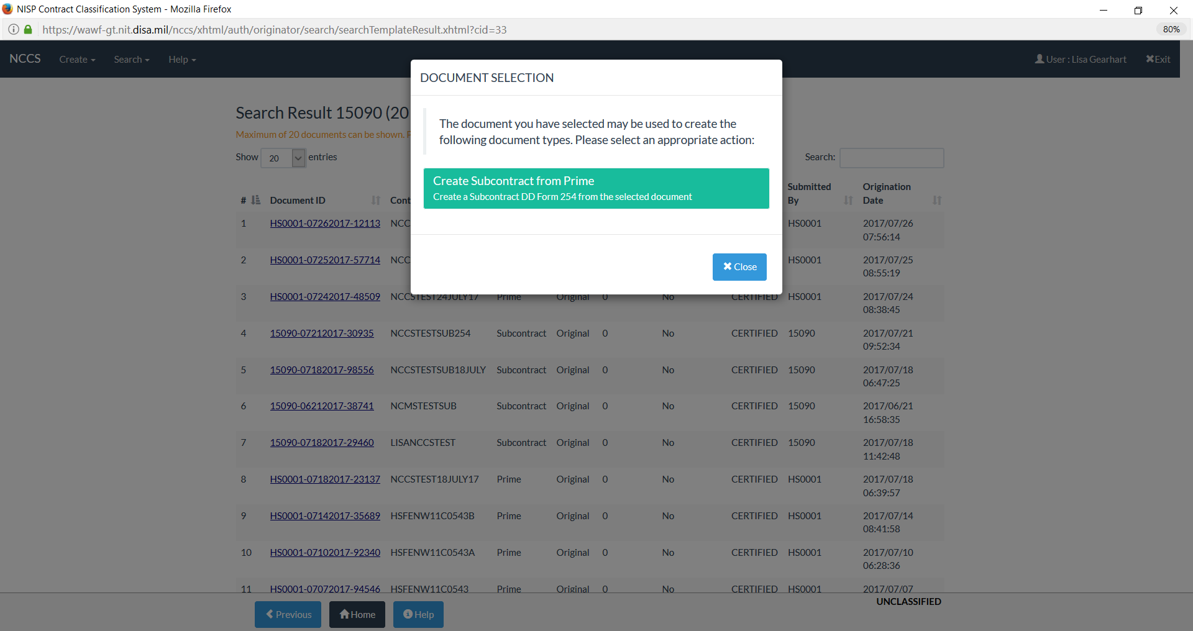
NCCS Vendor View
Notes:
Presenter
2017-03-22 18:04:10
--------------------------------------------
View of what the Government Originator can see in the dashboard.

Slide 38
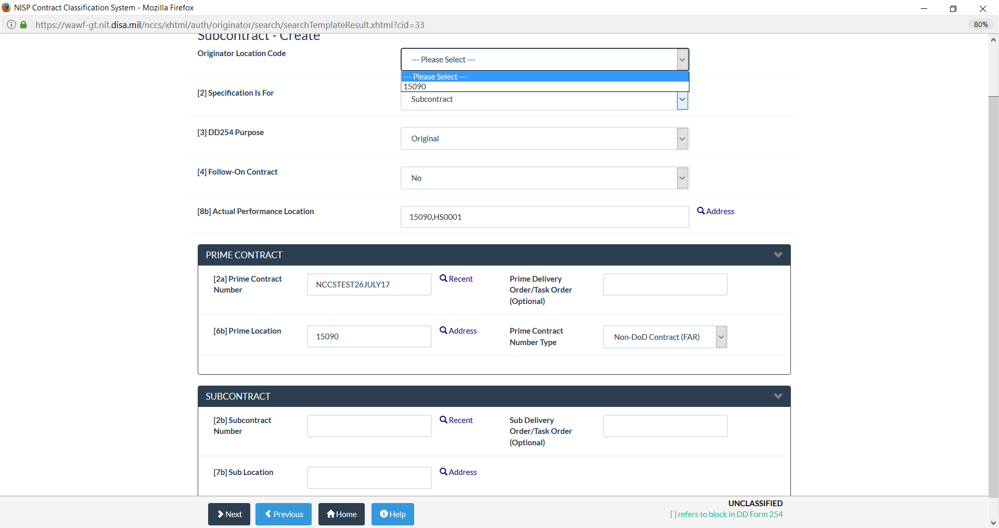
NCCS Vendor Sub 254
Notes:
Presenter
2017-03-22 18:04:10
--------------------------------------------
View of what the Government Originator can see in the dashboard.

Slide 39
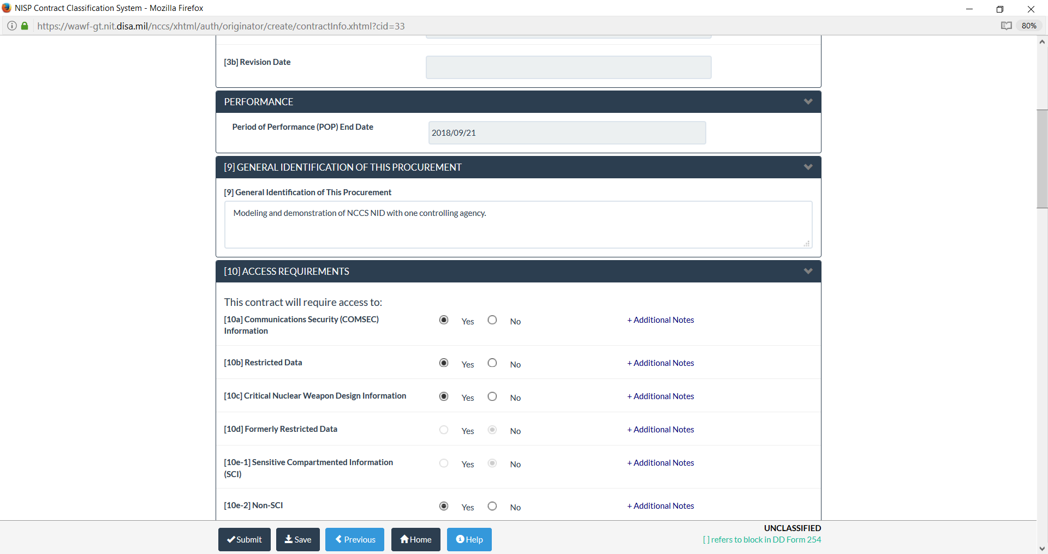
NCCS Vendor Sub 254
Notes:
Presenter
2017-03-22 18:04:10
--------------------------------------------
View of what the Government Originator can see in the dashboard.

Slide 40
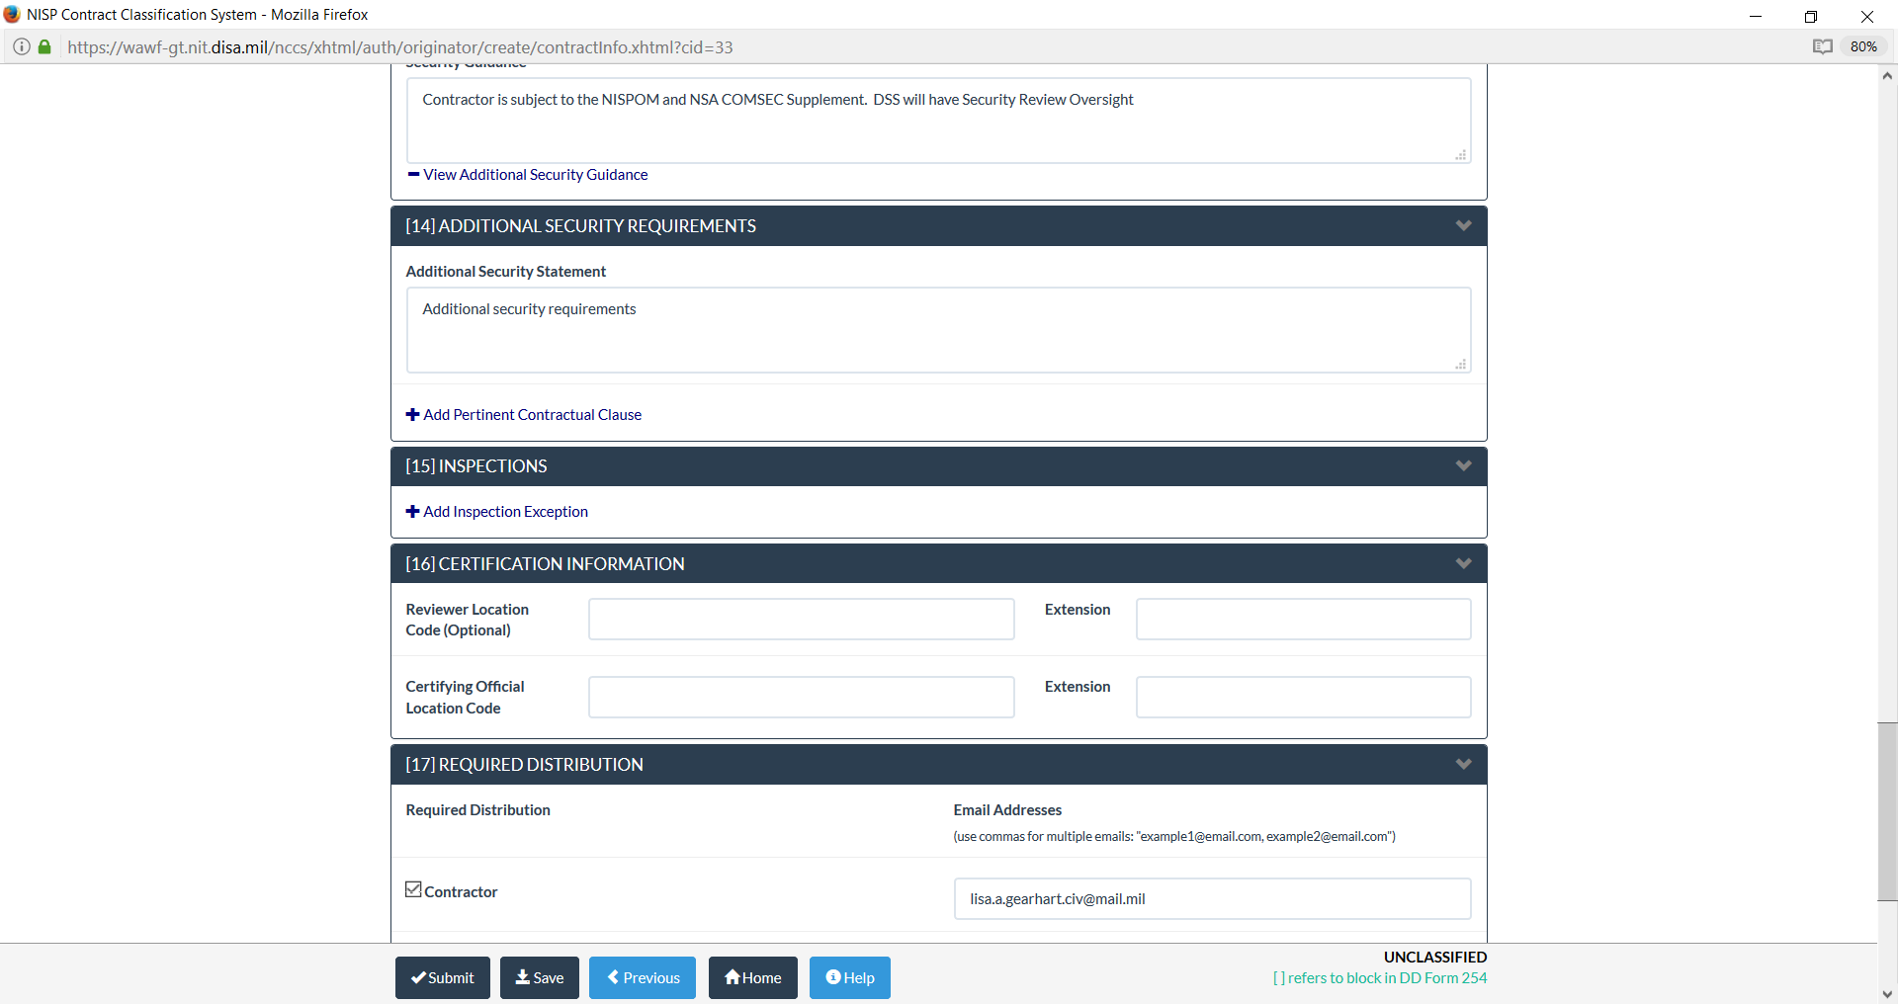
NCCS Vendor View
Notes:
Presenter
2017-03-22 18:04:10
--------------------------------------------
View of what the Government Originator can see in the dashboard.

Slide 41
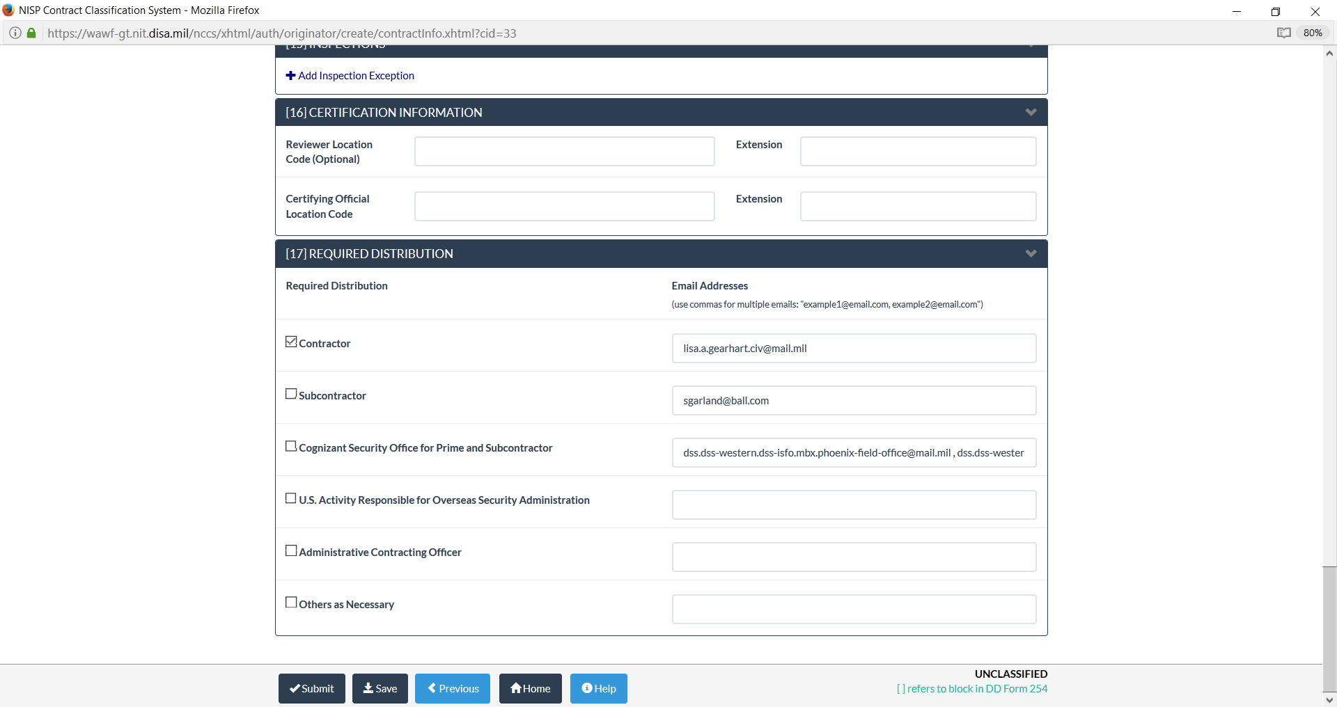
NCCS Vendor View
Notes:
Presenter
2017-03-22 18:04:10
--------------------------------------------
View of what the Government Originator can see in the dashboard.

Slide 42
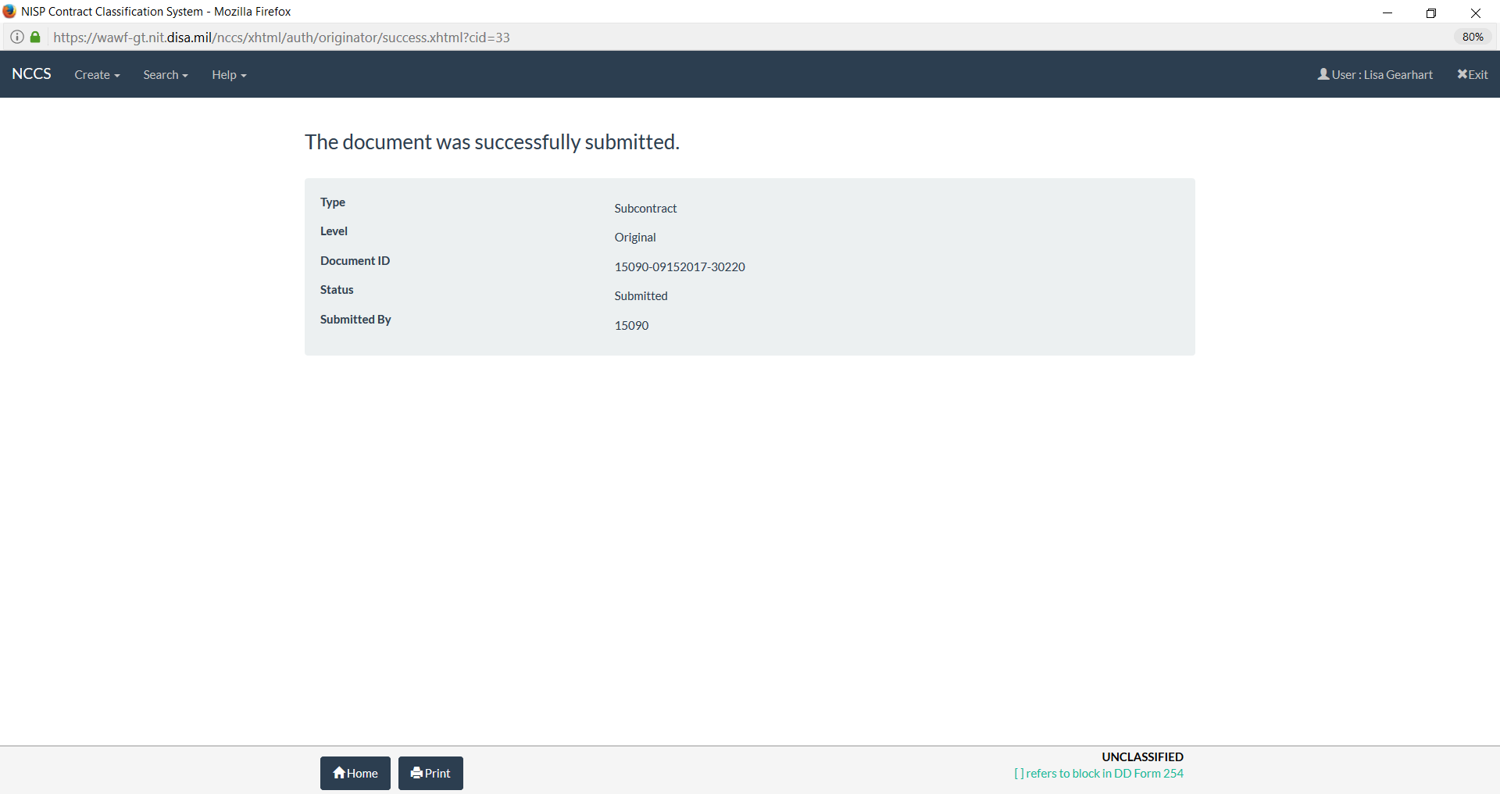
NCCS Vendor View
Notes:
Presenter
2017-03-22 18:04:10
--------------------------------------------
View of what the Government Originator can see in the dashboard.

Slide 43
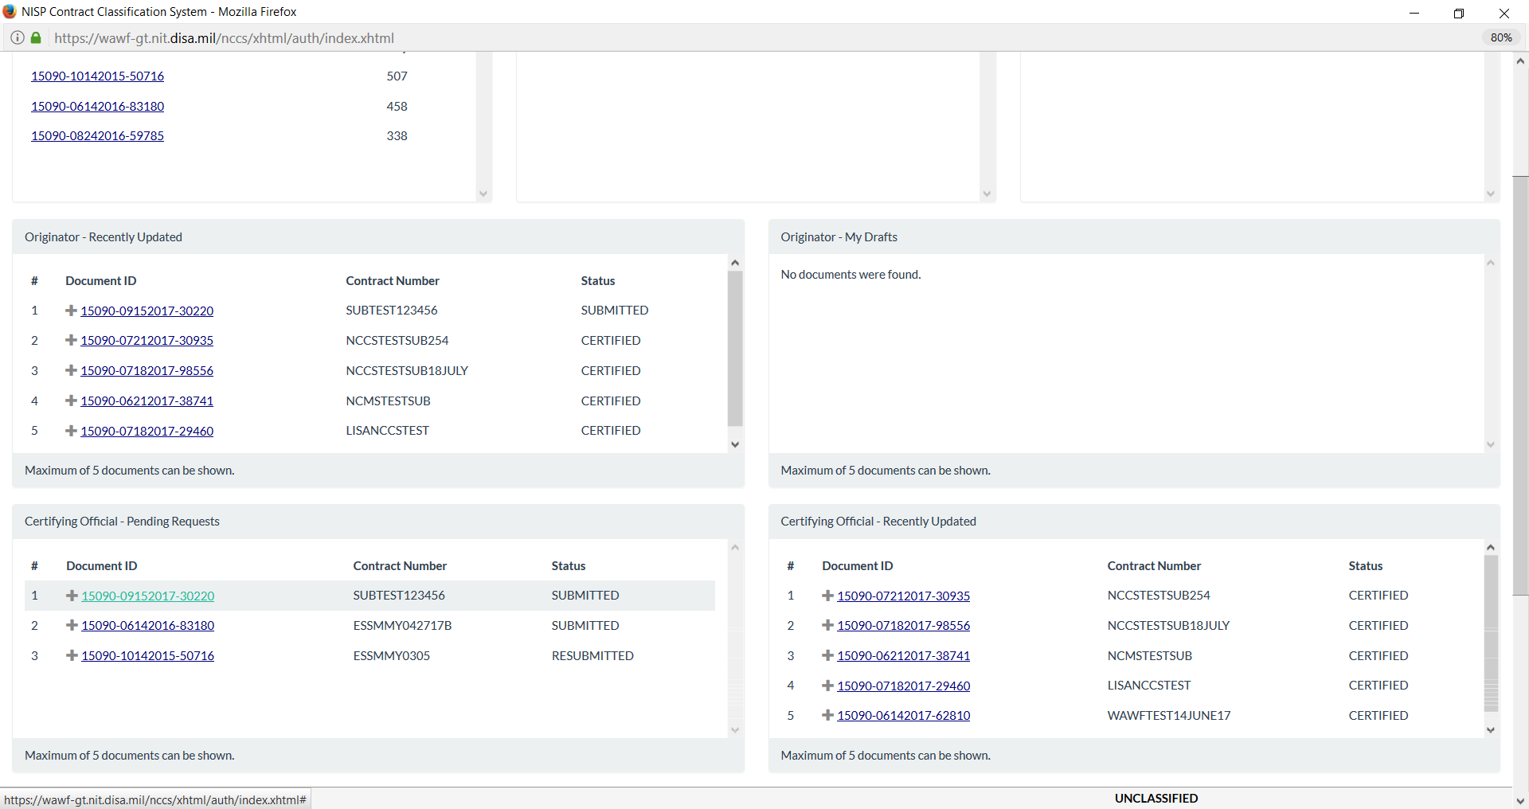
NCCS Vendor View
Notes:
Presenter
2017-03-22 18:04:10
--------------------------------------------
View of what the Government Originator can see in the dashboard.

Slide 44
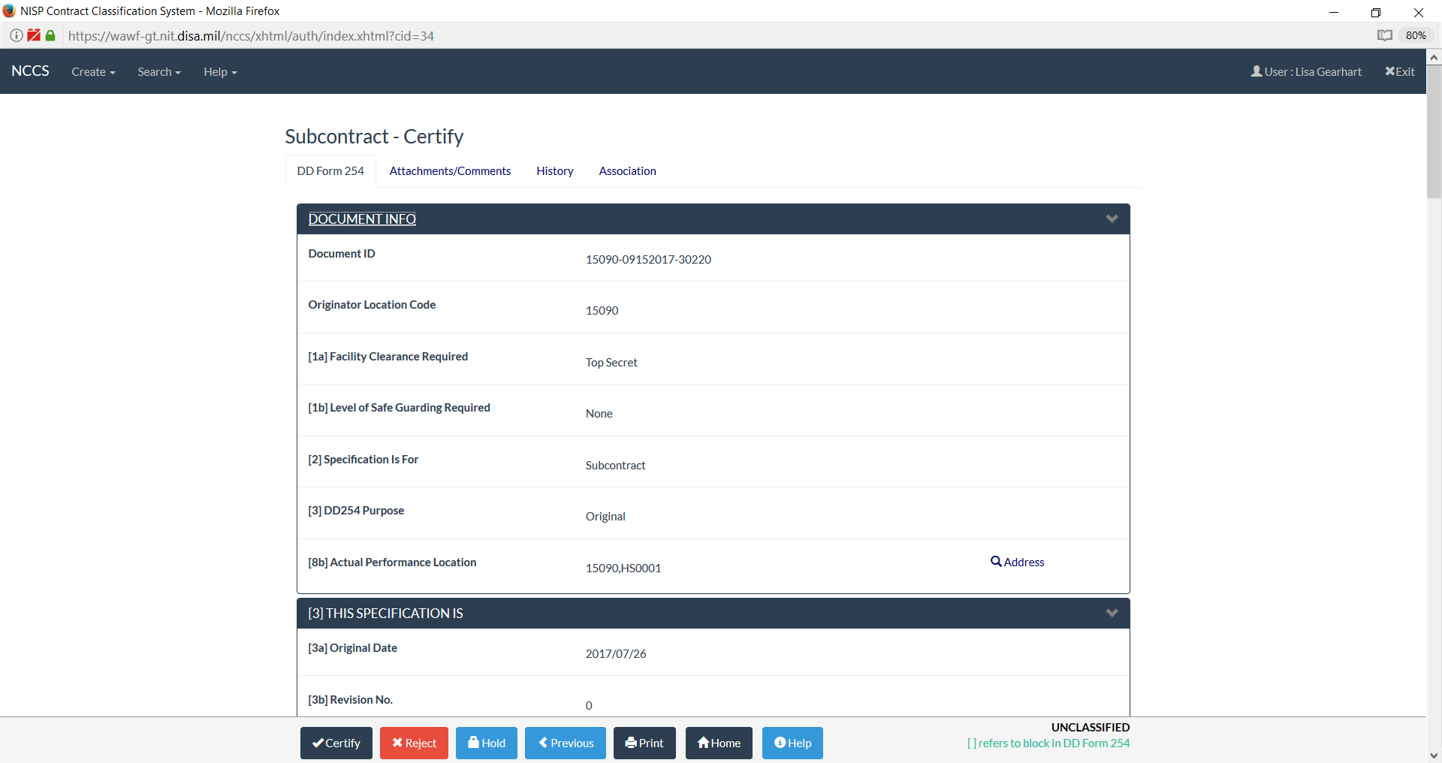
NCCS Vendor View
Notes:
Presenter
2017-03-22 18:04:10
--------------------------------------------
View of what the Government Originator can see in the dashboard.

Slide 45
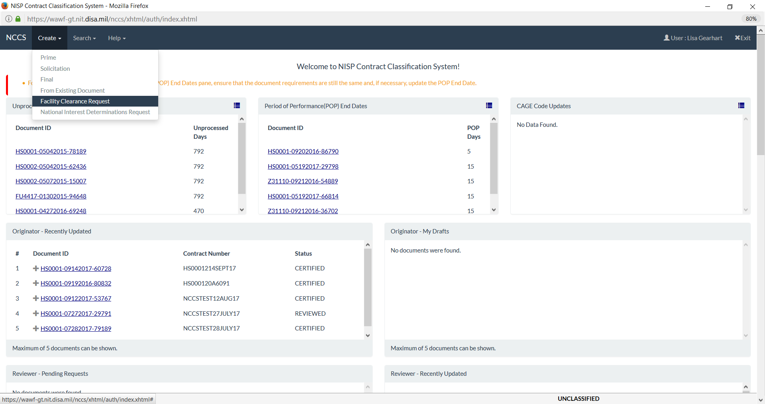
Facility Clearance Request
Notes:
COMSEC, CNWDI, SCI, TEMPEST and NATO

Slide 46
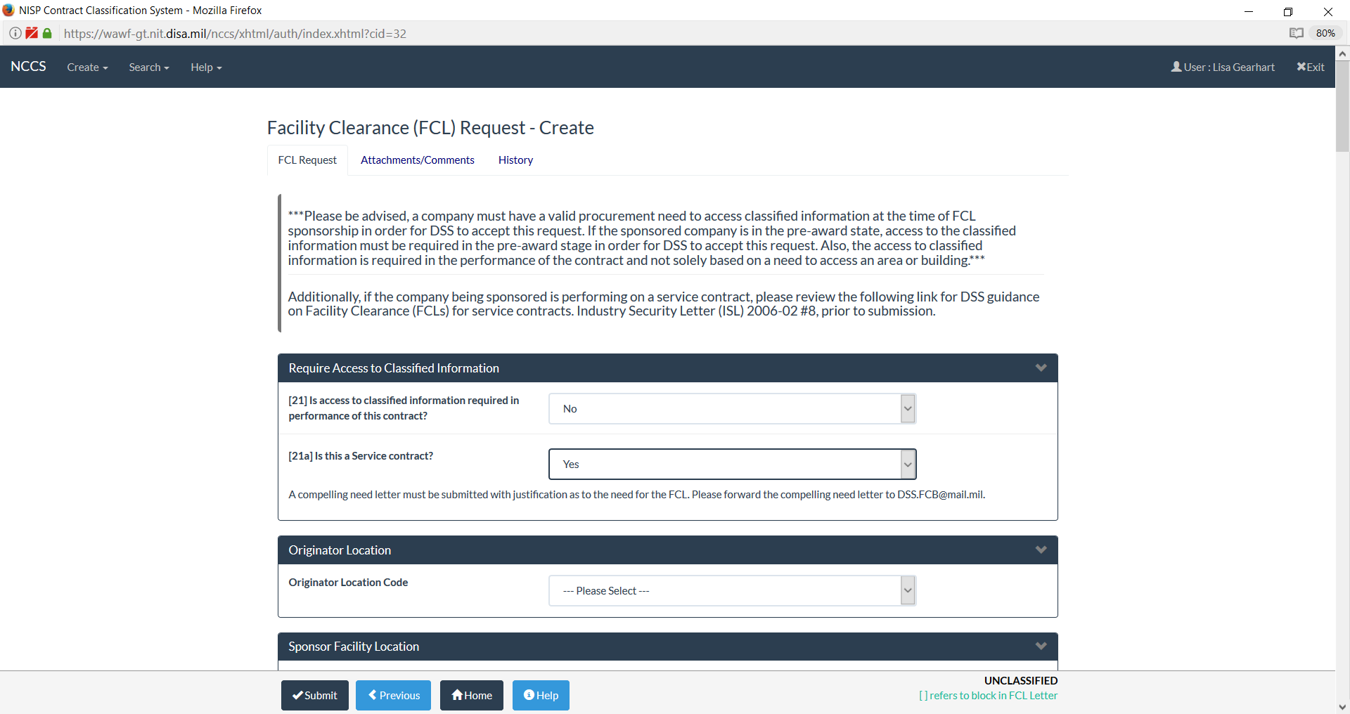
Facility Clearance Request
Notes:
COMSEC, CNWDI, SCI, TEMPEST and NATO

Slide 47
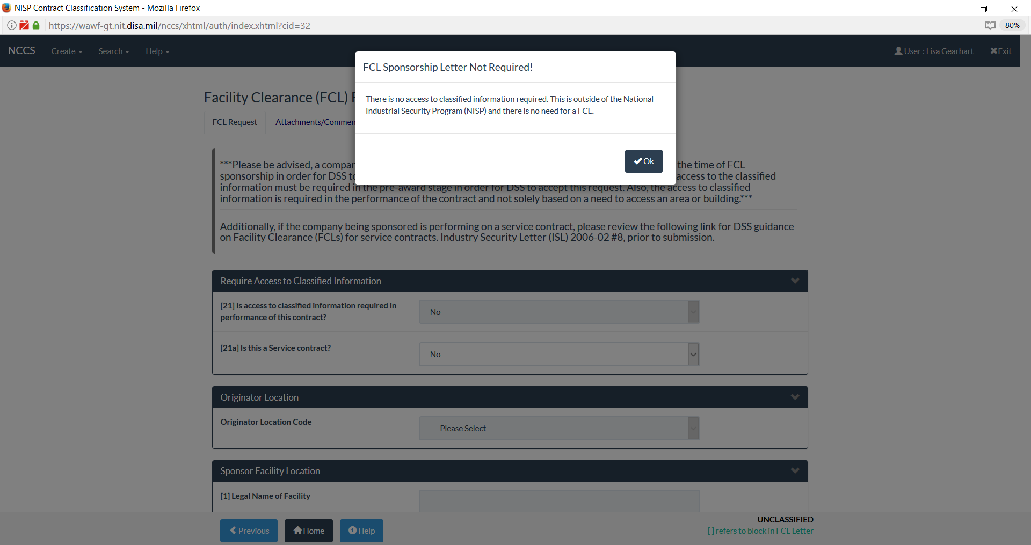
Facility Clearance Request
Notes:
COMSEC, CNWDI, SCI, TEMPEST and NATO

Slide 48
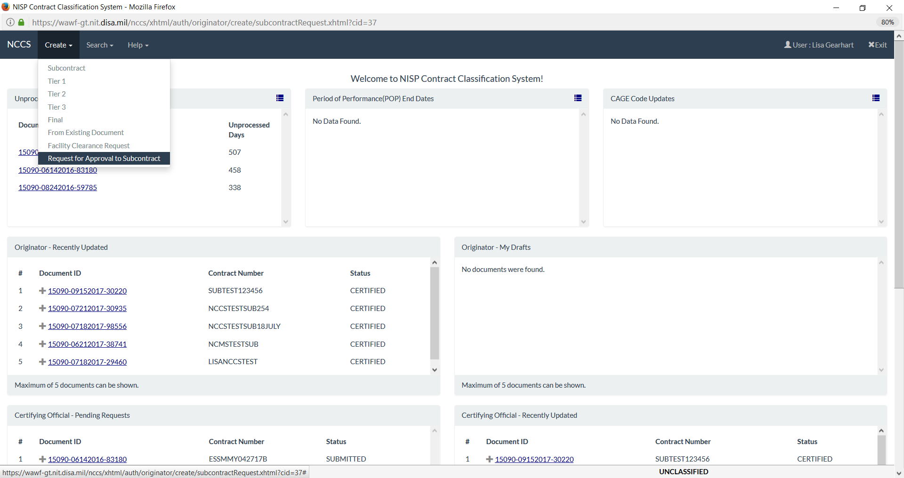
Request for Approval to Subcontract
Notes:
COMSEC, CNWDI, SCI, TEMPEST and NATO

Slide 49
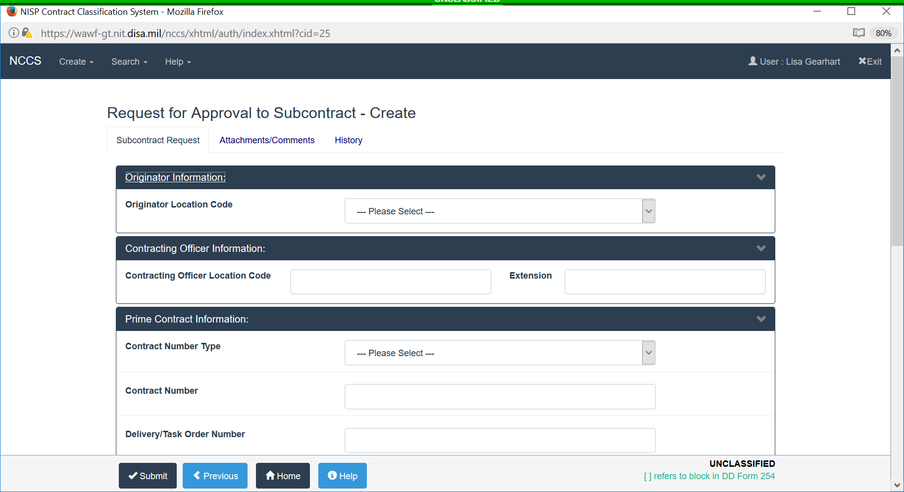
Request for Approval to Subcontract
Notes:
COMSEC, CNWDI, SCI, TEMPEST and NATO

Slide 50
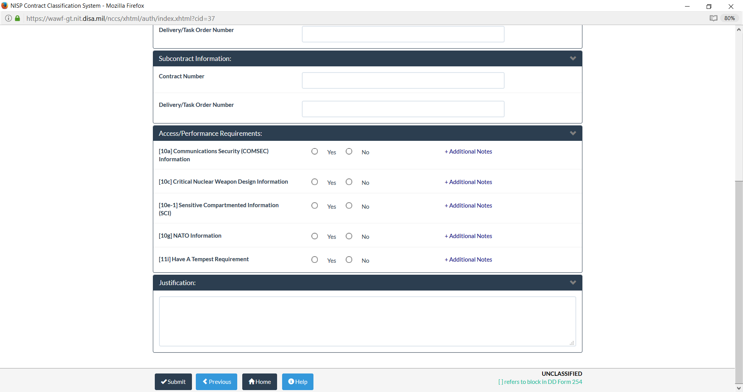
Request for Approval to Subcontract
Notes:
COMSEC, CNWDI, SCI, TEMPEST and NATO

Slide 51
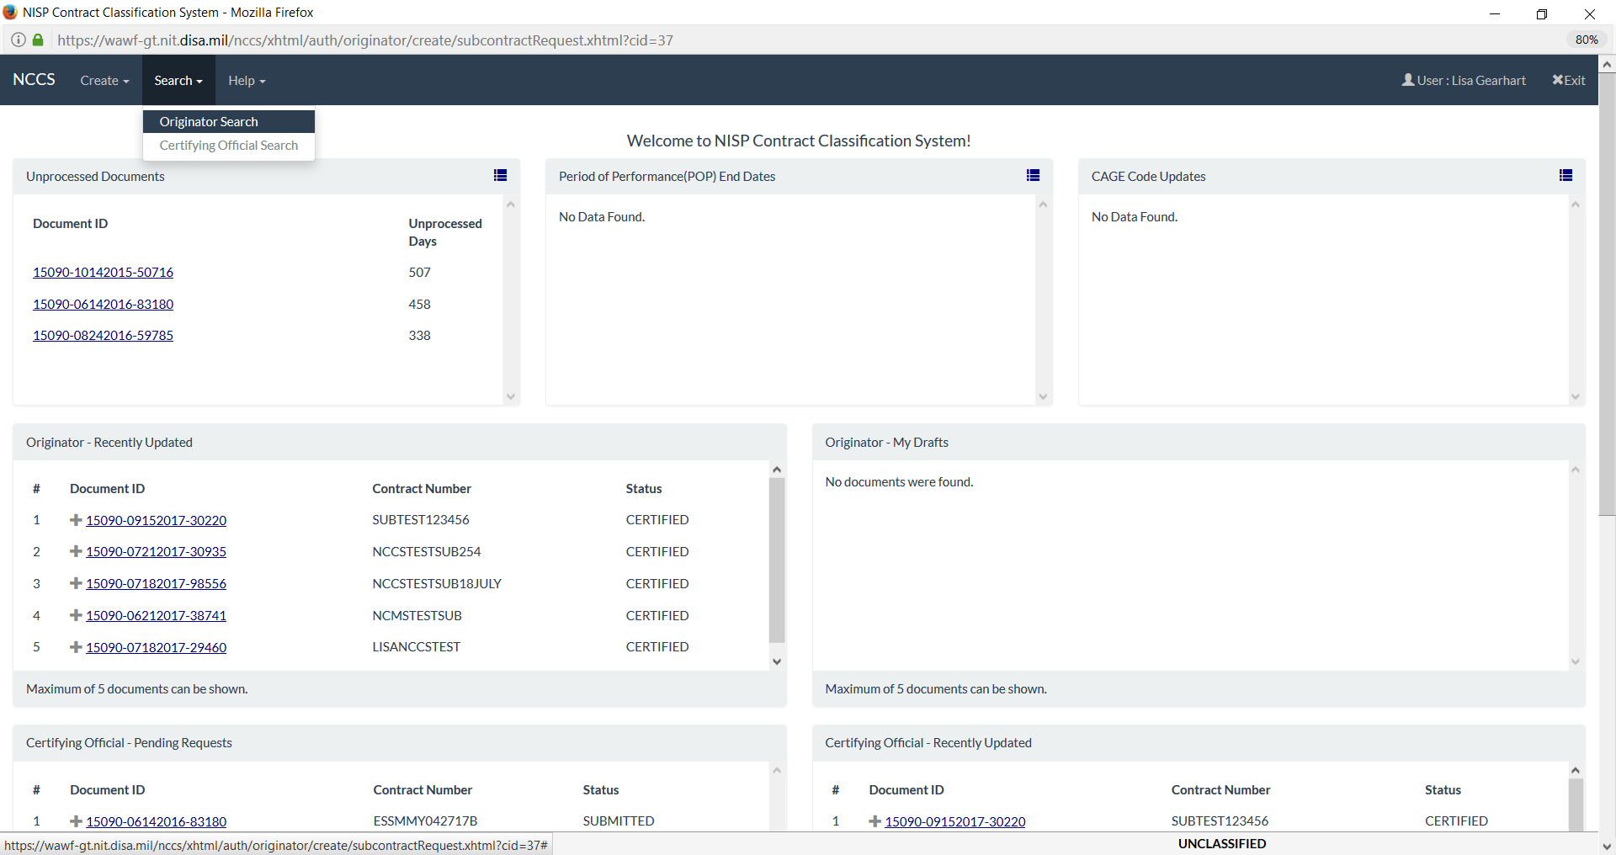
Vendors Search for Prime 254s

Slide 52
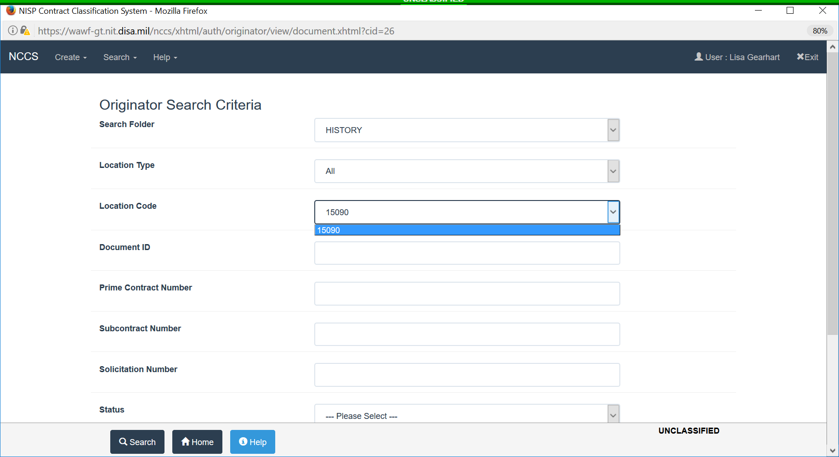
Vendors Search for Prime 254s

Slide 53
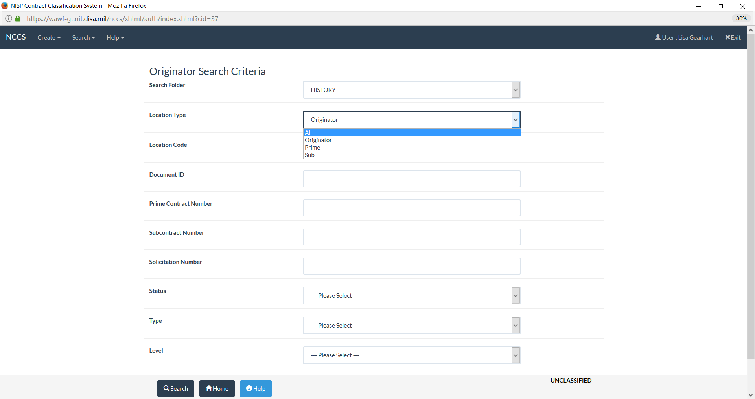
Vendors Search for Prime 254s

Slide 54
Vendors Search for Prime 254s

Slide 55
Vendors User Information

Slide 56
Questions?
DSS.NCCS@mail.mil
9
DSS Industrial Security Field Operations

