Slide 1
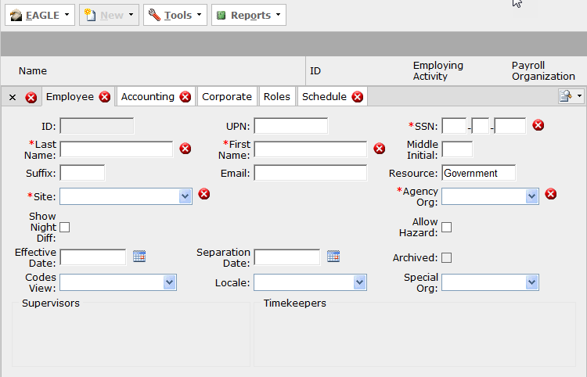
SSN Entered By the Payroll Centers of Excellence When Creating Government Employee Record

Slide 2
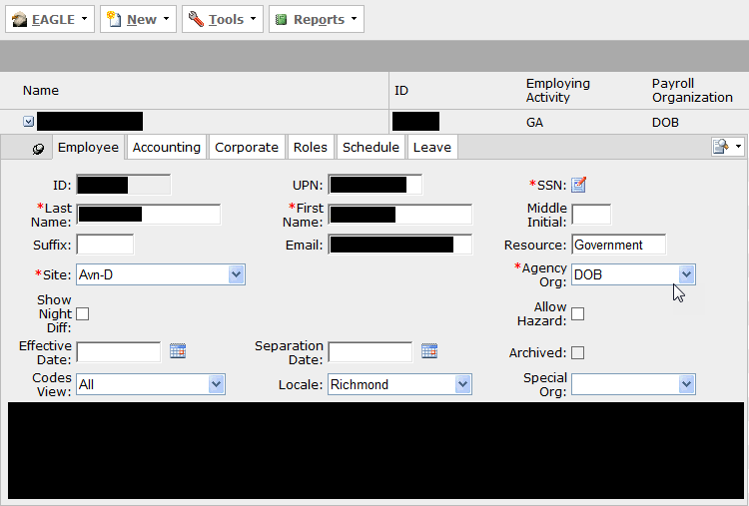
SSN is hidden after entry unless needed. SSN is encrypted in the database and during transmission using NIST-approved encryption.

Slide 3
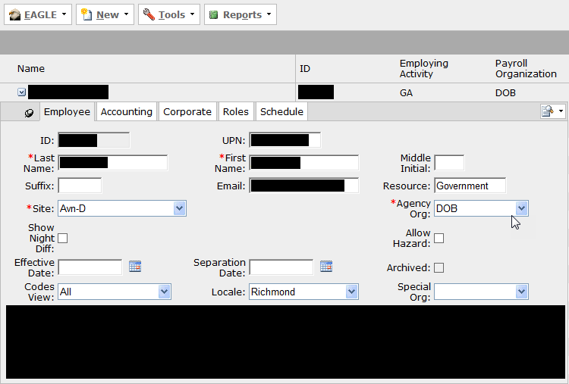
SSN is only available to DLA Payroll Centers of Excellence (CoE) Customer Service Representatives (CSR). Shown here is the screen seen by non-CoE users.

