Slide 1
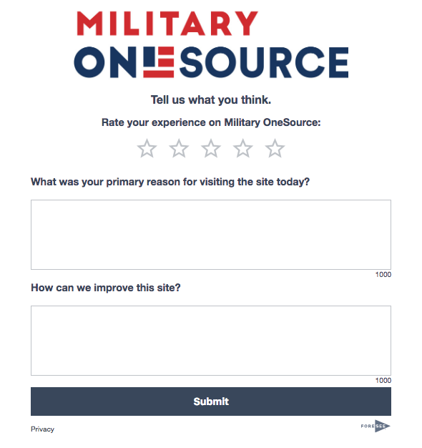
Draft Feedback Questionnaire
Rate your experience on Military OneSource
What was your primary reason for visiting the site today?
How can we improve this site?

