Slide 1
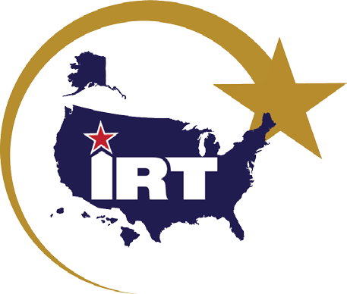
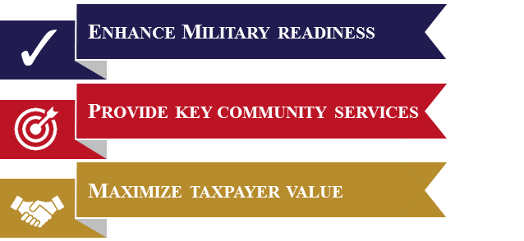
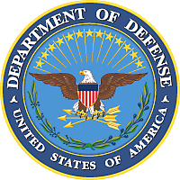
What is IRT?
Innovative Readiness Training (IRT) is a Department of Defense (DoD) military training opportunity, exclusive to the United States and its territories, that delivers joint training opportunities to increase deployment readiness. Simultaneously, IRT provides key services (health care, construction, transportation, and cybersecurity) with lasting benefits for our American communities.
Innovative Readiness Training
Military training that benefits DoD & American communities
Significance
Hands-on, real-world training to improve readiness and survivability in contingency environments
Sharing DoD and community resources creates cost efficiencies for both entities
Diverse military capabilities can directly address entrenched local challenges
Learn more at: http://irt.defense.gov Questions: osd.irt@mail.mil

Slide 2
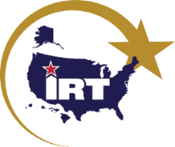
Program Authorities
10 U.S. Code §2012, Support & services for eligible organizations & activities outside Department of Defense
Department of Defense Directive 1100.20, Support & Services for Eligible Organizations & Activities Outside the Department of Defense
Military Service instructions & policies
Military Participation
The Military Services select missions based on military training needs and value
The Military Services may apply for IRT funding to augment training budgets
Military Services that use this authority without Office of the Secretary of Defense (OSD) funding are required to submit a Notice of Intent to Train
*Applications received after the September 30 deadline are unlikely to be matched until the next mission planning cycle.
IRT Partnerships may be Requested by
Government entities
Federal, regional, state, local
State or federally recognized tribes
Youth & charitable organizations specified in law (32 U.S. Code §508)
Other organizations reviewed for eligibility by the Department of Defense upon request by the Military Services
Community (Partner) Responsibilities
Written request for support (IRT form)
Sustainable vision
Non-competition with the private sector
Liability release, hold-harmless agreement
Designs, blueprints, property access
Construction materials
National Environmental Policy Act
Medical credentialing & privileging
Additional partners, donors, & volunteers
Strong Applications are
Aligned to military training requirements
Submitted on time, complete, & signed
Low risk for schedule change
Flexible scope & complexity
Opportunities to train many skill sets at the same time
Opportunities for joint, total force, interagency, & multinational teams to train together
Opportunities to integrate with community personnel & resources
IRT is not for
Missions with no military training value
Law enforcement
Response to natural or manmade disasters
Commercial development
For smaller community projects, Military Services may expedite the timeline if no DoD IRT funds are requested
IRT is a collaborative program that that leverages military contributions and community resources to multiply value and cost savings for participants.
Learn more at: http://irt.defense.gov Questions: osd.irt@mail.mil

