Slide 1
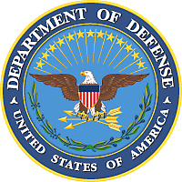
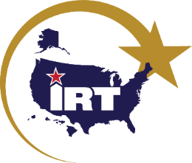
Innovative Readiness Training
Innovative Readiness Training (IRT) is a Department of Defense (DoD) military training opportunity, exclusive to the United States and its territories, that delivers joint training opportunities to increase deployment readiness. Simultaneously, IRT provides key services with lasting benefits for our American communities.
Building Civil-Military Partnerships
Providing Key Services
Construction
Roads, buildings, refurbishments
Build community relationships
Build partnerships
Ensure military readiness
Leverage resources
Medical
Optometry (including eyeglasses), medical services
Military
Community
Dental
Cleanings, fillings, extractions
Fulfill training requirements
Provide essential services
Veterinary
Neutering, basic veterinary exams
Leveraging Resources
IRT is a collaborative program that that leverages military contributions and community resources to multiply value and cost savings for participants. Communities typically provide materials (e.g. construction materials) and basic services (e.g. facilities).
Cybersecurity
Cyber health assessments, scenario-based exercises
Aerial Spray
Crop dusting, mosquito reduction
Authorized under: 10 U.S. Code §2012, Support & services for eligible organizations & activities outside Department of Defense
Learn more at: http://irt.defense.gov Questions: osd.irt@mail.mil

Slide 2
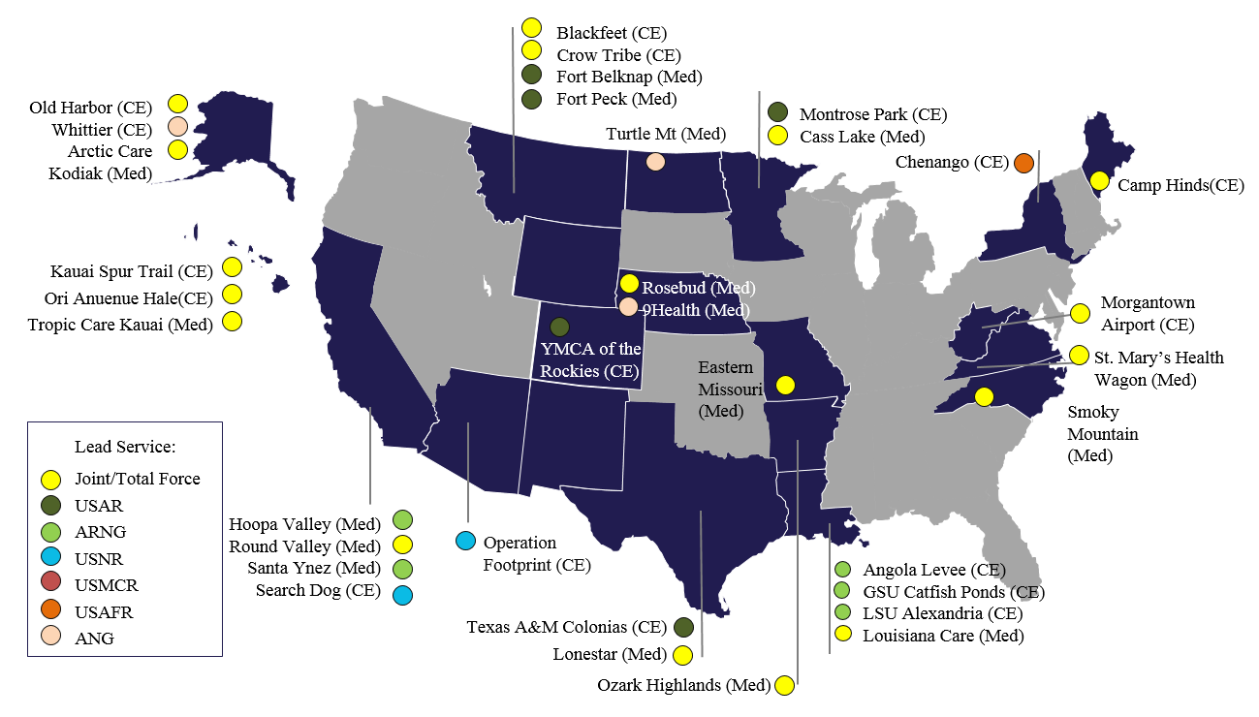
Innovative Readiness Training
Innovative Readiness Training (IRT) is a Department of Defense (DoD) military training opportunity, exclusive to the United States and its territories, that delivers joint training opportunities to increase deployment readiness. Simultaneously, IRT provides key services (health care, construction, transportation, and cybersecurity) with lasting benefits for our American communities.
2017 Mission Highlights
FY 2017 Program Summary
Arctic Care (AK) provided medical, dental, optometry, and veterinary training to over 175 military personnel, and services valued at $280k to over 3,900 underserved and uninsured patients from Kodiak Island.
Smoky Mountain Medical (NC) more than 200 sailors, soldiers and airmen worked with over 100 community partners to serve over 5,800 patients in Swain and Clay counties, including over 500 pairs of eyeglasses.
Camp Hinds Construction (ME) provided the Boy Scouts of America electrical services, road construction, and building renovations, as well as over 19,000 hands-on training hours to 260 service member over 14 weeks.
1
1
3
2
2
3
Community Timeline
(18 Months – 2 Years)
How To Apply
Apply here: http://irt.defense.gov/Applications.aspx
Questions: osd.irt@mail.mil
*Ask us how to connect with your local military unit to establish a partnership for smaller community projects.

