Slide 1
Appendix I: Courseware for FoodLogger Installation and Data Entry Training
This presentation is released to inform interested parties of research and to encourage discussion. The views expressed are those of the authors and not necessarily those of the U.S. Census Bureau.

Slide 2
Installing FoodLogger: iPhone Users
Go to the App Store on your phone
Search for “FoodLogger”
Download the free app
Open the FoodLogger app
Enter your household’s unique PIN to login
Review terms and conditions
Select your name from the dropdown menu and tap “Continue”
When asked, give FoodLogger permission to use your location
If asked, allow the FoodLogger to send you notifications

Slide 3
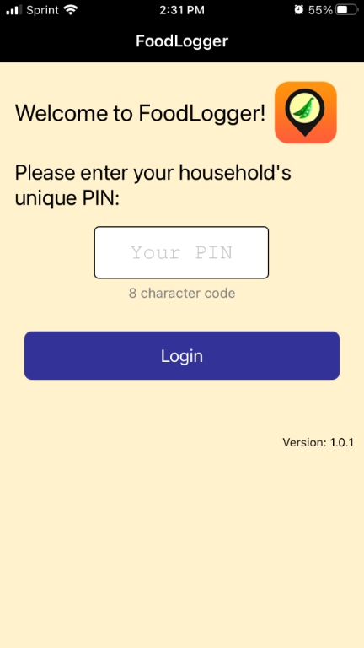
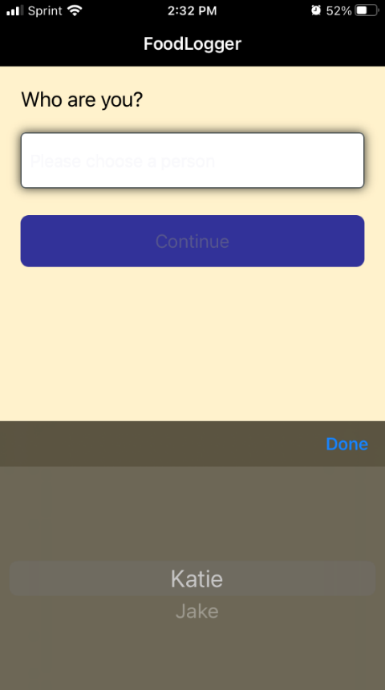
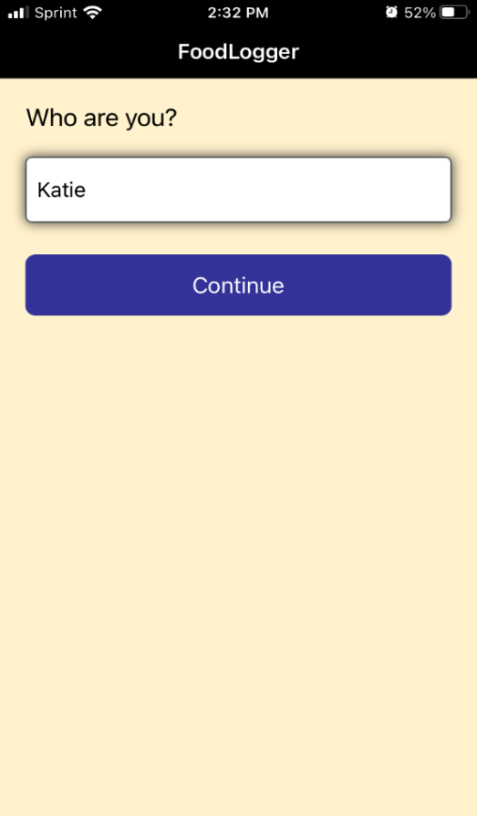
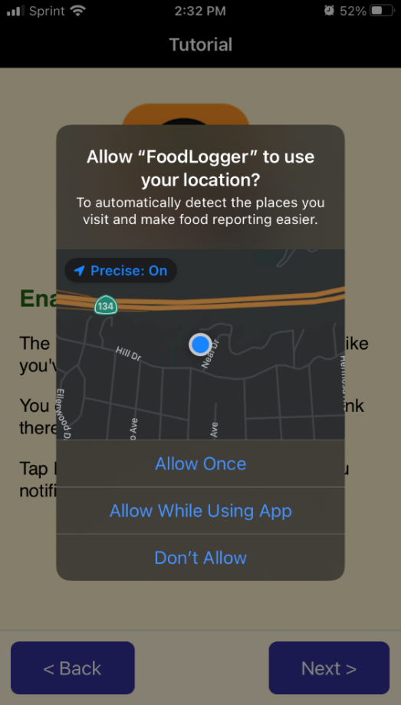
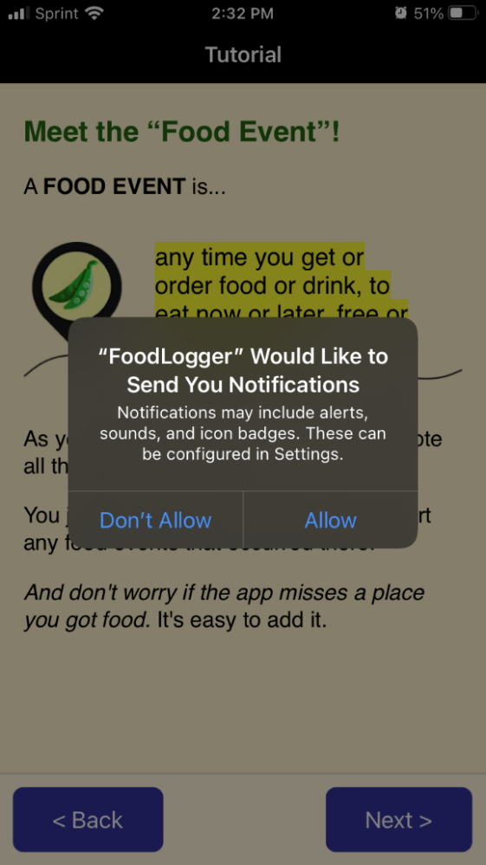
Download FoodLogger: iPhone Users (con’t)

Slide 4
Installing FoodLogger: Android Users
Go to the Google Play store on your phone
Search for “FoodLogger”
Download the free app
Open the FoodLogger app
Enter your household’s unique PIN to login
Review terms and conditions
Select your name from the dropdown menu and tap “Continue”
When prompted, give FoodLogger permission to access your device’s location
If asked, allow the FoodLogger to send you notifications

Slide 5
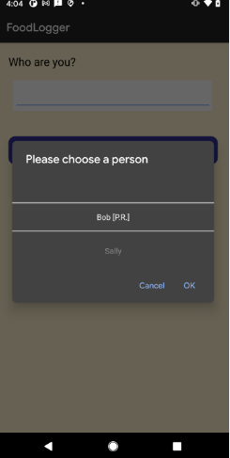
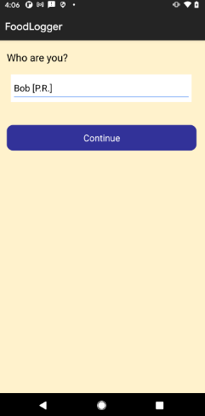
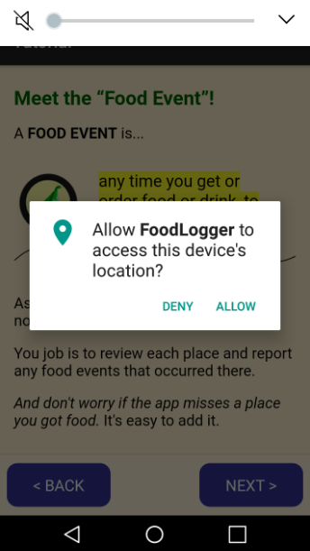
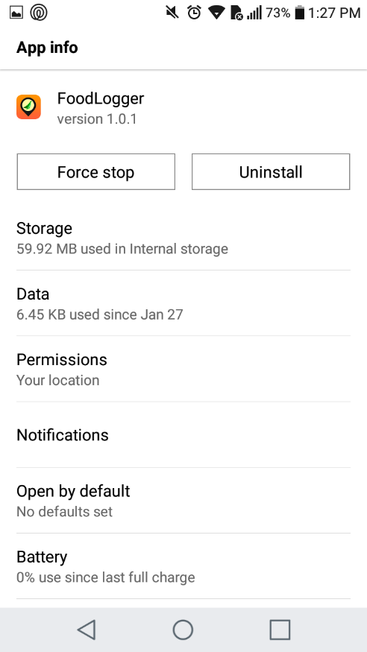
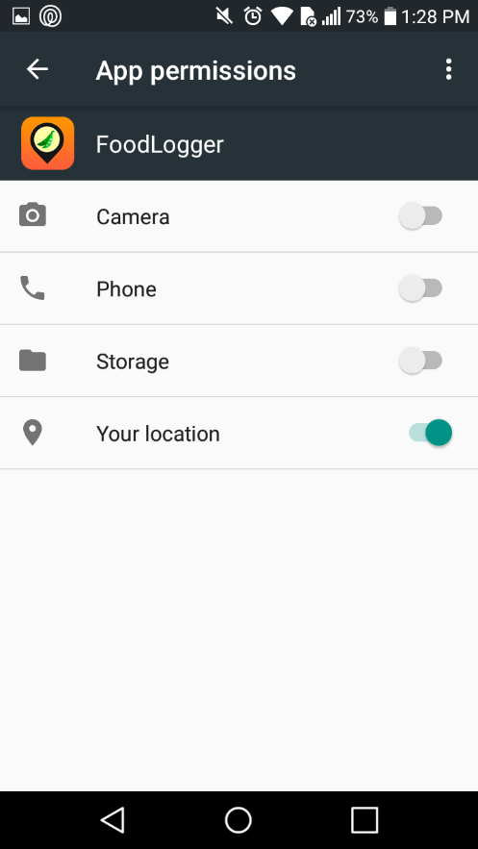
Download FoodLogger: Android Users (con’t)

Slide 6
Basic concepts
What is FoodLogger?
A mobile app running on a smartphone
A survey instrument – You will use it to report all the foods you will acquire over the next 7 days
What are foods?
Anything that you can eat or drink
The concept of food acquisition
Any food items that you get from outside of your home
Foods can be purchased or free
You may or may not eat those acquired foods while you are participating the study
In the next seven days, if you eat a food item (e.g., a bagel) that was acquired before today, this item cannot be counted in food acquisition.

Slide 7
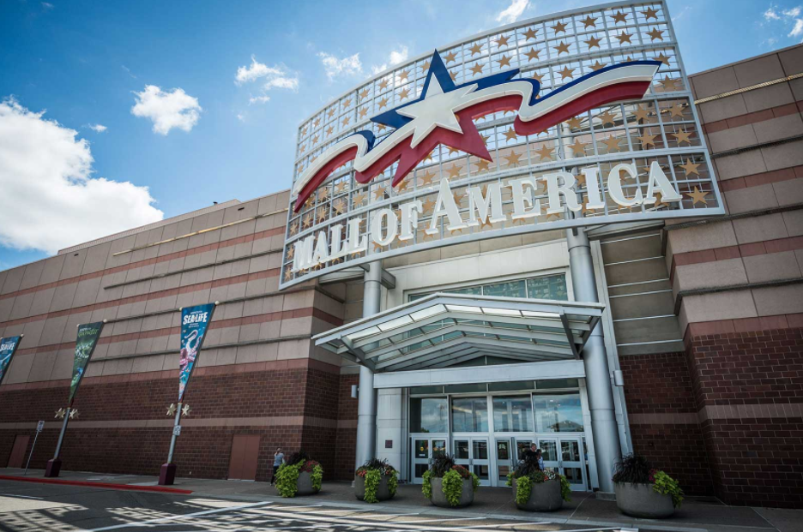
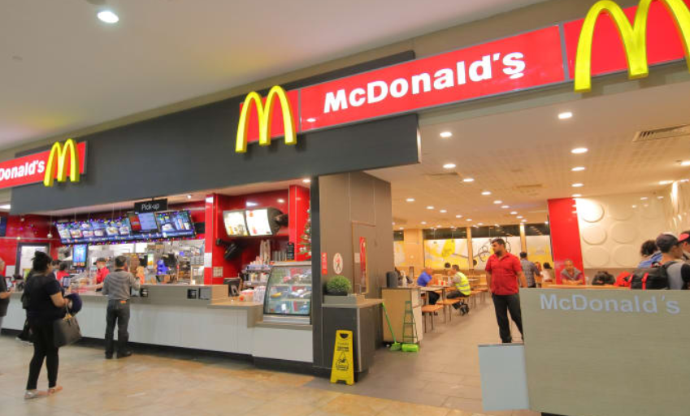
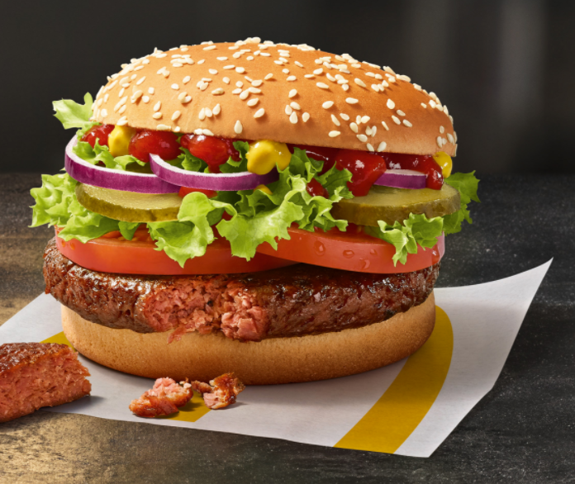
Basic concepts (con’t)
DAY
Day 1
Day 2
Day 3
Day 4
Day 5
Day 6
Day 7
STOP
Stop 1
Stop 2
Stop F
FOOD EVENT
Food Event 1
Food Event 2
Food Event K
FOOD ITEM
Food Item 2
Food Item 1
Food Item N

Slide 8
Basic concepts (con’t)
A food item has:
Name (e.g., Apple)
Weight/Volume/Size (e.g., 5 lb, 20 fl oz, 1 serving)
Cost (free item has the cost of $0)
Multiple same food items also have:
Count/quantity (e.g., 5 bottles of water)
A food event has:
Payment (free event has a payment of $0)

Slide 9
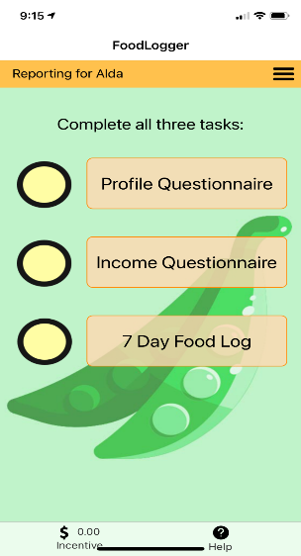
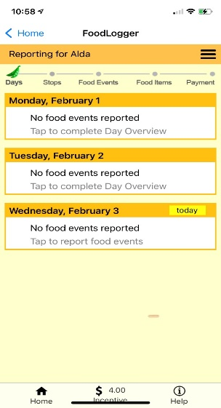
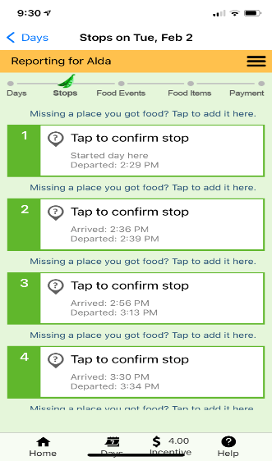
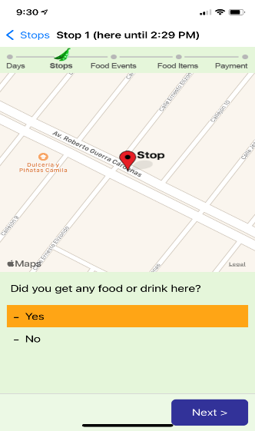
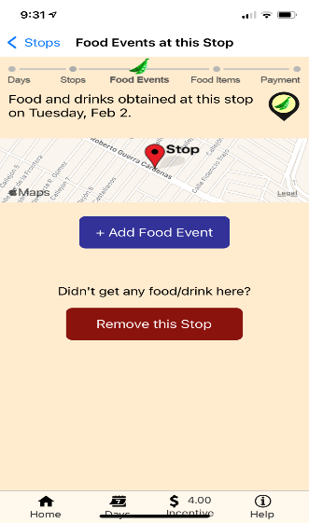
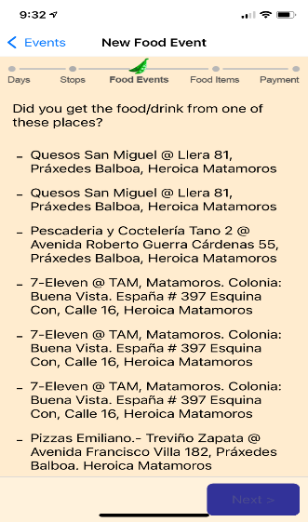
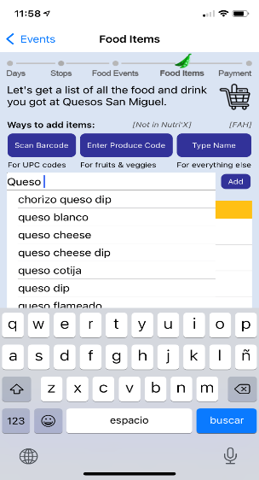
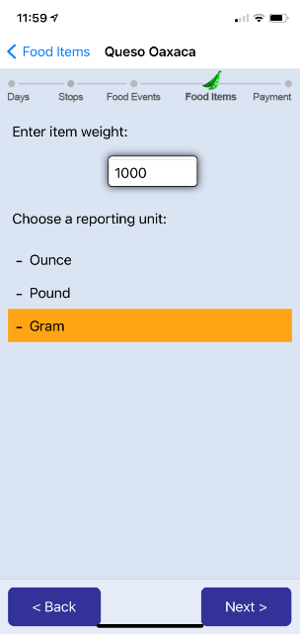
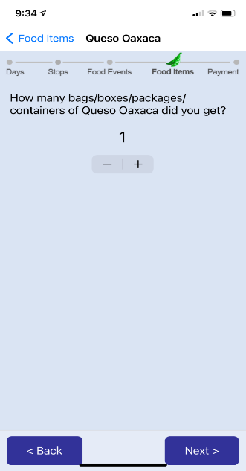
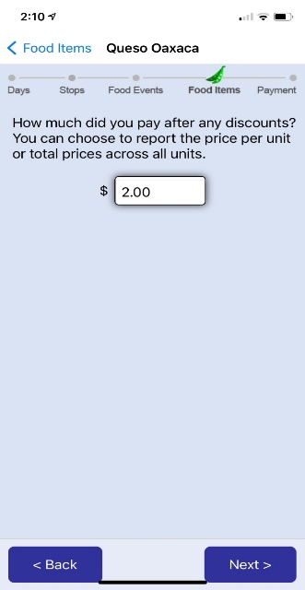
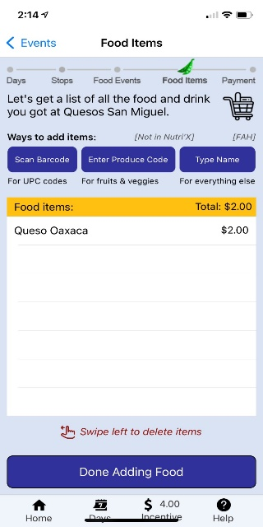
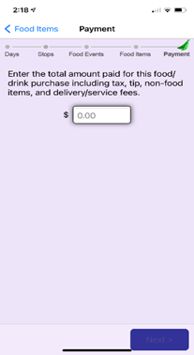
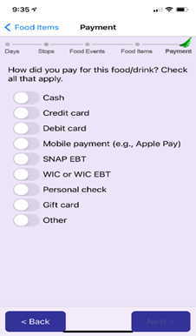
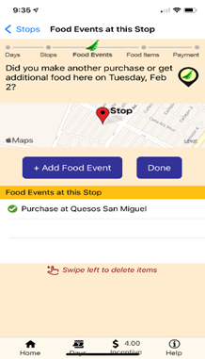
Data Entry Workflow

Slide 10
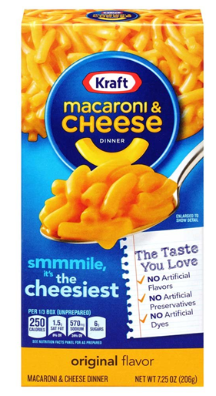
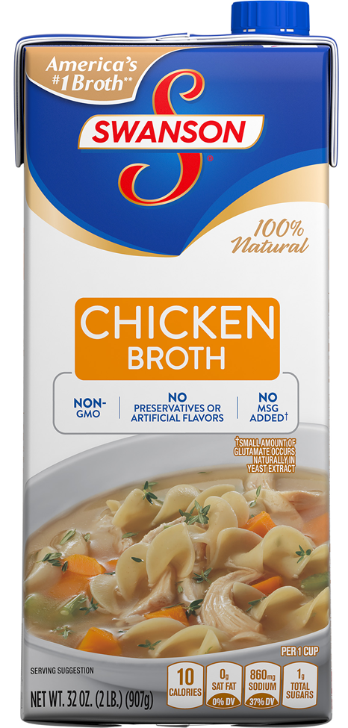
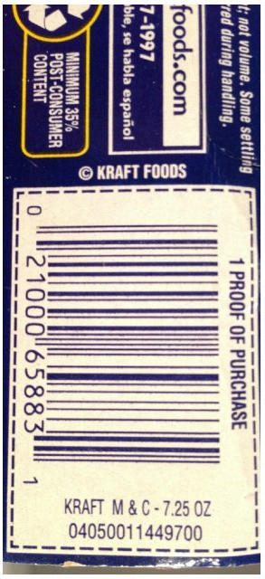
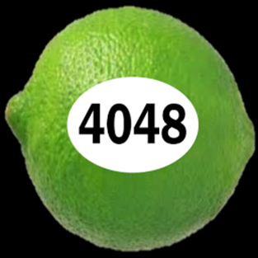
Practice (I)
Start a day
Add a food stop manually
Add a food event manually
Enter item name
Barcode
PLU
Text
Enter weight/volume
Enter number of items
Enter payment
Single item
Multiple items
Payment modes

Slide 11
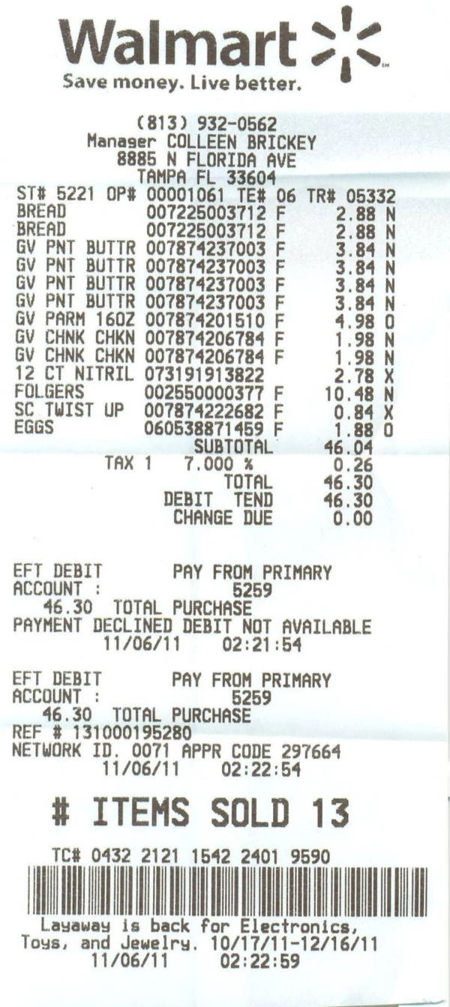
Practice (II)

Slide 12
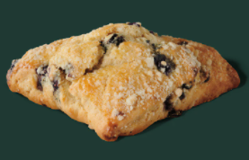
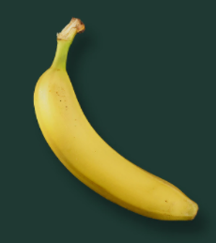
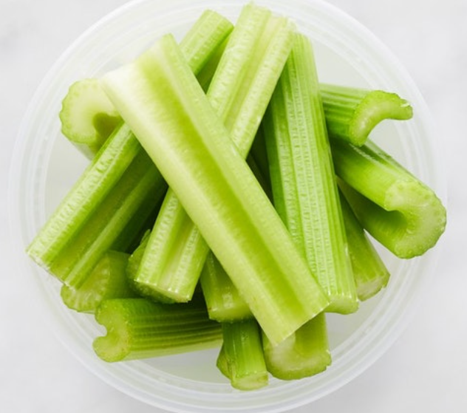
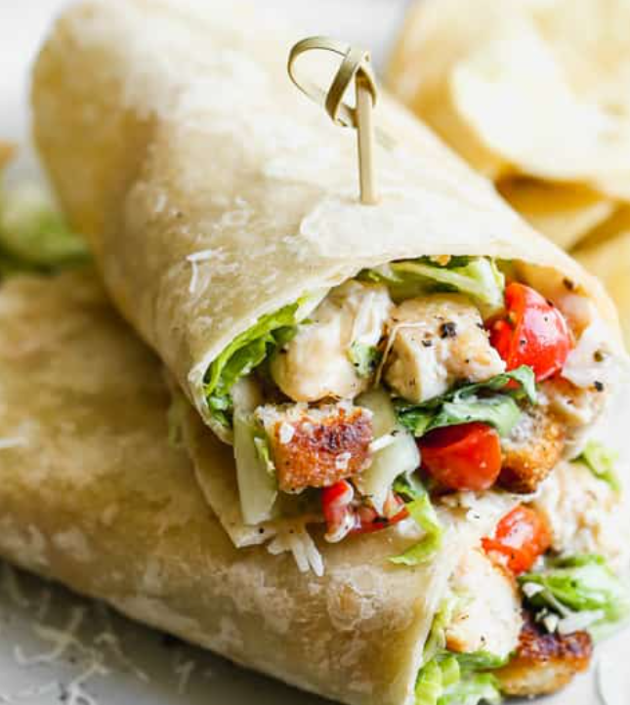
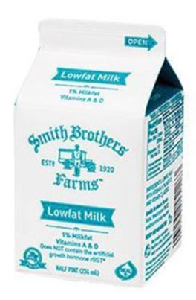
Practice (III)
Breakfast at Starbucks
One Blueberry Scone ($2.40)
One Banana ($0.90)
One Caffe Latte (tall, $3.50)
School lunch (combo, free)
Chicken Caesar Wrap
Celery Sticks
One Fresh Orange
1% White Milk (Half Pint)

Slide 13
Exercise
Pick 5 items from your pantry, and enter the food information into the FoodLogger

Slide 14
Profile and Income Information
Complete these two questionnaires by yourself.
Use FAKE data to complete these to questionnaires.
Do not enter your actual personal information!

Slide 15
Assignment
Teach your child participant how to use FoodLogger to enter the foods he/she acquires, for example, school meals.

