Slide 1
I-539, Application To Extend/Change Nonimmigrant Status
United States Citizenship and Immigration Services
myUSICS Team
January 2019
Screenshots

Slide 2
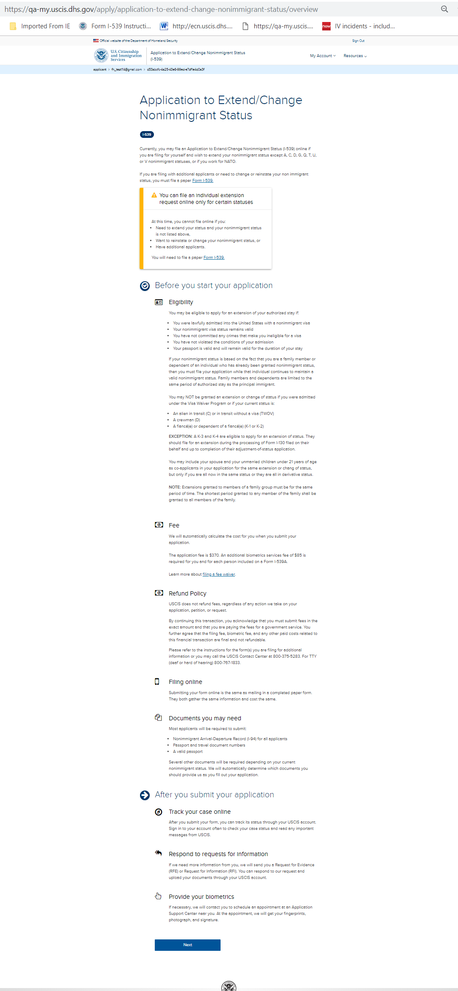
I-539: Application Overview

Slide 3
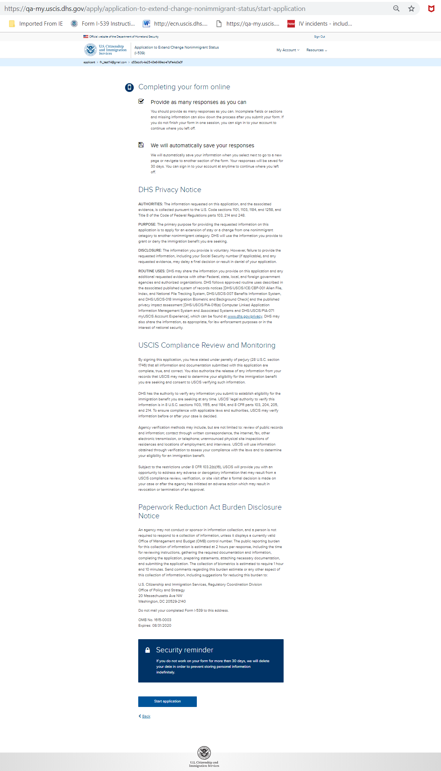
I-539: Start Application

Slide 4
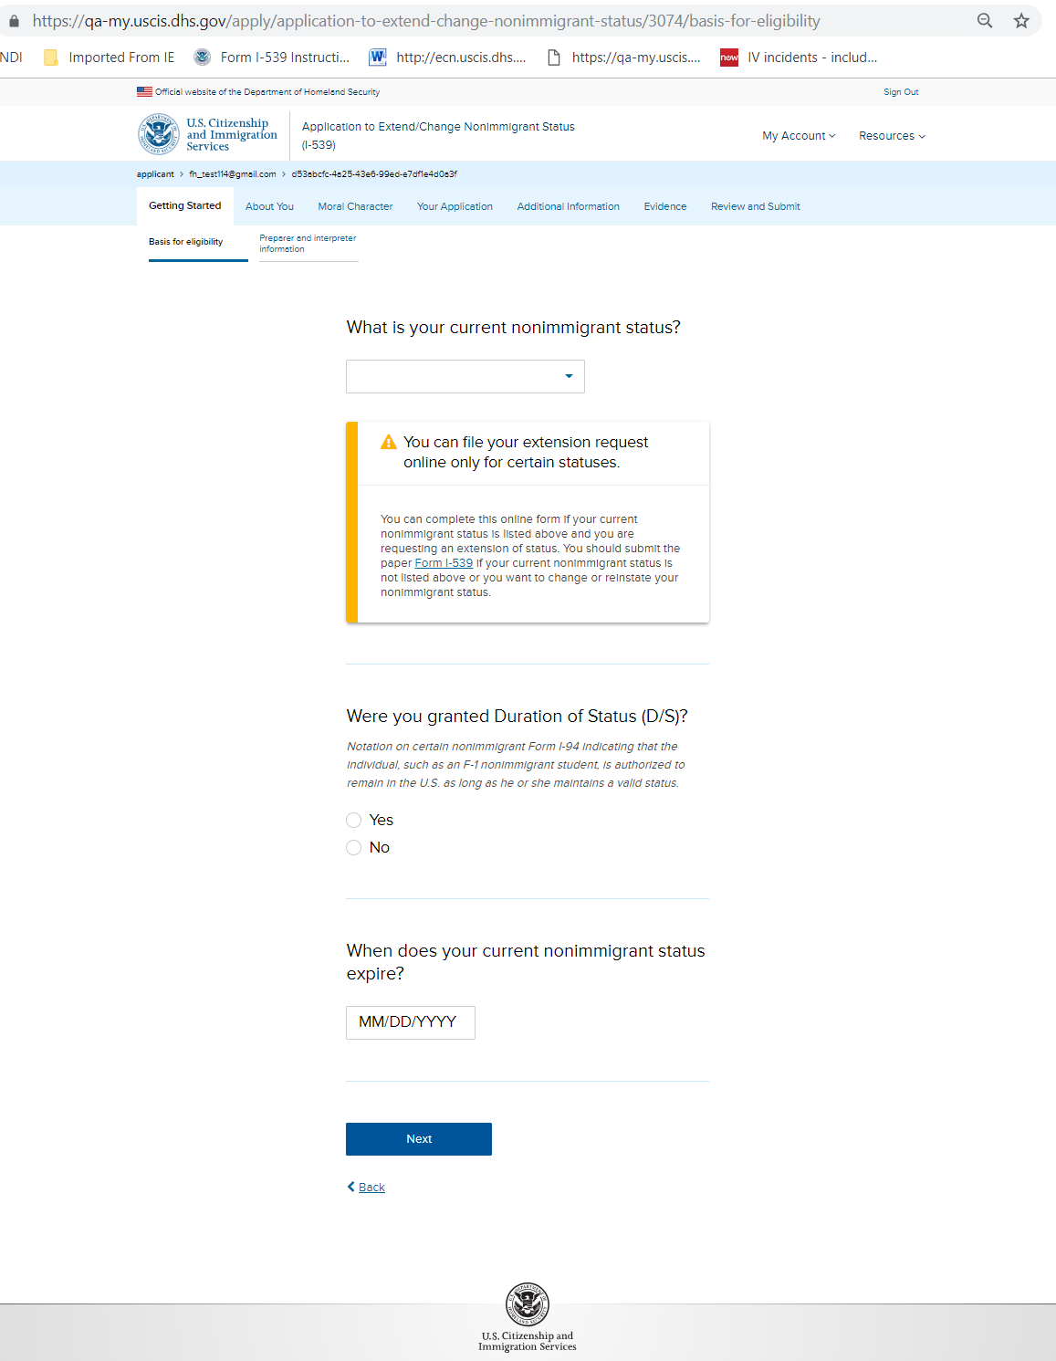
I-539: Getting Started – Basis for eligibility

Slide 5
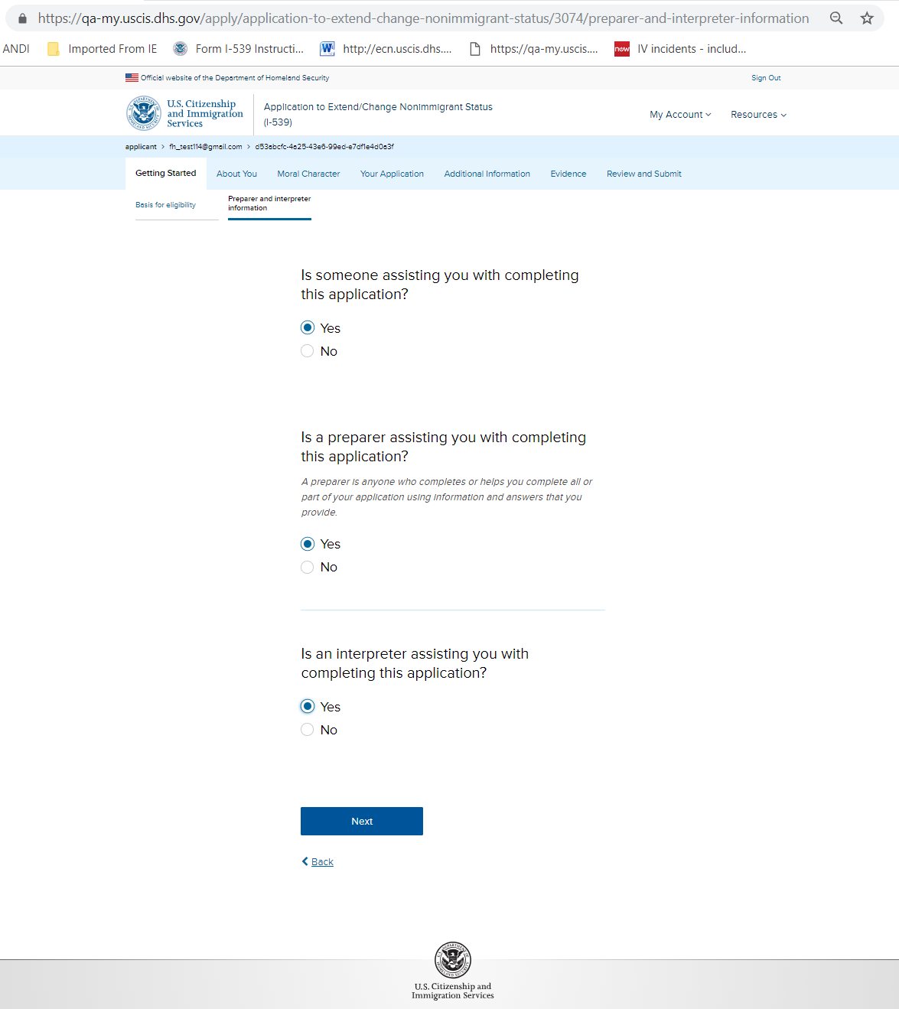
I-539: Getting Started – Preparer and interpreter information

Slide 6
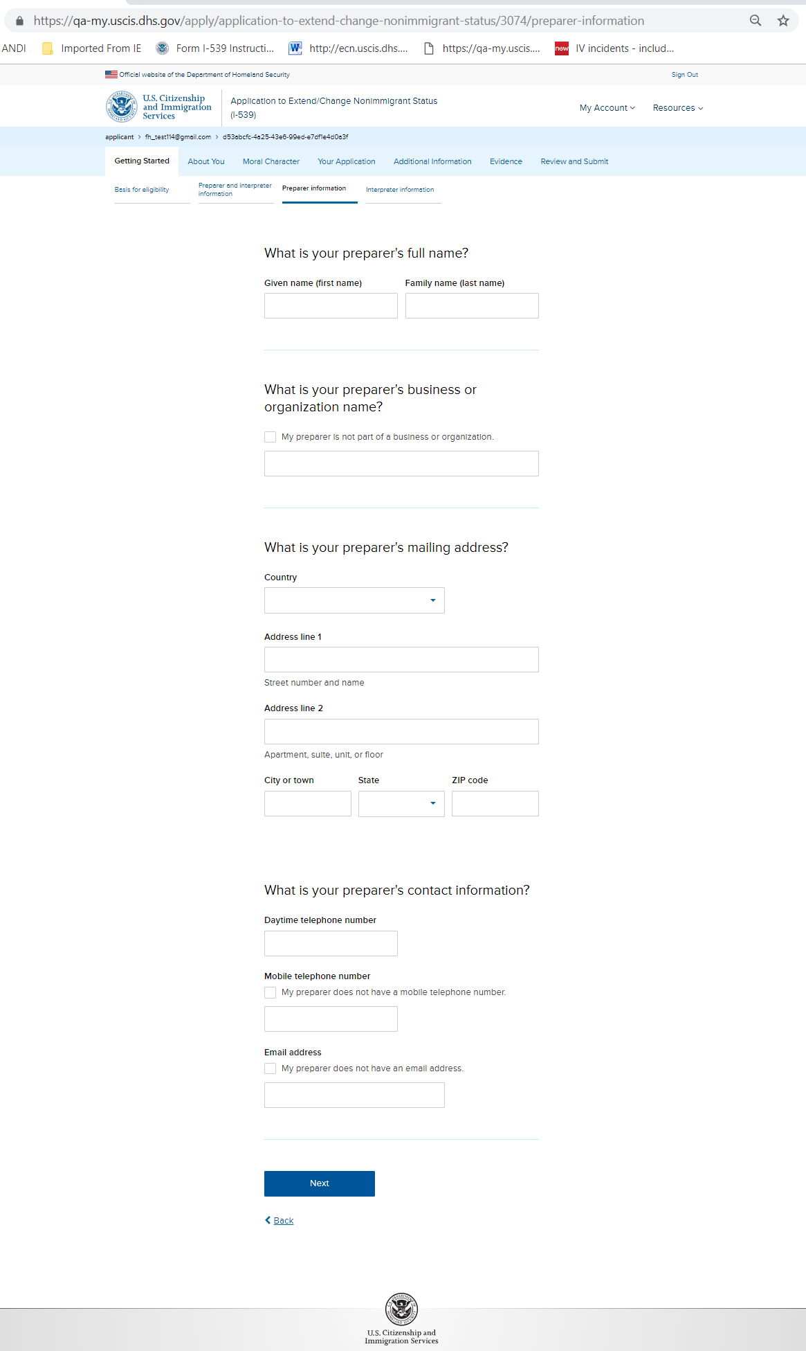
I-539: Getting Started – Preparer information

Slide 7
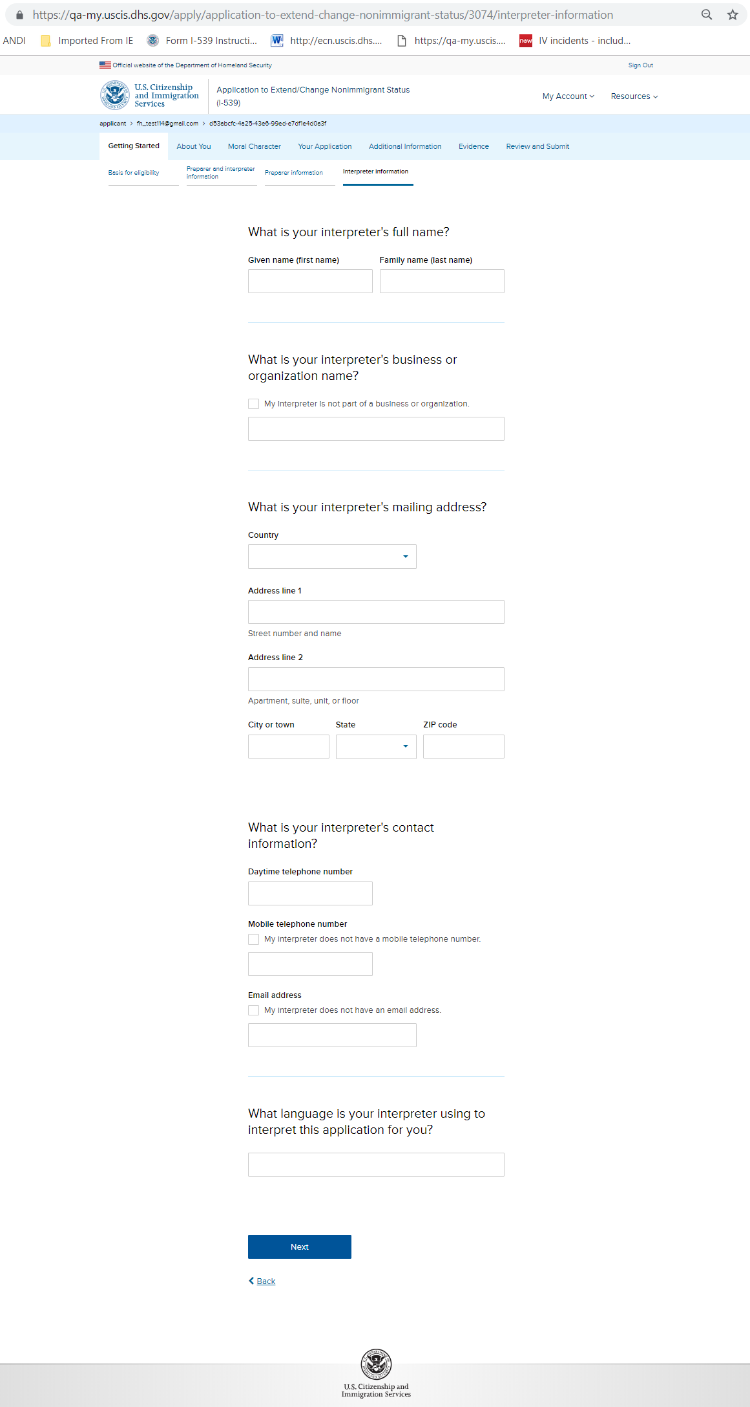
I-539: Getting Started – Interpreter information

Slide 8
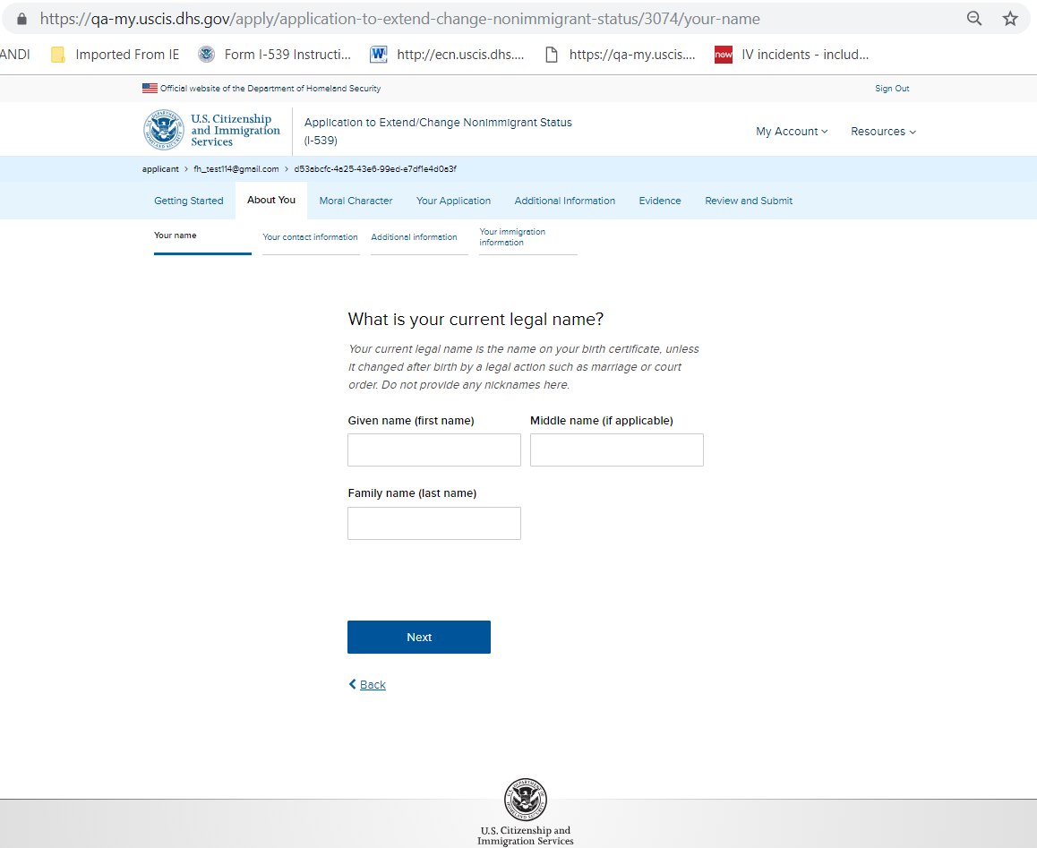
I-539: About You – Your name

Slide 9
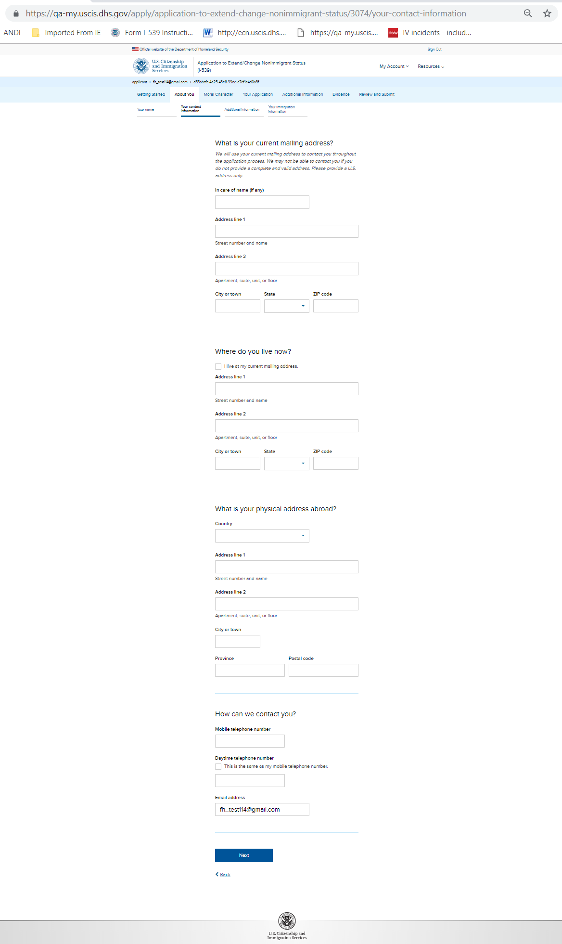
I-539: About You – Your contact information

Slide 10
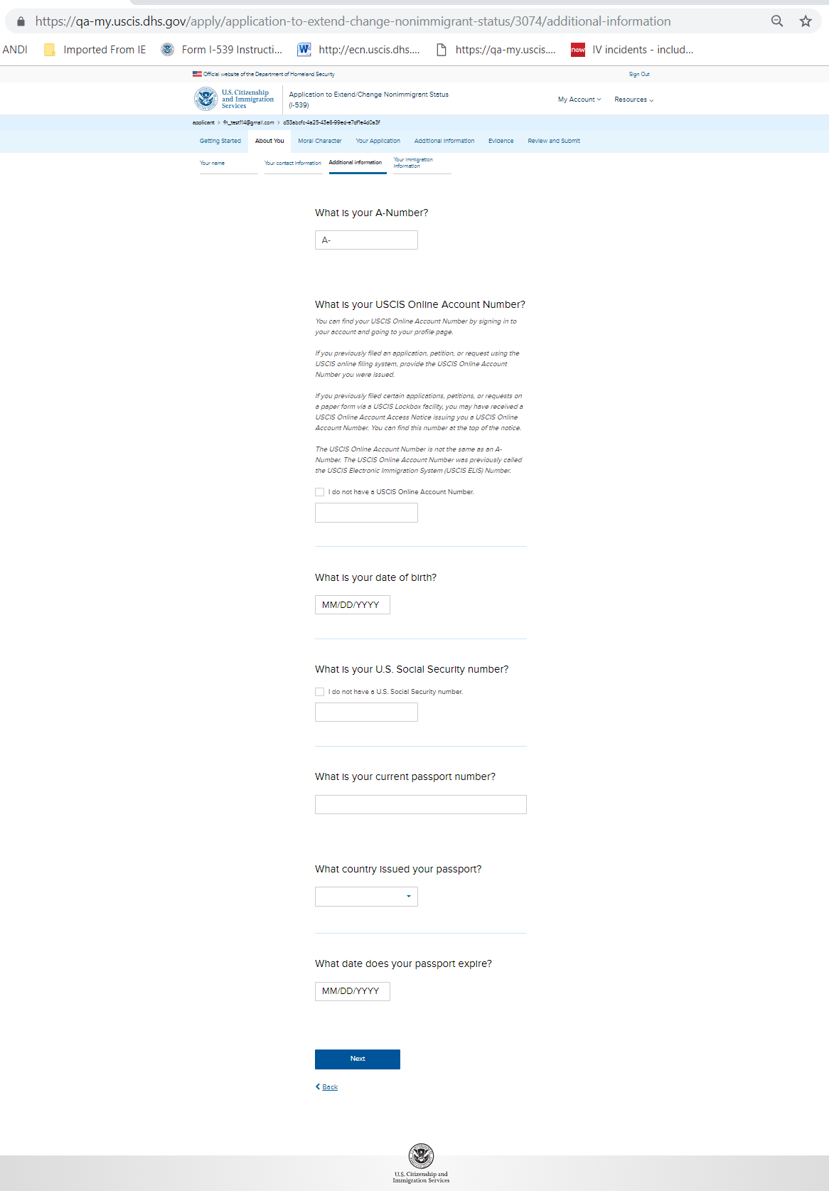
I-539: About You – Additional information

Slide 11
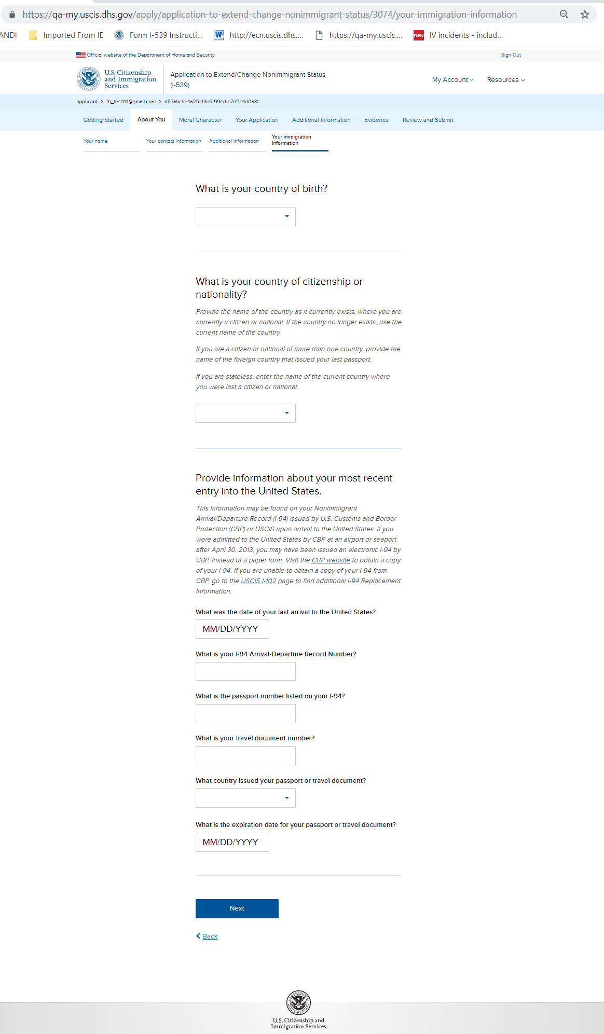
I-539: About You – Your immigration information

Slide 12
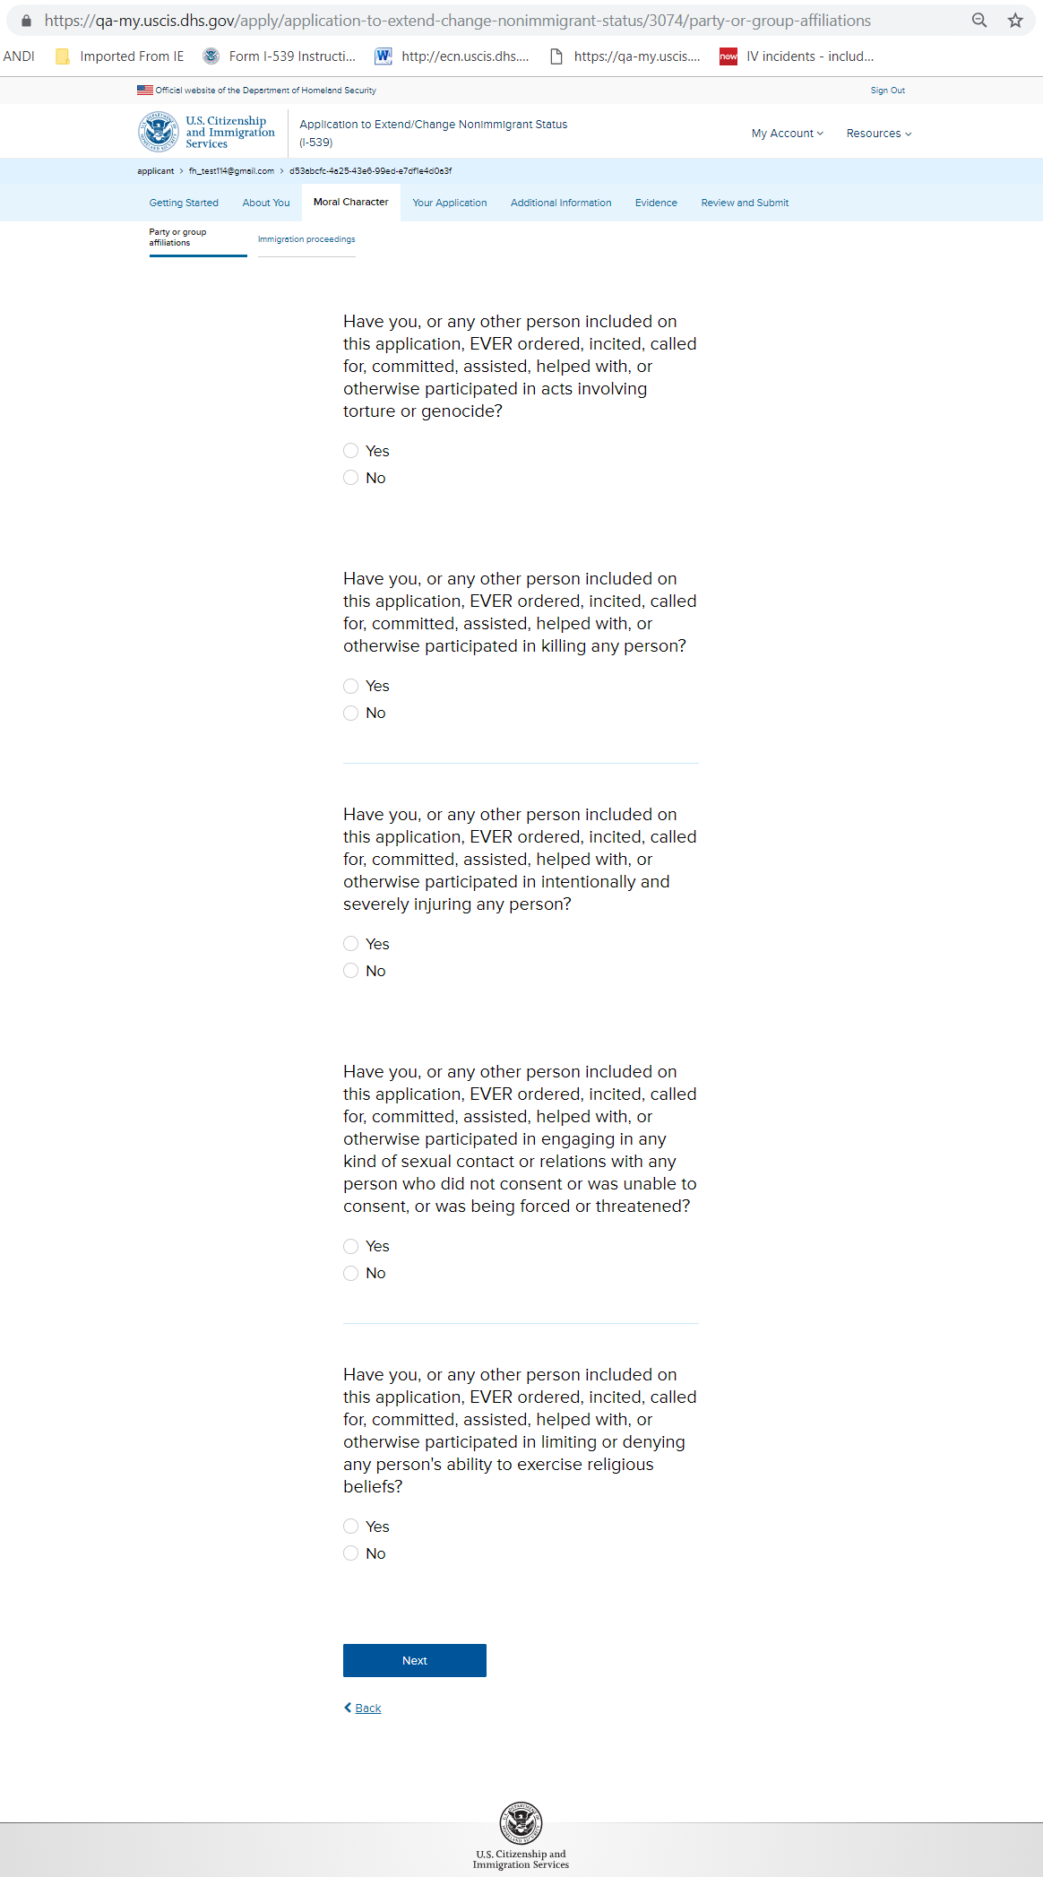
I-539: Moral Character – Party or group affiliations

Slide 13
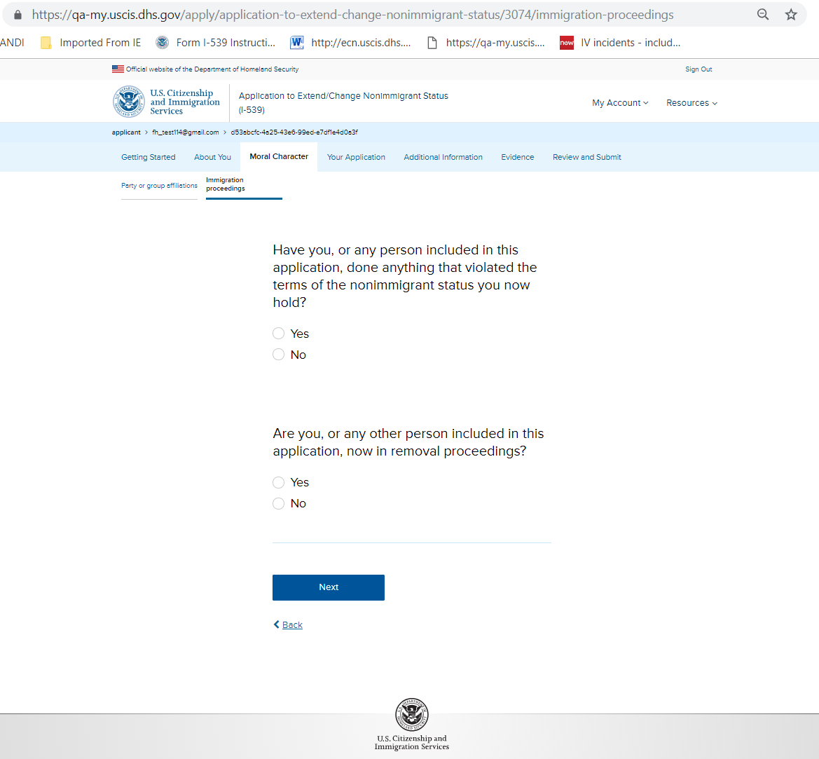
I-539: Moral Character – Immigration Proceedings

Slide 14
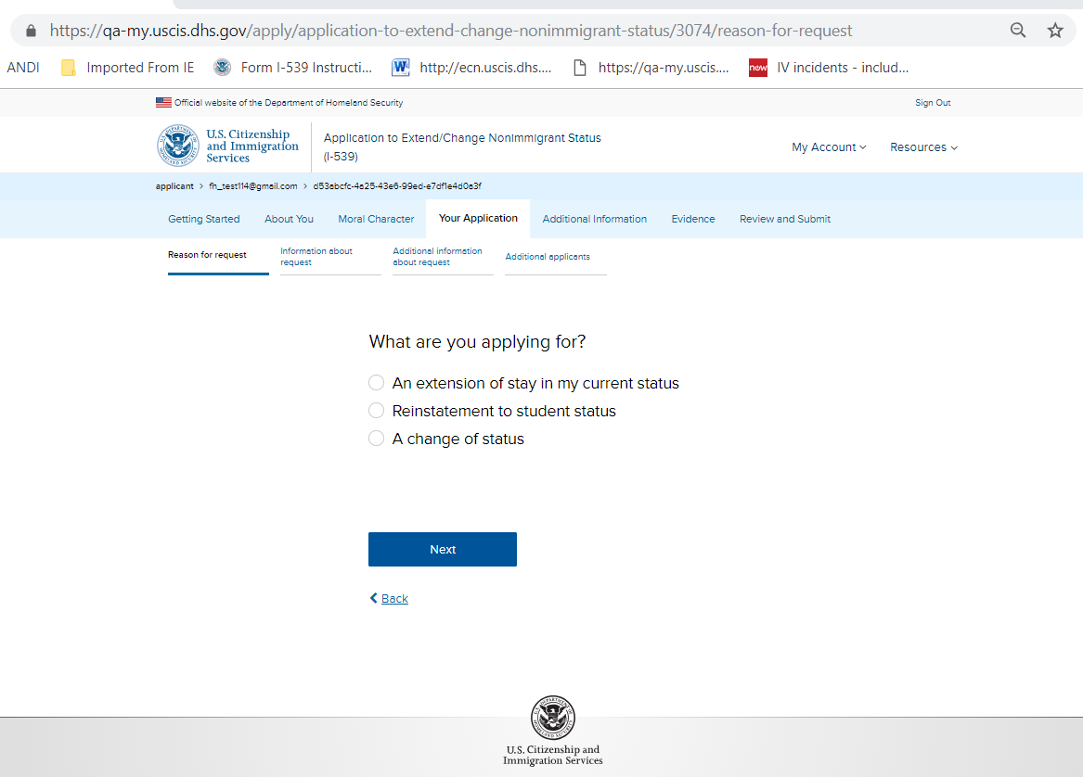
I-539: Your Application – Reason for request (without hard stop)

Slide 15
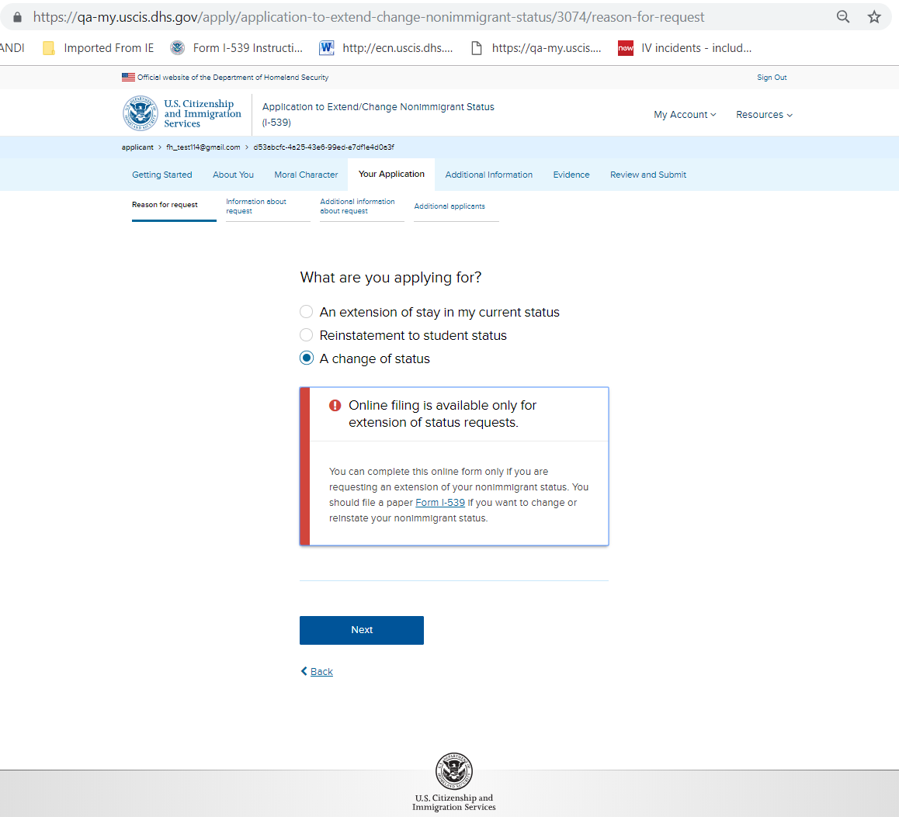
I-539: Your Application – Reason for request (with hard stop)

Slide 16
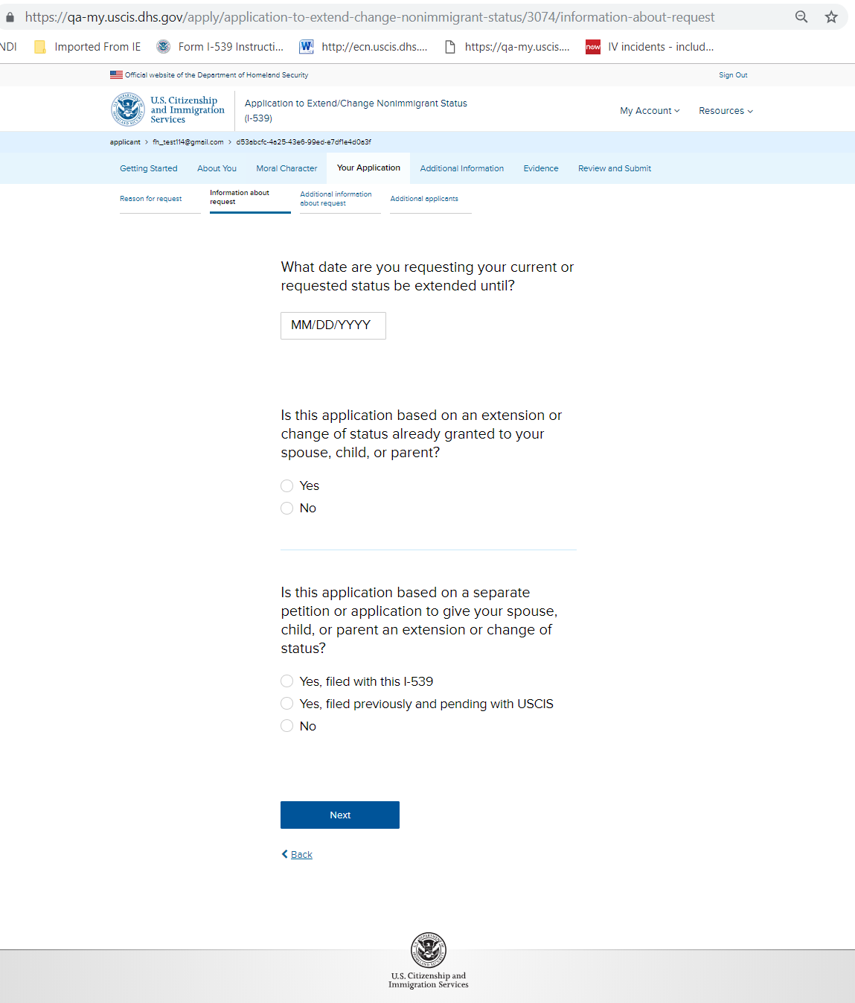
I-539: Your Application – Information about request

Slide 17
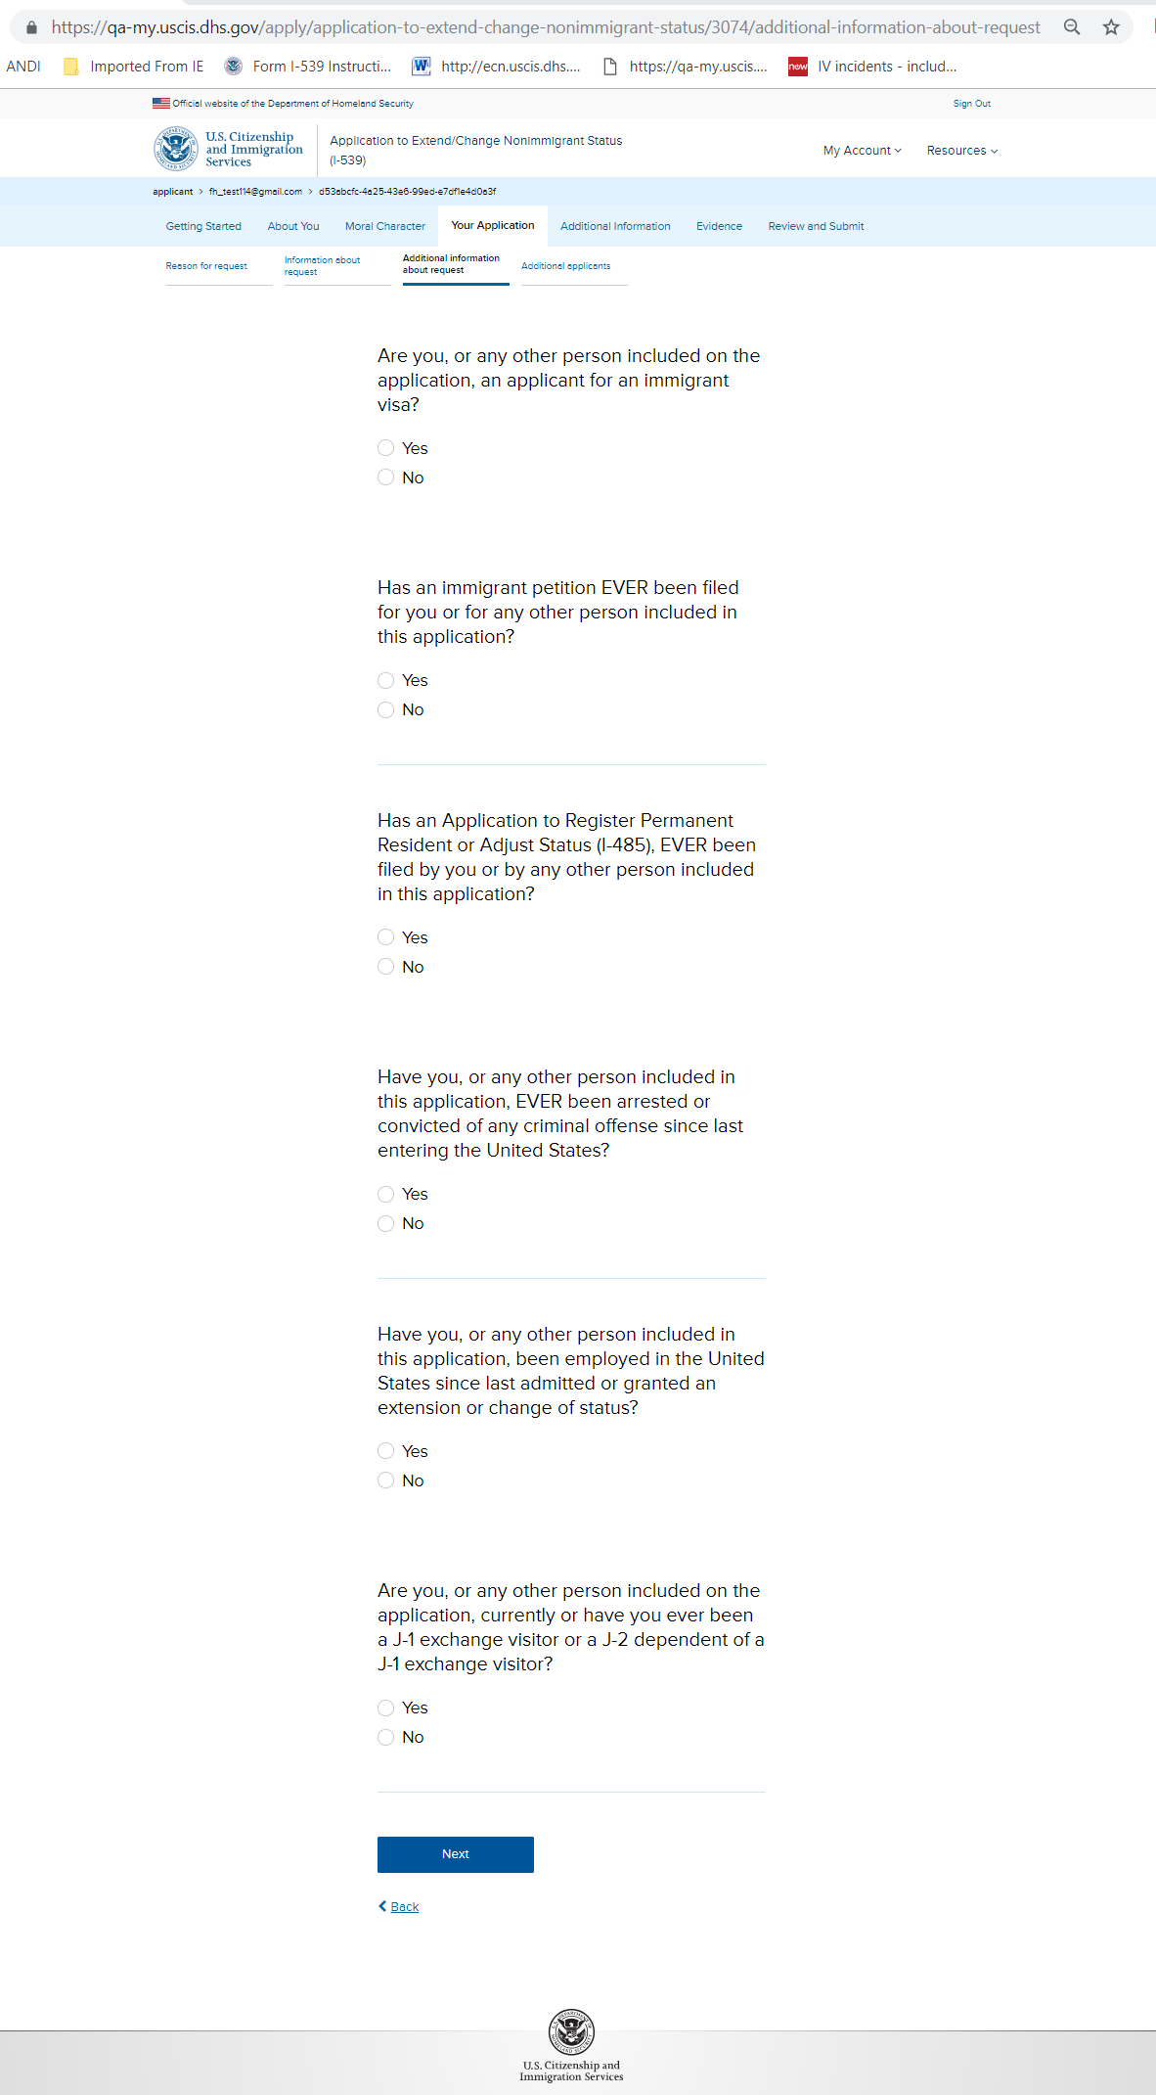
I-539: Your Application – Additional information about request

Slide 18
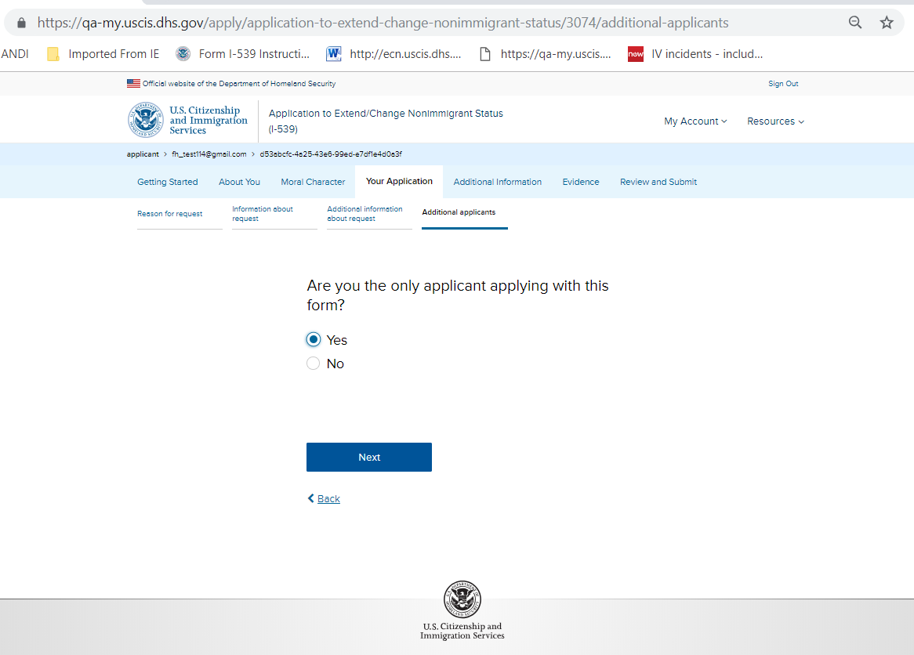
I-539: Your Application – Additional applicants (without hard stop)

Slide 19
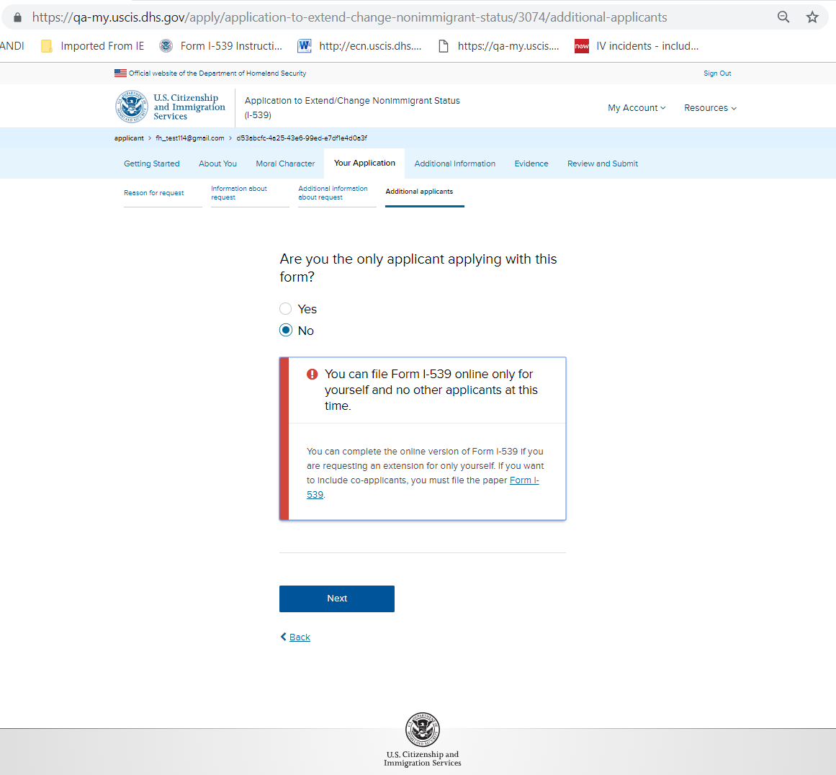
I-539: Your Application – Additional applicants (with hard stop)

Slide 20
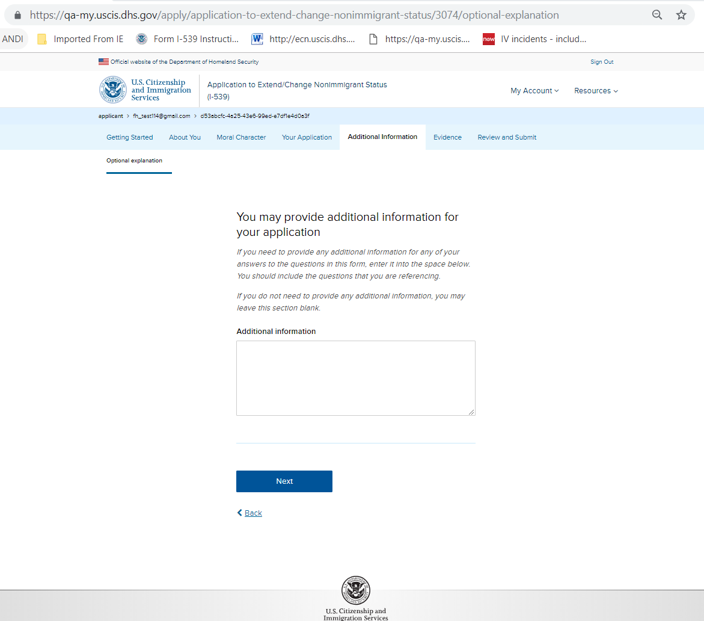
I-539: Additional Information – Optional explanation

Slide 21
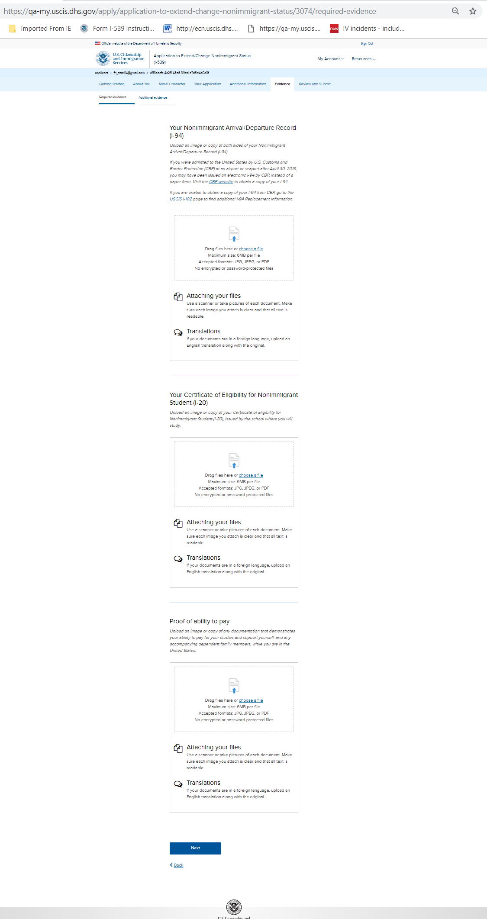
I-539: Evidence – Required evidence

Slide 22
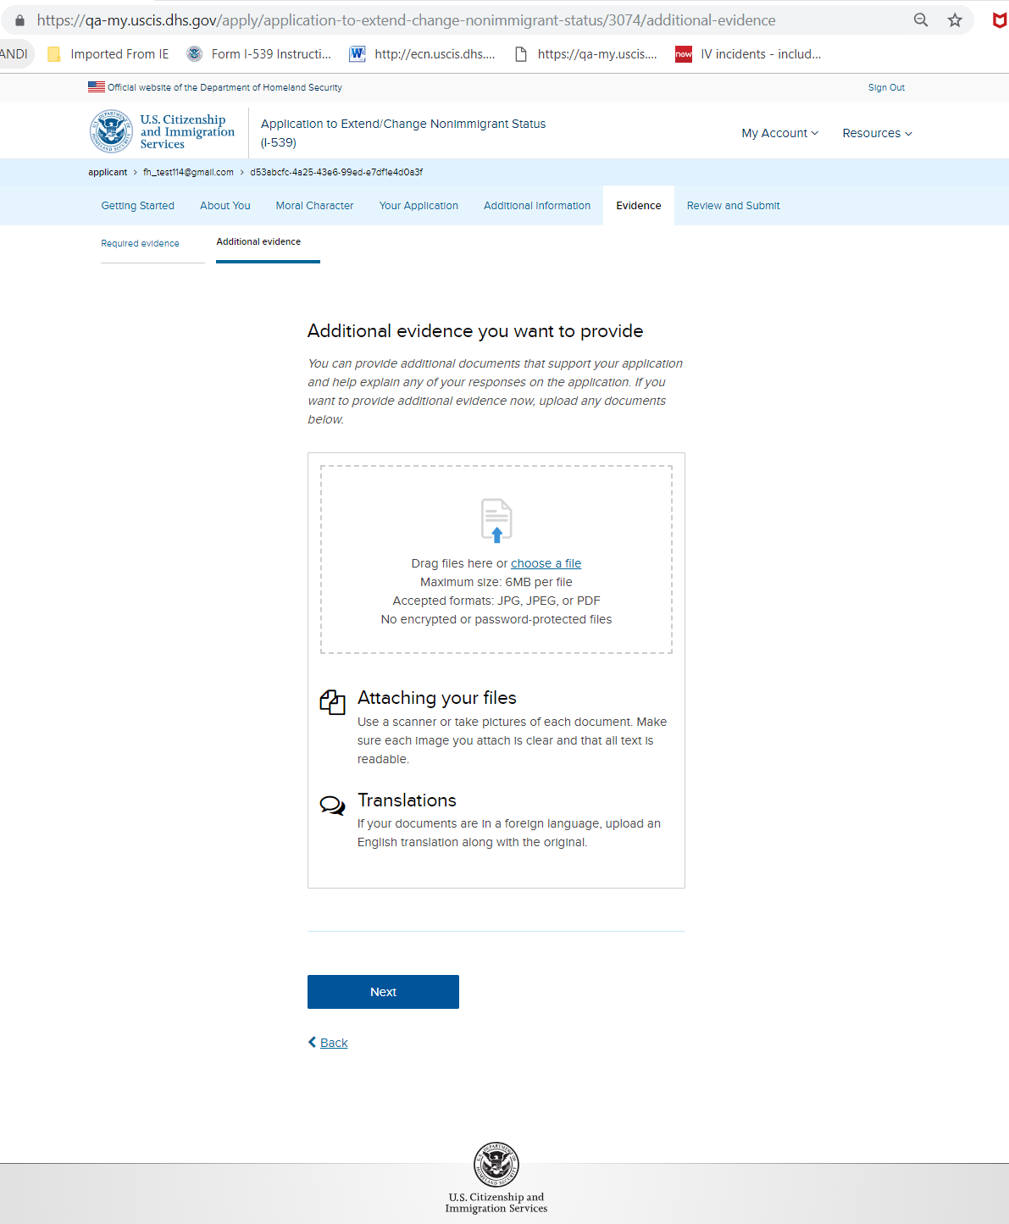
I-539: Evidence – Additional evidence

Slide 23
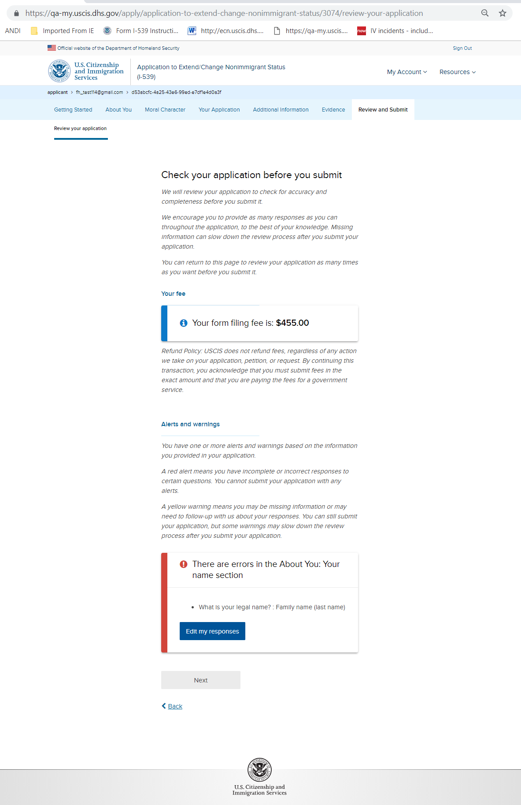
I-539: Review and Submit – Review your application (with hard stop)

Slide 24
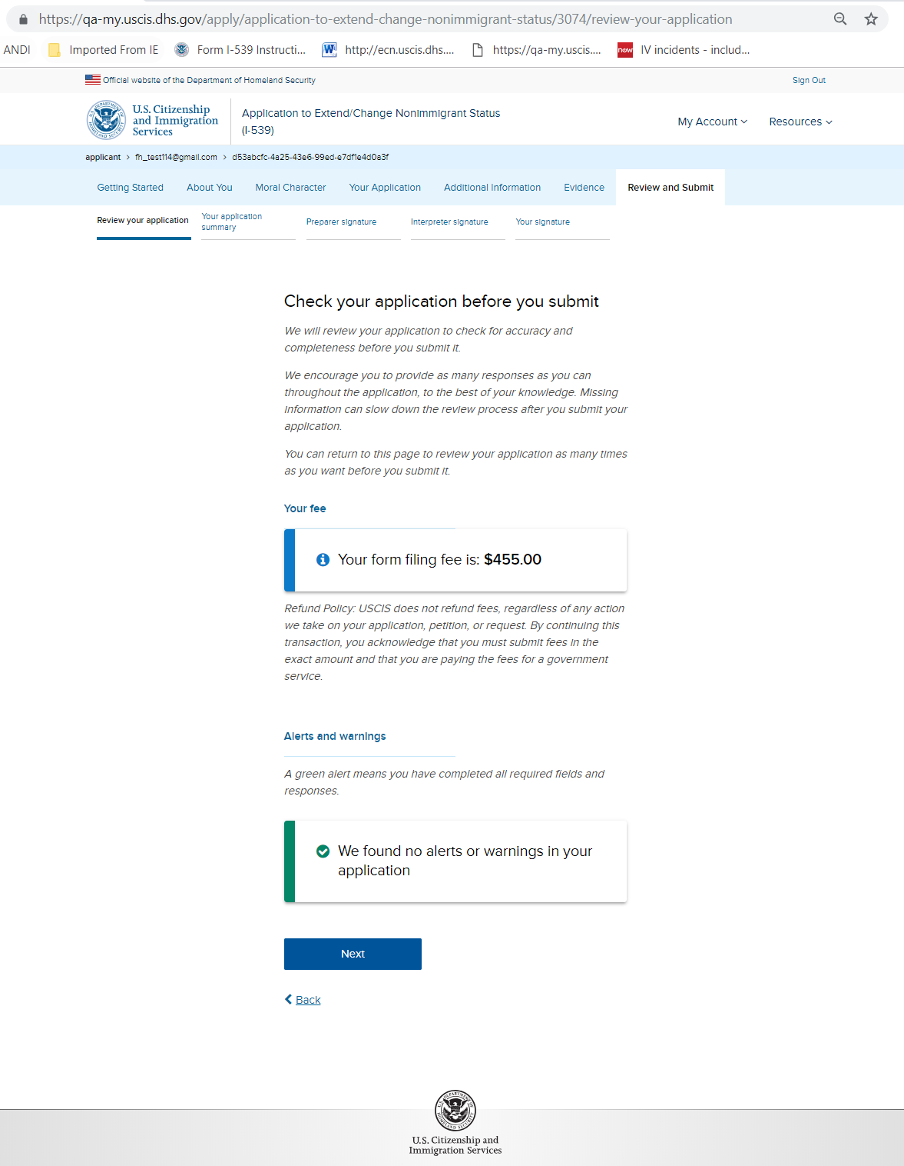
I-539: Review and Submit – Review your application (without hard stop)

Slide 25
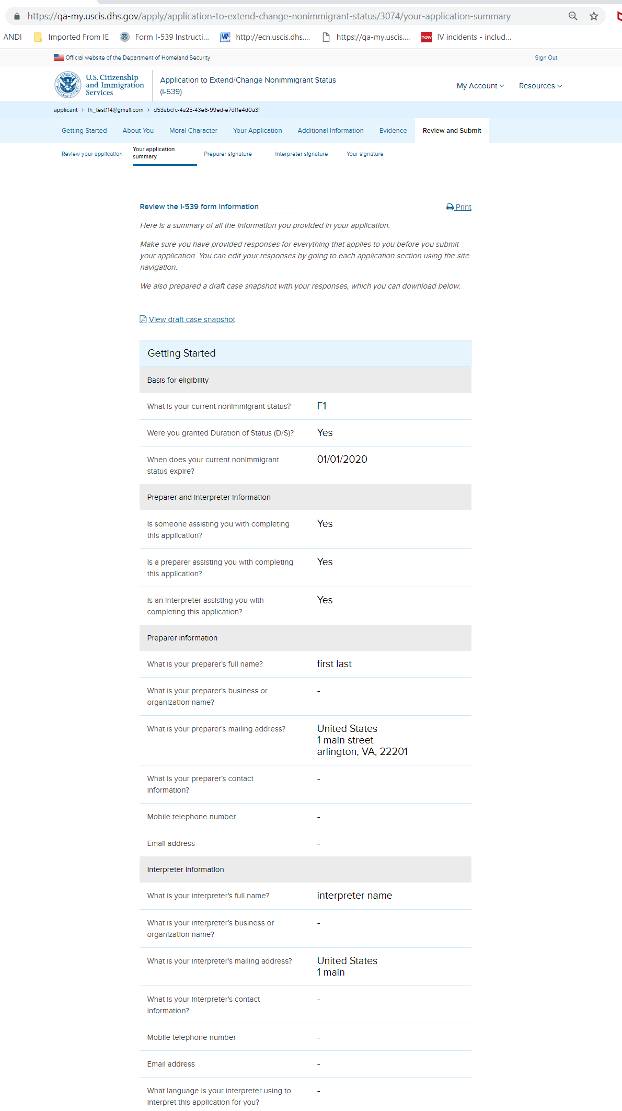
I-539: Review and Submit – Your application summary

Slide 26
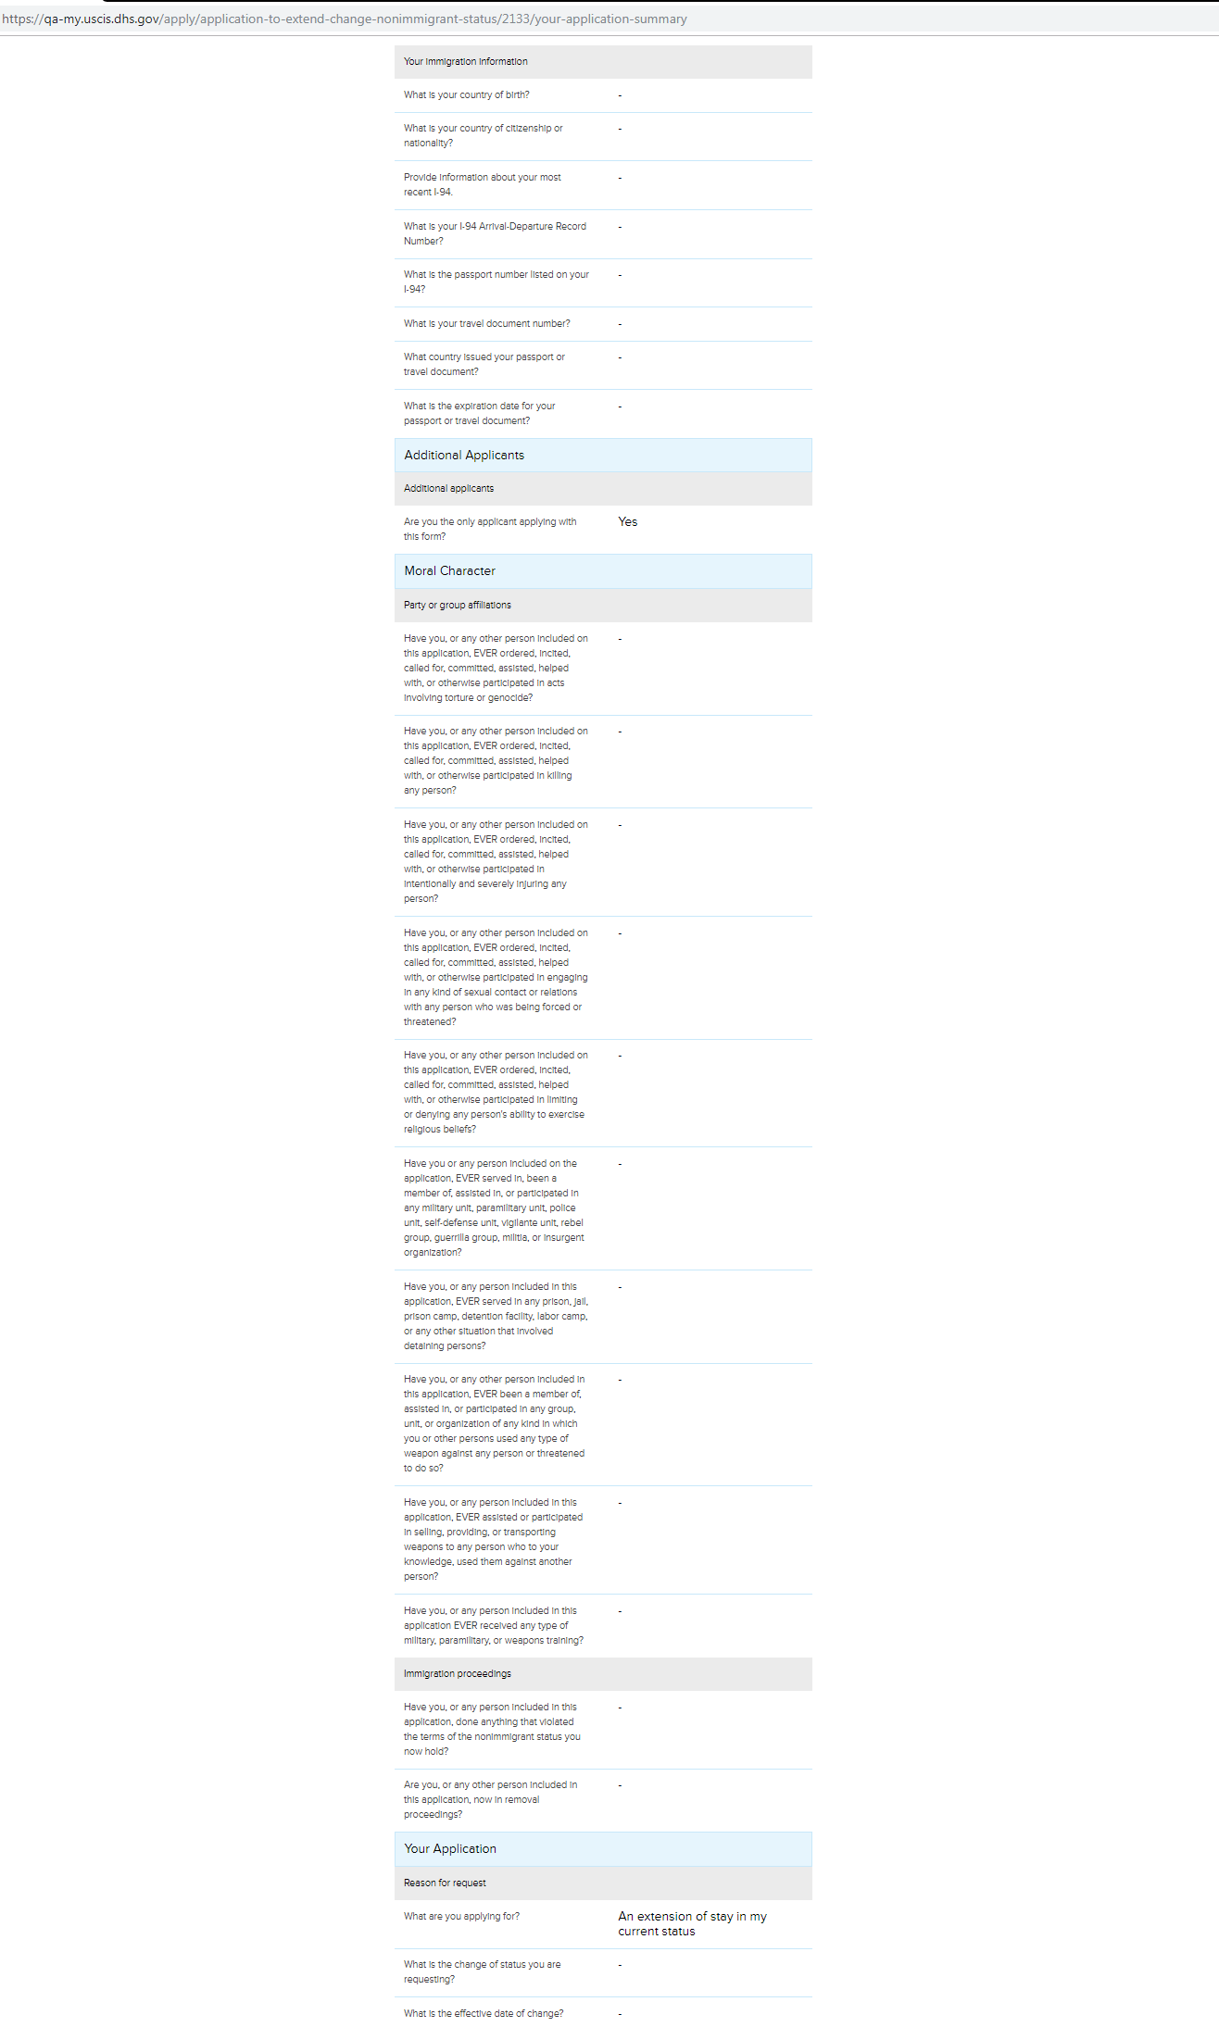
I-539: Review and Submit – Your application summary continued

Slide 27
I-539: Review and Submit – Your application summary continued

Slide 28
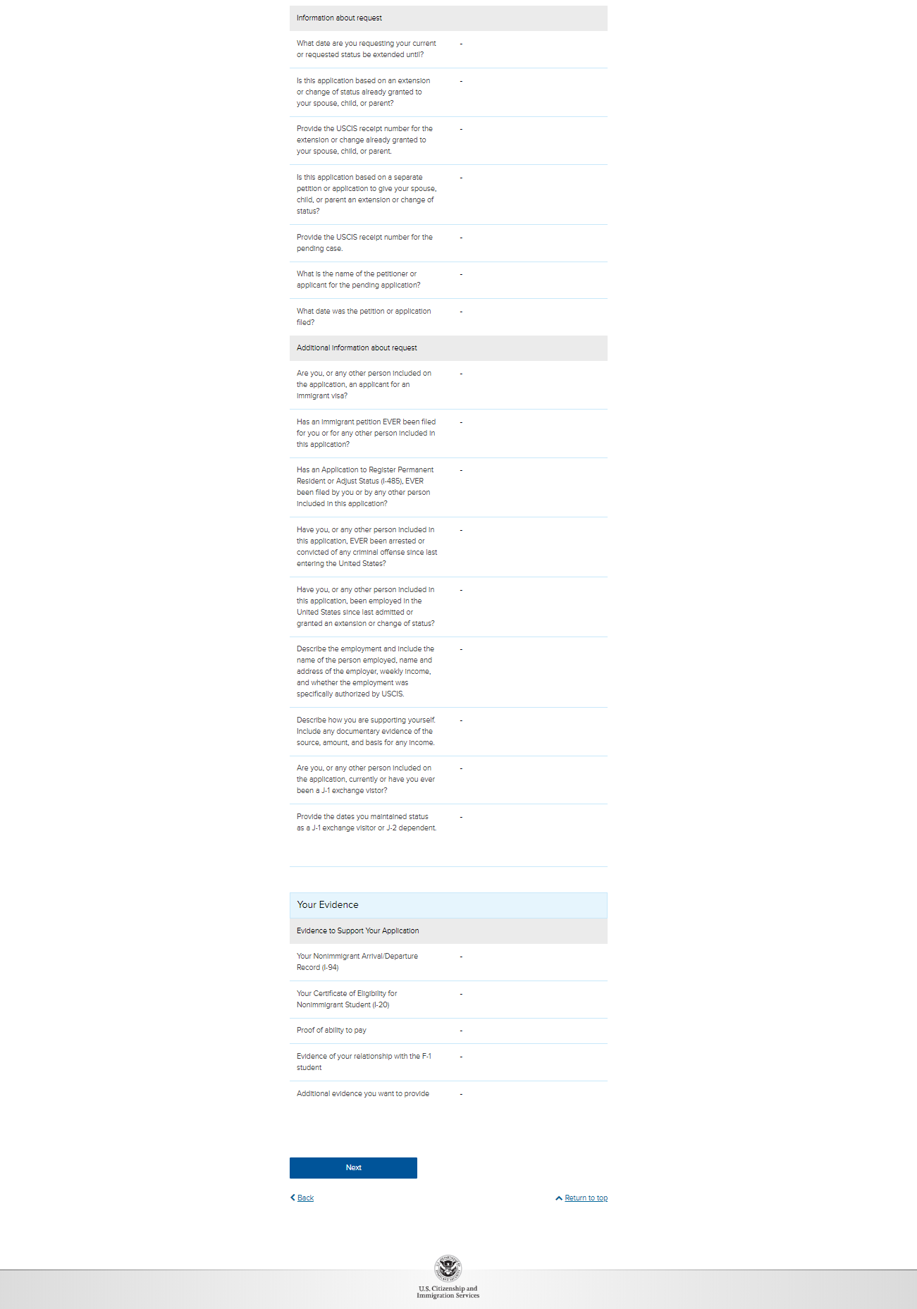
I-539: Review and Submit – Your application summary continued

Slide 29
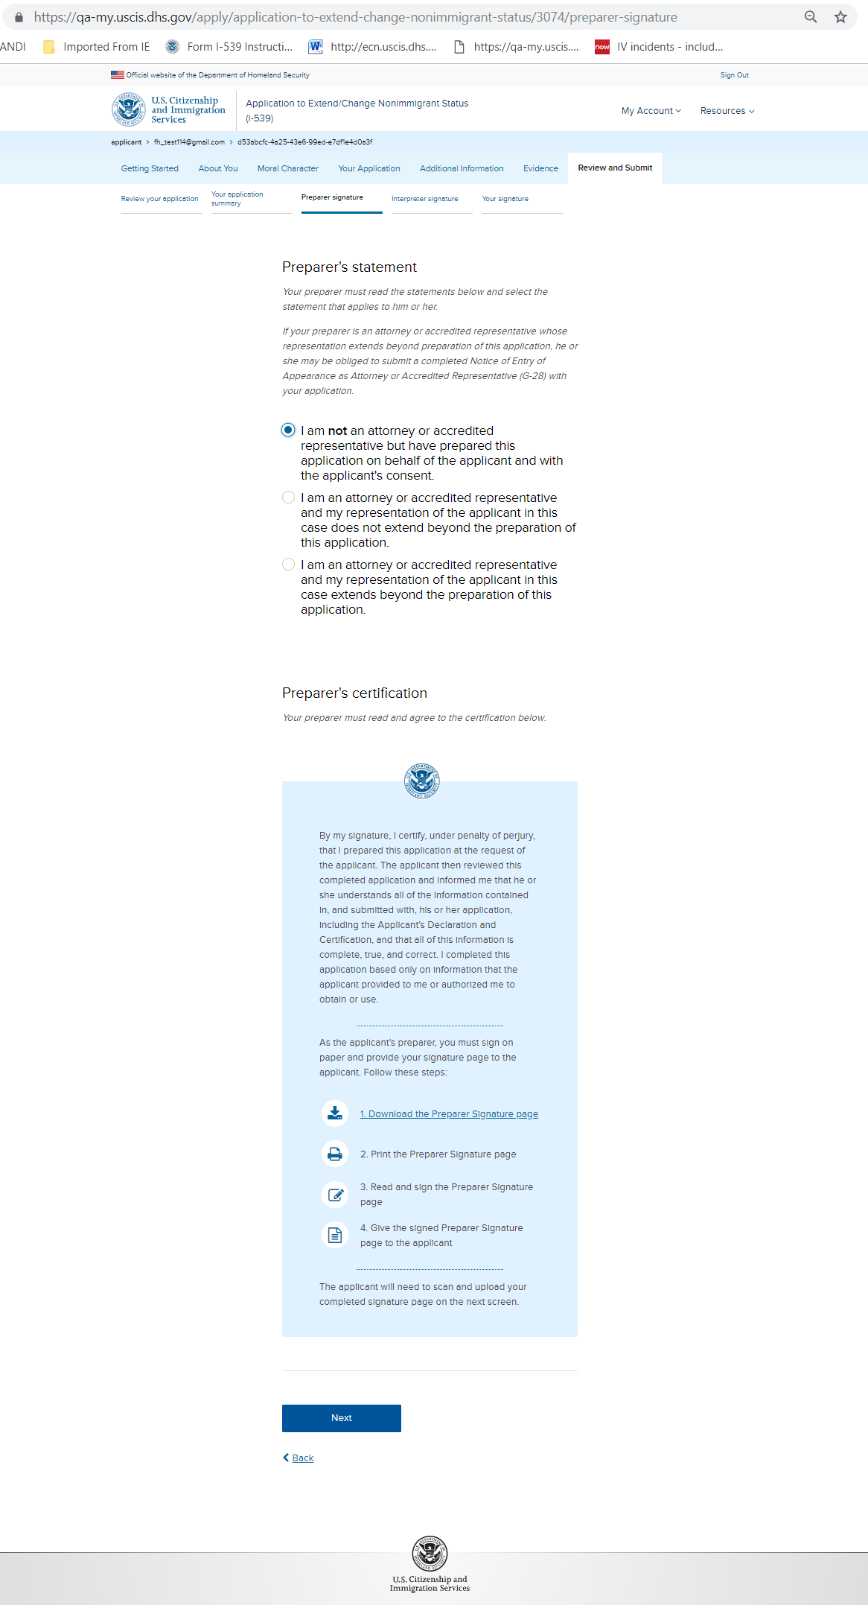
I-539: Review and Submit – Preparer signature Note: if preparer exists

Slide 30
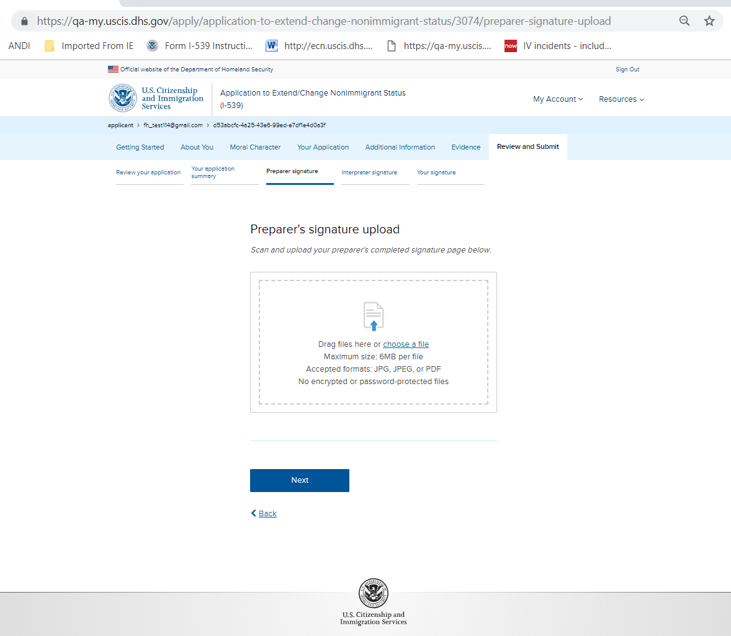
I-539: Review and Submit – Preparer signature upload Note: if preparer exists

Slide 31
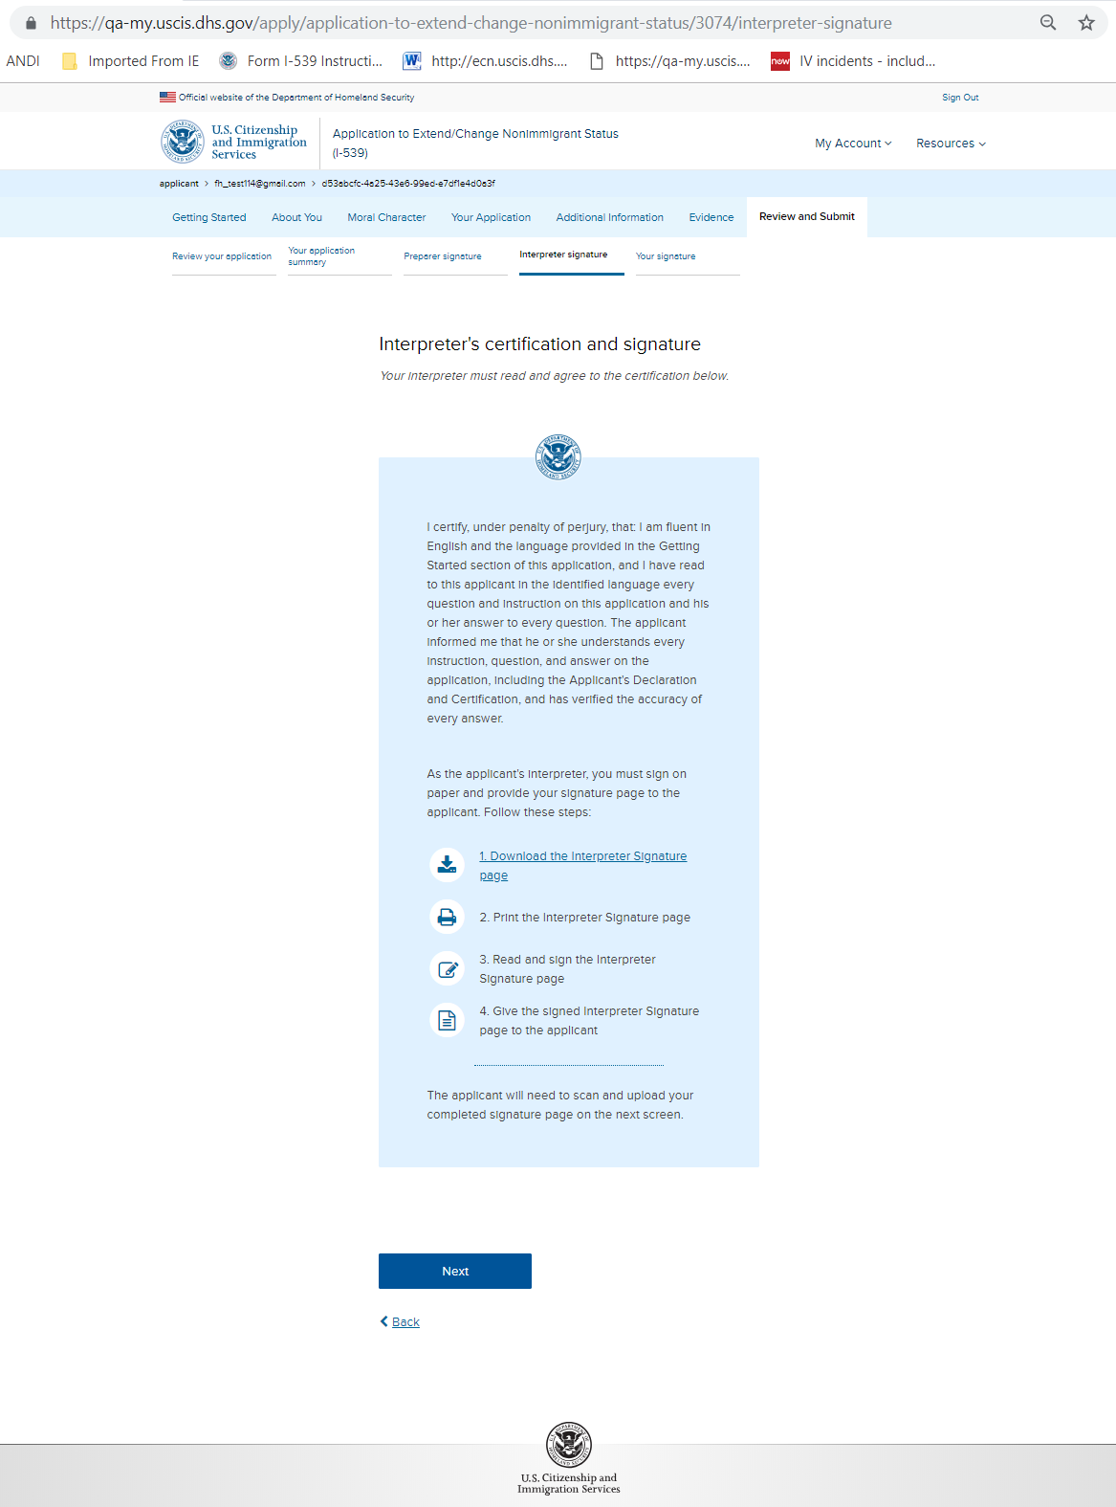
I-539: Review and Submit – Interpreter signature Note: if Interpreter exists

Slide 32
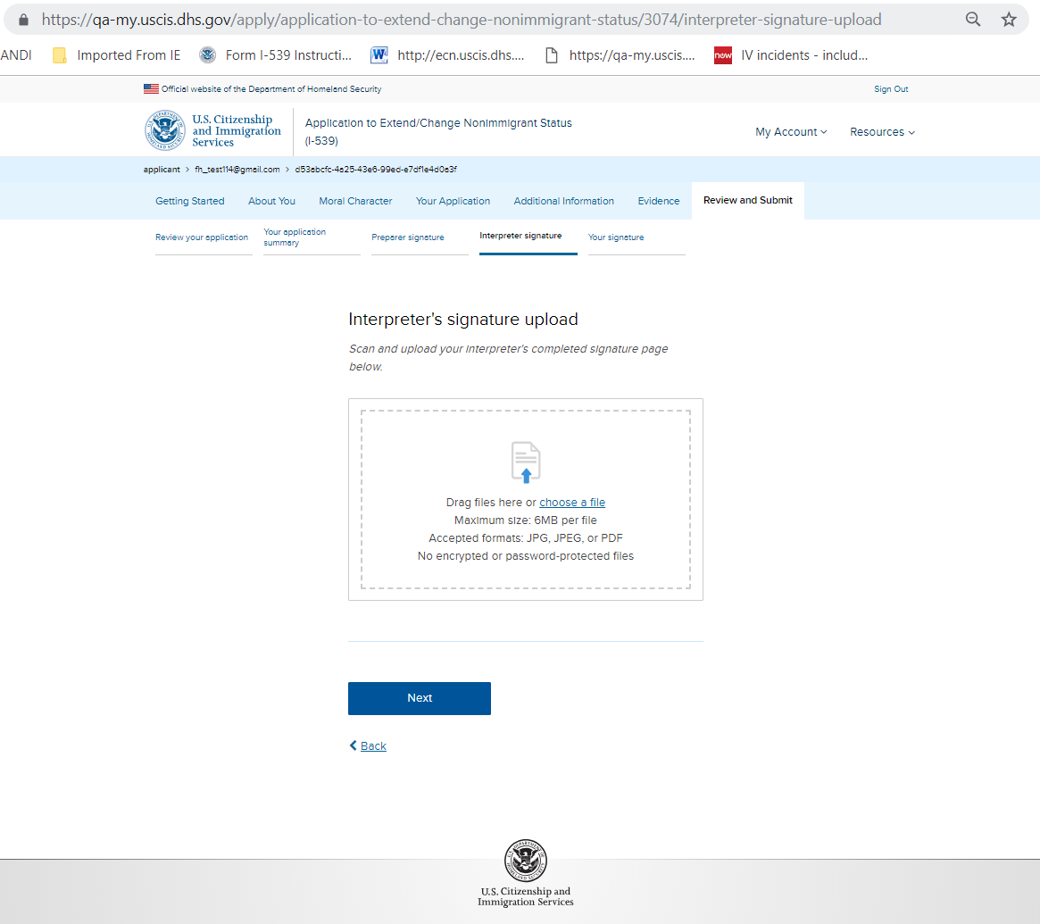
I-539: Review and Submit – Interpreter signature upload Note: if Interpreter exists

Slide 33
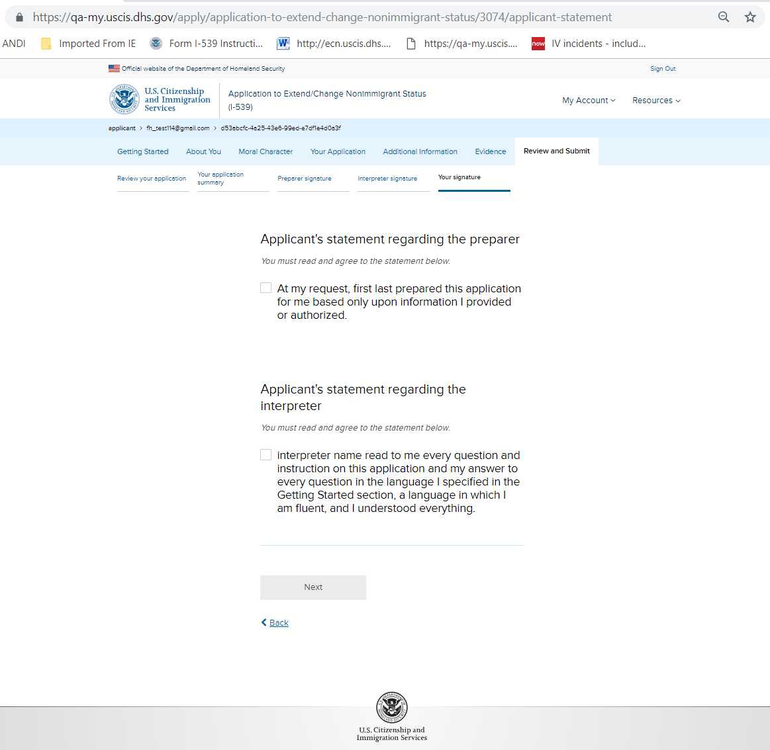
I-539: Review and Submit – Your signature Note: with Interpreter and Preparer

Slide 34
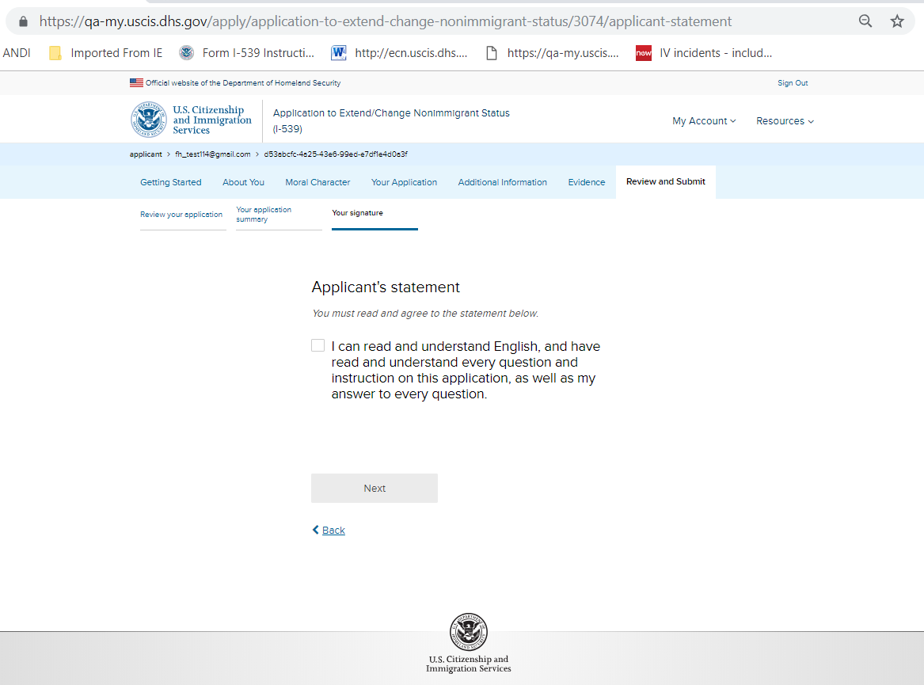
I-539: Review and Submit – Your signature Note: without Interpreter and Preparer

Slide 35
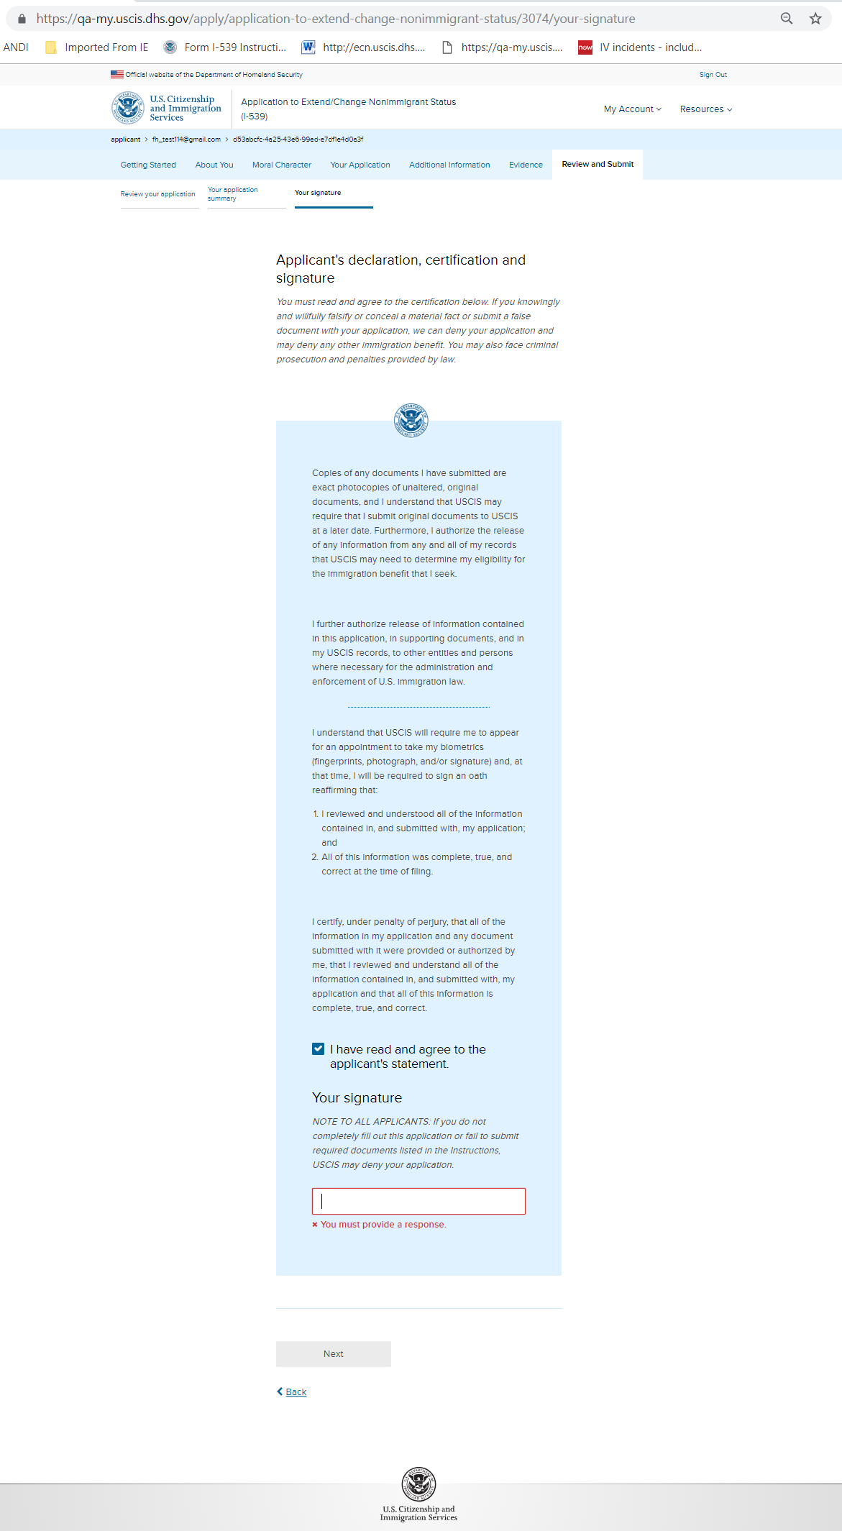
I-539: Review and Submit – Your signature

Slide 36
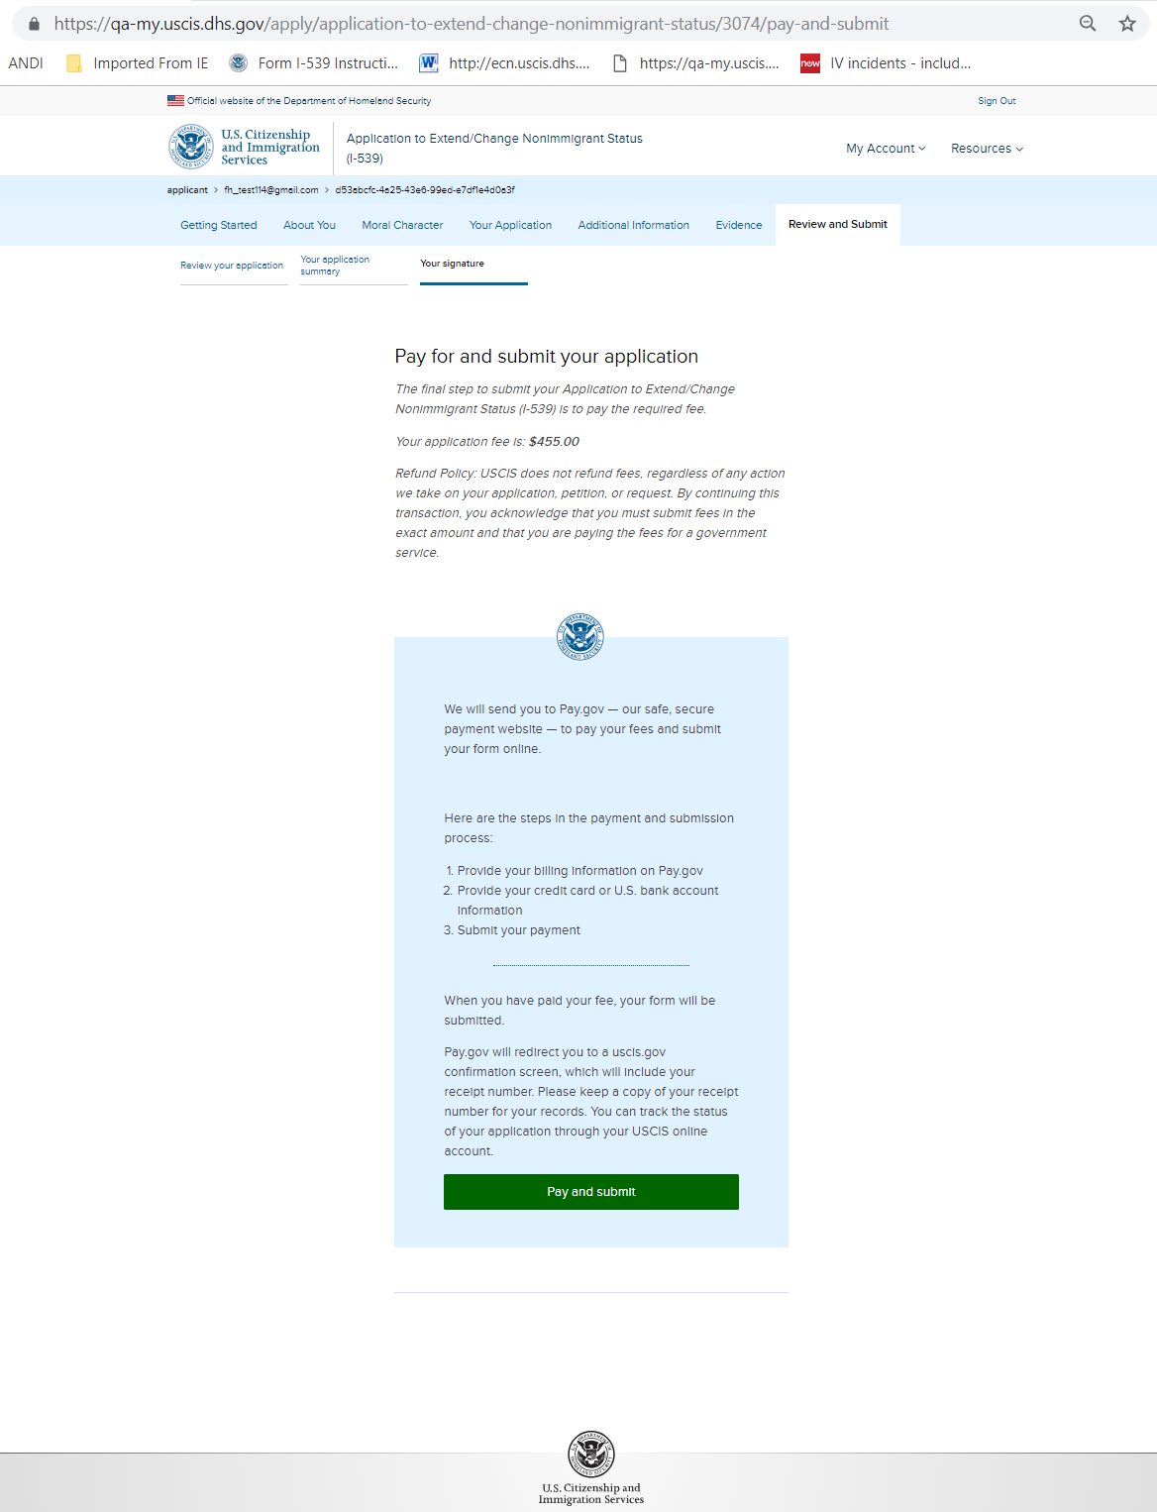
I-539: Review and Submit – Pay and submit

Slide 37
Pay.gov screens

Slide 38
I-539: Confirmation – payment unsuccessful

Slide 39
I-539: Confirmation – payment successful

