Slide 1
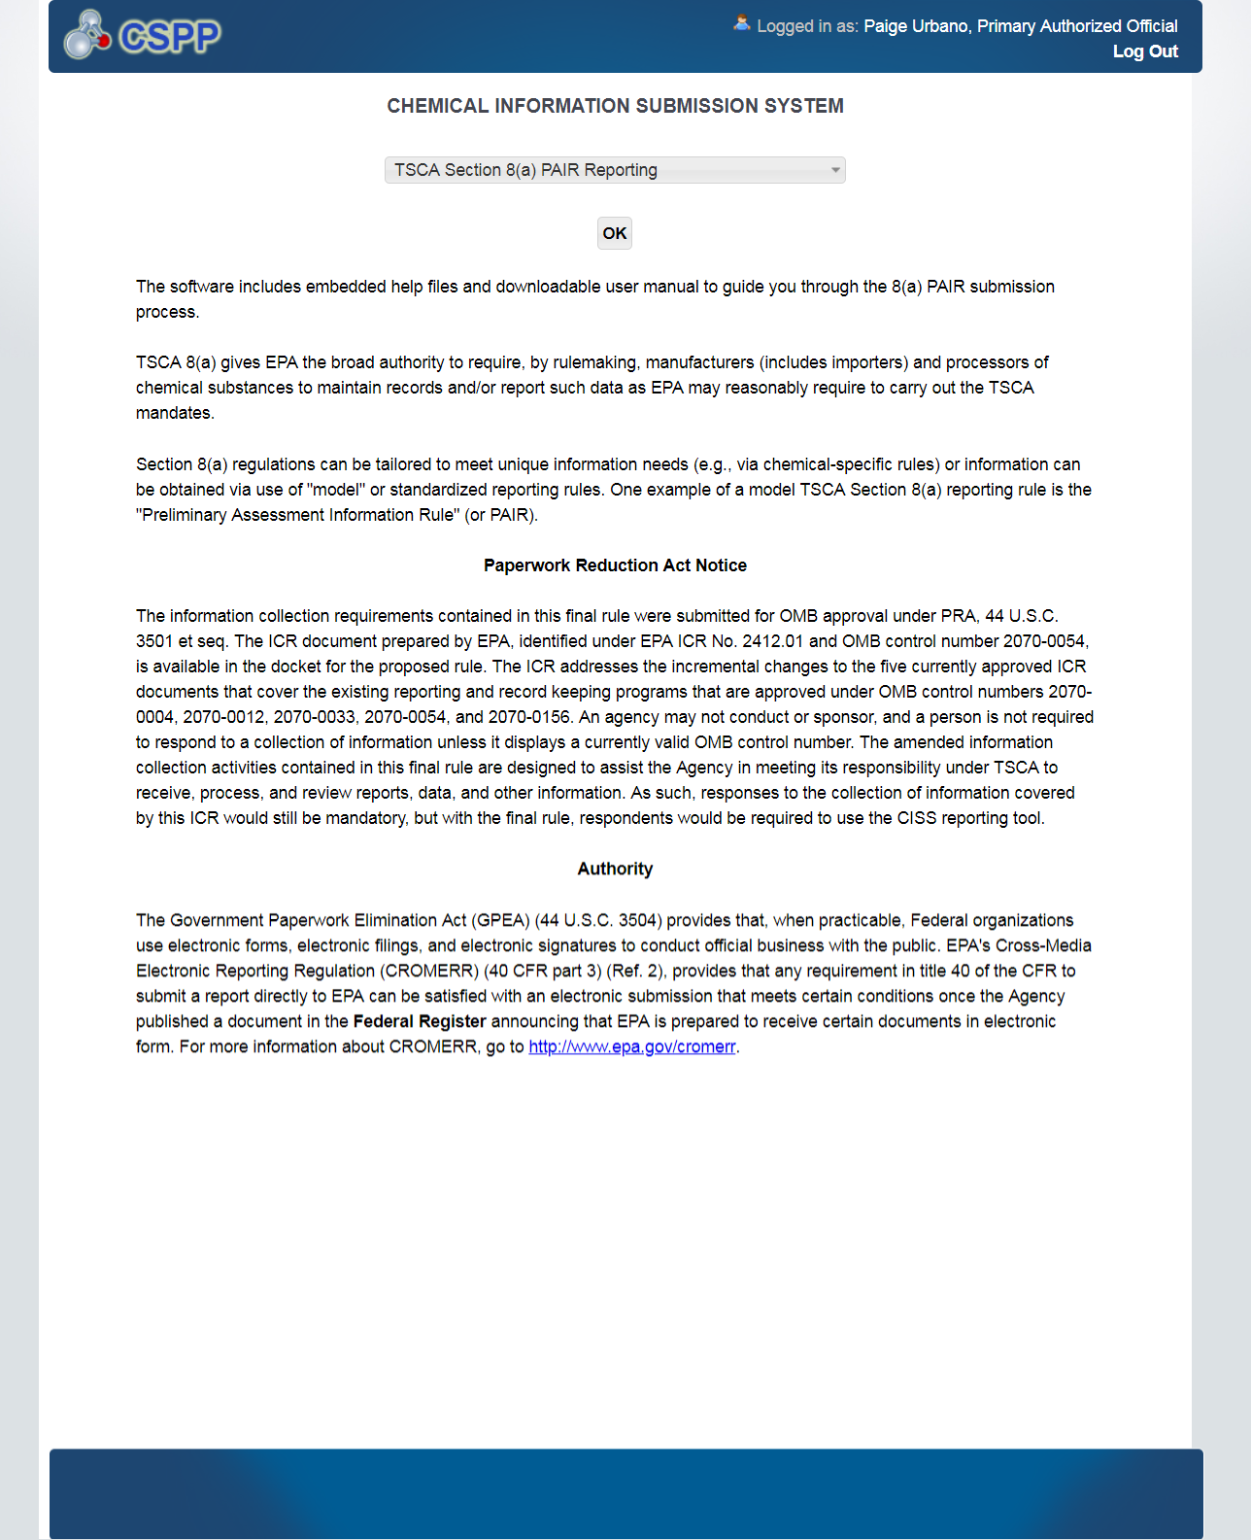
The software includes embedded help files and downloadable user manual to guide you through the 8(a) PAIR submission process. TSCA 8(a) gives EPA the broad authority to require, by rulemaking, manufacturers (includes importers) and processors of chemical substances to maintain records and/or report such data as EPA may reasonably require to carry out the TSCA mandates. Section 8(a) regulations can be tailored to meet unique information needs (e.g., via chemical-specific rules) or information can be obtained via use of "model" or standardized reporting rules. One example of a model TSCA Section 8(a) reporting rule is the "Preliminary Assessment Information Rule" (or PAIR).
Paperwork Reduction Act Notice
The public reporting and record keeping burden for this collection is estimated to average about 30 hours per response, including the time for reviewing instructions, searching existing data sources, gathering and maintaining the data needed, and completing and reviewing the collection of information. This is a mandatory collection pursuant to 40 CFR part 712 Subpart B. An agency may not conduct or sponsor, and a person is not required to respond to, a collection of information unless it displays a valid OMB Control Number. The OMB Control Numbers for this collection of information is OMB 2070-0054. Send comments regarding this burden estimate or any other aspect of this collection of information, including suggestions for reducing the burden, to Director, Collection Strategies Division (Mail Code 2822T), U.S. Environmental Protection Agency, Washington, DC 20460. Include the 0MB control number in any correspondence, but do not submit the form or report to this address. The form should be submitted in accordance with the instructions on the top of the form.
Authority
The Government Paperwork Elimination Act (GPEA) (44 U.S.C. 3504) provides that, when practicable, Federal organizations use electronic forms, electronic filings, and electronic signatures to conduct official business with the public. EPA's Cross-Media Electronic Reporting Regulation (CROMERR) (40 CFR part 3) (Ref. 2), provides that any requirement in title 40 of the CFR to submit a report directly to EPA can be satisfied with an electronic submission that meets certain conditions once the Agency published a document in the Federal Register announcing that EPA is prepared to receive certain documents in electronic form. For more information about CROMERR, go to http://www.epa.gov/cromerr.

