Slide 1
Checking AMCS Vitals: Airman Satisfaction Survey 2014 Results

Slide 2
Content
Respondent Demographics
Summary Results and Trends
Airman Satisfaction
Use of MedXPress
AME Performance
Medical Certification Process
Closing Comments

Slide 3
Respondent Demographics
36% of invited airmen (n=3,703) participated.
All domestic regions represented in survey data with minimal fluctuations in response rates.
Certificate applied for:
18% Class I (↓2)
29% Class II
53% Class III (↑2)
Pilot certificate held
46% Commercial (↑1)
40% Private
33% Airline Transport
Ratings held
72% IFR (↑24)
28% CFI
22% ‘Other’
19% Do not hold any rating
Notes:
Note: Arrows represent changes relative to airman respondents to the 2012 survey.
Note: Airman = airman applicant

Slide 4
Respondent Demographics
75% of airmen (n=2,698) are NOT employed as a pilot at the time of survey completion.
Airmen employed with certificated operators conducting flights under:
40% part 91 (↑1)
28% part 121 (↓5)
19% part 135 (↑1)
14% other part or operation (↑2)
6% part 61 (↓2)
Notes:
Next are the results, starting with trends in airmen satisfaction with AMCS.

Slide 5
Respondent Demographics
53% of airmen applied within the past 6 months.
The majority of airman (90%) contacted only 1 AME-- the top 3 reasons they chose the AME are:
Performed previous exam (54%, ↓2)
Nearest location (26%, ↓4)
Referred by pilot (19%, ↓1)
Year of most recent medical certification:
45% 2014
35% 2013
14% 2012
7% 2011
Notes:
Survey responses are based on the airman’s MOST RECENT application for medical certification!
Bottom of list of reasons for selecting AME in 2014:
- 11% licensed to perform needed service (up 1)
- 8% earliest available appt (↓ 1)
8% referred by flight instructor or school
7% referred by doctor or previous AME (↓1)
6% is my primary care doctor (↓1)
6% Other reason (↓1)
5% handles complex cases (not assessed in 2012)
5% low cost (↓1)
3% make quick certification decisions
1% referred by airline or AME employed by airline
Next are the results, starting with trends in airmen satisfaction with AMCS.

Slide 6
Trends in Airman Satisfaction
 | Rate | Trend
AME services (n=3,584) | 90% | ↑3
Exam appointment (n=3,616) | 88% | ↑1
Performance of MedXPress (n=3,151) | 72% | ↓6
FAA medical representative services (n=632) | 29% | ↓17
Notes:
Listed highest to lowest rates of satisfaction. Smaller n for ‘FAA med representatives’ is a function of deferred applications.
Note: Twice as many airmen reported use of MedXPress in 2014 (2012 n=1,631), reflecting its mandated use.
Next is a look at rates of satisfaction by class of certificate.

Slide 7
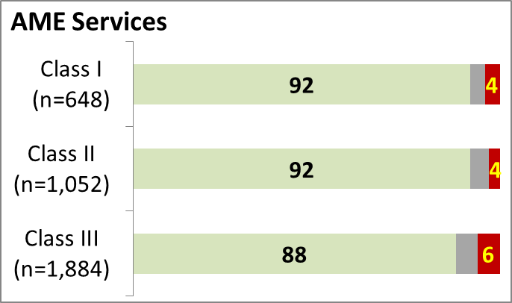
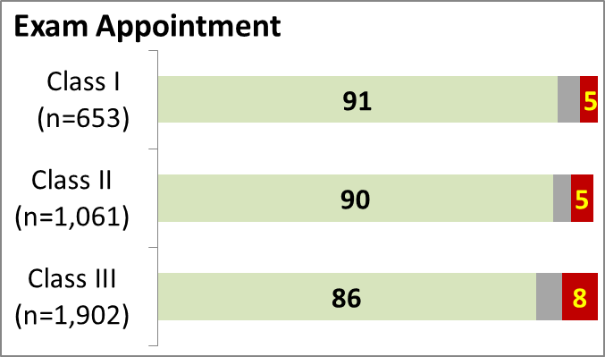
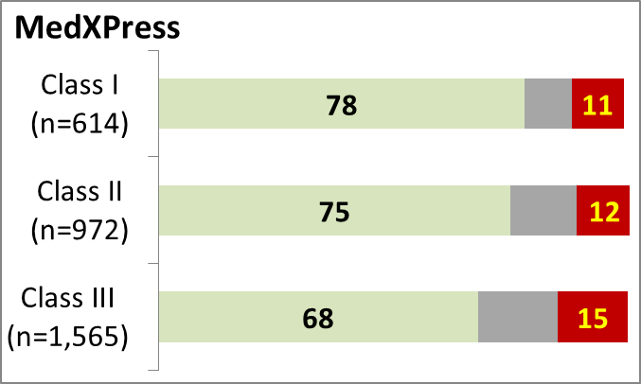
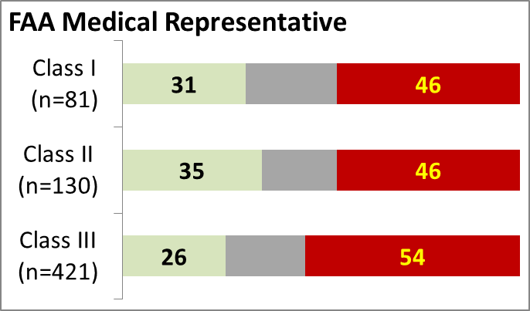
Satisfaction Rates (%) by Cert Class
Very Satisfied/Satisfied Neither Dissatisfied/Very Dissatisfied
Notes:
2014 was the first collection of reasons airmen were dissatisfied – presented in next slide.

Slide 8
Why Airmen Are Dissatisfied
 | Rate | Top 3 Reasons
AME services | 5% (↓3) | 52% - Certificate not issued during appointment 49% - Not informed of additional documents required by FAA to issue 43% - Other
Exam appointment | 7% (↓3) | 57% - Certificate not issued during appointment 18% - Exam not thorough 17% - Not treated courteously/respectfully
FAA medical representative services | 52% (↑15) | 57% - Poor communication of where app was in review process 56% - Review took too long 44% - Other
Notes:
Other responses for dissatisfaction with AME, Exam appt, and FAA med rep.
Quality of AME services (other responses)
32% - not informed of status of application
22% - not informed of required documents for exam
21% - AME lacked knowledge of standards
Exam appt (other responses)
9% - not examined in a professional manner
Services provided by FAA medical representative (other responses)
40% - not adequately informed of requirements for documentation
37% - denied
37% - not informed of status of deferral
33% - failed to explain required documentation
13% - not treated with courtesy and respect
NOTE: ‘Other reasons’ held the 3rd position for dissatisfaction with quality of services provided by both the AME and FAA med rep
Next is Use of MedXPress.

Slide 9
Use of MedXPress
91% of airmen applied (↑50) through MedXPress.
Of the applicants using MedXPress…
72% were satisfied/very satisfied
Only 6% of AMEs (n=119) reportedly did NOT access MedXPress during the exam – why:
69% other reason
21% AME did not require MedXPress
5% did not have their confirmation number
3% AME did not accept MedXPress
Notes:
The rate of high satisfaction with MedXPress dropped 6 percentage points from 2012, with around twice as many users providing satisfaction ratings in 2014 (2012, n=1,631; 2014, n=3,151).
Removed:
70% had their expectations met by MedXPress
65% rated MedXPress performance good/excellent
‘Other reason’ (n=79) was selected most often (69%) as the reason AME did NOT access MedXPress during exam, regardless of the year certification was issued. However, the majority responding ‘AME did not require MedXPress’ were airman whose certifications were issued in 2013 or 2014.
Next up are applicant assessments of the AME.

Slide 10
Use of MedXPress
Did you use MedXPress to submit your application?
(Excludes Do not remember)
Notes:
2012 and 2014 comparison
Yes and No percentages EXCLUDE those who responded Do not remember.
Percent Yes is discussed in previous summary slide. Graph shown for detail.

Slide 11
Use of MedXPress
Overall how satisfied were you with the performance of MedXPress?
Notes:
2012 and 2014 comparison
Sat/Very sat discussed in previous summary slide. Graph shown for detail.

Slide 12
AME Performance
Were you told to bring the following to your exam appointment? | % No, but needed | % Yes | % No, not needed
MedXPress confirmation number | 4 | 88 | 8
Valid photo ID | 7 | 79 | 14
MedXPress Summary Sheet printout | 7 | 72 | 22
List of meds | 9 | 68 | 24
Medical history details | 12 | 62 | 27
Current medical tests/labs | 12 | 40 | 49
Past medical tests/labs | 12 | 31 | 56
SI paperwork | 10 | 29 | 60
SODA paperwork | 10 | 12 | 78
Notes:
*60% were asked to provide their MedXPress Summary Sheet before their appointment, and 28% of those were then asked to bring supporting documents to the appointment.
NOTE that all these percentages EXCLUDE those responding Do not remember.
NOTE that 8% said confirmation number not needed and 14% said valid photo id not needed; however, both are required.

Slide 13
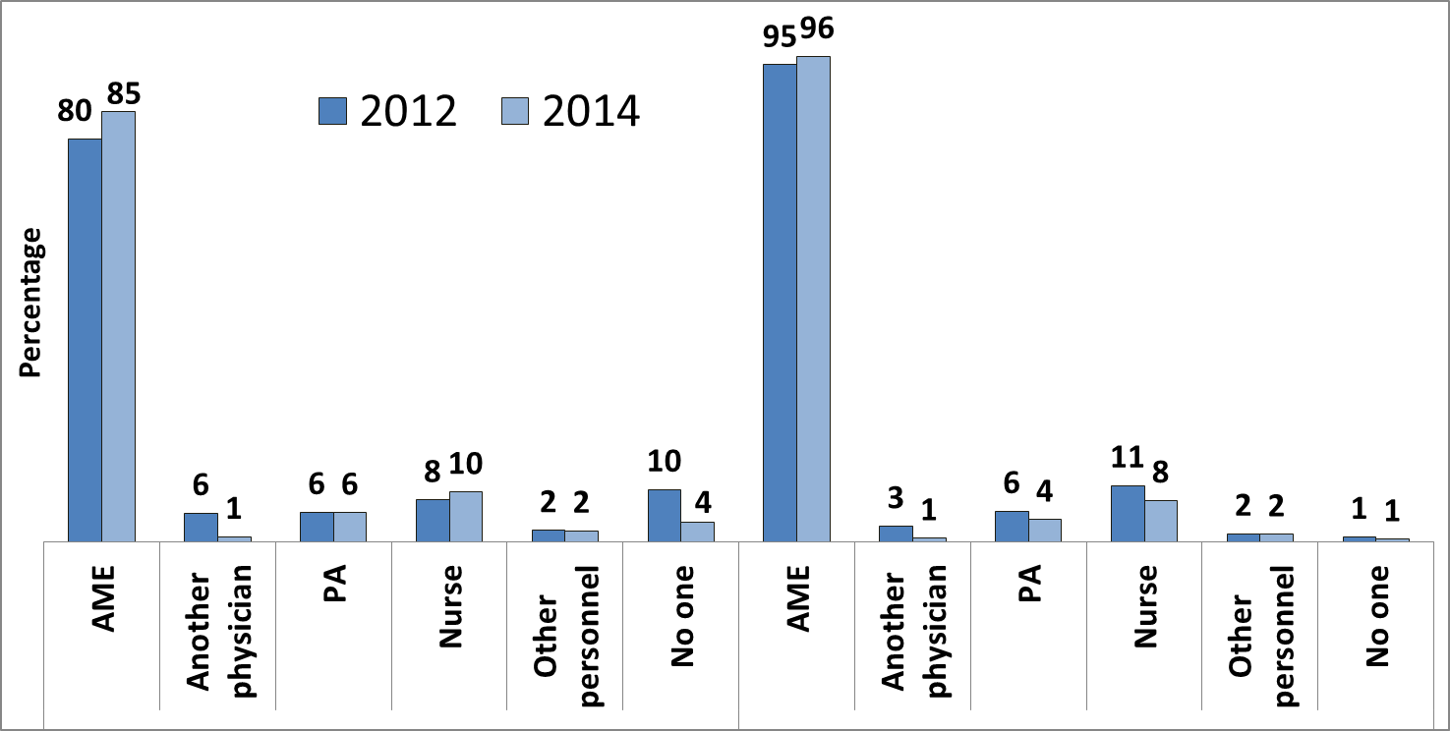
AME Performance
Notes:
JK Note – suggest using this slide and deleting previous slide

Slide 14
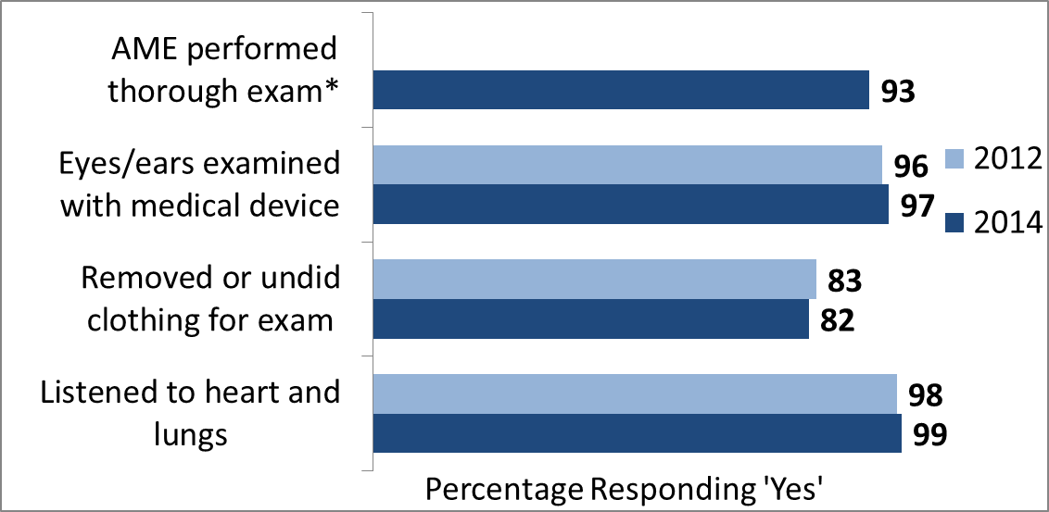
AME Performance
* Not assessed in 2012

Slide 15
AME Performance
 | 2012* | 2014* | ∆
Treated with courtesy/respect | 92 | 92 | --
Examined in a professional setting | 89 | 90 | ↑1
Information provided was accurate | 84 | 85 | ↑1
Provided all requested information | 82 | 84 | ↑3
Information provided in a timely manner | 82 | 84 | ↑2
AME charged appropriately for services | 71 | 75 | ↑4
Clearly explained airman responsibilities | 72 | 73 | ↑2
*Considerable/Great extent
Notes:
These are listed by 2014 rates of airmen indicating that the AME performed the behavior (considerable/great extent).
Item 17a through 17g ranked from high to low.

Slide 16
Medical Certification Process
89% of applicants not issued certificate at exam had application deferred to RFS or AMCD.
Notes:
Vast majority of airmen whose applications were deferred were in contact with the FAA (RFS 16%, AMCD 61%, and OAM 7%) via Postal mail.

Slide 17
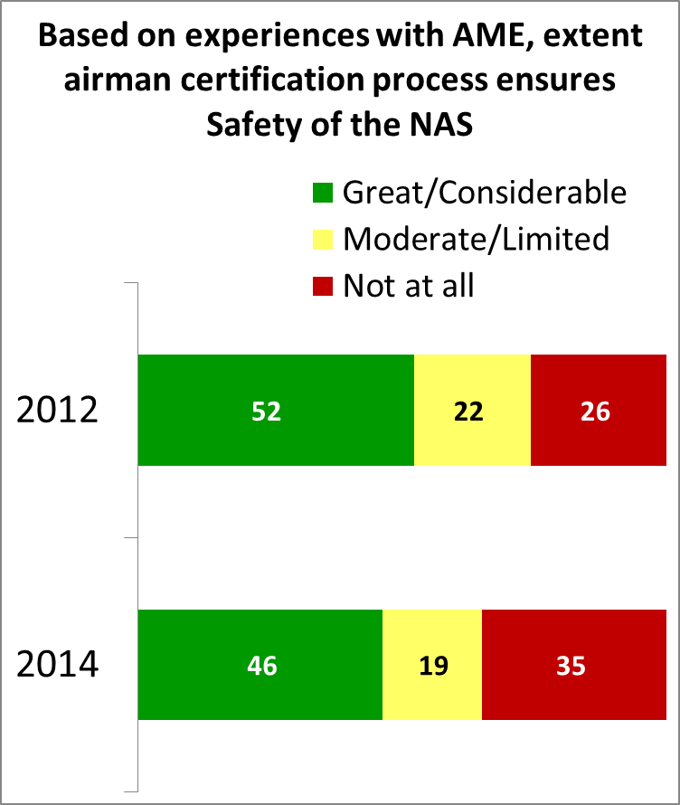
Medical Certification Process
Fewer applicants (↓6) link the airman certification process to ensuring the safety of the NAS based on their most recent AME experiences.
Reasons given by the 54% (n=1,909) indicating moderate, limited, or not at all:
15% - deters pilots from applying
14% - encourages pilots to be dishonest
14% - exam not comprehensive
10% - exam not thorough
47% - provided other reason(s)
Notes:
Based on most recent experience with your AME

Slide 18
Closing Comments
Expedited processing is key to service quality.
Clearly communicate required supporting medical documentation to airmen applicants.
Inform AMEs of the value of requesting and reviewing the MedXPress summary sheet prior to an airman’s appointment to inform them of documentation to bring to their exam.
Upon decision to defer to RFS or AMCD, applicants would like information of what and when supporting documentation is required.
Rely on electronic media to share information with applicants on deferral status.

Slide 19
Questions or Comments?

