Slide 1
ADS-B Rebate Web Pages (3.0.3.13)
Slides 2-5: Reserve
Slide 2 Reservation Checklist
Slide 3 Tail Number Entry
Slides 4 & 5 Reservation Page
Slides 6-8: Validate
Slides 9-11: Claim
Slide 9 Claim Checklist
Slide 10 Reservation Lookup
Slides 11-12 Claim Page

Slide 2
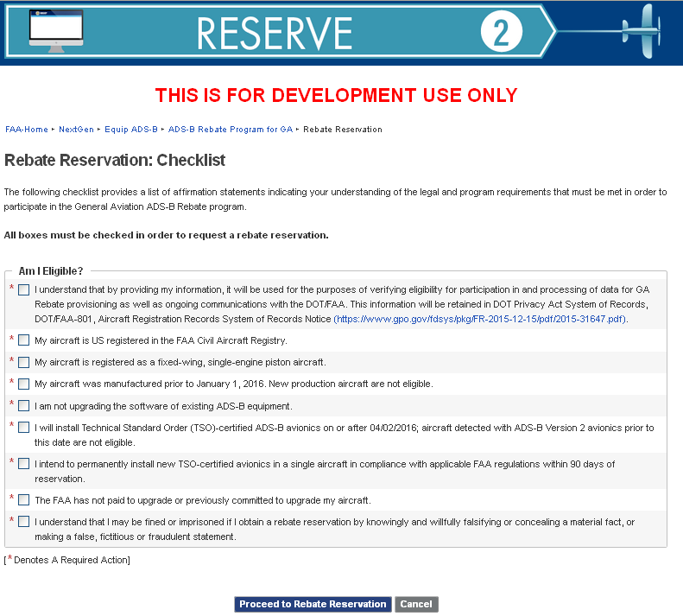

Slide 3
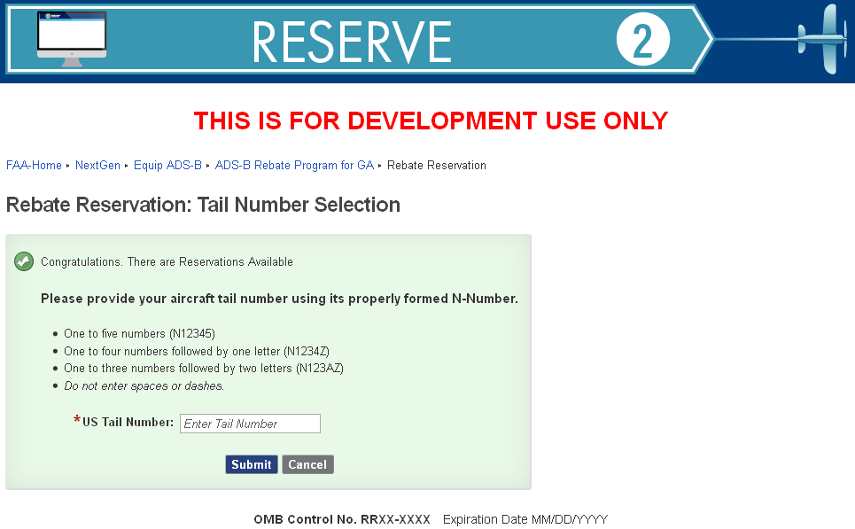

Slide 4
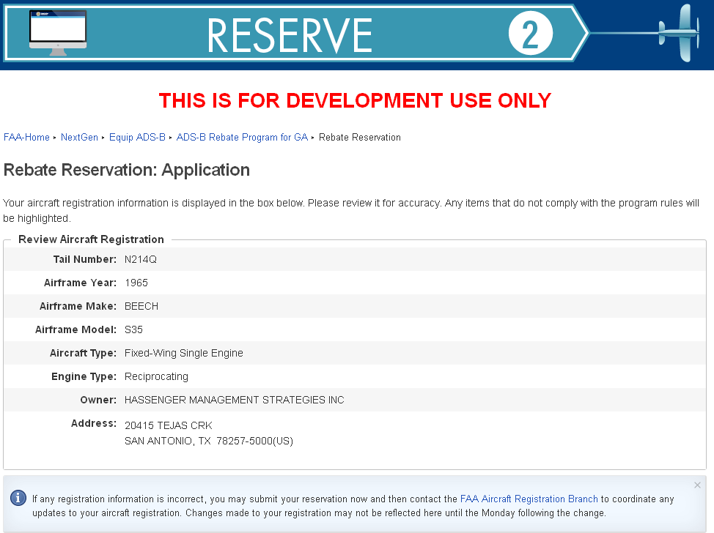

Slide 5
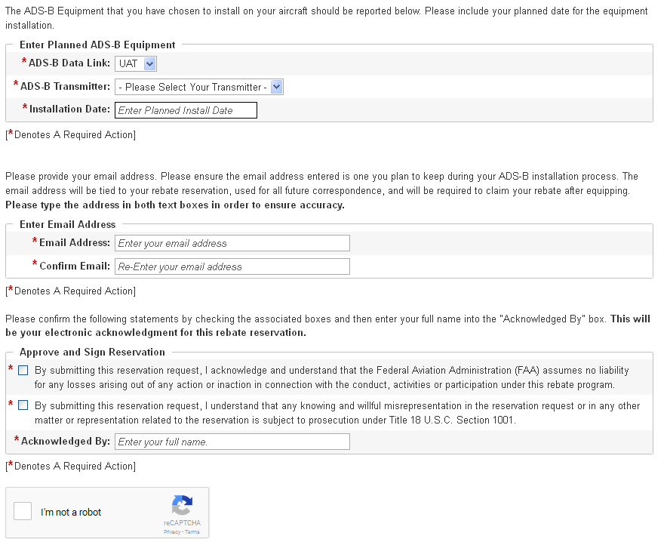

Slide 7
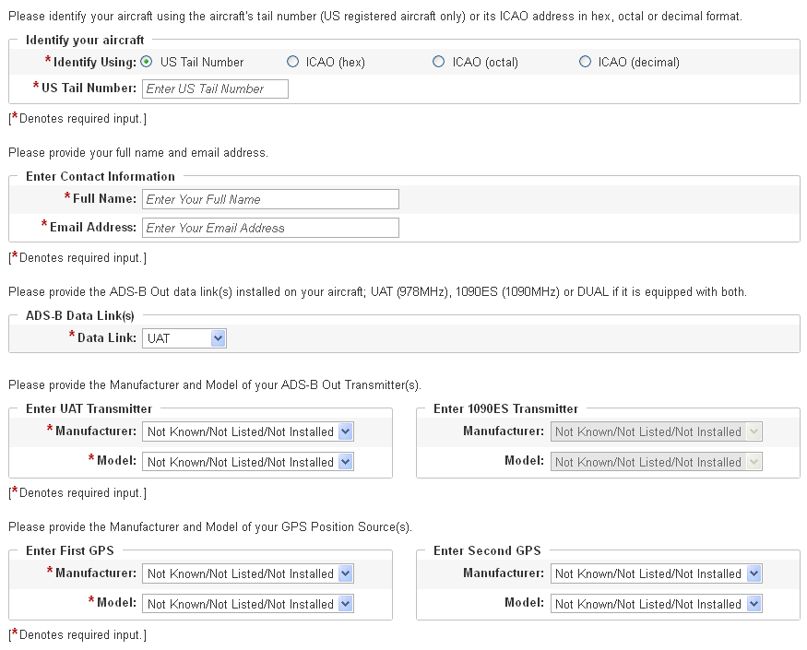

Slide 8
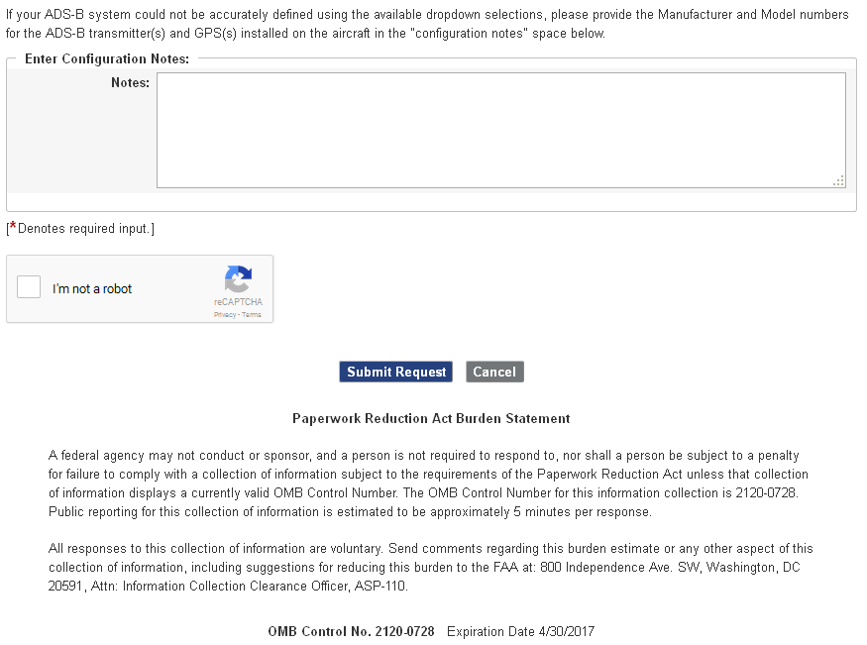

Slide 9
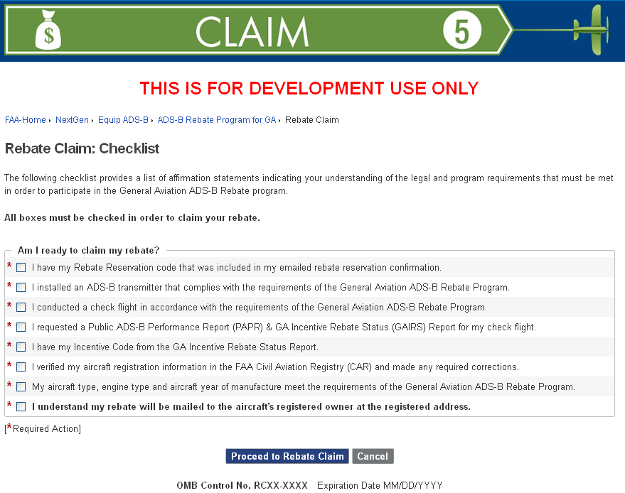

Slide 10
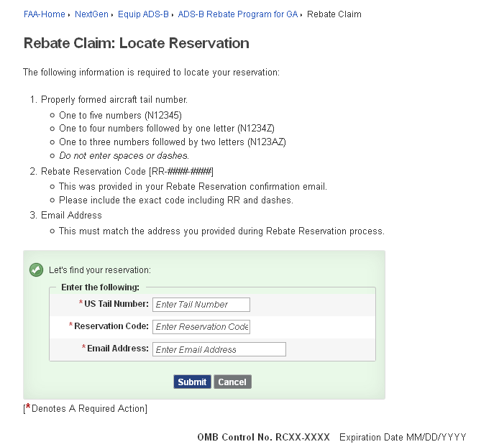

Slide 11
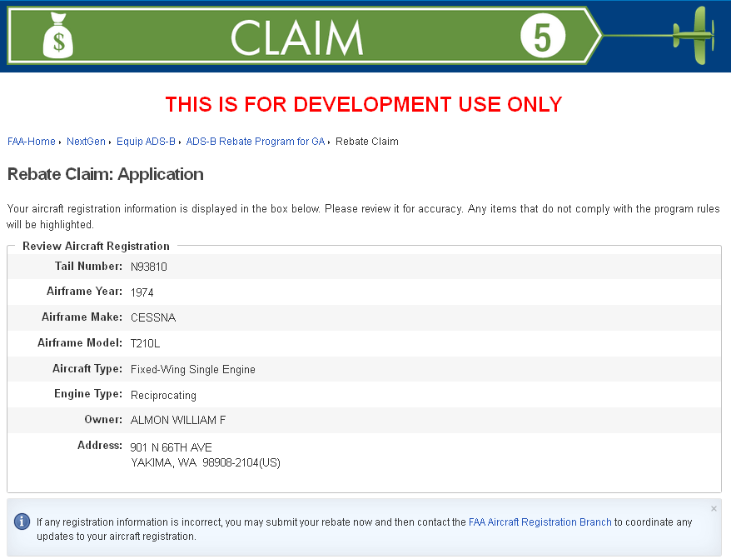

Slide 12
